Slide 1
3D Material Style Transfer
Chuong H. Nguyen¹, Tobias Ritschel², Karol Myszkowski¹, Elmar Eisemann², Hans-Peter Seidel¹
¹Max-Planck-Institut Informatik
²Telecom ParisTech / CNRS

Slide 2
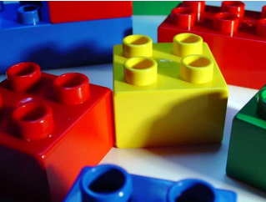
Background – Material Perception
[Ce Liu et al. 2010]
Notes:
Real world objects come along with their material properties
(Click) By looking at the image, human can easily identify object’s material whether they are made of glass, leather, wood, metal, stone or plastic… etc

Slide 3
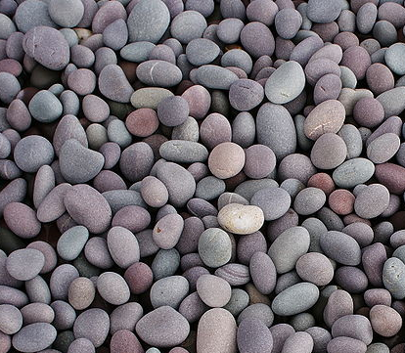
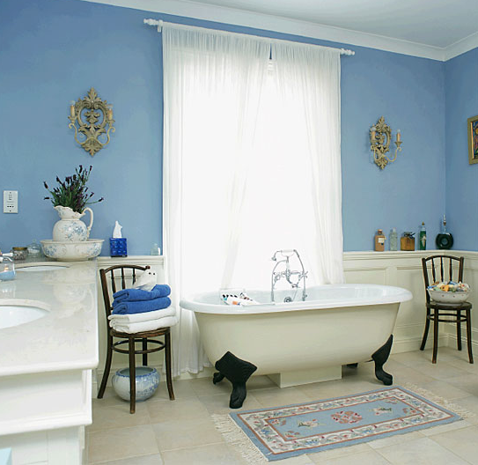
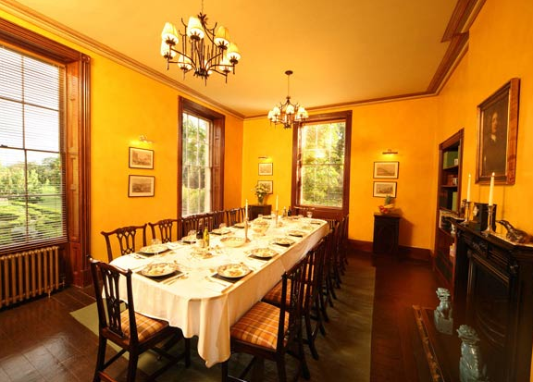
Background - Mood
Notes:
In a higher level structure, different layout of objects with different materials expose certain mood to the overall feeling of the scene
(Click) For example, yellow captures the joy of sunshine and communicates happiness, so it’s perfect for kitchens, dining rooms and bathrooms.
(Click) Blue is considered calming, relaxing and serene and is often recommended for bedrooms and bathrooms.
There are some principle of design such as ceilings that are lighter than the walls feel higher, while those that are darker feel lower.
(Click) Or even the layout of different pebble in different beaches convey certain moods
These days, it’s easy to access huge amount of data with these…

Slide 4
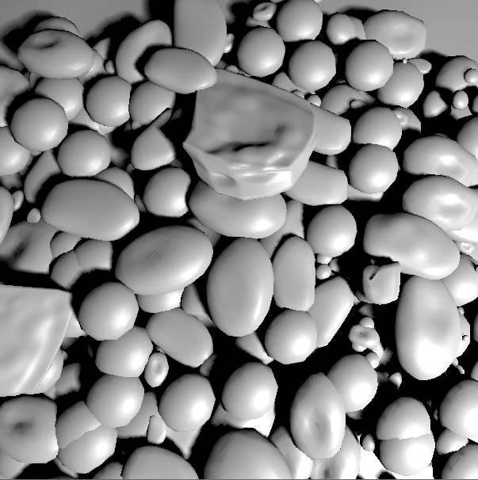
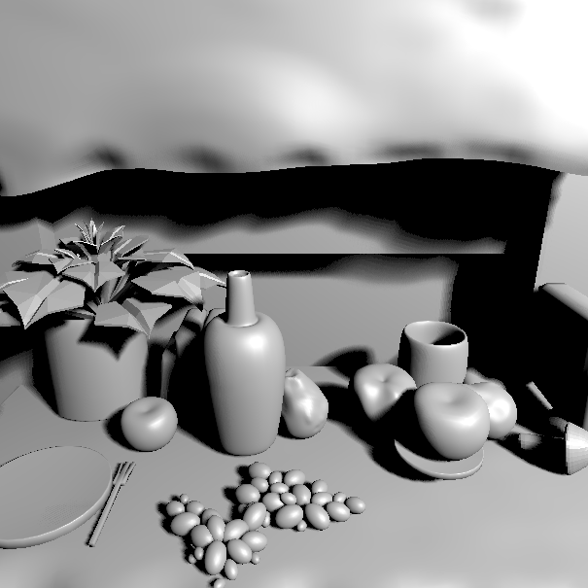
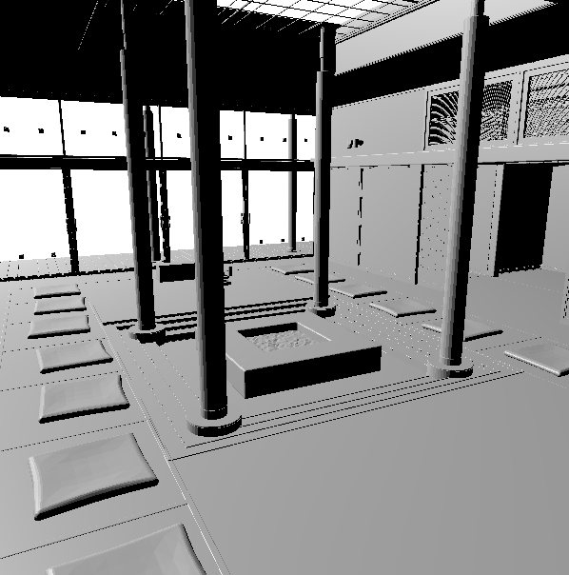
Background
Notes:
Recent years, it is easy to access huge number of available cg scenes from internet.
However, not all 3d scenes come with appropriate assigned materials, scene taken from the internet was simply crafted without them
With new tools like google warehouse or google sketchup, where 3D data are available, users can easily make new scenes by copy and paste the available geometries
3) When material assignment is needed but not available, it can be tedious to do it manually. Especially when high number of objects are available.
4) The ability to assign materials to objects (like bed-room) that satisfy certain rules is impossible for novice user without prior knowledge of interior designs.
6)

Slide 5
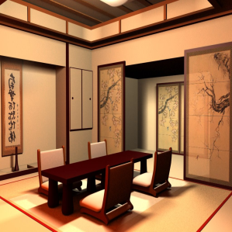
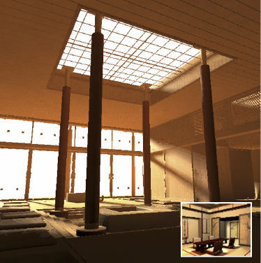
Motivation
Guide Image
Scene without Materials
Scene with Materials
Notes:
Taken into account all these observations
(Click) Consider example of a temple scene without material
(Click) For a given guidance source, our goal is to transfer the material style from this guide source into the 3D scene..
The guide source can be an image or video which is semantically similar. If proper chosen, these guide source implicitly include all design rules and moods properties.
(Click) Final result resembles material style of the guide source

Slide 6
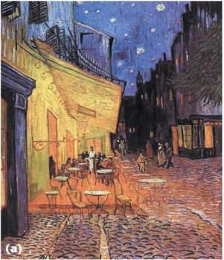
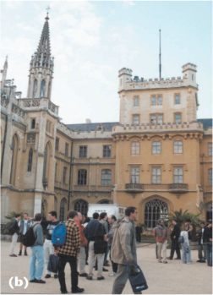
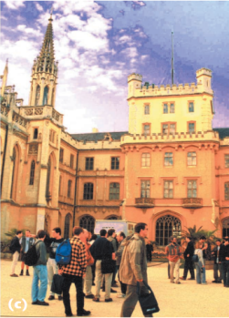
Previous Works - Colorization
Color Transfer
Reinhard et al: Color Transfer between Images, IEEE CG&A 2001
Colorization
Welsh et al: Transfering Color to Greyscale Images, Siggraph 2001
Irony et al: Colorization by Examples, EGSR 2005
Notes:
1) Another body of related works tried to do image color adjustment by example.
For a given source image (a) and (Click) a target image (b)
The goal is to robustly transfer the color palette from source to target the recolored image took the color palette from source and image structure from target
2) Colorization method take a grey image and put in color using example from other images.
While bearing a lot of similarity with these works, our work mostly work with material, also we take advantage of geometry in 3D scene that make it more robust for our assignment

Slide 7
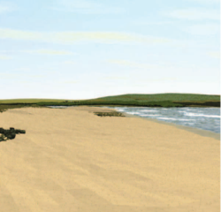
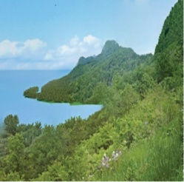
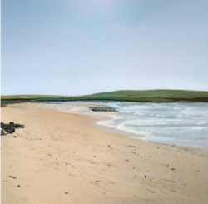
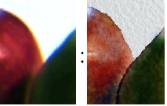
Previous Works – Detail Synthesis
Improving the Realism
Johnson et al: CG2Real: Improving the Realism of Computer Generated Images using a Large Collection of Photographs, IEEE TVCG 2010
Analogy
Hertzmann et al: Image Analogies, Siggraph 2001
Mertens et al: Texture Transfer Using Geometry Correlation, EGSR 2007
Notes:
1) Realistic image synthesis come from the cost of long and expensive manual modeling.
2) Even so, often, humans can still distinguish between CG and real images
3) (Click) For example with these computer generated images
4) (Click) Their algorithm retrieved a small number of real images from a large collection of photographs with similar global structure and automatically transfer color, tone, and texture from matching regions to the CG images
5) Their results are image compositions, view dependent and cannot be easily used for further editing of 3D scenes
Image analogies can produce new exemplars with details that fit specified content.

Slide 8
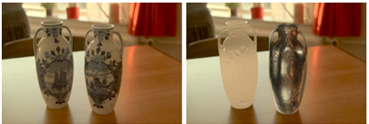
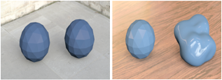
Previous Work – Materials
Image-Based Material Editing
Khan et al: Image-Based Material Editing , Siggraph 2006
Material Perception
Vangorp et al: The Influence of Shape on the Perception of Material Reflectance , Siggraph 2007
Notes:
Image-based editing framework using simple heuristic algorithm to allow the modification of brdf ..
In term of material perception, Vangorp et al. [2007] point out the influence of shape on the material perception
All those observations suggest that judging material properties independently without taking into account shape, lighting, layout might be difficult

Slide 9
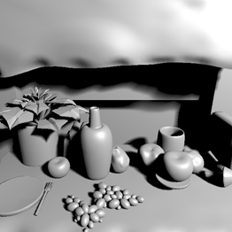
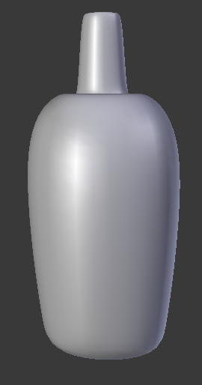
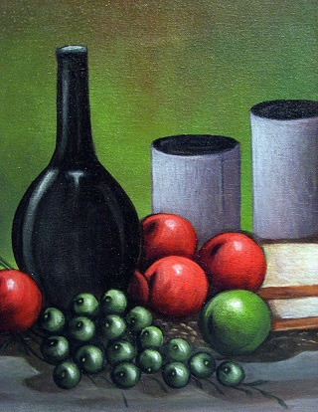
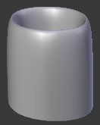
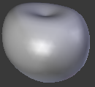
Problem statement
3D Scene
Guide Source
Objects
Materials
Notes:
(Click) Consider a guide source, which can be either an image or video. From now, for easy discussion, I will only talk about image.. ☺
(Click) We extract a plausible set of representative materials in the guide source
3) (Click) Given a 3D scene, objects’ geometry is clearly define.
4) (Click) Our task is to assign every single objects in scene to one material in the extracted set
5) We investigate which should be the objective of our assignment

Slide 10
Material Extraction
3D Scene
Guide Source
Objects
Materials
Notes:
((Click) First is material extraction step
In general, material extraction step try to extract representative materials of a guide source
Since extracting physically materials from images is a very ill-posed problem, we extract plausible materials by splitting the image into several component that map to different shading parameters: diffuse, speculariy and texture

Slide 11
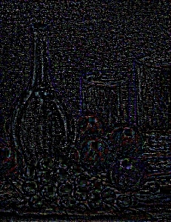
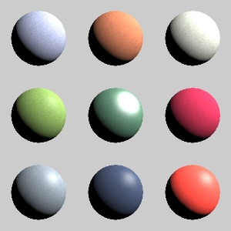
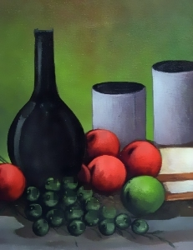
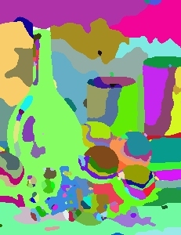
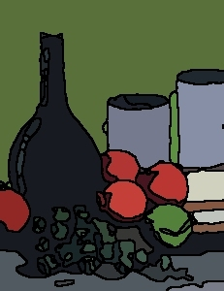
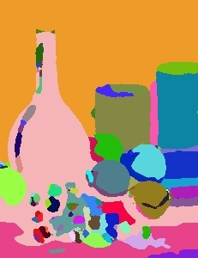
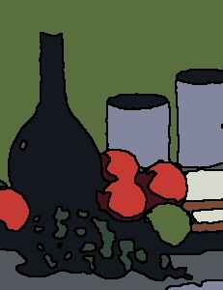
Material Extraction
Original
Specular
Texture
Extracted Materials
Diffuse
1st K-Mean
Merging
2nd K-Mean
Diffuse and Specular Extraction
Yang et al: Real-time Specular Highlight Removal Using Bilateral Filtering, ECCV, 2010
Notes:
In detail
Given an input image guide source
Input image is decomposed into diffuse, specular and texture component using existing algorithm
The texture component is then represented using local statistics
Using diffuse color component, we first segment the image using K-mean
After this step might over-segment some part, we then use a merging step: merge all segment those boundary are similar into one cluster
Within a single cluster, we then compute its color, specularity and local statistic coefficients.
Finally the full high-dimensional material (diffuse, specular and detail statistics) is segment into discrete clusters according to a user ‘s defined N cluster.
Our material extraction is not designed for accuracy but rather plausible, since photometric approach to recognize material is far from working properly. Specular extraction step only worked to some extend

Slide 12
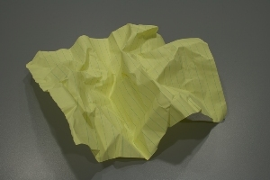
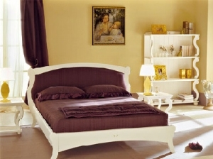
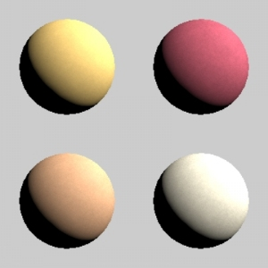
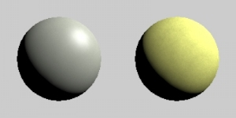
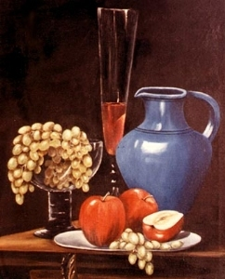
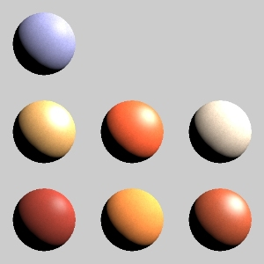
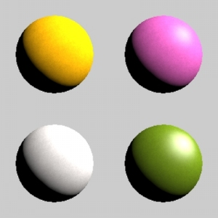
Material Extraction Results
Notes:
Some extraction results show our plausible extraction
Note how specular and noise texture are extracted to certain extend
The total number of extracted material depend on user input

Slide 13
Material Assignment
3D Scene
Guide Source
Objects
Materials
Notes:
(Click) After the material set has been extracted, the task is to assign every objects in scene with one material from the extracted materials.
(Click) Currently, we set the assignment step to satisfy some objective properties.
Unlike traditional color to greyscale images problem, our guide source give us both material and geometry information, their spatial distribution is also somewhat important

Slide 14
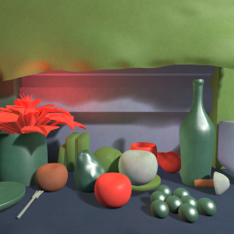
Material Assignment Goal
(Image Cost)
Guide Source
1.
(Geometry Cost)
2.
Objects
Materials
Notes:
(Click) After the material set has been extracted, the task is to assign every objects in scene with one material from the extracted materials.
(Click) Currently, we set the assignment step to satisfy some objective properties.
Unlike traditional color to greyscale images problem, our guide source give us both material and geometry information, their spatial distribution is also somewhat important

Slide 15
Material Assignment Goal – Image Cost
(Image Cost)
Guide Source
1.
(Geometry Cost)
2.
Objects
Materials
Notes:
(Click) After the material set has been extracted, the task is to assign every objects in scene with one material from the extracted materials.
(Click) Currently, we set the assignment step to satisfy some objective properties.
Unlike traditional color to greyscale images problem, our guide source give us both material and geometry information, their spatial distribution is also somewhat important

Slide 16
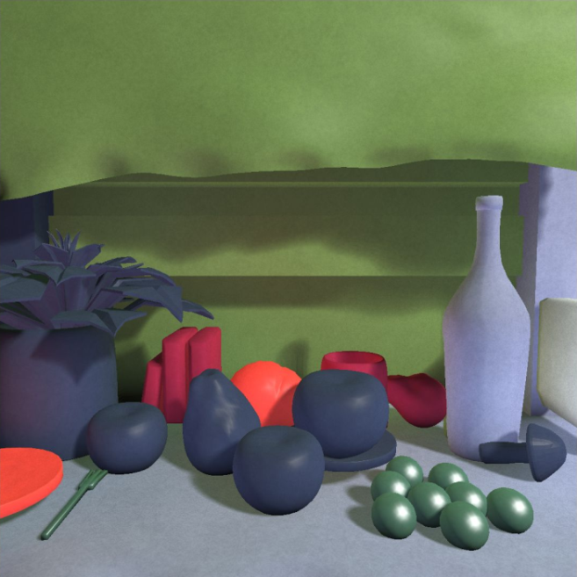
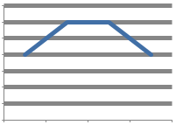
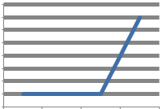
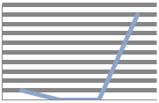
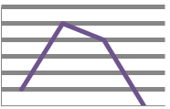
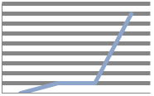
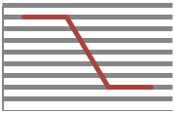
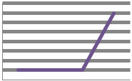
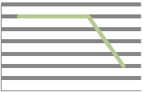
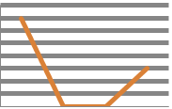
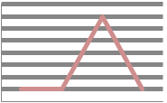
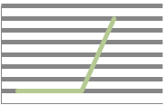
Material Assignment - Image Cost
3D Scene
Guide Source
∑
ϴ
Notes:
Image Cost is to measure the similarity appearance of the rendered images
In general, we calculate the histogram between two image
Image cost is the distance between the 2 histogram (with gaussian bin)
In order to take spatial color distribution layout, image are divide in to 3x3 local patches
Image cost is the maximum cost of all local image cost

Slide 17
Material Assignment Goal – Geometry Cost
(Image Cost)
Guide Source
1.
(Geometry Cost)
2.
Objects
Materials
Notes:
(Click) After the material set has been extracted, the task is to assign every objects in scene with one material from the extracted materials.
(Click) Currently, we set the assignment step to satisfy some objective properties.
Unlike traditional color to greyscale images problem, our guide source give us both material and geometry information, their spatial distribution is also somewhat important

Slide 18
Material Assignment - Geometry Cost
3D Scene
Guide Source
Notes:
(Click) The goal of geometry cost is to assign similar objects with same material. A guide source give us more than just material but also objects inside
(Click) For this purpose, we need to extract meaningful segment from the image. Unfortunately, there is no such segmentation algorithm that can work for all test cases. For this reason, we chose a multi-segmentation approach. Image are segmented using mean-shift with different parameters
(Click) After this step, we have a geometry bag with some meaningful and some meaningless object extracted from the guide source
(Click) For example, we want to measure the assignment cost of bottle to the 1st material in the extracted set
(Click) We look up at the geometry bag for objects with same material
(Click) The geometry assignment cost of assign this bottle
Every segment have an accompanied material

Slide 19
Geometry Cost – Shape Descriptor
2D Angular Radial Transform (ART)
Bober et al: MPEG-7 visual shape descriptors, IEEE Circuits and Sys. Vid. Tech. 11, 6 (2001)
35 coefs (F)
35 coefs (G)
35 coefs (H)
35 coefs(E)
35 coefs (D)
35 coefs (O)
35 coefs (B)
35 coefs (C)
35 coefs (A)
$$=min⁡\left\{\left\|A−O\right\|,\left\|B−O\right\|,\left\|C−O\right\|,\text{..} \right\}$$
,…
ϴ
Notes:
(Click) In order to compactly represent a shape, for every object in scene, let take example the bottle
We render it from different view camera
We then use the angular radial transform and keep 35 coefficient per render view for the shape descriptor
The same for segment in images
To get the visual shape difference between the 2 of them, the minimum Euclidian distance between any view and 1 material is given
Also every segment is accompanied by an extracted material
So, eventually, the geometry cost to assign 1 object to 1 material is forward…
There are case of several segment with same extracted material, then geometry distance is the minimum of them

Slide 20
Cost Function = Image Cost + Geometry Cost
ϴ
ϴ
+
ϴ
ϴ
ϴ
ϴ
…
…
Notes:
(Click) Finally, the cost function consist of a geometry component and an image component, that taken both geometry similarity and image mood into account with weight according to different target

Slide 21
Material Assignment
3D Scene
Guide Source
Objects
Materials
Notes:
(Click) After the material set has been extracted, the task is to assign every objects in scene with one material from the extracted materials.
(Click) Currently, we set the assignment step to satisfy some objective properties.
Unlike traditional color to greyscale images problem, our guide source give us both material and geometry information, their spatial distribution is also somewhat important

Slide 22
Optimization – Simulated Annealing
ϴ
ϴ
ϴ
ϴ
ϴ
+
ϴ
ϴ
+
ϴ
ϴ
ϴ
ϴ
ϴ
…
…
…
…
assignment i+1th
otherwise
assignment i^{th}
Notes:
To deal with the prohibitively large search space, we chose a stochastic optimization approach to find the best solution
We use simulated annealing for the optimization solver
Simulated annealing is an iterative improvement algorithm, in which permuted „neighboring” solutions are used to evaluate the cost function and submitted to an acceptance test. Permutations leading to a cost decrement are always accepted while permutations resulting in an increase are accepted according to a probability based on the Boltzmann factor

Slide 23
Results: Pebbles
Notes:
1) The pebbles scene contains a lot of small pebbles, which would be tedious to assign every single objects separately

Slide 24
Results: Temple
Notes:
1) Temple scene rendered with only light source from outside, the scene is mostly litted global illumination.

Slide 25
Results: Kitchen
Notes:
1) Finally, we show the case of still-life. There is some lacking of white in the image due to extraction error

Slide 26
Results: Bedroom
Notes:
A bed room scene with some object in similar

Slide 27
Perceptual Study – Step 1
Notes:
In first stage, we ask user to edit a scene, given a guide image
In second stage, we to pick the image that most resemble the input guide source
Our conclusion is:
Some interesting remark include it is difficult to find the correct color especially with GI on..
Need to explain more this part

Slide 28
Perceptual Study – Step 2
60% best
Notes:
In first stage, we ask user to edit a scene, given a guide image
In second stage, we to pick the image that most resemble the input guide source
Our conclusion is:
Some interesting remark include it is difficult to find the correct color especially with GI on..
Need to explain more this part

Slide 29
Limitations
Plausible material extraction
Image segmentation errors
Fix lighting
Notes:
However, there are some limitations.
The material extraction is prone to erroneous. Extraction from single image is a difficult task without extra assumptions on the object geometry and scene lighting that we avoid
Hard shadows or unusual highlights happen to be interpreted as individual objects during geometry and material extraction step
Geometry extraction step are far from perfect: image segmentation is still an active research area. Quite using multi-segmentation, our is not
The lighting in 3D scene are fixed beforehand, and we only deal with materials for final appearance transfer

Slide 30
Conclusion and Future Work
Conclusion
Plausible material extraction from images
An automatic system for 3D material style transfer
Future work
Material database for different objects
Better object recognition techniques
Notes:
In conclusion, we proposed an automatic system to transfer the appearance from a guide source to a 3D scene. This serve as a basic for further editing from user.
Our system successfully captures the overall appearance of the guidance source.

Slide 31
Thank you!
Notes:
1) Thank you very much for your attention.

