Slide 1
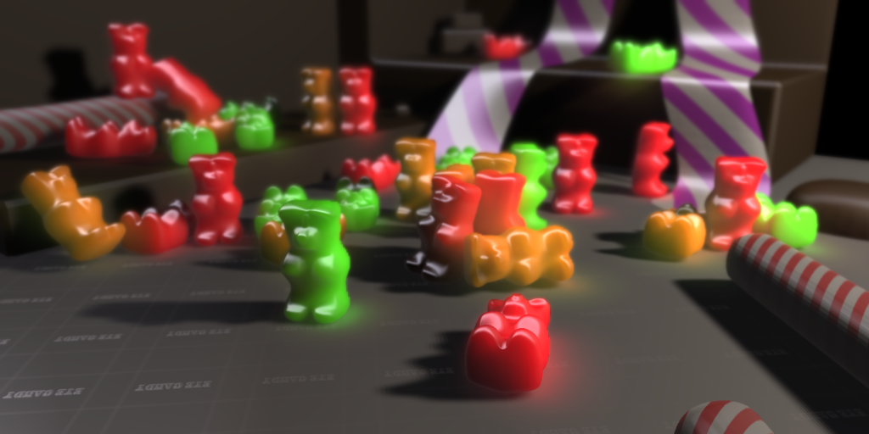
Deep Screen Space
Oliver Nalbach, Tobias Ritschel, Hans-Peter Seidel

Slide 2
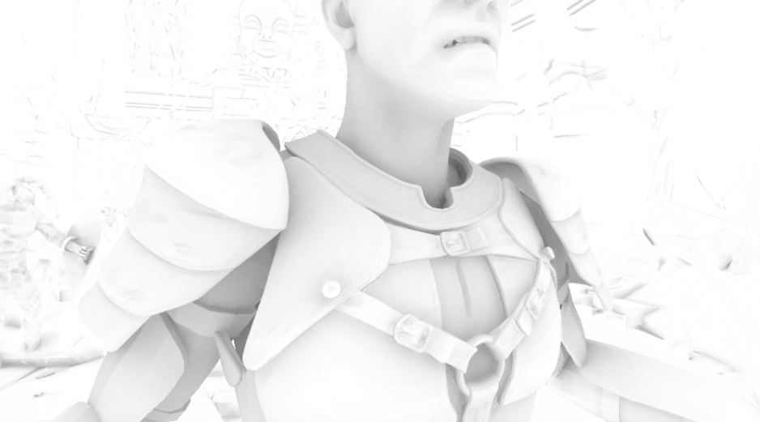
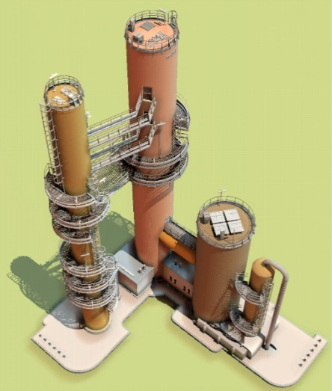
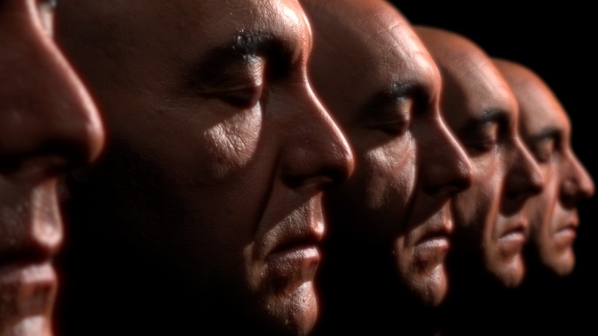
Screen Space Shading
[Bavoil et al. ‘08]
[Ritschel et al. ‘09]
[Jimenez et al. ‘09]

Slide 3
Gathering in Screen Space

Slide 4
Screen Space Tradeoffs
Advantages
Disadvantages
Fast computation
Inherently dynamic
Versatile
Ambient occlusion
Indirect light
Scattering
Depth of field
Typically used for small effect distances
Strong view dependency
Grazing angles
Occlusions

Slide 5
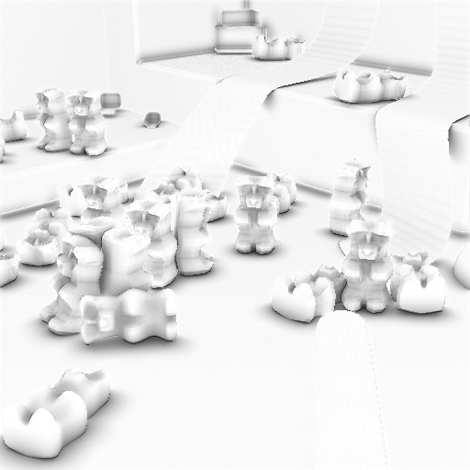
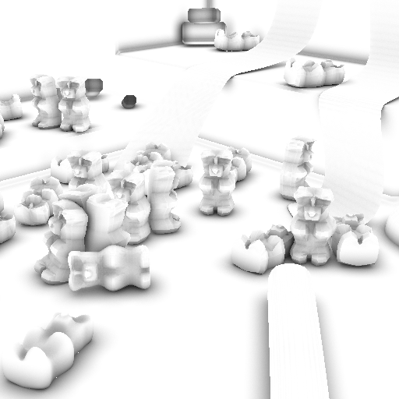
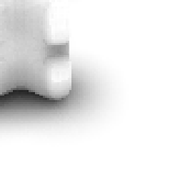
Example: Missing Occlusions
Horizon Based AO
[Bavoil et al. 2008]
Raytracing

Slide 6
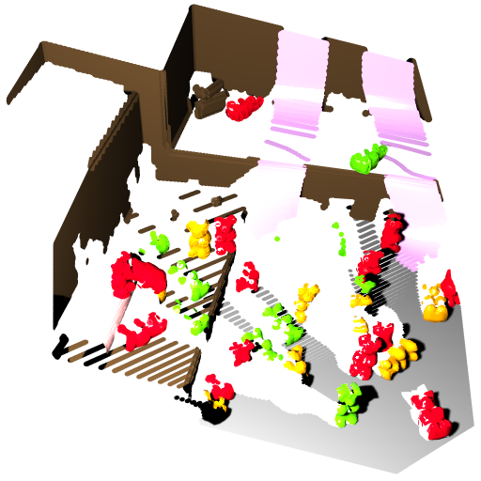
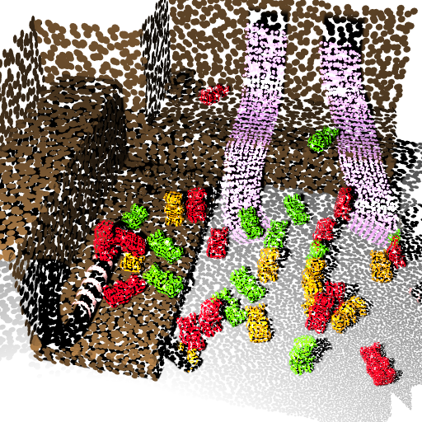
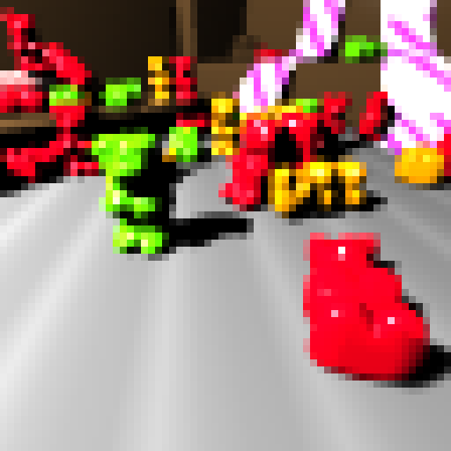
“Deep” Screen Space
Framebuffer
Screen space information
Deep screen space information

Slide 7
Two Necessary Steps
?
?

Slide 8
Distance-dependent Surfel Radii
$$A$$
$$B$$
$$d_{A}$$
$$d_{B}$$

Slide 9
Two Necessary Steps
?

Slide 10
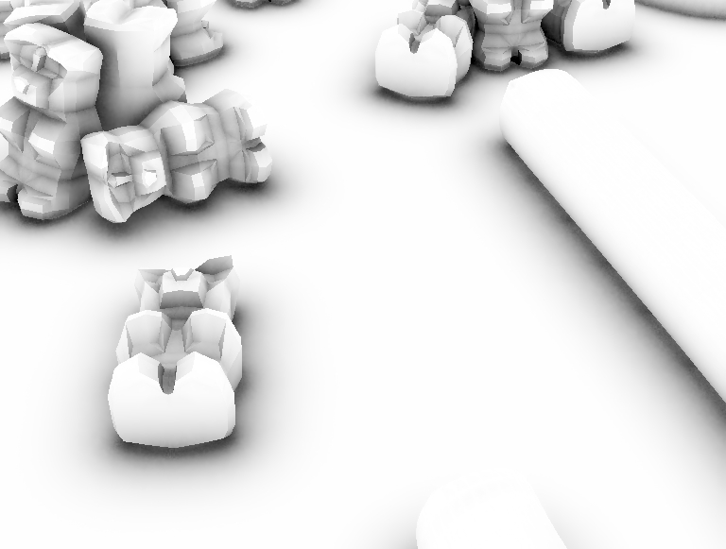
Distance-dependent Accuracy
3
2
2
Level
of
Detail
1
surfel
1
1

Slide 11
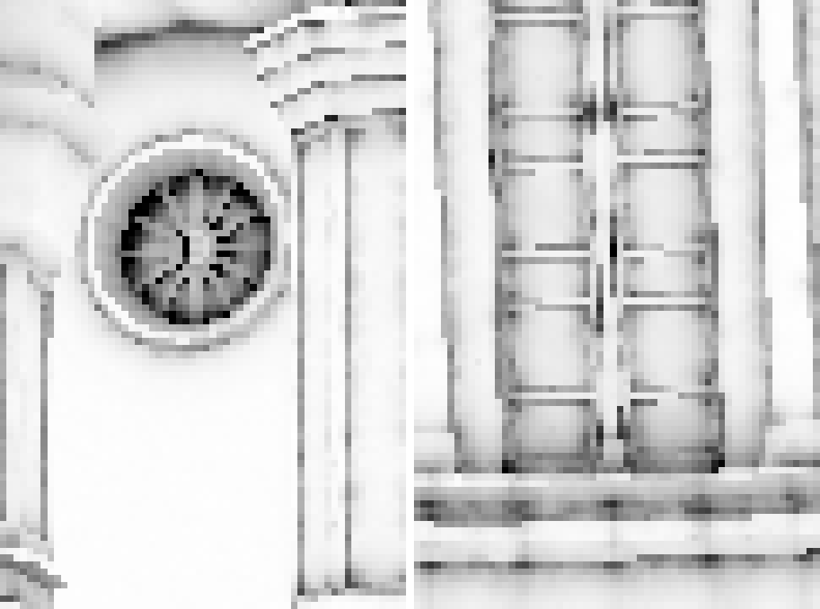
How to Sub-Sample?
Low Resolution, Many Samples
High Resolution, Few Samples

Slide 12
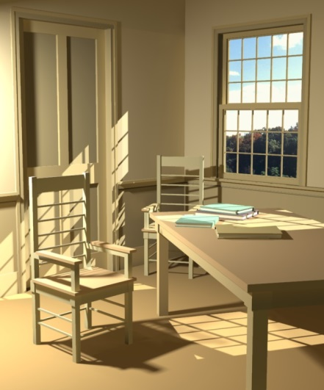
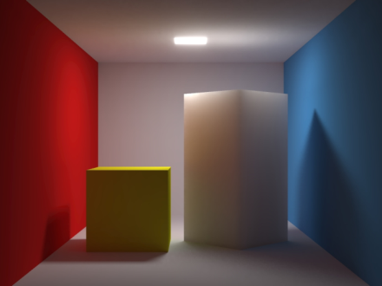
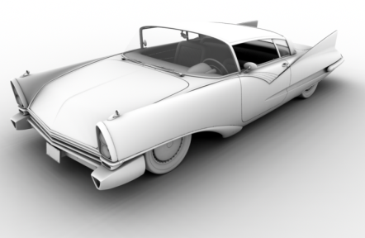
Gathering from Hierarchy?
[Lischinski et al. 1993]
[Jensen & Buhler 2002]
[Christensen 2008]

Slide 13
Shell Splatting Idea
Shell 0
Sampling: 1/1
Shell 1
Sampling: 1/4
Shell 2
Sampling: 1/16

Slide 14
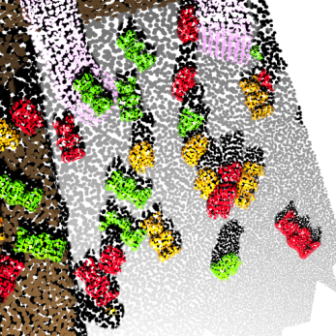
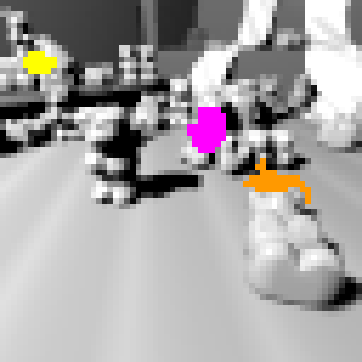
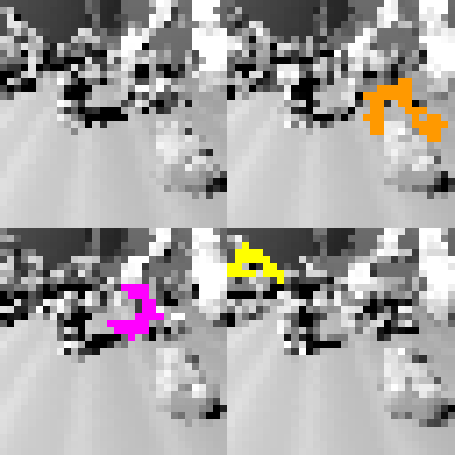
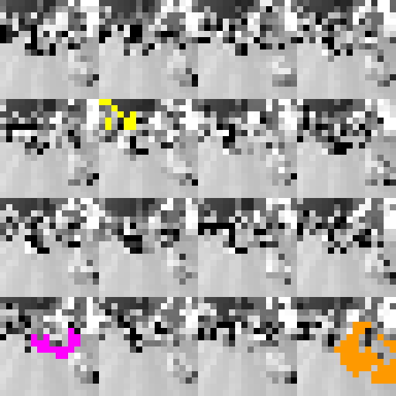
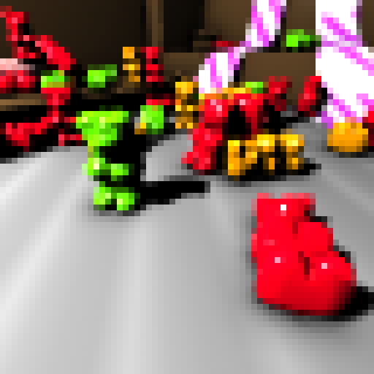
Our Pipeline
1
2
3
4

Slide 15
Hardware Surfel Cloud Generation
Hardware tessellation
… in point mode

Slide 16
Problem: Protruding Surfels
Move surfels towards center

Slide 17
Shell Splatting Implementation
Level 0
Level 1
Level 2

Slide 18
How to Compute the Splat Size?
$$c$$
$f(S,R)$ (effect)
$S$ (disk)
$R$ (point)
Determine (smallest) “effect radius” $r$ s.t.
$f\left(S,R\right)<ε$, for all $R$with $dist\left(S,R\right)≥r$
Use the projected diameter of a sphere with world space radius $r$ centered at the surfel‘s center $c$

Slide 19
Joint Bilateral Blurring
Level 0
Level 1
Level 2
Blur in x- and y-direction, radius $2^{l}$ for level $l$
Level 0
Level 1
Level 2

Slide 20
Combining the Levels
Level 0
Level 1
Level 2
+

Slide 21
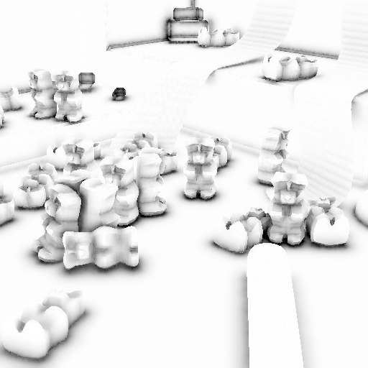
Application: Ambient Occlusion
10 ms
22 ms
> 1 s
Horizon Based AO
[Bavoil et al. 2008]
Deep screen space AO
Raytracing

Slide 22
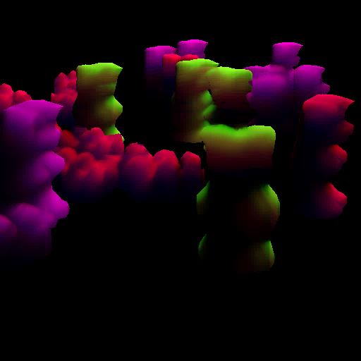
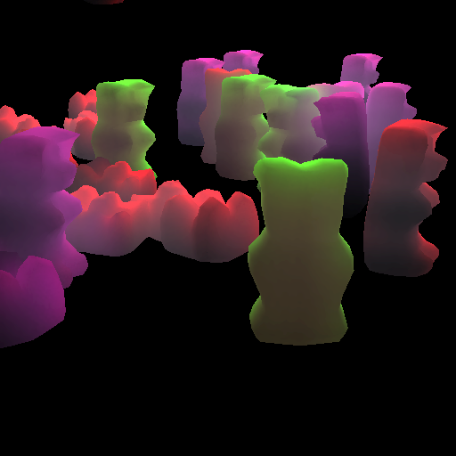
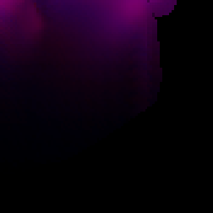
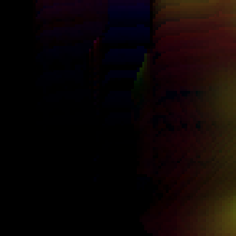
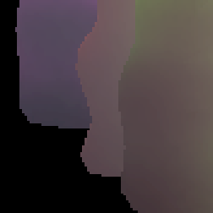
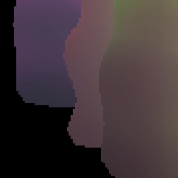
Application: Sub-surface Scattering
5 ms
22 ms
> 1 s
Screen Space
Sub-surface Scattering
[Jimenez et al. 2009]
Deep screen space
Sub-surface Scattering
Diffusion approximation
based on irradiance samples
[Jensen and Buhler 2002]

Slide 23
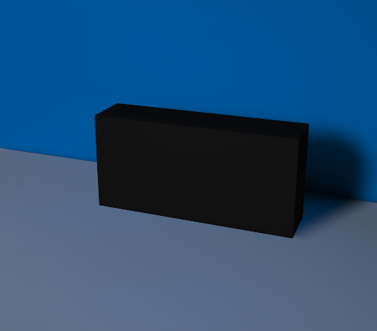
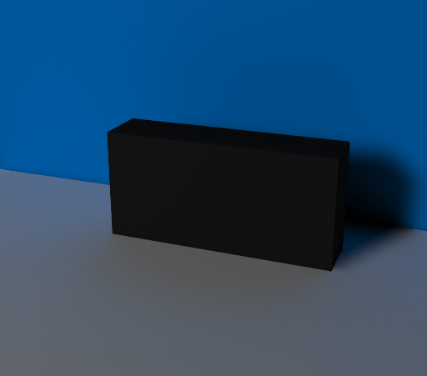
Problem: Indirect Visibility
Object
Occluder
Deep screen space
Light source
Raytracing

Slide 24
Conclusion
Supports arbitrarily deforming geometry
Similar efficiency but without the strong viewing angle dependency
Fits the rendering pipeline
More applications seem possible
Indirect lighting of volumes
Motion blur
Depth of field

Slide 25
Thank you.
Project page: http://www.mpi-inf.mpg.de/~onalbach/DeepScreenSpace/
Contact: onalbach(at)mpi-inf.mpg.de

