Slide 1
A Transformation-Aware Perceptual Image Metric
Petr Kellnhofer¹ | Tobias Ritschel^{1,2}
Karol Myszkowski¹ | Hans-Peter Seidel¹
1
2

Slide 2
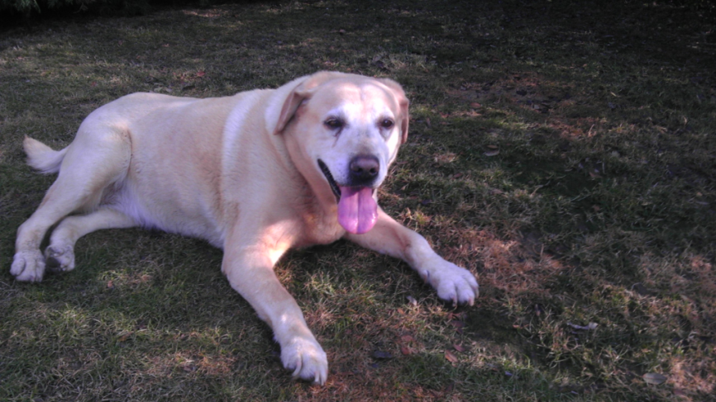
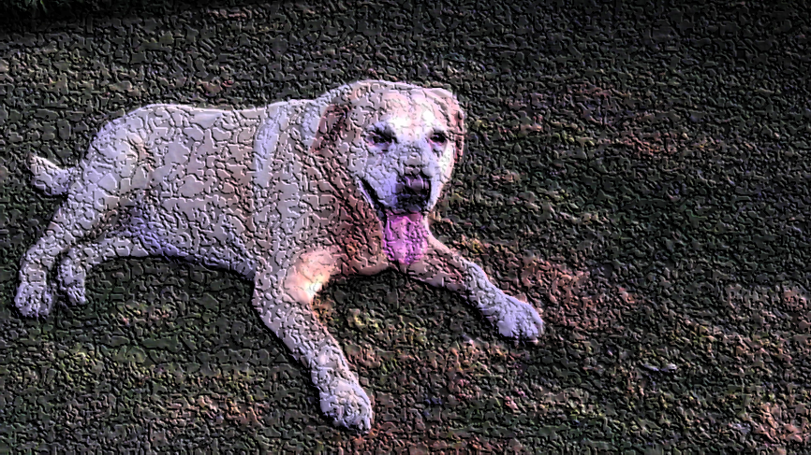
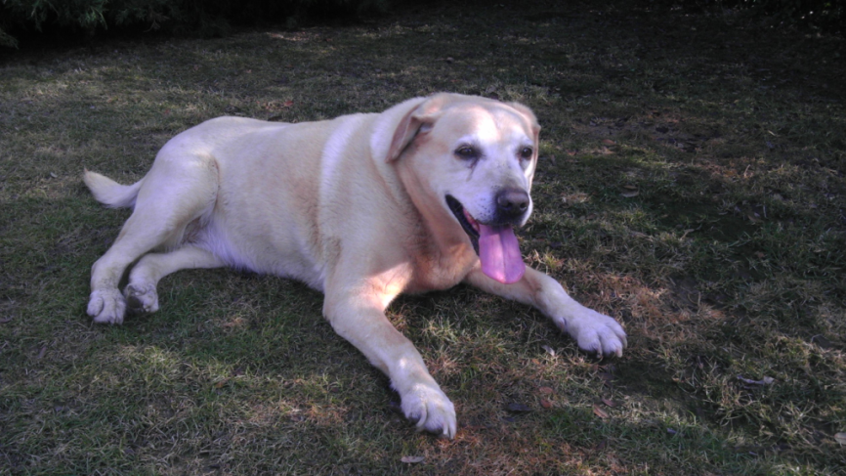
Image difference

Slide 3
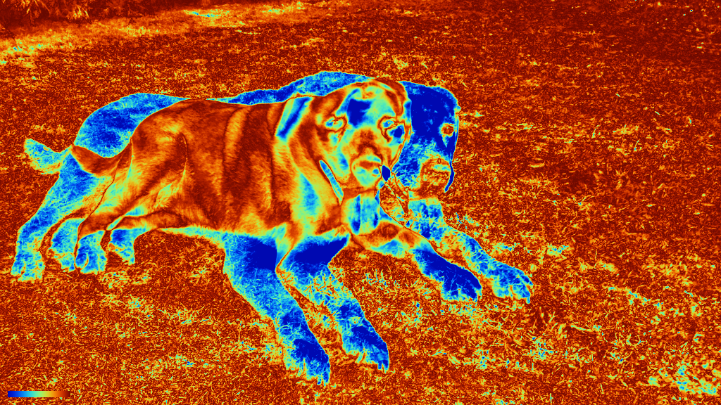
( - ) =

Slide 4
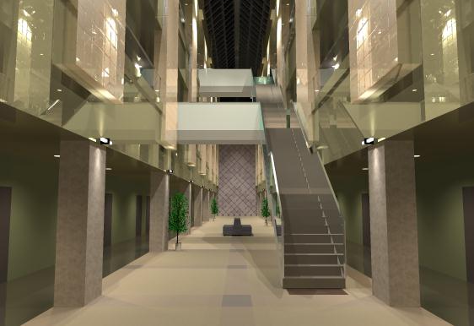
Re-rendering
Visualization of an atrium at the University of Aizu

Slide 5
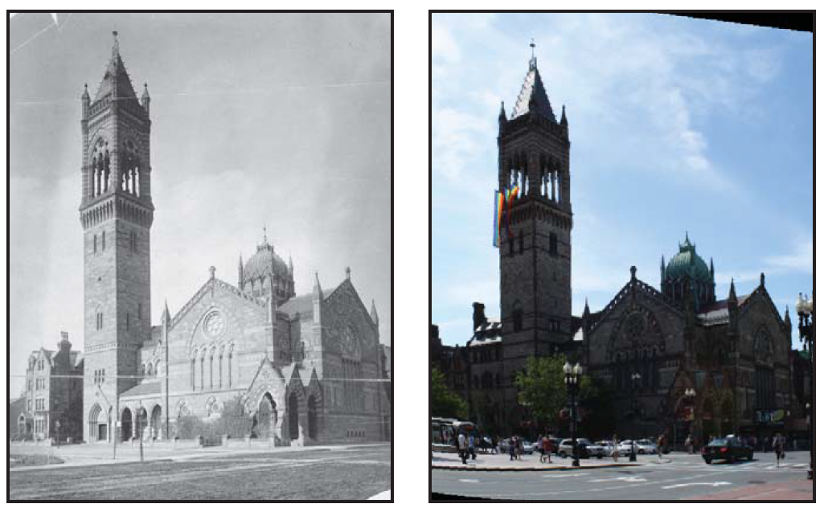
Re-photography
Computational rephotography, Bae et al. 2010

Slide 6
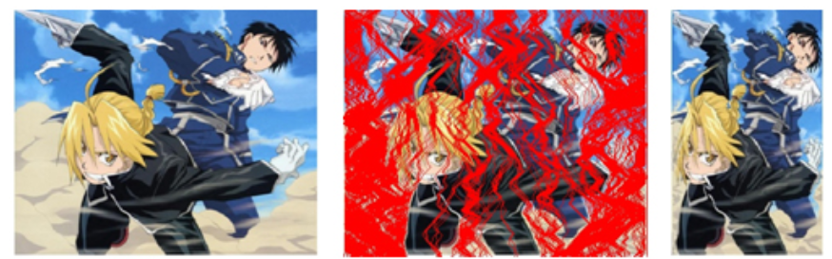
Retargeting
Original image
Seam to be deleted
Retarget
Image Retargeting Quality Assessment, Liu et. al. 2011

Slide 7
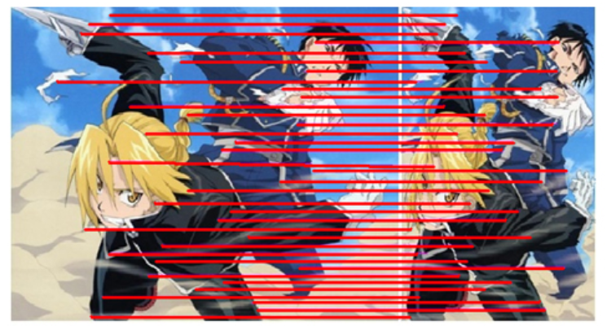
Alignment
Image Retargeting Quality Assessment, Liu et. al. 2011

Slide 8
Image A
Image B
D ( , )
$$>$$
D ( , )
D ( , )
$$<$$
D ( , )

Slide 9
D ( ,
)
D ( ,
)

Slide 10
D ( , )
D ( , )

Slide 11
$$<$$
Rigid transformation or perspective change
Random and incoherent flow

Slide 12
Mental rotation
Easy
Hard
Fast
Slow

Slide 13
$$y=H x$$
Rotation
Translation
Scale
Shear
Perspective
$$H=\left(\begin{matrix}h_{11} & h_{12} & h_{13} \\ h_{21} & h_{22} & h_{23} \\ h_{31} & h_{32} & h_{33}\end{matrix}\right)=$$
Local homography

Slide 15
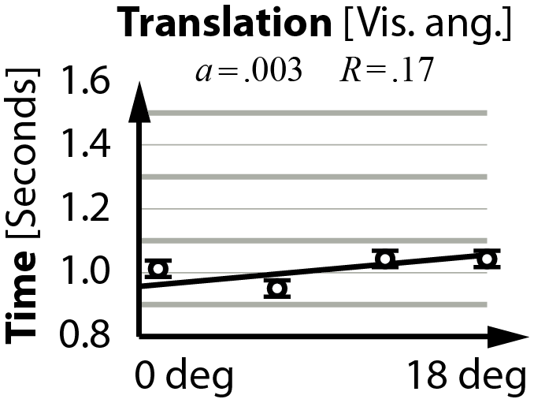
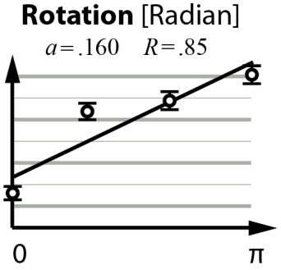
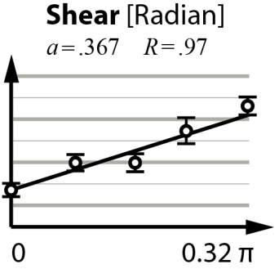
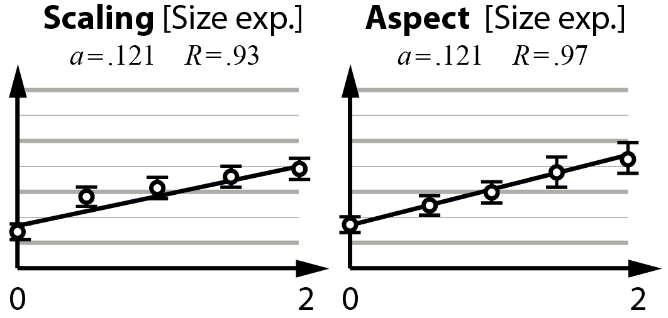
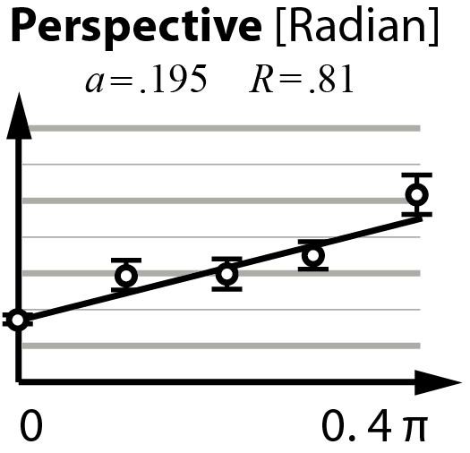
Transformation difficulty

Slide 16
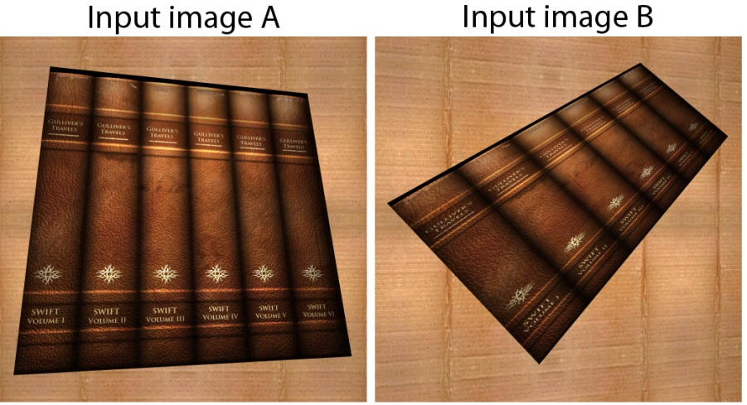
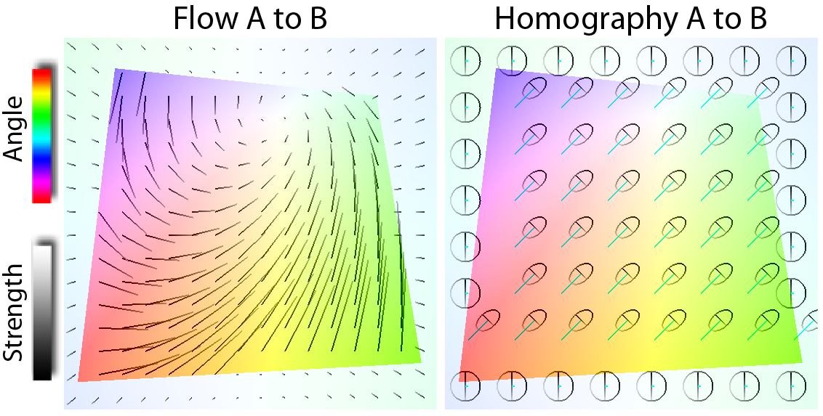
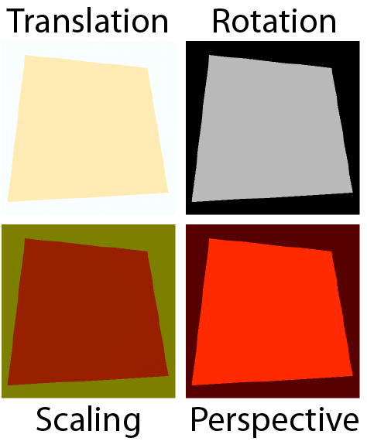

Slide 17
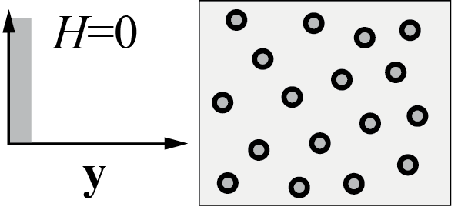
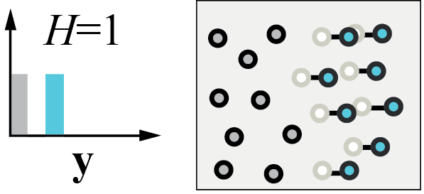
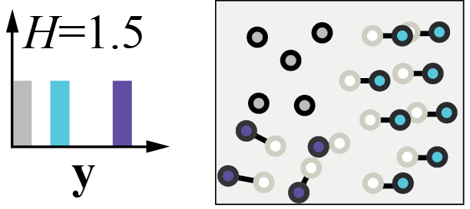
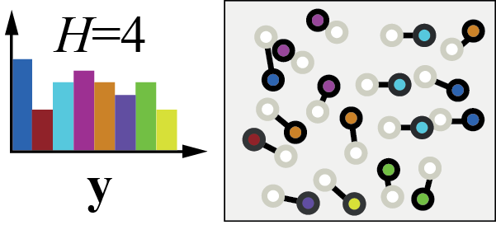
Entropy

Slide 18
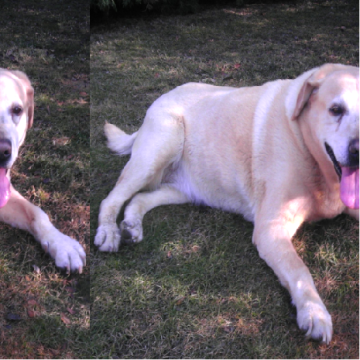
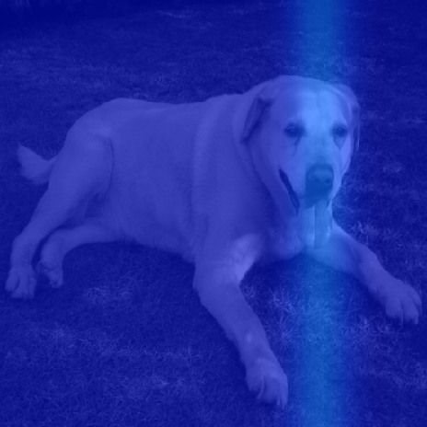
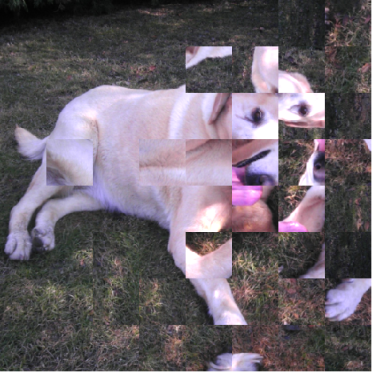
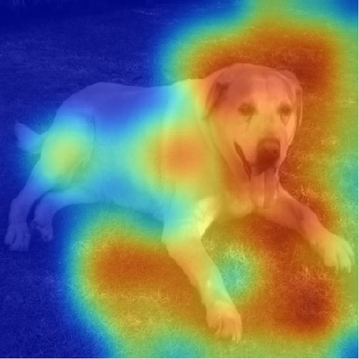
Transformation
Entropy

Slide 19
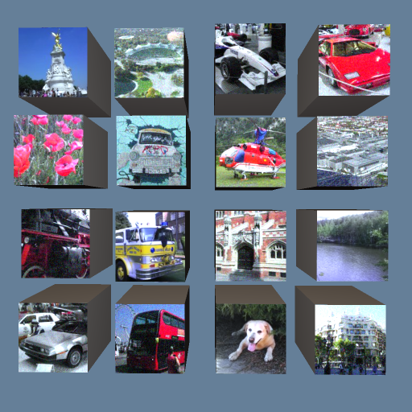
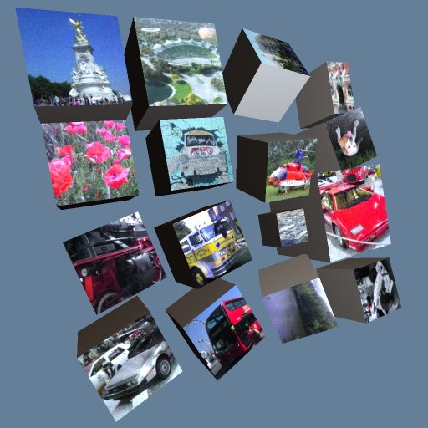
Validation
Pearson’s r correlation of success rate and metric = 0.701 (p < 0.05)

Slide 20
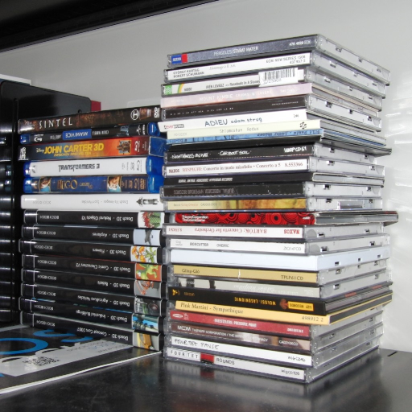
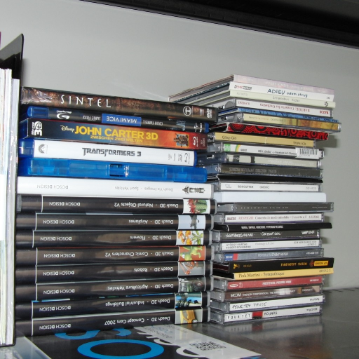
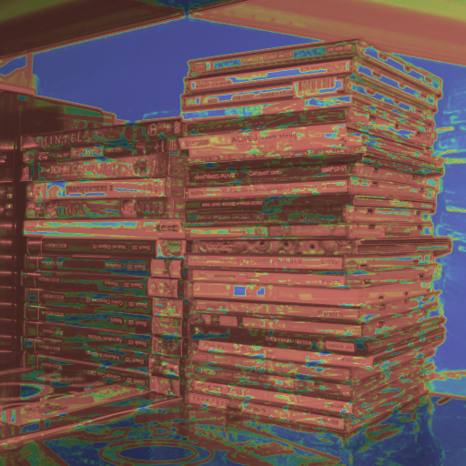
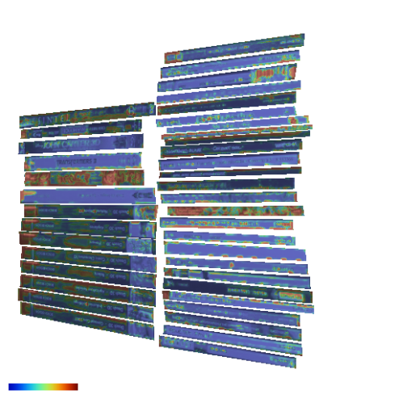
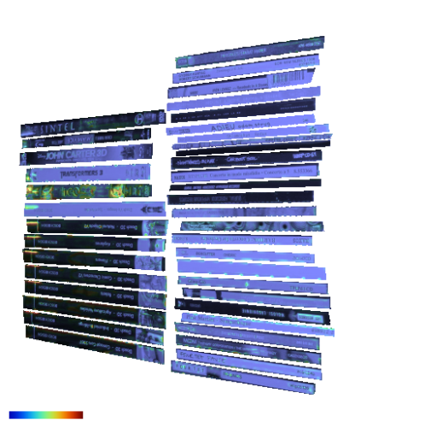
Image metric
SSIM
Align + SSIM
Ours

Slide 21
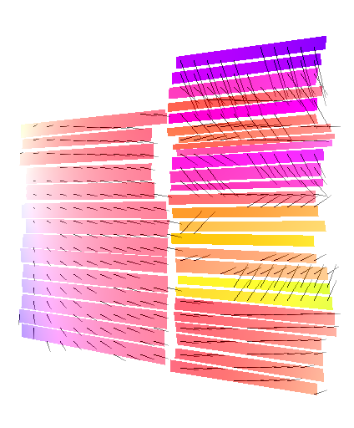
Flow A to B
Total transformation magnitude
Total transformation entropy

Slide 22
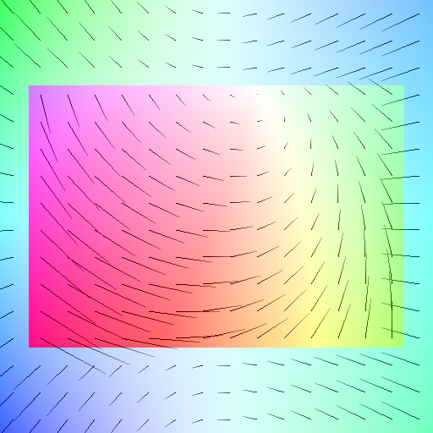
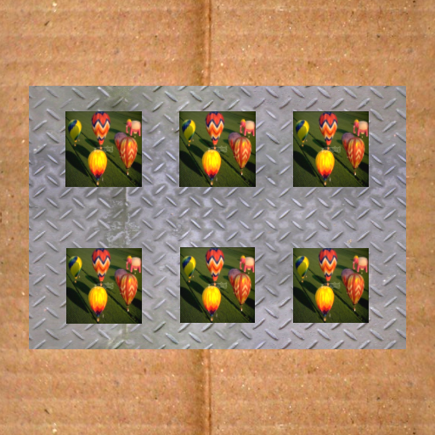
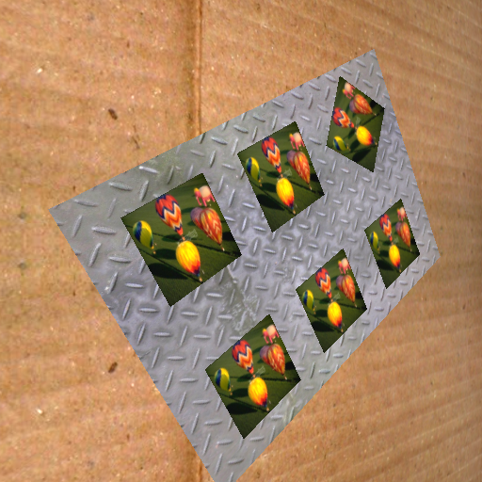
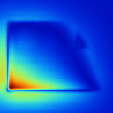
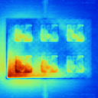
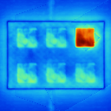
Saliency
Flow A to B
Standard Itty
Ours

Slide 23
Conclusion
Transformations cannot be ignored or just removed
We treat them as part of the problem
The model can predict the difficulty of comparing two images

Slide 24
Future work
Role of time – side-by-side vs. video

Slide 25
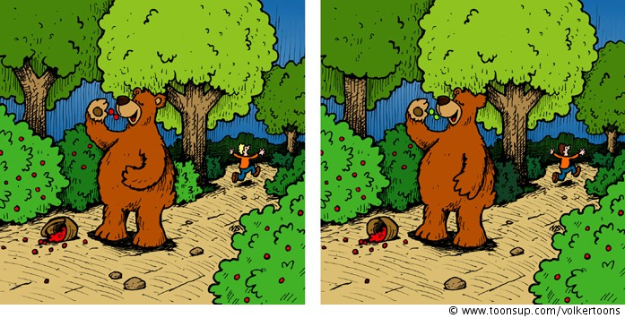

Slide 27
Future work
Role of time – side-by-side vs. video
Unclear interaction with complex image content
Relative weight of transformation difficulty and other effects such as texture masking, image saliency etc. is to be investigated

Slide 28
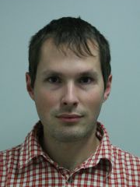
A Transformation-Aware Perceptual Image Metric
Project page: http://resources.mpi-inf.mpg.de/TransformationAwareMetric/
Contact: pkellnho(at)mpi-inf.mpg.de
THANK YOU

