Slide 1
Creating Probabilistic Databases from IE Models
M.Theobald
Olga Mykytiuk, 21 July 2011

Slide 2
Outline
Motivation for probabilistic databases
Model for automatic extraction
Different representation
One-row model
Multi-row model
Approximation methods
One-row model approximation
Enumeration-based approach
Structural approach
Merging
Evaluation

Slide 3
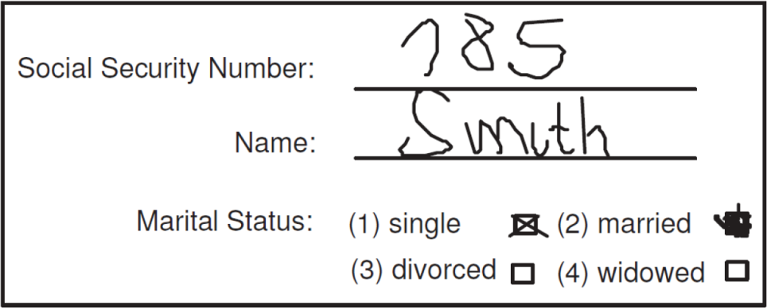
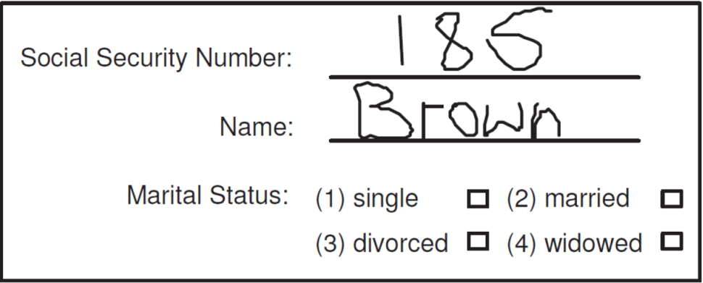
Motivation
Ambiguity:
Is Smith single or married?
What is the marital status of Brown?
What is Smith's social security number: 185 or 785?
What is Brown's social security number: 185 or 186?

Slide 4
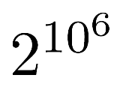
Motivation
Probabilistic database:
Here: 2 × 4 × 2 × 2 = 32 possible readings → can easily store all of them
200M people, 50 questions, 1 in 10000 ambiguous (2 options)
→ possible readings

Slide 5
Sources of uncertinity
Certain Data | Uncertain Data
The temperature is 25.634589 C. | Sensor reported 25 +/- 1 C.
Bob works for Yahoo. | Bob works for Yahoo or Microsoft.
UDS is located in Saarbrücken. | UDS is located in Saarland.
Mary sighted a crow. | Mary sighted either a crow (80%) or a raven(20%).
It will rain in Saarbrücken tomorrow. | There is a 60% chance of rain in Saarbrücken tomorrow.
Olga's age is 18. | Olga's age is in [10,30].
Paul is married to Amy. | Paul is married to Amy. Amy is married to Frank.
Precision
Lack of information
Coarse-grained
information
Ambiguity
Uncertainty about
future
Anonymization
Inconsistent data

Slide 6
Sources of uncertainty
Information extraction → from probabilistic models
Data integration → from background knowledge & expert feedback
Moving objects → from particle lters
Predictive analytics → from statistical models
Scientific data → from measurement uncertainty
Fill in missing data → from data mining
Online applications → from user feedback

Slide 7
Or-set tables
Name | Bird | Species
Besnik | Bird-1 | Finch: 0.8 || Toucan: 0.2
Niket | Bird-2 | Nightingale: 0.65 || Toucan: 0.35
Stephan | Bird-3 | Humming bird: 0.55 || Toucan: 0.45
t1
t2
t3
Observed Species
Species
Finch | (t1,1)
Toucan | (t1,2) ˅(t2,2) ˅(t3,2)
Nightingale | (t2,1)
Humming bird | (t3,1)

Slide 8
Pc-table
FID | SSN | Name
1 | 185 | Smith | X=1
1 | 785 | Smith | X≠1
2 | 185 | Brown | Y=1˄ X≠1
2 | 186 | Brown | Y ≠1 ˅ X = 1
V | D | P
X | 1 | 0.2
X | 2 | 0.8
Y | 1 | 0.3
Y | 2 | 0.7
FID | SSN | Name
1 | 185 | Smith
2 | 186 | Brown
FID | SSN | Name
1 | 185 | Smith
2 | 186 | Brown
FID | SSN | Name
1 | 185 | Smith
2 | 186 | Brown
{X→1, Y →1 }
{X→1, Y →2 }
0.2×0.3+ 0.2×0.7=0.2
{X→2, Y →1 }
0.8×0.3=0.24
{X→2, Y →2 }
0.8×0.7=0.56

Slide 9
Tuple-independent databases
Birds
P (Finch) = P(X1) = 0.8
Is there a finch?
Q ← Birds(Finch)
P (Q ) = 0.8
Is there some bird?
Q ← Birds(s)?
Q = X1 ˅ X2 ˅ X3 ˅ X4
P (Q ) = 99,1%
Species | P
Finch | 0.80 | X1
Toucan | 0.71 | X2
Nightingale | 0.65 | X3
Humming bird | 0.55 | X4
Notes:
Tuple-independent database
I Each tuple t annotated with a unique boolean variable Xt
I We write P ( t ) = P (Xt )
Boolean query Q
I With lineage Q
I We write P (Q ) = P (Q )
Goal: compute P (Q ) when Q is tractable
I Evaluation process guided by query expression q
I I.e., without rst computing lineage!

Slide 10
Outline
Motivation for probabilistic databases
Model for automatic extraction
Different representation
One-row model
Multi-row model
Approximation methods
One-row model approximation
Enumeration-based approach
Structural approach
Merging
Evaluation

Slide 11
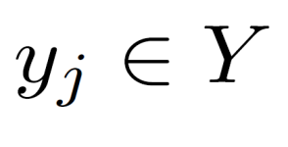
Semi-CRF
Input: sequence of tokens
Output: segmentation s
With a label
Y consists of K attribute labels
And a special “Other”
A probability distribution over s:

Slide 12
Semi-CRF
“52-A Goregaon West Mumbai PIN 400 062”
House_no
Area
City
Other
Zip
Y1
Y2
Y3
Y4
Y5
Y6
Y7
52
A
Goregaon
West
Mumbai
PIN
400 062

Slide 13
Semi-CRF
ID | House_no | Area | City | Pincode | Prob
1 | 52 | Goregaon West | Mumbai | 400 062 | 0.1
1 | 52-A | Goregaon | West Mumbai | 400 062 | 0.2
1 | 52-A | Goregaon West | Mumbai | 400 062 | 0.5
1 | 52 | Goregaon | West Mumbai | 400 062 | 0.2
0.2
House_no
other
Area
City
Other
Zip
House_no
Area
City
Other
Zip
0.5
Y1
Y2
Y3
Y4
Y5
Y6
Y7
52
A
Goregaon
West
Mumbai
PIN
400 062

Slide 14
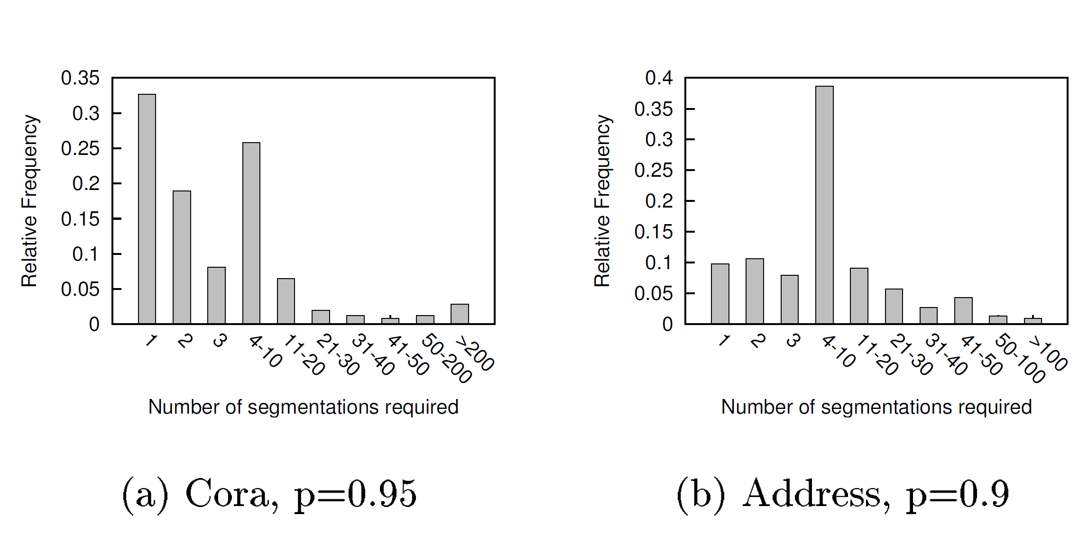
Number of segmentation required

Slide 15
Outline
Motivation for probabilistic databases
Model for automatic extraction
Different representation
One-row model
Multi-row model
Approximation methods
One-row model approximation
Enumeration-based approach
Structural approach
Merging
Evaluation

Slide 16
Segmentation per row
ID | House_no | Area | City | Pincode | Prob
1 | 52 | Goregaon West | Mumbai | 400 062 | 0.1
1 | 52-A | Goregaon | West Mumbai | 400 062 | 0.2
1 | 52-A | Goregaon West | Mumbai | 400 062 | 0.5
1 | 52 | Goregaon | West Mumbai | 400 062 | 0.2
0.2
House_no
other
Area
City
Other
Zip
House_no
Area
City
Other
Zip
0.5
Y1
Y2
Y3
Y4
Y5
Y6
Y7
52
A
Goregaon
West
Mumbai
PIN
400 062
Notes:
Figure 2 illustrates- large number of segmentations
Not enumerate top segmentations
Small number of rows - > approximately methods

Slide 17
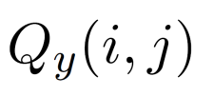
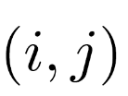
One Row Model
ID | House_no | Area | City | Pincode
1 | 52(0.3) 52-A (0.7) | Goregaon West(0.6) Goregaon (0.4) | Mumbai (0.6) Mumbai West (0.4) | 400 062 (1.0)
Let be probability for segment
Probability of the query
Pr((Area=‘Goregaon West’),City=‘Mumbai’) = 0.6×0.6 = 0.36
ID | House_no | Area | City | Pincode
1 | 52(0.3) 52-A (0.7) | Goregaon West(0.6) Goregaon (0.4) | Mumbai (0.6) Mumbai West (0.4) | 400 062 (1.0)

Slide 18
One Row Model
ID | House_no | Area | City | Pincode | Prob
1 | 52 | Goregaon West | Mumbai | 400 062 | 0.1
1 | 52-A | Goregaon | West Mumbai | 400 062 | 0.2
1 | 52-A | Goregaon West | Mumbai | 400 062 | 0.5
1 | 52 | Goregaon | West Mumbai | 400 062 | 0.2
Pr((Area=‘Goregaon West’),City=‘Mumbai’)
= 0.5 + 0.1 = 0.6
ID | House_no | Area | City | Pincode
1 | 52(0.3) 52-A (0.7) | Goregaon West(0.6) Goregaon (0.4) | Mumbai (0.6) Mumbai West (0.4) | 400 062 (1.0)

Slide 19
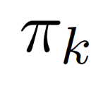
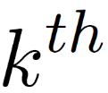
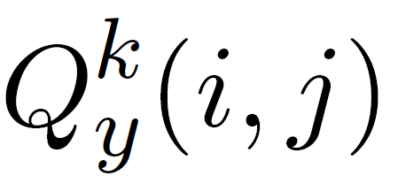
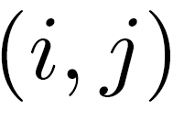
Multi-row Model
Let denote the row probability of row
- multinomial parameter for the segment for column y of the row
Pr((Area=‘Goregaon West’),City=‘Mumbai’) = 1*1*0.6+0*0*0.4 = 0.6
ID | House_no | Area | City | Pincode | P
1 | 52(0.167) 52-A (0.833) | Goregaon West(1.0) | Mumbai (1.0) | 400 062 (1.0) | 0.6
1 | 52(0.5) 52-A (0.5) | Goregaon (1.0) | Mumbai West (1.0) | 400 062 (1.0) | 0.4

Slide 20
Outline
Motivation for probabilistic databases
Model for automatic extraction
Different representation
One-row model
Multi-row model
Approximation methods
One-row model approximation
Enumeration-based approach
Structural approach
Merging
Evaluation

Slide 21
Approximation Quality
Kullback–Leibler divergence
The parameters for One-Row model:

Slide 22
Parameters for One Row Model
A Probability of segmentation s in model:
The marginal probabilityof segment s:

Slide 23
Computing Marginals
Forward pass: let be
Backward pass
Computing marginals:

Slide 24
Computing Marginals
H_no
H_no
H_no
H_no
area
area
area
area
∑(Pr) = β
∑(Pr) = α
S
city
city
…
city
city
E
Zip
Zip
Zip
Zip
other
other
other
other

Slide 25
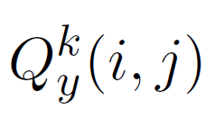
Parameters for Multi-Row model
m – number of rows
Compute:
Row probabilities
Distribution parameters
Where objective

Slide 26
Enumeration-based Approach
Let be an enumeration of all segments
Objective
Expectation-Minimization algorithm
E step
M step
Notes:
Updates until convergences
Local optimal value
Y=3-7 with multiple randomly seeded of initial soft assignment ->always reaches global value
Good yardstick to benchmark

Slide 27
Structural Approach
Components cover disjoint sets of segmentation
Binary decision tree
Each segmentation – one of the path
ID | House_no | Area | City | Pincode
1 | 52(0.3) 52-A (0.7) | Goregaon West(0.6) Goregaon (0.4) | Mumbai (0.6) Mumbai West (0.4) | 400 062 (1.0)

Slide 28
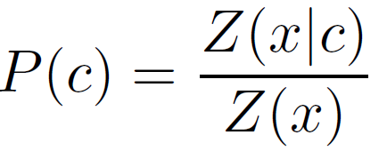
Structural Approach
Three kinds of variables:
For a given condition c entropy measure:
Information gain for
Notes:
Maximize gain

Slide 29
Computing parameters
H_no
H_no
H_no
H_no
area
area
area
area
∑(Pr) = β
∑(Pr) = α
S
city
city
…
city
city
E
Zip
Zip
Zip
Zip
other
other
other
other
Under condition c

Slide 30
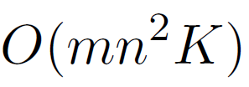
Structural Approach
A
’52-A’, House_no
no
yes
C
B
‘West’,_
yes
no
yes
no
s₄
s₁
s₂
s₃

Slide 31
Merging structures
Use E-M algorithm for all paths until converges:
M-step
E-step
Column of row are independent
Each label defines a multinomial distribution over it’s possible segments → generate one MD from another

Slide 32
Merging structures example
For disjoint segmentation:
s1= {‘52-A’, ‘Goregaon West’, ‘Mumbai’, 400062} s2= {’52’, ‘Goregaon’, ‘West Mumbai’, 400062} ...
For m=2 rows:
R[1,s1] =0.2 R[1,s2] =0.1 R[2,s2] =0.9 R[2,s1] =0.8
s1, s2 → row 2
ID | House_no | Area | City | Pincode
2 | 52-A(0.3) 52 (0.7) | Goregaon West(0.6) Goregaon (0.4) | Mumbai (0.6) West Mumbai (0.4) | 400 062 (1.0)

Slide 33
Outline
Motivation for probabilistic databases
Model for automatic extraction
Different representation
One-row model
Multi-row model
Approximation methods
One-row model approximation
Enumeration-based approach
Structural approach
Merging
Evaluation

Slide 34
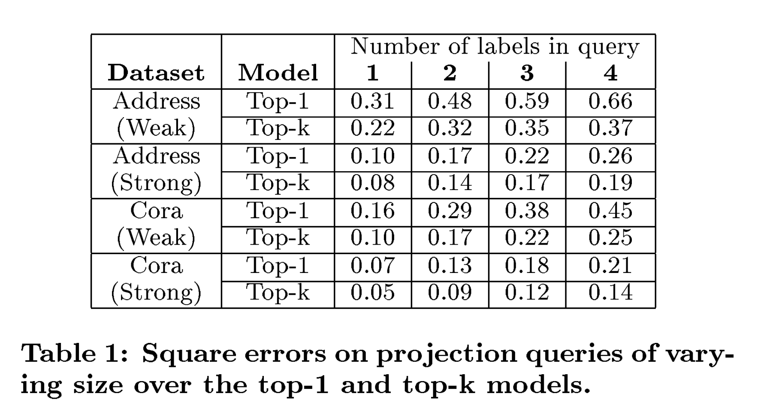
Evaluation
Two datasets
Cora
Address dataset
Strong(30%, 50%), Weak CRF (10%)

Slide 35
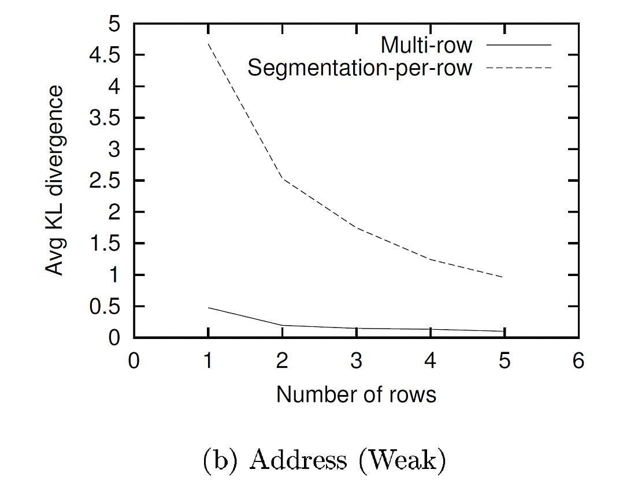
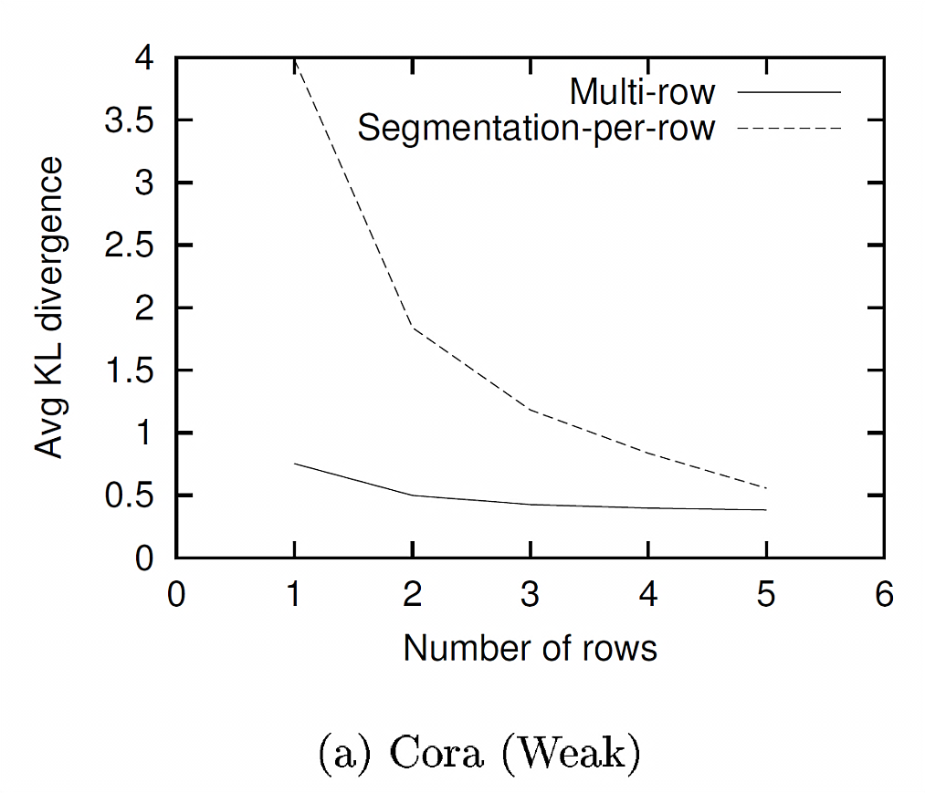
Comparing Models
Comparing divergence of 2 models with the same number of parameters
Notes:
Top-k
Same # of parameters

Slide 36
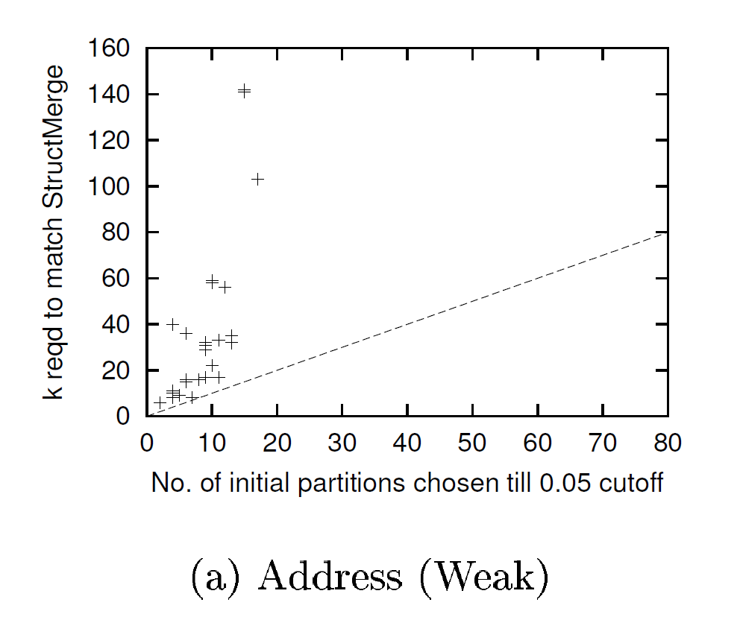
Comparing Models
Variation of k with m_0,
ξ = 0.005
Notes:
Multi-row by struct+merg -> much fewer parameters
Mo –number of initial partitions ;
K –smallest where using to-k has smaaler KL

Slide 37
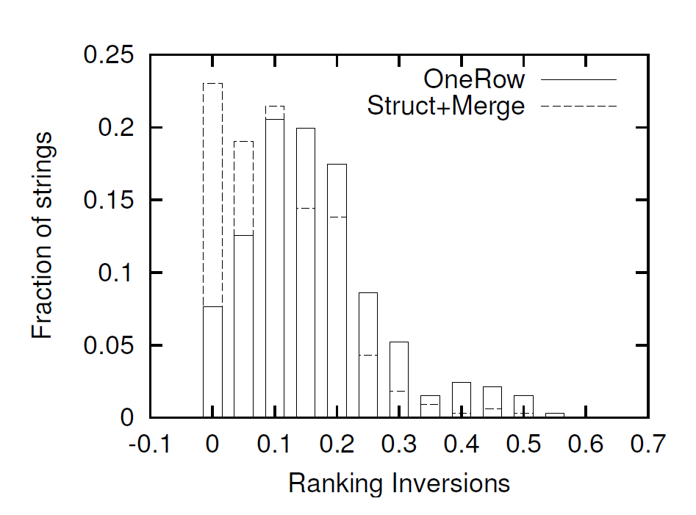
Impact on Query Result

Slide 38
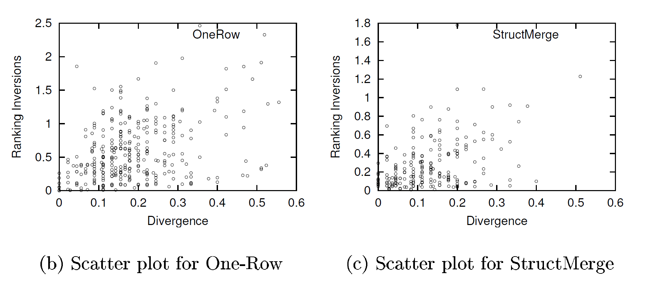
Impact on Query Result
Correlation between KL and inversion score. For StructMerge approach,
m=2, ξ = 0.005

Slide 39
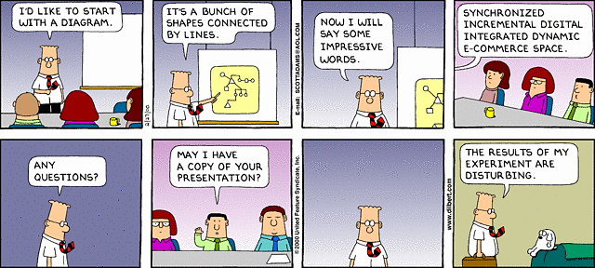
Questions?
http://dilbert.com/strips/comic/2000-02-27/

Slide 40
References
Rahul Gupta, Sunita Sarawagi “Creating Probabilistic Databases from IE Models”
Reiner Gemulla, Lecture Notes of Scalable Uncertainty Management.
Wikipedia http://en.wikipedia.org/wiki/Kullback%E2%80%93Leibler_divergence

