Slide 1
Information Retrieval & Data Mining
Universität des Saarlandes, Saarbrücken
Winter Semester 2011/12

Slide 2
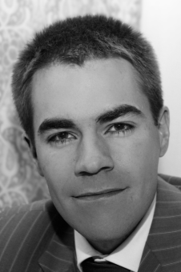
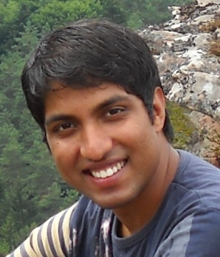
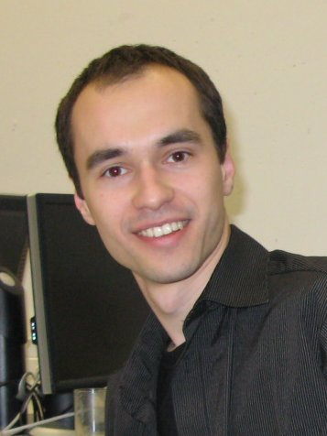
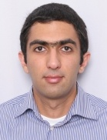
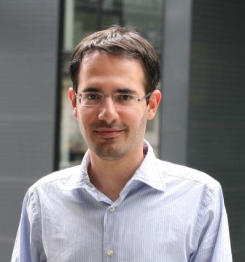
The Course
Lecturers
Teaching Assistants
Martin Theobald
martin.theobald@mpi-inf.mpg.de
Pauli Miettinen
pmiettin@mpi-inf.mpg.de
Sarath K. Kondreddi
skondred@mpii.de
Erdal Kuzey
ekuzey@mpii.de
Niket Tandon
ntandon@mpii.de
Tomasz Tylenda
stylenda@mpii.de
Mohamed Yahya
myahya@mpii.de
Faraz Makari
fmakari@mpii.de
D5: Databases & Information Systems Group
Max Planck Institute for Informatics

Slide 3
Organization
Lectures:
Tuesday 14-16 and Thursday 16-18
in Building E1.3, HS-003
Office hours/appointments by e-mail
Assignments/tutoring groups
Friday 12-14, R023, E1.4 (MPI-INF building) *changed from 14-16
Friday 14-16, SR107, E1.3 (University building)
Friday 14-16, R023, E1.4 (MPI-INF building) *changed from 16-18
Friday 16-18, SR016, E1.3 (University building)
Assignments given out in Thursday lecture, to be solved until next Thursday
First assignment sheet given out on Thursday, Oct 20
First meetings of tutoring groups on Friday, Oct 28

Slide 4
Requirements for Obtaining 9 Credit Points
Pass 2 out of 3 written tests
Tentative dates: Thu, Nov 17; Thu, Dec 22; Thu, Jan 26
(45-60 min each)
Pass the final written exam
Tentative date: Tue, Feb 21 (120-180 min)
Must present solutions to 3 assignments, more possible
(You must return your assignment sheet and have a correct
solution in order to present in the exercise groups.)
1 bonus point possible in tutoring groups
Up to 3 bonus points possible in tests
Each bonus point earns one mark in letter grade
(0.3 in numerical grade)

Slide 5
Register for Tutoring Groups
http://www.mpi-inf.mpg.de/departments/d5/teaching/ws11_12/irdm/
Register for one of the tutoring groups until Oct. 27
Check back frequently for updates & announcements

Slide 6
Agenda
I. Introduction
Basics from probability theory & statistics
Ranking principles
Link analysis
Indexing & searching
Information extraction
Frequent item-sets & association rules
Unsupervised clustering
(Semi-)supervised classification
Advanced topics in data mining
Wrap-up & summary
Information
Retrieval
Data
Mining

Slide 7
Literature (I)
Information Retrieval
Christopher D. Manning, Prabhakar Raghavan, Hinrich Schütze.
Introduction to Information Retrieval
Cambridge University Press, 2008.
Website: http://nlp.stanford.edu/IR-book/
R. Baeza-Yates, R. Ribeiro-Neto.
Modern Information Retrieval: The concepts and technology behind search.
Addison-Wesley, 2010.
W. Bruce Croft, Donald Metzler, Trevor Strohman.
Search Engines: Information Retrieval in Practice.
Addison-Wesley, 2009.
Website: http://www.pearsonhighered.com/croft1epreview/

Slide 8
Literature (II)
Data Mining
Mohammed J. Zaki, Wagner Meira Jr.
Fundamentals of Data Mining Algorithms
Manuscript (will be made available during the semester)
Pang-Ning Tan, Michael Steinbach, Vipin Kumar.
Introduction to Data Mining
Addison-Wesley, 2006.
Website: http://www-users.cs.umn.edu/%7Ekumar/dmbook/index.php

Slide 9
Literature (III)
Background & Further Reading
Jiawei Han, Micheline Kamber, Jian Pei.
Data Mining - Concepts and Techniques, 3rd ed., Morgan Kaufmann, 2011
Website: http://www.cs.sfu.ca/~han/dmbook
Stefan Büttcher, Charles L. A. Clarke, Gordon V. Cormack.
Information Retrieval: Implementing and Evaluating Search Engines,
MIT Press, 2010
Christopher M. Bishop.
Pattern Recognition and Machine Learning, Springer, 2006.
Larry Wasserman.
All of Statistics, Springer, 2004.
Website: http://www.stat.cmu.edu/~larry/all-of-statistics/
Trevor Hastie, Robert Tibshirani, Jerome Friedman.
The elements of statistical learning, 2nd edition, Springer, 2009.

Slide 10
Quiz Time!
Please answer the 20 quiz questions during the rest of the lecture.
The quiz is completely anonymous, but keep your id on the top-right corner. There will be a prize for the 3 best answer sheets.

Slide 11
Chapter I: Introduction – IRDM Applications & System Architectures
Information Retrieval & Data Mining
Universität des Saarlandes, Saarbrücken
Winter Semester 2011/12

Slide 12
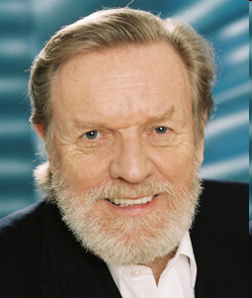
Chapter I: IRDM Applications and System Architectures
1.1 Overview of IRDM Technologies & Applications
1.2 Search Engines – IR in a Nutshell
Deep Web / Hidden Web, Semantic Web, Multimodal Web, Social Web (Web 2.0)
1.3 Data Mining in a Nutshell
Real-world DM applications
„We are drowning in information,
and starved for knowledge.“
-- John Naisbitt

Slide 13
I.1 Overview of Applications & Technologies
Objective: Satisfy information demand & curiosity of human users –
and eliminate the (expensive) bottleneck of human time !
Information Retrieval (IR):
Data Mining (DM):
document content & structure analysis
indexing, search, relevance ranking
classification, grouping, segmentation
interaction with knowledge bases
annotation, summarization, visualization
personalized interaction & collaboration
learning predictive models from data
pattern, rule, trend, outlier detection
classification, grouping, segmentation
knowledge discovery in data collections
information extraction from text & Web
graph mining (e.g. on Web graph)
application areas:
Web & Deep Web search
digital libraries & enterprise search
XML & text integration
multimedia information
Web 2.0 and social networks
personalized & collaborative filtering
application areas:
bioinformatics, e.g.: protein folding,
medical therapies, gene co-regulation
business intelligence, e.g.: market baskets,
CRM, loan or insurance risks
scientific observatories, e.g.: astrophysics,
Internet traffic (incl. fraud, spam, DoS)
Web mining & knowledge harvesting
Connected to natural language processing (NLP) and statistical machine learning (ML)

Slide 14
Tag Clouds – Retrieval or Mining?
http://www.wordle.net/

Slide 15
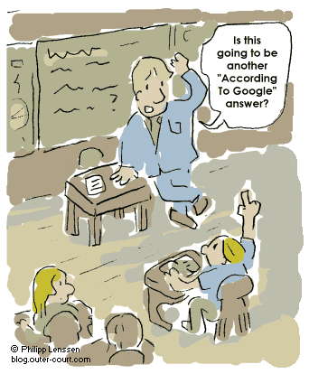
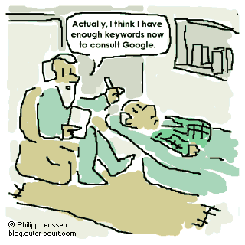
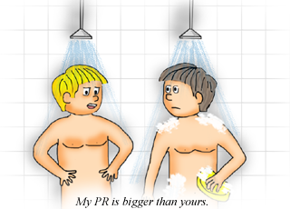
The Google Revolution
© 2003 Verity Intellectual Properties Pty Ltd
great for e-shopping, school kids, scientists, doctors, etc.
high-precision results for simple queries
superb scalability & throughput (> 20 Bio. docs, > 1000 queries/sec)
continuously enhanced: GoogleScholar, GoogleEarth, Google+,
multilingual for >100 languages, calendar, query auto-completion,…

Slide 16
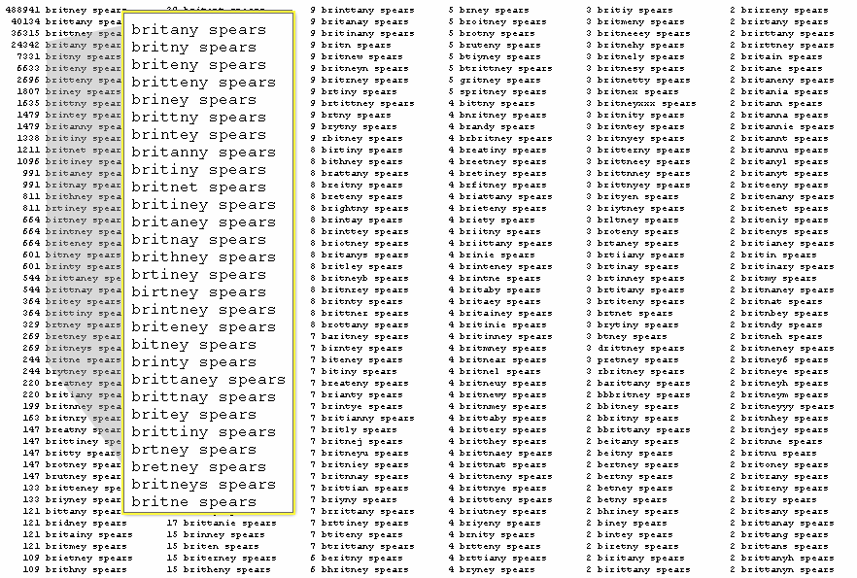
Search Engine Users
http://www.google.com/press/zeitgeist2010/
regions/de.html
Google.com 2008 (U.S.)
1. obama
2. facebook
3. att
4. iphone
5. youtube
Google news 2008 (U.S.)
1. sarah palin
2. american idol
3. mccain
4. olympics
5. ike (hurricane)
Google image 2008 (U.S.)
1. sarah palin
2. obama
3. twilight
4. miley cyrus
5. joker
Google translate 2008 (U.S.)
1. you
2. what
3. thank you
4. please
5. love
Google.de 2008
1. wer kennt wen
2. juegos
3. facebook
4. schüler vz
5. studi vz
6. jappy
7. youtube
8 yasni
9. obama
10. euro 2008
People who can‘t spell!
[Amit Singhal: SIGIR’05 Keynote]

Slide 17
Web Search Patterns [Rose/Levinson: WWW 2004]
navigational: find specific homepage with unknown URL, e.g. Cirrus Airlines
transactional: find specific resource, e.g. download Lucene source code,
Sony Cybershot DSC-W5, Mars surface images, hotel beach south Crete August
informational: learn about topic
focused, e.g. Chernoff bounds, soccer world championship qualification
unfocused, e.g. undergraduate statistics, dark matter, Internet spam
seeking advice, e.g. help losing weight, low-fat food, marathon training tips
locating service, e.g. 6M pixel digital camera, taxi service Saarbrücken
exhaustive, e.g. Dutch universities, hotel reviews Crete, MP3 players
embedded in business workflow (e.g. CRM, business intelligence) or
personal agent (in cell phone, MP3 player, or ambient intelligence at home)
with automatically generated queries
natural-language question answering (QA):
factoids, e.g. when was Johnny Depp born, where is the Louvre,
who is the CEO of Google, what kind of particles are quarks, etc.
list queries, e.g. in which movies did Johnny Depp play
opinions, e.g. Barack Obama, should Germany leave Afghanistan, etc.

Slide 18
I.2 Search Engines (IR in a Nutshell)
- Web, intranet, digital libraries, desktop search
- Unstructured/semistructured data
......
.....
......
.....
crawl
extract
& clean
index
search
rank
present
handle
dynamic pages,
detect duplicates,
detect spam
fast top-k queries,
query logging,
auto-completion
GUI, user guidance,
personalization
strategies for
crawl schedule and
priority queue for
crawl frontier
build and analyze
Web graph,
index all tokens
or word stems
scoring function
over many data
and context criteria
Server farms with 10 000‘s (2002) – 100,000’s (2010) computers,
distributed/replicated data in high-performance file system (GFS,HDFS,…),
massive parallelism for query processing (MapReduce, Hadoop,…)

Slide 19
Content Gathering and Indexing
......
.....
......
.....
Bag-of-Words representations
Surfing
Internet
Cafes
...
Surf
Internet
Cafe
...
Surf
Wave
Internet
WWW
eService
Cafe
Bistro
...
Crawling
Web Surfing:
In Internet
cafes with or
without
Web Suit ...
Extraction
of relevant
words
Linguistic
methods:
stemming,
lemmas
Statistically
weighted
features
(terms)
Indexing
Documents
Thesaurus
(Ontology)
Index
(B⁺-tree)
Synonyms,
Sub-/Super-
Concepts
...
Bistro
Cafe
URLs

Slide 20
Vector Space Model for Relevance Ranking
Ranking by
descending
relevance
Similarity metric:
Search engine
Query
(set of weighted
features)
Documents are feature vectors
(bags of words)

Slide 21
Vector Space Model for Relevance Ranking
Ranking by
descending
relevance
Similarity metric:
Search engine
Query
(set of weighted
features)
Documents are feature vectors
(bags of words)
e.g., using:
tf*idf
formula

Slide 22
Link Analysis for Authority Ranking
Ranking by
descending
relevance & authority
Search engine
Query
(set of weighted
features)
+ Consider in-degree and out-degree of Web nodes:
Authority Rank (d_{i}) :=
Stationary visitation probability [d_{i}]
in random walk on the Web (ergodic Markov Chain)
+ Reconciliation of relevance and authority by ad hoc weighting

Slide 23
Google’s PageRank in a Nutshell [Page/Brin 1998]
PageRank (PR): links are endorsements & increase page authority,
authority is higher if links come from high-authority pages
“Social” Ranking
with
and
Authority (page q) =
stationary prob. of visiting q
Random walk: uniform-randomly choose links & random jumps

Slide 24
Indexing with Inverted Lists
Vector space model suggests term-document matrix,
but data is sparse and queries are even very sparse
→ better use inverted index lists with terms as keys for B+ tree
q: professor
research
xml
B+ tree on terms
...
...
professor
research
xml
17: 0.3
17: 0.3
12: 0.5
11: 0.6
index lists
with postings
(DocId, Score)
sorted by DocId
44: 0.4
44: 0.4
14: 0.4
17: 0.1
17: 0.1
Google:
> 10 Mio. terms
> 20 Bio. docs
> 10 TB index
52: 0.1
28: 0.1
28: 0.7
53: 0.8
44: 0.2
...
44: 0.2
55: 0.6
51: 0.6
...
52: 0.3
...
terms can be full words, word stems, word pairs, substrings, N-grams, etc.
(whatever “dictionary terms” we prefer for the application)
index-list entries in DocId order for fast Boolean operations
many techniques for excellent compression of index lists
additional position index needed for phrases, proximity, etc.
(or other pre-computed data structures)

Slide 25
Query Processing on Inverted Lists
q: professor
research
xml
B+ tree on terms
...
...
professor
research
xml
17: 0.3
17: 0.3
12: 0.5
11: 0.6
index lists
with postings
(DocId, Score)
sorted by DocId
44: 0.4
44: 0.4
14: 0.4
17: 0.1
17: 0.1
52: 0.1
28: 0.1
28: 0.7
53: 0.8
44: 0.2
...
44: 0.2
55: 0.6
51: 0.6
...
52: 0.3
...
Given: query q = t₁ t₂ ... t_{z} with z (conjunctive) keywords
similarity scoring function score(q,d) for docs d∈D, e.g.:
with precomputed scores (index weights) s_{i}(d) for which q_{i}≠0
Find: top-k results for score(q,d) =aggr{s_{i}(d)} (e.g.: Σ_{i∈q} s_{i}(d))
Join-then-sort algorithm:
top-k (
σ[term=t₁] (index) ⏐×⏐_{DocId}
σ[term=t₂] (index) ⏐×⏐_{DocId}
... ⏐×⏐_{DocId}
σ[term=t_{z}] (index) order by s desc)

Slide 26
Evaluation of Search Result Quality: Basic Measures
Ideal measure is “satisfaction of user’s information need”
heuristically approximated by benchmarking measures
(on test corpora with query suite and relevance assessment by experts)
Capability to return only relevant documents:
Precision =
typically for
r = 10, 100, 1000
Capability to return all relevant documents:
typically for
r = corpus size
Recall =
Typical quality
Ideal quality
Precision
Precision
Recall
Recall

Slide 27
Deep Web (Hidden Web)
Data (in DBS or CMS) accessible only through query interfaces:
HTML forms, API’s (e.g. Web Services with WSDL/REST)
Study by B. He, M. Patel, Z. Zhang, K. Chang, CACM 2006:
> 300 000 sites with > 450 000 databases and > 1 200 000 interfaces
coverage in directories (e.g. dmoz.org) is < 15%,
total data volume estimated 10-100 PBytes
Examples of Deep Web sources:
e-business and entertainment: amazon.com, ebay.com, realtor.com, cars.com,
imdb.com, reviews-zdnet.com, epinions.com
news, libraries, society: cnn.com, yahoo.com, spiegel.de, deutschland.de,
uspto.gov, loc.gov, dip.bundestag.de, destatis.de, ddb.de, bnf.fr, kb.nl, kb.se,
weatherimages.org, TerraServer.com, lonelyplanet.com
e-science: NCBI, SRS, SwissProt, PubMed, SkyServer, GriPhyN

Slide 28
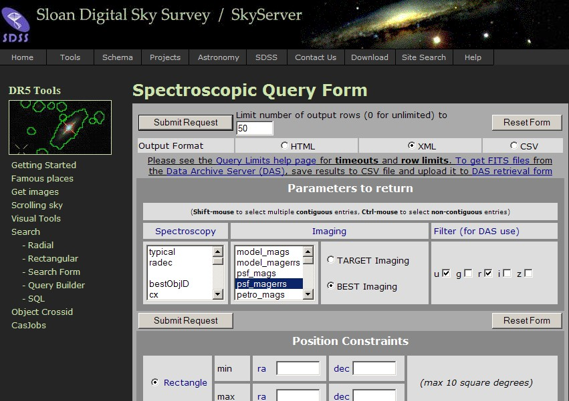
Example SkyServer
http://skyserver.sdss.org

Slide 29
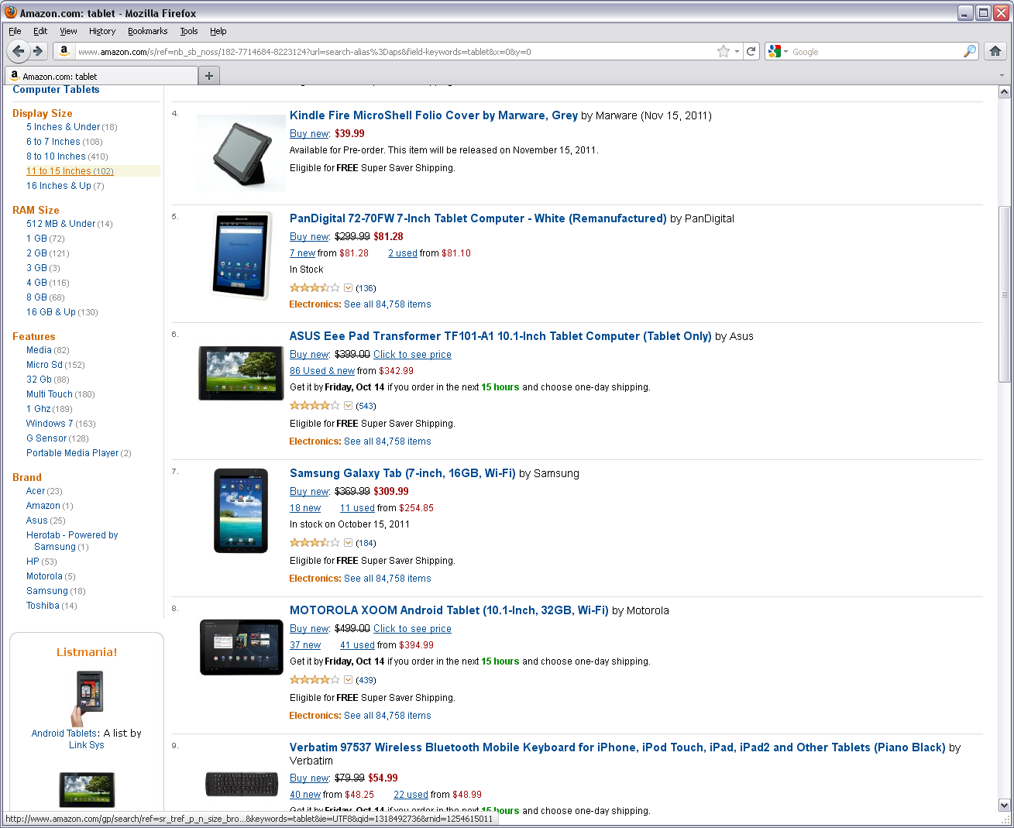
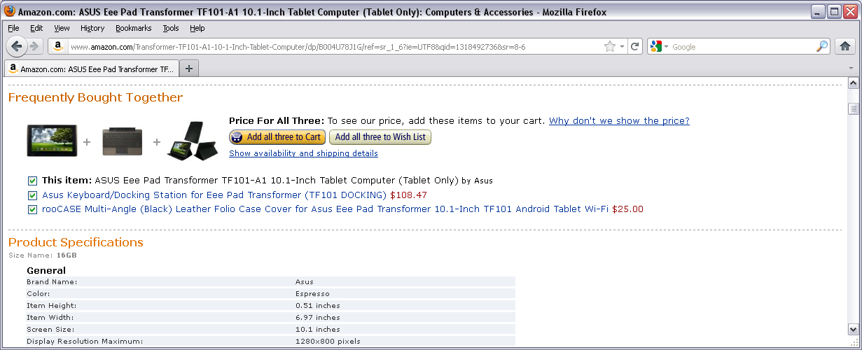
Faceted Search on Deep-Web Sources
Products grouped by facets (characteristic properties)
Facets form lattices
Drill-down
Roll-up
Classical data-mining example:
“Other user who bought this item also bought …”
Frequent item sets
“Basket Mining”

Slide 30
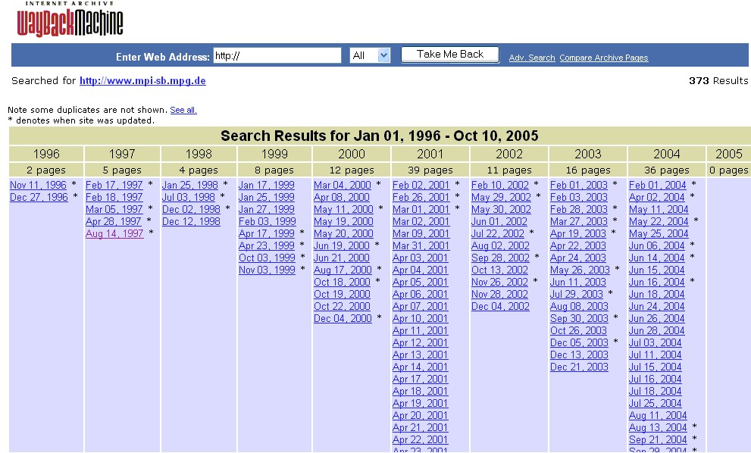
Web Archiving
http://www.archive.org
40 Billion URLs archived every 2 months since 1996 → 500 TBytes

Slide 31
Time Travel in Web Archives

Slide 32
Beyond Google: Search for Knowledge
Answer “knowledge queries” (by scientists, journalists, analysts, etc.)
such as:
drugs or enzymes that inhibit proteases (HIV)
German Nobel prize winner who survived both world wars
and outlived all of his four children
who was German chancellor when Angela Merkel was born
how are Max Planck, Angela Merkel, and the Dalai Lama related
politicians who are also scientists

Slide 33
Example: WolframAlpha
How was the weather in
Saarbrücken in October 2008?
http://www.wolframalpha.com/

Slide 34
Semantic Search
Search on entities, attributes, and relationships
focus on structured data sources (relational, XML, RDF)
leverage manually annotated data (social tagging, Web2.0)
perform info extraction on semi-structured & textual data
Motivation and Applications:
Web search for vertical domains
(products, traveling, entertainment, scholarly publications, etc.)
backend for natural-language QA
towards better Deep-Web search, digital libraries, e-science
System architecture:
focused
crawling &
Deep-Web
crawling
record
extraction
(named entity,
attributes)
record
linkage &
aggregation
(entity
matching)
keyword /
record
search
(faceted
GUI)
entity
ranking

Slide 35
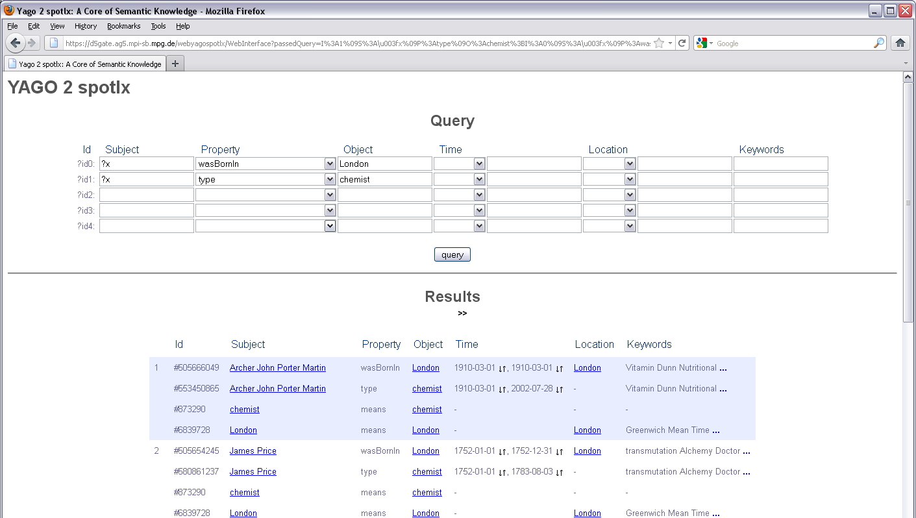
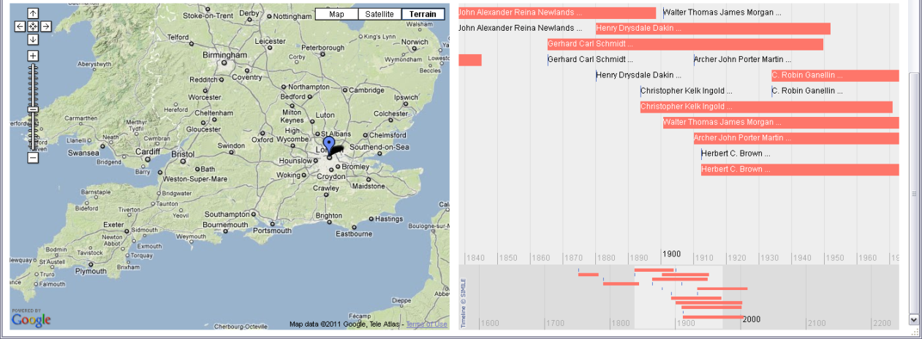
Example: YAGO-NAGA
http://www.mpi-inf.mpg.de/
yago-naga/

Slide 36
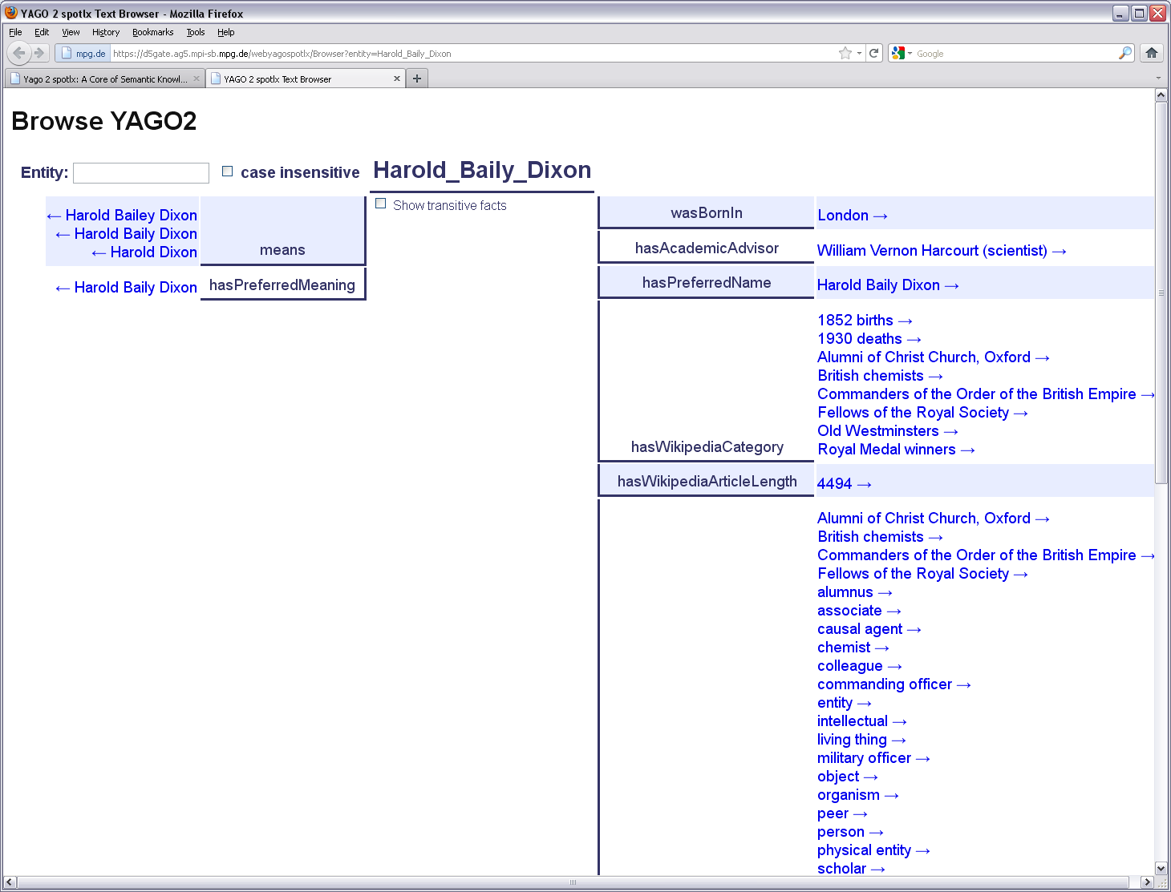
Example: YAGO-NAGA
http://www.mpi-inf.mpg.de/
yago-naga/

Slide 37
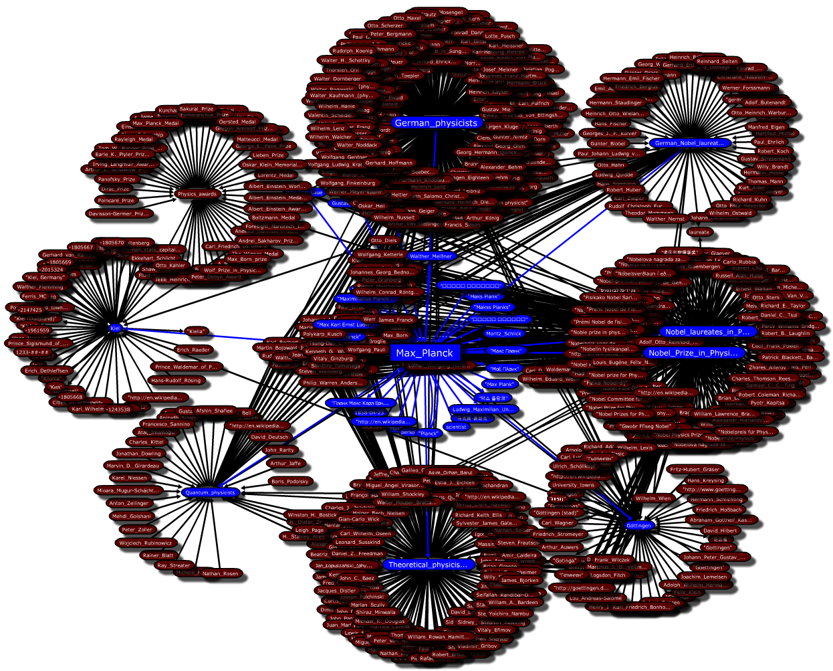
Example: URDF
http://urdf.mpi-inf.mpg.de/

Slide 38
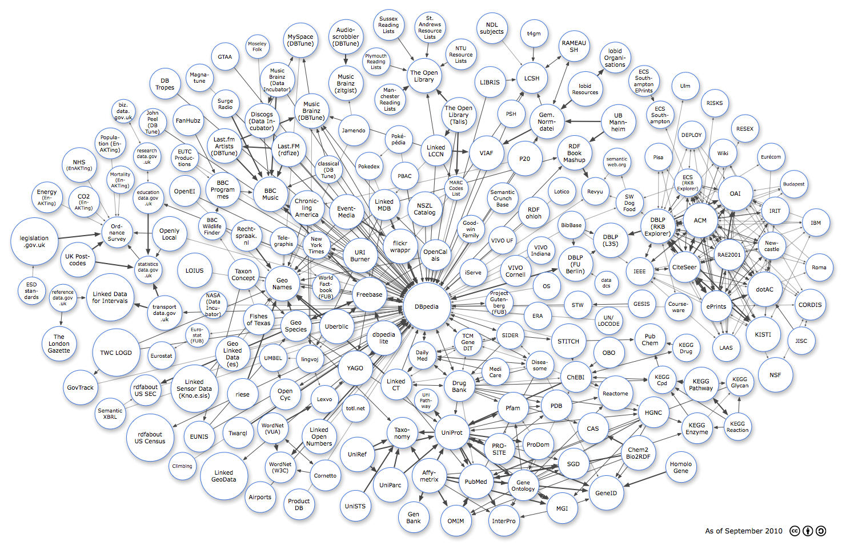
The Linking Open Data (LOD) Project
http://dbpedia.org/
Currently (2010)
200 sources
25 billion triples
400 million links
http://richard.cyganiak.de/2007/10/lod/imagemap.html

Slide 39
The Linking Open Data (LOD) Project
http://dbpedia.org/
Currently (2010)
200 sources
25 billion triples
400 million links
http://richard.cyganiak.de/2007/10/lod/imagemap.html

Slide 40
Multimodal Web (Images, Videos, NLP, …)
Search for images, speech, audio files, videos, etc.:
based on signal-level content features
(color distribution, contours, textures, video shot sequence,
pitch change patterns, harmonic and rythmic features, etc. etc.)
complement signal-level features with annotations from context
(e.g. adjacent text in Web page, GPS coordinates from digital camera)
query by example: similarity search w.r.t. given object(s)
plus relevance feedback
Question answering (QA) in natural language:
express query as NL question: Who ..., When ..., Where ..., What ...
provide short NL passages as query result(s), not entire documents

Slide 41
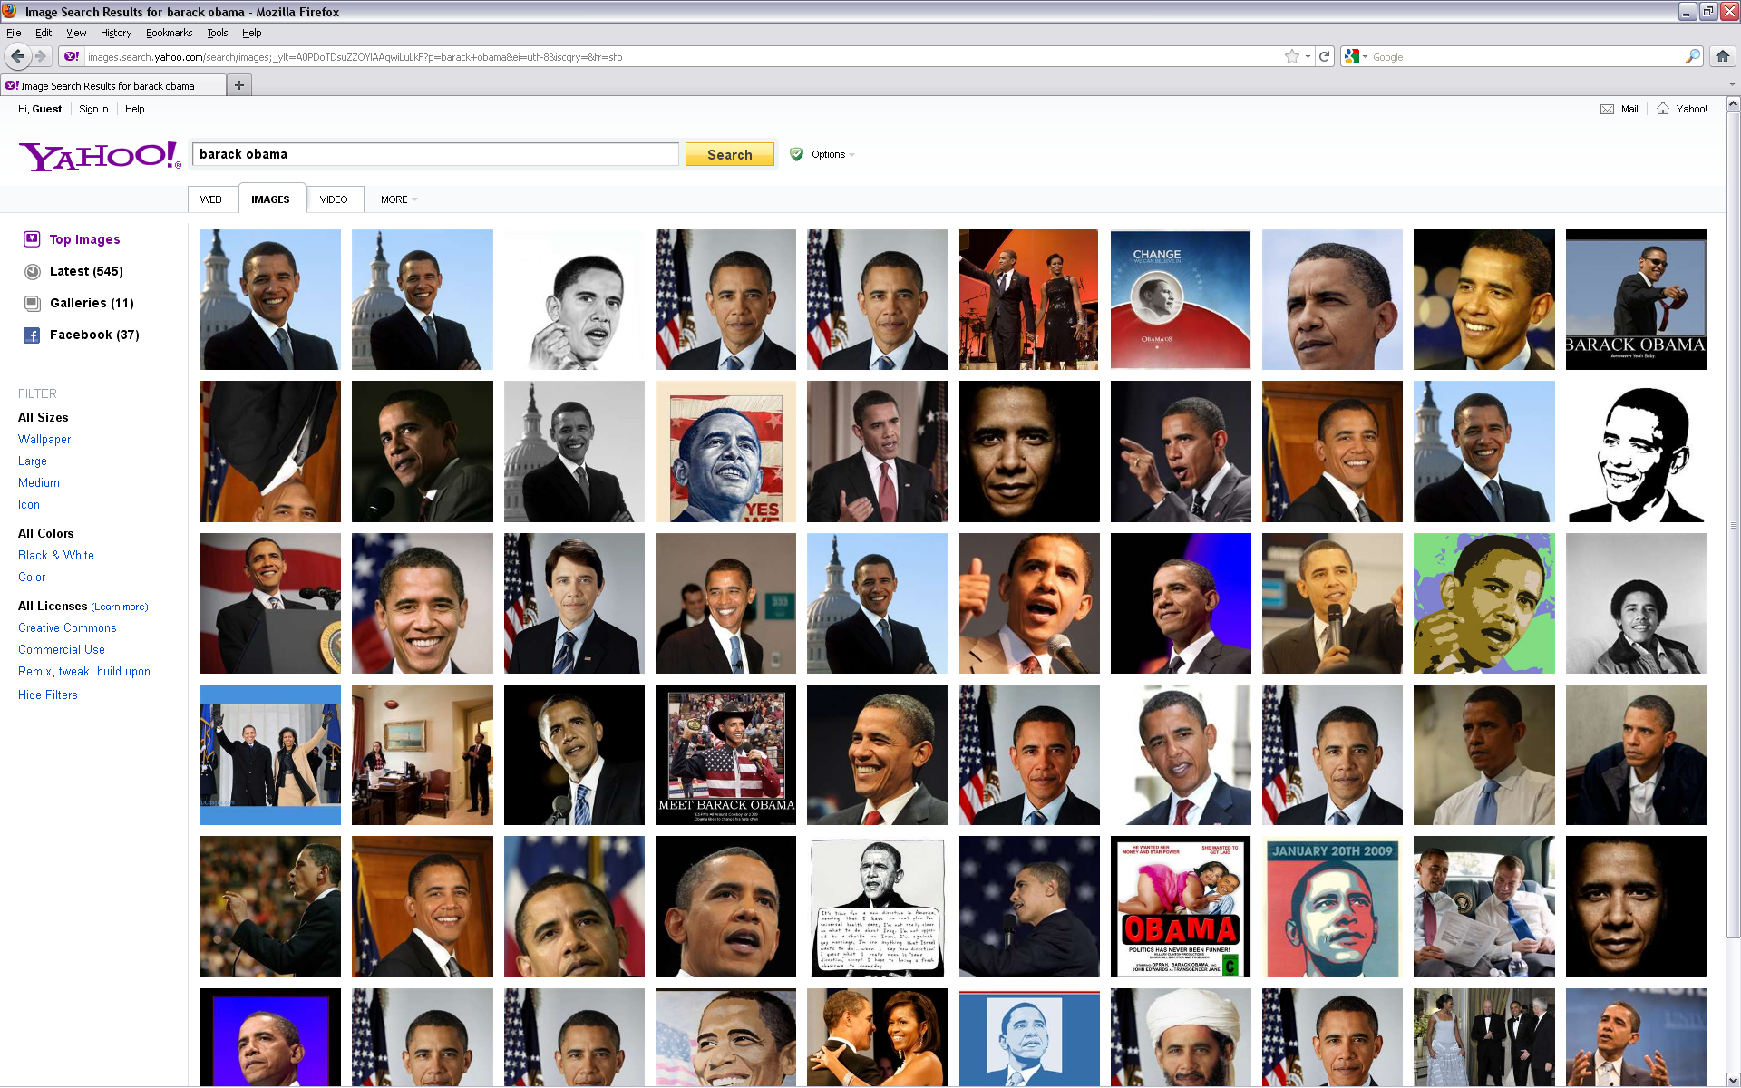
Internet Image Search
http://www.bing.com/images/

Slide 42
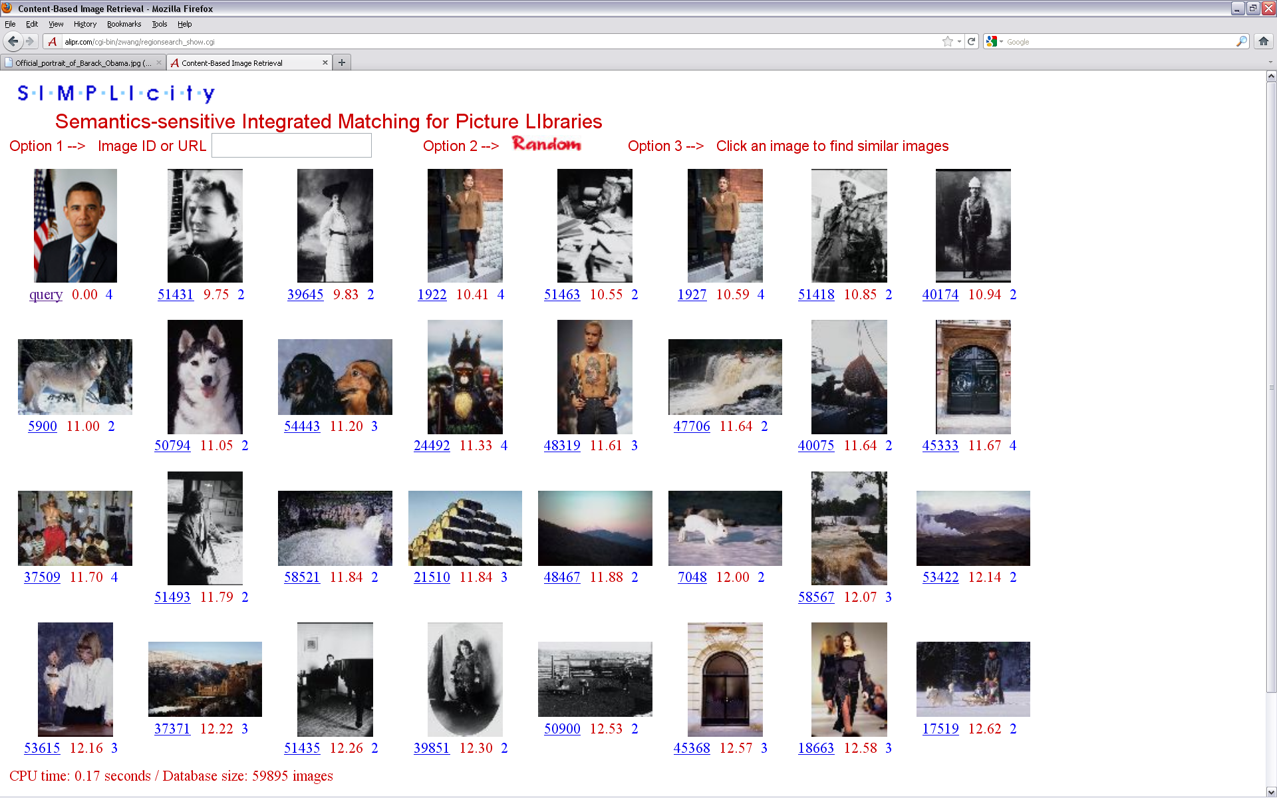
Content-based Image Retrieval by Example
http://wang.ist.psu.edu/IMAGE/

Slide 43
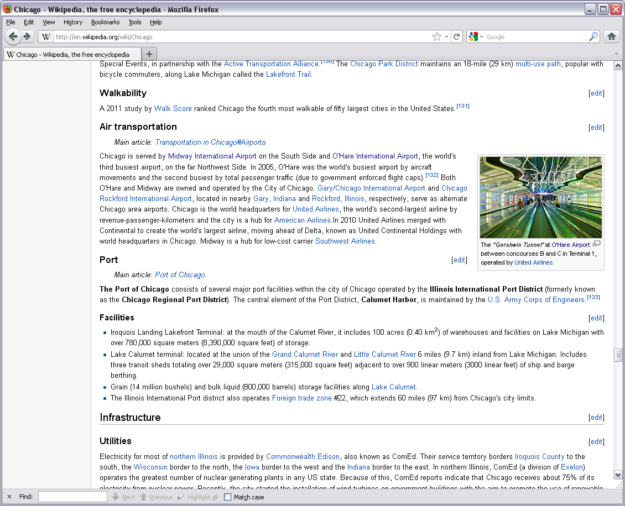
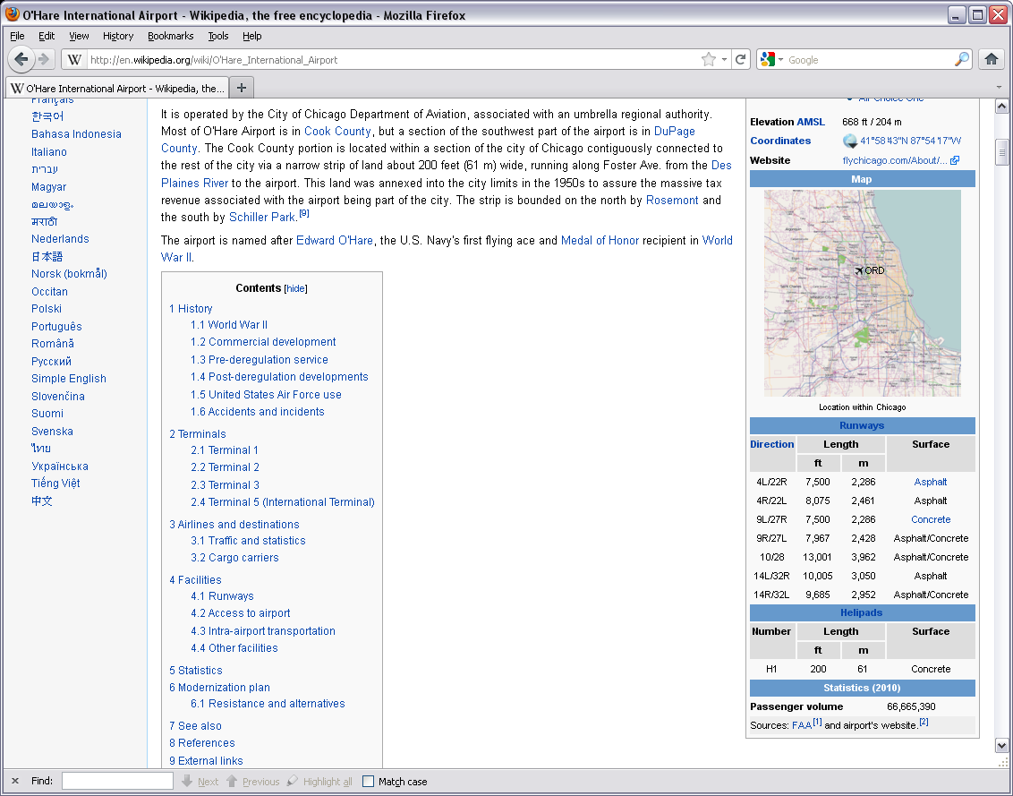
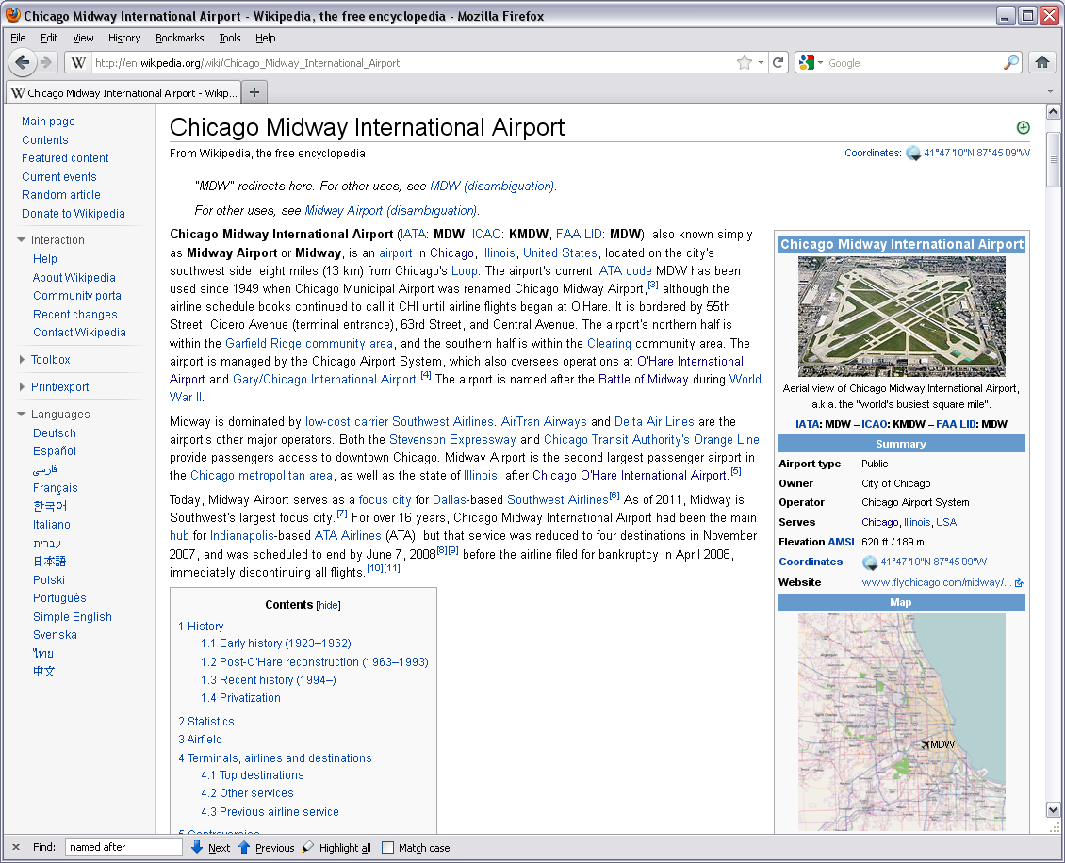
Jeopardy!
A big US city with two airports, one named after a World
War II hero, and one named after a World War II battle field?

Slide 44
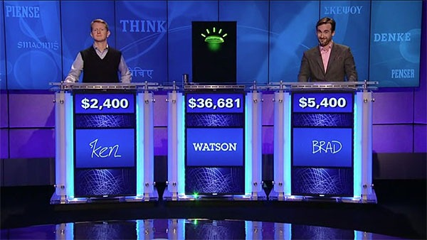
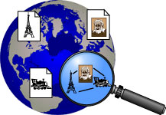
Deep-QA in NL
William Wilkinson's "An Account of the Principalities of Wallachia and Moldavia" inspired this author's most famous novel
This town is known as "Sin City" & its downtown is "Glitter Gulch"
As of 2010, this is the only
former Yugoslav republic in the EU
99 cents got me a 4-pack of Ytterlig coasters from this Swedish chain
question
classification &
decomposition
knowledge
backends
D. Ferrucci et al.: Building Watson: An Overview of the
DeepQA Project. AI Magazine, 2010.
YAGO
www.ibm.com/innovation/us/watson/index.htm

Slide 45
“Wisdom of the Crowds” at Work on Web 2.0
Information enrichment & knowledge extraction by humans:
Collaborative Recommendations & QA
Amazon (product ratings & reviews, recommended products)
Netflix: movie DVD rentals → $ 1 Mio. Challenge
answers.yahoo.com, iknow.baidu, www.answers.com, etc.
Social Tagging and Folksonomies
del.icio.us: Web bookmarks and tags
flickr.com: photo annotation, categorization, rating
librarything.com: same for books
Human Computing in Game Form
ESP and Google Image Labeler: image tagging
labelme.csail.mit.edu: objects in images
more games with a purpose at http://www.gwap.com/gwap/
Online Communities
dblife.cs.wisc.edu for database research, etc.
yahoo! groups, facebook, Google+, studivz, etc. etc.

Slide 46
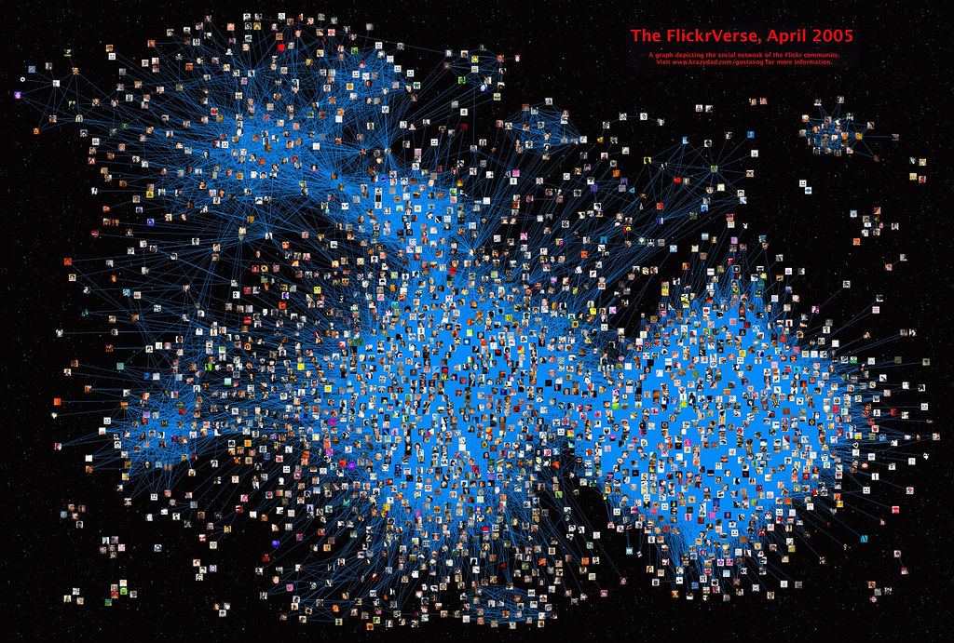
Social-Tagging Community
http://www.flickr.com
> 10 Mio. users
> 3 Bio. photos
> 10 Bio. tags
30% monthly growth
Source: www.flickr.com

Slide 47
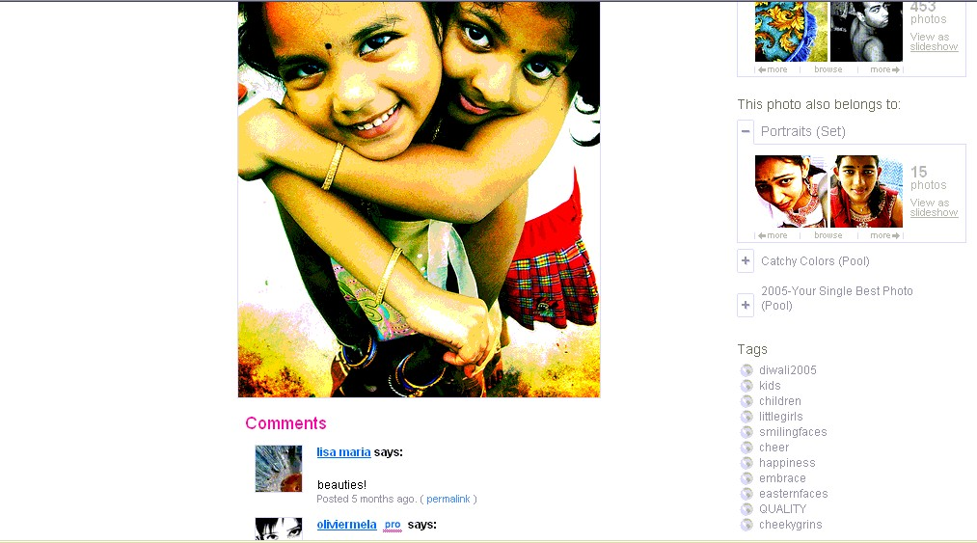
Social Tagging: Example Flickr

Slide 48
IRDM Research Literature
Important conferences on IR and DM
(see DBLP bibliography for full detail, http://www.informatik.uni-trier.de/~ley/db/)
SIGIR, WSDM, ECIR, CIKM, WWW, KDD, ICDM, ICML, ECML
Important journals on IR and DM
(see DBLP bibliography for full detail, http://www.informatik.uni-trier.de/~ley/db/)
TOIS, TOW, InfRetr, JASIST, InternetMath, TKDD, TODS, VLDBJ
Performance evaluation/benchmarking initiatives:
Text Retrieval Conference (TREC), http://trec.nist.gov
Cross-Language Evaluation Forum (CLEF), www.clef-campaign.org
Initiative for the Evaluation of XML Retrieval (INEX),
http://www.inex.otago.ac.nz/
KDD Cup, http://www.kdnuggets.com/datasets/kddcup.html
& http://www.sigkdd.org/kddcup/index.php

