Slide 1
III.5 Advanced Query Types
(MRS book, Chapters 9+10; Baeza-Yates, Chapters 5+13)
5.1 Query Expansion & Relevance Feedback
5.2 Vague Search:
Phrases, Proximity-based Ranking,
More Similarity Measures: Phonetic, Editex, Soundex
5.3 XML-IR

Slide 2
III.5.1 Query Expansion & Relevance Feedback
Average length of a query (in any of the major search engines) is about 2.6 keywords.
(source: http://www.keyworddiscovery.com/keyword-stats.html)
May be sufficient for most everyday queries:
“steve jobs”
…but not for all:
“transportation tunnel disasters”
Navigational
→ find specific resource;
known information need
Informational
→ learn about topic in general;
target not known; relevant
instances not captured
by keywords

Slide 3
Explicit vs. Implicit Relevance Feedback
Manual document selection
Query & click logs
Eye tracking
Pseudo relevance feedback
explicit
implicit

Slide 4
Relevance Feedback for the VSM
Given: a query q, a result set (or ranked list) D,
a user’s assessment u: D → {+, −}
yielding positive docs D⁺⊆D and negative docs D⁻ ⊆D
Goal: derive query q’ that better captures the user’s intention,
by adapting term weights in the query or by query expansion
Classical approach: Rocchio method (for term vectors)
with α, β, γ ∈ [0,1]
and typically α > β > γ
Modern approach: replace explicit feedback by implicit feedback
derived from query & click logs (pos. if clicked, neg. if skipped)
or rely on pseudo-relevance feedback:
assume that all top-k results are positive

Slide 5
Rocchio Example
Documents d₁…d₄ with relevance feedback:
tf₁ tf₂ tf₃ tf₄ tf₅ tf₆ R
d₁ 1 0 1 1 0 0 1
d₂ 1 1 0 1 1 0 1
d₃ 0 0 0 1 1 0 0
d₄ 0 0 1 0 0 0 0
|D⁺|=2, |D⁻|=2
Given:
Then:
→
→
with α=1/2, β=1/3
and γ = 1/4, tf_{ij}∈[0,1]
Using
Multiple feedback iterations possible: set q = q’ for the next iteration.

Slide 6
Relevance Feedback for Probabilistic IR
Compare to Robertson/Sparck-Jones formula (see Chapter III.3):
Where
N: #docs in sample
R: # relevant docs in sample
n_{i}: #docs in sample that contain term i
r_{i}: #relevant docs in sample that contain term i
Advantage of RSJ over Rocchio:
No tuning parameters for reweighting the query terms!
Disadvantages:
Document term weights are not taken into account
Weights of previous query formulations are not considered
No actual query expansion is used (existing query terms are just reweighted)

Slide 7
TREC Query Format & Example Query
<num> Number: 363
<title> transportation tunnel disasters
<desc> Description: What disasters have occurred in tunnels used for transportation?
<narr> Narrative: A relevant document identifies a disaster in a tunnel used for trains, motor vehicles, or people. Wind tunnels and tunnels used for wiring, sewage, water, oil, etc. are not relevant. The cause of the problem may be fire, earthquake, flood, or explosion and can be accidental or planned. Documents that discuss tunnel disasters occurring during construction of a tunnel are relevant if lives were threatened.
See also: TREC 2004/2005 Robust Track http://trec.nist.gov/data/robust.html
Specifically picks difficult queries (topics) from previous ad-hoc search tasks
Relevance assessments by retired NIST staff

Slide 8
Query Expansion Example
Q: transportation tunnel disasters (from TREC 2004 Robust Track)
transportation tunnel disasters
1.0
1.0
1.0
transit
highway
train
truck
metro
“rail car”
car
…
0.9
0.8
0.7
0.6
0.6
0.5
0.1
tube
underground
“Mont Blanc”
…
0.9
0.8
0.7
catastrophe
accident
fire
flood
earthquake
“land slide”
…
1.0
0.9
0.7
0.6
0.6
0.5
d₂
d₁
Expansion terms from (pseudo-) relevance feedback,
thesauri/gazetteers/ontologies, Google top-10 snippets,
query & click logs, user’s desktop data, etc.
Term similarities pre-computed from corpus-wide
correlation measures, analysis of co-occurrence matrix, etc.

Slide 9
Towards Robust Query Expansion
Threshold-based query expansion:
Substitute ~w by exp(w):={c₁ ... c_{k}} for all c_{i} with sim(w, c_{i}) ≥ δ
Naive scoring:
s(q,d) = Σ_{w∈q} Σ_{c∈exp(w)} sim(w,c) * s_{c}(d)
danger of
“topic dilution”/
“topic drift”
Approach to careful expansion and scoring:
Determine phrases from query or best initial query results
(e.g., forming 3-grams and looking up ontology/thesaurus entries)
If uniquely mapped to one concept
then expand with synonyms and weighted hyponyms
Avoid undue score-mass accumulation by expansion terms:
s(q,d) = Σw∈q max _{c∈exp(w)} { sim(w,c) * s_{c}(d) }
[Theobald,Schenkel,Weikum: SIGIR’05]

Slide 10
Query Expansion Example
From TREC 2004 Robust Track Benchmark:
Title: International Organized Crime
Description: Identify organizations that participate in international criminal
activity, the activity, and collaborating organizations and the countries involved.

Slide 11
Query Expansion Example
From TREC 2004 Robust Track Benchmark:
Title: International Organized Crime
Description: Identify organizations that participate in international criminal
activity, the activity, and collaborating organizations and the countries involved.
Query = {international[0.145],
{gangdom[1.00], gangland[0.742], "organ[0.213] & crime[0.312]", camorra[0.254],
maffia[0.318], mafia[0.154], "sicilian[0.201] & mafia[0.154]",
"black[0.066] & hand[0.053]", mob[0.123], syndicate[0.093]},
organ[0.213], crime[0.312], collabor[0.415], columbian[0.686], cartel[0.466], …}
Top-5 Results (in TREC Aquaint News Collection)
Interpol Chief on Fight Against Narcotics
Economic Counterintelligence Tasks Viewed
Dresden Conference Views Growth of Organized Crime in Europe
Report on Drug, Weapons Seizures in Southwest Border Region
SWITZERLAND CALLED SOFT ON CRIME
...

Slide 12
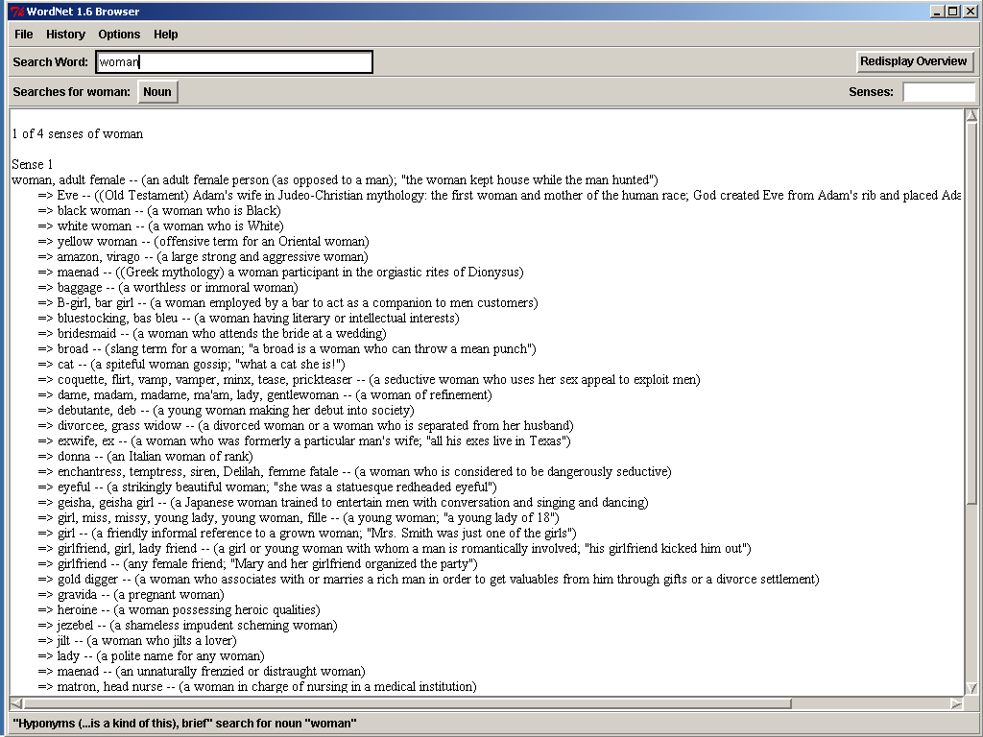
Thesaurus/Ontology-based Query Expansion
General-purpose thesauri: WordNet family
200,000 concepts and relations;
can be cast into
description logics or
graph, with weights for relation strengths
(derived from co-occurrence statistics)
woman, adult female – (an adult female person)
=> amazon, virago – (a large strong and aggressive woman)
=> donna -- (an Italian woman of rank)
=> geisha, geisha girl -- (...)
=> lady (a polite name for any woman)
...
=> wife – (a married woman, a man‘s partner in marriage)
=> witch – (a being, usually female, imagined to
have special powers derived from the devil)

Slide 13
Most Important Relations among Semantic Concepts
Synonymy (different words with the same meaning)
e.g., “emodiment” ↔ “archetype”
Hyponymy (more specific concept)
e.g., “vehicle” → “car”
Hypernymy (more general concept)
e.g., “car” → “vehicle”
Meronymy (part of something)
e.g., “wheel” → “vehicle”
Antonymy (opposite meaning)
e.g. “hot” ↔ “cold”
Further issues include NLP techniques such as Named Entity Recognition (NER) (for noun phrases) and more general Word Sense Disambiguation (WSD) (incl. verbs, etc.) of words in context.

Slide 14
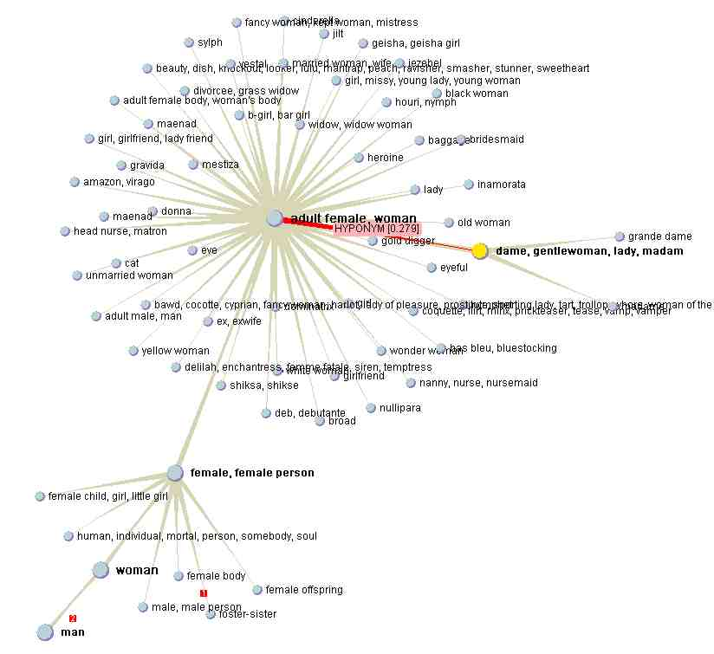
WordNet-based Ontology Graph
[Fellbaum:
Cambridge Press’98]
instance
(0.2)
...
part (0.3)
character
Lady Di
lady
hypo (0.77)
human
syn (1.0)
nanny
hypo (0.35)
personality
hypo (0.3)
woman
hyper (0.9)
part
(0.5)
instance (0.61)
witch
hypo
(0.42)
...
body
part
(0.8)
heart
Mary
Poppins
instance
(0.1)
fairy
...

Slide 15
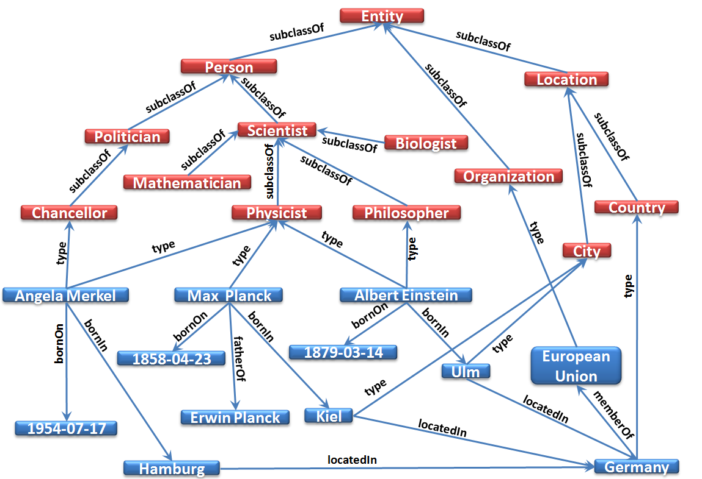
YAGO (Yet Another Great Ontology)
[Suchanek et al: WWW’07
Hoffart et al: WWW’11]
Combine knowledge from WordNet & Wikipedia
Additional Gazetteers (geonames.org)
Part of the Linked-Data cloud

Slide 16
YAGO-2 Numbers
[Hoffart et al: WWW’11]
 | Just Wikipedia | Incl. Gazetteer Data
#Relations | 104 | 114
#Classes | 364,740 | 364,740
#Entities | 2,641,040 | 9,804,102
#Facts | 120,056,073 | 461,893,127
- types & classes | 8,649,652 | 15,716,697
- base relations | 25,471,211 | 196,713,637
- space, time & proven. | 85,935,210 | 249,462,793
Size (CSV format) | 3.4 GB | 8.7 GB
estimated precision > 95%
(for base relations excl. space, time & provenance)
www.mpi-inf.mpg.de/yago-naga/

Slide 17
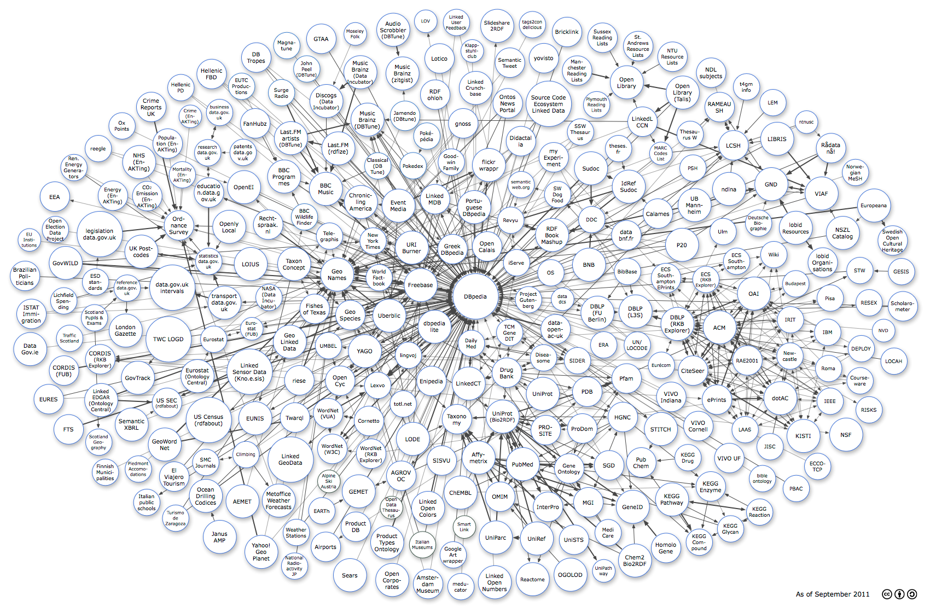
Linked Data Cloud
Currently (Sept. 2011)
> 200 sources
> 30 billion RDF triples
> 400 million links
http://linkeddata.org/

Slide 18
Currently (Sept. 2011)
> 5 million owl:sameAs links
between DBpedia/YAGO/Freebase

Slide 19
Common Similarity Measures for Ontological Relations
Dice coefficient:
Jaccard coefficient:
Conditional
Probability:
PMI (Pointwise
Mutual Information):
(With freq(c) and freq(c₁ /\ c₂ ) usually estimated over large Web sample)

Slide 20
Graph-specific Similarity Measures
Compute (graph-based) similarity between Philosopher and Chancellor in an IS-A ontology
Leacock-Chodorow Measure:
len(c₁,c₂): length of shortest path between c₁,c₂
D: depth of the IS-A ontology
Lin Similarity:
LCA(c₁,c₂): lowest common ancestor of c₁,c₂
IC(c): Information Content of c in the IS-A DAG
(including all sub-concepts/hyponyms)
Transitive path similarity:
(Computed by adaptation of Dijkstra‘s shortest-path algorithm)

Slide 21
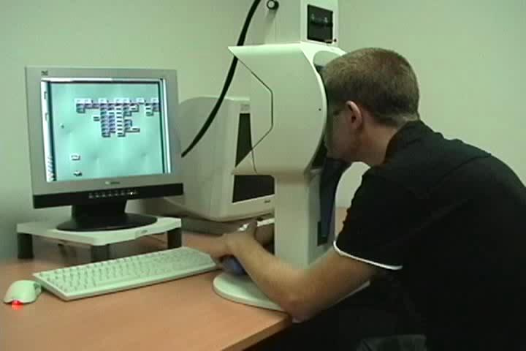
Eye Tracking and Relevance Judgments
Eye tracking experiments
@University of Lübeck, 2007
Can correctly detect the area of the screen that is focused by the user in 60-90% of the cases
Distinguish between
- Pupil fixation
- Saccades (abrupt stops)
- Pupil dilation
- San paths
Pupil fixations mostly used to interpret the user’s interest
However generally not appropriate to judge the quality of search results (fixation strongly biased toward the top-ranked results in 60-70% of the cases → “trust bias”)
@University of Tampere, 2007

Slide 22
Exploiting Query Logs for Query Expansion
Given: user sessions of the form (q, D⁺),
and let “d∈D⁺” denote the event that d is clicked on
We are interested in the correlation between words
w in a query and w’ in a clicked-on document:
Estimate
from query log:
relative frequency
of w’ in d
relative frequency of d being
clicked on when w appears in query
Expand query by adding top m
words w’ in descending order of

Slide 23
Implicit Relevance Feedback → Local Context Analysis
[Xu, Croft: SIGIR’96]
Retrieve top n ranked passages by breaking the initial result documents into smaller passages (e.g., 300 words)
δ∈[0,1]: tuning par.
For each noun group c (i.e., concept), compute the similarity sim(q,c) to the query q using a variant of TF*IDF
Expand q by the top r concepts according to sim(q,c) using
1- (0.9 m/r) as expansion weight, where m is the position of c in the ranked list of concepts
pf_{i,j}: frequency of
term i in passage j
N: #passages in collection
np_{c}: #passages
containing c

Slide 24
Implicit Relevance Feedback → Global Context Analysis
[Qiu, Frei: SIGIR’93]
t: #distinct terms
in collection
Idea: build global similarity thesaurus automatically!
Consider inverse term frequency ITF_{j} of document d_{j}
Compute weight vector k_{i} of term i
TF*IDF-style weights w_{i,j}
for term i in document d_{j}
Correlation matrix c_{u,v} between terms u, v
(Usually expand query with top r ranked terms v according to q)
t_{j}: #distinct terms
in d_{j}

Slide 25
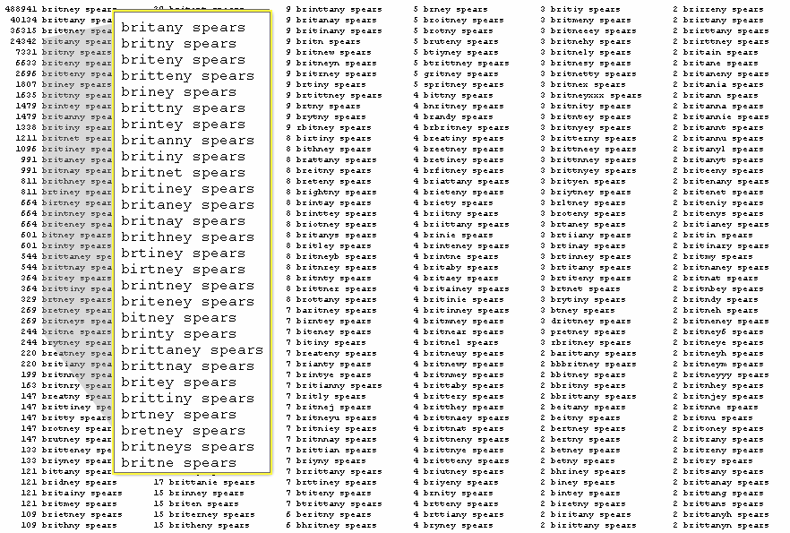
III.5.2 Vague Search
http://www.google.com/press/zeitgeist2010/
regions/de.html
http://www.google.com/press/zeitgeist2010/
regions/de.html
Google.com 2008 (U.S.)
1. obama
2. facebook
3. att
4. iphone
5. youtube
Google news 2008 (U.S.)
1. sarah palin
2. american idol
3. mccain
4. olympics
5. ike (hurricane)
Google image 2008 (U.S.)
1. sarah palin
2. obama
3. twilight
4. miley cyrus
5. joker
Google translate 2008 (U.S.)
1. you
2. what
3. thank you
4. please
5. love
Google.de 2008
1. wer kennt wen
2. juegos
3. facebook
4. schüler vz
5. studi vz
6. jappy
7. youtube
8 yasni
9. obama
10. euro 2008
Search Engine Users: People who can‘t spell!
[Amit Singhal: SIGIR’05 Keynote]

Slide 26
Vague String Matching with Edit Distance
Idea:
Tolerate mis-spellings and other variations of search terms
and score matches based on editing distance.
Examples:
1) Query: “Microsoft”
Vague Match: “Migrosaft”
Score ~ edit distance 3
Query: “Microsoft”
Vague Match: “Microsiphon”
Score ~ edit distance 5
3) Query: “Microsoft Corporation, Redmond, WA”
Vague match (at token level): “MS Corp., Readmond, USA”
But:
Requires substantial amount of query rewriting/expansion
and/or expensive string similarity comparisons at query time!

Slide 27
Similarity Measures on Strings (1)
Hamming distance of strings s₁, s₂ ∈Σ* with |s₁|=|s₂|:
number of different characters (cardinality of {i: s₁[i] ≠ s₂[i]})
Levenshtein distance (edit distance) of strings s₁, s₂ ∈Σ*:
minimal number of editing operations on s₁
(replacement, deletion, insertion of a character)
to change s₁ into s₂
For edit (i, j): Levenshtein distance of s₁[1..i] and s₂[1..j] it holds:
edit (0, 0) = 0, edit (i, 0) = i, edit (0, j) = j
edit (i, j) = min { edit (i-1, j) + 1,
edit (i, j-1) + 1,
edit (i-1, j-1) + diff (i, j) }
with diff (i, j) = 1 if s₁[i] ≠ s₂[j], 0 otherwise
→ Efficient computation by dynamic programming

Slide 28
Dynamic Programming Example
for Levenshtein Edit Distance: grate[1..i] → great[1..j]
g
r
e
a
t
g
0
1
2
3
4
r
1
0
1
2
3
a
2
1
1
1
2
t
3
2
2
2
1
e
4
3
2
3
2
edit (s[1..i], t[1..j]) = min {
edit (s[1..i-1], t[1..j]) + 1,
edit (s[1..i], t[1..j-1]) + 1,
edit (s[1..i-1], t[1..j-1]) + diff (s[i], t[j] }

Slide 29
Similarity Measures on Strings (2)
Damerau-Levenshtein distance of strings s₁, s₂ ∈Σ*:
minimal number of replacement, insertion, deletion, or
transposition operations (exchanging two adjacent characters)
for changing s₁ into s₂
For edit (i, j): Damerau-Levenshtein distance of s₁[1..i] and s₂[1..j] :
edit (0, 0) = 0, edit (i, 0) = i, edit (0, j) = j
edit (i, j) = min { edit (i-1, j) + 1,
edit (i, j-1) + 1,
edit (i-1, j-1) + diff (i, j),
edit (i-2, j-2) + diff(i-1, j) + diff(i, j-1) +1 }
with diff (i, j) = 1 if s₁[i]≠ s₂[j], 0 otherwise

Slide 30
Similarity based on N-Grams
Determine for string s the set of its N-grams:
G(s) = {substrings of s with length N}
(often tri-grams are used, i.e. N=3)
Distance of strings s₁ and s₂:
|G(s₁)| + |G(s₂)| - 2|G(s₁)∩G(s₂)|
Example:
G(rodney) = {rod, odn, dne, ney}
G(rhodnee) = {rho, hod, odn, dne, nee}
distance (rodney, rhodnee) = 4 + 5 – 2*2 = 5
Alternative similarity measures:
Jaccard coefficient: |G(s₁)∩G(s₂)| / |G(s₁)∪G(s₂)|
Dice coefficient: 2 |G(s₁)∩G(s₂)| / (|G(s₁)| + |G(s₂)|)

Slide 31
N-Gram Indexing for Vague Search
Theorem (Jokinen and Ukkonen 1991):
For a query string s and a target string t, the Levenshtein
edit distance is bounded by the N-gram-based bag-overlap:
For vague-match queries with edit-distance tolerance d,
perform top-k query over N-grams, using counts of
N-grams as score aggregation.

Slide 32
Example for Jokinen/Ukkonen Theorem
edit(s,t) ≤ d ⇒ overlap(s,t) ≥ |s| − (N−1) − dN
overlap(s,t) < |s| − (N−1) − dN ⇒ edit(s,t) > d
s = abababababa, |s|=11
N=2 → N-grams(s) = {ab(5),ba(5)}
N=3 → N-grams(s) = {aba(5), bab(4)}
N=4 → N-grams(s) = {abab(4), baba(4)}
t₁ = ababababab, |t₁|=10
t₂ = abacdefaba, |t₂|=10
t₃ = ababaaababa, |t₃|=11
t₄ = abababb, |t₄|=7
t₅ = ababaaabbbb, |t₅|=11
task: find all t_{i} with edit(s,t_{i}) ≤ 2
N=2:
N-grams(t₁) = {ab(5),ba(4)}
N-grams(t₂)
= {ab(2),ba(2),ac,cd,de,ef,fa}
N-grams(t₃) =
= {ab(4),ba(4),aa(2)}
N-grams(t₄) = {ab(3),ba(2),bb}
N-grams(t₅)
= {ab3),ba(2),aa(2)bb(3)}
→ prune all t_{i} with edit(s,t_{i}) > 2 = d
overlapBound = |s| − (N−1) − dN
= 6 (for N=2)
→ prune all t_{i} with overlap(s,t_{i}) < 6
→ prune t₂, t₄, t₅ because overlap(s,t_{j}) < 6 for these t_{j}

Slide 33
Phrase Queries and Proximity Queries
Phrase queries such as:
“George W. Bush”, “President Bush”, “The Who”, “Evil Empire”,
“PhD admission”, “FC Schalke 04”, “native American music”,
“to be or not to be”, “The Lord of the Rings”, etc. etc.
Difficult to anticipate and index all (meaningful) phrases
Sources would be thesauri (e.g. WordNet) or query logs
Standard approach:
Combine single-term index with separate position index
term doc score
...
empire 77 0.85
empire 39 0.82
...
evil 49 0.81
evil 39 0.78
evil 12 0.75
...
evil 77 0.12
...
term doc offset
...
empire 39 191
empire 77 375
...
evil 12 45
evil 39 190
evil 39 194
evil 49 190
...
evil 77 190
...
B+ tree
on term
B+ tree
on term, doc

Slide 34
Biword and Phrase Indexing
Build index over all word pairs:
index lists (term₁, term₂, doc, score) or
for each term₁ store nested list (term₂, doc, score)
Variations:
treat nearest nouns as pairs,
or discount articles, prepositions, conjunctions
index phrases from query logs, compute correlation statistics
Query processing:
decompose even-numbered query phrases into biwords
decompose odd-numbered query phrases into biwords
with low selectivity (as estimated by df(term₁))
may additionally use standard single-term index if necessary
Examples:
“to be or not to be” → (to be) (or not) (to be)
“The Lord of the Rings” → (The Lord) (Lord of) (the Rings)

Slide 35
N-Gram Indexing and Wildcard Queries
Queries with wildcards (simple regular expressions),
to capture mis-spellings, name variations, etc.
Examples:
Brit*ney, Sm*th*, Go*zilla, Marko*, reali*ation, *raklion
Approach:
decompose words into N-grams of N successive letters
and index all N-grams as terms
query processing computes AND of N-gram matches
Example (N=3):
Brit*ney → Bri AND rit AND ney
Generalization: decompose words into frequent fragments
(e.g., syllables, or fragments derived from mis-spelling statistics)

Slide 36
Proximity-based Ranking
Proximity Query Examples:
“root polynom three”, “high cholesterol measure”, “doctoral degree defense”, “statistical relational learning”
→ Particularly important for combinations of mostly frequent (and a few infrequent) keywords with otherwise different meaning.
Idea: Identify positions (pos) of all query-term occurrences
in a document and reward short distances.
“Holistic” keyword proximity scores: [Büttcher/Clarke: SIGIR’06]
aggregation of per-term scores # + per-term-pair scores attributed to each term
acc(t_{j}): cannot be pre-computed
→ expensive at query-time
count only pairs of query terms
with no other query term in between

Slide 37
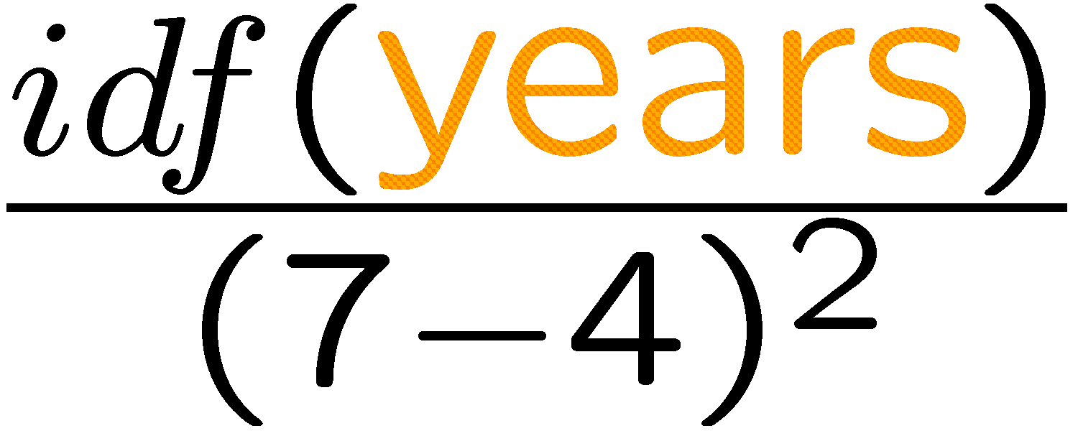
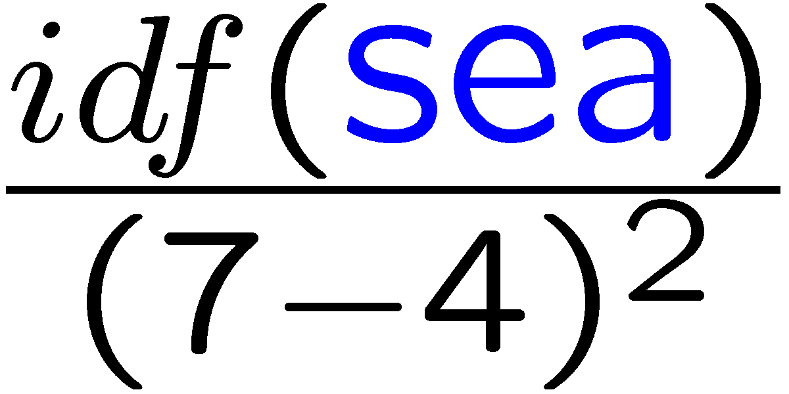
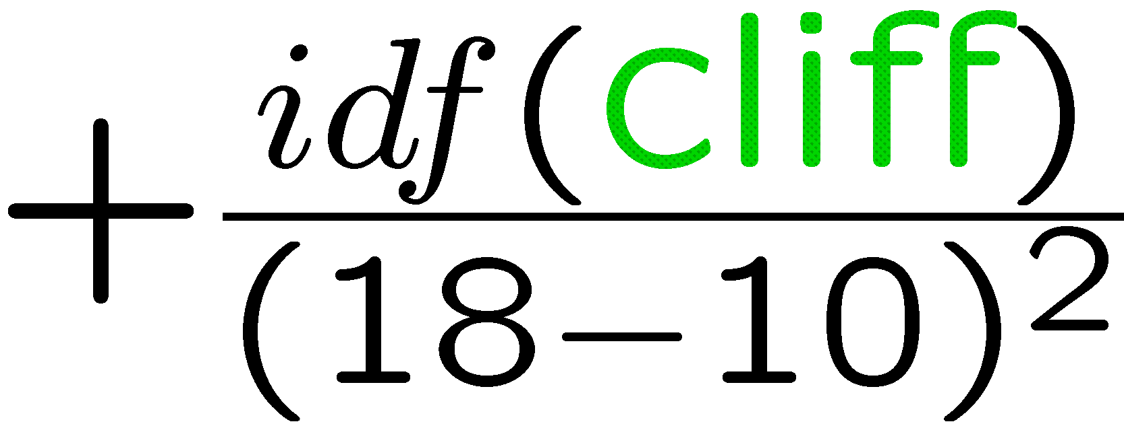
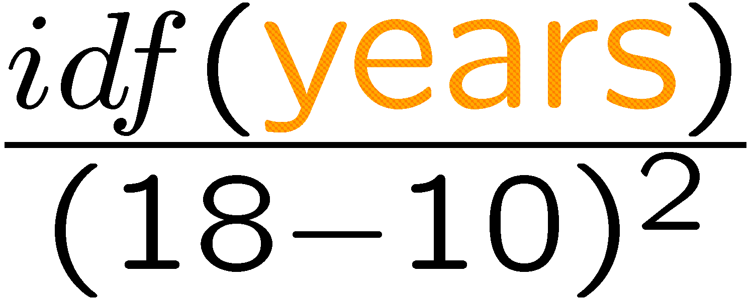
Example: Proximity Score Computation
It¹ took² the³ sea⁴ a⁵ thousand⁶ years,⁷
A⁸ thousand⁹ years¹⁰ to¹¹ trace¹²
The¹³ granite¹⁴ features¹⁵ of¹⁶ this¹⁷ cliff,¹⁸
In¹⁹ crag²⁰ and²¹ scarp²² and²³ base.²⁴
Query: < sea, years, cliff > (→ order of query terms matters!)
E.J. Pratt (1882-1964)

Slide 38
Efficient Proximity Search
Define aggregation function to be distributive [Broschart et al. 2007]
rather than “holistic” [Büttcher/Clarke 2006]:
→ pre-compute term-pair distances at indexing time
and simply sum up at query-time!
count over all pairs of query terms
→ empirical result quality comparable to „holistic“ scores
Extensions: index all pairs within max. window size
(or nested list of nearby terms for each term),
with precomputed pair-score mass.

Slide 39
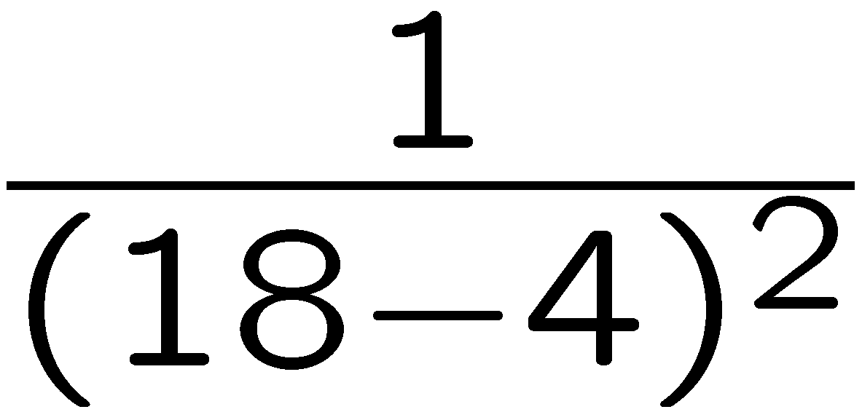
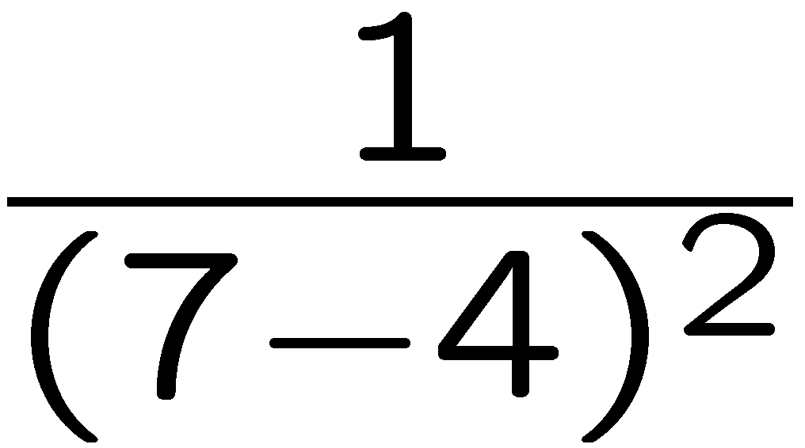
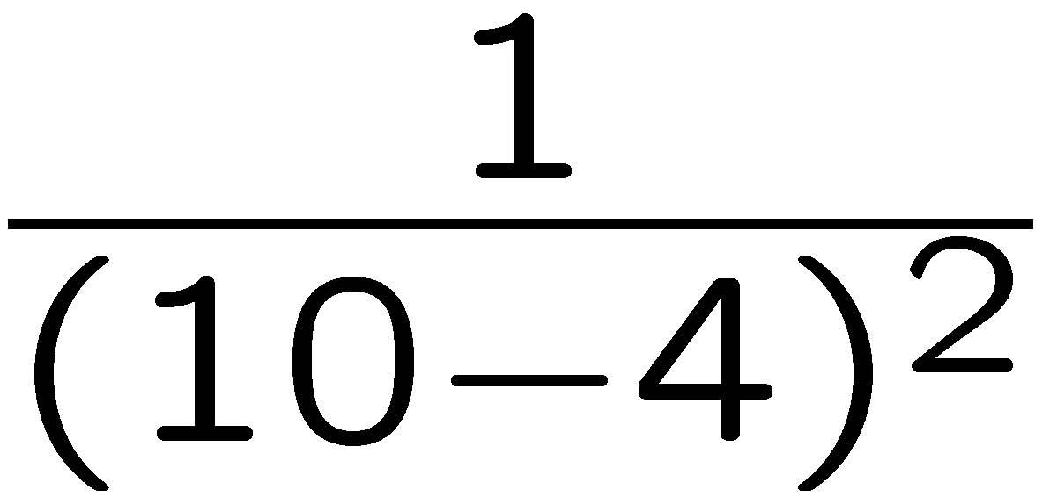
Example with More Efficient Proximity Scoring Function
It¹ took² the³ sea⁴ a⁵ thousand⁶ years,⁷
A⁸ thousand⁹ years¹⁰ to¹¹ trace¹²
The¹³ granite¹⁴ features¹⁵ of¹⁶ this¹⁷ cliff,¹⁸
In¹⁹ crag²⁰ and²¹ scarp²² and²³ base.²⁴
Query: {sea, years, cliff} (→ order of terms does not matter!)
E.J. Pratt (1882-1964)

Slide 40
Phonetic Similarity (1)
Soundex Code: (for English)
Mapping of words (especially last names) onto 4-letter codes
such that words that are similarly pronounced have the same code
first position of code = first letter of word
vowels and “weak” consonants (a, e, i, o, u, y, h, w are ignored)
code positions 2, 3, 4 :
b, p, f, v → 1 c, s, g, j, k, q, x, z → 2
d, t → 3 l → 4
m, n → 5 r → 6
Successive identical code letters are combined into one letter
(unless separated by the letter h)
Examples:
Powers → P620 , Perez → P620
Penny → P500, Penee → P500
Tymczak → T522, Tanshik → T522

Slide 41
Phonetic Similarity (2)
Editex similarity:
edit distance with consideration of phonetic codes
For editex (i, j): Editex distance of s₁[1..i] and s₂[1..j] it holds:
editex (0, 0) = 0,
editex (i, 0) = editex (i-1, 0) + d(s₁[i-1], s₁[i]),
editex (0, j) = editex (0, j-1) + d(s₂[j-1], s₂[j]),
editex (i, j) = min { editex (i-1, j) + d(s₁[i-1], s₁[i]),
editex (i, j-1) + d(s₂[j-1], s₂[j]),
edit (i-1, j-1) + diffcode (i, j) }
with diffcode (i, j) = 0 if s₁[i]= s₂[j]
1 if group(s₁[i]) = group(s₂[j]), 2 otherwise
und d(X, Y) = 1 if X ≠ Y and X is h or w,
diffcode (X, Y) otherwise
with group:
{a e i o u y}, {b p}, {c k q}, {d t}, {l r},
{m n}, {g j}, {f p v}, {s x z}, {c s z}

Slide 42
III.5.3 XML-IR

Slide 43
History of INEX
2002-2011 (and beyond?)
Co-Initiative by the University of Duisburg-Essen (Norbert Fuhr) and Queen Mary University London (Mounia Lalmas)
Funded by
DELOS Network of Excellence (EU)
IEEE Computer Society
Combine two longstanding paradigms:
DB and IR
Many tracks over the years, including
Ad-hoc
Efficiency
Question Answering
Relevance Feedback
Interactive Track
Books & Social Search
Snippet Retrieval
Link-The-Wiki

Slide 44
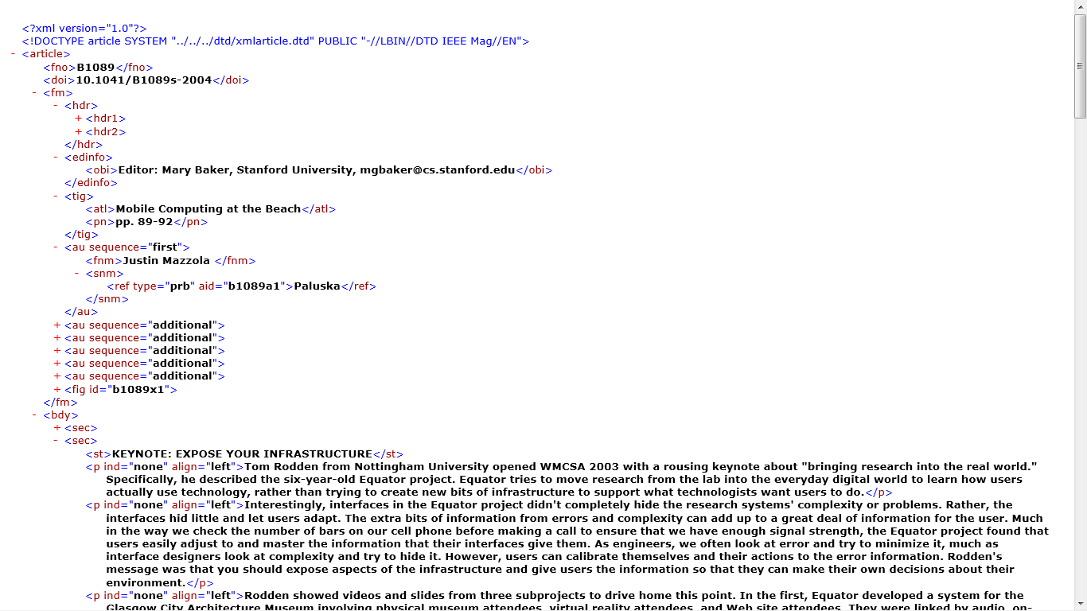
INEX 2002-2006 Ad-Hoc Collection
16,000 IEEE articles (scientific journal publications)
XML-ified bibtex + document meta data, ~750 MB XML

Slide 45
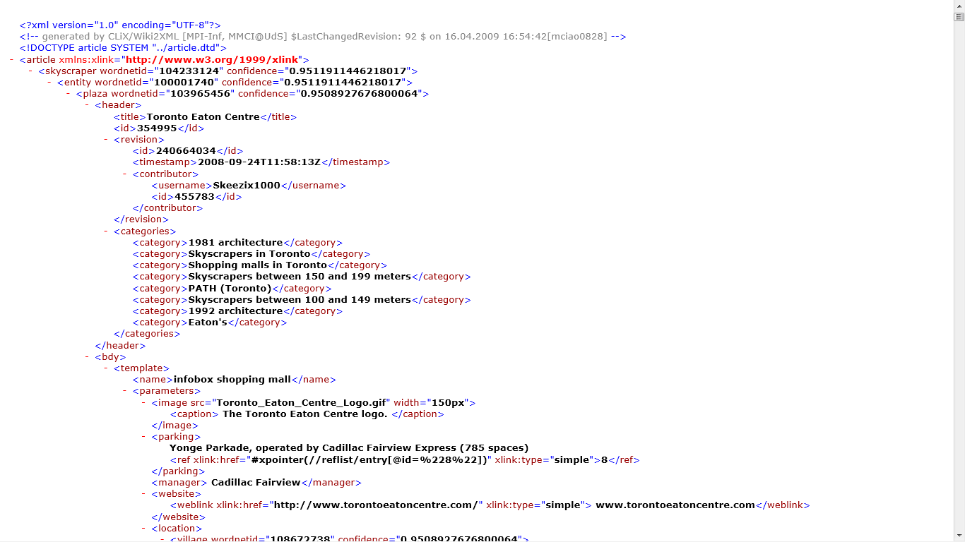
INEX 2007-2009 Ad-Hoc Collection
2.6 Mio Wikipedia articles wrapped into XML
Wiki-Markup + semantic annotations, ~50 GB XML data

Slide 46
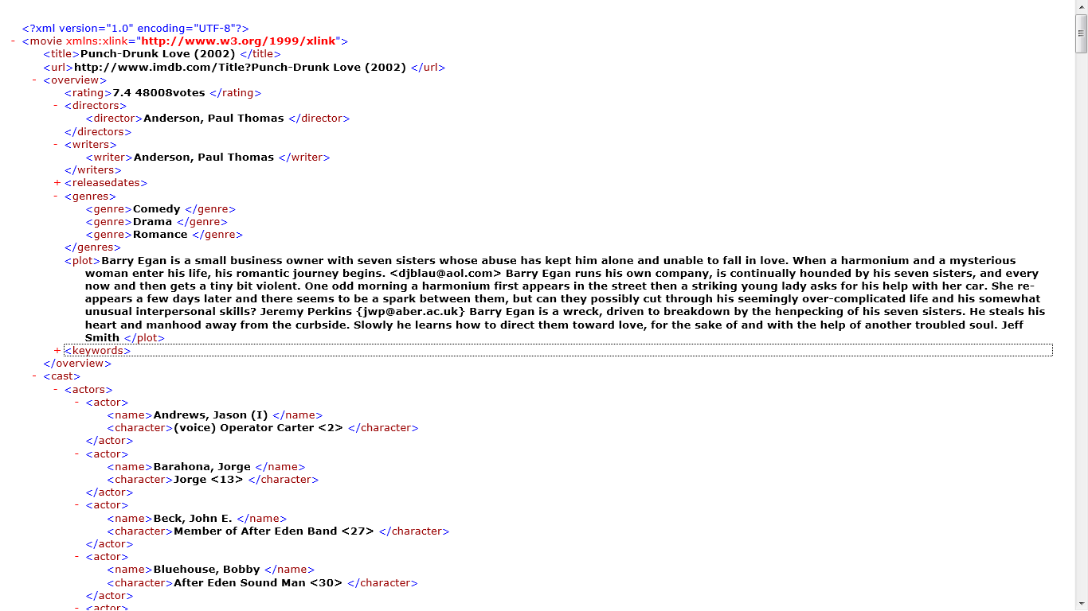
INEX 2010-2011 Data-Centric Collection
4.5 Mio IMDB files about movies/actors/directors
Highly structured content + large textual fields (plots, etc.), ~4.5 GB

Slide 47
NEXI Query Language
[Trotman, Sigurbjörnsson: INEX’04]
Narrowed Extended XPath I
Proposes a simple query language for both unstructured and structured IR queries against XML documents
Content-only (CO) queries
“punch drunk love” +“seven sisters”
Content-And-Structure (CAS) queries
//article[about(.//title, “punch drunk love”)]
//sec[about(.//, “seven sisters”)]

Slide 48
XML-IR and the W3C
http://www.w3.org/TR/xpath-full-text-10/
doc("http://example.com/full-text.xml") /books/book[count(./content ftcontains "tests")>0]
http://www.w3.org/TR/2005/WD-xmlquery-full-text-use-cases-20051103/
for $book in doc("http://example.com/full-text.xml")/books/book
let $cont := $book/content[. ftcontains "tests"]
where count($cont)>0
return $book

Slide 49
Query Evaluation (Sub-Tasks)
Article
Retrieve entire XML articles
Thorough
Retrieve individual XML elements (including overlapping ones)
Focused
Retrieve individual XML elements (non-overlapping)
With a plethora of evaluation metrics, including precision, recall, MA(i)P, NDC(i)G, etc.

Slide 50
BM25 with Multiple Weighted Fields
[Robertson,Zaragossa,Taylor: CIKM’04]
Idea:
Extend BM25 to handle the impact of different document fields
(HTML: <B>Punch Drunk Love</B> <P>Punch Drunk Love</P>
→
With field-specific weights v₁,…,v_{K}
Preserves the non-linearity of the tf component
But:
Requires adjustment of len(d_{j}) to match weighted tf components
Involves new tuning parameters v_{f}

Slide 51
TopX Data Model
“xml data manage xml manage system vary wide expressive power native xml native xml data base system store
schemaless data“
ftf (“xml”,
article₁ ) = 4
<article>
<title>XML Data Management
</title>
<abs>XML management systems vary
widely in their expressive power.
</abs>
<sec>
<title>Native XML Data Bases.
</title>
<par>Native XML data base systems
can store schemaless data.
</par>
</sec>
</article>
article
1
6
“native xml data base
native xml data base
system store
schemaless data“
title
abs
sec
2
1
3
2
4
5
“xml data manage”
“xml manage system vary wide expressive
power“
title
par
5
3
6
4
“native xml data base”
“native xml data base system store schemaless data“
ftf (“xml”,
sec₄ ) = 2
XML trees with XML elements as
inner nodes and text nodes as leafs
Additionally associate inner nodes with redundant full-content text nodes for entire subtree

Slide 52
BM25 with Hierarchical Scores _{[TopX @ INEX ’05–’09]}
Content Index (Tag-Term Pairs)
Element Freq.
Element Statistics
DocID | Tag | Term | Pre | Post | FTF
1 | article | xml | 1 | 6 | 4
1 | sec | xml | 4 | 5 | 2
1 | title | xml | 5 | 3 | 1
1 | par | xml | 6 | 4 | 1
… | … | … | … | … | …
Tag | Term | EF
article | xml | 863
sec | xml | 947
title | xml | 62
par | xml | 674
… | … | …
Tag | N | AvLen
article | 659K | 269.2
sec | 1.6M | 89.1
title | 2.2M | 2.8
par | 2.8M | 34.1
… | … | …
author[“gates”]
vs.
section[“gates”]
XML-specific variant of Okapi BM25
with k₁ = 2.0, b=0.75, and
tag-specific element frequencies ef_{A} and full-text term frequencies ftf over XML subtrees

Slide 53
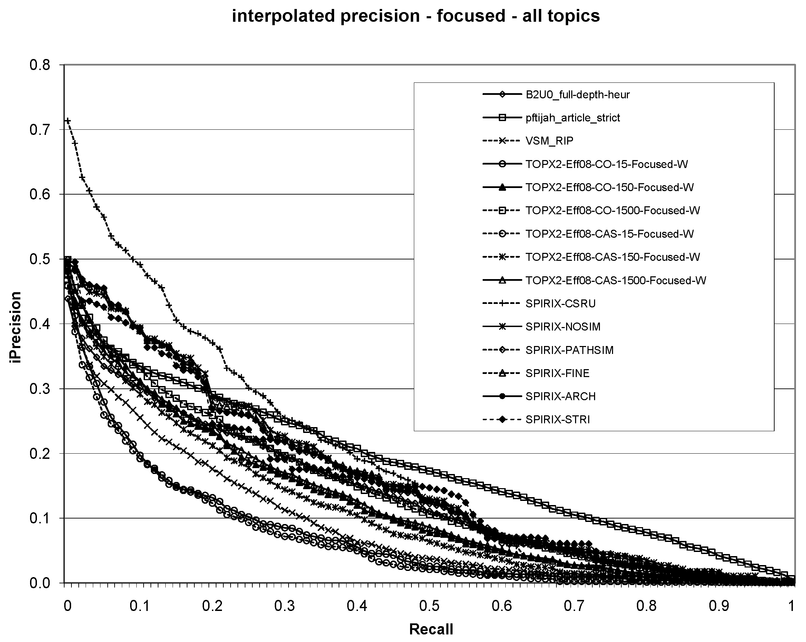
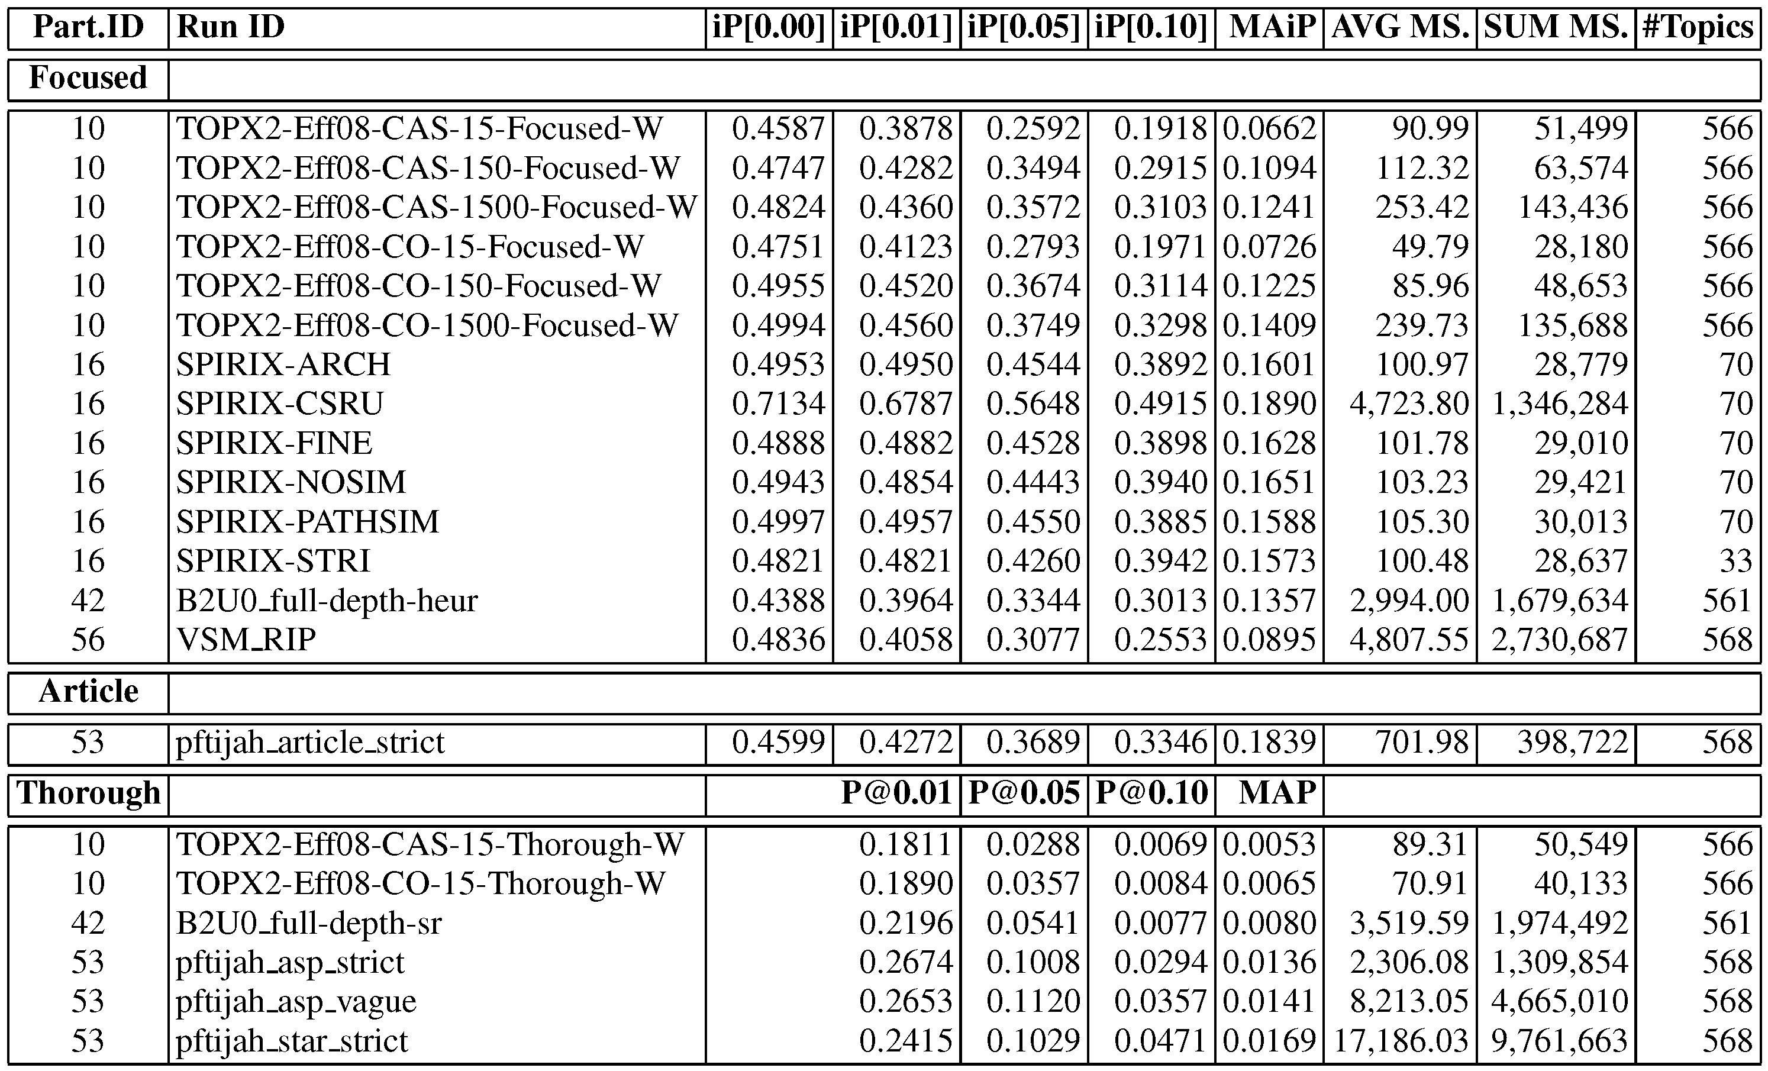
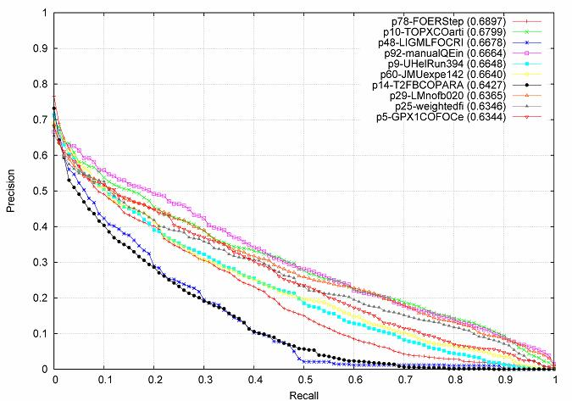
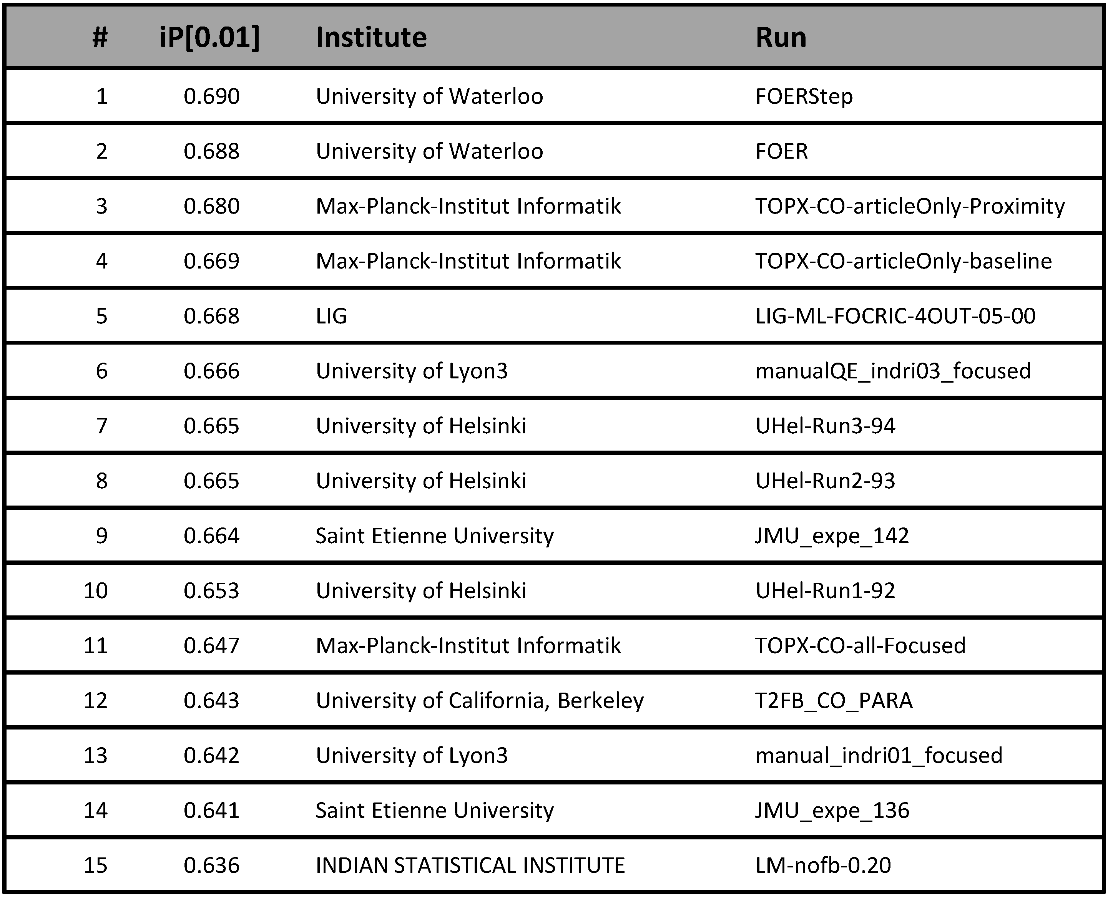
TopX 2008 Results
INEX Efficiency Track 2008:
Summary of 21 Runs by 5 Groups
INEX Ad-Hoc Track 2008:
Top-15 out of 163 Runs by 23 Groups

Slide 54
Summary of Section III.5
Difficult queries cannot easily be solved with 2.6 keywords
Relevance feedback and query expansion can more accurately reflect the user’s information need
Simple Roccio weighting scheme vs. Probabilistic IR
→ lots of heuristics and ad-hoc tuning parameters
Explicit thesauri and implicit term correlations for automatic query expansion with phrases and proximty-based ranking
XML-IR combines ideas from DB and IR in a unified (semistructured) data model with both text and semantic annotations

Slide 55
Additional References
Yonggang Qiu, Hans-Peter Frei: Concept Based Query Expansion. SIGIR 1993: 160-169
Jinxi Xu, W. Bruce Croft: Query Expansion Using Local and Global Document Analysis. SIGIR 1996: 4-11
Christiane Fellbaum: A Semantic Network of English: The Mother of All WordNets. Computers and the Humanities 32(2-3): 209-220 (1998)
Fabian M. Suchanek, Gjergji Kasneci, Gerhard Weikum: Yago: a core of semantic knowledge. WWW 2007: 697-706
Johannes Hoffart, Fabian M. Suchanek, Klaus Berberich, Edwin Lewis-Kelham, Gerard de Melo, Gerhard Weikum: YAGO2: exploring and querying world knowledge in time, space, context, and many languages. WWW (Companion Volume) 2011: 229-232
Martin Theobald, Mohammed AbuJarour, Ralf Schenkel: TopX 2.0 at the INEX 2008 Efficiency Track. INEX 2008: 224-236
Martin Theobald, Ralf Schenkel, Gerhard Weikum: Efficient and self-tuning incremental query expansion for top-k query processing. SIGIR 2005: 242-249
Andrew Trotman, Börkur Sigurbjörnsson: Narrowed Extended XPath I (NEXI). INEX 2004: 16-40
Stephen E. Robertson, Hugo Zaragoza, Michael J. Taylor: Simple BM25 extension to multiple weighted fields. CIKM 2004: 42-49
Wei Lu, Stephen E. Robertson, Andrew MacFarlane: Field-Weighted XML Retrieval Based on BM25. INEX 2005: 161-171

