Slide 1
V.2 Index Compression
Heap’s law (empirically observed and postulated):
Size of the vocabulary (distinct terms) in a corpus
with total number of term occurrences n, and constants α, β (β < 1),
classically α≈20, β≈0.5 (→ ~ 3 Mio terms for 20 Bio docs)
Zipf’s law (empirically observed and postulated):
Relative frequencies of terms in the corpus
with parameter θ, classically set to 1
→ Both laws strongly suggest opportunities for compression!

Slide 2
Recap: Huffman Coding
Variable-length unary code based on frequency analysis of the underlying distribution of symbols (e.g., words or tokens) in a text.
Key idea: choose shortest unary sequence for most frequent symbol.
Symbol x | Frequency f(x) | Huffman Encoding
a | 0.8 | 0
peter | 0.1 | 10
picked | 0.07 | 110
peck | 0.03 | 111
Huffman tree
0
1
10
11
110
111
a
peter
picked
peck
Let f(x) be the probability (or relative frequency) of the x-th symbol
in some text d. The entropy of the text
(or the underlying prob. distribution f) is:
H(d) is a lower bound for the average (i.e., expected) amount of bits per symbol needed with optimal compression. Huffman comes close to H(d).

Slide 3
Overview of Compression Techniques
Dictionary-based encoding schemes:
Ziv-Lempel: LZ77
(entire family of Zip encodings: GZip, BZIP2, etc.)
Variable-length encoding schemes:
Variable-Byte encoding (byte-aligned)
Gamma, Golomb/Rice (bit-aligned)
S16 (byte-aligned, actually creates entire 32- or 64-bit words)
P-FOR-Delta
(bit-aligned, with extra space for “exceptions”)
Interpolative Coding (IPC)
(bit-aligned, can actually plug in various schemes for binary code)

Slide 4
Ziv-Lempel Compression
LZ77 (Adaptive Dictionary) and further variants:
Scan text & identify in a lookahead window the longest string
that occurs repeatedly and is contained in a backward window.
Replace this string by a “pointer” to its previous occurrence.
Encode text into list of triples <back, count, new> where
back is the backward distance to a prior occurrence of the string
that starts at the current position,
count is the length of this repeated string, and
new is the next symbol that follows the repeated string.
Triples themselves can be further encoded (with variable length).
Better variants use explicit dictionary with statistical analysis
(need to scan text twice).

Slide 5
Example: Ziv-Lempel Compression
peter_piper_picked_a_peck_of_pickled_peppers
<0, 0, p> for character 1: p
<0, 0, e> for character 2: e
<0, 0, t> for character 3: t
<-2, 1, r> for characters 4-5: er
<0, 0, _> for character 6: _
<-6, 1, i> for characters 7-8: pi
<-8, 2, r> for characters 9-11: per
<-6, 3, c> for charaters 12-13: _pic
<0, 0, k> for character 16 k
<-7,1,d> for characters 17-18 ed
...
great for text, but not appropriate for index lists

Slide 6
Variable-Byte Encoding
Encode sequence of numbers into variable-length bytes using one status bit per byte indicating whether the current number expands into next byte.
Example:
To encode the decimal number 12038, write:
1st 8-bit word = 1 byte
2nd 8-bit word = 1 byte
Thus needs 2 bytes
instead of 4 bytes
(regular 32-bit integer)!
1
1011110
0
0000110
1 status bit
7 data bits
per byte

Slide 7
Gamma Encoding
Delta-encode gaps in inverted lists (successive doc ids):
Unary coding:
gap of size x encoded by:
log₂(x) times 0 followed by one 1
(log₂(x) + 1 bits)
Binary coding:
gap of size x encoded by
binary representation of number x
(log₂ x bits)
good for short gaps
good for long gaps
Gamma (γ) coding:
length:= floor(log₂ x) in unary, followed by
offset := x − 2^(floor(log₂ x)) in binary
Results in (1 + log₂ x + log₂ x) bits per input number x
generalization: Golomb/Rice code (optimal for geometr. distr. x)
still need to pack variable-length codes into bytes or words

Slide 8
Example: Gamma Encoding
Number x | Gamma Encoding
1 = 2⁰ | 1
5 = 2² + 2⁰ | 00101
15 = 2³+2² +2¹+2⁰ | 0001111
16 = 2⁴ | 000010000
Particularly useful when:
Distribution of numbers (incl. largest number) is not known ahead of time
Small values (e.g., delta-encoded docIds or low TF*IDF scores) are frequent

Slide 9
Golomb/Rice Encoding
For a tunable parameter M, split input number x into:
Quotient part q := floor(x/M) stored in unary code (using q x 1 + 1 x 0)
Remainder part r:= (x mod M) stored in binary code
If M is chosen as a power of 2,
then r needs log₂(M) bits (→ Rice encoding)
else set b := ceil(log₂(M))
If r < 2^{b}−M, then r as plain binary number using b-1 bits
else code the number r + 2^{b} − M in plain binary representation using b bits
M=10
b=4
Number x | q | Output bits q
0 | 0 | 0
33 | 3 | 1110
57 | 5 | 111110
99 | 9 | 1111111110
r | Binary (b bits) | Output bits r
0 | 0000 | 000
3 | 0011 | 011
7 | 1101 | 1101
9 | 1111 | 1111
Example:

Slide 10
S9/S16 Compression [Zhang, Long, Suel: WWW’08]
32-bit word (integer) = 4 bytes
1001
1011110000100001101100101111
4 status bits
28 data bits
Byte aligned encoding (32-bit integer words of fixed length)
4 status bits encode 9 or 16 cases for partitioning the 28 data bits
Example: If the above case 1001 denotes 4 x 7 bit for the data part, then the data part encodes the decimal numbers: 94, 8, 54, 47
Decompression implemented by case table or by hardcoding all cases
High cache locality of decompression code/table
Fast CPU support for bit shifting integers on 32-bit to 128-bit platforms

Slide 11
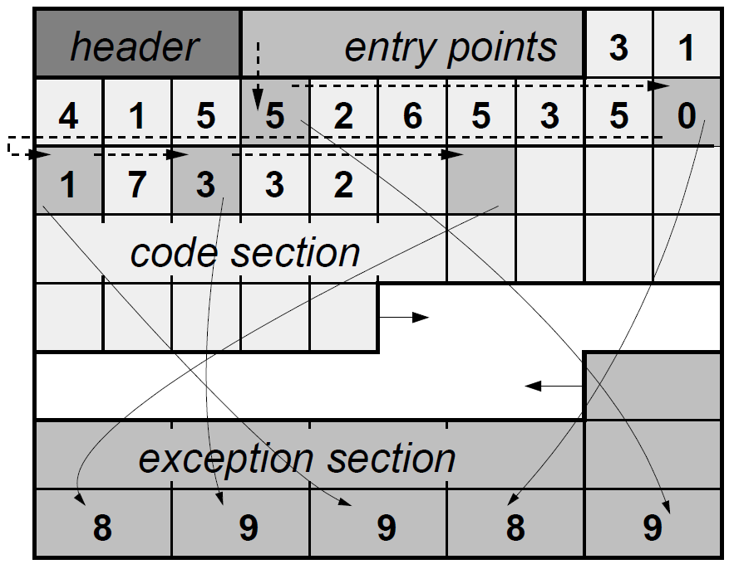
P-FOR-Delta Compression [Zukowski, Heman, Nes, Boncz: ICDE’06]
For “Patched Frame-of-Reference” w/Delta-encoded Gaps
Key idea: encode individual
numbers such that “most”
numbers fit into b bits.
Focuses on encoding an entire
block at a time by choosing a
value of b bits such that
[high_{coded}, low_{coded}] is small.
Outliers (“exceptions”) stored
in extra exception section at the
end of the block in reverse order.
Encoding of 31415926535897932
using b=3 bitwise coding blocks
for the code section.

Slide 12
Interpolative Coding (IPC) [Moffat, Stuiver: IR’00]
IPC directly encodes docIds rather than gaps.
Specifically aims at bursty/clustered docId’s of similar range.
Recursively splits input sequence into low-distance ranges.
<1; 3; 8; 9; 11; 12; 13; 17>
<1; 3; 8; 9;> <11; 12; 13; 17>
<1; 3> <8; 9;> <11; 12> <13; 17>
Requires ceil(log₂(high_{i} – low_{i} + 1)) bits per number for bucket i in binary!
But: → Requires the decoder to know all high_{i}/low_{i} pairs.
→ Need to know large blocks of the input sequence in advance.

Slide 13
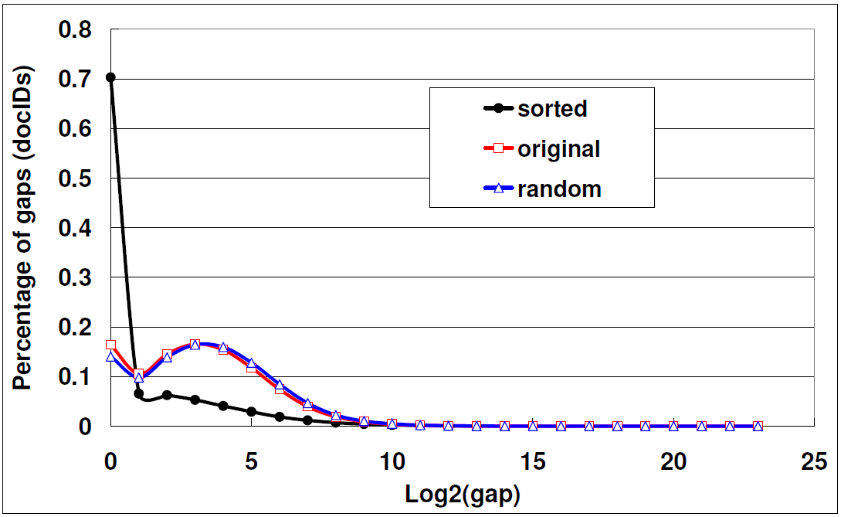
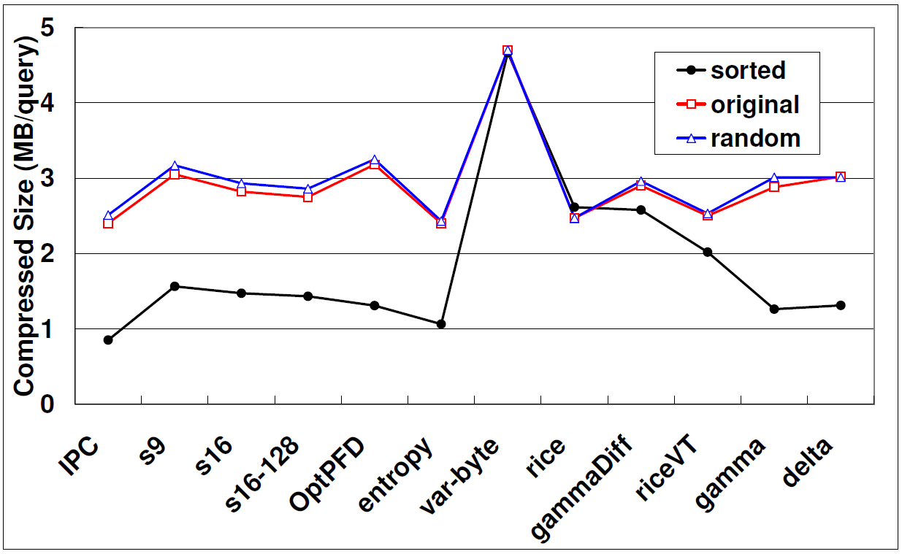
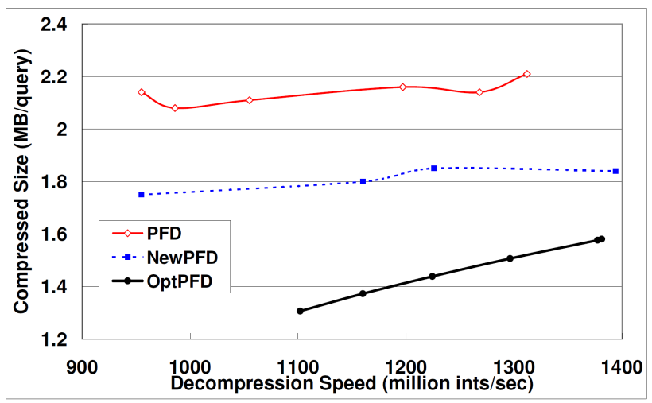
Comparison of Compression Techniques [Yan, Ding, Suel: WWW’09]
Distribution of docID-gaps on TREC GOV2 (~25 Mio docs) reporting averages over 1,000 queries
Compressed docId sizes (MB/query) on
TREC GOV2 (~25 Mio docs) reporting averages over 1,000 queries
Variable-length encodings usually win by far in (de-) compression speed over dictionary & entropy-based schemes, at comparable compression ratios!
Decompression speed (MB/query) for
TREC GOV2, 1,000 queries

Slide 14
Layout of Index Postings [J. Dean: WSDM 2009]
word
word
skip table
block 1
…
block N
one block
(with n postings):
delta to last docId in block
header
#docs in block: n
n-1 docId deltas: Rice_{M} encoded
docId postings
tf values : Gamma encoded
layout
allows
incremental
decoding
term attributes: Huffman encoded
payload
(of postings)
term positions: Huffman encoded

Slide 15
Additional Literature for Chapters V.1-2
Indexing with inverted files:
J. Zobel, A. Moffat: Inverted Files for Text Search Engines, Comp. Surveys 2006
S. Brin, L. Page: The Anatomy of a Large-Scale Hypertextual Web Search Engine,
WWW 1998
L.A. Barroso, J. Dean, U. Hölzle: Web Search for a Planet: The Google Cluster
Architecture. IEEE Micro 2003
J. Dean, S. Ghemawat: MapReduce: Simplified Data Processing in Large Clusters,
OSDI 2004
X. Long, T. Suel: Three-Level Caching for Efficient Query Processing in
Large Web Search Engines, WWW 2005
H. Yan, S. Ding, T. Suel: Compressing Term Positions in Web Indexes, SIGIR 2009
J. Dean: Challenges in Building Large-Scale Information Retrieval Systems,
Keynote, WSDM 2009, http://videolectures.net/wsdm09_dean_cblirs/
Inverted index compression:
Marvin Zukowski, Sándor Héman, Niels Nes, Peter A. Boncz: Super-Scalar RAM-CPU Cache Compression. ICDE 2006
Jiangong Zhang, Xiaohui Long, Torsten Suel: Performance of compressed inverted list caching in search engines. WWW 2008
Alistair Moffat, Lang Stuiver: Binary Interpolative Coding for Effective Index Compression. Inf. Retr. 3(1): 25-47 (2000)
Hao Yan, Shuai Ding, Torsten Suel: Inverted index compression and query processing with optimized document ordering. WWW 2009

