Slide 1
Time is of Essence: Improving Recency Ranking Using Twitter Data
Anlei Dong Ruiqiang Zhang Pranam Kolari Jing Bai
Fernando Diaz Yi Chang Zhaohui Zheng
2009
Information Retrieval Seminar
Universität des Saarlandes – Max Planck Institute für Informatik
Speaker: Luciano Del Corro
Opponent: Monika Mitrevska
November 29th , 2010

Slide 2
An effective portal web search must provide an efficient ranking system for different type of queries
Navigational Queries: Queries that seek a single website or web
page of a single entity (e.g. yahoo).
Transactional Queries: Queries that reflect the intent of the user to
perform a particular action
(e.g. book a hotel).
Informational Queries: Queries that look for information. Tend not to be site specific (e.g. an Address).
Recency Sensitive Queries: Queries where user expects documents
which are both topically relevant as well as
fresh (e.g. Breaking News).
Each query class may require a different ranking system

Slide 3
Recency content is more than news
Current Approaches
→ Integrate content from specialized news index.
→ Problems:
Relevant documents for sensitive queries are web pages, not just news.
A relevant document may be published on a low-priority site.
Even when relevant news exists, the web search results may remain stale.
Addressing recency ranking should focus
on web results directly

Slide 4
Failures for time sensitive queries can be more severe than for other type of queries
They are more likely to suffer from zero recall problem
The search engine fails to index any relevant document for a given query.
Queries refer to documents that have been lightly published.
TERMINAL PROBLEM: no reformulation or scanning can expose
the user to relevant documents.
The need for relevant content is immediate
Relevant documents may appear very low in the ranking.
The probability that the users see it is close to 0.
Time sensitive queries should be handled more carefully

Slide 5
Fresh documents are too fresh to be treated as normal web pages
1. Standard crawling may be too slow.
→ Recency Sensitive Queries requires fast indexing and an efficient
selective method.
2. Query-independent signals may be useless
→ Some features are not accurately represented
(e.g. in-links, aggregated clicks)
Addressing time sensitive queries requires
additional data and methods

Slide 6
Aim of the paper
Use the micro-blogging data stream to detect and rank fresh URLs
to blend them into a general web search engine.

Slide 7
Micro-blogging data is varied and among the freshest
Web publishing system constrained in size.
→ Allow rapid posting from a variety of interfaces.
→ Encourages low-cost real-time updates and links on developing topics (cheap generation of content).
Posted links include news and non-news URLs.
→ Allow gathering of fresh non-news documents.
Post can consist on videos or images embedded or links to web pages.
→ It provides a rich linking structure.
Links posts according to diverse and dynamic browsing priorities.
→ No need to predict priority
Transparent topography of the social network structure.
→ Relatively easy to modelize (typically as a directed graph).
Micro-blogging data may be an opportunity to improve
search engine performance for recency sensitive queries

Slide 8
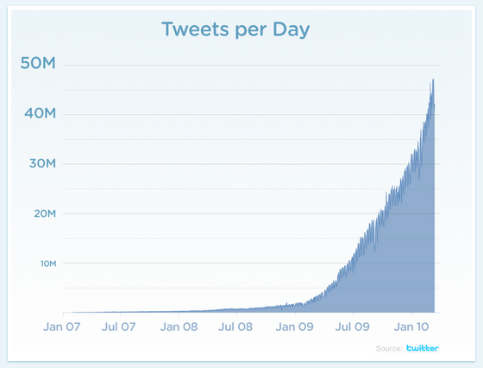
Twitter may provide a rich and easy to gather dataset
One of the most popular micro-blogging plataforms with a high
growth rate of users and posts with more than half of the users active.
Wide range of possibilities to interact with the system (Web, SMS, IM Agent)
Public content and social network geography and topology
Public timeline of recent updates
Millions of updates per day
Twitter Stats (jan 2010)
More than 106MM users.
300,000 new users per day.
180MM of unique visitors.
75% of traffic from external sources
Search engine receives 600MM q.
37% use the phone to tweet.
Data gathered from twitter may be useful
to address recency sensitive queries

Slide 9
The evidence presented in the paper
Support the following claims
1. Twitter is likely to contain URLs of uncrwawled documents
likely to be relevant to recency sensitive queries. This pages
can be quickly surfaced on a general search results page.
2. The text of Twitter can be used to expand document text
representations.
3. The social network of Twitter can be used to improve ranking.

Slide 10
A two-phase method
1. Crawl and Filter URLs from Twitter posts
2. Incorporate those URLs into a larger web ranking system

Slide 11
Crawiling twitter URLs
URLs posted tend to include a significant amount of links
to spam, adult and self-promotion pages.
Requires considerable overhead.
Filtering Heuristic
2. URLs only referred to by just one
user are also discharged
1. URLs referred to by the same user
more than 2 times are discharged
Experiments
In 5 hours (15:00-20:00), 1,069,309 URLs were posted in Twitter
After the first filtering rule 713,178 URLs remained (66,7%).
After the second rule just 63,184 remained (5,9%).
90% of the URLs were not crawled by the standard procedure.

Slide 12
Learning to rank (MLR) (I):
a brief introduction
Ranking using machine learning technologies.
Feature Based
→ Each feature represents a characteristic of the documents that is
supposed to influence its relevance.
→ How this feature influences the relevance is what needs to be learned.
→ The combination of features is possible and desirable.
Discriminative Training
→ Automatic Learning (input space, output space, hypothesis space,
loss function).
→ A wide set of algorithms available.
→ How often should updates be performed?
→ Parameter tuning?
The result is a function that ranks a set of documents according to their
relevamce to a given query Usually just the top positions matter.

Slide 13
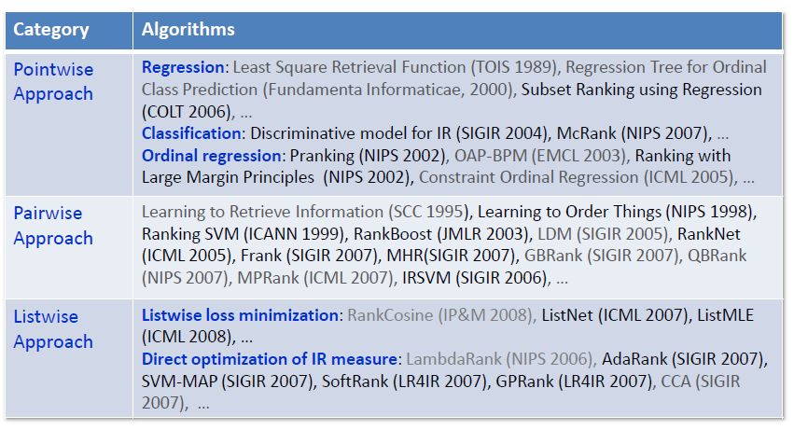
Learning to rank (MLR) (II): Algorithm categories
(Tie-Yan Liu, 2009)

Slide 14
Learning to rank (MLR) (III):
selecting an algorithm
Which are the particularities of the problem?
What kind of data is going to be used?
How will the query be represented?
Which algorithm does better adapt to these particularities?
Which desirable characteristics of the algorithm can give more clarity over
the hypothesis being tested?
What is an appropriate measure of similarity?
Which algorithm perform the best?
Which algorithm is more cost-efficient?

Slide 15
Ranking twitter URLs
Prerequisites to build a ranking system
Define a learning algorithm.
Gather a training set.
Define a Feature Set.
→ Content Features: related to the content of the document.
→ Aggregate Features: those that represent the long term popularity and usage.
Specific requirements for fresh URLs
Agregate features tend to be poorly represented.
Twitter features: those features which are related to tweets containing a
URL pointing to a document.
Micro-blogging data is not only used to extract fresh URLs but also to rank those URLs

Slide 16
Twitter Features (I)
Textual Features
→ A URLs posted in Twitter is associated with the text surrounding it
We define two matrices
and
with tweets, URLs and words. An element in indicates the presence of a URL in a tweet. An element in represents how many times a tweet contains a given term.
→ term vector for a given URL from the combination of tweets content
is then defined as a query vector. Then a similarity measure can be defined as
tweets should also have a special treatment as they are very short.
Let be the binary version of and the binary version of
Then

Slide 17
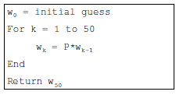
Twitter Features (II)
Social Network Features
The centrality of a user in the graph is used as a measure of its authority.
(based on PageRank).
We define as the adjacency matrix of the network. is the eigenvector associated with the largest eigenvalue λ, providing a natural measure of the centrality of the user.
The eigenvector can be calculated using powered iteration
Then the URL will be assigned the authority of the user who posted it
The authority of the user is also used to compute the unit match score

Slide 18
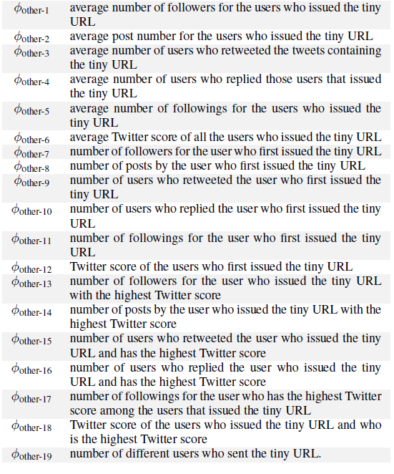
Twitter Features (III)
Other Features
General user features (1-6)
First poster of the URL (7-12)
User with the highest score (13-19)

Slide 19
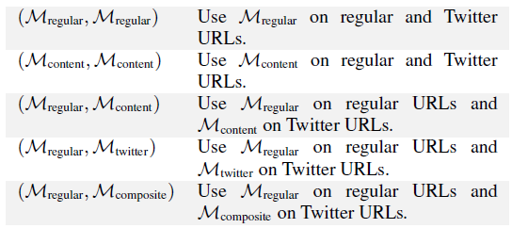
Ranking Method
Gradient Boosted Decision Tree (GBDT)
stagewise additive expansions + steepest descent minimization
The function is represented as a combination of decision trees.
where is a tree at iteration t and λ is the learning rate.
are the spliting variables, split locations and the terminal nodes of the individual trees

Slide 20
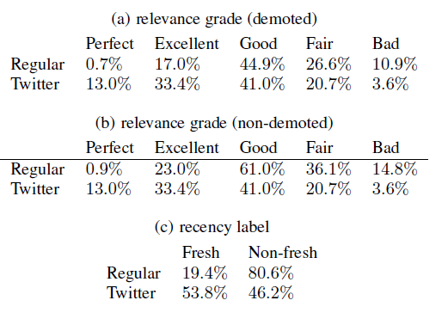
Methods and Materials
Only time sensitive queries are considered.
Two sets of URLs were constructed (Twitter and regular URLs).
Tuples (query, URL, t_{query}) were manually labeled according to content and
freshness
Evaluation
The idea is to give more importance to what happens in the first positions
→ Normalized Discounted Cumulative Gain (NDCG).
→ Discounted Comulative Freshness (DCF).

Slide 21
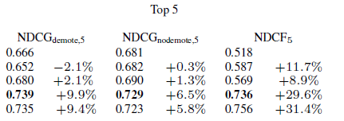
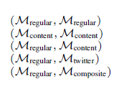
Results (I)

Slide 22
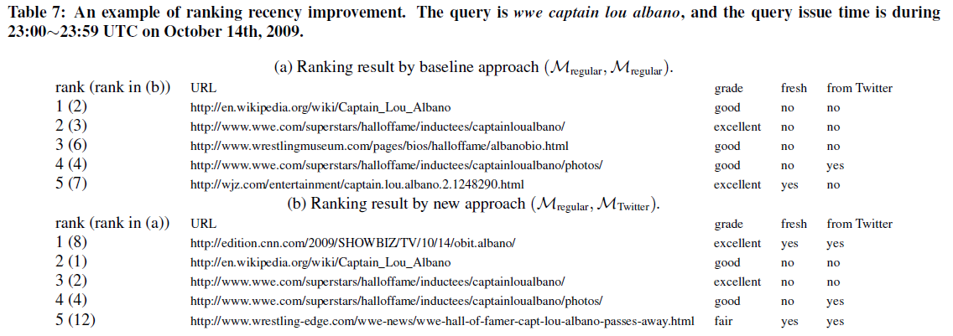
Results (II)

Slide 23
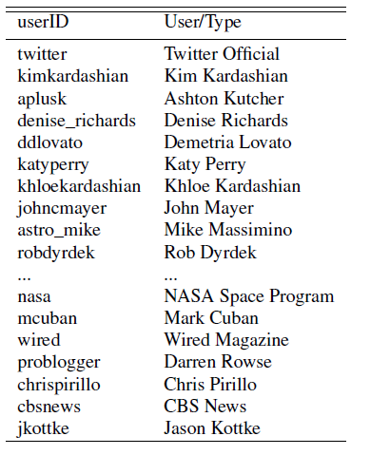
Results (III)

Slide 24
Results (IV)

Slide 25
Discussion
How often should updates be performed? How fast do the structural
properties of Micro-Blogging data evolve?
Can data generated by a non-representative set of users be used to blend the
URLs from Twitter in a general web search engine? (biased results?).
Does the authority of a user truly represents the authority of a document?
Does micro-blogging data provide enough redundancies to perform an
accurate ranking?
Does the ranking method matters? Is there a ranking method particularly
suitable to deal with micro-blogging data?
How should be the training and test data prepared?
THANKS!

