Slide 1
Chapter II: Basics from probability theory and statistics
Information Retrieval & Data Mining
Universität des Saarlandes, Saarbrücken
Winter Semester 2011/12

Slide 2
Chapter II: Basics from Probability Theory and Statistics*
II.1 Probability Theory
Events, Probabilities, Random Variables, Distributions, Moment-Generating Functions, Deviation Bounds, Limit Theorems
Basics from Information Theory
II.2 Statistical Inference: Sampling and Estimation
Moment Estimation, Confidence Intervals
Parameter Estimation, Maximum Likelihood, EM Iteration
II.3 Statistical Inference: Hypothesis Testing and Regression
Statistical Tests, p-Values, Chi-Square Test
Linear and Logistic Regression
*mostly following L. Wasserman, with additions from other sources

Slide 3
II.1 Basic Probability Theory
Probability
Data generating process
Observed data
Statistical Inference/Data Mining
Probability Theory
Given a data generating process, what are the properties
of the outcome?
Statistical Inference
Given the outcome, what can we say about the process that generated the data?
How can we generalize these observations and make predictions about future outcomes?

Slide 4
Sample Spaces and Events
A sample space Ω is a set of all possible outcomes of an experiment.
(Elements e in Ω are called sample outcomes or realizations.)
Subsets E of Ω are called events.
Example 1:
If we toss a coin twice, then Ω = {HH, HT, TH, TT}.
The event that the first toss is heads is A = {HH, HT}.
Example 2:
Suppose we want to measure the temperature in a room.
Let Ω = R = {-∞, ∞}, i.e., the set of the real numbers.
The event that the temperature is between 0 and 23 degrees is A = [0, 23].

Slide 5
Probability
A probability space is a triple (Ω, E, P) with
a sample space Ω of possible outcomes,
a set of events E over Ω,
and a probability measure P: E → [0,1].
Example: P[{HH, HT}] = 1/2; P[{HH, HT, TH, TT}] = 1
Three basic axioms of probability theory:
Axiom 1: P[A] ≥ 0 (for any event A in E)
Axiom 2: P[Ω] = 1
Axiom 3: If events A₁, A₂, … are disjoint, then P[∪_{i} A_{i}] = ∑_{i} P[A_{i}] (for countably many A_{i}).

Slide 6
Probability
More properties (derived from axioms)
P[∅] = 0 (null/impossible event)
P[Ω] = 1 (true/certain event, actually not derived but 2nd axiom)
0 ≤ P[A] ≤ 1
If A ⊆ B then P[A] ≤ P[B]
P[A] + P[¬A] = 1
P[A ∪ B] = P[A] + P[B] – P[A ∩ B] (inclusion-exclusion principle)
Notes:
E is closed under ∩, ∪, and – with a countable number of operands (with finite Ω, usually E=2^{Ω}).
It is not always possible to assign a probability to every event in E if the sample space is large. Instead one may assign probabilities to a limited class of sets in E.

Slide 7
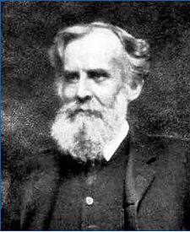
Venn Diagrams
Ω
B
A
A ∩ B
John Venn
1834-1923
Proof of the Inclusion-Exclusion Principle:
P[A ∪ B] = P[ (A ∩ ¬B) ∪ (A ∩ B) ∪ (¬A ∩ B) ]
= P[A ∩ ¬B] + P[A ∩ B] + P[¬A ∩ B] + P[A ∩ B] – P[A ∩ B]
= P[(A ∩ ¬B) ∪ (A ∩ B)] + P[(¬A ∩ B) ∪ (A ∩ B)] – P[A ∩ B]
= P[A] + P[B] – P[A ∩ B]

Slide 8
Independence and Conditional Probabilities
Two events A, B of a probability space are independent
if P[A ∩ B] = P[A] P[B].
A finite set of events A={A₁, ..., A_{n}} is independent
if for every subset S ⊆ A the equation
holds.
The conditional probability P[A | B] of A under the
condition (hypothesis) B is defined as:
An event A is conditionally independent of B given C
if P[A | BC] = P[A | C].

Slide 9
Independence vs. Disjointness
Set-Complement
P[⌐A] = 1 – P[A]
Independence
P[A ∩ B] = P[A] P[B]
P[A ∪ B] = 1 – (1 – P[A])(1 – P[B])
Disjointness
P[A ∩ B] = 0
P[A ∪ B] = P[A] + P[B]
Identity
P[A] = P[B] = P[A ∩ B] = P[A ∪ B]

Slide 10
Murphy’s Law
“Anything that can go wrong will go wrong.”
Example:
Assume a power plant has a probability of a
failure on any given day of p.
The plant may fail independently on any given
day, i.e., the probability of a failure over n days
is: P[failure in n days] = 1 – (1 – p)^{n}
Set p = 3 accidents / (365 days * 40 years) = 0.00021, then:
P[failure in 1 day] = 0.00021
P[failure in 10 days] = 0.002
P[failure in 100 days] = 0.020
P[failure in 1000 days] = 0.186
P[failure in 365*40 days] = 0.950

Slide 11
Birthday Paradox
In a group of n people, what is the probability that at least 2 people have the same birthday?
→ For n = 23, there is already a 50.7% probability of least 2 people having the same birthday.
Let N denote the event that in a group of n-1 people a newly added person does not share a birthday with any other person, then:
P[N=1] = 365/365, P[N=2]= 364/365, P[N=3] = 363/365, …
P[N’=n] = P[at least two birthdays in a group of n people coincide]
= 1 – P[N=1] P[N=2] … P[N=n-1] = 1 – ∏ _{k=1,…,n-1} (1 – k/365)
P[N’=1] = 0
P[N’=10] = 0.117
P[N’=23] = 0.507
P[N’=41] = 0.903
P[N’=366] = 1.0

Slide 12
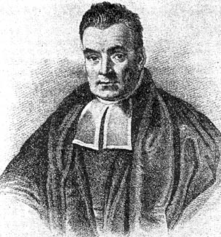
Total Probability and Bayes’ Theorem
The Law of Total Probability:
For a partitioning of Ω into events A₁, ..., A_{n}:
Thomas Bayes
1701-1761
Bayes’ Theorem:
P[A|B] is called posterior probability
P[A] is called prior probability

Slide 13
Random Variables
How to link sample spaces and events to actual data / observations?
Example:
Let’s flip a coin twice, and let X denote the number of heads we observe. Then what are the probabilities P[X=0], P[X=1], etc.?
P[X=0] = P[{TT}] = 1/4
P[X=1] = P[{HT, TH}] = 1/4 + 1/4 = 1/2
P[X=2] = P[{HH}] = 1/4
What is the probability of P[X=3] ?
x | P(X=x)
0 | 1/4
1 | 1/2
2 | 1/4
Distribution of X

Slide 14
Random Variables
A random variable (RV) X on the probability space (Ω, E, P) is a
function X: Ω → M with M ⊆ R s.t. {e | X(e) ≤ x}∈E for all x ∈M
(X is observable).
Example: (Discrete RV)
Let’s flip a coin 10 times, and let X denote the number of heads we observe.
If e = HHHHHTHHTT, then X(e) = 7.
Example: (Continuous RV)
Let’s flip a coin 10 times, and let X denote the ratio between heads and tails we observe. If e = HHHHHTHHTT, then X(e) = 7/3.
Example: (Boolean RV, special case of a discrete RV)
Let’s flip a coin twice, and let X denote the event that heads occurs first.
Then X=1 for {HH, HT}, and X=0 otherwise.

Slide 15
Distribution and Density Functions
F_{X}: M → [0,1] with F_{X}(x) = P[X ≤ x] is the
cumulative distribution function (cdf) of X.
For a countable set M, the function f_{X}: M → [0,1]
with f_{X}(x) = P[X = x] is called the probability density function
(pdf) of X; in general f_{X}(x) is F’_{X}(x).
For a random variable X with distribution function F, the inverse
function F⁻¹(q) := inf{x | F(x) > q} for q ∈ [0,1] is called quantile
function of X.
(the 0.5 quantile (aka. “50th percentile”) is called median)
Random variables with countable M are called discrete,
otherwise they are called continuous.
For discrete random variables, the density function is also
referred to as the probability mass function.

Slide 16
Important Discrete Distributions
Uniform distribution over {1, 2, ..., m}:
Bernoulli distribution (single coin toss with parameter p; X: head or tail):
Binomial distribution (coin toss n times repeated; X: #heads):
Geometric distribution (X: #coin tosses until first head):
Poisson distribution (with rate λ):
2-Poisson mixture (with a₁+a₂=1):

Slide 17
Important Continuous Distributions
Uniform distribution in the interval [a,b]
Exponential distribution (e.g. time until next event of a Poisson process)
with rate λ = lim_{Δt→0} (# events in Δt) / Δt :
Hyper-exponential distribution:
Pareto distribution:
Example of a “heavy-tailed” distribution with
Logistic distribution:

Slide 18
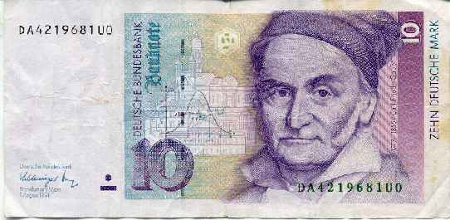
Normal (Gaussian) Distribution
Normal distribution N(μ,σ²) (Gauss distribution;
approximates sums of independent,
identically distributed random variables):
Normal (cumulative) distribution function N(0,1):
Theorem:
Let X be Normal distributed with
expectation μ and variance σ².
Then
is Normal distributed with expectation 0 and variance 1.
Carl Friedrich
Gauss, 1777-1855

Slide 19
Multidimensional (Multivariate) Distributions
Let X₁, ..., X_{m} be random variables over the same probability space with domains dom(X₁), ..., dom(X_{m}).
The joint distribution of X₁, ..., X_{m} has the density function
(discrete case)
(continuous case)
The marginal distribution of X_{i} in the joint distribution of X₁, ..., X_{m} has the density function
(discrete case)
(continuous case)

Slide 20
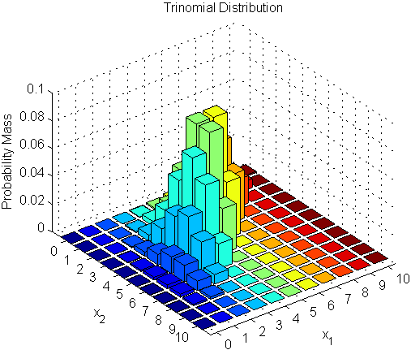
Important Multivariate Distributions
Multinomial distribution (n, m) (n trials with m-sided dice):
Multidimensional Gaussian distribution ( ):
with covariance matrix Σ with Σ_{ij} := Cov(X_{i},X_{j})
(Plots from http://www.mathworks.de/)

Slide 21
Expectation Values, Moments & Variance
For a discrete random variable X with density f_{X}
is the expectation value (mean) of X
is the i-th moment of X
is the variance of X
For a continuous random variable X with density f_{X}
is the expectation value (mean) of X
is the i-th moment of X
is the variance of X
Theorem: Expectation values are additive:
(distributions generally not)

Slide 22
Properties of Expectation and Variance
E[aX+b] = aE[X]+b for constants a, b
E[X₁+X₂+...+X_{n}] = E[X₁] + E[X₂] + ... + E[X_{n}]
(i.e. expectation values are generally additive, but distributions are not!)
E[XY] = E[X]E[Y] if X and Y are independent
E[X₁+X₂+...+X_{N}] = E[N] E[X]
if X₁, X₂, ..., X_{N} are independent and identically distributed (iid) RVs
with mean E[X] and N is a stopping-time RV
Var[aX+b] = a² Var[X] for constants a, b
Var[X₁+X₂+...+X_{n}] = Var[X₁] + Var[X₂] + ... + Var[X_{n}]
if X₁, X₂, ..., X_{n} are independent RVs
Var[X₁+X₂+...+X_{N}] = E[N] Var[X] + E[X]² Var[N]
if X₁, X₂, ..., X_{N} are iid RVs with mean E[X] and variance Var[X]
and N is a stopping-time RV

Slide 23
Correlation of Random Variables
Covariance of random variables X_{i} and X_{j}
Correlation coefficient of X_{i} and X_{j}
Conditional expectation of X given Y=y
(discrete case)
(continuous case)

Slide 24
Transformations of Random Variables
Consider expressions r(X,Y) over RVs, such as X+Y, max(X,Y), etc.
For each z find A_{z} = {(x,y) | r(x,y)≤z}
Find cdf F_{Z}(z) = P[r(x,y) ≤ z] =
Find pdf f_{Z}(z) = F’_{Z}(z)
Important case: Sum of independent RVs (non-negative) Z = X+Y
F_{Z}(z) = P[r(x,y) ≤ z] =
“Convolution”
Discrete case:

Slide 25
Generating Functions and Transforms
X, Y, ...: continuous random variables
with non-negative real values
A, B, ...: discrete random variables with
non-negative integer values
Moment-generating function of X
Generating function of A
(z transform)
Laplace-Stieltjes transform (LST) of X
Laplace-Stieltjes transform of A
Examples:
Exponential:
Erlang-k:
Poisson:

Slide 26
Properties of Transforms
Convolution of independent random variables:
(continuous case)
(discrete case)
Many more properties for other transforms, see, e.g.:
L. Wasserman: All of Statistics
Arnold O. Allen: Probability, Statistics, and Queueing Theory

Slide 27
Use Case: Score prediction for fast Top-k Queries
[Theobald, Schenkel, Weikum: VLDB’04]
Given: Inverted lists L_{i} with continuous score distributions captured by independent RV’s S_{i}
Want to predict:
Consider score intervals [0, high_{i} ] at current scan positions in L_{i}, then f_{i}(x) = 1/high_{i} (assuming uniform score distributions)
Convolution S₁+S₂ is given by
But each factor is non-zero in 0 ≤ x ≤ high₁ and 0 ≤ z-x ≤ high₂ only (for high₁≤ high₂), thus
Cumbersome amount of case differentiations
L₁
L₂
L₃
D₁₀:0.8
D₇ : 0.8
D₂₁:0.7
high₁
…
…
D₄:1.0
D₉ :0.9
D1:0.8
high₂
…
D₂₁:0.3
…
D₆ :0.9
D₇ :0.8
D₁₀:0.6
high₃
…
D₂₁:0.6
…
→

Slide 28
Use Case: Score prediction for fast Top-k Queries
[Theobald, Schenkel, Weikum: VLDB’04]
Given: Inverted lists L_{i} with continuous score distributions captured by independent RV’s S_{i}
Want to predict:
Instead: Consider the moment-generating function for each S_{i}
For independent S_{i}, the moment of the convolution over all S_{i} is given by
Apply Chernoff-Hoeffding bound on tail distribution
→ Prune D₂₁ if P[S₂+S₃ > δ] ≤ ε (using δ = 1.4-0.7 and a small confidence threshold for ε, e.g., ε=0.05)
L₁
L₂
L₃
D₁₀:0.8
D₇ : 0.8
D₂₁:0.7
high₁
…
…
D₄:1.0
D₉ :0.9
D1:0.8
high₂
…
D₂₁:0.3
…
D₆ :0.9
D₇ :0.8
D₁₀:0.6
high₃
…
D₂₁:0.6
…
→

Slide 29
Inequalities and Tail Bounds
Markov inequality: P[X ≥ t] ≤ E[X] / t for t > 0 and non-neg. RV X
Chebyshev inequality: P[ |X−E[X]| ≥ t] ≤ Var[X] / t² for t > 0 and non-neg. RV X
Chernoff-Hoeffding bound:
Corollary:
for Bernoulli(p) iid. RVs
X₁, ..., X_{n} and any t > 0
for N(0,1) distr. RV Z
and t > 0
Mill‘s inequality:
Cauchy-Schwarz inequality:
Jensen’s inequality: E[g(X)] ≥ g(E[X]) for convex function g
E[g(X)] ≤ g(E[X]) for concave function g
(g is convex if for all c∈[0,1] and x₁, x₂: g(cx₁ + (1-c)x₂) ≤ cg(x₁) + (1-c)g(x₂))

Slide 30
Convergence of Random Variables
Let X₁, X₂, ... be a sequence of RVs with cdf’s F₁, F₂, ...,
and let X be another RV with cdf F.
X_{n} converges to X in probability, X_{n} →_{P} X, if for every ε > 0
P[|X_{n}−X| > ε] → 0 as n → ∞
X_{n} converges to X in distribution, X_{n} →_{D} X, if
lim _{n→ ∞} F_{n}(x) = F(x) at all x for which F is continuous
X_{n} converges to X in quadratic mean, X_{n} →_{qm} X, if
E[(X_{n}−X)²] → 0 as n → ∞
X_{n} converges to X almost surely, X_{n} →_{as} X, if P[X_{n} →X] = 1
Weak law of large numbers (for )
if X₁, X₂, ..., X_{n}, ... are iid RVs with mean E[X], then
that is:
Strong law of large numbers:
if X₁, X₂, ..., X_{n}, ... are iid RVs with mean E[X], then
that is:

Slide 31
Convergence & Approximations
Theorem: (Binomial converges to Poisson)
Let X be a random variable with Binomial distribution with
parameters n and p := λ/n with large n and small constant λ << 1.
Then
Theorem: (Moivre-Laplace: Binomial converges to Gaussian)
Let X be a random variable with Binomial distribution with
parameters n and p. For -∞ < a ≤ b < ∞ it holds that:
Φ(z) is the Normal distribution function N(0,1); a, b are integers

Slide 32
Central Limit Theorem
Theorem:
Let X₁, ..., X_{n} be n independent, identically distributed (iid) random variables with expectation µ and variance σ². The distribution function F_{n} of the random variable Z_{n} := X₁ + ... + X_{n}
converges to a Normal distribution N(nμ, nσ²) with expectation nμ and variance nσ². That is, for -∞ < x ≤ y < ∞ it holds that:
Corollary:
converges to a Normal distribution N(μ, σ²/n)
with expectation μ and variance σ²/n .

Slide 33
Elementary Information Theory
Let f(x) be the probability (or relative frequency) of the x-th symbol
in some text d. The entropy of the text
(or the underlying prob. distribution f) is:
H(d) is a lower bound for the bits per symbol
needed with optimal coding (compression).
For two prob. distributions f(x) and g(x) the
relative entropy (Kullback-Leibler divergence) of f to g is:
Relative entropy is a measure for the (dis-)similarity of two probability or frequency distributions. It corresponds to the average number of additional bits needed for coding information (events) with distribution f when using an optimal code for distribution g.
The cross entropy of f(x) to g(x) is:

Slide 34
Compression
Text is sequence of symbols (with specific frequencies)
Symbols can be
letters or other characters from some alphabet Σ
strings of fixed length (e.g. trigrams, “shingles”)
or words, bits, syllables, phrases, etc.
Limits of compression:
Let p_{i} be the probability (or relative frequency)
of the i-th symbol in text d
Then the entropy of the text:
is a lower bound for the
average number of bits per symbol in any compression (e.g. Huffman codes)
Note:
Compression schemes such as Ziv-Lempel (used in zip) are better because they consider context beyond single symbols; with appropriately generalized notions of entropy, the lower-bound theorem does still hold.

Slide 35
Summary of Section II.1
Bayes’ Theorem: very simple, very powerful
RVs as a fundamental, sometimes subtle concept
Rich variety of well-studied distribution functions
Moments and moment-generating functions capture distributions
Tail bounds useful for non-tractable distributions
Normal distribution: limit of sum of iid RVs
Entropy measures (incl. KL divergence)
capture complexity and similarity of prob. distributions

Slide 36
Reference Tables on Probability Distributions and Statistics (1)
Source: Arnold O. Allen, Probability, Statistics, and Queueing Theory
with Computer Science Applications, Academic Press, 1990

Slide 37
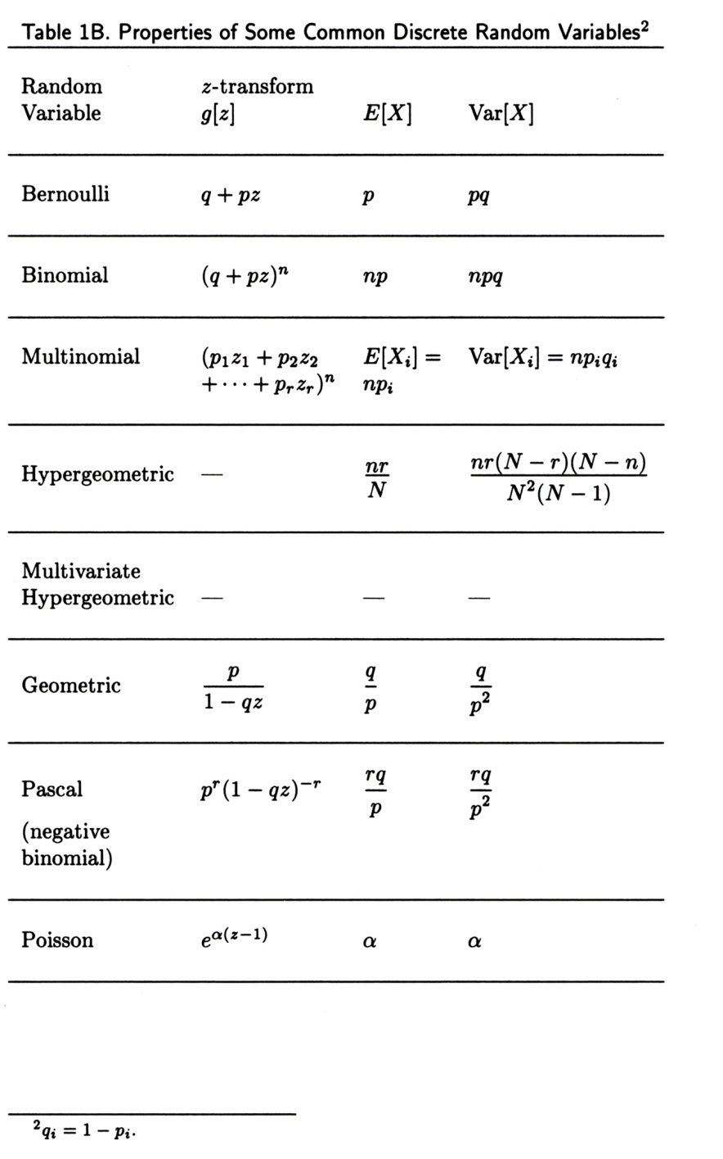
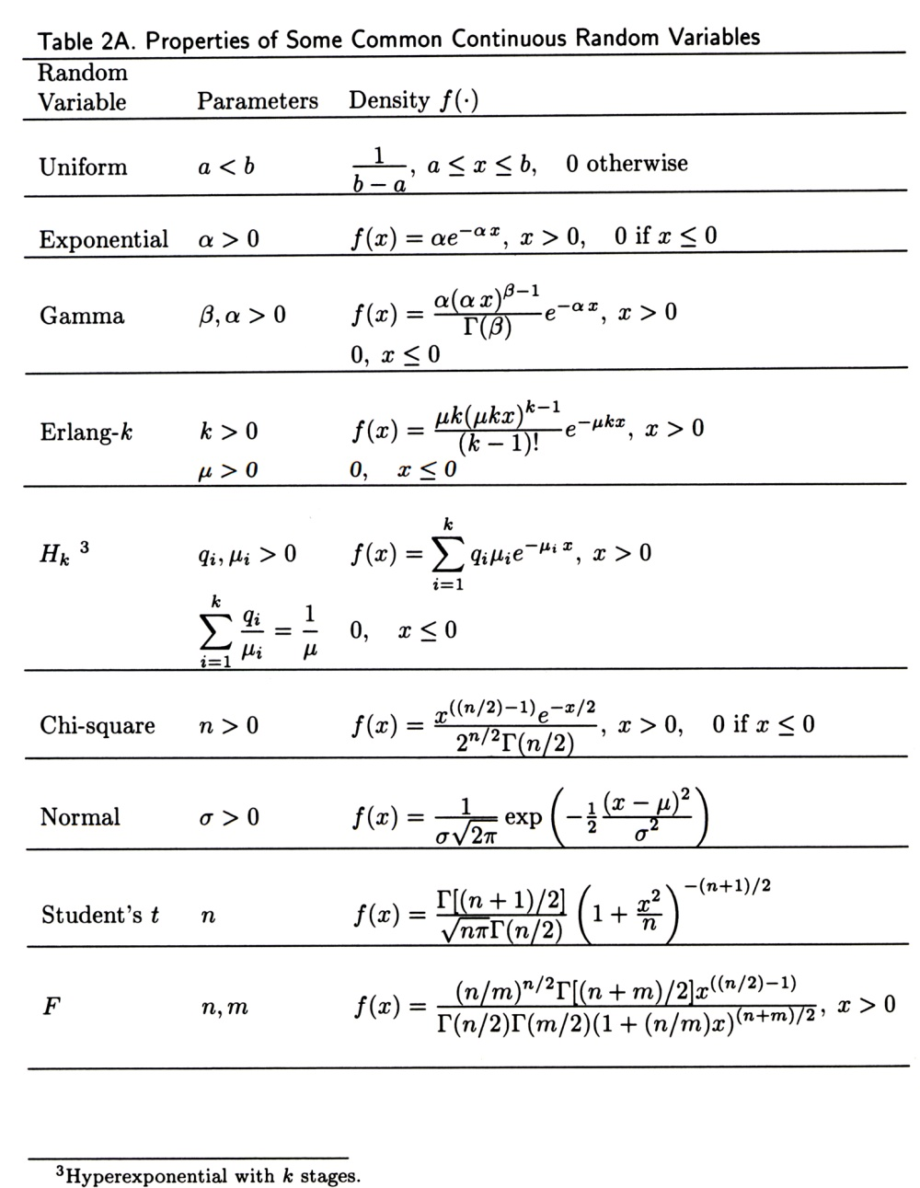
Reference Tables on Probability Distributions and Statistics (2)
Source: Arnold O. Allen, Probability, Statistics, and Queueing Theory
with Computer Science Applications, Academic Press, 1990

Slide 38
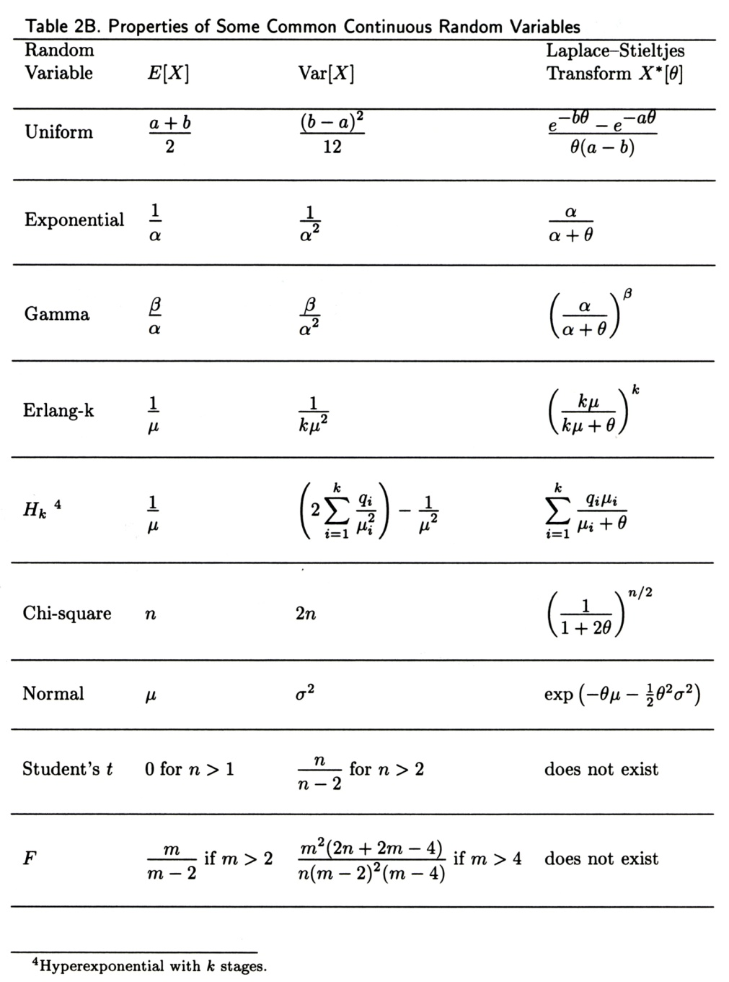
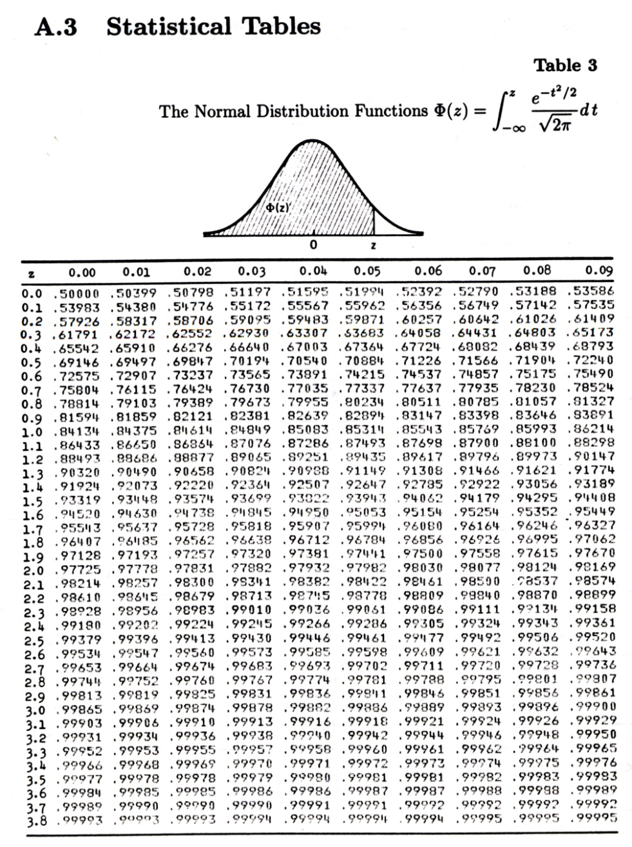
Reference Tables on Probability Distributions and Statistics (3)
Source: Arnold O. Allen, Probability, Statistics, and Queueing Theory
with Computer Science Applications, Academic Press, 1990

Slide 39
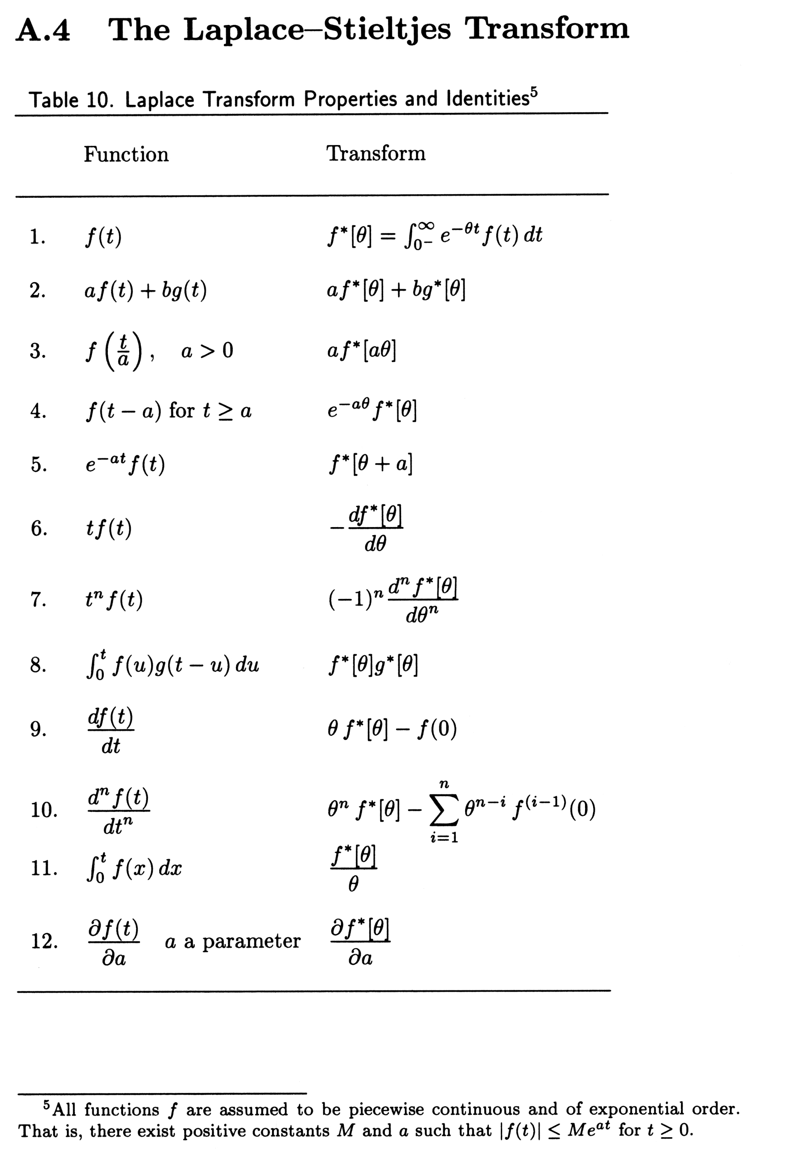
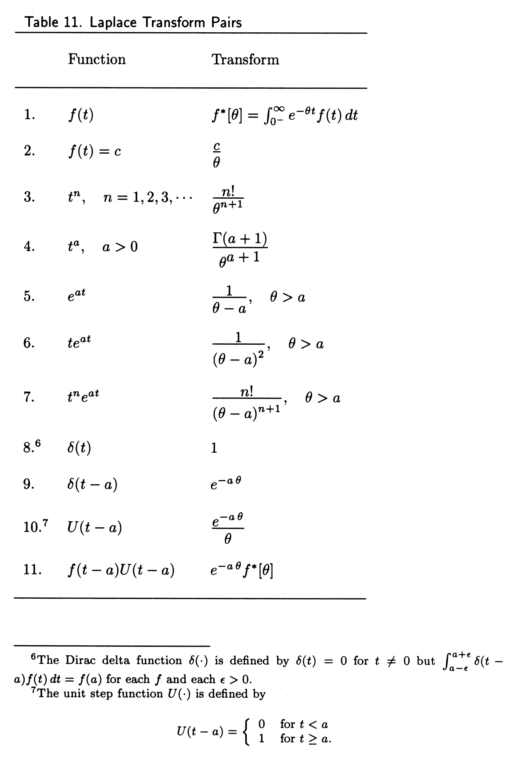
Reference Tables on Probability Distributions and Statistics (4)
Source: Arnold O. Allen, Probability, Statistics, and Queueing Theory
with Computer Science Applications, Academic Press, 1990

