Slide 1
VI.2 IE for Entities, Relations, Roles
Extracting named entities (either type-less constants or
typed unary predicates) in Web pages and NL text
Examples:
person, organization, monetary value, protein, etc.
Extracting typed relations between two entities (binary predicates)
Examples:
worksFor(person, company), inhibits(drug, disease),
person-hasWon-award, person-isMarriedTo-person, etc.
Extracting roles in relationships or events (n-ary predicates)
Examples:
conference at date in city, athlete wins championship in sports field,
outbreak of disease at date in country, company mergers,
political elections, products with technical properties and price, etc.

Slide 2
“Complexity” of IE Tasks
Usually:
Entity IE < Relation IE < Event IE (SRL)
Difficulty of input token patterns:
Closed sets, e.g., location names
Regular sets, e.g., phone numbers, birthdates, etc.
Complex patterns, e.g., full postal addresses, marriedTo relation in NL text
Ambiguous patterns
collaboration:
“at the advice of Alice, Bob discovered the super-discriminative effect”
capitalOfCountry:
“Istanbul is widely thought of as the capital of Turkey; however, …”

Slide 3
VI.2.1 Tokenization and NLP for Preprocessing
1) Determine boundaries of meaningful input units:
NL sentences, HTML tables or table rows, lists or list items,
data tables vs. layout tables, etc.
2) Determine input tokens:
words, phrases, semantic sequences, special delimiters, etc.
3) Determine features of tokens
(as input for rules, statistics, learning)
Word features:
position in sentence or table, capitalization, font, matches in dictionary , etc.
Sequence features:
length, word categories (PoS labels), phrase matches in dictionary, etc.

Slide 4
Linguistic Preprocessing
Preprocess input text using NLP methods:
Part-of-speech (PoS) tagging:
map each word (group) → grammatical role (NP, ADJ, VT, etc.)
Chunk parsing: map a sentence → labeled segments
(temporal adverbial phrases, etc.)
Link parsing: bridges between logically connected segments
NLP-driven IE tasks:
Named Entity Recognition (NER)
Coreference resolution (anaphor resolution)
Template (frame) construction
…
Logical representation of sentence semantics
(predicate-argument structures, e.g., FrameNet)

Slide 5
NLP: Part-of-Speech (PoS) Tagging
Tag each word with its grammatical role (noun, verb, etc.)
Use HMM (see 8.2.3), trained over large corpora
PoS Tags (Penn Treebank):
CC coordinating conjunction PRP$ possessive pronoun
CD cardinal number RB adverb
DT determiner RBR adverb, comparative
EX existential there RBS adverb, superlative
FW foreign word RP particle
IN preposition or subordinating conjunction SYM symbol
JJ adjective TO to
JJR adjective, comparative UH interjection
JJS adjective, superlative VB verb, base form
LS list item marker VBD verb, past tense
MD modal VBG verb, gerund or present participle
NN noun VBN verb, past participle
NNS noun, plural VBP verb, non-3rd person singular present
NNP proper noun VBZ verb, 3rd person singular present
NNPS proper noun, plural WDT wh-determiner (which …)
PDT predeterminer WP wh-pronoun (what, who, whom, …)
POS possessive ending WP$ possessive wh-pronoun
PRP personal pronoun WRB wh-adverb
http://www.lsi.upc.edu/~nlp/SVMTool/PennTreebank.html

Slide 6
NLP: Word Sense Tagging/Disambiguation
Tag each word with its word sense (meaning, concept)
by mapping to a thesaurus/ontology/lexicon such as WordNet.
Typical approach:
Form context con(w) of word w in sentence (and passage)
Form context con(s) of candidate sense s
(e.g., using WordNet synset, gloss, neighboring concepts, etc.)
Assign w to s with highest similarity between con(w) and con(s)
or highest likelihood of con(s) generating con(w)
Incorporate prior: relative frequencies of senses for same word
Joint disambiguation: map multiple words to their most likely
meaning (semantic coherence, compactness)
Evaluation initiative: http://www.senseval.org/

Slide 7
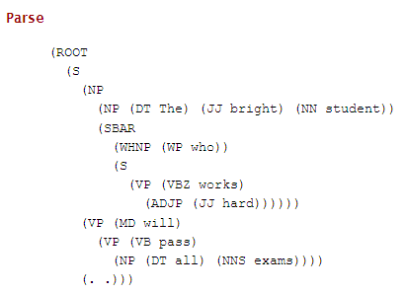
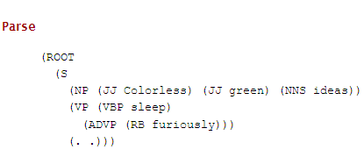
NLP: Deep Parsing for Constituent Trees
Construct syntax-based parse tree of sentence constituents
Use non-deterministic context-free grammars (natural ambiguity)
Use probabilistic grammar (PCFG): likely vs. unlikely parse trees
(trained on corpora, analogously to HMMs)
S
NP
VP
NP
SBAR
WHNP
S
VP
VP
ADVP
NP
NP
The bright student who works hard will pass all exams.
Extensions and variations:
Lexical parser: enhanced with lexical dependencies
(e.g., only specific verbs can be followed by two noun phrases)
Chunk parser: simplified to detect only phrase boundaries

Slide 8
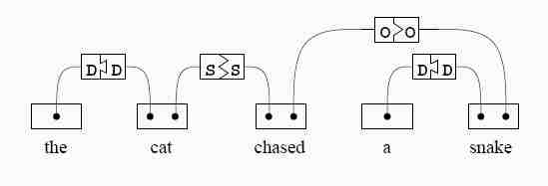
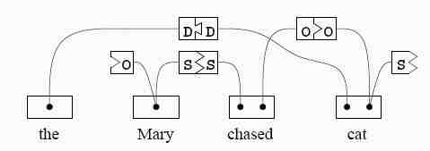
NLP: Link-Grammar-Based Dependency Parsing
Dependency parser based on grammatical rules for left and right connector:
[Sleator/
Temperley
1991]
Rules have form: w1 → left: { A1 | A2 | …} right: { B1 | B2 | …}
w2 → left: { C1 | B1 | …} right: {D1 | D2 | …}
w3 → left: { E1 | E2 | …} right: {F1 | C1 | …}
Parser finds all matches that connect all words into planar graph
(using dynamic programming for search-space traversal).
Extended to probabilistic parsing and error-tolerant parsing.
O(n³) algorithm with many implementation tricks, and grammar size n is huge!

Slide 9
Dependency Parsing Examples (1)
http://www.link.cs.cmu.edu/link/
Selected tags (CMU Link Parser), out of ca. 100 tags (with more variants):
MV connects verbs to modifying phrases like adverbs, time expressions, etc.
O connects transitive verbs to direct or indirect objects
J connects prepositions to objects
B connects nouns with relative clauses

Slide 10
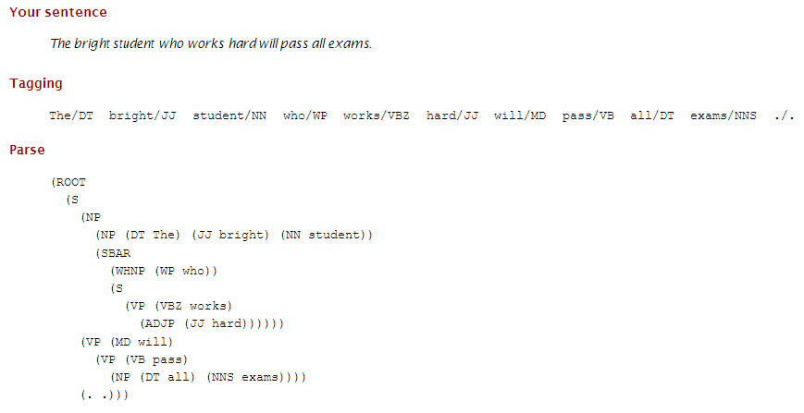
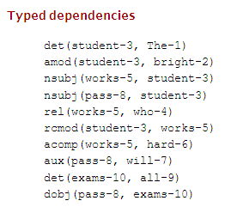
Dependency Parsing Examples (2)
http://nlp.stanford.edu/software/lex-parser.shtml
Selected tags (Stanford Parser), out of ca. 50 tags:
nsubj: nominal subject amod; adjectival modifier
rel: relative rcmod: relative clause modifier
dobj: direct object acomp: adjectival complement
det: determiner poss: possession modifier …

Slide 11
Named Entity Recognition & Coreference Resolution
Named Entity Recognition (NER):
Run text through PoS tagging or stochastic-grammar parsing
Use dictionaries to validate/falsify candidate entities
Example:
The shiny red rocket was fired on Tuesday. It is the brainchild of Dr. Big Head.
Dr. Head is a staff scientist at We Build Rockets Inc.
<person>Dr. Big Head</person>
<person>Dr. Head</person>
<organization>We Build Rockets Inc.</organization>
<time>Tuesday</time>
Coreference resolution (anaphor resolution):
Connect pronouns etc. to subject/object of previous sentence
Examples:
The shiny red rocket was fired on Tuesday. It is the brainchild of Dr. Big Head.
→ … It <reference>The shiny red rocket</reference> is the …
Harry loved Sally and bought a ring. He gave it to her.

Slide 12
Semantic Role Labeling (SRL)
Identify semantic types of events or n-ary relations
based on taxonomy (e.g., FrameNet, VerbNet, PropBank).
Fill components of n-ary tuples (semantic roles, slots of frames).
Example:
Thompson is understood to be accused of importing heroin into the United States.
<event>
<type> drug-smuggling </type>
<destination> <country>United States</country></destination>
<source> unknown </source>
<perpetrator> <person> Thompson </person> </perpetrator>
<drug> heroin </drug>
</event>

Slide 13
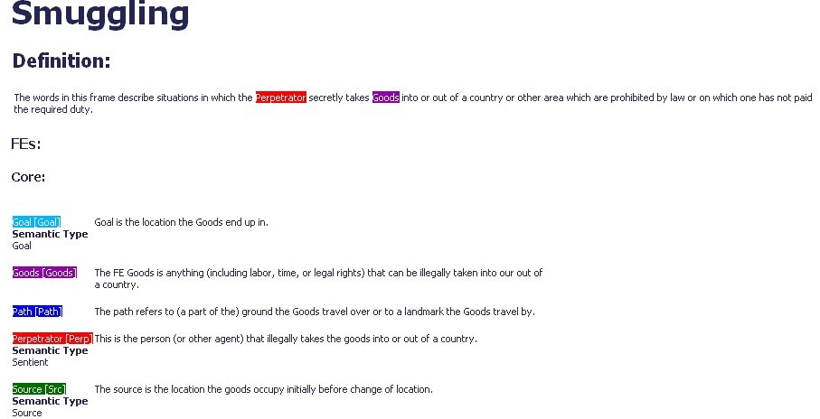
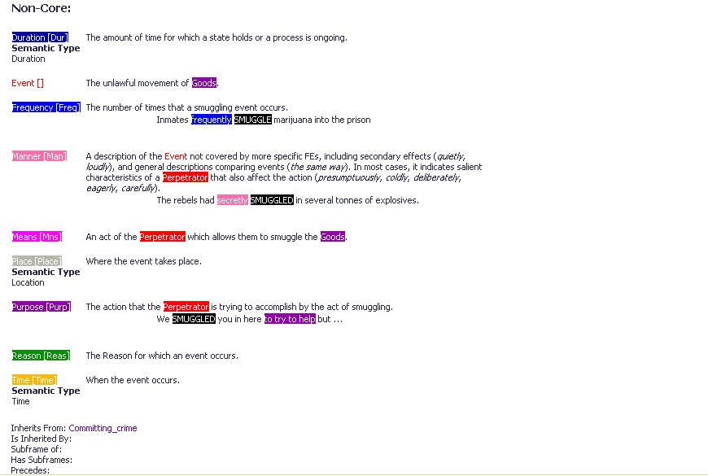
FrameNet Representation for SRL
Source:
http://framenet.icsi.berkeley.edu/

Slide 14
PropBank Representation for SRL
Large collection of annotated newspaper articles;
roles are simpler (more generic) than FrameNet.
Arg0, Arg1, Arg2, … and ArgM with modifiers
LOC: location EXT: extent
ADV: general purpose NEG: negation marker
MOD: modal verb CAU: cause
TMP: time PNC: purpose
MNR: manner DIR: direction
Example:
Revenue edged up 3.4% to $904 million
from $874 million in last year‘s third quarter.
[Arg0: Revenue] increased [Arg2-EXT: by 3.4%] [Arg4: to $904 million ]
[Arg3: from $874 million] [ArgM-TMP: in last year‘s third quarter].
http://verbs.colorado.edu/~mpalmer/projects/ace.html

Slide 15
VI.2.2 Rule-based IE (Wrapper Induction)
Goal:
Identify & extract unary, binary, and n-ary relations as facts
embedded in regularly structured text, to generate entries in
a schematized database.
Approach:
Rule-driven regular expression matching:
Interpret docs from source (e.g., Web site to be wrapped) as
regular language, and specify rules for matching specific types of facts.
Hand-annotate characteristic sample(s) for pattern
Infer rules/patterns (e.g., using W4F (Sahuguet et al.) on IMDB):
movie = html
(.head.title.txt, match/(.*?) [(]/ //title
.head.title.txt, match/.*?[(]([0-9]+)[)]/ //year
.body->td[i:0].a[*].txt //genre
where html.body->td[i].b[0].txt = “Genre”
and ...

Slide 16
LR Rules and Their Generalization
Annotation of delimiters produces many small rules
Generalize by combining rules (via inductive logic programming)
Simplest rule type: LR rule
L token (left neighbor) fact token R token (right neighbor)
pre-filler pattern filler pattern post-filler pattern
Example:
<HTML> <TITLE> Some Country Codes </TITLE> <BODY>
<B> Congo </B> <I> 242 </I> <BR>
<B> Egypt </B> <I> 20 </I> <BR>
<B> France </B> <I> 30 </I> <BR>
</BODY> </HTML>
Should produce binary relation with 3 tuples:
{<Congo, 242>, <Egypt, 20>, <France, 30>}
Rules are:
L=<B>, R=</B> → Country
L=<I>, R=</I> → Code
Generalize rules by combinations (or even FOL formulas).
E.g.: (L=<B> ∨ L=<td>) ∧ isNumeric(token) ∧ … → code
Generalize LR rules into L e1 M e2 R for binary tuple (e1,e2).
Implemented in RAPIER (Califf/Mooney) and other systems.

Slide 17
Advanced Rules: HLRT, OCLR, NHLRT, etc.
Limit application of LR rules to proper contexts
(e.g. to skip over Web page header
<HTML> <TITLE> <B> List of Countries </B> </TITLE> <BODY> <B> Congo ...)
HLRT rules (head left token right tail):
apply LR rule only if inside H … T
OCLR rules (open (left token right)* close):
O and C identify tuple, LR repeated for individual elements.
NHLRT rules (nested HLRT):
apply rule at current nesting level,
or open additional level, or return to higher level.
Incorporate HTML-specific functions and predicates into rules:
inTitleTag(token), tableRowHeader(token), tableNextCol(token), etc.

Slide 18
Set Completion: SEAL
d₂
[Cohen et al.: EMNLP‘09]
Demo: http://boowa.com/
contains
Start with seeds: a few class instances
Find lists, tables, text snippets
(“for example: …”), …
that contain one or more seeds
Extract candidates: noun phrases from vicinity
Gather co-occurrence statistics
(seed&candidate/candidate&class-name pairs)
Rank candidates by similarity to seeds
Point-wise mutual information, …
PageRank-style random walk on seed-cand graph
contains
m₂
contains
extracts
w₁
extracts
m₁
extracts
contains
contains
contains
w₂
contains
d₁
URL: http://www.shopcarparts.com/
Wrapper: .html” CLASS="shopcp">[…] Parts</A> <br>
Content: acura, audi, bmw, buick, chevrolet, …
URL: http://www.hertrichs.com/
Wrapper: <li class=“franchise […]”> <h4><a href=“#”>
Content: acura, audi, chevrolet, chrysler, …

Slide 19
Set Completion: SEAL
d₂
[Cohen et al.: EMNLP‘09]
Demo: http://boowa.com/
contains
Start with seeds: a few class instances
Find lists, tables, text snippets
(“for example: …”), …
that contain one or more seeds
Extract candidates: noun phrases from vicinity
Gather co-occurrence statistics
(seed&candidate/candidate&class-name pairs)
Rank candidates by similarity to seeds
Point-wise mutual information, …
PageRank-style random walk on seed-cand graph
contains
m₂
contains
extracts
w₁
extracts
m₁
extracts
contains
contains
contains
w₂
contains
d₁
But:
Precision drops for classes with sparse statistics (DB profs, …)
Harvested items are names, not entities (no disambiguation)
Not aware of semantic classes

Slide 20
Learning Regular Expressions
Input: hand-tagged examples of a regular language
Learn: (restricted) regular expression for the language
or a finite-state transducer that reads sentences of the language
and outputs the tokens of interest
Example:
This apartment has 3 bedrooms. <BR> The monthly rent is $ 995.
This apartment has 3 bedrooms. <BR> The monthly rent is $ 995.
The number of bedrooms is 2. <BR> The rent is $ 675 per month.
Learned pattern: * Digit * “<BR>” * “$” Number *
Input sentence: There are 2 bedrooms. <BR> The price is $ 500 for one month.
Output tokens: Bedrooms: 2, Price: 500
But: Grammar inference for full-fledged regular languages is hard.
→ Focus on restricted fragments of the class of regular languages.
Implemented in WHISK (Soderland 1999) and a few other systems.

Slide 21
IE as Boundary Classification
Key idea:
Learn classifiers (e.g., SVMs) to recognize start token and end token
for the facts under consideration.
Combine multiple classifiers (ensemble learning) for robustness.
person
Examples:
There will be a talk by Alan Turing at the CS Department at 4 PM.
Prof. Dr. James D. Watson will speak on DNA at MPI on Thursday, Jan 12.
The lecture by Sir Francis Crick will be in the Institute of Informatics this week.
place
time
Classifiers test each token (with PoS tag, LR neighbor tokens, etc.
as features) for two classes: begin-fact, end-fact
Implemented in ELIE system (Finn/Kushmerick).

Slide 22
Properties and Limitations of Rule-based IE
Powerful for wrapping regularly structured Web pages
(typically from same Deep-Web site)
Many complications on real-life HTML
(e.g. misuse of HTML tables for layout)
→ Use classifiers to distinguish good vs. bad HTML
Flat view of input limits the sample annotation
→ Consider hierarchical document structure: XHTML/XML
Learn extraction patterns for restricted regular languages
(ELog extraction language combines concepts of XPath & FOL,
see e.g. Lixto (Gottlob et al.), Roadrunner (Crescenzi/Mecca))
Regularities with exceptions difficult to capture
→ Learn positive and negative cases (and use statistical models)

Slide 23
VI.2.3 Learning-based IE
For heterogeneous sources and for natural-language text:
NLP techniques (PoS tagging, parising) for tokenization
Identify patterns (regular expressions) as features
Train statistical learners for segmentation and labeling
(HMM, CRF, SVM, etc.), augmented with lexicons
Use learned model to automatically tag new input sentences
Training data:
The WWW conference takes place in Banff in Canada.
Today’s keynote speaker is Dr. Berners-Lee from W3C.
The panel in Edinburgh, chaired by Ron Brachman from Yahoo!, …
…
<location>
<organization>
<person>
<event>
<lecture>
NP
NP
NN
IN
DT
NP
VB
IN
DT
ADJ
NN
PP
NP
IN
CD
Ian Foster, father of the Grid, talks at the GES conference in Germany on 05/02/07.
<person>
<event>
<location>
<date>

Slide 24
Text Segmentation and Labeling
Source: concatenation of structured elements with limited reordering and some missing fields
Example: addresses, bibliographic records
House number
Building
Road
City
State
Zip
4089 Whispering Pines Nobel Drive San Diego CA 92122
Author
Year
Title
Journal
Volume
Page
P.P.Wangikar, T.P. Graycar, D.A. Estell, D.S. Clark, J.S. Dordick (1993) Protein and Solvent Engineering of Subtilising BPN' in Nearly Anhydrous Organic Media J.Amer. Chem. Soc. 115, 12231-12237.
Source: Sunita Sarawagi:
Information Extraction Using HMMs,
http://www.cs.cmu.edu/~wcohen/10-707/talks/sunita.ppt

Slide 25
Hidden Markov Models (HMMs)
Idea:
Text doc is assumed to be generated by a regular grammar (i.e., a FSA)
with some probabilistic variation and uncertainty.
→ Stochastic FSA = Markov model
HMM – intuitive explanation:
Associate with each state a tag or symbol category (e.g., noun, verb,
phone number, person name) that matches some words in the text.
The instances of the category are given by a probability
distribution of possible outputs/labels in this state.
The goal is to find a state sequence from a start to an end state
with maximum probability of generating the given text.
The outputs are known, but the state sequence cannot be observed,
hence the name hidden Markov model

Slide 26
Hidden Markov Model (HMM): Formal Definition
An HMM is a discrete-time, finite-state Markov model with
state set S = (s₁, ..., s_{n}) and the state in step t denoted X(t),
initial state probabilities p_{i} (i=1, ..., n),
transition probabilities p_{ij}: S×S→[0,1], denoted p(s_{i}→s_{j}),
output alphabet Σ = {w₁, ..., w_{m}}, and
state-specific output probabilities q_{ik}: S×Σ →[0,1], denoted q(s_{i} ↑w_{k})
(or transition-specific output probabilities).
Probability of emitting output sequence o₁... o_{T} ∈ Σ^{T} is:
with

Slide 27
Three Major Issues for HMMs [Rabiner’89]
Compute probability of output sequence (for known parameters)
→ forward/backward computation
Compute most likely state sequence (decoding)
(for given output and known parameters)
→ Viterbi algorithm
(dynamic programming with memoization,
alternates forward and backward computations)
Estimate parameters (transition prob’s, output prob’s)
from training data (output sequences only)
→ Baum-Welch algorithm (specific form of EM)

Slide 28
HMM Forward/Backward Computation
Probability of emitting output o₁... o_{T} ∈ Σ^{T} is:
with
→ A naive computation would require O(n^{T}) operations!
Better approach: compute iteratively with clever caching and reuse of
intermediate results (“memoization”) → requires O(n² T) operations!
Begin:
Induction:
Similar approach also for backward computation:
Begin:
Induction:
Note:
and

Slide 29
HMM Example
Goal: Label the tokens in the sequence
“Max-Planck-Institute Stuhlsatzenhausweg 85”
with the labels Name, Street, and Number.
→ Σ = {“MPI”, “St.”, “85”} // output alphabet
S = {Name, Street, Number} // (hidden) states
p_{i} = {0.6, 0.3, 0.1} // initial state probabilities (connected to Start state),
all other transition and emission prob. are
depicted in the HMM figure
0.1
0.3
0.3
0.2
0.4
0.1
Start
0.6
Name
Street
Number
End
0.5
0.4
0.4
0.2
0.4
0.1
0.7
0.8
1.0
0.2
0.3
“MPI”
“St.”
“85”

Slide 30
Trellis Diagram for HMM Example
t=1
t=2
t=3
Name
Name
Name
Start
Street
Street
Street
End
Number
Number
Number
“MPI”
“St”
“85”
Forward prob’s:
α_{Name}(1) = 0.6
α_{Street}(1) = 0.3
α_{Number}(1) = 0.1
α_{Name}(2) = 0.6 · 0.2 · 0.7
+ 0.3 · 0.2 · 0.2
+ 0.1 · 0.1 · 0.0 = 0.096
α_{Street}(2) = 0.6 · 0.5 · 0.7
+ 0.3 · 0.4 · 0.2
+ 0.1 · 0.4 · 0.0 = 0.234
α_{Number}(2) = 0.6 · 0.3 · 0.7
+ 0.3 · 0.4 · 0.2
+ 0.1 · 0.1 · 0.0 = 0.15
α_{Name}(3) = 0.096 · 0.2 · 0.3
+ 0.234 · 0.2 · 0.8
+ 0.15 · 0.1 · 0.0
= 0.0432
…
A similar computation for backward prob’s yields the marginals P[o₁,…,o_{T}, X(t)=i] and P[o₁,…,o_{T}].
Note: The entire sequence o₁,…,o_{T} is emitted by reaching the End state at time T+1.

Slide 31
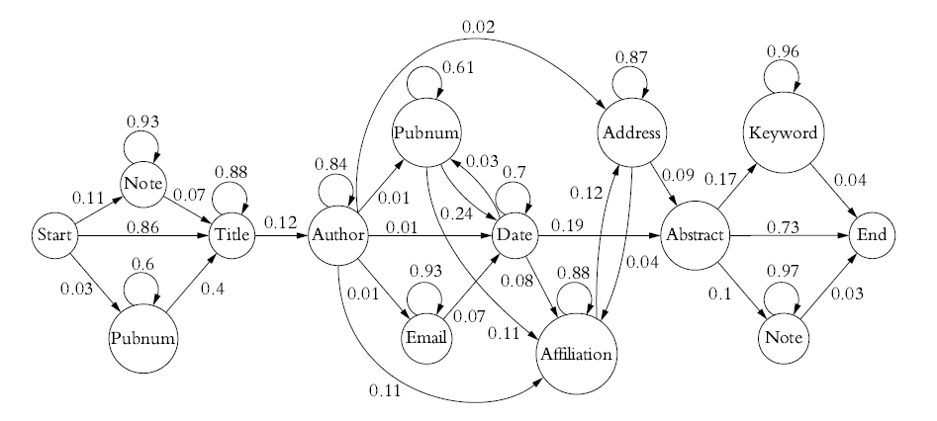
Larger HMM for Bibliographic Records
Source: Soumen Chakrabarti, Tutorial at WWW 2009

Slide 32
Viterbi Algorithm: Finding the Most Likely State Sequence
Find
Viterbi algorithm (dynamic programming):
prob:
iterate for
t = 1, ..., T
state:
Store argmax in each step;
alternate between forward computation (for δ)
and backward computation (for ψ).

Slide 33
Training of HMM
Simple case: with fully tagged training sequences
→ Simple MLE for HMM parameters:
Standard case: training with unlabeled sequences
(output sequence only, state sequence unknown)
→ EM (Baum-Welch algorithm)
Note: There exist also some works for learning the structure of an HMM (#states, connections, etc.), but this remains very difficult and computationally expensive!

Slide 34
Problems and Extensions of HMMs
Individual output letters/word may not show learnable patterns.
Output words can be entire lexical classes
(e.g., numbers, zip codes, etc.).
Geared for flat sequences, not for structured text docs.
→ Use nested HMM where each state can hold another HMM
Cannot capture long-range dependencies
(e.g., in addresses: with first word being “Mr.” or “Mrs.” the
probability of later seeing a P.O. box rather than a street address
would decrease substantially).
Use dictionary lookups in critial states and/or
combine HMMs with other techniques for long-range effects.
→ Use conditional random fields (CRFs) or semi-Markov models.

Slide 35
Conditional Random Fields (CRFs)
Key extensions over HMMs:
Exploit complete symbol sequence for predicting state transition,
not just last symbol
Use feature functions over entire input sequence.
(e.g., hasCap, isAllCap, hasDigit, isDate, firstDigit,
isGeoname, hasType, afterDate, directlyPrecedesGeoname, etc.)
For symbol sequence x=x₁…x_{k} and state sequence y=y₁..y_{k}
HMM models joint distr. P[x,y] = Π_{i=1..k} P[y_{i}|y_{i-1}]*P[x_{i}|y_{i}]
CRF models conditional distr. P[y|x]
with conditional independence of non-adjacent y_{i}‘s given x
y₁
y₂
y₃
…
y_{k}
y₁
y₂
y₃
…
y_{k}
HMM
CRF
x₁
x₂
x₃
…
x_{k}
x₁
x₂
x₃
…
x_{k}

Slide 36
Conditional Random Fields (CRFs)
Graph structure of conditional-independence assumptions leads to:
where j ranges over feature functions and Z(x) is a normalization constant
(similar to inference in graphical models, e.g., Markov Random Fields).
Parameter estimation with n training sequences:
MLE with regularization
Inference of most likely (x,y) for given x:
→ Dynamic programming (forward/backward, Viterbi)

Slide 37
Beyond CRFs
Exploit constraints on the sequence structure.
Examples:
In a postal address, there is exactly one zip code.
The city name is fully functionally dependent on the zip code.
In a bibliographic record, there is at most one journal name.
Markov Random Fields with cross-dependencies
Probabilistic models with constraints
Constrained Conditional Models (CCMs)
(http://cogcomp.cs.illinois.edu/page/project_view/22)
Markov Logic Networks
(http://alchemy.cs.washington.edu/)
Joint inference in generic graphical models via factor graphs
(http://code.google.com/p/factorie/,
http://research.microsoft.com/en-us/um/cambridge/projects/infernet/)

