Slide 1
Algorithmic Basics of
DPLL, DPLL(T) based
Satisfiability Modulo Theories
Solving
Nikolaj Bjørner
Microsoft Research
VTSA 2014
Luxembourg, October 30-31 2014

Slide 2
Overall Plan
Lecture 1: Algorithmic Basics of DPLL DPLL(T) based SMT solving
Lecture 2: Horn Clauses, Introduction
Lecture 3: Methods for solving Horn Clauses
Lecture 4: Methods for solving Horn Clauses

Slide 3
Plan
Progress in automated reasoning
SAT, Automated Theorem Proving, SMT
2. Integrating Theories
3. An abstract account for SMT search (DPLL+T)
Takeaway: Theorem Proving is cool

Slide 4
Symbolic Engines: SAT, FTP and SMT
SAT: Propositional Satisfiability.
(Tie ∨ Shirt) ∧ ( ¬Tie ∨ ¬Shirt) ∧ (¬Tie ∨ Shirt)
FTP: First-order Theorem Proving.
∀X,Y,Z [X*(Y*Z) = (X*Y)*Z]
∀X [X*inv(X) = e] ∀X [X*e = e]
SMT: Satisfiability Modulo background Theories
b + 2 = c ∧ A[3] ≠ A[c-b+1]

Slide 5
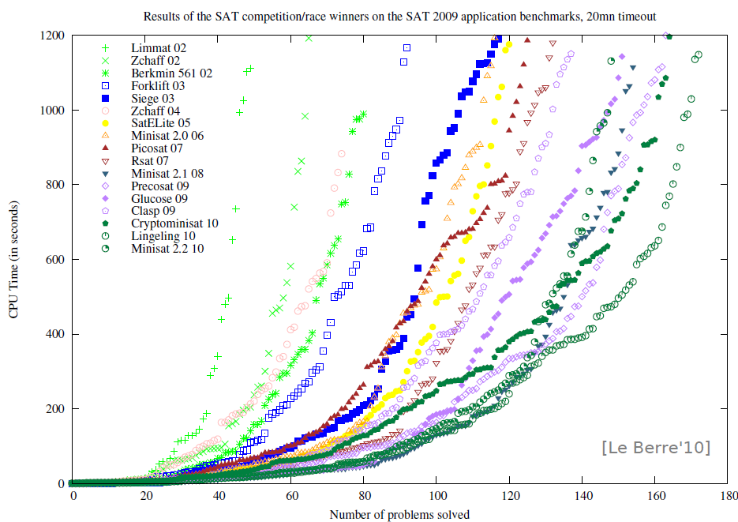
SAT - Milestones
Problems impossible 10 years ago are trivial today
year | Milestone
1960 | Davis-Putnam procedure
1962 | Davis-Logeman-Loveland
1984 | Binary Decision Diagrams
1992 | DIMACS SAT challenge
1994 | SATO: clause indexing
1997 | GRASP: conflict clause learning
1998 | Search Restarts
2001 | zChaff: 2-watch literal, VSIDS
2005 | Preprocessing techniques
2007 | Phase caching
2008 | Cache optimized indexing
2009 | In-processing, clause management
2010 | Blocked clause elimination
Concept
2002
2010
Millions of
variables from
HW designs
Courtesy Daniel le Berre

Slide 6
FTP - Milestones
Year | Milestone | Who | Year | Milestone | Who
1930 | Hebrand's theorem | Herbrand | 1970 | Completion and saturation procedures | many people and provers
1934 | Sequent calculi | Gentzen | 1970 | Knuth-Bendix ordering | Knuth; Bendix
1934 | Inverse method | Gentzen | 1971 | Selection function | Kowalski; Kuehner
1955 | Semantic tableaux | Beth | 1972 | Built-in equational theories | Plotkin
1960 | Herbrand-based theorem proving | Wang Hao | 1972 | Prolog | Colmerauer
1960 | Ordered resolution | Davis; Putnam | 1974 | Saturation algorithms | Overbeek
1962 | DLL | Davis; Logemann; Loveland | 1975 | Completeness of paramodulation | Brand
1963 | First-order inverse method | Maslov | 1975 | AC-unification | Stickel
1965 | Unification | J. Robinson | 1976 | Resolution as a decision procedure | Joyner
1965 | First-order resolution | J. Robinson | 1979 | Basic paramodulation | Degtyarev
1965 | Subsumption | J. Robinson | 1980 | Lexicographic path orderings | Kamin; Levy
1967 | Orderings | Slagle | 1985 | Theory resolution | Stickel
1967 | Demodulation or rewriting | Wos; G. Robinson; Carson; Shalla | 1986 | Definitional clause form transformation | Plaisted; Greenbaum
1968 | Model elimination | Loveland | 1988 | Superposition | Zhang
1969 | Paramodulation | G. Robinson; Wos | 1988 | Model construction | Zhang
 |  |  | 1989 | Term indexing | Stickel; Overbeek
 |  |  | 1990 | General theory of redundancy | Bachmair; Ganzinger
 |  |  | 1992 | Basic superposition | Nieuwenhuis; Rubio
 |  |  | 1993 | First instance-based methods | Billon; Plaisted
 |  |  | 1993 | Discount saturation algorithm | Avenhaus; Denzinger
 |  |  | 1998 | Finite model finding using SAT | McCune
 |  |  | 2000 | First-order DPLL | Baumgartner
 |  |  | 2003 | iProver method | Ganzinger; Korovin
 |  |  | 2008 | Sine selection | Hoder
Some success stories:
Open Problems (of 25 years):
XCB: X ≡ ((X ≡ Y) ≡ (Z ≡ Y)) ≡ Z)
is a single axiom for equivalence
Knowledge Ontologies
GBs of formulas
Courtesy Andrei Voronkov, U of Manchester

Slide 7
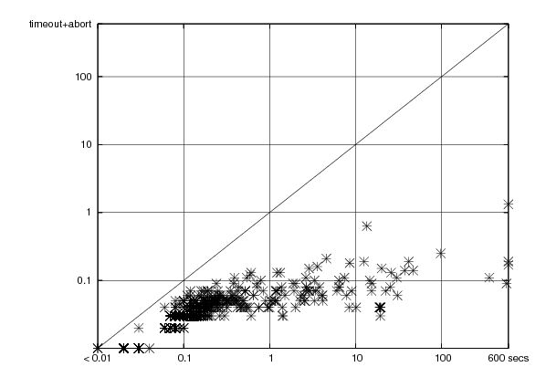
SMT - Milestones
year | Milestone
1977 | Efficient Equality Reasoning
1979 | Theory Combination Foundations
1979 | Arithmetic + Functions
1982 | Combining Canonizing Solvers
1992-8 | Systems: PVS, Simplify, STeP, SVC
2002 | Theory Clause Learning
2005 | SMT competition
2006 | Efficient SAT + Simplex
2007 | Efficient Equality Matching
2009 | Combinatory Array Logic, …
Z3
(of ’07)
Time
On
Boogie
Regression
1sec
Simplify (of ’01) time
Z3
Time
On
VCC
Regression
Includes progress from SAT:
SAT
Theory
Solvers
SMT
15KLOC + 285KLOC = Z3
Nov 08
March 09

Slide 8
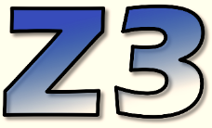
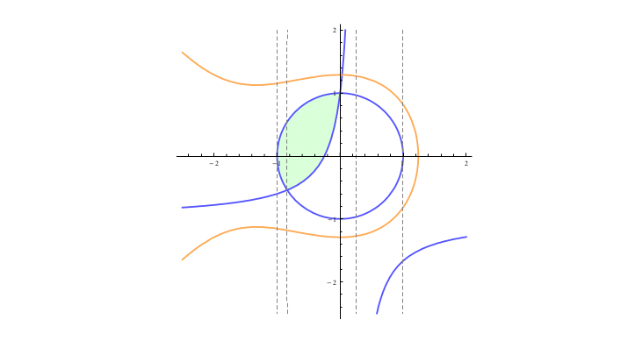

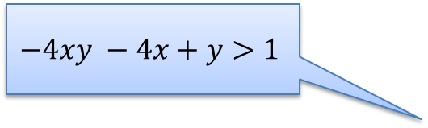
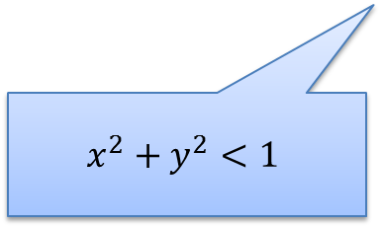
News: Solving ∃R Efficiently
A key idea: Use partial solution to guide the search
Feasible Region
$$x^{3}+2x^{2}+3y^{2}−5<0$$
$$−4xy −4x+y>1$$
x = 0.5
Extract small core
$$x^{2}+y^{2}<1$$
Dejan Jojanovich & Leonardo de Moura, IJCAR 2012

Slide 9
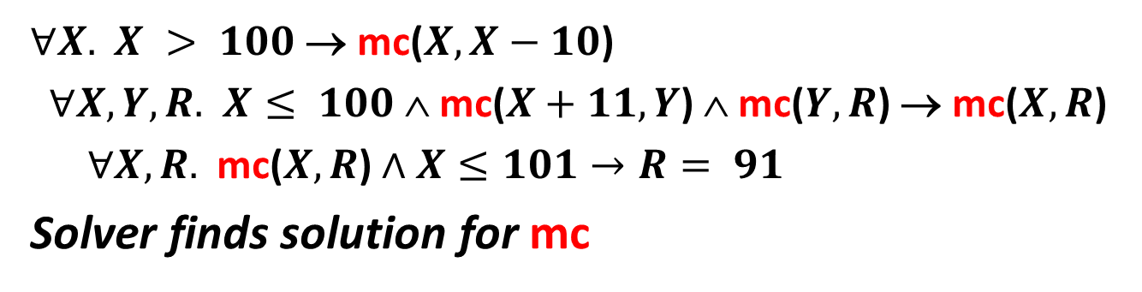
News: Horn Clause Satisfiability
mc(x) = x-10 if x > 100
mc(x) = mc(mc(x+11)) if x ≤ 100
assert (x ≤ 101 ⇒ mc(x) = 91)
$∀X.$ $X > 100$→ mc($X,X−10$)
$∀X,Y,R.$ $X≤ 100$∧ mc($X+11,Y$) ∧ mc($Y,R$) → mc($X,R$)
$∀X,R.$ mc($X,R$) $∧X≤101→R= 91$
Solver finds solution for mc
Krystof Hoder & Nikolaj Bjorner, SAT 2012
Bjorner, McMillan, Rybalchenko, SMT 2012

Slide 10
Digression: naïve All-SAT

Slide 11
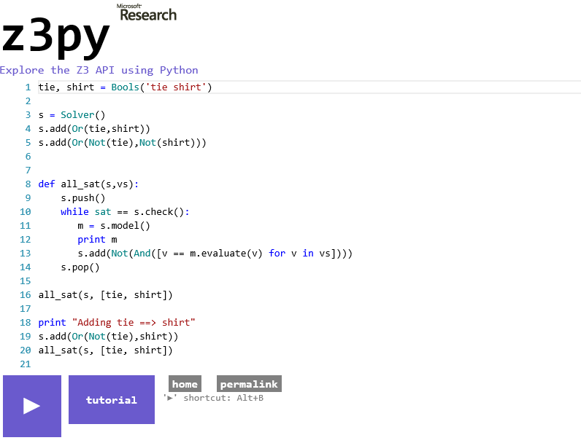

Slide 12
SMT solving

Slide 13

SMT : Basic Architecture
SAT
Theory
Solvers
SMT
Equality + UF
Arithmetic
Bit-vectors
…
Case Analysis

Slide 14
SAT + Theory solvers
Basic Idea
x ≥ 0, y = x + 1, (y > 2 ∨ y < 1)
Abstract (aka “naming” atoms)
p₁, p₂, (p₃ ∨ p₄)
p₁ ≡ (x ≥ 0), p₂ ≡ (y = x + 1),
p₃ ≡ (y > 2), p₄ ≡ (y < 1)

Slide 15
SAT + Theory solvers
Basic Idea
x ≥ 0, y = x + 1, (y > 2 ∨ y < 1)
Abstract (aka “naming” atoms)
p₁, p₂, (p₃ ∨ p₄)
p₁ ≡ (x ≥ 0), p₂ ≡ (y = x + 1),
p₃ ≡ (y > 2), p₄ ≡ (y < 1)
SAT
Solver

Slide 16
SAT + Theory solvers
Basic Idea
x ≥ 0, y = x + 1, (y > 2 ∨ y < 1)
Abstract (aka “naming” atoms)
p₁, p₂, (p₃ ∨ p₄)
p₁ ≡ (x ≥ 0), p₂ ≡ (y = x + 1),
p₃ ≡ (y > 2), p₄ ≡ (y < 1)
SAT
Solver
Assignment
p₁, p₂, ¬p₃, p₄

Slide 17
SAT + Theory solvers
Basic Idea
x ≥ 0, y = x + 1, (y > 2 ∨ y < 1)
Abstract (aka “naming” atoms)
p₁, p₂, (p₃ ∨ p₄)
p₁ ≡ (x ≥ 0), p₂ ≡ (y = x + 1),
p₃ ≡ (y > 2), p₄ ≡ (y < 1)
SAT
Solver
Assignment
p₁, p₂, ¬p₃, p₄
x ≥ 0, y = x + 1,
¬(y > 2), y < 1

Slide 18
SAT + Theory solvers
Basic Idea
x ≥ 0, y = x + 1, (y > 2 ∨ y < 1)
Abstract (aka “naming” atoms)
p₁, p₂, (p₃ ∨ p₄)
p₁ ≡ (x ≥ 0), p₂ ≡ (y = x + 1),
p₃ ≡ (y > 2), p₄ ≡ (y < 1)
SAT
Solver
Assignment
p₁, p₂, ¬p₃, p₄
x ≥ 0, y = x + 1,
¬(y > 2), y < 1
Unsatisfiable
x ≥ 0, y = x + 1, y < 1
Theory
Solver

Slide 19
SAT + Theory solvers
Basic Idea
x ≥ 0, y = x + 1, (y > 2 ∨ y < 1)
Abstract (aka “naming” atoms)
p₁, p₂, (p₃ ∨ p₄)
p₁ ≡ (x ≥ 0), p₂ ≡ (y = x + 1),
p₃ ≡ (y > 2), p₄ ≡ (y < 1)
SAT
Solver
Assignment
p₁, p₂, ¬p₃, p₄
x ≥ 0, y = x + 1,
¬(y > 2), y < 1
New Lemma
¬p₁∨¬p₂∨¬p₄
Unsatisfiable
x ≥ 0, y = x + 1, y < 1
Theory
Solver

Slide 20
SAT + Theory solvers
New Lemma
¬p₁∨¬p₂∨¬p₄
Unsatisfiable
x ≥ 0, y = x + 1, y < 1
Theory
Solver
AKA
Theory conflict

Slide 21
SAT/SMT solving using DPLL(T)
[Davis Putnam Logeman Loveland modulo theories]

Slide 22
Mile High: Modern SAT/SMT search
Backjump
Models
literal assignments
Proofs
Conflict Clauses
Conflict Resolution
Propagate

Slide 23
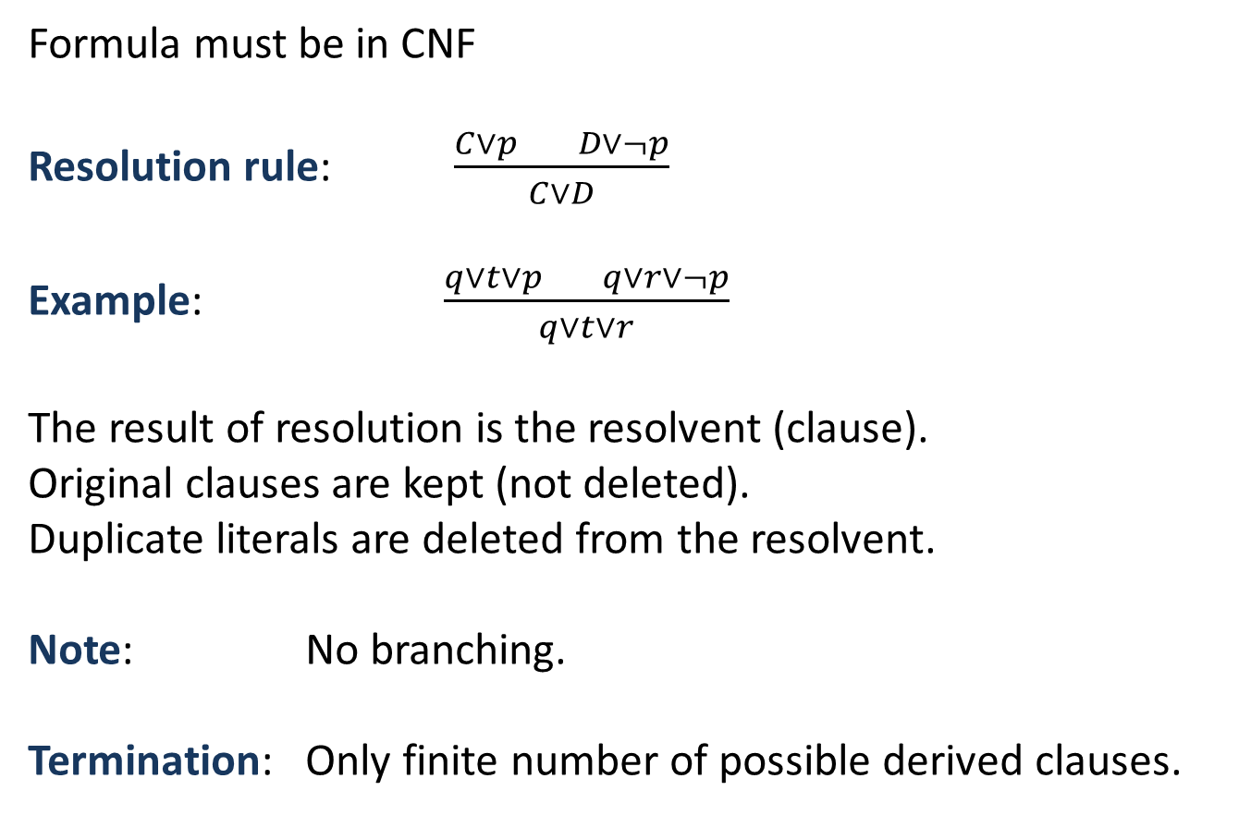
Resolution
Formula must be in CNF
Resolution rule: $\frac{C∨p D∨¬p}{C∨D}$
Example: $\frac{q∨t∨p q∨r∨¬p}{q∨t∨r}$
The result of resolution is the resolvent (clause).
Original clauses are kept (not deleted).
Duplicate literals are deleted from the resolvent.
Note: No branching.
Termination: Only finite number of possible derived clauses.

Slide 24
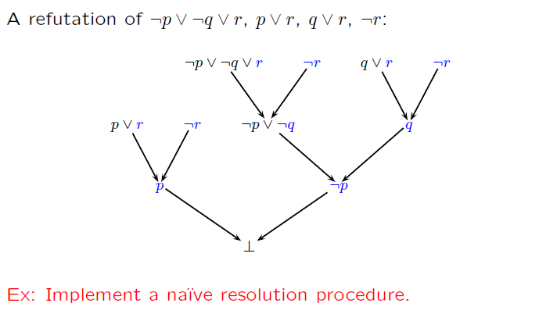
Resolution (example)

Slide 25
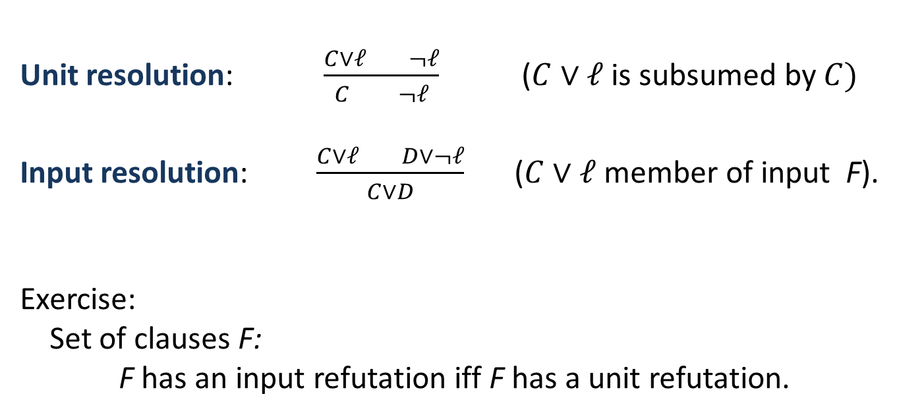
Unit & Input Resolution
Unit resolution: $\frac{C∨ℓ ¬ℓ}{C ¬ℓ}$ ($C∨ℓ$is subsumed by $C)$
Input resolution: $\frac{C∨ℓ D∨¬ℓ}{C∨D}$ ($C∨ℓ$ member of input F).
Exercise:
Set of clauses F:
F has an input refutation iff F has a unit refutation.

Slide 26
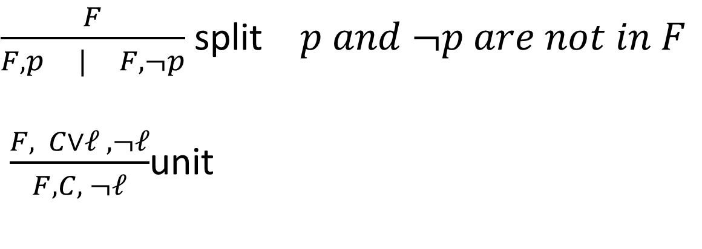
DPLL
DPLL: David Putnam Logeman Loveland = Unit resolution + split rule.
$\frac{F}{F,p | F, ¬p}$ split $p and ¬p are not in F$
$\frac{F, C∨ℓ , ¬ℓ}{F, C, ¬ℓ}$unit
Ingredient of most efficient SAT solvers

Slide 27
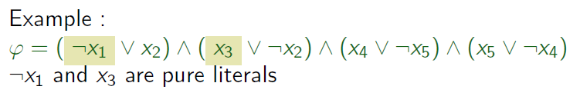
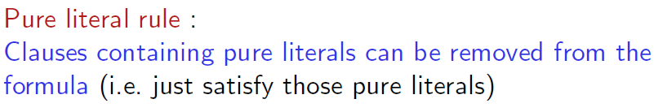

Pure Literals
A literal is pure if only occurs positively or negatively.

Slide 28
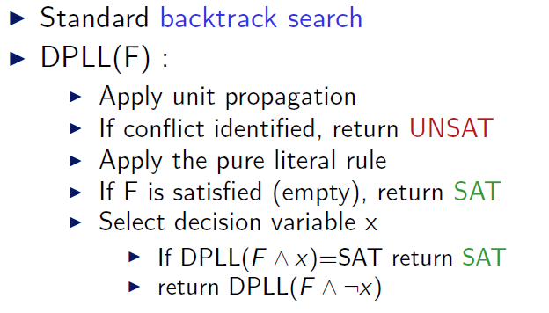
DPLL (as a procedure)

Slide 29
DPLL
M | F
Partial model
Set of clauses

Slide 30
DPLL
Guessing
  p | p ∨ q, ¬q ∨ r
  p, ¬q | p ∨ q, ¬q ∨ r

Slide 31
DPLL
Deducing
  p | p ∨ q, ¬p ∨ s
  p, s| p ∨ q, ¬p ∨ s

Slide 32
DPLL
Backtracking
  p, ¬s, q | p ∨ q, s ∨ q, ¬p∨ ¬q
  p, s | p ∨ q, s ∨ q, ¬p∨ ¬q

Slide 33
Modern DPLL
Non-chronological backtracking (backjumping)
Lemma learning
and
Efficient indexing (two-watch literal)
…

Slide 34
CDCL – Conflict Directed Clause Learning
Lemma learning
  ¬t, p, q, s | t ∨ ¬p ∨ q, ¬q ∨ s, ¬p∨ ¬s
  ¬t, p, q, s | t ∨ ¬p ∨ q, ¬q ∨ s, ¬p∨ ¬s |¬p∨ ¬s
  ¬t, p, q, s | t ∨ ¬p ∨ q, ¬q ∨ s, ¬p∨ ¬s |¬p∨ ¬q
  ¬t, p, q, s | t ∨ ¬p ∨ q, ¬q ∨ s, ¬p∨ ¬s |¬p∨ t

Slide 35
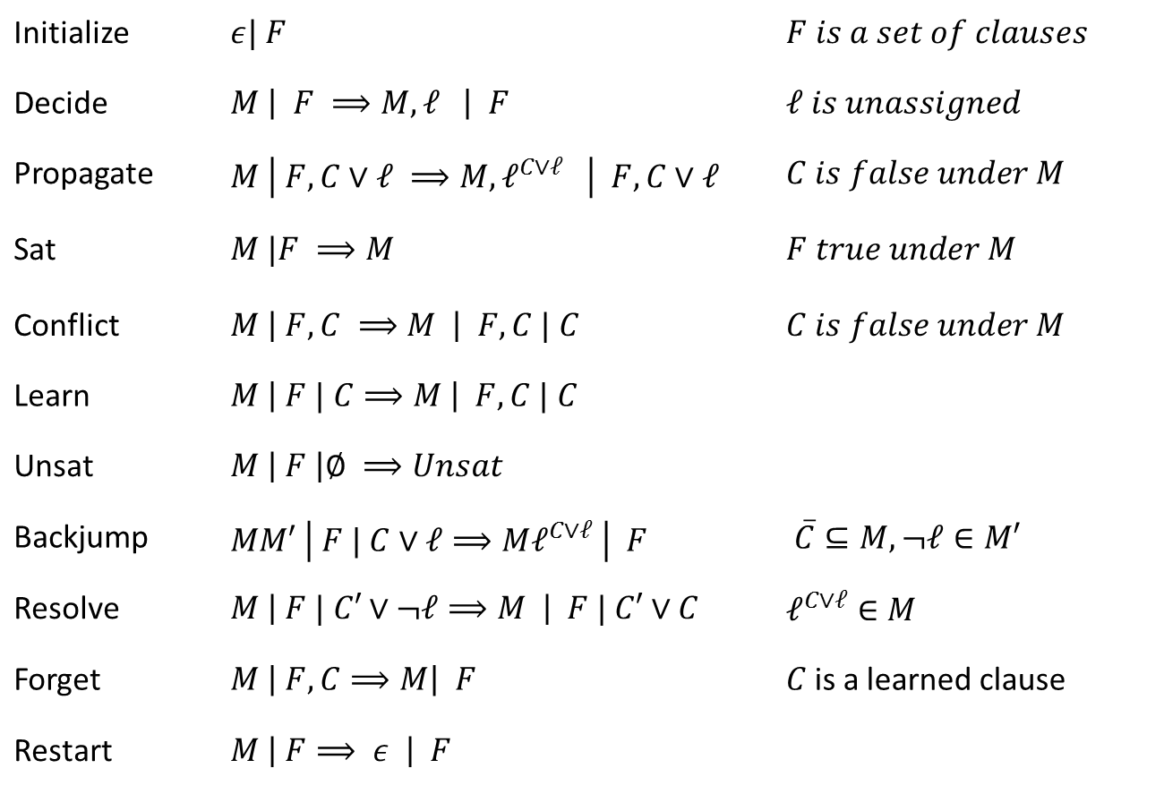
Core Engine in Z3:
Modern DPLL/CDCL
“It took me a year to understand the Mini-SAT FUIP code”
Mate Soos to
Niklas Sörenson
over ice-cream in Trento
Initialize | $ε| F$ | $F is a set of clauses$
Decide | $M \left| F ⟹M, ℓ \right| F$ | $ℓ is unassigned$
Propagate | $M \left| F, C∨ℓ ⟹M, ℓ^{C∨ℓ} \right| F,C∨ℓ$ | $C is false under M$
Sat | $M |F ⟹M$ | $F true under M$
Conflict | $M \left| F, C ⟹M \right| F,C | C$ | $C is false under M$
Learn | $M \left| F | C⟹M \right| F, C | C$
Unsat | $M \left| F \right|∅ ⟹Unsat$
Backjump | $MM′ \left| F | C∨ℓ⟹Mℓ^{C∨ℓ} \right| F$ | $\overline{C}⊆M, ¬ℓ∈M′$
Resolve | $M \left| F | C′∨¬ℓ⟹M \right| F | C′∨C$ | $ℓ^{C∨ℓ}∈M$
Forget | $M \left| F, C⟹M\right| F$ | $C$is a learned clause
Restart | $M \left| F⟹ ε \right| F$
Model
Proof
We will now motivate the CDCL algorithm
as a cooperative procedure between model and proof search
Conflict
Resolution
[Nieuwenhuis, Oliveras, Tinelli J.ACM 06] customized

Slide 36
Mile High: Modern SAT/SMT search
Backjump
Models
literal assignments
Proofs
Conflict Clauses
Conflict Resolution
Propagate

Slide 37
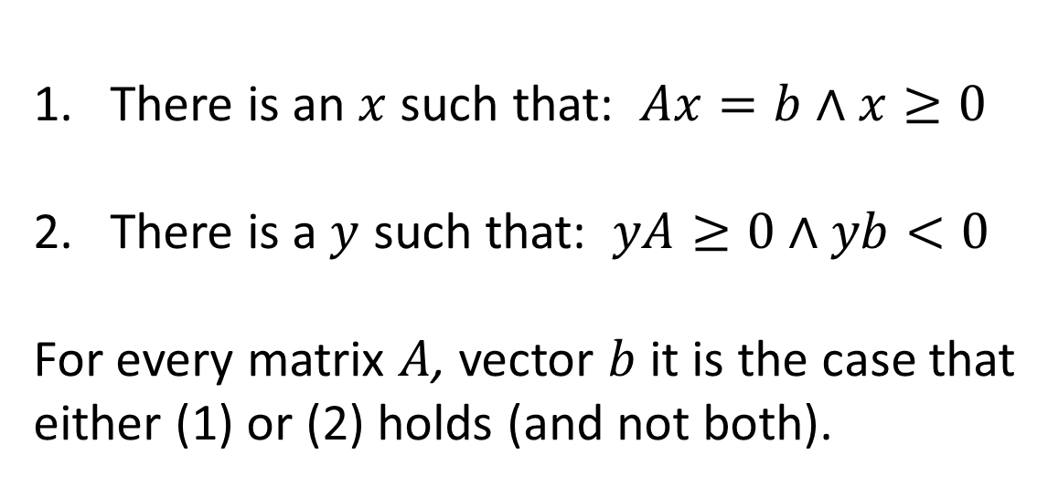
The Farkas Lemma Dichotomy
There is an $x$ such that: $Ax=b∧x≥0$
There is a $y$ such that: $yA≥0∧yb<0$
For every matrix $A$, vector $b$ it is the case that
either (1) or (2) holds (and not both).

Slide 38
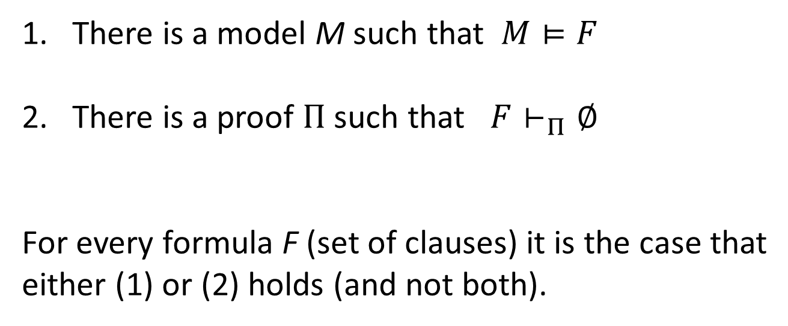
A Dichotomy of Models and Proofs
There is a model M such that $M⊨F$
There is a proof $Π$ such that $F⊢_{Π}∅$
For every formula F (set of clauses) it is the case that
either (1) or (2) holds (and not both).

Slide 39
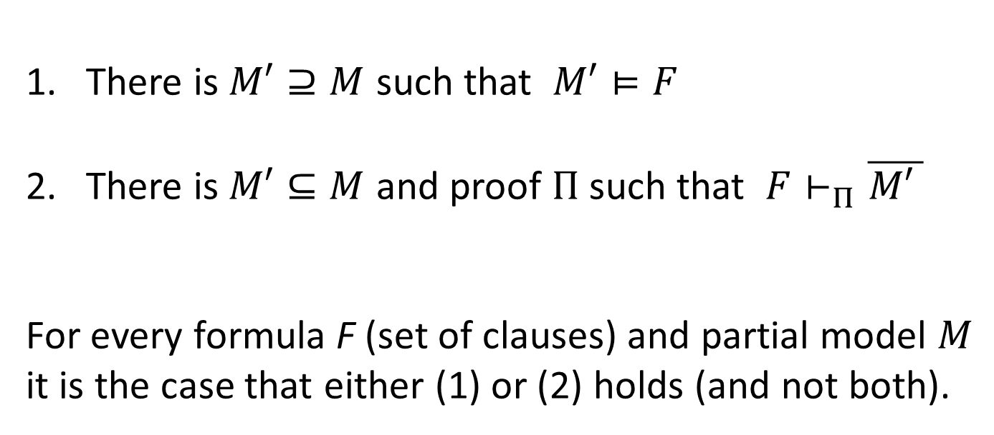
A Dichotomy of Models and Proofs
There is $M′⊇M$ such that $M′⊨F$
There is $M′⊆M$ and proof $Π$ such that $F⊢_{Π}\overline{M\text{′} }$
For every formula F (set of clauses) and partial model $M$
it is the case that either (1) or (2) holds (and not both).

Slide 40
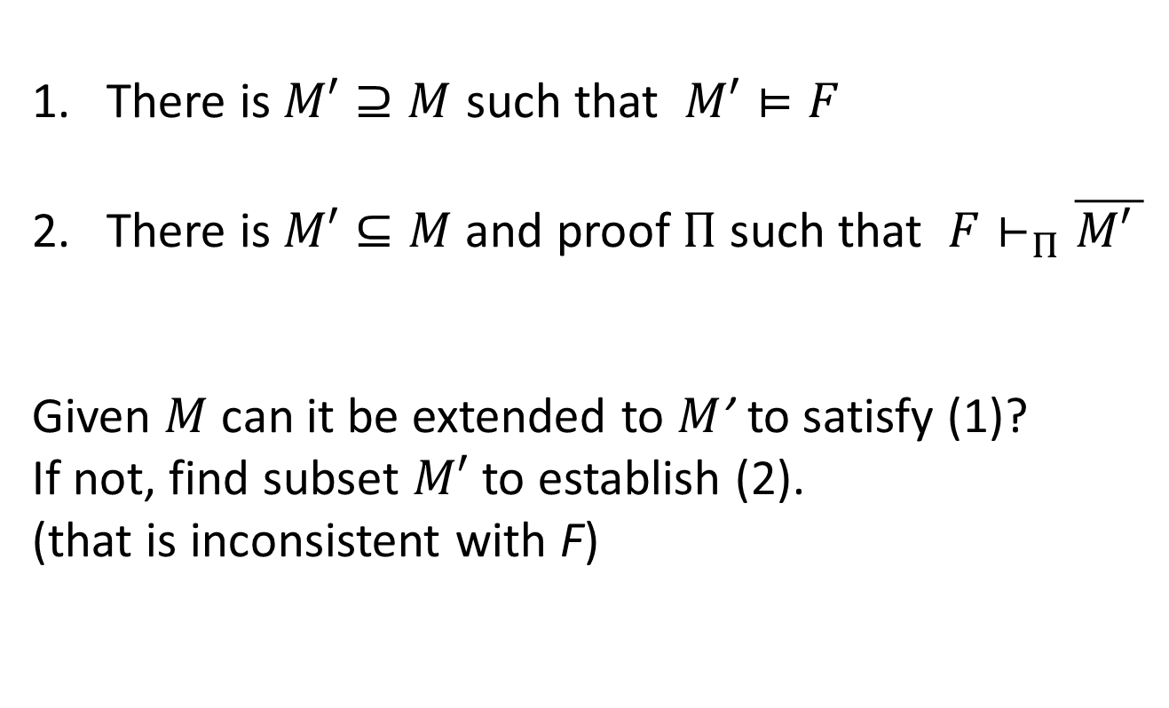
A Dichotomy of Models and Proofs
There is $M′⊇M$ such that $M′⊨F$
There is$M′⊆M$ and proof $Π$ such that $F⊢_{Π}\overline{M\text{′} }$
Given $M$ can it be extended to $M$’ to satisfy (1)?
If not, find subset $M′$ to establish (2).
(that is inconsistent with F)

Slide 41
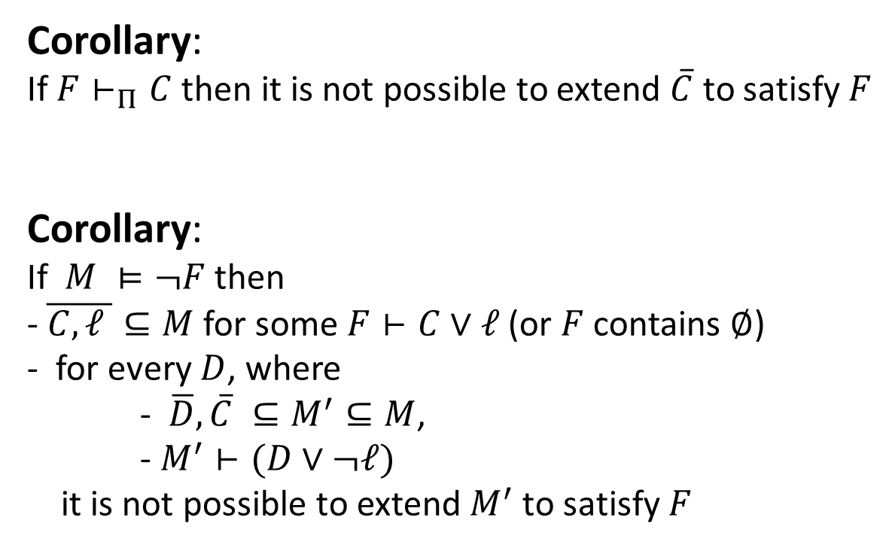
A Dichotomy of Models and Proofs
Corollary:
If $F⊢_{Π}C$ then it is not possible to extend $\overline{C}$ to satisfy $F$
Corollary:
If $M ⊨¬F$ then
- $\overline{C,ℓ }⊆M$ for some $F⊢C∨ℓ$ (or $F$ contains $∅$)
- for every $D$, where
- $\overline{D},\overline{C} ⊆M^{′}⊆M$,
- $M^{′}⊢(D∨¬ℓ)$
it is not possible to extend${ M}^{′}$ to satisfy $F$

Slide 42

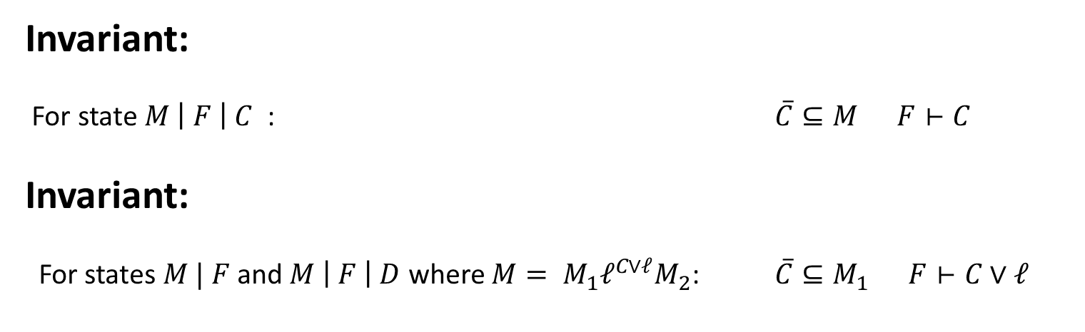
CDCL Search – Data structures
Partial Model:
Sequence of literals
Decision lits:
case splits
Propagation lits:
only one case
makes sense.
$$M | F$$
Formula:
set of clauses
Proof: Implicit
Consequences added to F
Invariant:
For state $M \left| F \right| C$ : $\overline{C}⊆M F⊢C$
Invariant:
For states $M | F$and $M \left| F \right| D$ where ${M= M}_{1}ℓ^{C∨ℓ}M_{2}$: $\overline{C}⊆M_{1} F⊢C∨ℓ$

Slide 43
CDCL steps
Initialize | $ε| F$ | $F is a set of clauses$
No model candidate has been fixed

Slide 44
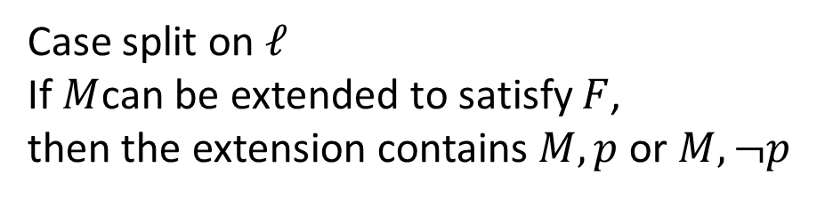
CDCL steps
Decide | $M \left| F ⟹M, ℓ \right| F$ | $ℓ is unassigned$
Case split on $ℓ$
If $M$can be extended to satisfy $F$,
then the extension contains $M, p$ or $M, ¬p$

Slide 45
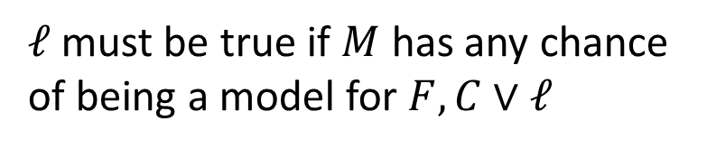
CDCL steps
Propagate | $M \left| F, C∨ℓ ⟹M, ℓ^{C∨ℓ} \right| F,C∨ℓ$ | $C is false under M$
$ℓ$ must be true if $M$ has any chance
of being a model for $F, C∨ℓ$

Slide 46
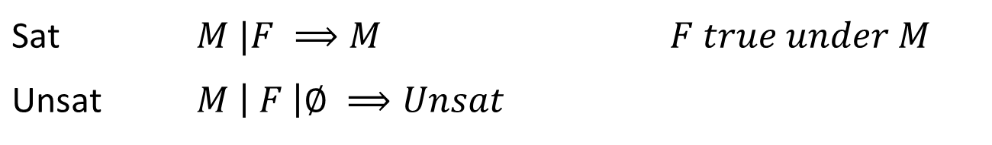
CDCL steps
Sat | $M |F ⟹M$ | $F true under M$
Unsat | $M \left| F \right|∅ ⟹Unsat$

Slide 47
CDCL steps
Conflict | $M \left| F, C ⟹M \right| F,C | C$ | $C is false under M$
$C$ is a sufficient explanation why $M$ is not a model of $F$

Slide 48
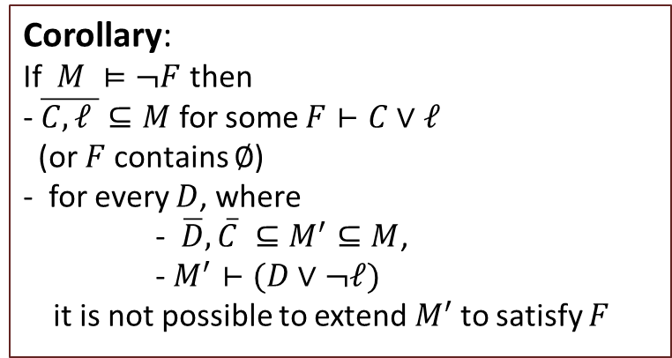
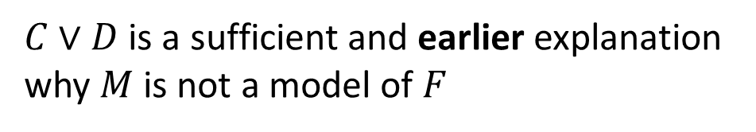
CDCL steps
Resolve | $M \left| F | C∨¬ℓ⟹M \right| F | C∨D$ | $ℓ^{D∨ℓ}∈M$
Recall
Corollary:
If $M ⊨¬F$ then
- $\overline{C,ℓ }⊆M$ for some $F⊢C∨ℓ$
(or $F$ contains $∅$)
- for every $D$, where
- $\overline{D},\overline{C} ⊆M^{′}⊆M$,
- $M^{′}⊢(D∨¬ℓ)$
it is not possible to extend${ M}^{′}$ to satisfy $F$
$C∨D$ is a sufficient and earlier explanation
why $M$ is not a model of $F$

Slide 49
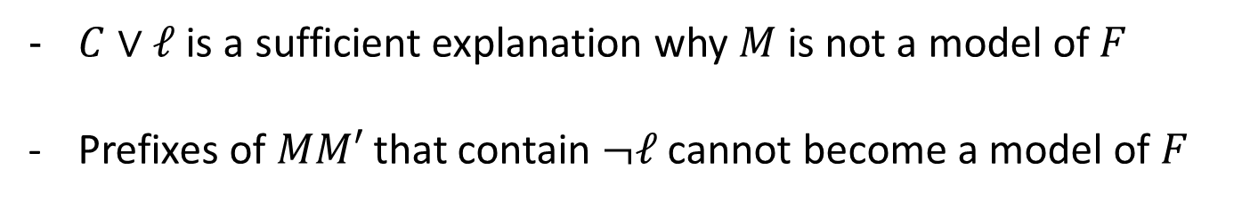
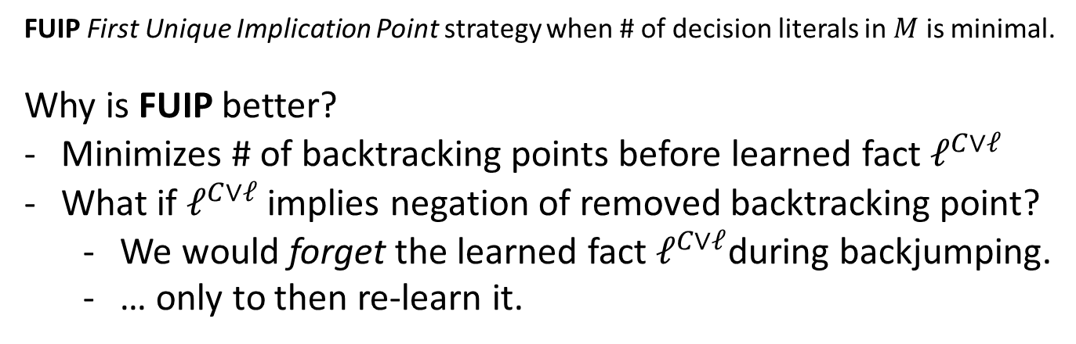
CDCL steps
Backjump | $MM′ \left| F | C∨ℓ⟹Mℓ^{C∨ℓ} \right| F$ | $\overline{C}⊆M, ¬ℓ∈M′$
$C∨ℓ$ is a sufficient explanation why $M$ is not a model of $F$
Prefixes of $MM′$ that contain $¬ℓ$ cannot become a model of $F$
FUIP First Unique Implication Point strategy when # of decision literals in $M$ is minimal.
Why is FUIP better?
Minimizes # of backtracking points before learned fact $ℓ^{C∨ℓ}$
What if $ℓ^{C∨ℓ}$ implies negation of removed backtracking point?
  We would forget the learned fact $ℓ^{C∨ℓ}$during backjumping.
  … only to then re-learn it.

Slide 50
CDCL steps
Learn | $M \left| F | C⟹M \right| F, C | C$
Re-use proof step for later: build DAG proof instead of TREE proof

Slide 51
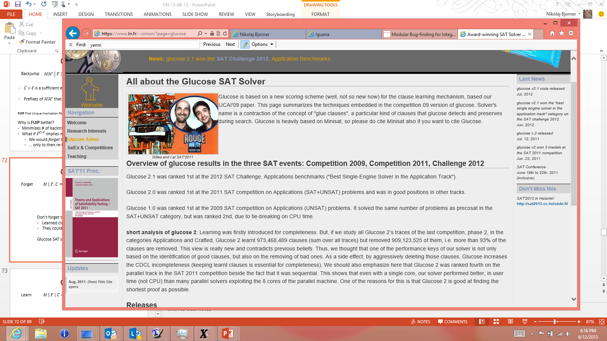
CDCL steps
Forget | $M \left| F, C⟹M\right| F$ | $C$is a learned clause
Don’t forget to forget:
Learned clauses could turn out to be useless.
They could hog resources
Blocked Clause Elimination:
- Remove clauses that will not be used in proofs

Slide 52
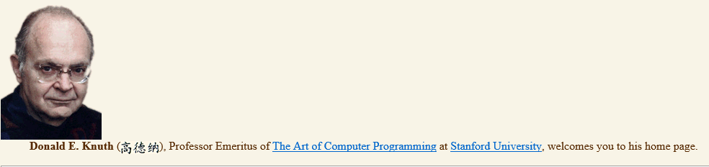
CDCL steps
Restart | $M \left| F⟹ ε \right| F$
Avoid getting trapped in one part of search space.
Restart with increased delay:
$$S_{1},S_{2},…. =1,1,2,1,1,2,4,1,1,2,1,1,2,4,8,1,1,2,1,1,2,4,1,1,2,4,8,1,…$$
[Reluctant doubling sequence: Luby, Sinclair, Zuckerman, IPL 47]
Generating
function
[fasc6a
draft chapter
on SAT]
$$\left(u_{n+1}, v_{n+1}\right)=\left(u_{n}\& −u_{n}?\left(u_{n}+1,1\right):\left(u_{n}, 2v_{n}\right)\right).$$

Slide 53
Modern DPLL - tuning
Restart frequency
  Why is restarting good?
  Efficient replay trick for frequent restart
Which variable to split on
Which branch to explore first
Which lemmas to learn
Blocked clause elimination
Cache binary propagations
  This is just scratching the surface

Slide 54
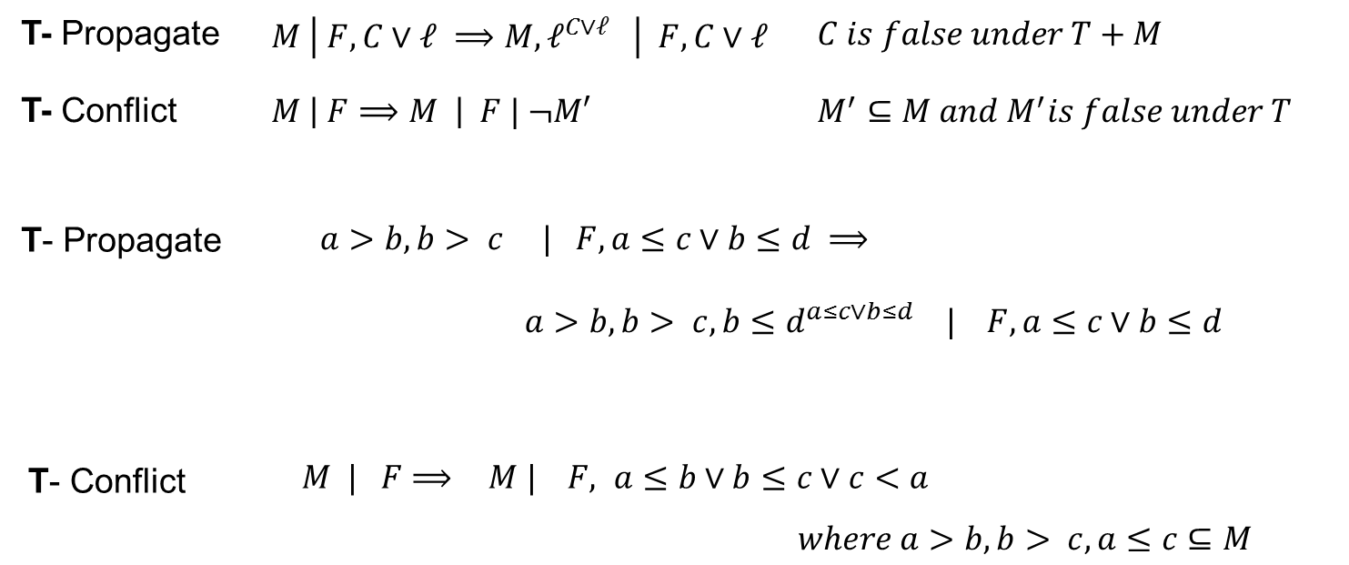
DPLL(T) solver interaction

Slide 55
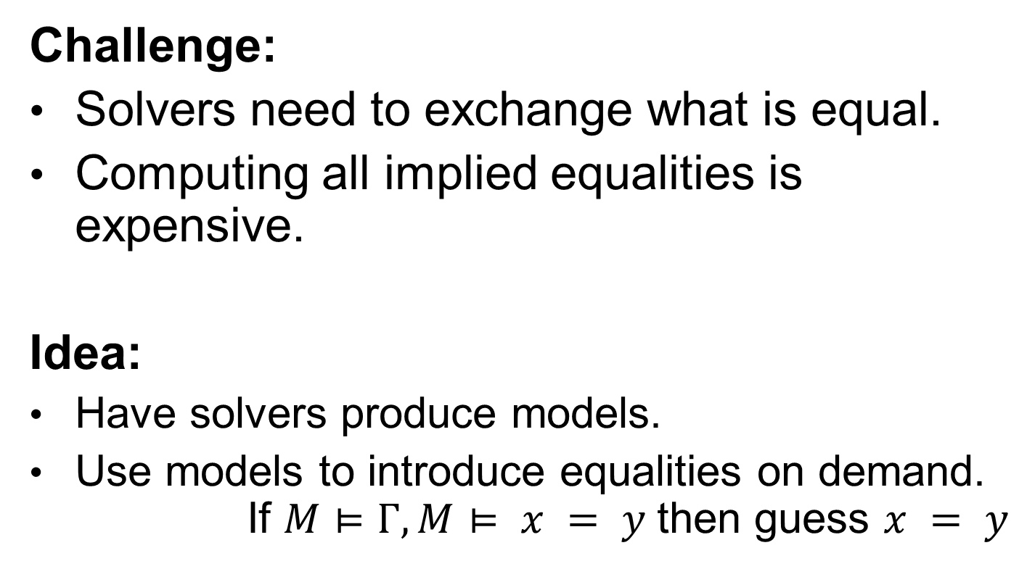
Model based Theory Combination
Challenge:
Solvers need to exchange what is equal.
Computing all implied equalities is expensive.
Idea:
Have solvers produce models.
Use models to introduce equalities on demand.
If $M⊨Γ, M⊨ x = y$then guess $x = y$

Slide 56
Summary
Progress in automated reasoning
SAT, Automated Theorem Proving, SMT
An abstract account for SMT search (DPLL+T)
Integrating Theories
Takeaway: Theorem Proving is cool

