Slide 1
Outline
Introduction
Harvesting Classes
Harvesting Facts
Common Sense Knowledge
Knowledge Consolidation
Web Content Analytics
Wrap-Up
Entity Discovery in Web Contents
Entity-centric Search & Analytics
KB-enhanced Sentiment Analysis

Slide 2
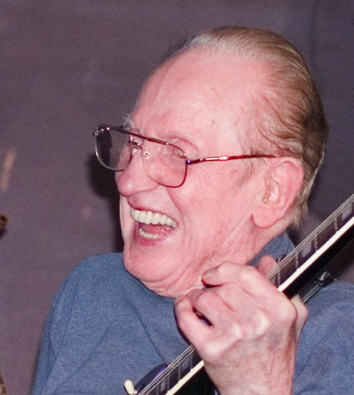
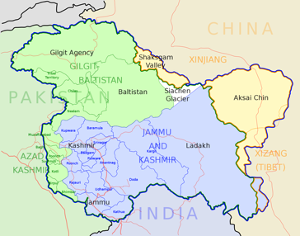
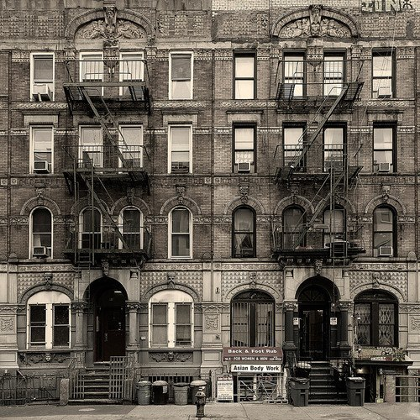
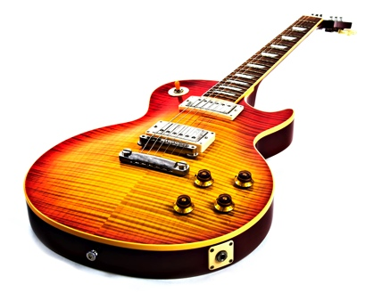
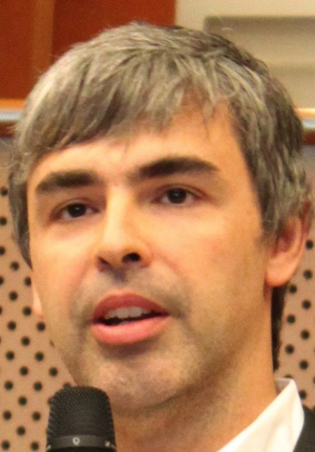
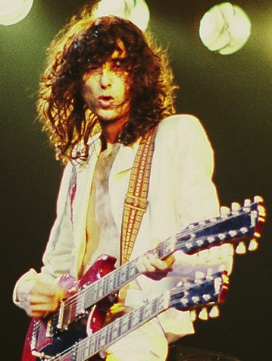
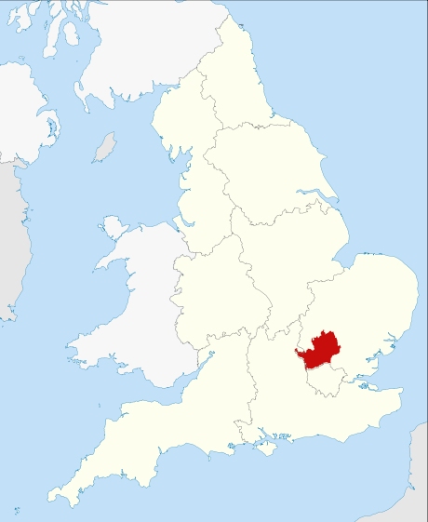
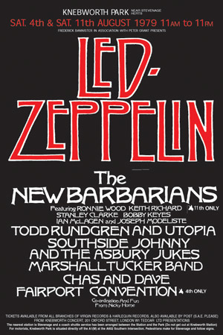
Disambiguating Names to Entities
When Page played Kashmir at Knebworth, his Les Paul was uniquely tuned.
Images taken from Wikipedia under CC BY-SA 3.0

Slide 3
Disambiguating Names to Entities
+18
+1
When Page played Kashmir at Knebworth, his Les Paul was uniquely tuned.
127080
possible
combinations
+4
+351
Images taken from Wikipedia under CC BY-SA 3.0

Slide 4
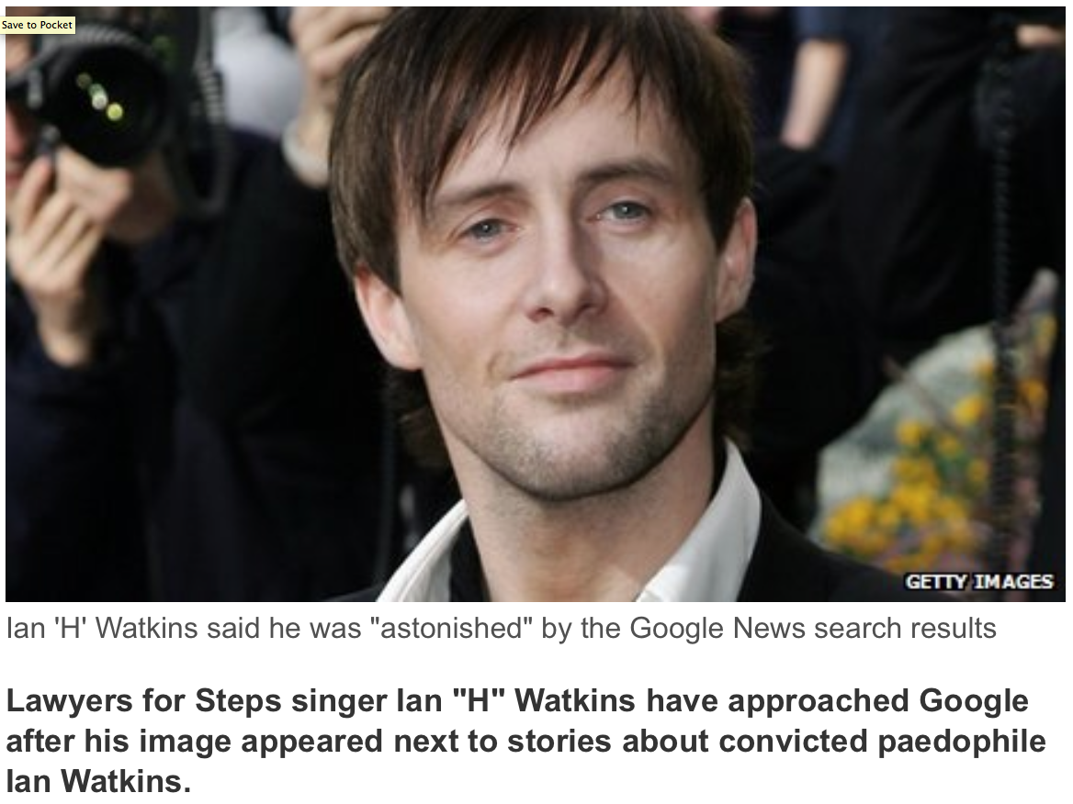


Slide 5




Common Features for Disambiguation
India
Pakistan
Pashmina
…
Prior
Context
Coherence
91%
0.0
When Page played Kashmir at Knebworth, his Les Paul was uniquely tuned.
5%
2.4
Led Zeppelin
Jimmy Page
Knebworth Festival
…
How often did “Kashmir” link to this entity in Wikipedia?
How good do entity keyphrases and context tokens overlap?
Are the disambiguated entities related?
Images taken from Wikipedia under CC BY-SA 3.0

Slide 6
Mention-Entity Popularity Weights
[Mihalcea/Tarau 2007, Spitkovsky/Chang 2012]
Need dictionary with entities‘ names:
  full names: Arnold Alois Schwarzenegger, Los Angeles, Microsoft Corp.
  short names: Arnold, Arnie, Mr. Schwarzenegger, New York, Microsoft, …
  nicknames & aliases: Terminator, City of Angels, Evil Empire, …
  acronyms: LA, UCLA, MS, MSFT
  role names: the Austrian action hero, Californian governor, CEO of MS, …
…
plus gender info (useful for resolving pronouns in context):
Bill and Melinda met at MS. They fell in love and he kissed her.
Collect hyperlink anchor-text / link-target pairs from
  Wikipedia redirects
  Wikipedia links between articles and Interwiki links
  Web links pointing to Wikipedia articles
  query-and-click logs
…
Build statistics to estimate P[entity | name]

Slide 7
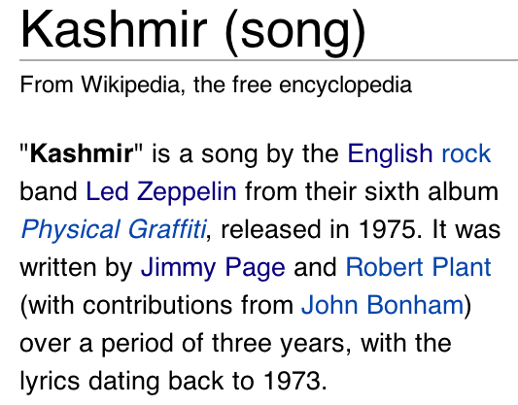

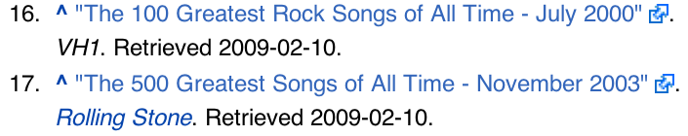
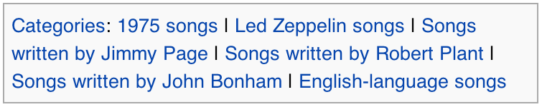
Mention-Entity Context
Knebworth Festival
Led Zeppelin Remasters
Link Anchor Texts
John Paul Jones
Mellotron
Citation Titles
Titles of Linking Articles
Category Names

Slide 8
Mention-Entity Context
Keyphrases (kp) commonly occur only partially
To score an entity, all keyphrase scores are summed
Account for partial matches
Weight of contained tokens w
Kashmir was written by Page and Plant.
“Songs written by Robert Plant”
cover
8

Slide 9
Mention-Entity Context
Global IDF of a keyphrase token w in Wikipedia
Mutual Information of a token w and an associated entity
  How often does the token occur in the keyphrase set of an entity
9

Slide 10
Entity-Entity Coherence
Precompute overlap of incoming links for entities e1 and e2
Alternatively compute overlap of anchor texts for e1 and e2
or overlap of keyphrases, or similarity of bag-of-words, or …
Optionally combine with type distance of e1 and e2
(e.g., Jaccard index for type instances)
For special types of e1 and e2 (locations, people, etc.)
use spatial or temporal distance
Overview by [Ceccarelli et al.: CIKM 2013]

Slide 11
Joint Mapping: Prob. Factor Graph
50
30
50
20
30
10
10
90
100
30
80
20
90
100
90
5
30
Collective Learning with Probabilistic Factor Graphs
[Kulkarni et al.: KDD’09]:
  model P[m|e] by similarity and P[e1|e2] by coherence
  consider likelihood of P[e1 … ek|m1 … mk]
  factorize by all m-e pairs and e1-e2 pairs
  use MCMC, hill-climbing, LP etc. for solution

Slide 12
Joint Mapping: Dense Subgraph
[J. Hoffart et al.: EMNLP‘11]
50
30
50
20
30
10
10
90
100
30
80
20
90
100
90
5
30
Compute dense subgraph such that:
each m is connected to exactly one e (or at most one e)
NP-hard → approximation algorithms

Slide 13
Random Walks Algorithm
ε
0.5
50
ε
0.83
0.3
50
30
0.2
20
0.23
ε
0.1
0.17
30
10
10
0.7
90
0.77
100
0.25
30
0.2
ε
0.4
20
0.75
80
90
0.75
0.96
90
100
ε
0.15
0.04
30
5
ε
for each mention run random walks with restart
(like personalized PageRank with jumps to start mention(s))
rank candidate entities by stationary visiting probability
very efficient, decent accuracy
can be improved by judicious selection of mention order [Guo & Barbosa: CIKM 2014]

Slide 14
Coherence-aware Feature Engineering
[Cucerzan: EMNLP 2007; Milne/Witten: CIKM 2008, Art.Int. 2013]
m
e
Avoid explicit coherence computation by turning
other mentions‘ candidate entities into features
sim(m,e) uses these features in context(m)
special case: consider only unambiguous mentions
or high-confidence entities (in proximity of m)

Slide 15
TagMe: NED with Light-Weight Coherence
[P. Ferragina et al.: CIKM‘10, WWW‘13]
m
e
e₁
m_{j}
e₂
e₃
Reduce combinatorial complexity by using
avg. coherence of other mentions‘ candidate entities
for score(m,e) compute
avg _{ei ∈ cand(mj)} coherence (e_{i} ,e) ⋅ popularity (e_{i} | m_{j})
then sum up over all m_{j} ≠ m („voting“)
15

Slide 16
Long-Tail and Emerging Entities
wikipedia.org/Good_Luck_Cave
Cave
composed
haunting
songs like
Hallelujah,
O Children,
and the
Weeping Song.
wikipedia.org/Nick_Cave
wikipedia/Hallelujah_Chorus
wikipedia/Hallelujah_(L_Cohen)
last.fm/Nick_Cave/Hallelujah
wikipedia/Children_(2011 film)
last.fm/Nick_Cave/O_Children
wikipedia.org/Weeping_(song)
last.fm/Nick_Cave/Weeping_Song
16

Slide 17
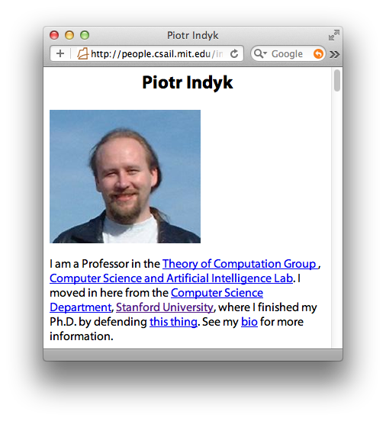
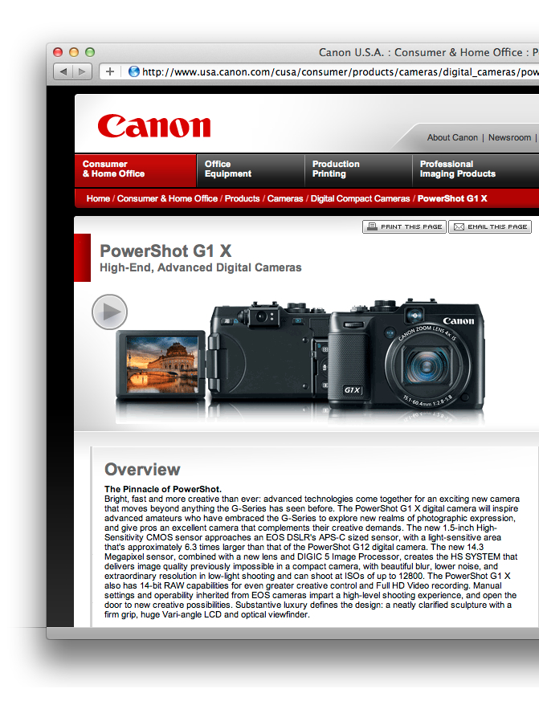
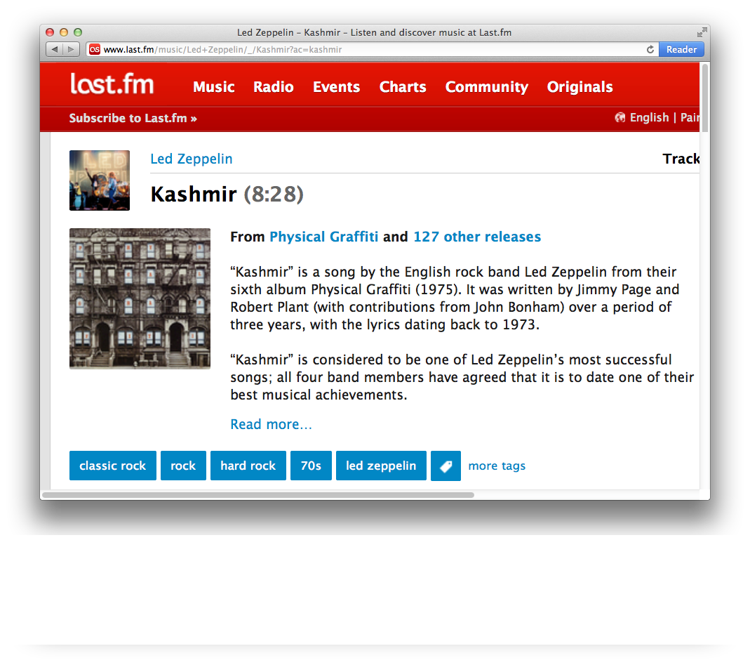
Keyphrases, Not Links
Long-Tail entities
not in Wikipedia
Persons
Products
Songs
17

Slide 18
KORE: Keyphrase Overlap RElatedness
Intuition:
Related entities have highly overlapping keyphrase sets.
Knebworth Festival
Led Zeppelin
Knebworth Festival
song
Led Zeppelin
Rock guitarist
…
Physical Graffiti
…
Pro
Con
Independent of links
Good quality
Computationally intensive due to partial overlap
Can be addressed using locality sensitive hashing
[J. Hoffart et al.: CIKM’12]

Slide 19
Long-Tail and Emerging Entities
Gunung Mulu National Park
Sarawak Chamber
largest underground chamber
wikipedia.org/Good_Luck_Cave
Bad Seeds
No More Shall We Part
Murder Songs
Cave
composed
haunting
songs like
Hallelujah,
O Children,
and the
Weeping Song.
wikipedia.org/Nick_Cave
Messiah oratorio
George Frideric Handel
wikipedia/Hallelujah_Chorus
Leonard Cohen
Rufus Wainwright
Shrek and Fiona
wikipedia/Hallelujah_(L_Cohen)
last.fm/Nick_Cave/Hallelujah
eerie violin
Bad Seeds
No More Shall We Part
wikipedia/Children_(2011 film)
South Korean film
last.fm/Nick_Cave/O_Children
Nick Cave & Bad Seeds
Harry Potter 7 movie
haunting choir
wikipedia.org/Weeping_(song)
Dan Heymann
apartheid system
last.fm/Nick_Cave/Weeping_Song
Nick Cave
Murder Songs
P.J. Harvey
Nick and Blixa duet
19

Slide 20

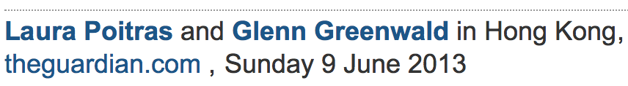



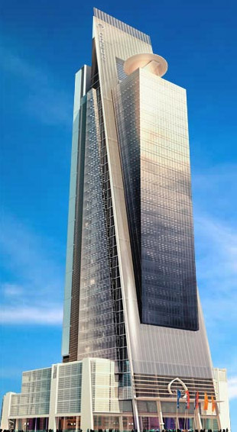

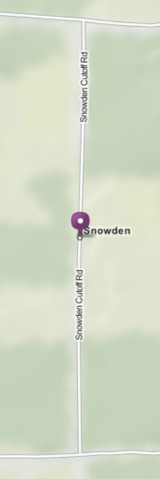


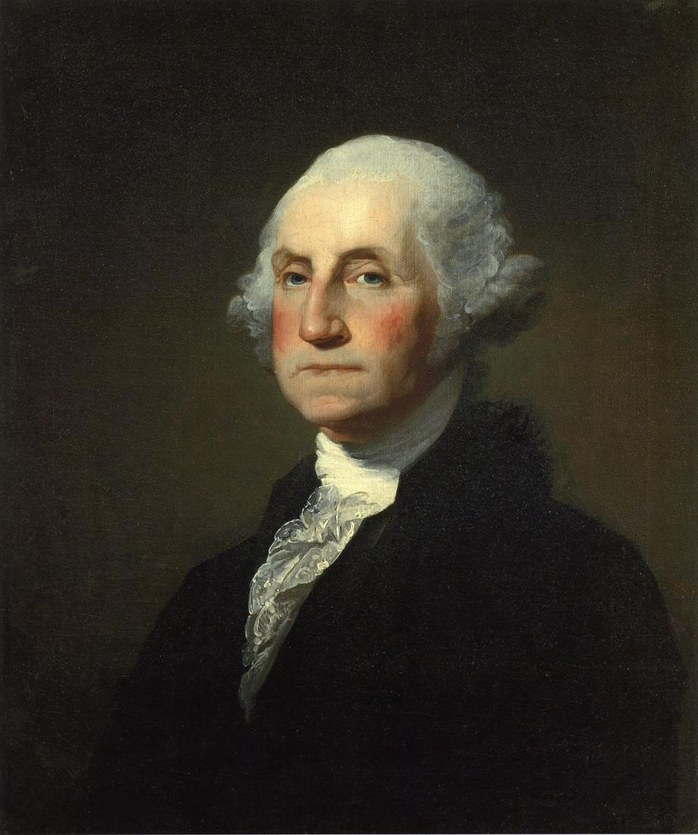
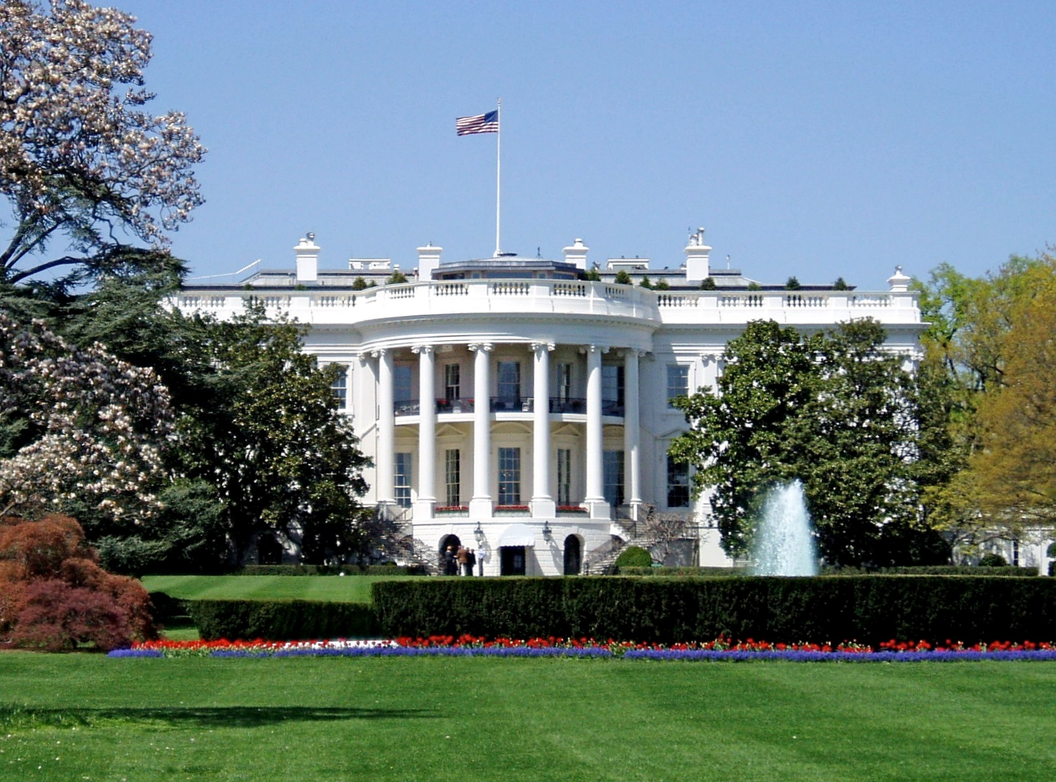
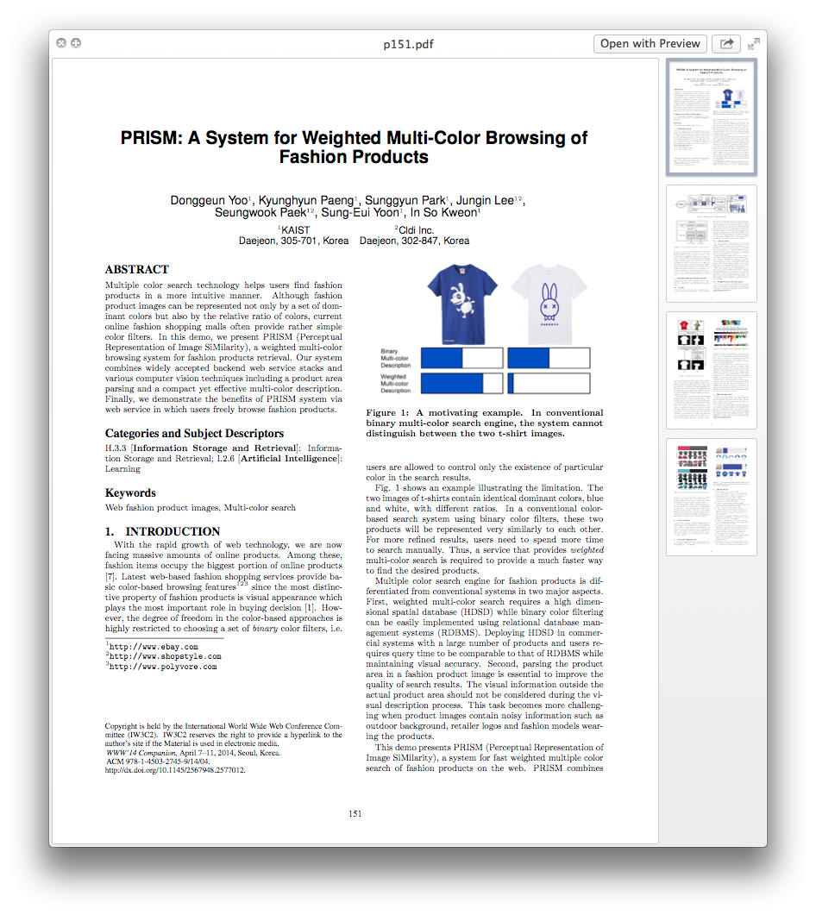
“Washington’s Prism program was revealed by the whistleblower Snowden.”
Notes:
Imagine you are in June 9th plus put date on slide

Slide 21
Harvesting Emerging Entity Keyphrases
Entity
Keyphrases
extracted from
annotations of
entities referred to by
PRISM
(TV network)
Prism
PRISM (website)
Prism (album)
Name Keyphrases
extracted from any
document mentioning
”PRISM”
Prism
[J. Hoffart et al.: WWW 2014]
21

Slide 22
Harvesting Emerging Entity Keyphrases
Entity
Keyphrases
extracted from
annotations of
entities referred to by
Emerging Entity Keyphrases
PRISM
(TV network)
Prism
PRISM (website)
Prism (album)
Name Keyphrases
extracted from any
document mentioning
Prism
[J. Hoffart et al.: WWW 2014]
22

Slide 23
Extracting Keyphrases from Text
...
The PRISM program collects a wide range of data from a number of companies, e.g. Google and Facebook. The leaked National Security Agency (NSA) documents where obtained by the Guardian.
...
keyphrases defined by POS pattern filters for
named entities and technical terms

Slide 24
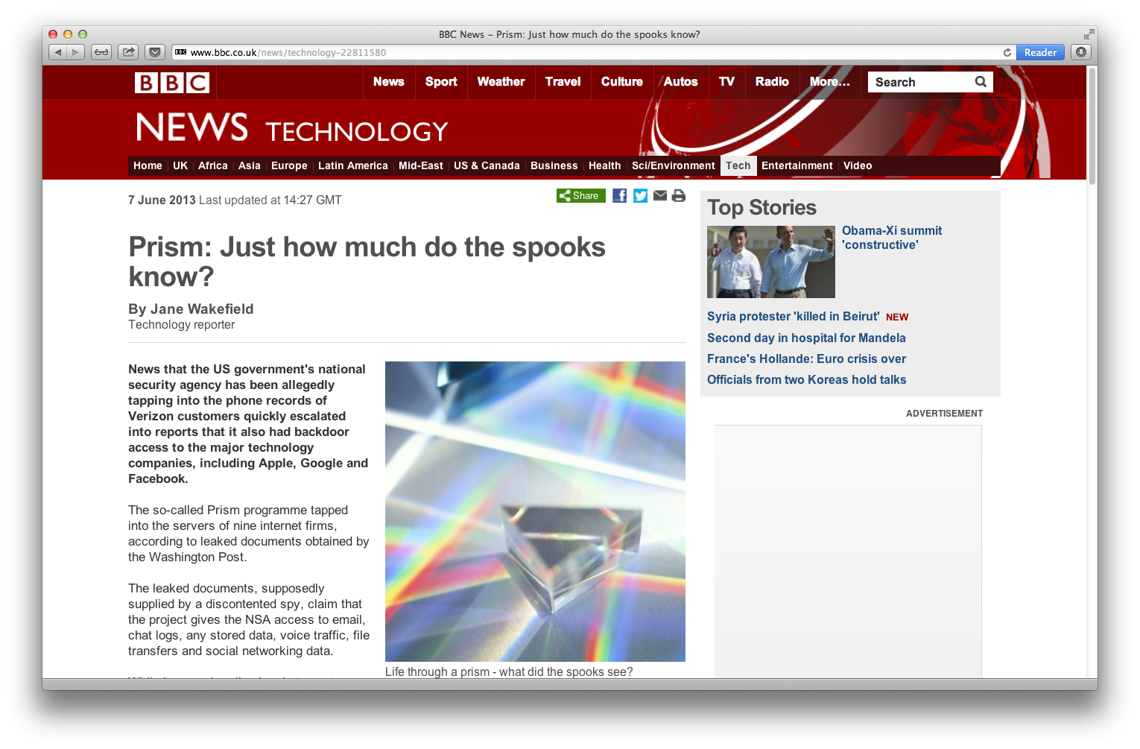
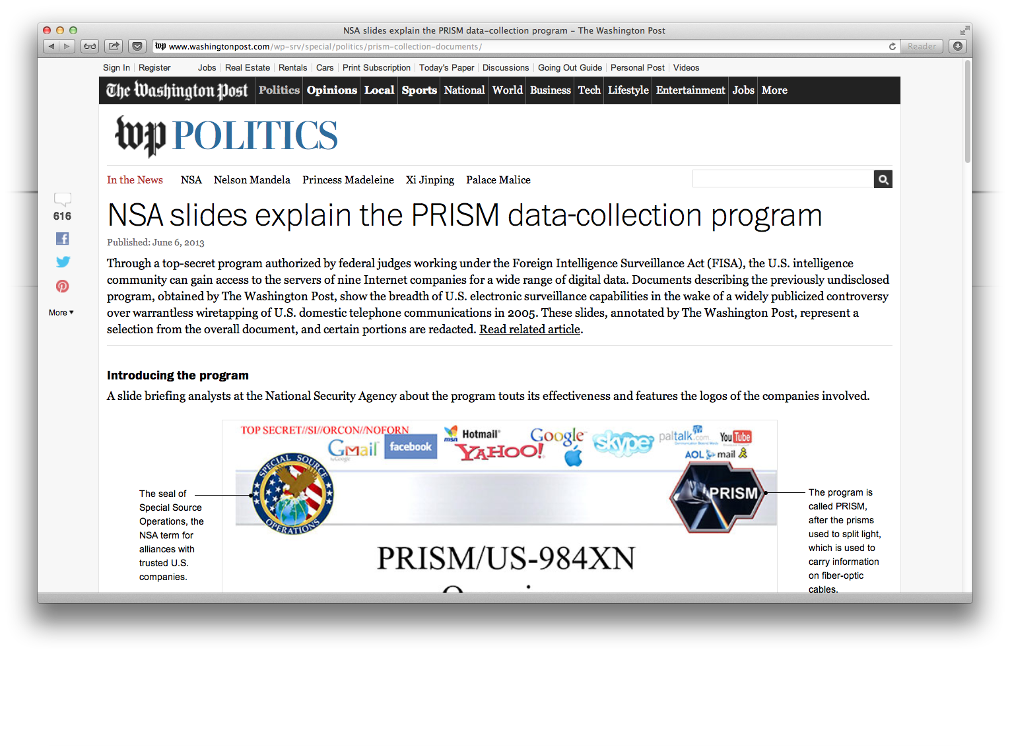
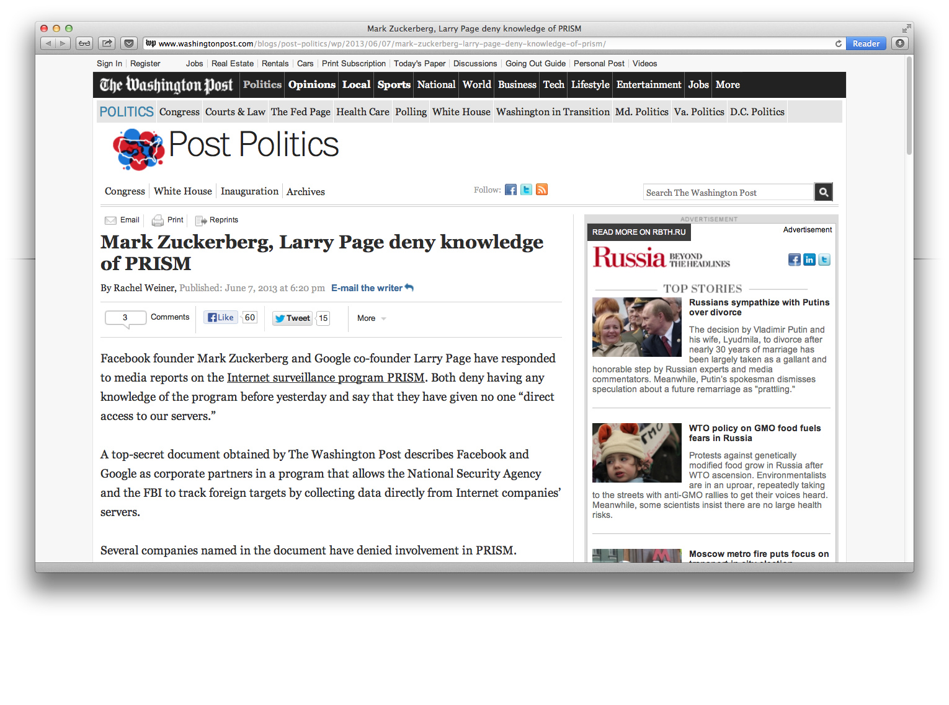
Enriching Existing Entities
Knowledge Base
US Government
“White House”, 0.4
“Obama”, 0.4
“US President”, 0.3
Existing
entity keyphrases
harvested from
Wikipedia
“PRISM”, 0.3
Enrich by context of
high-confidence
disambiguations
in input texts

Slide 25
Discovering Emerging Entities
Knowledge Base
Add new Entities
Harvest Entity
Keyphrases
Identify
Emerging Entities
Iterate over slices
June 6
June 7
June 8
News article clusters over time.
25

Slide 26
NERD Online Tools
  J. Hoffart et al.: EMNLP 2011, VLDB 2011
  http://mpi-inf.mpg.de/yago-naga/aida/
  P. Ferragina, U. Scaella: CIKM 2010
  http://tagme.di.unipi.it/
  R. Isele, C. Bizer: VLDB 2012
  http://spotlight.dbpedia.org/demo/index.html
  Reuters Open Calais: http://viewer.opencalais.com/
  Alchemy API: http://www.alchemyapi.com/api/demo.html
  S. Kulkarni, A. Singh, G. Ramakrishnan, S. Chakrabarti: KDD 2009
  http://www.cse.iitb.ac.in/soumen/doc/CSAW/
  D. Milne, I. Witten: CIKM 2008
  http://wikipedia-miner.cms.waikato.ac.nz/demos/annotate/
  L. Ratinov, D. Roth, D. Downey, M. Anderson: ACL 2011
  http://cogcomp.cs.illinois.edu/page/demo_view/Wikifier
  D. Ceccarelli, C. Lucchese,S. Orlando, R. Perego, S. Trani. CIKM 2013
  http://dexter.isti.cnr.it/demo/
  A. Moro, A. Raganato, R. Navigli. TACL 2014
  http://babelfy.org
  some use Stanford NER tagger for detecting mentions
  http://nlp.stanford.edu/software/CRF-NER.shtml
26

Slide 27
Outline
Introduction
Harvesting Classes
Harvesting Facts
Common Sense Knowledge
Knowledge Consolidation
Web Content Analytics
Wrap-Up
Entity Discovery in Web Contents √
Entity-centric Search & Analytics
KB-enhanced Sentiment Analysis

Slide 28
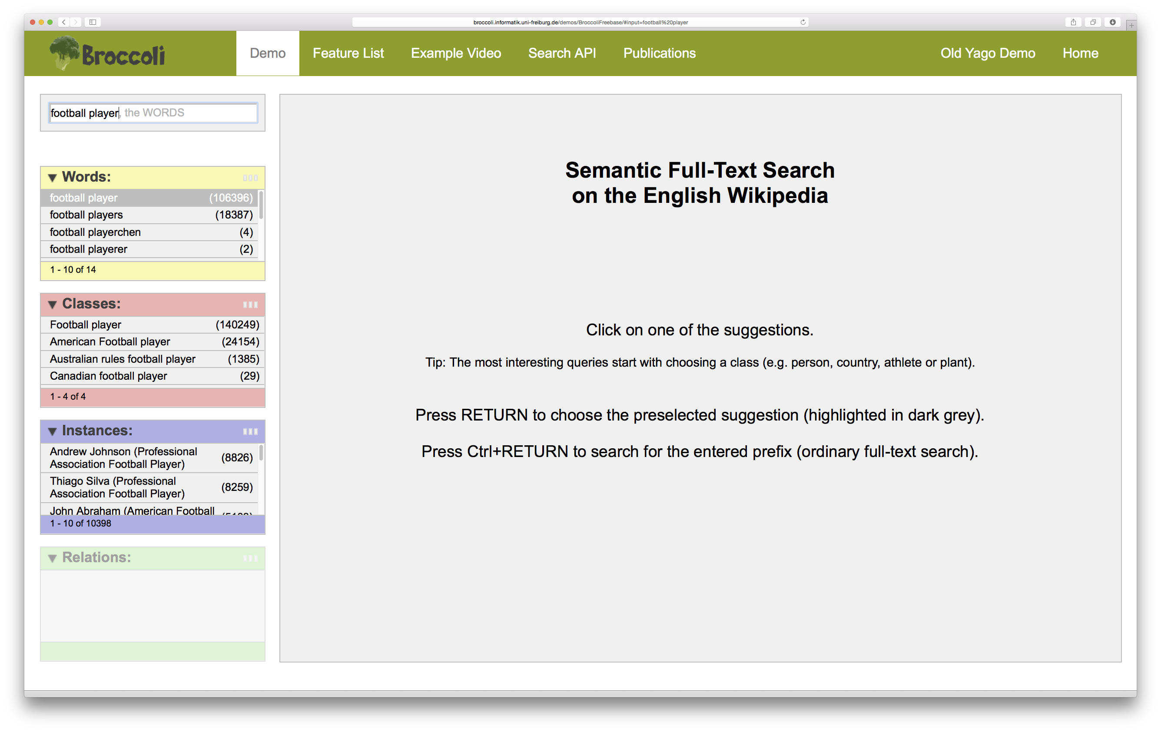
[H. Bast et al.: SIGIR 2014]

Slide 29
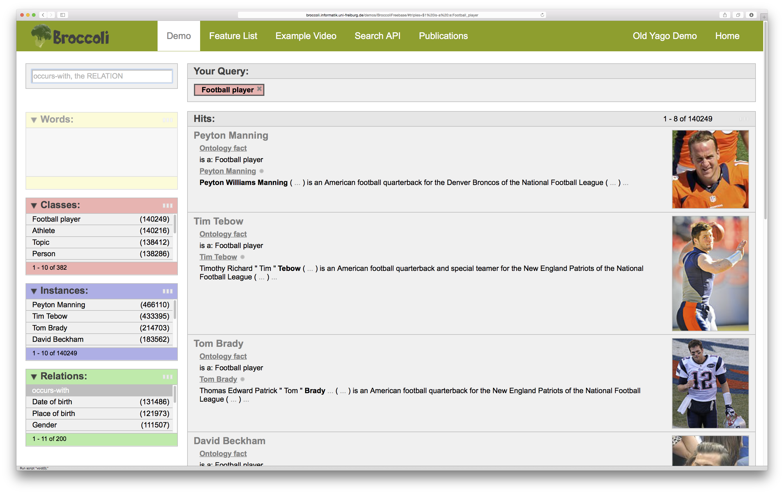

Slide 30
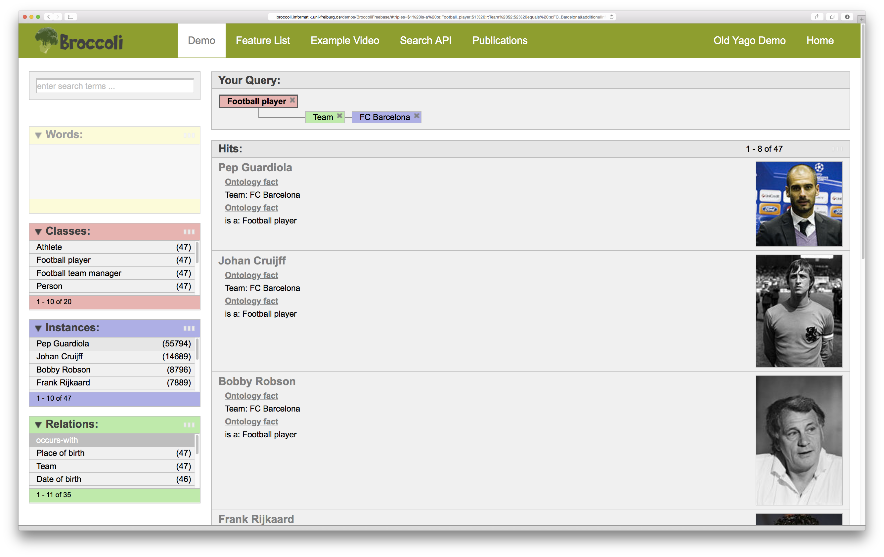

Slide 31
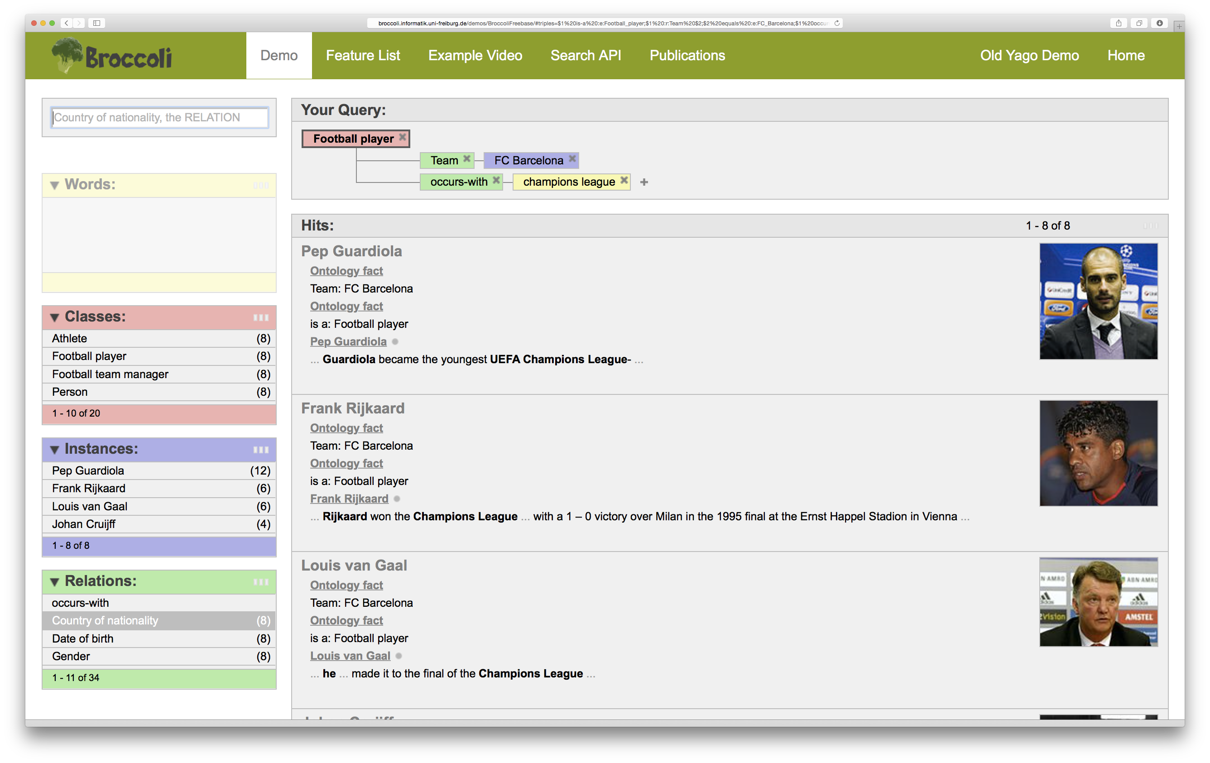

Slide 32

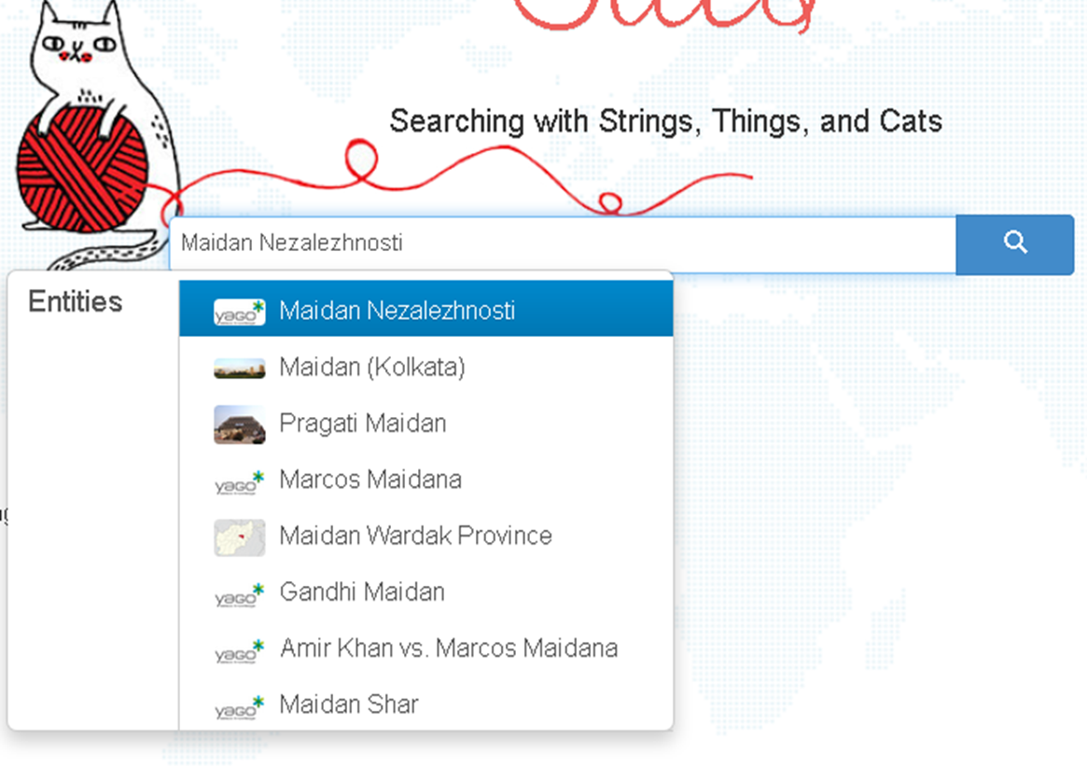
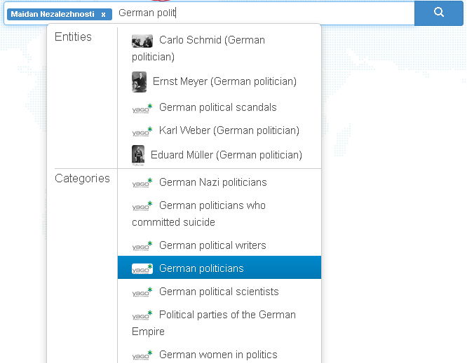
Use Case: Semantic Search over News
stics.mpi-inf.mpg.de

Slide 33
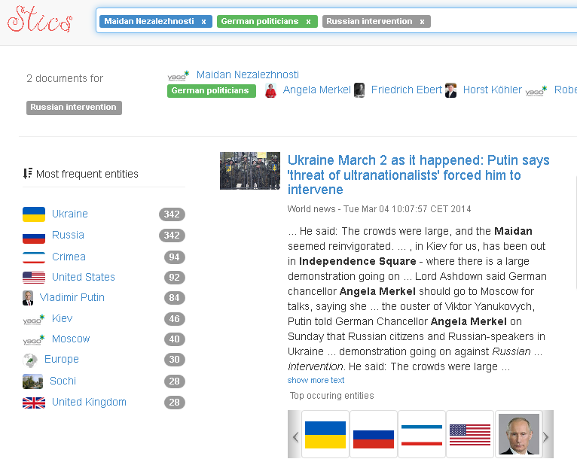
Use Case: Semantic Search over News

Slide 34
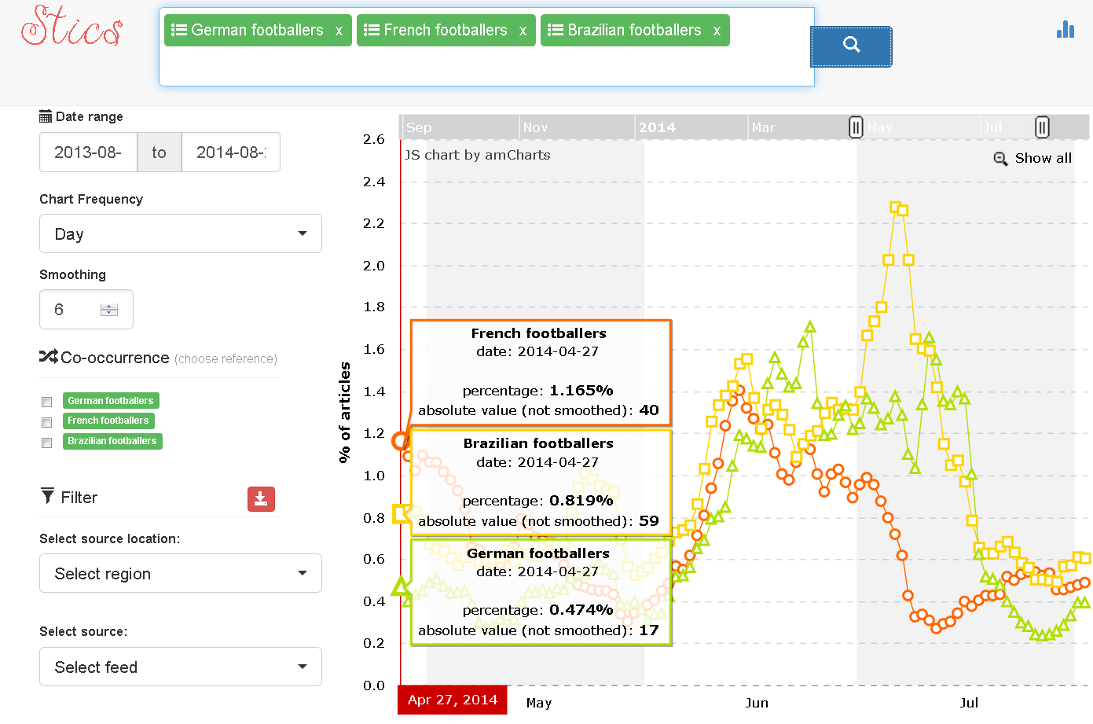
Use Case: Analytics over News
stics.mpi-inf.mpg.de/stats

Slide 35
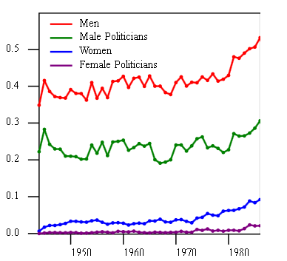
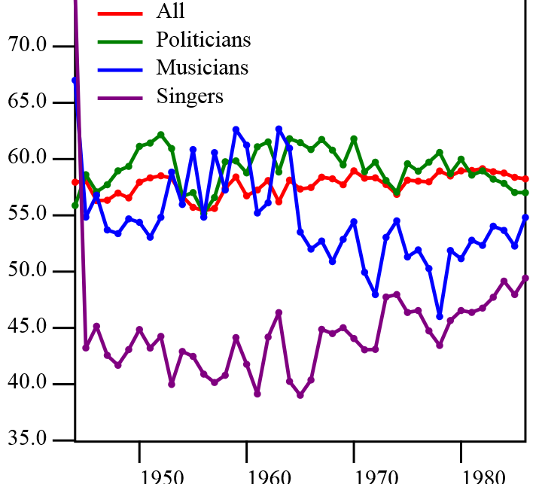
Use Case: Semantic Culturomics
[Huet et al.: AKBC‘13]
Age
based on entity recognition & semantic classes of KB
over archive of Le Monde, 1945-1985

Slide 36
Outline
Introduction
Harvesting Classes
Harvesting Facts
Common Sense Knowledge
Knowledge Consolidation
Web Content Analytics
Wrap-Up
Entity Discovery in Web Contents √
Entity-centric Search & Analytics √
KB-enhanced Sentiment Analysis

Slide 37
Knowledge-enhanced Sentiment Analysis
“The bar at the Hilton was hot but the beer was cold.”
POSITIVE
OBJECTIVE
NEGATIVE
Goal:
(Recognize and disambiguate entities)
Identify overall sentiment
Understand which entities and aspects contribute to the sentiment, and how they contribute

Slide 38
Knowledge-enhanced Sentiment Analysis
“The bar at the Hilton was hot but the beer was cold.”
POSITIVE
OBJECTIVE
NEGATIVE
Problem:
No single, unambiguous sentiment term like good/nice/bad/horrible
Solution:
Common-sense and factual knowledge

Slide 39
Polarity of Synsets
“The bar at the Hilton was hot but the beer was cold.”
POSITIVE
OBJECTIVE
NEGATIVE
NEGATIVE
SentiWordNet provides objectivity, polarity for WordNet synsets
cold#1: having a low or inadequate temperature or feeling a sensation of coldness […] "a cold climate"; "a cold room"; "dinner has gotten cold”; "a cold beer” (P: 0 O: 0.25 N: 0.75)
hot#1: used of physical heat; having a high or higher than desirable temperature; "hot stove"; "hot water” (P: 0 O: 1 N: 0)
[Baccianella et al., LREC 2010]

Slide 40
Understanding Entities and Aspects
“The bar at the Hilton was hot but the beer was cold.”
POSITIVE
OBJECTIVE
NEGATIVE
Goal:
(Recognize and disambiguate entities)
Identify overall sentiment
Understand which entities and aspects contribute to the sentiment, and how they contribute

Slide 41
Understanding Entities and Aspects
POSITIVE
OBJECTIVE
NEGATIVE
“The bar at the Hilton was hot but the beer was cold.”
POSITIVE
OBJECTIVE
NEGATIVE
Goal:
(Recognize and disambiguate entities)
Identify overall sentiment
Understand which entities and aspects contribute to the sentiment, and how they contribute

Slide 42
Polarity of Multi-Word Sentiment Terms
POSITIVE
OBJECTIVE
NEGATIVE
NEGATIVE
“The bar at the Hilton was hot but the beer was cold.”
POSITIVE
POSITIVE
OBJECTIVE
NEGATIVE
SenticNet provides polarity for multi-word sentiment terms
Cold beer: P: 1.0 O: 0.0 N: 0
Hot bar: P: 0.0 O: 0.2 N: 0.8
[Cambria et al., AAAI 2014]

Slide 43
Understanding Entities and Aspects
POSITIVE
POSITIVE
OBJECTIVE
NEGATIVE
NEGATIVE
“The bar at the Hilton was hot but the beer was cold.”
POSITIVE
POSITIVE
OBJECTIVE
NEGATIVE
Hot bar?
hot#1: used of physical heat; having a high or higher than desirable temperature; "hot stove"; "hot water” (P: 0 O: 1 N: 0)
hot#11: very popular or successful; "one of the hot young talents"; "cabbage patch dolls were hot last season” (P: 0.625 O: 0.375 N: 0)

Slide 44
Disambiguation of Sentiment Terms
Address ambiguity of sentiment terms, e.g. hot
  He is a hot young talent.
  The bar is hot and stuffy.
Link ambiguous sentiment terms to
  ConceptNet (vector space term similarity)
  WordNet (graph similarity)
Context terms are assigned a probability for creating a positive or negative sentiment for the ambiguous term, e.g. hot:
  talent (P: 0.9)
  stuffy (N: 0.8)
[Weichselbraun et al., Knowledge-Based Systems 2014]
44

Slide 45

Take-Home Lessons
NERD is key for contextual knowledge
High-quality NERD uses joint inference over various features:
popularity + similarity + coherence
State-of-the-art tools available & beneficial
Maturing now, but still room for improvement,
especially on efficiency, scalability & robustness
Semantic Search & Analytics already benefits
Connecting unstructured texts to knowledge bases opens up new possibilities
Sentiment analysis needs KBs and disambiguation
To identify companies and products as well as their aspects
To understand opinion bearing words
45

Slide 46


Open Problems and Grand Challenges
Efficient interactive & high-throughput batch NERD
a day‘s news, a month‘s publications, a decade‘s archive
Entity name disambiguation in difficult situations
Short and noisy texts about long-tail entities in social media
Robust disambiguation of entities, relations and classes
Relevant for question answering & question-to-query translation
Key building block for KB building and maintenance
Effective entity-centric document retrieval and exploration
Understand impact of KB on ranking and exploring documents and knowledge
Fully automatic linking of Web and news texts to
continuously updated KBs with high accuracy
46

