Slide 1
Guiding Image Manipulations Using Shape-appearance Subspaces from Co-alignment of Image Collections
Chuong H. Nguyen^{1,2}, Oliver Nalbach¹, Tobias Ritschel^{1,2}, Hans-Peter Seidel¹
1
2

Slide 2
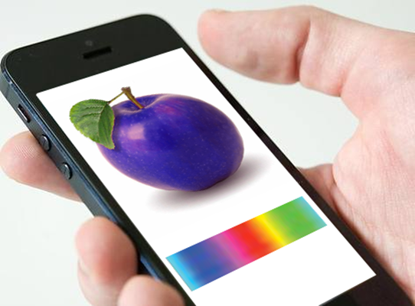
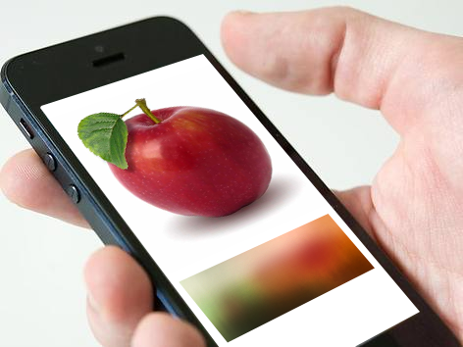
Previous Work: Global Color Editing
Nguyen et al.: Data-driven Color Manifolds
ACM Transactions on Graphics, Volume 34 Issue 2, February 2015
Notes:
Common image manipulation software offers users to change, for example, the appearance of objects in an image in any way they like
But not only does this require a certain level of expertise, the cavalcade of options also hinders decisions
For example, with common color pickers you can give an apple any color you want, but this also includes unnatural colors
[click] This we adressed in previous work by presenting data-driven color manifolds for global color manipulation, restricting color options to those which are plausible for an object class
Today I want to talk about how we extended this to spatially varying color and shape manipulation

Slide 3
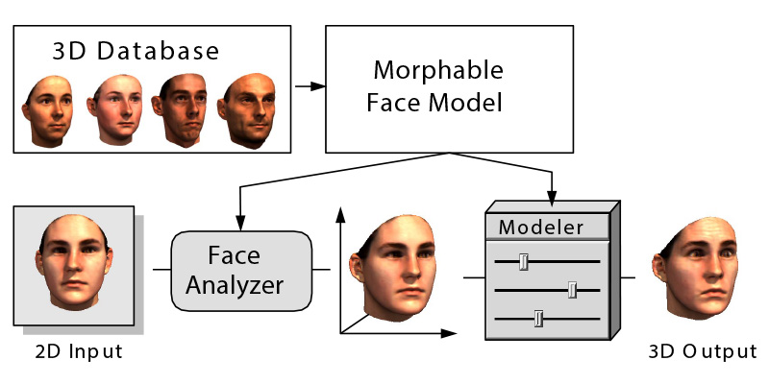
Previous Work: Morphable 3D Face Models
Blanz & Vetter.: A Morphable Model for the Synthesis of 3D Faces
ACM SIGGRAPH 1999
Notes:
Our approach bears some similarities to the seminal work by Blanz and Vetter regarding the construction of a morphable 3D face model from a database
While their approach allows the deformation of faces in images, our method deals with multiple classes which can be more heterogeneous than human faces

Slide 4
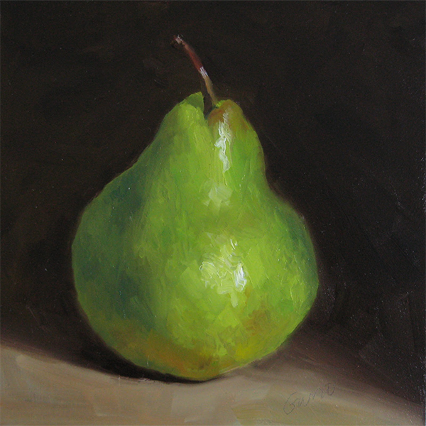
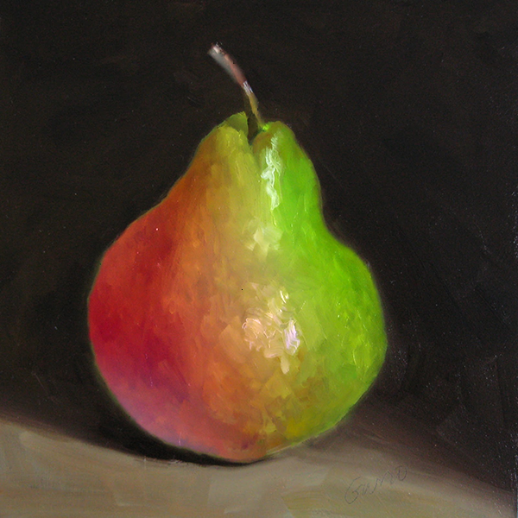
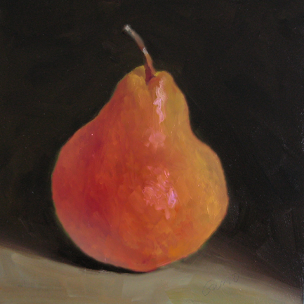
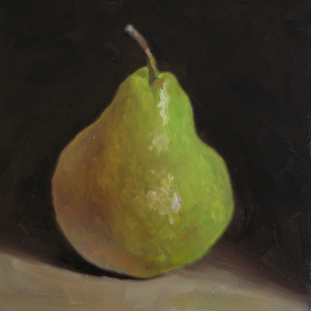
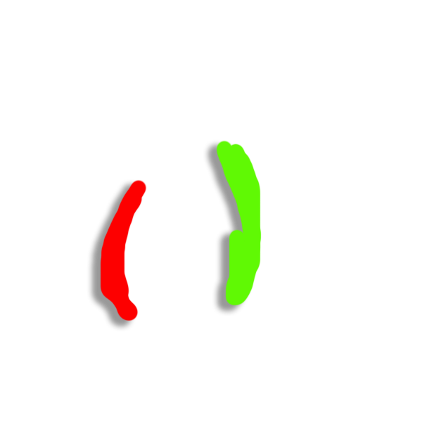
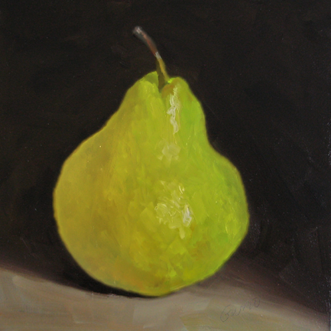
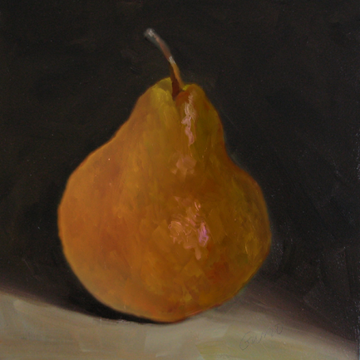
Motivation: Intuitive Appearance Editing
Notes:
For example, with our method, we can recolor objects with a few strokes [click]
Or get suggestions for new color schemes [click]

Slide 5
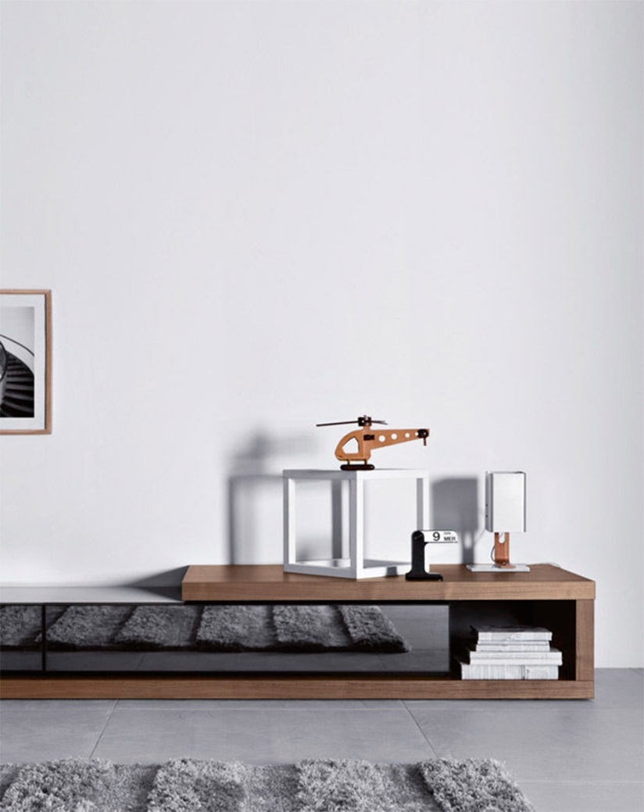
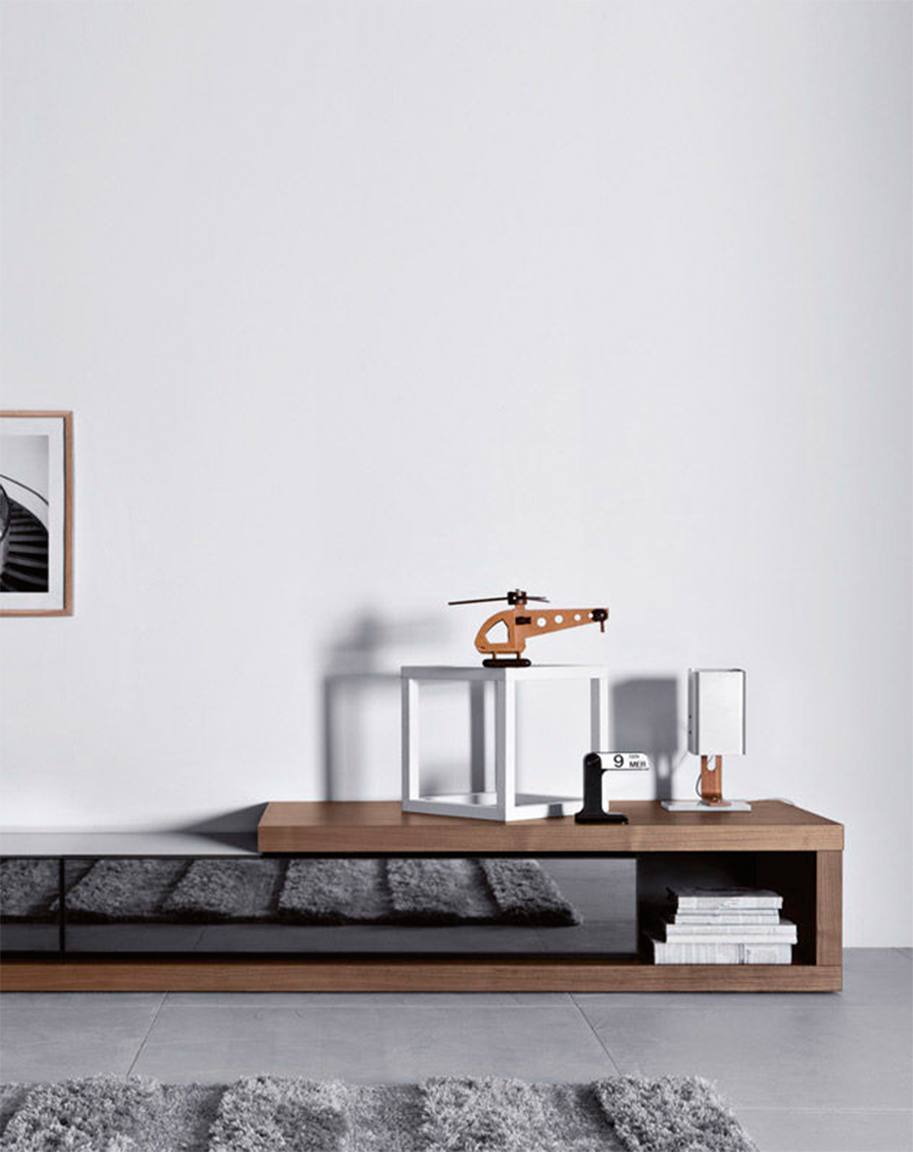
Motivation: Automatic Shape Suggestions
Notes:
Or, say you want to decorate your living room with butterfly stickers
Without variations [click] this will look boring
Our approach [click] can automatically suggest a variety of butterflies shapes, allowing for an interesting look

Slide 6
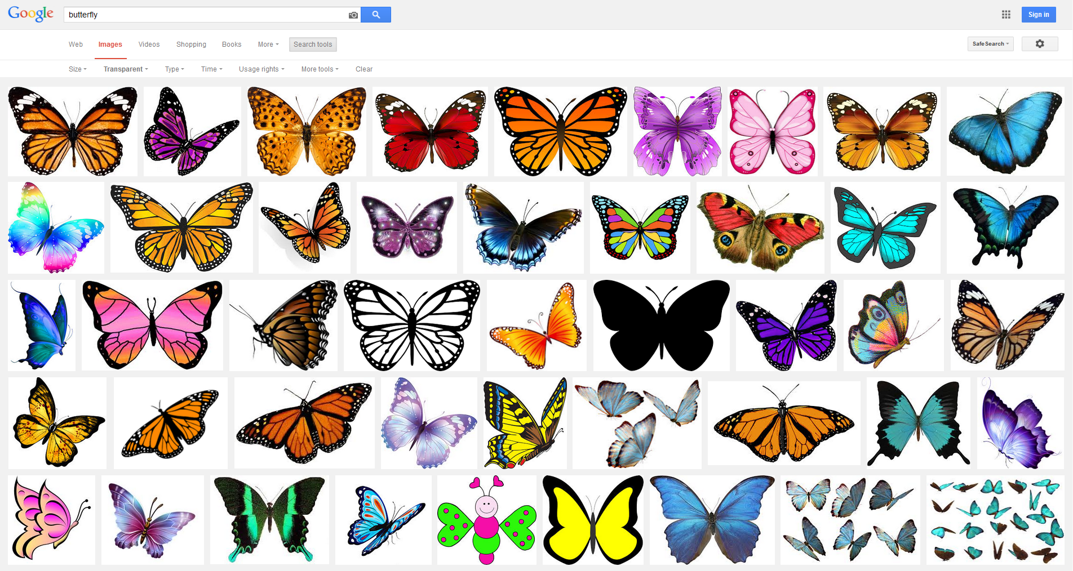
Image Sets in the Wild
Notes:
To achieve this, our approach aligns and analyzes sets of images showing instances of the same object class in front of a neutral or transparent background
We can collect such image sets very fast using advanced search engines, which for example allow to search for images with transparent background only
The impressive “Distilled Collections” which we have just seen would also make an ideal starting point for our method

Slide 7
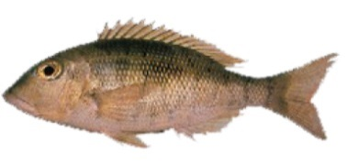
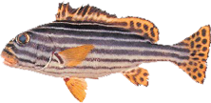
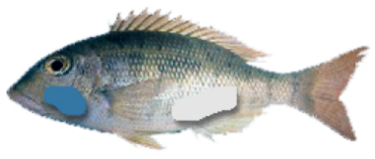
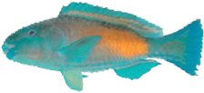
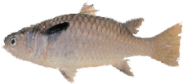
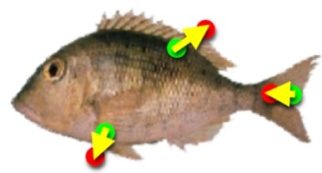
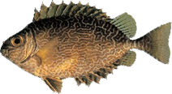
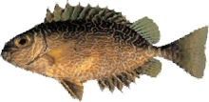
Overview of the Method
*
Shape space
Shape and
appearance
manipulation
Image set
Aligned set
Appearance space
Notes:
Let’s look at an outline of our algorithm
The most critical requirement to the analysis of color and shape variations in an image set is to have a set of well aligned images
Starting from an initial set of images showing instances of the same object class, in the first step, we pick a reference image [click]
In this case, the fish on the top
And then align the other instances to the reference [click]
This alignment we consider as our main contribution
[click]
In the next step, we perform principal component analysis on the set of aligned images and corresponding deformations to build shape and appearance subspaces
[click]
Which, in the end, enables us to guide image manipulations, restricting them to meaningful results

Slide 8
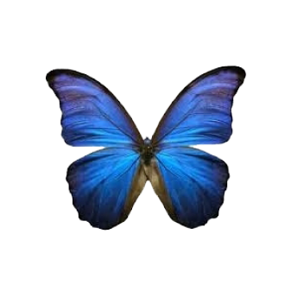
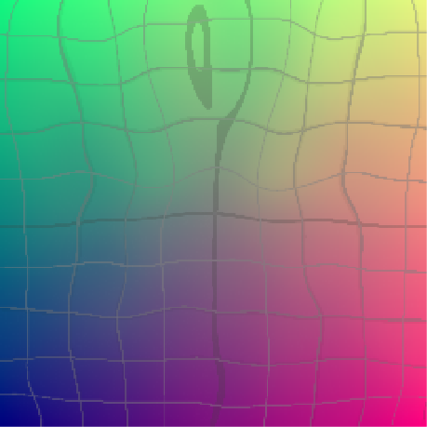
Alignment Requirements
Plausible aligned image
Align
Smooth flow field
Notes:
Aligning 2D images to later analyze them demands for several properties of the alignment method
First, the aligned image should look plausible, without disturbing artifacts
This alone is not easy because the appearance of object distances can vary drastically as in this example
Second, the alignment implies a deformation
We use these deformations to build our shape subspaces, and therefore they, too, should look nice and smooth while still aligning well

Slide 9
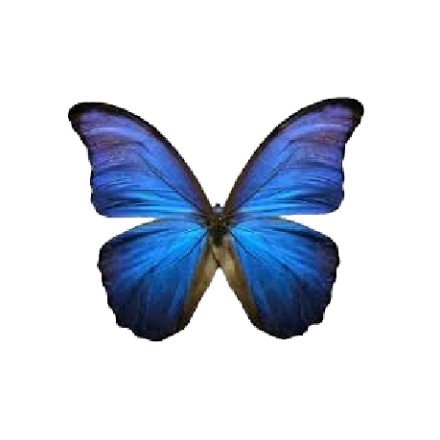
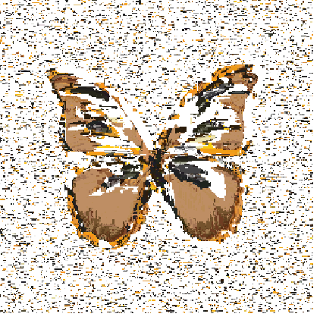
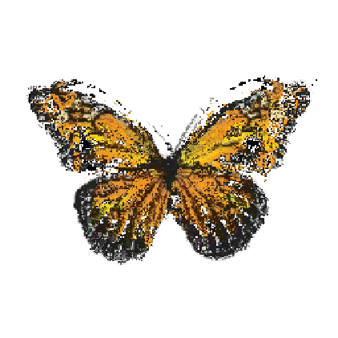
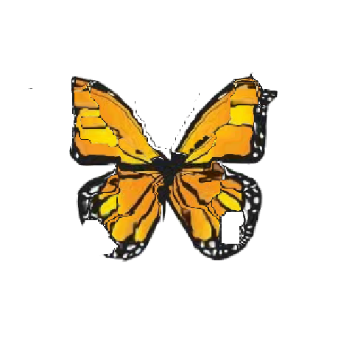
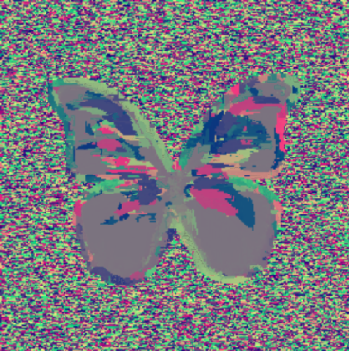
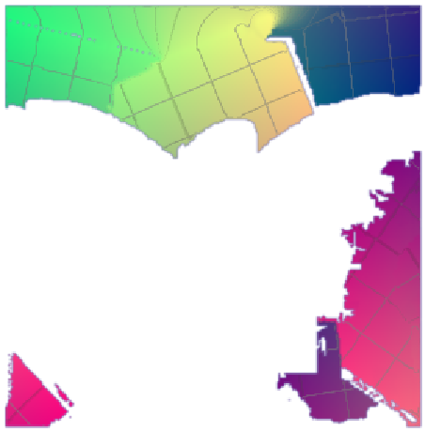
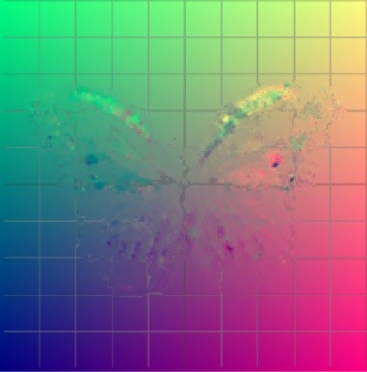
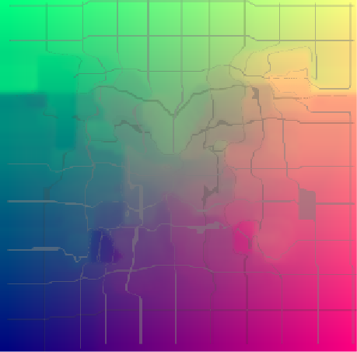
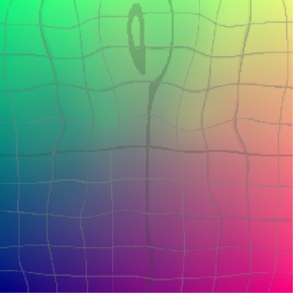
Multitude of Alignment Methods
Patch match
NRDC
Lucas Kanade
SIFT Flow
Ours
Aligned image
Flow field
Notes:
Of course we tried many existing alignment methods before inventing our own
Methods like Patch match or Non-Rigid Dense Correspondences strugglewith the very different appearance of the butterflies
Other methods like the classic Lucas Kanade optical flow are designed for very similar images with small disparities
The resulting image and flow look noisy
SIFT flow allows for quite robust matching of images with different appearance but the resulting flow is only piecewise-smooth, and the image still looks distorted
Our method, which is based on the assumption of a single object, works best and gives us what we need to compute subspaces later on

Slide 10
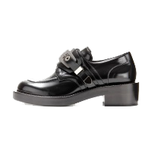
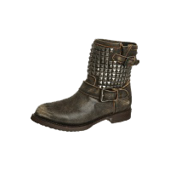
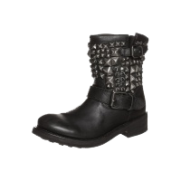
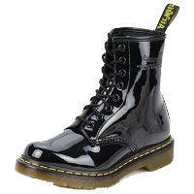
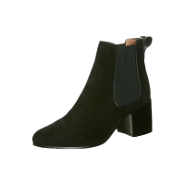
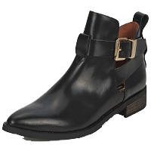
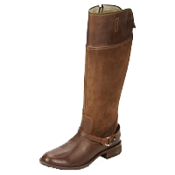
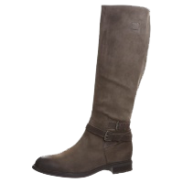
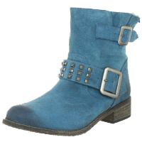
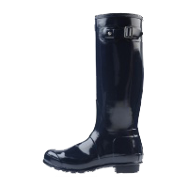
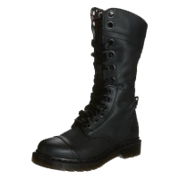
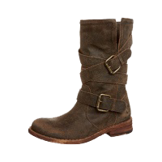
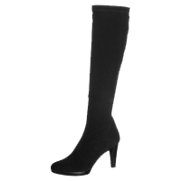
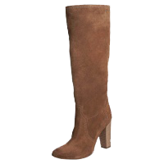
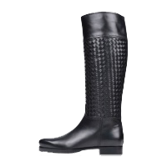
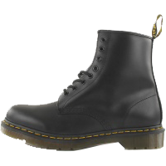
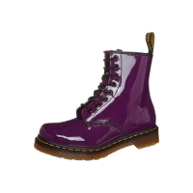
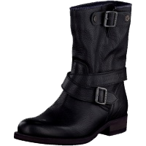
Direct Alignment is Difficult
Notes:
This is one of the datasets we used, showing many instances of boots
Say this boot on the lower left is the reference shape [click]
And we want to align this one now highlighted in blue [click]
Clearly, directly aligning the two is a difficult task
But we have more boots in our dataset, some of which [click] have shapes which are somewhere in between the shapes of the two we want to align [next slide]

Slide 11
Alignment Tree
Need to compare the yet unaligned images
L2-norm not robust enough
Min-pooling LAB-difference:
 |  |  | $$A_{i,j}$$
 |  |  | $$A_{i,j}$$
 |  |  | $$A_{i,j}$$
 |  |  | $$B_{i,j}$$
 |  |  | $$B_{i,j}$$
 |  |  | $$B_{i,j}$$
Notes:
The idea is to perform indirect alignment, aligning the high boot step-by-step to boots which are closer and closer to the target shape
To this end, we find the tree of shortest paths to the reference in a graph where the edges correspond to a similarity metric between pairs of images
The paths to the reference define the alignment steps we will take
Which similarity metric do we use?
[click] It is important to note that we are here comparing the yet unaligned images, [click] so common metric like L2 or SSIM would not be very useful here
[click] Instead, we use the min-pooling lab-color-difference
How does it work?
We have two very low res images here
We are integrating a difference term over the whole image
Say we are at pixel (i,j)
Then we look at neighborhoods in both images [click]
And search for the pair of most similar LAB values [click] which then defines the difference for pixel (i,j)

Slide 12
Pairwise Alignment: Initial Flow
Align
Search for best match in neighborhood
Energy term
Gaussian weighted LAB difference over patch
Length of the resulting flow vector
Notes:
So we have a plan for aligning very different images by using intermediate steps
Now, let’s look how we perform each alignment step
The alignment starts with a simple neighborhood search
Each pixel [click] searches independently over a neighborhood in the other image [click]
We compute an energy consisting of a gaussian-weighted LAB difference over patches around the two pixels and the length of the resulting flow vector as a “regularizer”
The pixel with minimal energy in the searched neighborhood is considered as match

Slide 13
Pairwise Alignment: Refining the Flow
Source $a$
Flow $f$
Target $b$
Warp $f(a)$
Blend
Blend $f(a)$, $b$
Notes:
Here we see the result of this first step
For the example, the aligned image looks very close to the target
However [click], the corresponding flow is not smooth
We can also see that, when blending between the two images, the transition is not smooth
We need to improve the flow [next slide]

Slide 14
Confidence Measure
Curvature
of Energy Term
Forward/Backward Flow Agreement
+
+
Flow
Thresholding
1
0
Notes:
For this, we define a confidence measure on the flow field
I won’t go into details here
But the confidence includes, first, the curvature of the energy function which we used for computing the flow over the image
To this, we add an agreement check between the forward and backward flows between the pair of images
Finally, the confidence is thresholded
Then we blur the flow field while giving more weight to the confident areas
For example, if the confident part around the left eye says that the flow should go right, then this is propagated to the less confident surroundings
[next slide]

Slide 15
Pairwise Alignment: Refining the Flow
Source $a$
Flow $f$
Confidence-guided blur
Target $b$
Warp $f(a)$
Blend
Blend $f(a)$, $b$
Notes:
After this step, the flow field already looks much smoother and the aligned image also keeps more of the original appearance
And the warp now looks like this [video]
Much nicer but the face of the cat is still distorted too much in some spots
This is why, in a final step, we enforce the flow to become locally rigid [next slide]

Slide 16
Locally Rigid Flow
Flow $f$
Rigid $r$
Notes:
Say we are at a pixel which is here shown in the middle of a neighborhood surrounding it
The flow “f” we have so far defines a transformation of this neighborhood to new positions in the aligned image
We search for the rigid transformation which is closest to “f” and use this instead
This we do at each pixel individually

Slide 17
Pairwise Alignment: Refining the Flow
Source $a$
Flow $f$
Confidence-guided blur
Target $b$
Warp $f(a)$
Locally rigid flow
Blend
Blend $f(a)$, $b$
Notes:
And this is now the final result
The flow field looks regular and smooth
The aligned image has the original appearance but a new shape
And the blend [click] also verifies the quality of the alignment

Slide 18
Alignment Results: Butterflies
Source
Target
Deformation
Blend

Slide 19
Alignment Results: Fish
Source
Target
Deformation
Blend

Slide 20
Overview of the Method
*
Shape space
Shape and
appearance
manipulation
Image set
Aligned set
Appearance space
Notes:
Now we have an aligned image set, [click] we can compute shape and appearance subspaces [next slide]

Slide 21
Subspace Construction
Image with $n$ pixels as vector $∈R^{\left(3+2\right)n}$
PCA on the set of image vectors
Down-sampled images
Transparent pixels are set to average
Scaling to weight importance of color / shape
Notes:
We perform principal component analysis on the set of image vectors
There are three things to note here
First [click], we use downsampled images because, considering the size of our data sets, we cannot expect to capture high frequency variations
Second [click], our images are in front of a neutral / transparent background
The background pixels should not affect the PCA, so we set them to the average of all non-transparent pixels at the respective position in the set
This results in their entries in the covariance matrix becoming 0
Third [click], by scaling the color or deformation components of the 5D-images, we scale the importance of color or shape variations [next slide]

Slide 22
Resulting Subspaces
-1
+1
-1
+1
-1
+1
-1
+1
Shape directions
Color directions
Notes:
The PCA results in a set of image vectors corresponding to the most important directions of variation in the data set
Here we see an example of shape vectors for our fish dataset
For example, the direction on the top apparently corresponds to thin vs fat fish while the one on the bottom determines the “roundness” of the fish
Here are some appearance variations of the same dataset [click]
For example, the top variation is between the colors orange and blue and the one on the bottom distinguishes fish which are darker at the top vs those which are darker at their bottom

Slide 23
Overview of the Method
*
Shape space
Shape and
appearance
manipulation
Image set
Aligned set
Appearance space
Notes:
Having computed the subspaces [click], we can finally use them to guide image manipulations [next slide]

Slide 24
Subspace-aware Editing
$$b_{1}$$
$$x=(x_{0},x_{1},x_{2})$$
Original
$$b_{0}$$
Subspace reconstruction
$$b_{2}$$
Appearance subspace
Final Result
Notes:
I will sketch how this works
Assume the user paints this fish with some strokes [click]
We then find the closest point in the subspace on the left while giving higher weights to the strokes than to the original fish pixels
The result is this new color scheme for the fish, shown on the right
Which is then transferred to the original [click] using a locally rigid appearance transfer

Slide 25
Locally Rigid Color Transfer
R
R
R
Source
B
Target
B
Result
B
Notes:
The locally rigid color transfer is another contribution of our paper
Actually, it is not too different from the orthogonalization of the flow, but it operates on 3D colors while the other one operates on 2D positions
Consider the 3x3 pixel image, if we plot the colors in this patch in a two-dimensional Red-Blue space [click], this is what we get
[click] Now, say we have this other patch and, we want to transfer the “color scheme” while preserving local details
What we do is, we look at the color distributions and find the closest rigid transformation, which might look like this [click]
As you can see, structures like edges

Slide 26
Application: Appearance Editing
Without Subspace
(Domain Transform Filtering)
Input
Ours
Notes:
The first example shows appearance editing on a pear
As you can see, our approach produces realistically colored pears while the common approach cannot restrict colors to plausible ones
Here you also see how the approach is robust to extreme edits

Slide 27
Application: Appearance Editing
Without Subspace
(Domain Transform Filtering)
Input
Ours
Notes:
In this second example, a chicken is recolored
Our approach knows, which colors should appear in which parts of the chicken and acts accordingly

Slide 28
Application: Shape Editing
Without Subspace
(Moving Least Squares
Image Deformation)
Input
Ours
Notes:
Finally, some shape editing on a butterfly
Observe, how the subspace automatically enforces the edits to stay symmetric

Slide 29
Ending Credits
Visit the project homepage at: http://tinyurl.com/subspaces
Paper
More Videos
Presentation Slides
Datasets
Notes:
Let me conclude the talk with a link to our project homepage
There, you can find not only the paper but also more videos, the presentation slides and finally the datasets which we used
Thank you for your attention

Slide 31
Boundary-based Alignment
Shape Context: A new descriptor for shape matching and object recognition S. Belongie, J. Malik, J. Puzicha
Data-Driven Object Manipulation in Images C.Goldberg, T. Chen, F.-L. Zhang, A. Shamir, S.-M. Hu
Source
Target
Shape Context
Ours
Notes:
The images we have to align vary drastically in their appearance, but they also show a single object instance each
So one might consider a boundary-based alignment, for example using the shape context descriptor which has been used for similar applications before
The reason why we don’t use such a method is that we also want to align the insides of objects if possible to compute more expressive subspaces
[click] Consider this example of two rather similar butterflies where we want to align the left one to the right
[click] These are the results produced by boundary based alignment and our method, regarding their boundary alignment, they are comparable
But if we blend them with the target image [click], we see that our method also aligns the inner structure [click], while the competitor doesn’t

Slide 32
Joint Shape-Appearance Spaces

Slide 33
User Study

