Slide 1
Manipulating refractive and reflective binocular disparity
Łukasz Dąbała^{1,4}, Petr Kellnhofer¹, Tobias Ritschel^{1,3},
Piotr Didyk², Krzysztof Templin^{1,2}, Karol Myszkowski¹, Przemysław Rokita⁴, Hans-Peter Seidel¹
¹MPI Informatik ²MIT CSAIL ³Saarland University ⁴Warsaw University of Technology

Slide 2
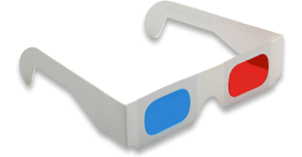
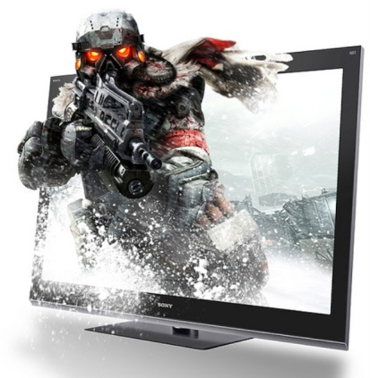
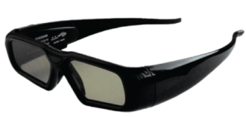
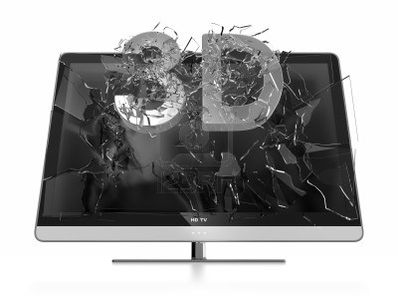
Stereoscopy nowadays

Slide 3
Diffuse case
Disparity
Screen
Diffuse object
Notes:
Bracket is blue, legend under blue line => no legend, screen size = blue line size

Slide 4
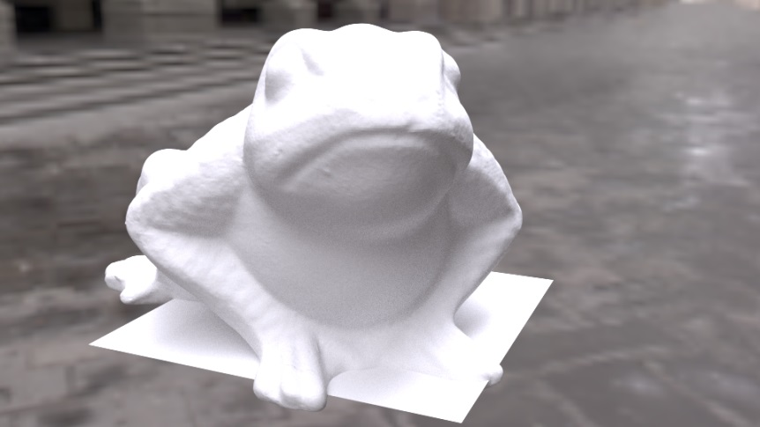
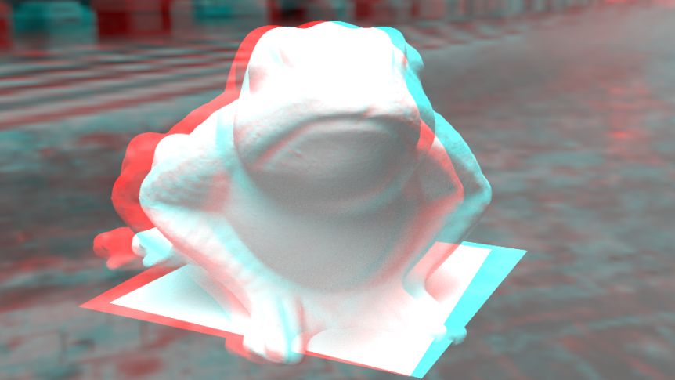
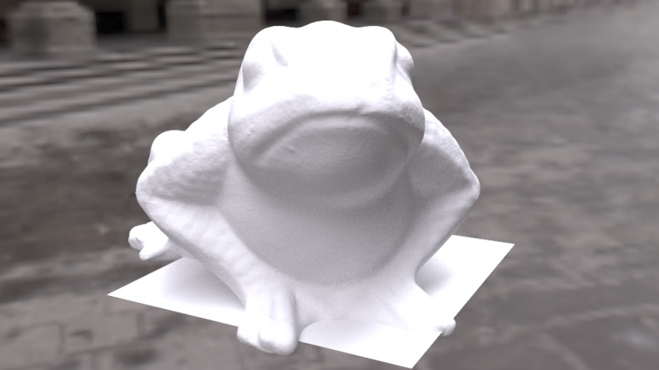
Stereo for diffuse case

Slide 5
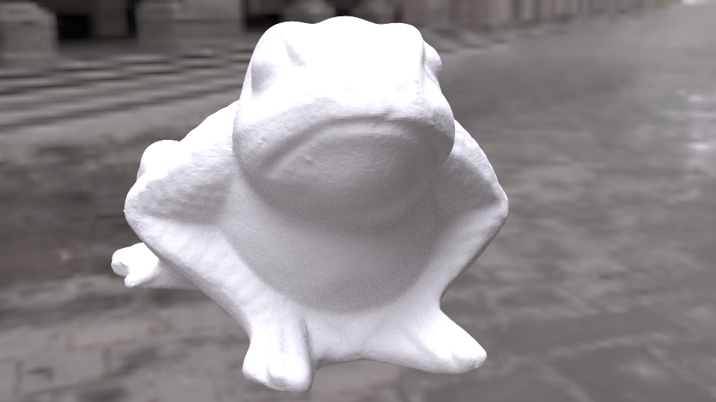
Specular case
Notes:
Image there

Slide 6
Specular case
Reflected object
Specular disparity
Diffuse disparity
Screen
Object with specular properties
Notes:
Bracket colors, legend

Slide 7
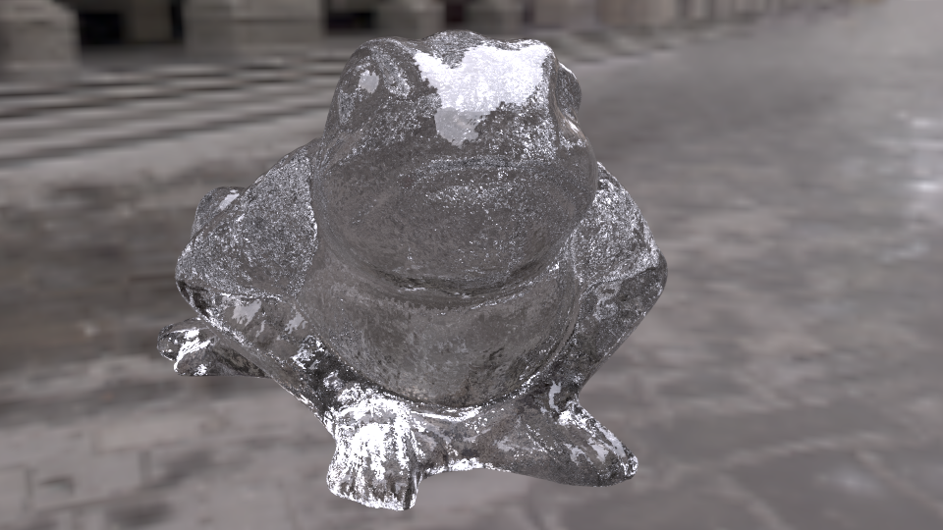
Refractive case
Notes:
Image there

Slide 8
Screen-door transparency case
„Transparent” disparity
Diffuse disparity
Screen
Transparent object
Other object
Notes:
Red thing as plane, ray start at one point on blue and one on red, show disparity brackets as well

Slide 9
Refractive case
Diffuse disparity
Refractive disparity
Screen
Refractive object
Other object
Notes:
As before, plus blue thing split into two interfaces with light blue in the middle + make another slide/animation with the blue thing becoming curved

Slide 10
Refractive case
Refractive disparity
Diffuse disparity
Screen
Refractive object
Other object
Notes:
As before, plus blue thing split into two interfaces with light blue in the middle + make another slide/animation with the blue thing becoming curved

Slide 11
Eikonal case
Notes:
Image there

Slide 12
Eikonal case
Screen
Medium with refractive properties
Other object
Notes:
Make arrows filled, the red thing as plane, legends as usual, no brackets needed here

Slide 13
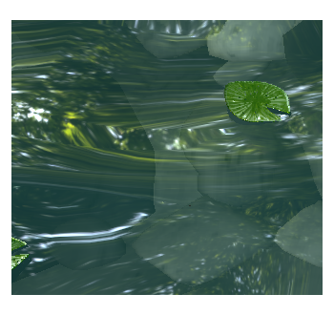
Problem 1: Rivalry
Notes:
Fix the wiggling

Slide 14
Problem 2: Accommodation and vergence conflict
Perceived object
Accommodation plane (screen)
Vergence
Disparity
Comfort zone
Notes:
Show disparity axis arrow and label

Slide 15
What we want to achieve
Realistically looking optical effects
Comfortable depth reproduction
Limited vertical disparity
Limited rivalry

Slide 16
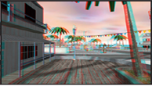
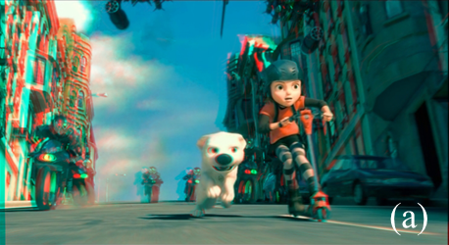
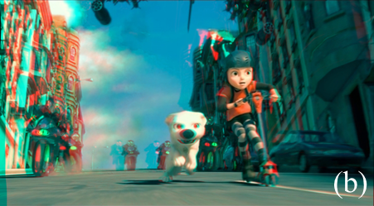
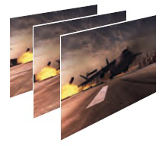
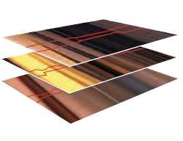
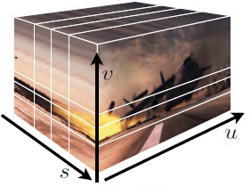
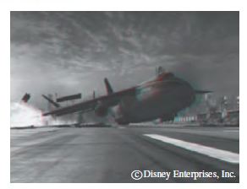
Previous solutions
OSCAM - Optimized Stereoscopic Camera Control for Interactive 3D.
Oskam et al.
SIGGRAPH Asia 2011
Nonlinear Disparity Mapping for Stereoscopic 3D.
Lang et al.
SIGGRAPH 2010
Multi-perspective stereoscopy from light fields
Kim et al.
Proc. SIGGRAPH Asia 2011
Notes:
Say that it goes from easy to hard

Slide 17
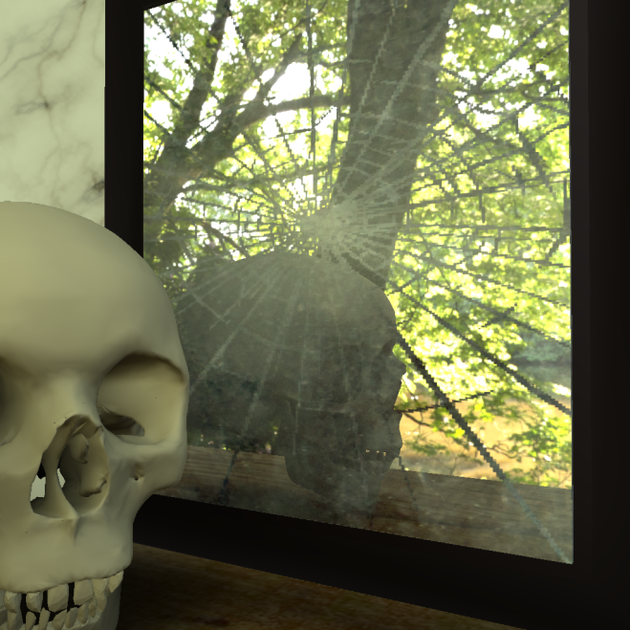
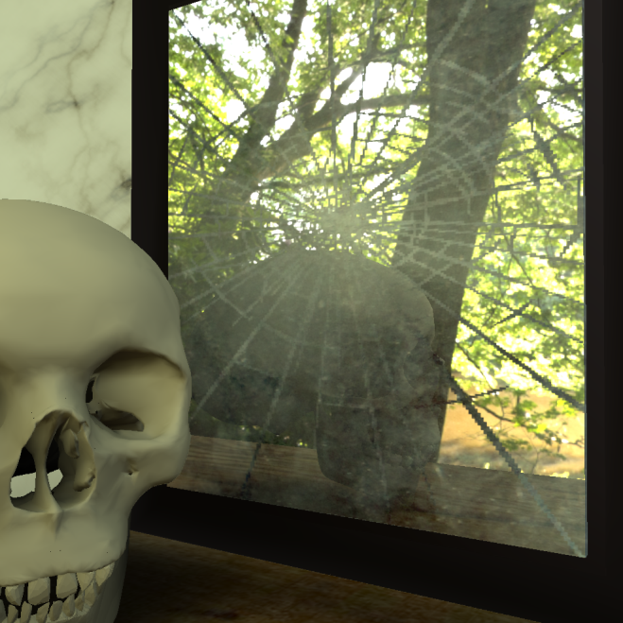
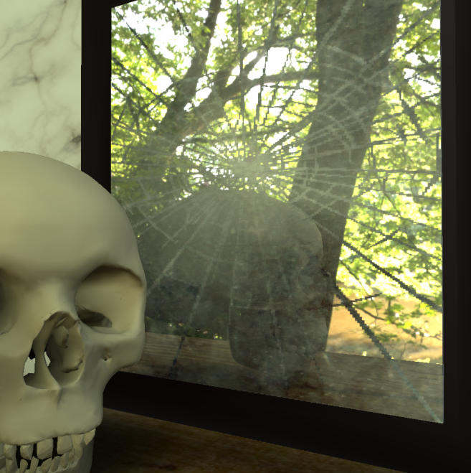
What about many layers?
Moving into comfort zone results in flat reflection

Slide 18
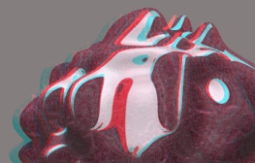
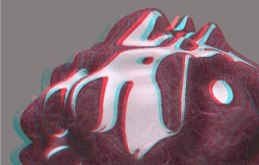
Extension for specular
Highlight microdisparity for improved gloss depiction
Templin et al.
SIGGRAPH 2012

Slide 19
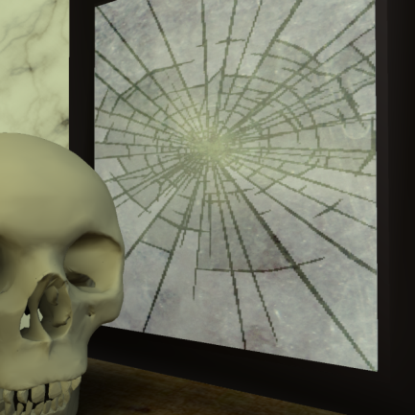
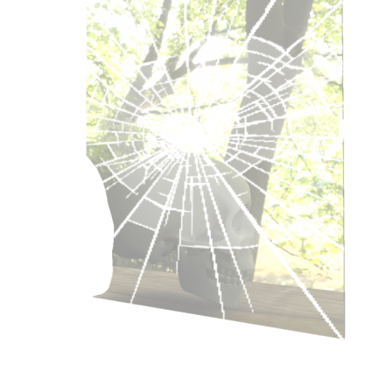
Rig for reflections
Decompose image
Rig for every layer
Generalize even further

Slide 20
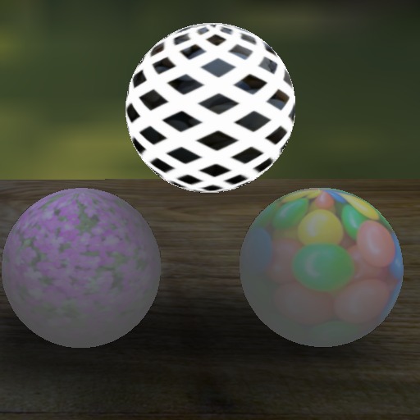
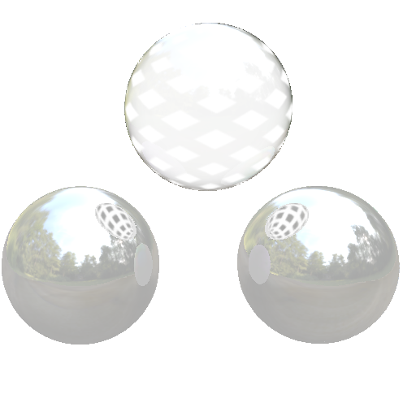
What do we optimize?
Notes:
Completely redo. Make multiple slides. First show colorful nodes and camera for each node with different color + maybe some inset of image (single layer render). Other slide will show per pixel, so there will be some plane with huge pixels (1D) and for some of them something,…. Make it aligned V or H, I do not know and make reflections correct

Slide 21
What do we optimize?
Pixels in layer 3
Camera baseline
Notes:
Completely redo. Make multiple slides. First show colorful nodes and camera for each node with different color + maybe some inset of image (single layer render). Other slide will show per pixel, so there will be some plane with huge pixels (1D) and for some of them something,…. Make it aligned V or H, I do not know and make reflections correct

Slide 22
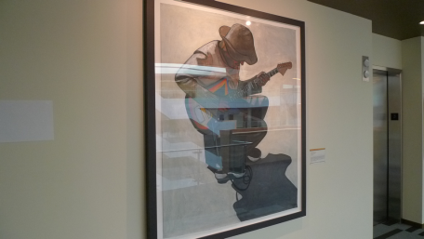
How to get disparity?
Difficult with real images
Image-based rendering for scenes with reflections
Sinha et al.
SIGGRAPH 2012
Notes:
Do not say they are stupid XD

Slide 23
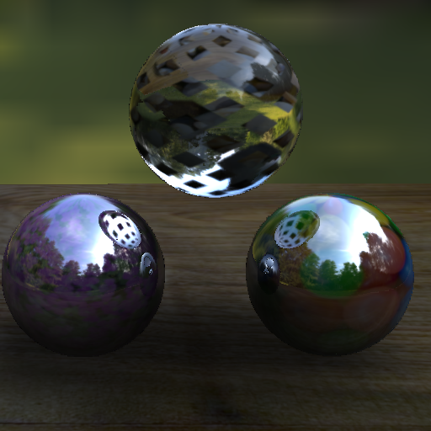
Limitation to CG
Notes:
Make one slide with complete render, then replace by 3 node tree with those layer renders and then slowly replace them by disparities

Slide 24
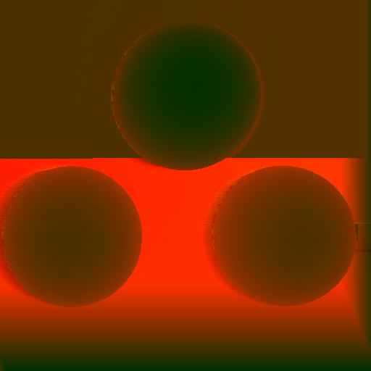
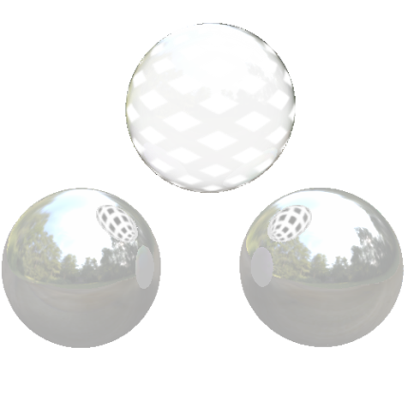
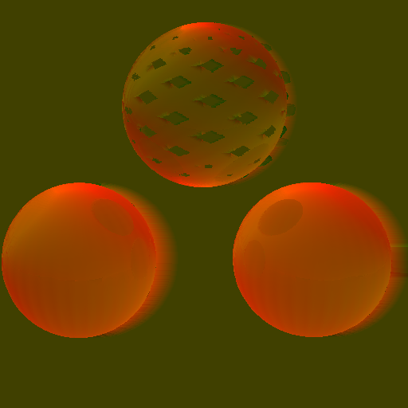
Limitation to CG
Diffuse layer
Specular layer
Refractive layer
Notes:
Make one slide with complete render, then replace by 3 node tree with those layer renders and then slowly replace them by disparities

Slide 25
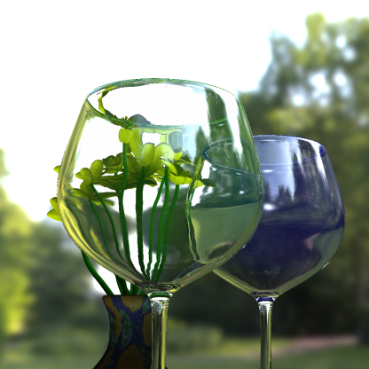
And how to measure rivalry?
How compatible are both views?
Difference of locally aligned images
Disparity value

Slide 26
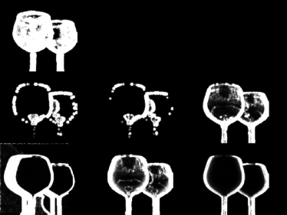
How do we optimize?
Sample all cameras for each layer and pixel
Evaluate disparity and rivalry
Choose the one with minimal error energy
Energy
Camera Baseline

Slide 27
1. Data term
Notes:
Put shadows on the ground, make the screen look less bad (also put shadows), move it to the right but not completely to the screen edge! There should be some margin

Slide 28
2. Absolute disparity

Slide 29
3. Relative disparity
Layer 2 Layer 5

Slide 30
4. Rivalry
Left Right

Slide 31
Optimization
$$f\left(d, r, w\right)=α_{d}f_{d}\left(d,w\right)+α_{a}f_{a}\left(d,w\right)+α_{p}f_{p}\left(d,w\right)+α_{r}f_{r}\left(r,w\right)$$
$α_{d}f_{d}\left(d,w\right)−Data term$
$α_{a}f_{a}\left(d,w\right) −Absoulte disparity$
$α_{p}f_{p}\left(d,w\right) −Relative disparity$
$α_{r}f_{r}\left(r,w\right) −Rivalry$
Minimization using multiple starts of gradient descent

Slide 32
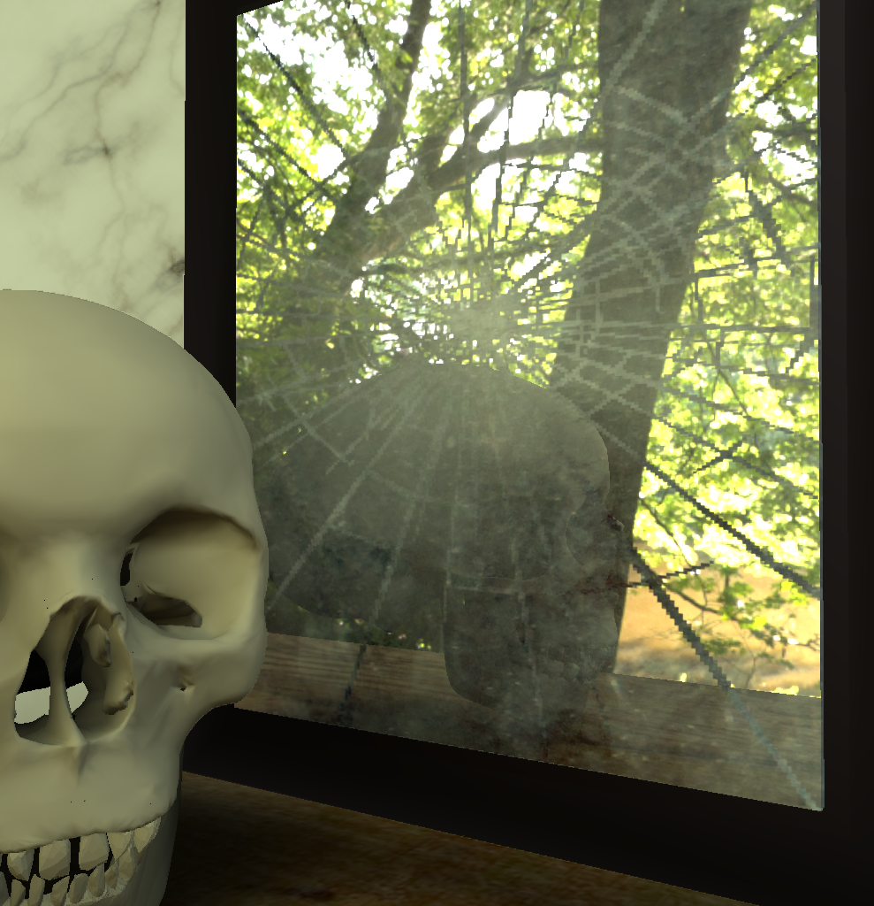
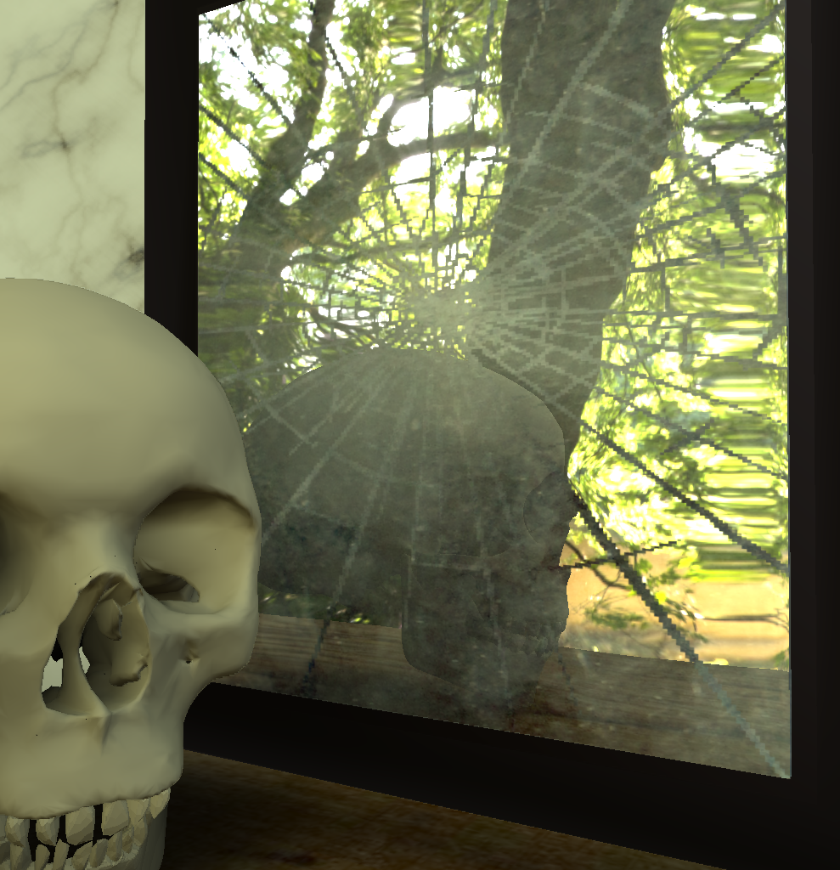
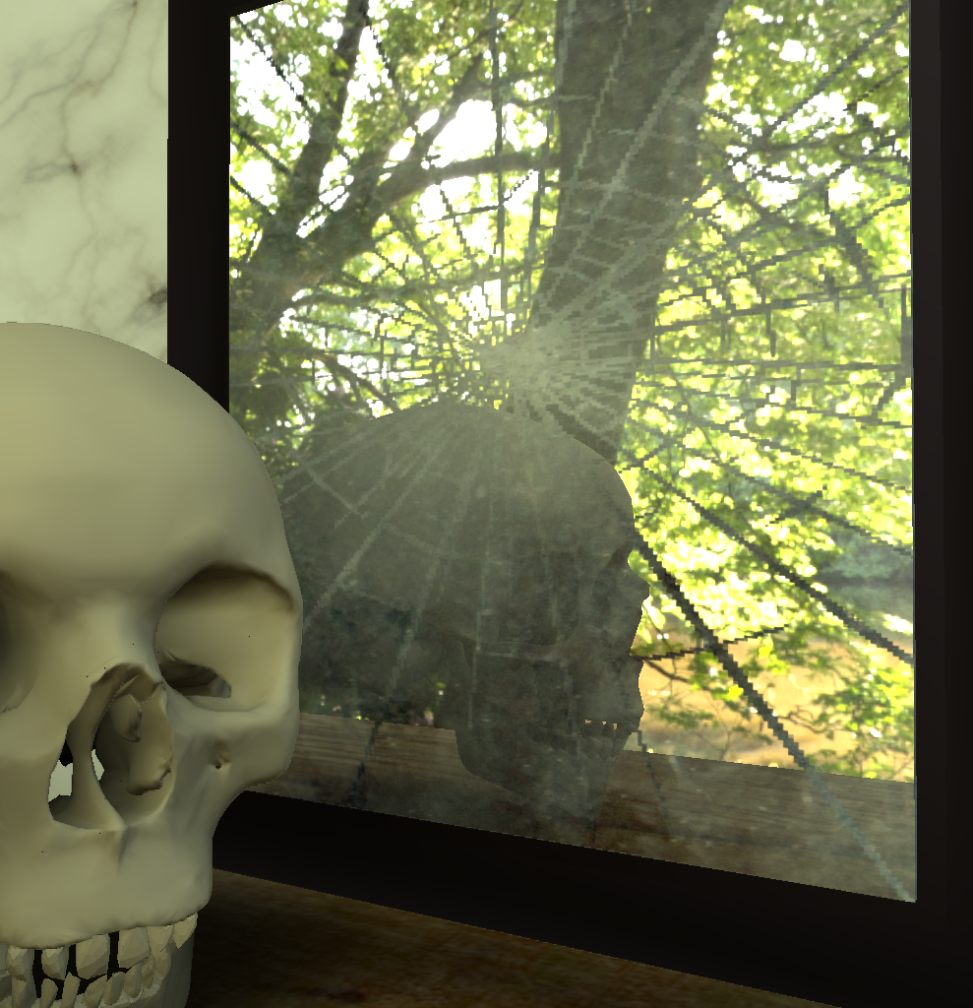
Results
Physical
Ours

Slide 33
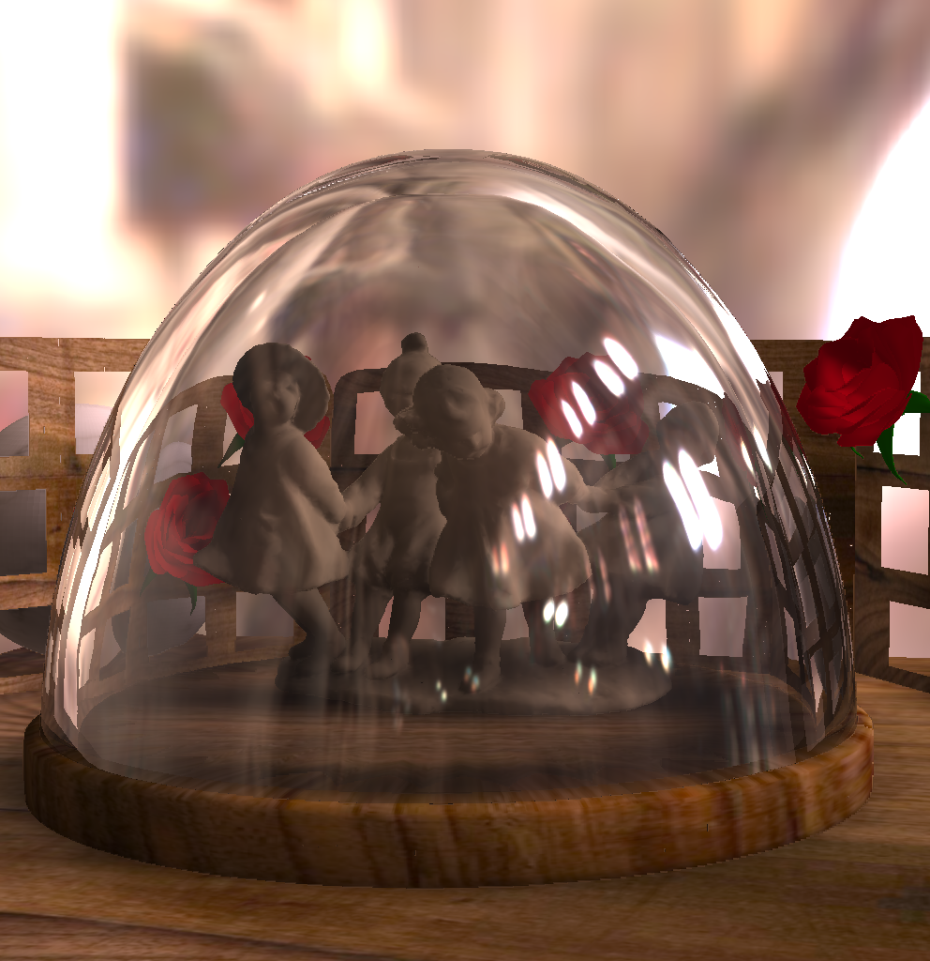
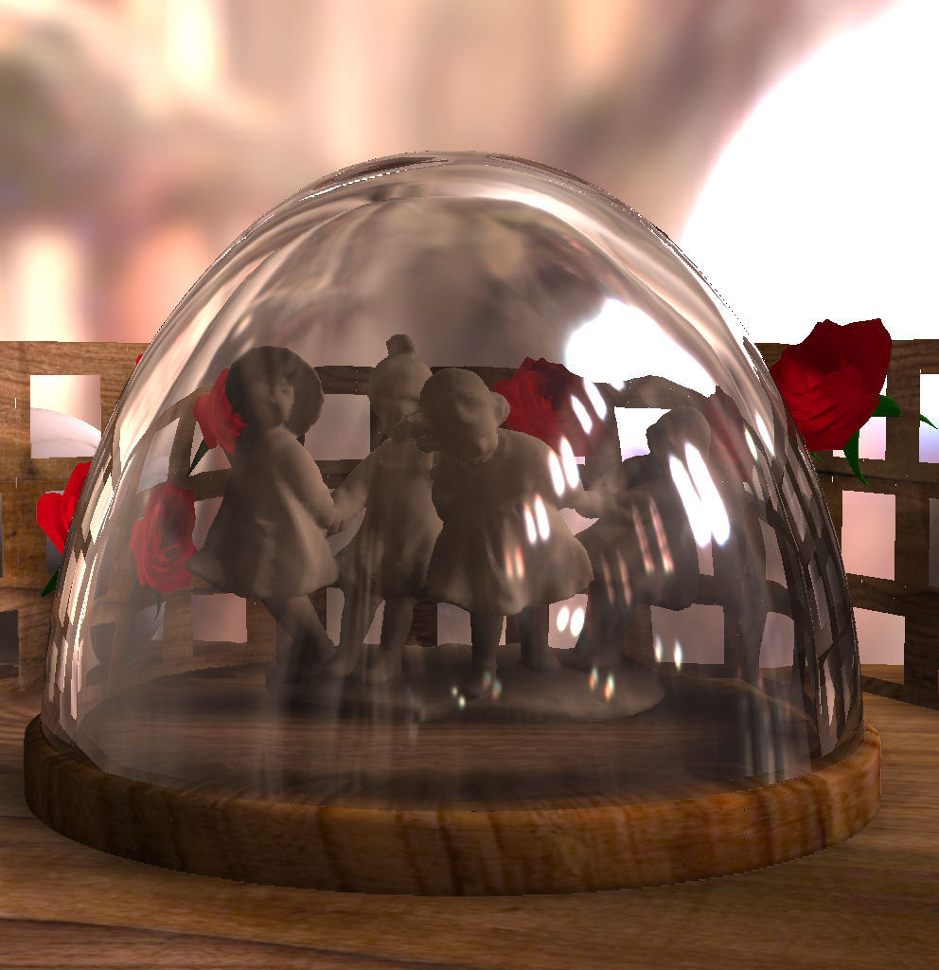
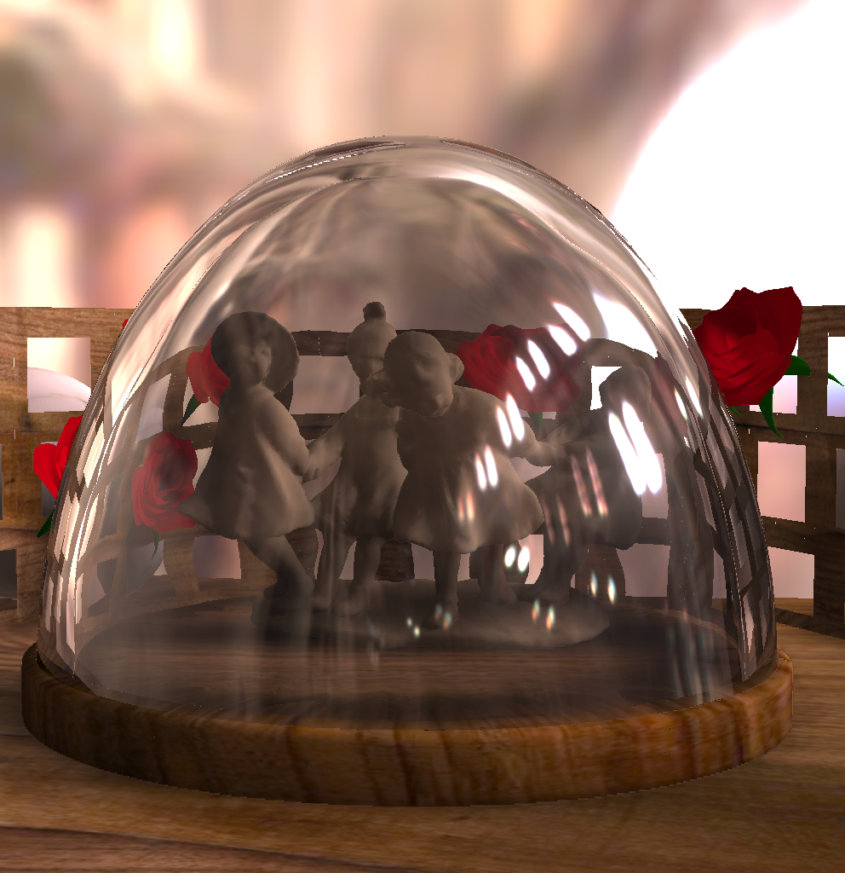
Results
Physical
Ours

Slide 34
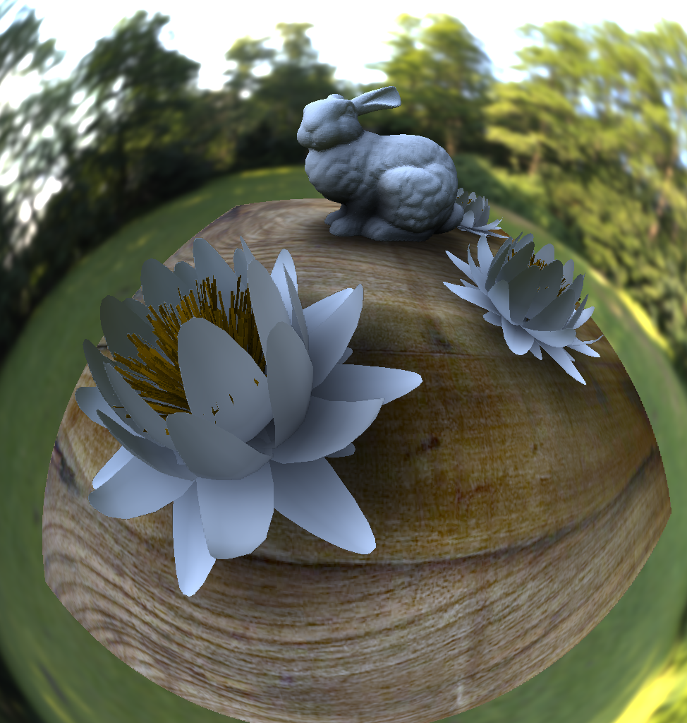
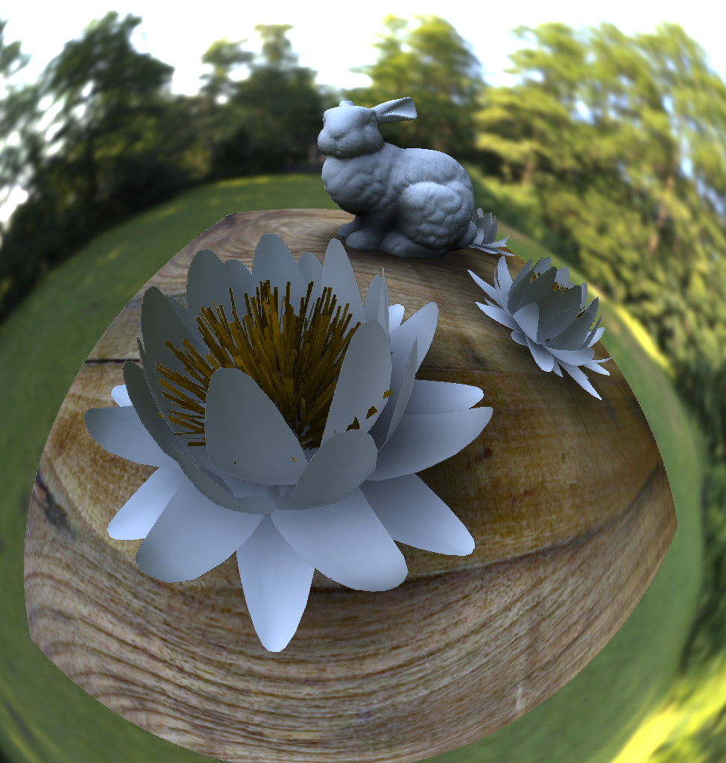
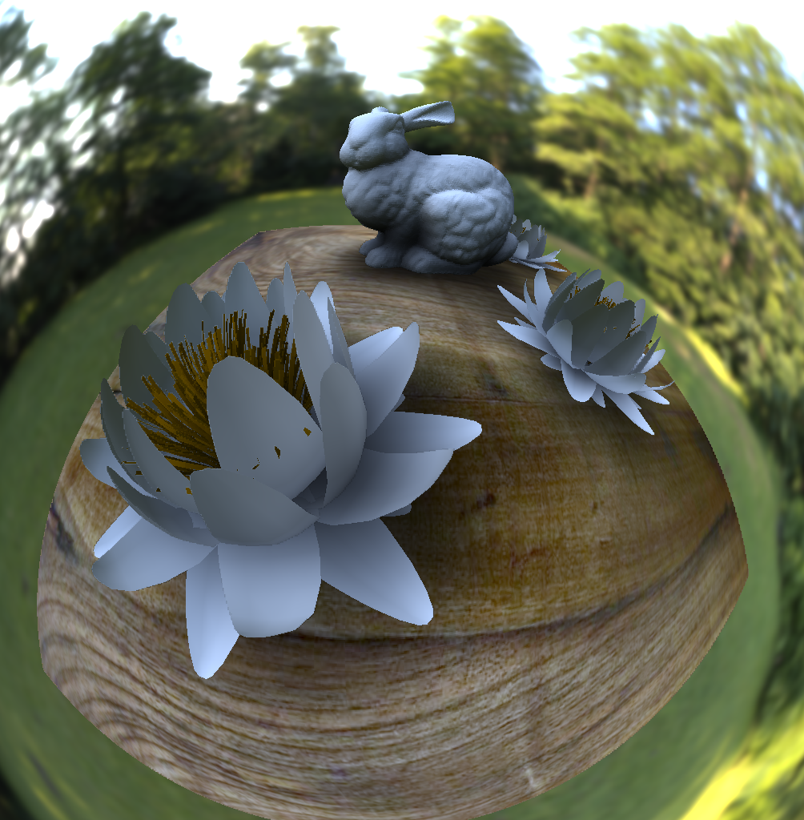
Results
Physical
Ours

Slide 35
Results

Slide 36
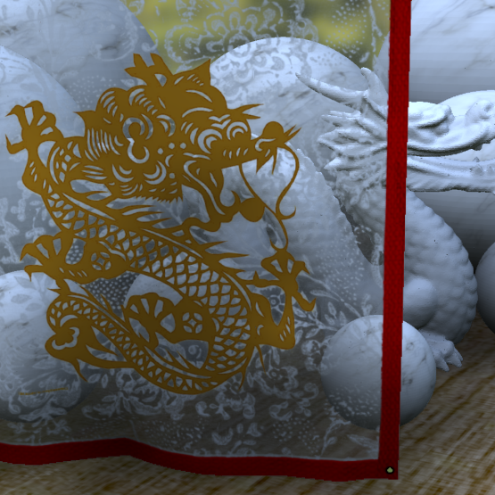
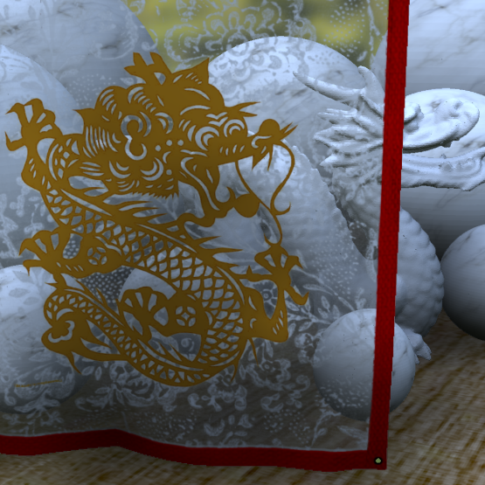
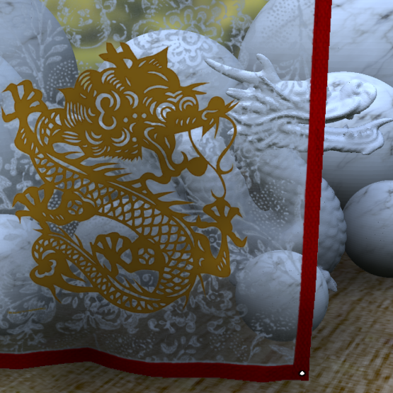
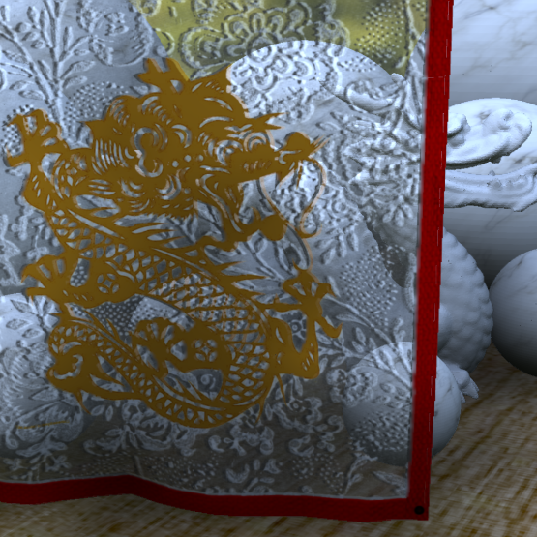
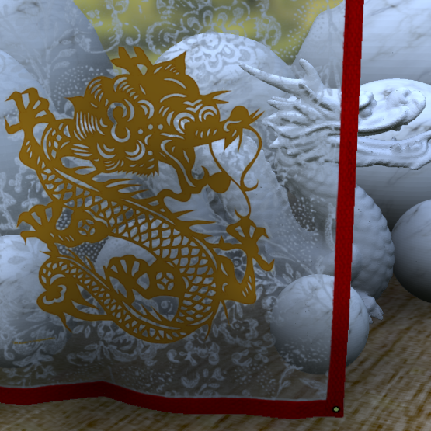
Comparison with other methods
Physical
On surface
Near-surface
Ours

Slide 37
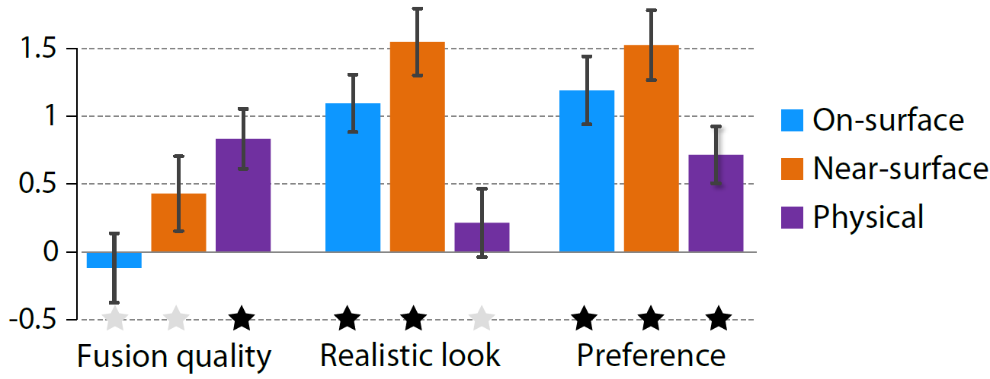
Tests
Ranking of methods (on-surface, near-surface, physical and ours)

Slide 38
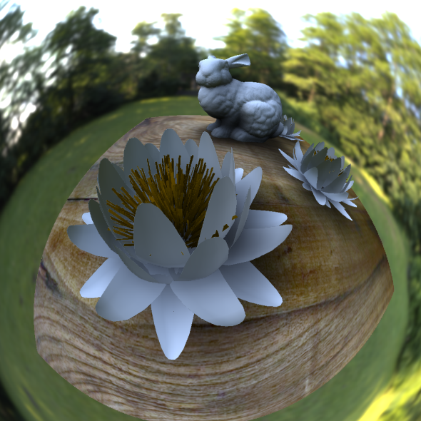
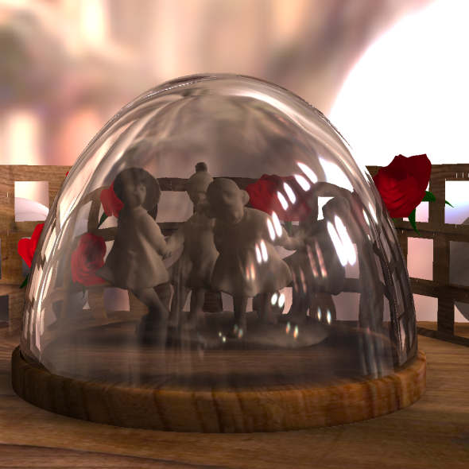
Conclusion
Explained issues of 3D in presence of reflections and refractions
Presented remedy
Validated results in a user study
Notes:
Put three overlapping results

Slide 39
Manipulating refractive and reflecting binocular disparity
Project page: http://resources.mpi-inf.mpg.de/StereoRefraction/
Contact: lukasz.dabala(at)gmail.com
pkellnho(at)mpi-inf.mpg.de
THANK YOU

Slide 40
Stereo rig
Stereo compositing Accelerated by Quadtree Structures in Piecewise Linear and Curvilinear Spaces.
Pinskiy et al.
DigiPro ’13 Proceedings of the Symposium on Digital Production
Notes:
Kill

Slide 41
Human limitations
Disocclusions
Luminance structure
Luminance contrast
?
?
?

Slide 42
Weights influence
All costs
Rivalry term only
Data term only
Layer separation term only

Slide 43
Results
Physical
Ours

Slide 44
Diffuse case
Notes:
Image there

Slide 45
Why stereo content?
Benefits:
More realism
Excitement from unusual experience
Possibility to see more details
Defects:
Need for special equipment
Much harder content production
Some people do not see it

Slide 46
Binocular disparity
Accommodation
(focal plane)
Screen
Object in right eye
Viewing discomfort
Vergence
Pixel disparity
Comfort zone
Object in left eye
Object perceived in 3D
Depth
Notes:
Diffuse image before this slide

Slide 47
Comfort in stereo 3D
Comfort zone
Scene manipulation
Viewing discomfort
Viewing comfort

Slide 48
Algorithm
Image decomposition to set of layers
Tone mapping
Stereo matching
Take into consideration limitations of human visual system
Find potential regions of rivalry
Optimize for the final image using maps of disparity, rivalry and importance

Slide 49
Stereo matching
Problem with finding corresponding points in real images
Possibility to have multiple matches

