Slide 1
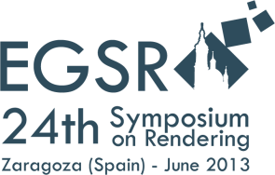
Optimizing Disparity for Motion in Depth
Petr Kellnhofer | Tobias Ritschel
Karol Myszkowski | Hans-Peter Seidel

Slide 2
Overview
Introduction to stereoscopic 3D
Optimizing disparity for motion in depth
3D Warping
Conclusion

Slide 3




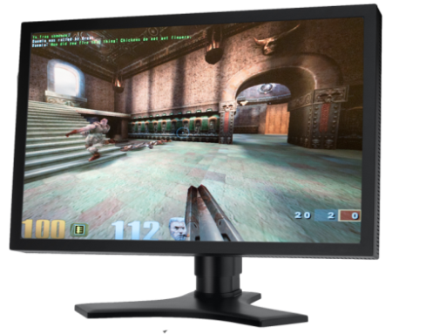



Stereoscopic 3D
Benefits:
  More realistic presentation
  Excitement from unusual experience
  Better separation of scene layers
Drawbacks:
  Requires more equipment
  More complicated content production
  Some people do not see it

Slide 4
Why is it difficult?
Due to cue interplay!
  Pictoral
    Size
    Occlusion
    Shadow
    …
  Occular
    Accommodation
    Vergence
  Binocular disparity
Vergence
Accomodation

Slide 5
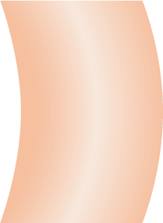
How does disparity work?
Accommodation
(focal plane)
Screen
Object in right eye
Viewing discomfort
Vergence
Pixel disparity
Comfort zone
Object in left eye
Object perceived in 3D
Depth
Notes:
Put another animation with compression after it

Slide 6
Preventing discomfort
Comfort zone
Scene manipulation
Viewing discomfort
Viewing comfort

Slide 7
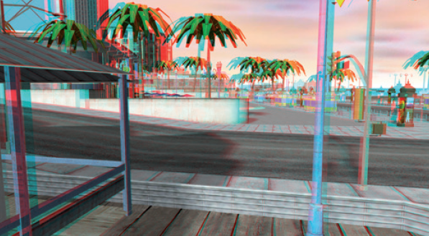
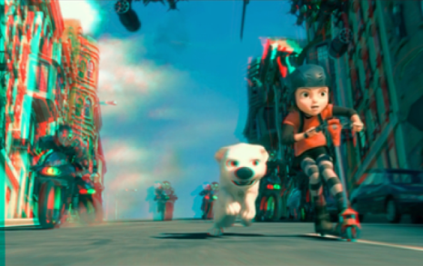
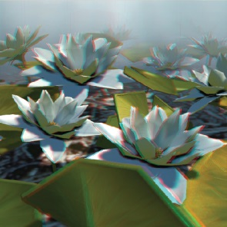
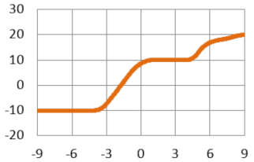
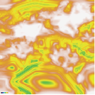
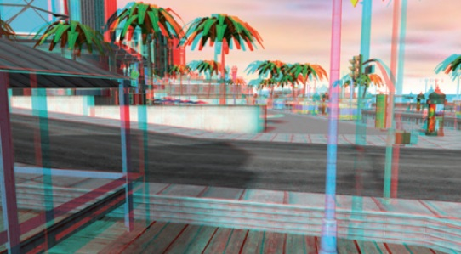
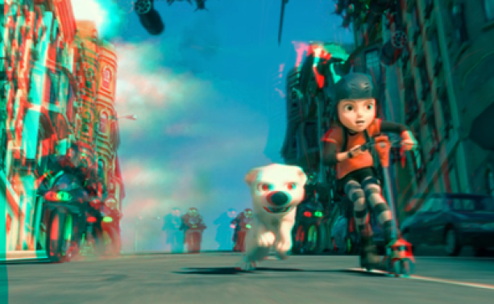
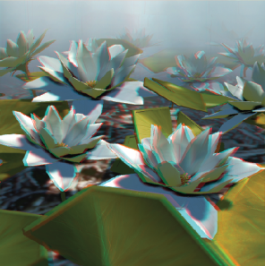
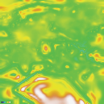
Disparity manipulation
Perceived distortions
Output disparity
strong
Input disparity
weak
Perceived distortions
OSCAM - Optimized Stereoscopic Camera Control for Interactive 3D.
Oskam et al.
SIGGRAPH Asia 2011
Nonlinear Disparity Mapping for Stereoscopic 3D.
Lang et al.
SIGGRAPH 2010
A perceptual model for disparity.
Didyk et al.
SIGGRAPH 2011
Notes:
Put compression to the next
Add examples of Lang and Didyk instead from Piotr

Slide 8
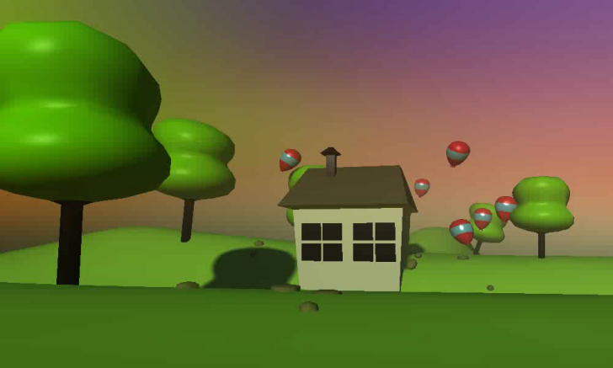
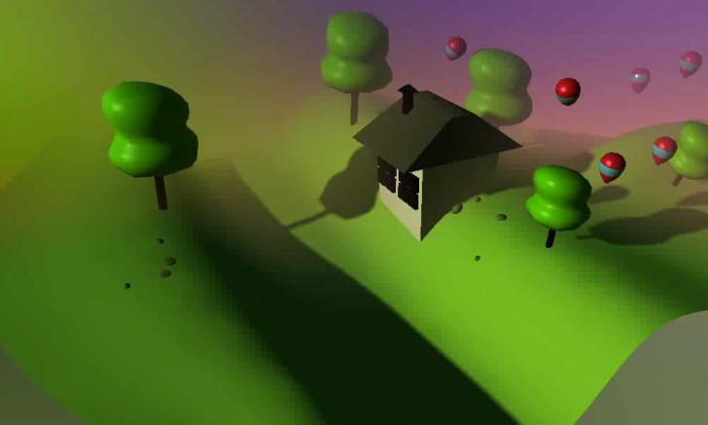
Optimizing Motion in Depth
Compression removes empty space
We want to
  maintain manipulation
  but at the same time
  locally correct the motion
Original
disparity
Manipulated
disparity
Depth
Depth
Notes:
Disparity is important for TTC etc!

Slide 9
Algorithm
Subsample in space and time
Minimize perceived motion error
Upsample in space and time
Apply disparity to the image
Input: Original disparity g and
Manipulated disparity h
Output: Optimized disparity f and final sequence of stereo images

Slide 10
Data flow
g
h
f
g
h
f
Disparity
Manipulation
Our
Optimization
Original
disparity
Manipulated
disparity
Optimized
disparity

Slide 11
Energy term #1
g
h
f
Optimized disparity should be similar to the manipulated disparity
Optimization
Manipulated disparity
Optimized disparity
Notes:
Talk about graphs

Slide 12
Energy term #2
g
h
f
Optimization spatially smooth
Optimization
Manipulated disparity
Optimized disparity
Notes:
Talk about graphs

Slide 13
Energy term #3
g
h
f
  Optimization temporarily smooth
Optimization
Manipulated disparity
Optimized disparity
Notes:
Say that these are what makes us better

Slide 14
Energy term #4
g
h
f
Maintain the original acceleration
Optimization
Original disparity
Optimized disparity
Notes:
Say that these are what makes us better

Slide 15

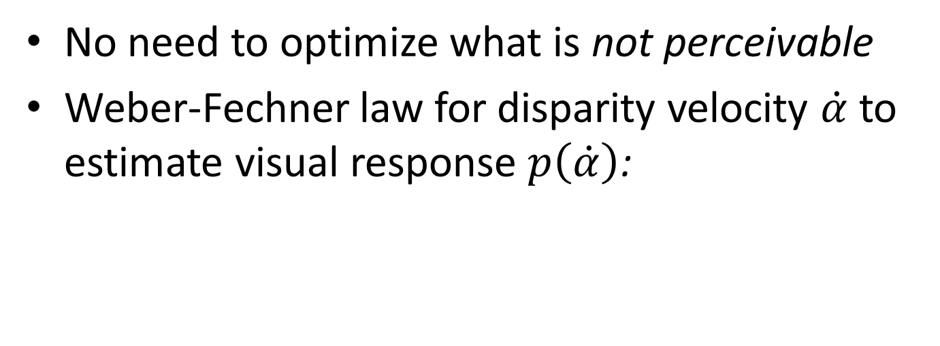

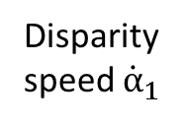
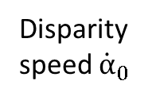

Perceptualization
No need to optimize what is not perceivable
Weber-Fechner law for disparity velocity $\dot{α}$ to estimate visual response $p\left(\dot{α}\right)$:
$$p\left(\dot{α}\right)$$
$$\dot{α}$$
Perceived difference of $\dot{α}$
Not
perceivable
Disparity
speed ${\dot{α}}_{1}$
Disparity
speed ${\dot{α}}_{0}$
Notes:
Say that we do that visual response function and then talk more about animation that it compares and diogonal is zero a that higher speed changes are less important
Add red diagonal to the animation

Slide 16
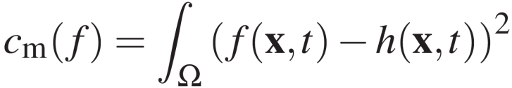
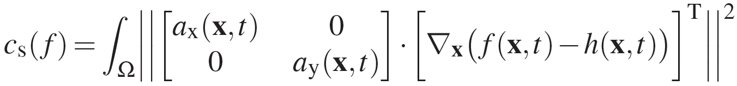
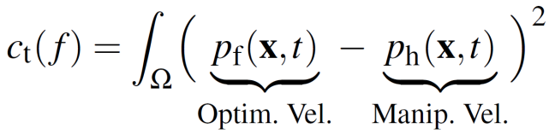
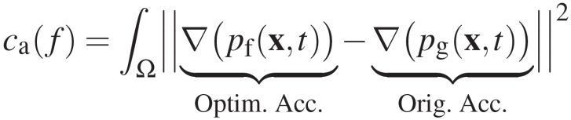
Cost functions
#1
Similarity
h
f
#2
Spatial
smoothness
h
f
#3
Temporal
smoothness
h
f
#4
Acceleration
g
f

Slide 17



Cost Functions
#1
Similarity
#2
Spatial
smoothness
#3
Temporal
smoothness
#4
Acceleration

Slide 18
Optimization
Cost is non-linear
We minimize using gradient descent
  + boundary constraints
Cost
Disparity content

Slide 19
Image production
Linear disparity scaling
  → Camera adjustment
What about local or
non-linear disparity
manipulation?
  → Single camera
+ warping

Slide 20
Image-space warping
Isolated objects
  No problem
More occluding objects
  Disocclusion problem
?

Slide 21
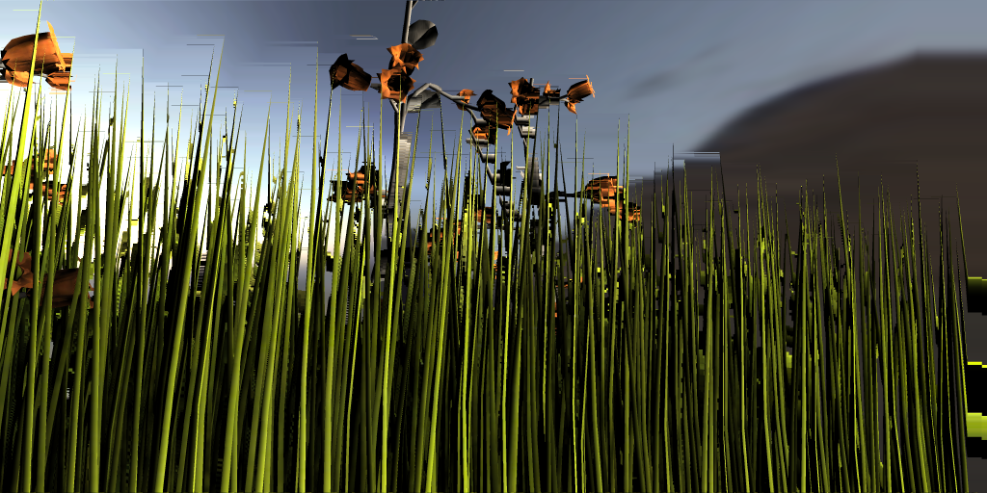
Warping results
Image-Space

Slide 22
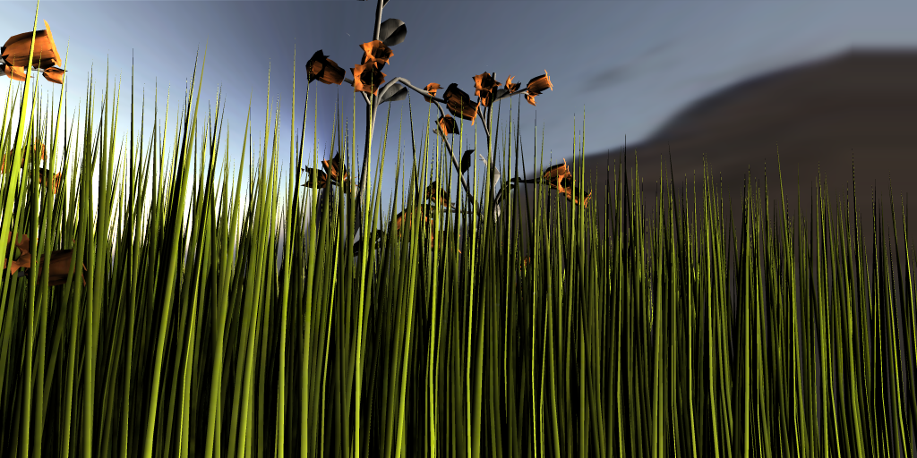
Warping results
Ours

Slide 23
3D warping
Warp geometry before the image is rendered
  No disocclusions
  Missing information “behind framebuffer”
Notes:
Say that we do inverse projection …or smt like that, I forgot. Refer to Tobias for more info.

Slide 24
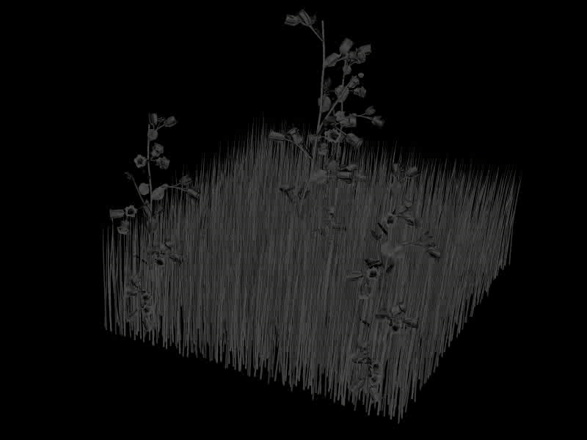
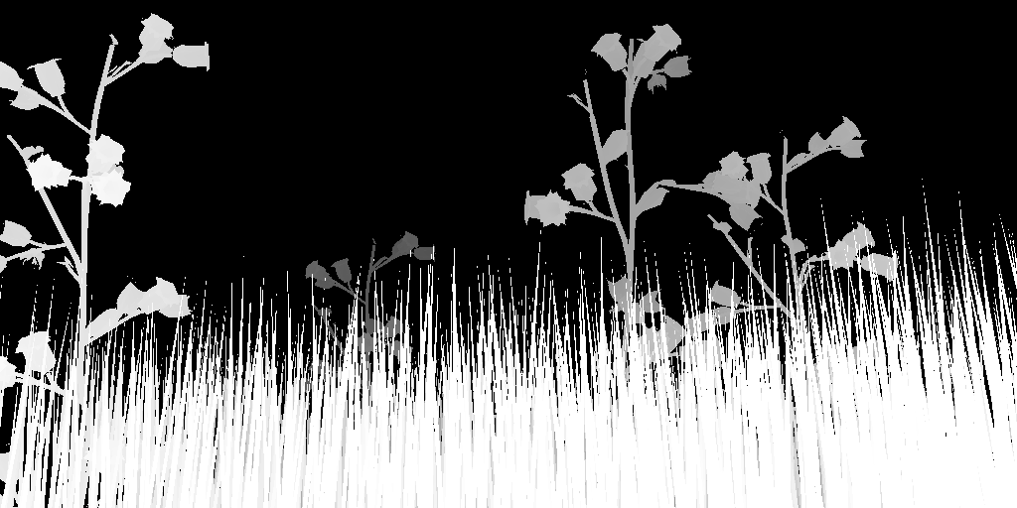

Stage 1
Direct fetching
Global curve reconstruction
Neighbourhood search

Slide 25
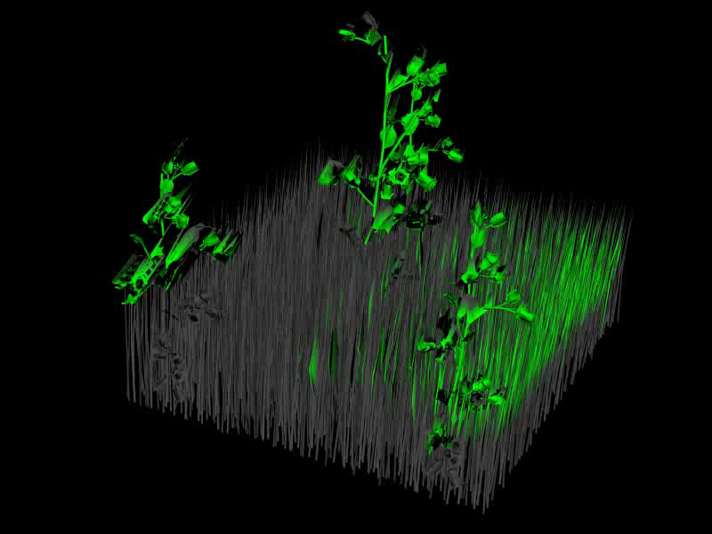
Stage 2
Direct fetching
Neighbourhood search
Global curve reconstruction
If failed
Notes:
Image space

Slide 26
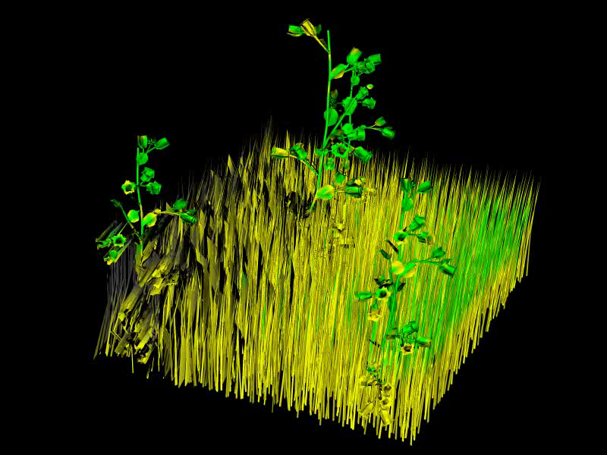
Stage 3
Direct fetching
Neighbourhood search
Global curve reconstruction
If failed
If failed
Disparity
Global curve
Depth

Slide 27
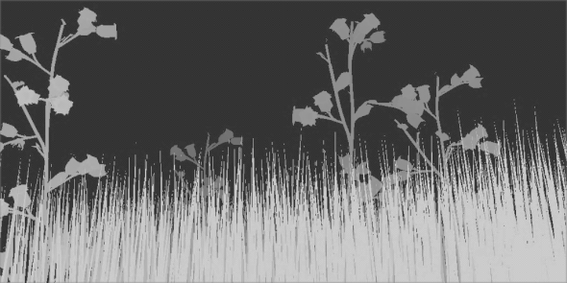
Global curve reconstruction
Using radial basis functions
Support size from histogram based predictor
  Resolves under-sampled intervals
  Keeps high frequencies
Depth
Image
Disparity
Image
Disparity
Count
Depth
Depth

Slide 28

From the camera view

Slide 29


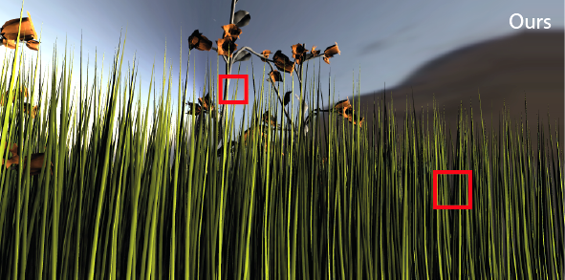


Comparison
Image-Space
Ours

Slide 30
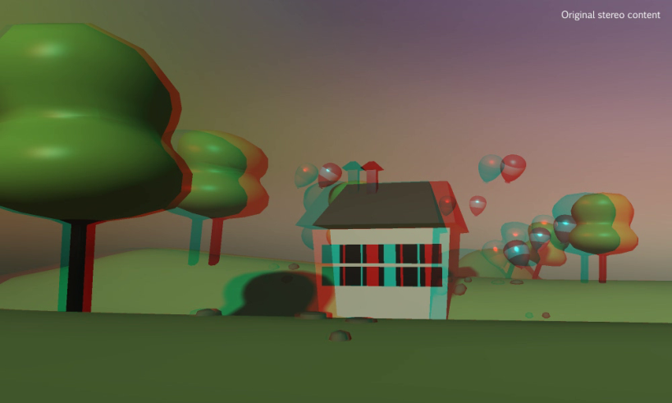
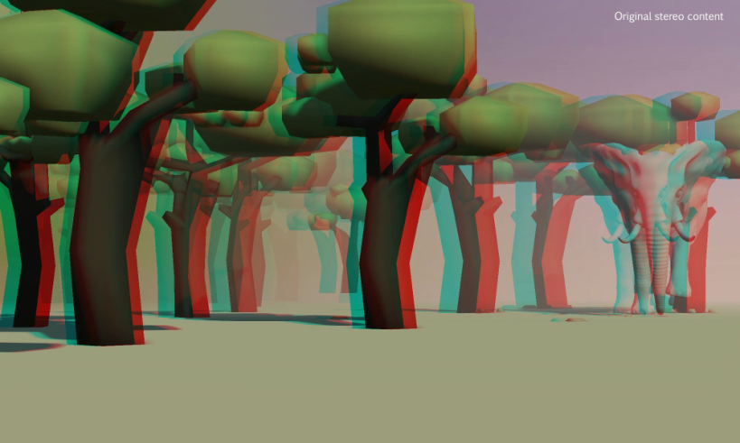
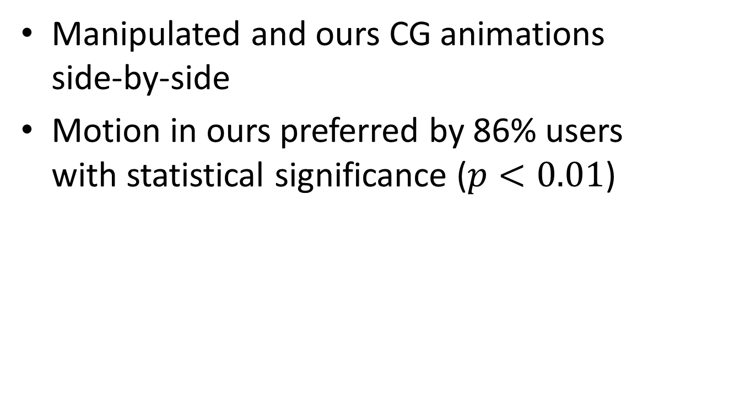
User preference study
Manipulated and ours CG animations
side-by-side
Motion in ours preferred by 86% users
with statistical significance ($p<0.01$)

Slide 31

Scene example

Slide 32
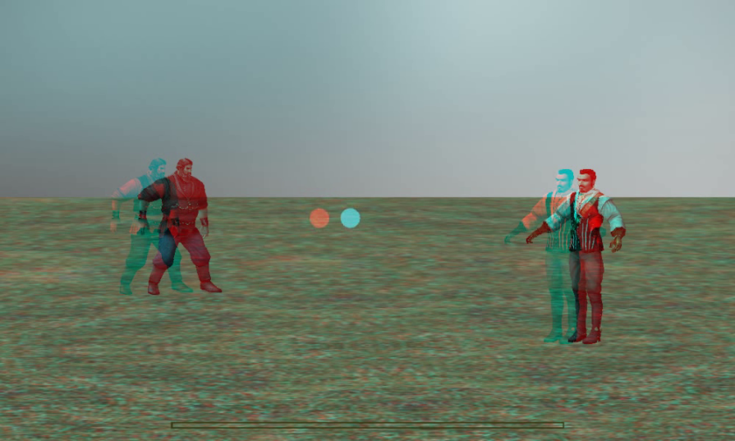
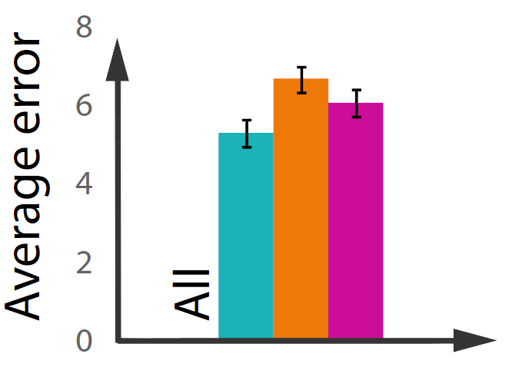
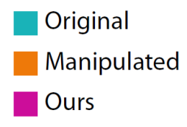

Task performance-study
User estimated ball landing spot in 3D game
Manipulated disparity significantly worse ($F\left(2,333\right)=3.99$, $p<0.02$)
Notes:
Do not say about our being not better, just say that we showed that manipulation of disparity is really dangerous

Slide 33
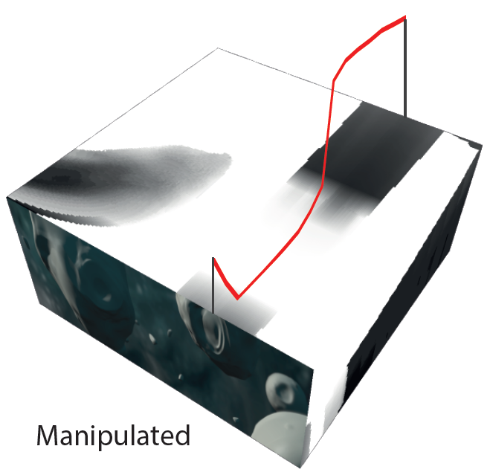
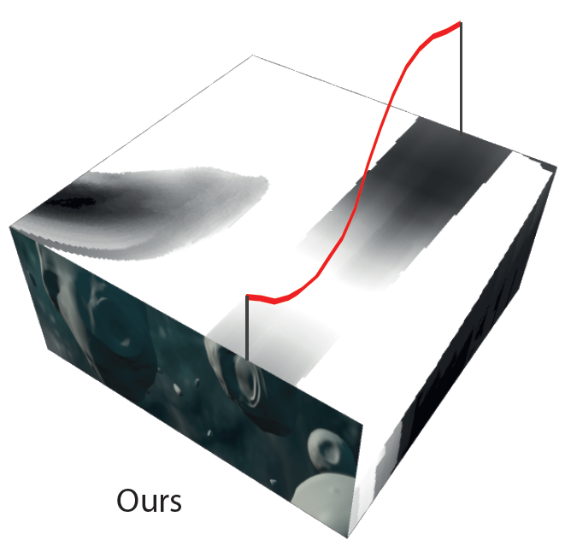
Conclusion
Motion in depth restored
Practical method for 3D content generation
Achieved visual preference

Slide 34
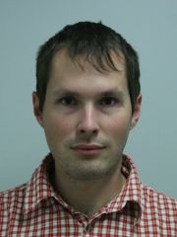
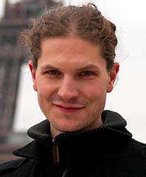
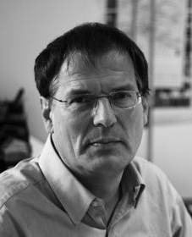

THANK YOU
Optimizing Disparity or Motion in Depth
Project page: http://resources.mpi-inf.mpg.de/TemporalStereo/
Contact: pkellnho(at)mpi-inf.mpg.de
We acknowledge Rafal Mantiuk for consultation.

Slide 35
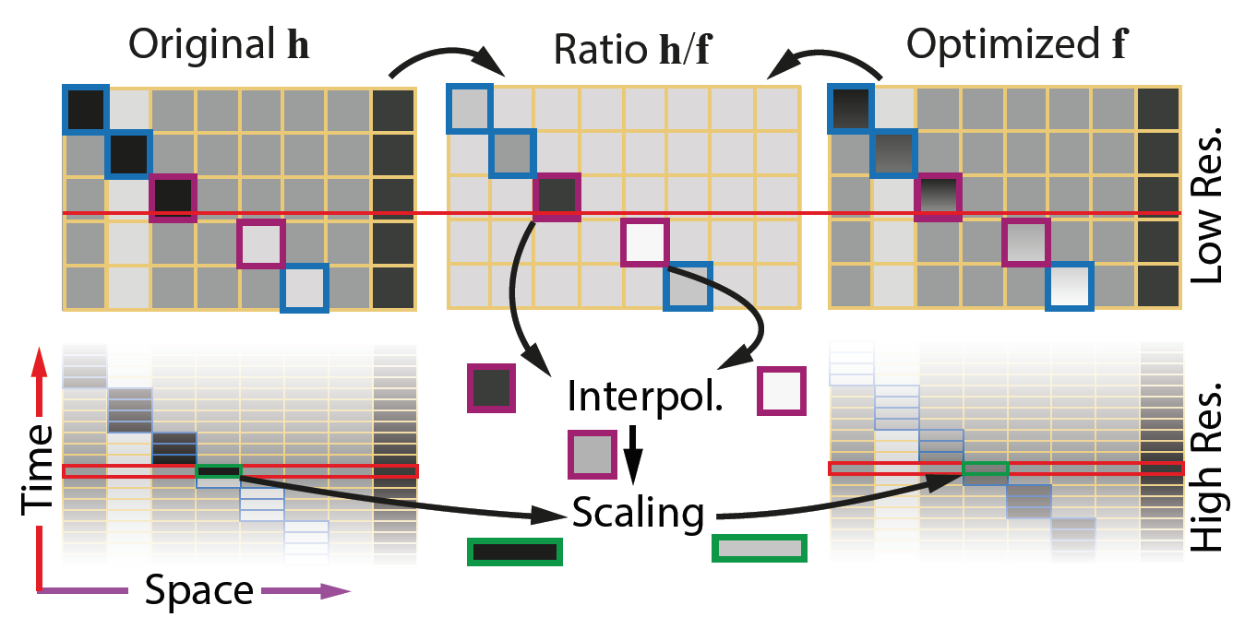
Upsampling
Low space-time resolution (~ 200 x 100 x 10) ⇒ high resolution (~ 2000 x 1000 x 200)
Temporal Upsampling
  Motion flow
  to key frames
Spatial Upsampling
  Guidance by high resolution disparity map

