Slide 1
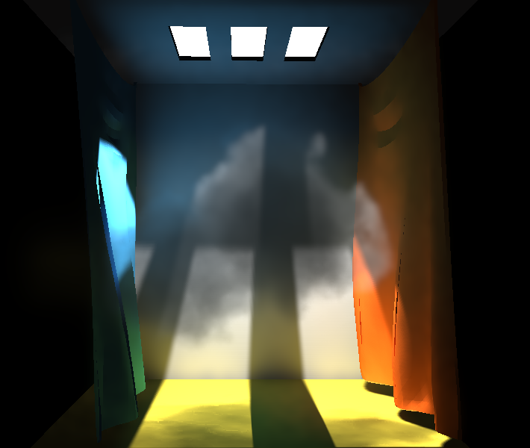
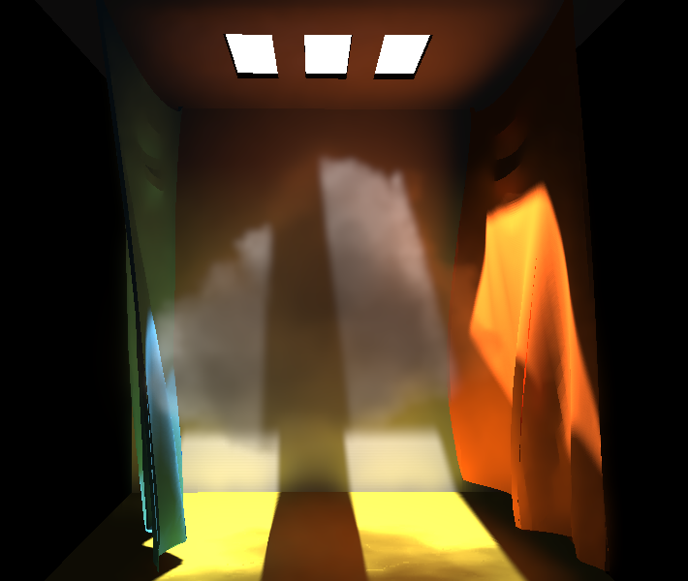
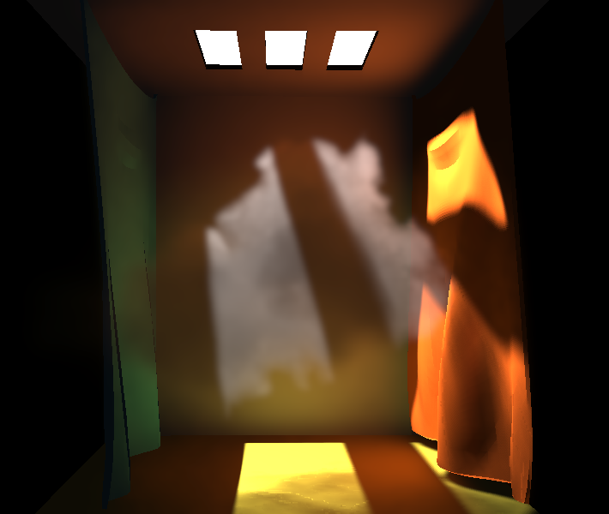
Shell Splatting for Indirect Lighting of Volumes
Oliver Nalbach, Tobias Ritschel, Hans-Peter Seidel

Slide 2
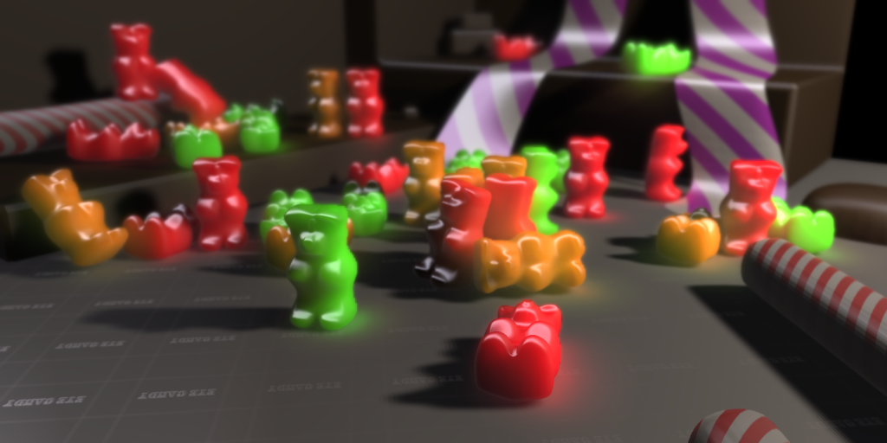
Outline
Previous work: Deep Screen Space
Extension to indirect lighting of volumes

Slide 3
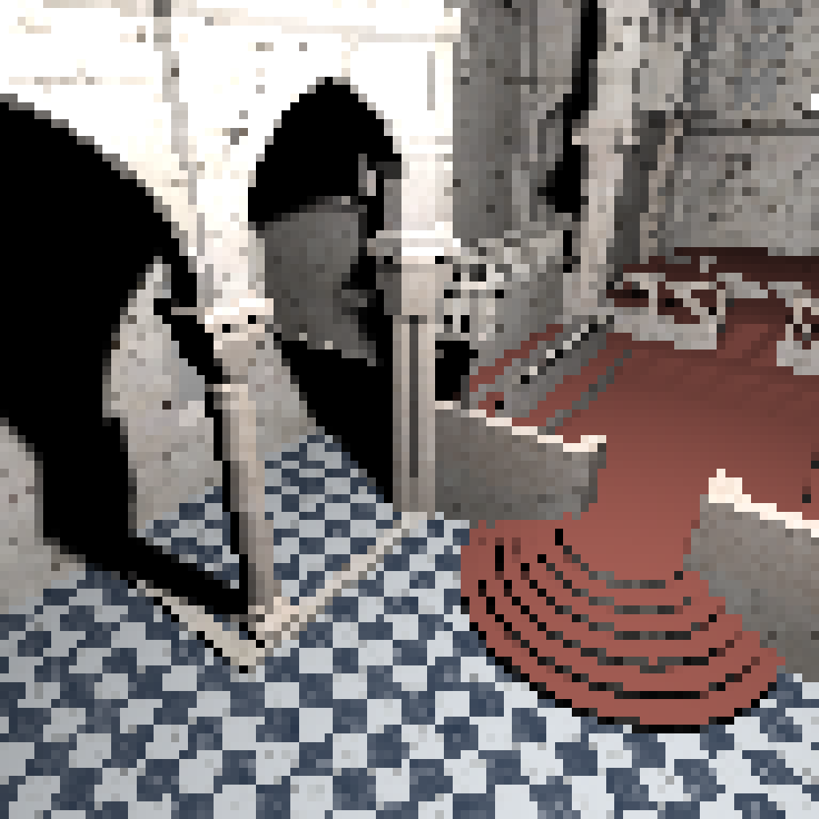
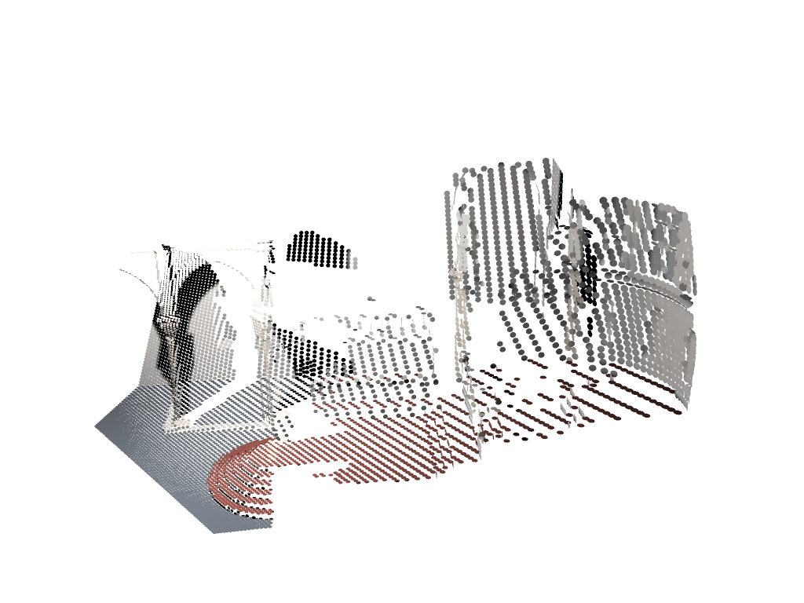
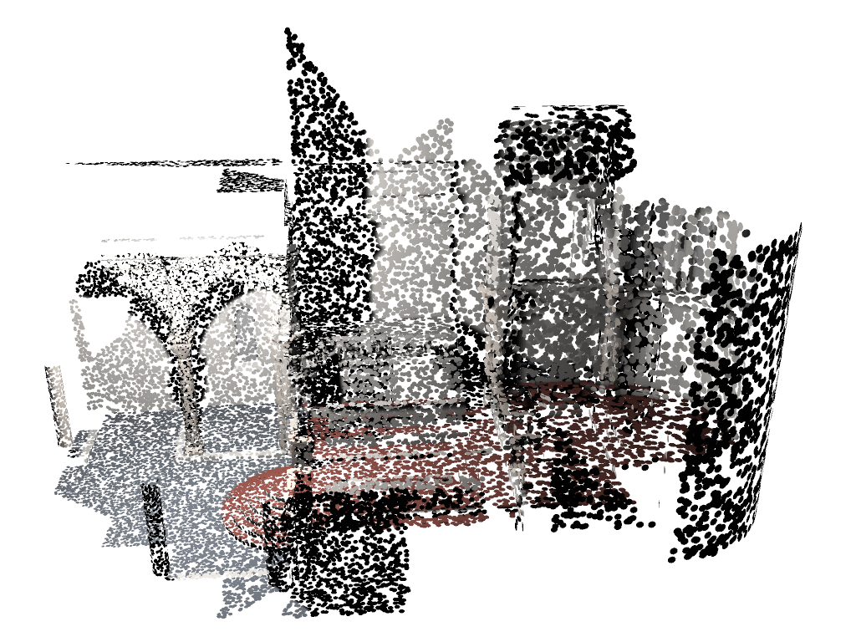
"Deep" Screen Space
Framebuffer
Screen space information
Deep screen space
information

Slide 4
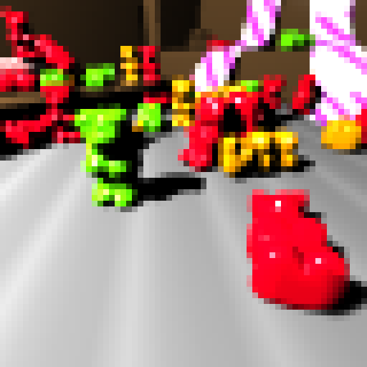
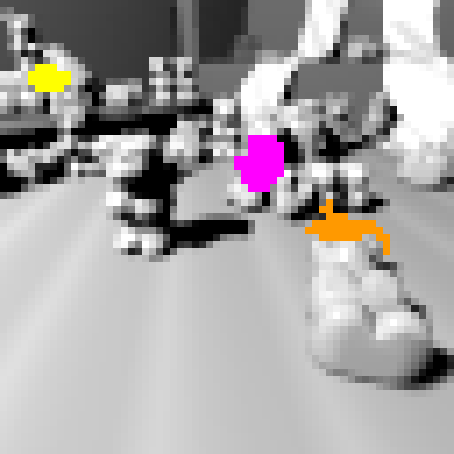
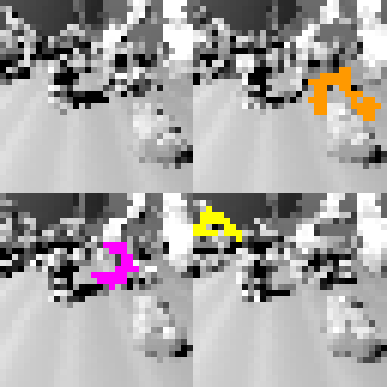
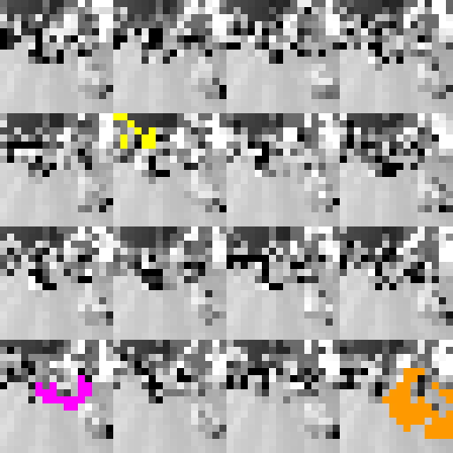
Shell Splatting
1/16
1/4
1
Level 0
Level 1
Level 2

Slide 5
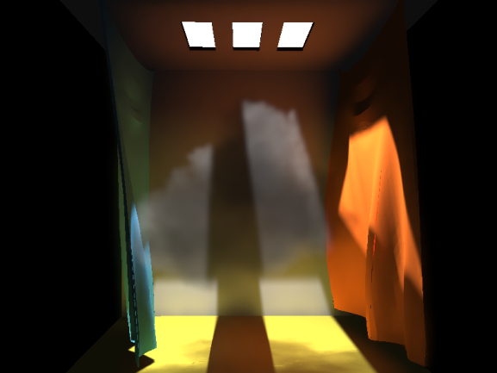
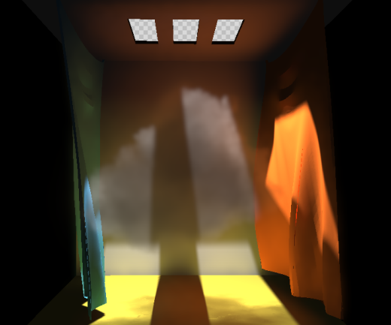
One-Bounce Surface to Volume

Slide 6
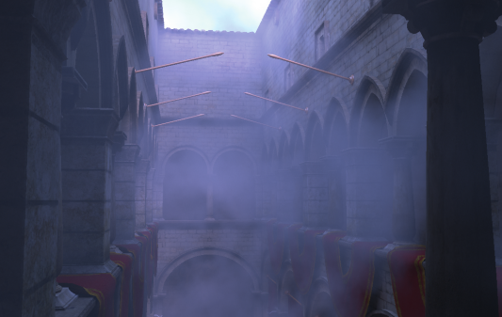
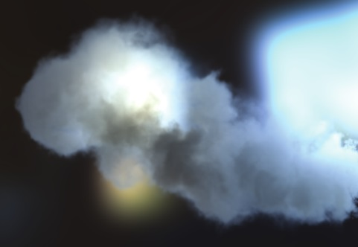
Previous Work
Offline methods
E.g. ray-marching + instant radiosity
General but slow
Realtime methods
E.g. prefiltered single scattering
Fast but limited range of settings
Diffusion-based Methods
E.g. principal ordinate propagation
Trade-off, also multiple scattering, but low-frequency indirect light
Engelhardt et al. ‘12
Klehm et al. ‘14
Elek et al. ‘14

Slide 7
Splatting to Surfaces vs. Volumes
Surface
Volume
Positions
Segments

Slide 8
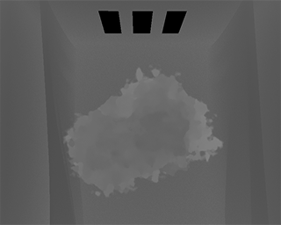
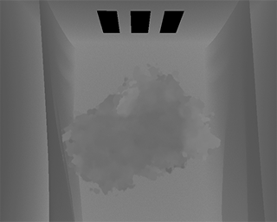
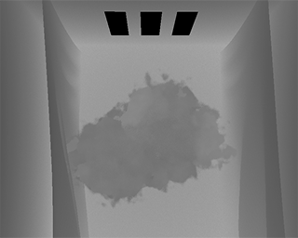
Transmittance Interval Map
$$d_{1}$$
$$1$$
$$d_{2}$$
$$d_{3}$$
$$d_{4}$$
Transmittance
$$d_{5}$$
$$d_{6}$$
$$τ_{min}$$
Depth

Slide 9
Shell-Splatting with Volume Receiver
$$x_{1}$$
$$x_{2}$$
$$x_{3}$$
$$x_{4}$$
$$x_{5}$$
$$x_{6}$$
$$S$$

Slide 10
Jittering
Transmittance
Transmittance
Depth
Depth

Slide 11
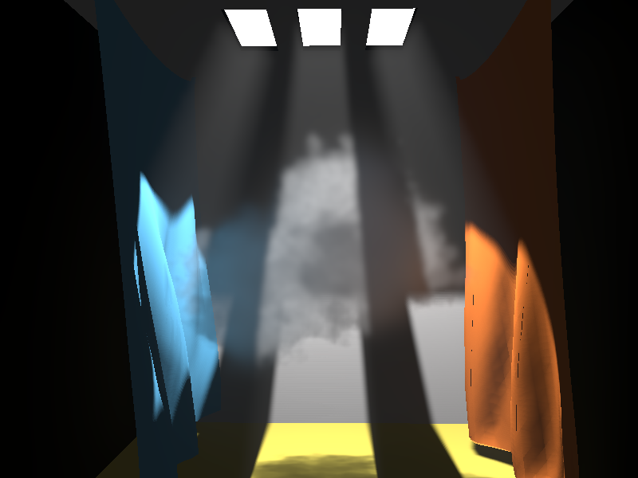
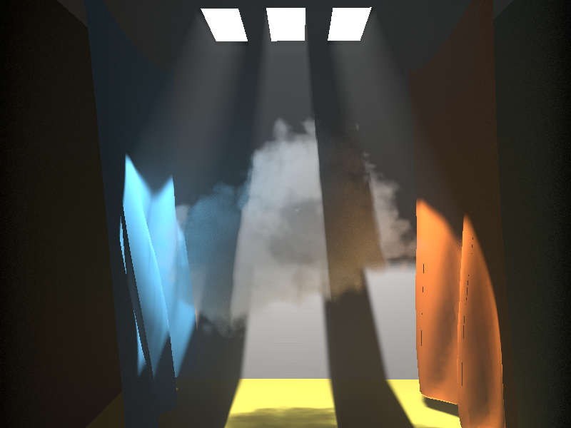
Results
Deep Screen Space
Ray marching / tracing
37ms
> 1s

Slide 12
Results

Slide 13
Conclusion
Supports fully dynamic scenes
Arbitrarily changing geometry
Dynamic lighting
Deforming, heterogeneous participating media
Problems / Future Work
Low number of samples dictates low frequency changes in the medium with depth
Lack of indirect visibility

Slide 14
Thank you.
Project page: http://people.mpi-inf.mpg.de/~onalbach/VolumeSplatting/
Contact: onalbach(at)mpi-inf.mpg.de

