Slide 1
Probabilistic Models for Information Extraction – Seminar, Summer 2011
Martin Theobald
Maximilian Dylla

Slide 2
Organization
Where:
Rotunda, 4th floor, MPI-INF
When:
Thursdays, 16:15
To register, send an email indicating your 3 favorite
topics with the subject “[IE Seminar]”
to mtb@mpi-inf.mpg.de or mdylla@mpi-inf.mpg.de
by Monday, April 25, 11:59pm

Slide 3
Requirements
Attendance of all talks is mandatory.
Duration of the talks should be 45 minutes.
Talks are followed by a 15-minute discussion.
Both the slides and the presentation itself must be in English.
A written report is due four weeks after the talk at the latest.
Read also the papers you are not presenting yourselves and actively take part in the discussions.
Schedule a first appointment with your tutor to go through your topic already a few weeks in advance. You are responsible for scheduling the meetings with your tutor.
Avoid copying material from anywhere!

Slide 4
Selection of Seminar Papers

Slide 5
Background Literature
Christopher D. Manning and Hinrich Schuetze:
Foundations of Statistical Natural Language Processing, MIT Press, 1999.
Daniel Jurafsky and James H. Martin:
Speech and Language Processing (2nd Edition), Prentice Hall, 2008.
Ronen Feldman and James Sanger:
The Text Mining Handbook,
Cambridge University Press, 2007.
Lise Getoor and Ben Taskar (Eds.):
Introduction to Statistical Relational Learning,
MIT Press, 2007.

Slide 6
What Does Information Extraction Do?
We can buy a can.
PRP
MD
VB
DT
NN
Part-Of-Speech Tagging
buy-3
nsubj
dobj
aux
Dependency Parsing
We-1
can-2
det
can-5
a-4
Subj: We Pred: buy Obj: can
Semantic Role Labeling

Slide 7
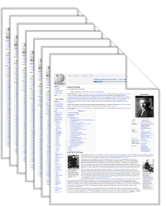
Information Extraction (IE) Paradigms
Surajit
obtained his
PhD in CS from
Stanford University
under the supervision
of Prof. Jeff.
He later joined HP and
worked closely with
Umesh …
instanceOf (Surajit, scientist)
inField (Surajit, computer science)
hasAdvisor (Surajit, Jeff)
almaMater (Surajit, Stanford U)
workedFor (Surajit, HP)
friendOf (Surajit, Umesh Dayal)
…
source-
centric IE
1) recall !
2) precision
Open IE
one source
near-human
quality!
hasAdvisor
yield-centric
harvesting
Student Advisor
Student Advisor
Student Advisor
Surajit Jeff
Alon Jeff
Jim Mike
… …
1) precision !
2) recall
Closed IE
almaMater
Student University
Surajit Stanford U
Alon Stanford U
Jim UC Berkeley
… …
Student University
many sources

Slide 8
What to Extract?
Entities
Surajit, Jim, Jeff, Mike, Stanford U, UC Berkeley
Unary relations/classes
scientist(Surajit), advisor(Jeff)
Binary relations (facts)
hasAdvisor(Surajit, Jeff)
spouse(Cecilia, Nicolas)
Sometimes also want higher-arity relations
(e.g., temporal/spatial annotations of facts)
spouse(Cecilia, Nicolas) [1996, 2007]

Slide 9
Entities & Classes
Which entity types (classes, unary predicates) are there?
scientists, doctoral students, computer scientists, …
female humans, male humans, married humans, …
Which subsumptions should hold
(subclass/superclass, hyponym/hypernym, inclusion dependencies)?
subclassOf (computer scientists, scientists),
subclassOf (scientists, humans), …
Which individual entities belong to which classes?
instanceOf (Surajit Surajit, computer scientists),
instanceOf (BarbaraLiskov, computer scientists),
instanceOf (Barbara Liskov, female humans), …
Which names denote which entities?
means (“Lady Di“, Diana Spencer),
means (“Diana Frances Mountbatten-Windsor”, Diana Spencer), …
means (“Madonna“, Madonna Louise Ciccone),
means (“Madonna“, Madonna(painting by Edward Munch)), …
...

Slide 10
Binary Relations
Which instances (pairs of individual entities) are there
for given binary relations with specific type signatures?
hasAdvisor (JimGray, MikeHarrison)
hasAdvisor (HectorGarcia-Molina, Gio Wiederhold)
hasAdvisor (Susan Davidson, Hector Garcia-Molina)
graduatedAt (JimGray, Berkeley)
graduatedAt (HectorGarcia-Molina, Stanford)
hasWonPrize (JimGray, TuringAward)
bornOn (JohnLennon, 9-Oct-1940)
diedOn (JohnLennon, 8-Dec-1980)
marriedTo (JohnLennon, YokoOno)
Which additional & interesting relation types are there
between given classes of entities?
competedWith(x,y), nominatedForPrize(x,y), …
divorcedFrom(x,y), affairWith(x,y), …
assassinated(x,y), rescued(x,y), admired(x,y), …

Slide 11
Higher-arity Relations & Reasoning
Time, location & provenance annotations
Knowledge representation – how do we model & store these?
Consistency reasoning – how do we filter out inconsistent facts that the extractor produced? how do we quantify uncertainty?
Reification:
“Facts about Facts”:
6: (1, inYear, 1968)
7: (2, inYear, 2006)
8: (3, validFrom, 22-Dec-2000)
9: (3, validUntil, Nov-2008)
10: (4, validFrom, 2-Feb-2008)
11: (2, source, SigmodRecord)
12: (5, inYear, 1999)
13: (5, location, CampNou)
14: (5, source, Wikipedia)
Facts (RDF triples):
(JimGray, hasAdvisor, MikeHarrison)
(SurajitSurajit, hasAdvisor, JeffJeff)
(Madonna, marriedTo, GuyRitchie)
(NicolasSarkozy, marriedTo, CarlaBruni)
(ManchesterU, wonCup, ChampionsLeague)
Facts (RDF triples)
1:
2:
3:
4:
5:

Slide 12
YAGO2
 | Just Wikipedia | Incl. GeoNames.org
#Relations | 86 | 92
#Classes | 563,374 | 563,997
#Entities | 2,639,853 | 9,819,683
#Facts | 495,770,281 | 996,329,323
- basic relations | 20,937,244 | 61,188,706
- types & classes | 8,664,129 | 181,977,830
- space, time & proven. | 466,168,908 | 753,162,787
Size (CSV format) | 23.4 GB | 37 GB
estimated precision > 95%
(for basic relations excl. space, time & provenance)
www.mpi-inf.mpg.de/yago-naga/

Slide 13
In this Seminar …
1) Set Completion:
SEAL
2) Parsing:
Probabilistic Context-Free Grammars (PCFGs)
3) Probabilistic Models for Information Extraction:
HMMs, MEMMs, CRFs
4) Combining FOL and PGMs:
Markov Logic Networks (MLNs), Constrained Conditional Models (CCMs)
5) Other Models/Inference Techniques:
Factor graphs, CCMs (linear programming), CRFs in probabilistic databases

Slide 14
Set Completion
Find entities/concepts with similar properties
Set completion algorithms
Unsupervised or semi-supervised clustering/classification techniques
Taxonomic/ontological structures
See, e.g.: Google Sets

Slide 15
Parsing (from NLP)
Shallow parsing (“chunking”)
Part-Of-Speech tagging (POS) http://cogcomp.cs.illinois.edu/demo/pos/
Named Entity Resolution (NER)
Deep parsing
Co-reference resolution http://cogcomp.cs.illinois.edu/demo/coref/
Dependency parsing http://nlp.stanford.edu:8080/parser/index.jsp
Semantic role labeling http://cogcomp.cs.illinois.edu/demo/srl/

Slide 16
Probabilistic Graphical Models for Information Extraction
Given a set of observations X and possible labels Y
→ Compute P(Y|X)
Choose your favorite model
Learn model parameters
3) Do the inference!
PRP
MD
VB
DT
NN
y₀
y₁
y₂
y₃
y₄
Conditional Random Field
(CRF)
x₀
x₁
x₂
x₃
x₄
We
can
buy
a
can

Slide 17
Inference: P(Y|X)
Full joint distribution?
Typically infeasible because of model complexity & training data sparseness
Rather factorize model into smaller, independent parts
(→ graphical model)
Do inference by combining the individual parts
Observations X
Labels Y
x₁ | x₂ | x₃ | x₄ | x₅ |  | y₁ | y₂ | y₃ | y₄ | y₅ |  | P
…
We | can | buy | a | can |  | PRP | MD | VB | DT | NN |  | 0.30
We | can | buy | a | can |  | PRP | MD | VB | DT | VB |  | 0.08
…
He | can | buy | a | mug |  | PRP | MD | VB | DT | NN |  | 0.40
…

Slide 18
Models for Sequence Labeling
y_{i-1}
y_{i}
y_{i+1}
y_{i-1}
y_{i}
y_{i+1}
x₀
x₁
x₂
x₀
x₁
x₂
Hidden Markov Model
(HMM)
Maximum Entropy
Markov Model
(MEMM)
y_{i-1}
y_{i}
y_{i+1}
x₀
x₁
x₂
Conditional Random Field
(CRF)

Slide 19
Markov Logic Networks (MLN‘s)
[Richardson/Domingos: ML 2006]
Ground logical constraints
into probabilistic graphical model: Markov Random Field (MRF)
First-Order-Logic rules (w/weights):
Entities/facts:
s(x,y) ∧ diff(y,z) ⇒ ¬s(x,z)
s(x,y) ⇒ f(x)
f(x) ⇒ ¬m(x)
s(Carla,Nicolas)
s(Cecilia,Nicolas)
s(Carla,Ben)
s(Carla,Sofie)
…
s(x,y) ∧ diff(w,y) ⇒ ¬s(w,y)
s(x,y) ⇒ m(y)
m(x) ⇒ ¬f(x)
Grounding: Literal → Boolean Var
Reasoning: Literal → Binary RV
Grounding:
¬s(Ca,Nic) ∨ ¬s(Ce,Nic)
¬s(Ca,Nic) ∨ ¬s(Ca,Ben)
¬s(Ca,Nic) ∨ m(Nic)
¬s(Ca,Nic) ∨ ¬s(Ca,So)
¬s(Ce,Nic) ∨ m(Nic)
¬s(Ca,Ben) ∨ ¬s(Ca,So)
¬s(Ca,Ben) ∨ m(Ben)
¬s(Ca,Ben) ∨ ¬s(Ca,So)
¬s(Ca,So) ∨ m(So)

Slide 20
Markov Logic Networks (MLN‘s)
[Richardson,Domingos: ML 2006]
Ground logical constraints
into probabilistic graphical model: Markov Random Field (MRF)
s(x,y) ∧ diff(y,z) ⇒ ¬s(x,z)
s(x,y) ⇒ f(x)
f(x) ⇒ ¬m(x)
s(Carla,Nicolas)
s(Cecilia,Nicolas)
s(Carla,Ben)
s(Carla,Sofie)
…
s(x,y) ∧ diff(w,y) ⇒ ¬s(w,y)
s(x,y) ⇒ m(y)
m(x) ⇒ ¬f(x)
s(Ce,Nic)
m(Nic)
RVs coupled
by MRF edge
if they appear
in same clause
s(Ca,Nic)
s(Ca,Ben)
m(Ben)
s(Ca,So)
m(So)
MRF assumption:
P[X_{i}|X₁..X_{n}]=P[X_{i}|MB(X_{i})]
joint distribution
has product form
over all cliques

Slide 21
Markov Logic Networks (MLN‘s)
[Richardson,Domingos: ML 2006]
¬ s(Ca,Nic) ∨ ¬s(Ce,Nic)
s(Ca,Nic) | s(Ce,Nic) | φ
0 | 0 | e^{5.9}
1 | 0 | e^{5.9}
0 | 1 | e^{5.9}
1 | 1 | e⁰
s(x,y) ∧ diff(y,z) ⇒ ¬s(x,z) [5.9]
s(Ce,Nic)
m(Nic)
RVs coupled
by MRF edge
if they appear
in same clause
s(Ca,Nic)
s(Ca,Ben)
m(Ben)
s(Ca,So)
m(So)
MRF assumption:
P[X_{i}|X₁..X_{n}]=P[X_{i}|MB(X_{i})]
Variety of algorithms for joint inference:
Gibbs sampling, other MCMC, belief propagation,
randomized MaxSat, …
joint distribution
has product form
over all cliques

Slide 22
Markov Logic Networks (MLN‘s)
[Richardson,Domingos: ML 2006]
Ground logical constraints
into probabilistic graphical model: Markov Random Field (MRF)
s(x,y) ∧ diff(y,z) ⇒ ¬s(x,z)
s(x,y) ⇒ f(x)
f(x) ⇒ ¬m(x)
s(Carla,Nicolas)
s(Cecilia,Nicolas)
s(Carla,Ben)
s(Carla,Sofie)
…
s(x,y) ∧ diff(w,y) ⇒ ¬s(w,y)
s(x,y) ⇒ m(y)
m(x) ⇒ ¬f(x)
s(Ce,Nic)
0.7
0.1
0.8
m(Nic)
s(Ca,Nic)
s(Ca,Ben)
0.6
m(Ben)
0.5
0.2
s(Ca,So)
0.7
m(So)
Consistency reasoning: prune low-confidence facts!
StatSnowball [Zhu et al: WWW‘09], BioSnowball [Liu et al: KDD‘10]
EntityCube, MSR Asia: http://entitycube.research.microsoft.com/

Slide 23
Related Alternative Probabilistic Models
Constrained Conditional Models [Roth et al. 2007]
log-linear classifiers with constraint-violation penalty
mapped into Integer Linear Programs
Factor Graphs with Imperative Variable Coordination
[McCallum et al. 2008]
RV‘s share “factors“ (joint feature functions)
generalizes MRF, BN, CRF, …
inference via advanced MCMC
flexible coupling & constraining of RV‘s
s(Ce,Nic)
m(Nic)
s(Ca,Nic)
s(Ca,Ben)
m(Ben)
Software tools:
alchemy.cs.washington.edu
code.google.com/p/factorie/
research.microsoft.com/en-us/um/cambridge/projects/infernet/
s(Ca,So)
m(So)

Slide 24
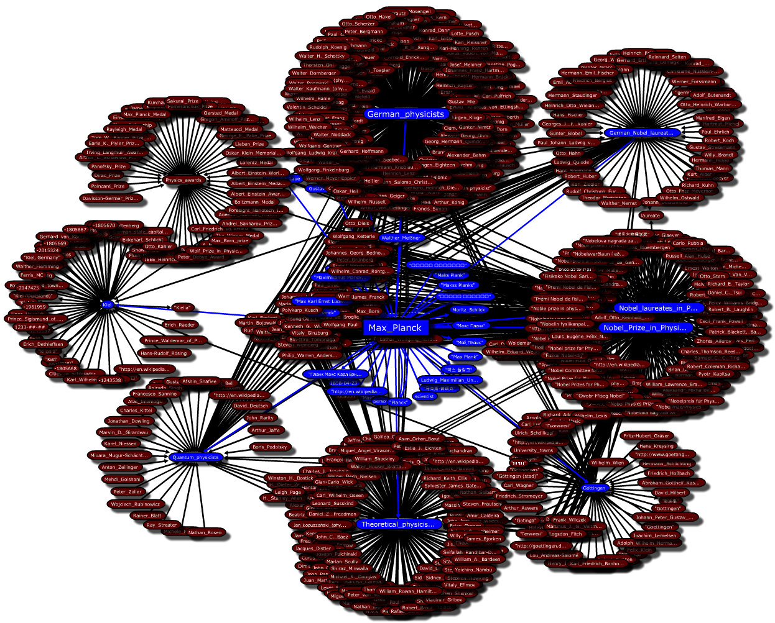
Demo!
URDF project at MPI: http://urdf.mpi-inf.mpg.de

