Slide 1
Exploring Reduction for Long Web Queries
Niranjan Balasubramanian, Giridhar Kuamaran, Vitor R. Carvalho
Speaker: Razvan Belet

Slide 2
Motivation
Q: easter egg hunts in northeast columbus parks and recreation centers
No useful results
Problem: Long Queries are hard

Slide 3
Motivation
User reduced the query
Q: easter egg hunts in northeast columbus parks
Many useful results
Solution: Reduced queries perform better

Slide 4
Motivation
What if the search engine was able to
automatically reduce the long, hard query
and provide better results ?

Slide 5
Outline
Background information
Formal Problem Statement
Proposed Approach
3 Reformulations of the Query Reduction Problem(all based on regression)
Experimental Results
Conclusions

Slide 6
Background Information
Query reduction techniques:
Term weighting vs. Query reduction
Regression
Simple linear regression
Regression trees

Slide 7
Query reduction techniques: Term Weighting
Identifies important query terms in long queries
Given: a long hard query
Q: Easter egg hunts in northeast Columbus parks and recreation centers
Query with weighted terms
(will perform better)
Term weighting
0.3
0.1
0.07
0.1
0.3
0.1
Q: Easter egg hunts in northeast Columbus parks
and recreation centers
0.01
0.01
0.01
Issue: Difficult to integrate with existing web search engines

Slide 8
Query reduction techniques: Query Reduction
A reduced(better performing) version of the query is executed instead of the original query
The reduced query is obtained by dropping terms
Given: a hard long query
Q: Easter egg hunts in northeast Columbus parks and recreation centers
Step 2: Estimate the performance of all the reduced versions & of the original query
Step 1: form the reduced versions
Step 3: Choose & return the results of the query with the best performance
Performance = quality of the results (measured
as e.g.: precision or NDCG)

Slide 9
Query reduction techniques: Query Reduction
Q: Easter egg hunts in northeast Columbus parks and recreation centers |Q| = n (# of terms)
1 term dropped: Easter egg hunts in northeast Columbus parks and recreation centers,
Easter egg hunts in northeast Columbus parks and recreation centers,
. . .
Easter egg hunts in northeast Columbus parks and recreation centers
2 terms dropped: Easter egg hunts in northeast Columbus parks and recreation centers,
Easter egg hunts in northeast Columbus parks and recreation centers,
. . .
Easter egg hunts in northeast Columbus parks and recreation centers
. . .
(n-1) terms dropped: Easter egg hunts in northeast Columbus parks and recreation centers,
Easter egg hunts in northeast Columbus parks and recreation centers
Issue :Exponential Complexity

Slide 10
Regression
A method for studying the relation between data :
Given a set of observations: , try to understand how they are related
X(predictor/feature) | Y (response variable)
parents’ average height | child height(at maturity)
light intensity of stars | surface temperature
web page freshness, in-links | number of visitors
child height
Given data
(observations)
172cm
168cm
parents’ average height

Slide 11
Types of Regression
Feature\ Regression function | LINEAR | NON-LINEAR
SIMPLE | r(x) is a linear function (Y₁ , X₁) . . . (Y_{n} , X_{n}) X_{i} = 3.4 | r(x) is a non-linear function (Y₁ , X₁) . . . (Y_{n} , X_{n}) X_{i} = 3.4
MULTIPLE | r(x) is a linear function (Y₁ , X₁) . . . (Y_{n} , X_{n}) X_{i} = (3.4, 1.1 … 0.9) | r(x) is a non-linear function (Y₁ , X₁) . . . (Y_{n} , X_{n}) X_{i} = (3.4, 1.1 … 0.9)
!
!
Regression
Simple
Multiple
Linear
Non-Linear
Linear
Non-Linear

Slide 12
Regression: Simple Linear Regression
One way to summarize the relationship between this data is using a function : y = r(x)
Approximated regression function (regressor), fitting the actual data
(r*(x) = a+ b*x)
r*(x)
r(x)
regression function
(regressor)
Issue: closed form of r(x) is unknown
Solution:
Make an assumption about r(x)(e.g. is linear) based on intuition or previous knowledge about the data
Approximate/estimate r(x) r*(x)

Slide 13
Regression: Simple Linear Regression
One application of regression: prediction
r*(x) is able to provide a value y for an unseen value of x
r*(x)
Predicted value of y
Unseen value of x

Slide 14
Regression: Simple Linear Regression
Shortcomings:
What if we cannot assume that r(x) is a linear function? ( (Y_{i} ,X_{i}) are not linearly related )
What if X_{i} are not simple numbers but tuples of numbers?
Solution: Multiple non-linear regression

Slide 15
Regression: Multiple Non-Linear Regression
Observed data is of the form:
(Y₁ , (x₁⁽¹⁾, x₂⁽¹⁾, … , x_{n}⁽¹⁾ )) . . . (Y_{n} , (x₁^{(n)}, x₂^{(n)}, … , x_{n}^{(n)} ))
r(x) is a non-linear function
Issues:
We cannot assume a closed form of r(x) (the observed data is very complex and not at all understood)
OR
r(x) has a complex/unusable form
Solution: Don’t try to find a closed form of r(x)
Take a different approach: Regression trees

Slide 16
Regression: Regression Trees
Goal remains the same:
Given a set of observations: (Y₁ , (x₁⁽¹⁾, x₂⁽¹⁾, … , x_{n}⁽¹⁾ )) . . . (Y_{n} , (x₁^{(n)}, x₂^{(n)}, … , x_{n}^{(n)} )), try to understand how they are related
No r(x) can be assumed as the observed data is very complex
Idea: partition the data into partitions for which r(x) can be assumed

Slide 17
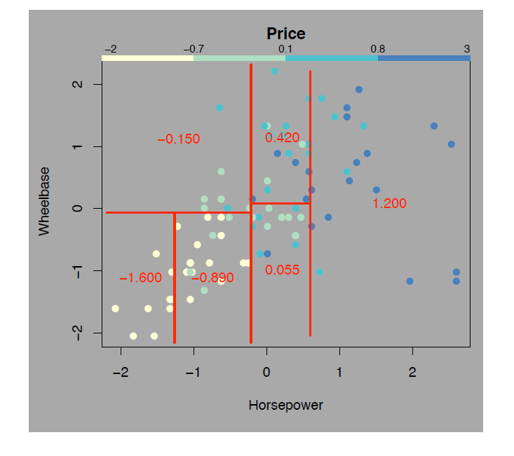
Observed data: (Price , (Wheelbase, Horsepower))
(
,
)
Y
(
x₁
,
x₂
)

Slide 18
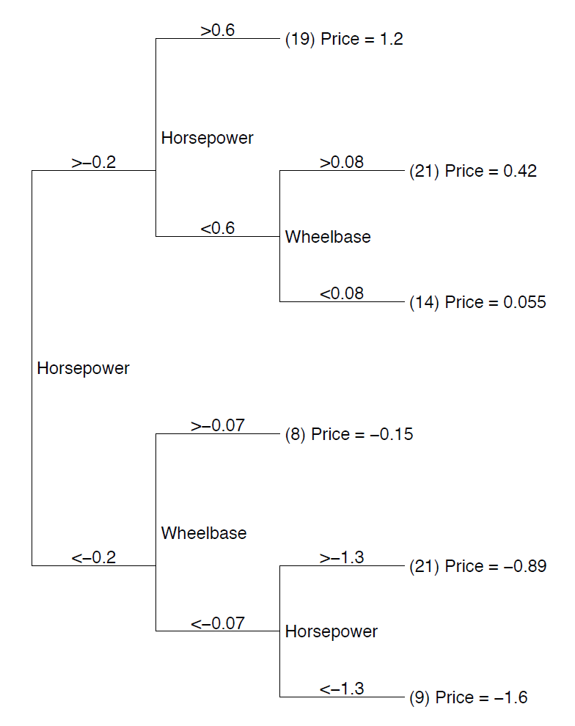
At each step: partition the data(based on x_{i}) so that the “homogeneity” of the 2 new partitions increases
Formally: “homogeneity” measured by :
r₁(x)
,
r₂(x)
C
S={(Price , (Wheelbase, Horsepower))}
In the end: obtain a number of partitions for which r(x) can be assumed
C’
r₅(x)

Slide 19
Regression Trees: Prediction
Use r₁(x) to predict the price
r₁(x)
New data comes in:
(?,(0.7,0.1))

Slide 20
Regression: A machine learning perspective
Regression can also be seen as a machine learning technique
Statistical Perspective | Machine Learning perspective
Given: a set of observations | Given: a training data set
Goal: fit/estimate a regressor r*(x) | Goal: learn a regresor r*(x)
Usage: predict values of y for unseen values of x | Usage: predict values of y for test values of x
Learn regressor r*(x)
Training data set

Slide 21
Formal Problem Definition
, ranking function that scores documents (D) with respect to a query P
denote a target measure of the effectiveness of the ranking produced by f for the query P (e.g. NDCG)
Given a query:
, to denote the power set of Q, i.e., the set containing all subsets of terms from query Q (including the original query Q)
REDUCTION PROBLEM: find the query, P* , such that:

Slide 22
Paper Contributions
Introduces yet another method for query reduction:
Based on a query performance prediction method
Applicable to Web queries
Experiments run in the context of a major Search engine using real Web queries
!
!

Slide 23
Query Reduction using regression: Overview of the method
Given: a set of long queries as training data
{Q _{i}= {t_{i,1}, t_{i,2}, … , t_{i,n}} }
Learn a regressor h* (used to predict performance of unseen queries)
1
!
Create the set of reduced queries + the original query :
P^{Q} = {Q, ReducedQuery₁, … , ReducedQuery_{k}}
2
!
Predict performance of each member of P^{Q} using regressor h
3
Choose the query with the best predicted performance and return its results
4

Slide 24
Query Reduction using regression: Overview of the method
In step 2:Create the set of reduced queries + the original query :
P^{Q} = {Q, ReducedQuery₁, … , ReducedQuery_{n}}
Remember: P^{Q} has exponential size exp. complexity
Solution: consider only the queries reduced by 1 term + the original query linear complexity
1 term dropped: Easter egg hunts in northeast Columbus parks and recreation centers,
Easter egg hunts in northeast Columbus parks and recreation centers,
. . .
Easter egg hunts in northeast Columbus parks and recreation centers
1 term dropped: Easter egg hunts in northeast Columbus parks and recreation centers,
Easter egg hunts in northeast Columbus parks and recreation centers,
. . .
Easter egg hunts in northeast Columbus parks and recreation centers
2 terms dropped: Easter egg hunts in northeast Columbus parks and recreation centers,
Easter egg hunts in northeast Columbus parks and recreation centers,
. . .
Easter egg hunts in northeast Columbus parks and recreation centers
(n-1) terms dropped: Easter egg hunts in northeast Columbus parks and recreation centers,
Easter egg hunts in northeast Columbus parks and recreation centers

Slide 25
Query Reduction using regression: Overview of the method
In step 1: Learn a regressor h* (used to predict performance of unseen queries)
Given training data
(Query Performance ,(Query))
How h* looks like?

Slide 26
Query Reduction: Overview of the method
3 versions of h* proposed:
Independent performance prediction (h_{i}*)
Difference prediction(h_{d}*)
Ranking queries(h_{r}*)
In all 3 version the idea is the same i.e.: learn a regressor based on some training data (only the mathematical expression differs )

Slide 27
Independent Prediction
Given: original query and its reduced versions
Predict performance of each query independently
The regressor is given by:
Choose the query P* such that :

Slide 28
Difference Prediction
Given: original query and its reduced versions
Predict the difference in performance between each reduced version and its original query
The regressor is given by:
Choose the query P* such that :

Slide 29
Ranking Queries
Given: original query and its reduced versions
Predict a tree hierarchy of the queries(i.e. rank the queries and obtain a heap structure)
Choose the query at top of the hierarchy

Slide 30
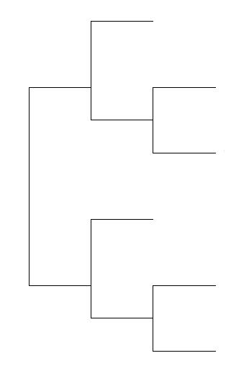
How the regressors are computed ?
Using Regression Trees
Input Data:
(QueryPerformance, (Query))
Basic Approach:
Train the regressor(i.e. build the regression tree) using training data of the form: (QueryPerformance, (Query))
Then, we can predict query performance for new incoming queries
Y
X
Given query set
(training set)
Query Performance
h*
?
Query
?

Slide 31
Computing the Regressors: Details
Input Data:
(QueryPerformance, (Query))
Y
?
?
X
Query is a set of terms (cannot be used as a predictor/feature variable)
What do we use as a predictor/feature variable?
How do we quantify the query performance?

Slide 32
Computing regressors: Details
Predictor/Feature variables:
Query features
Query-Document features
Query Performance measured as NDCG@5
Using these features, train a regressor to directly predict NDCG@5

Slide 33
Computing the Regressors: Details
How do we build and use the regression trees?
Using Random Forests
Algorithm:
(NDCG@5, (BM25, URL, QueryLength …))
New query performance prediction: (? , (BM25, …))
URL
BM25
QueryLength
URL
BM25
BM25
h*
h*
h*

Slide 34
Experimental Results
Experimental setup:
All 3 regressors have been already trained
Evaluation Data
Use 6400 long queries frequency-weighted sampled from a major Web search engine
For each long query got all reduced queries(by dropping 1 term)
Run each query and ask human annotators to judge the relevance of all queries(reduced & original) with respect to the original query

Slide 35
Experimental Results
Used 2 approaches:
Query Replacement: if there is a reduced query with the best predicted performance , return its results (drop the results of the original query)
Results Interleaving: don’t drop the results of the original query

Slide 36
Experimental Results
Query Replacement:
Effectiveness of Query Replacement.
The baseline i.e., using the original query,
has an overall NDCG@5 of 38.19

Slide 37
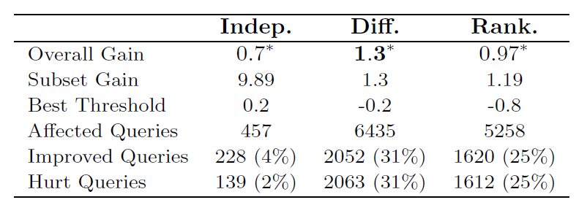
Experimental Results
Results Interleaving:

Slide 38
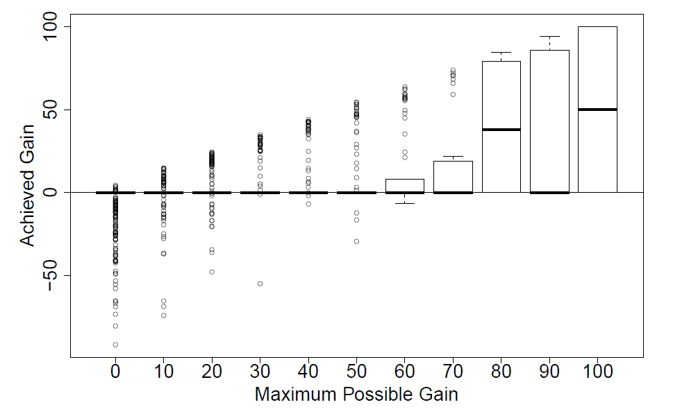
Experimental Results
Achieved Gains of the reduced queries for Independent

Slide 39
Conclusions
Existing method for query reduction are not applicable to web queries (efficiency limitations)
Paper presents a method for overcoming these limitations
Method presented in the paper seamlessly integrates with existing search engines
Query reduction using regression (3 versions presented)
Comprehensive evaluation on a large collection of real long web queries
Experimental results look promissing

