Slide 1
II.2 Statistical Inference:
Sampling and Estimation
A statistical model Μ is a set of distributions (or regression functions), e.g., all uni-modal, smooth distributions.
Μ is called a parametric model if it can be completely described by a finite number of parameters, e.g., the family of Normal distributions for a finite number of parameters μ, σ:

Slide 2
Statistical Inference
Given a parametric model M and a sample X₁,...,X_{n}, how do we infer (learn) the parameters of M?
For multivariate models with observed variable X and „outcome (response)“ variable Y, this is called prediction or regression, for a discrete outcome variable this is also called classification.
r(x) = E[Y | X=x] is called the regression function.

Slide 3


Idea of Sampling
Distribution X
(e.g., a population,
objects of interest)
Statistical Inference
What can we say about X based on
X₁,…,X_{n}?
Samples X₁,…,X_{n}
drawn from X
(e.g., people, objects)
Distrib. Param. Sample Param.
μ_{X} mean
variance
N size n
Example:
Suppose we want to estimate the average salary of employees in
German companies.
→ Sample 1: Suppose we look at n=200 top-paid CEOs of major banks.
→ Sample 2: Suppose we look at n=100 employees across all kinds of companies.

Slide 4
Basic Types of Statistical Inference
Given a set of iid. samples X₁,...,X_{n} ~ X
of an unknown distribution X.
e.g.: n single-coin-toss experiments X₁,...,X_{n} ~ X: Bernoulli(p)
Parameter Estimation
e.g.: - what is the parameter p of X: Bernoulli(p) ?
- what is E[X], the cdf F_{X} of X, the pdf f_{X} of X, etc.?
Confidence Intervals
e.g.: give me all values C=(a,b) such that P(p∈C) ≥ 0.95
where a and b are derived from samples X₁,...,X_{n}
Hypothesis Testing
e.g.: H₀ : p = 1/2 vs. H₁ : p ≠ 1/2

Slide 5
Statistical Estimators
A point estimator for a parameter θ of a prob. distribution X is a random variable derived from an iid. sample X₁,...,X_{n}.
Examples:
Sample mean:
Sample variance:
An estimator for parameter θ is unbiased
if E[ ] = θ;
otherwise the estimator has bias E[ ] – θ.
An estimator on a sample of size n is consistent
if
Sample mean and sample variance
are unbiased and consistent estimators of μ_{X} and .

Slide 6
Estimator Error
Let be an estimator for parameter θ over iid. samples X₁, ...,X_{n}.
The distribution of is called the sampling distribution.
The standard error for is:
The mean squared error (MSE) for is:
Theorem: If bias → 0 and se → 0 then the estimator is consistent.
The estimator is asymptotically Normal if
converges in distribution to standard Normal N(0,1).

Slide 7
Types of Estimation
Nonparametric Estimation
  No assumptions about model M nor the parameters θ of the underlying distribution X
  “Plug-in estimators” (e.g. histograms) to approximate X
Parametric Estimation (Inference)
  Requires assumptions about model M and the parameters θ of the underlying distribution X
  Analytical or numerical methods for estimating θ
  Method-of-Moments estimator
  Maximum Likelihood estimator
  and Expectation Maximization (EM)

Slide 8
Nonparametric Estimation
The empirical distribution function is the cdf that
puts probability mass 1/n at each data point X_{i}:
A statistical functional (“statistics”) T(F) is any function over F,
e.g., mean, variance, skewness, median, quantiles, correlation.
The plug-in estimator of θ = T(F) is:
→ Simply use instead of F to calculate the statistics T of interest.

Slide 9
Histograms as Density Estimators
Instead of the full empirical distribution, often compact data synopses
may be used, such as histograms where X₁, ...,X_{n} are grouped into
m cells (buckets) c₁, ..., c_{m} with bucket boundaries lb(c_{i}) and ub(c_{i}) s.t.
lb(c₁) = −∞, ub(c_{m} ) = ∞, ub(c_{i} ) = lb(c_{i+1} ) for 1≤ i<m, and
freq_{f} (c_{i} ) =
freq_{F} (c_{i} ) =
Example:
X₁= 1
X₂= 1
X₃= 2
X₄= 2
X₅= 2
X₆= 3
…
X₂₀=7
f_{X}(x)
5/20
4/20
3/20
3/20
2/20
2/20
1/20
1
2
3
4
5
6
7
x
Histograms provide a (discontinuous) density estimator.

Slide 10
Parametric Inference (1):
Method of Moments
Suppose parameter θ = (θ₁,…,θ_{k} ) has k components.
Compute j-th moment:
j-th sample moment: for 1 ≤ j ≤ k
Estimate parameter θ by method-of-moments estimator s.t.
and
… …
and (for the first k moments)
→ Solve equation system with k equations and k unknowns.
Method-of-moments estimators are usually consistent and
asymptotically Normal, but may be biased.

Slide 11
Parametric Inference (2):
Maximum Likelihood Estimators (MLE)
Let X₁,...,X_{n} be iid. with pdf f(x;θ).
Estimate parameter θ of a postulated distribution f(x;θ) such that
the likelihood that the sample values x₁,...,x_{n} are generated by
this distribution is maximized.
→ Maximum likelihood estimation:
Maximize L(x₁,...,x_{n}; θ) ≈ P[x₁, ...,x_{n} originate from f(x; θ)]
Usually formulated as
L_{n}(θ) = ∏_{i} f(X_{i}; θ)
Or (alternatively)
→ Maximize l_{n}(θ) = log L_{n}(θ)
The value that maximizes L_{n}(θ) is the MLE of θ.
If analytically untractable → use numerical iteration methods

Slide 12
Simple Example for
Maximum Likelihood Estimator
Given:
Coin toss experiment (Bernoulli distribution) with
unknown parameter p for seeing heads, 1-p for tails
Sample (data): h times head with n coin tosses
Want: Maximum likelihood estimation of p
Let L(h, n, p)
with h = ∑_{i} X_{i}
Maximize log-likelihood function:
log L (h, n, p)

Slide 13
MLE for Parameters of Normal Distributions
⇒

Slide 14
MLE Properties
Maximum Likelihood estimators are
consistent, asymptotically Normal, and
asymptotically optimal (i.e., efficient) in the following sense:
Consider two estimators U and T which are asymptotically Normal.
Let u² and t² denote the variances of the two Normal distributions
to which U and T converge in probability.
The asymptotic relative efficiency of U to T is ARE(U,T) := t²/u² .
Theorem: For an MLE and any other estimator
the following inequality holds:
That is, among all estimators MLE has the smallest variance.

Slide 15
Bayesian Viewpoint of Parameter Estimation
Assume prior distribution g(θ) of parameter θ
Choose statistical model (generative model) f (x | θ)
that reflects our beliefs about RV X
Given RVs X₁,...,X_{n} for the observed data,
the posterior distribution is h (θ | x₁,...,x_{n} )
For X₁= x₁, ... ,X_{n}= x_{n} the likelihood is
which implies
(posterior is proportional to
likelihood times prior)
MAP estimator (maximum a posteriori):
Compute θ that maximizes h(θ | x₁, …, x_{n} ) given a prior for θ.

Slide 16
Analytically Non-tractable MLE for parameters of Multivariate Normal Mixture
Consider samples from a k-mixture of m-dimensional Normal distributions
with the density (e.g. height and weight of males and females):
with expectation values
and invertible, positive definite, symmetric
m×m covariance matrices
→ Maximize log-likelihood function:

Slide 17
Expectation-Maximization Method (EM)
Key idea:
When L(X₁,...,X_{n}, θ) (where the X_{i} and θ are possibly multivariate)
is analytically intractable then
introduce latent (i.e., hidden, invisible, missing) random variable(s) Z
such that
  the joint distribution J(X₁,...,X_{n}, Z, θ) of the “complete” data
  is tractable (often with Z actually being multivariate: Z₁,...,Z_{m})
iteratively derive the expected complete-data likelihood by integrating J
and find best θ:
E_{Z|X,θ}[J(X₁,…,X_{n}, Z, θ)]

Slide 18
EM Procedure
Initialization: choose start estimate for θ⁽⁰⁾
(e.g., using Method-of-Moments estimator)
Iterate (t=0, 1, …) until convergence:
E step (expectation):
estimate posterior probability of Z: P[Z | X₁,…,X_{n}, θ^{(t)}]
assuming θ were known and equal to previous estimate θ^{(t)},
and compute E_{Z|X,θ(t)} [log J(X₁,…,X_{n}, Z, θ^{(t)})]
by integrating over values for Z
M step (maximization, MLE step):
Estimate θ^{(t+1)} by maximizing
θ^{(t+1)} = arg max_{θ} E_{Z|X,θ}[log J(X₁,…,X_{n}, Z, θ)]
→ Convergence is guaranteed
(because the E step computes a lower bound of the true L function,
and the M step yields monotonically non-decreasing likelihood),
but may result in local maximum of (log-)likelihood function

Slide 19
EM Example for Multivariate
Normal Mixture
Expectation step (E step):
Z_{ij} = 1
if i^{th} data point X_{i}
was generated
by j^{th} component,
0 otherwise
Maximization step (M step):
See L. Wasserman, p.121 ff.
for k=2, m=1

Slide 20
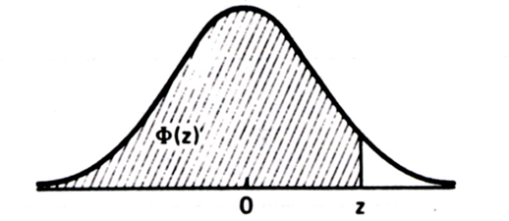
Confidence Intervals
Estimator T for an interval for parameter θ such that
[T-a, T+a] is the confidence interval and 1–α is the confidence level.
For the distribution of random variable X, a value
x_{γ} (0< γ <1) with
is called a γ-quantile; the 0.5-quantile is called the median.
For the Normal distribution N(0,1) the γ-quantile is denoted Φ_{γ} .
For a given a or α, find a value z of N(0,1)
that denotes the [T-a, T+a] conf. interval
or a corresponding γ-quantile for 1–α .

Slide 21
Confidence Intervals for Expectations (1)
Let x₁, ..., x_{n} be a sample from a distribution with unknown
expectation μ and known variance σ².
For sufficiently large n, the sample mean is N(μ,σ²/n) distributed
and is N(0,1) distributed:
For confidence interval or confidence level 1-α set
then look up Φ(z) to find 1–α
then

Slide 22
Confidence Intervals for Expectations (2)
Let X₁, ..., X_{n} be an iid. sample from a distribution X with unknown
expectation μ and unknown variance σ² and known sample variance S².
For sufficiently large n, the random variable
has a t distribution (Student distribution) with n-1 degrees of freedom:
with the Gamma function:

Slide 23
Summary of Section II.2
Quality measures for statistical estimators
Nonparametric vs. parametric estimation
Histograms as generic (nonparametric) plug-in estimators
Method-of-Moments estimator good initial guess but may be biased
Maximum-Likelihood estimator & Expectation Maximization
Confidence intervals for parameters

Slide 24
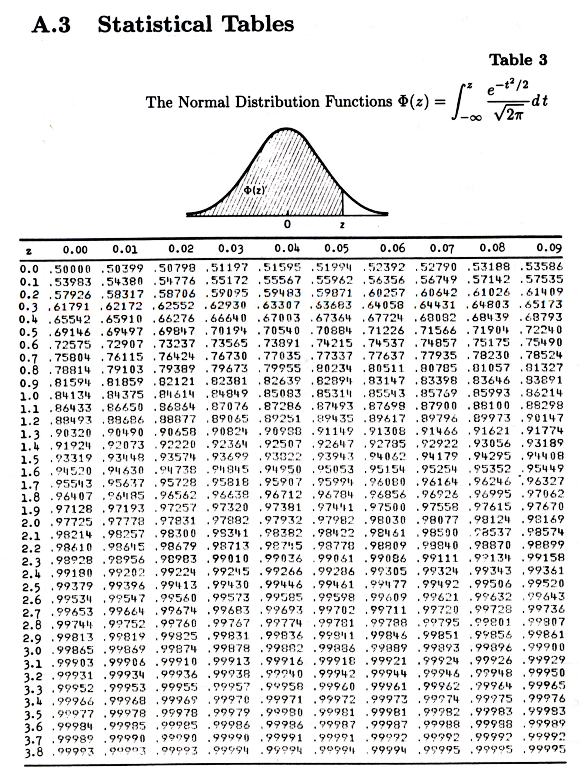
Normal Distribution Table

Slide 25
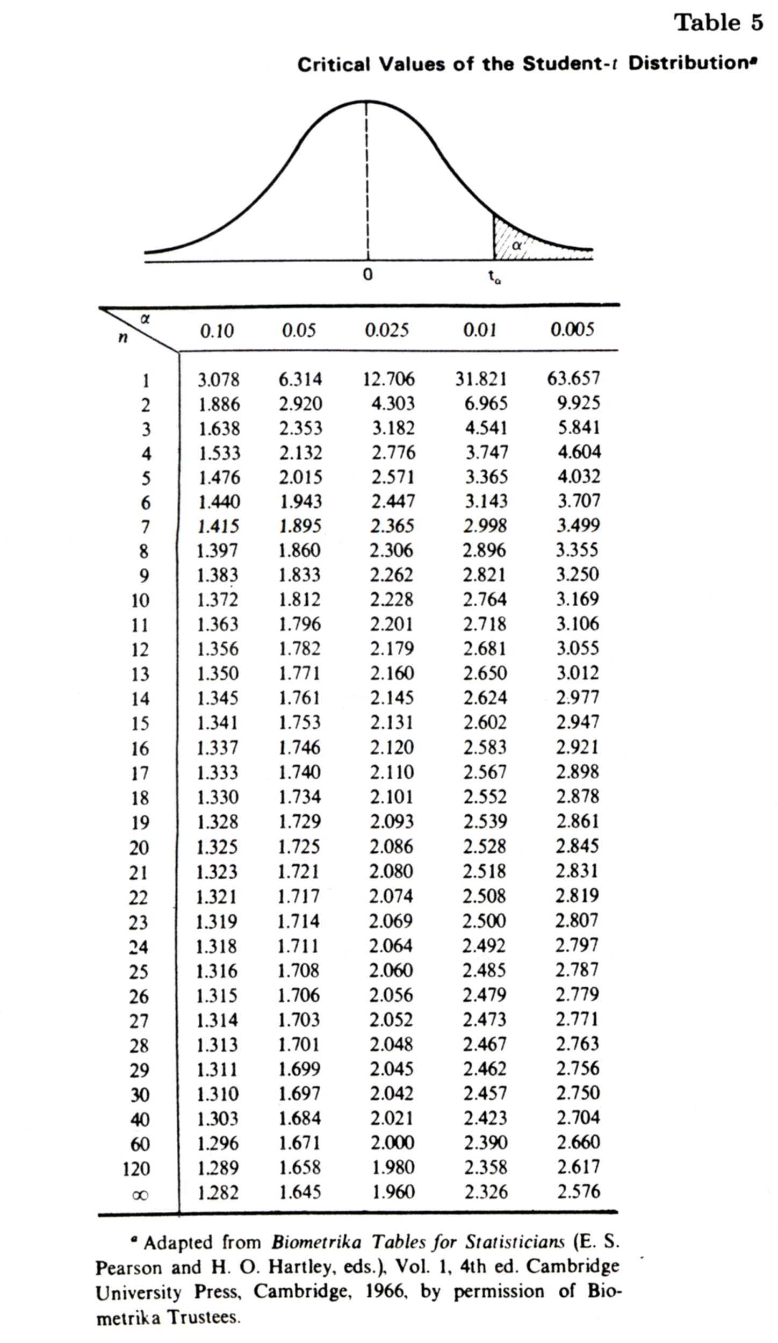
Student‘s t Distribution Table

