Slide 1
Chapter III: Ranking Principles
Information Retrieval & Data Mining
Universität des Saarlandes, Saarbrücken
Winter Semester 2011/12

Slide 2
Chapter III: Ranking Principles*
III.1 Document Processing & Boolean Retrieval
Tokenization, Stemming, Lemmatization, Boolean Retrieval Models
III.2 Basic Ranking & Evaluation Measures
TF*IDF & Vector Space Model, Precision/Recall, F-Measure, MAP, etc.
III.3 Probabilistic Retrieval Models
Binary/Multivariate Models, 2-Poisson Model, BM25, Relevance Feedback
III.4 Statistical Language Models (LMs)
Basic LMs, Smoothing, Extended LMs, Cross-Lingual IR
III.5 Advanced Query Types
Query Expansion, Proximity Ranking, Fuzzy Retrieval, XML-IR
*mostly following Manning/Raghavan/Schütze, with additions from other sources

Slide 3
III.3 Probabilistic Information Retrieval
III.3 Probabilistic IR (MRS book, Chapter 11)
3.1 Multivariate Binary Model & Smoothing
3.2 Poisson Model, Multinomial Model, Dirichlet Model
3.3 Probabilistic IR with Poisson Model (Okapi BM25)
3.4 Tree Dependence Model & Bayesian Nets for IR

Slide 4
TF*IDF vs. Probabilistic Models
TF*IDF sufficiently effective in practice but often criticized for being “too ad-hoc”
Typically outperformed by probabilistic ranking models and/or statistical language models in all of the major IR benchmarks:
TREC: http://trec.nist.gov/
CLEF: http://clef2011.org/
INEX: https://inex.mmci.uni-saarland.de/
Family of Probabilistic IR Models
Generative models for documents as bags-of-words
Binary independence model vs. multinomial (& multivariate) models
Family of Statistical Language Models
Generative models for documents (and queries) as entire sequences of words
Divergence of document and query distributions (e.g., Kullback-Leibler)

Slide 5
“Is This Document Relevant? … Probably”
A survey of probabilistic models in information retrieval.
Fabio Crestani, Mounia Lalmas, Cornelis J. Van Rijsbergen, and Iain Campbell
Computer Science Department
University of Glasgow

Slide 6
Probabilistic IR
Based on generative model:
probabilistic mechanism for producing document (or query)
usually with specific family of parameterized distribution
w₁,...,w_{m}
d₁,...,d_{n}
Very powerful model but restricted through practical limitations:
often with strong independence assumptions among words
justified by “curse of dimensionality”:
corpus with n docs and m terms has n = 2^{m} distinct possible docs
would have to estimate model parameters from n << 2^{m} docs
(problems of sparseness & computational tractability)

Slide 7
III.3.1 Multivariate Binary Model
For generating doc d from joint (multivariate) word distribution φ
consider binary RVs: X_{w} = 1 if word w occurs in doc d, 0 otherwise
postulate independence among these RVs
with vocabulary W
and parameters (priors)
φ_{w} =
P[randomly drawn word is w]
However:
presence of short documents underestimated
product for absent words underestimates prob. of likely docs
too much prob. mass given to very unlikely word combinations

Slide 8
Probabilistic Retrieval with the Binary Model [Robertson and Sparck-Jones 1976]
Binary Relevance Model:
Document d is relevant for query q (i.e., R=1) or not (i.e., R=0)
Ranking based on sim(doc d, query q) =
P[R=1|d,q] = P [ doc d is relevant for query q |
d has term vector X₁,...,X_{m} ]
Probability Ranking Principle (PRP)
PRP with Costs: [Robertson 1977]
For a given retrieval task, the cost of retrieving
d as the next result in a ranked list for query q is:
cost(d,q) := C₁ * P[R=1|d,q] + C₀ * P[R=0|d,q] (“1/0 loss case”)
with cost constants
C₁ = cost of retrieving a relevant doc
C₀ = cost of retrieving an irrelevant doc
For C₁ < C₀, the cost is minimized by choosing
arg max_{d} P[R=1|d,q]

Slide 9
Optimality of PRP
Goal:
Return top-k documents
in descending order of P[R=1|d,q] or cost(d,q), respectively.
Bayes’ Optimal Decision Rule: (PRP without cost function)
Return documents which are more likely
to be relevant than irrelevant, i.e.:
Document d is relevant for query q
iff P[R=1|d,q] > P[R=0|d,q]
Theorem:
The PRP is optimal, in the sense that it minimizes the expected
loss (aka. “Bayes’ risk”) under the 1/0 loss function.

Slide 10
Derivation of PRP
Consider doc d to be retrieved next,
i.e., d is preferred over all other candidate docs d’
cost(d) :=
C₁ P[R=1|d] + C₀ P[R=0|d] ≤ C₁ P[R=1|d’] + C₀ P[R=0|d’]
=: cost(d’)
⇔
C₁ P[R=1|d] + C₀ (1 − P[R=1|d]) ≤ C₁ P[R=1|d’] + C₀ (1 − P[R=1|d’])
⇔
C₁ P[R=1|d] − C₀ P[R=1|d] ≤ C₁ P[R=1|d’] − C₀ P[R=1|d’]
⇔
(C₁ − C₀) P[R=1|d] ≤ (C₁ − C₀) P[R=1|d’]
as C₁ < C₀
by assumption
⇔
P[R=1|d] ≥ P[R=1|d’]
for all d’

Slide 11
Binary Model and Independence
Basic Assumption:
Relevant and irrelevant documents differ in their term distribution.
Binary Independence Model (BIM) Model:
Probabilities for term occurrences are
pairwisely independent for different terms.
Term weights are binary∈ {0,1}.
→ For terms that do not occur in query q, the probabilities of such a
term to occur are the same among relevant and irrelevant documents.
→ Relevance of each document is independent of the relevance of
any other document.

Slide 12
Ranking Proportional to Relevance Odds
(using odds for relevance)
(Bayes’ theorem)
(independence or
linked dependence)
(P[d_{i}|R=1] = P[d_{i}|R=0]
for i ∉q)
d_{i} = 1 if d includes term i,
0 otherwise
X_{i} = 1 if random doc includes term i,
0 otherwise

Slide 13
Ranking Proportional to Relevance Odds
with estimators p_{i}=P[X_{i}=1|R=1]
and q_{i}=P[X_{i}=1|R=0]
with d_{i} =1 iff i∈ d, 0 otherwise
invariant of
document d

Slide 14
Probabilistic Retrieval: Robertson/Sparck-Jones Formula
Estimate p_{i} und q_{i} based on training sample
(query q on small sample of corpus) or based on
intellectual assessment of first round‘s results (relevance feedback):
Let N be #docs in sample
R be # relevant docs in sample
n_{i} be #docs in sample that contain term i
r_{i} be #relevant docs in sample that contain term i
⇒
Estimate:
(Lidstone smoothing
with λ=0.5)
or:
⇒
⇒
Weight of term i in doc d:

Slide 15
Example for Probabilistic Retrieval
Documents d₁…d₄ with relevance feedback:
t₁ t₂ t₃ t₄ t₅ t₆ R
d₁ 1 0 1 1 0 0 1
d₂ 1 1 0 1 1 0 1
d₃ 0 0 0 1 1 0 0
d₄ 0 0 1 0 0 0 0
n_{i} 2 1 2 3 2 0
r_{i} 2 1 1 2 1 0
p_{i} 5/6 1/2 1/2 5/6 1/2 1/6
q_{i} 1/6 1/6 1/2 1/2 1/2 1/6
q: t₁ t₂ t₃ t₄ t₅ t₆
N=4, R=2
Score of new document d₅ (smoothing omitted):
d₅∩q: <1 1 0 0 0 1>
sim(d₅, q) = log 5 + log 1 + log 1/5
+ log 5 + log 5 + log 5
using

Slide 16
Relationship to TF*IDF Formula
Assumptions (without training sample or relevance feedback):
p_{i} is the same for all i
most documents are irrelevant
each individual term i is infrequent
This implies:
with constant c
⇒
~ scalar product over
the product of tf and
dampend idf values
for query terms

Slide 17
Laplace Smoothing (with Uniform Prior)
Probabilities p_{i} and q_{i} for term i are estimated
by MLE for Binomial distribution
(repeated coin tosses for relevant docs, showing term i with prob. p_{i},
repeated coin tosses for irrelevant docs, showing term i with prob. q_{i})
To avoid overfitting to feedback/training,
the estimates should be smoothed
(e.g., with uniform prior):
Instead of estimating p_{i} = k/n estimate:
p_{i} = (k +1) / (n +2) (Laplace’s law of succession)
or with heuristic generalization:
p_{i} = (k +λ) / ( n +2λ) with λ > 0
(e.g., using λ=0.5) (Lidstone’s law of succession)
And for Multinomial distribution (n times w-faceted dice) estimate:
p_{i} = (k_{i} + 1) / (n + w)

Slide 18
III.3.2 Advanced Models: Poisson/Multinomial
For generating doc d
consider counting RVs: x_{w} = number of occurrences of w in d
still postulate independence among these RVs
Poisson model with word-specific parameters μ_{w}:
MLE for μ_{w} is straightforward but:
no likelihood penalty by absent words
no control of doc length
for n iid. samples (docs)
with values k_{w}
(word frequencies)

Slide 19
Multinomial Model
For generating doc d
consider counting RVs: x_{w} = number of occurrences of w in d
first generate doc length (a RV): l_{d} = Σ_{w} x_{w}
then generate word frequencies x_{w}
with word-specific
parameters θ_{w}
= P[randomly
drawn word is w]

Slide 20
Burstiness and the Dirichlet Model
Problem:
In practice, words in documents do not appear independently
Poisson/Multinomial underestimate likelihood of docs with high tf
“bursty” word occurrences are not unlikely:
term may be frequent in doc but infrequent in corpus
for example, P[tf > 10] is low, but P[tf > 10 | tf > 0] is high
Solution: Two-level model
Hypergenerator:
to generate doc, first generate word distribution in corpus
(thus obtain parameters of doc-specific generative model)
Generator:
then generate word frequencies in doc, using doc-specific model

Slide 21
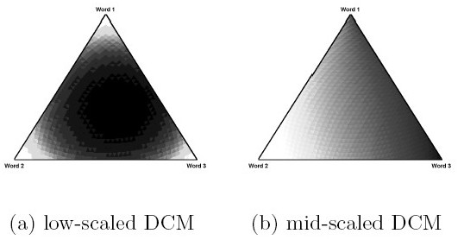
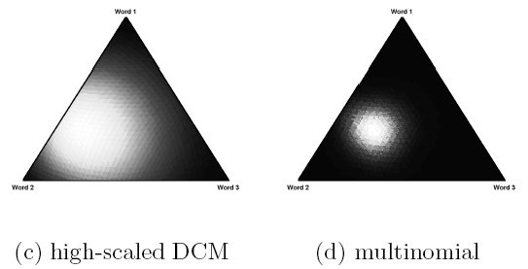
Dirichlet Distribution as Hypergenerator for Two-Level Multinomial Model
with
where Σ_{w} θ_{w}= 1 and θ_{w} ≥ 0 and α_{w} ≥ 0 for all w
α = (0.44, 0.25, 0.31)
α = (1.32, 0.75, 0.93)
α = (3.94, 2.25, 2.81)
θ = (0.44, 0.25, 0.31)
3-dimensional examples of Dirichlet and Multinomial
(Source: R.E. Madsen et al.: Modeling Word Burstiness Using the Dirichlet Distribution)
MAP of Multinomial with Dirichlet prior
is again Dirichlet (with different parameter values)
(“Dirichlet is the conjugate prior of Multinomial”)

Slide 22
MLE for Dirichlet Hypergenerator
2-step probability
of generating doc d
with independence assumptions:
for further steps for MLE use approximations and
numerical methods (e.g., EM or Newton iterations)

Slide 23
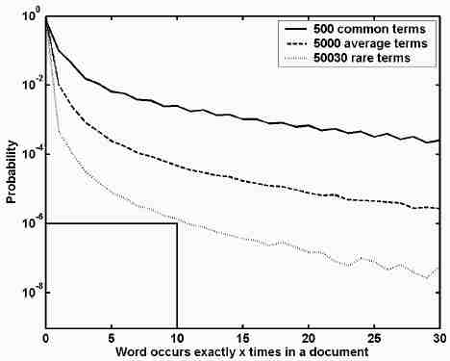
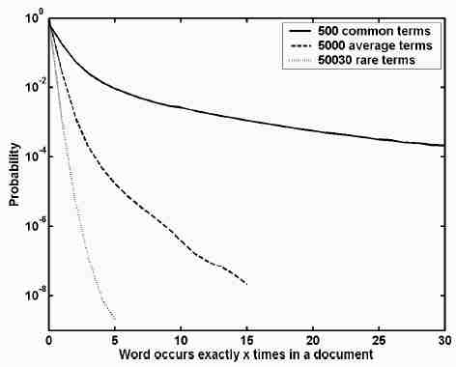
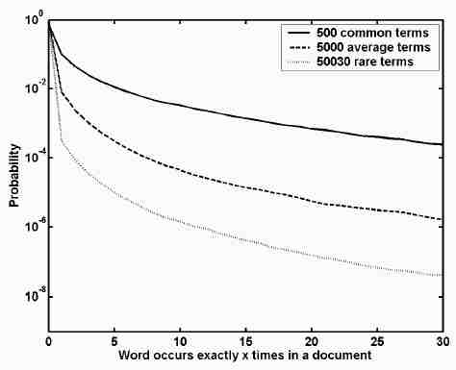
Practical Adequacy of the Dirichlet Model
real corpus
Multinomial
with MLE
Dirichlet
with MLE
Source: R. Madsen et al.: Modeling Word Burstiness Using the Dirichlet Distribution, ICML 2005
model goodness for data x₁, ..., x_{n} also measured by
perplexity = or
(i.e., the exponential of entropy or cross-entropy)

Slide 24
III.3.3 Probabilistic IR with Okapi BM25
Generalize term weight
into
with p_{j}, q_{j} denoting prob. that term occurs j times in rel./irrel. doc, resp.
Postulate Poisson (or 2-Poisson-mixture) distributions for terms:
But: aim to reduce the number of parameters μ, λ that need to be learned from training samples!
Want: ad-hoc ranking function of similar ranking quality without training data!

Slide 25
Okapi BM25
Approximation of Poisson model by similarly-shaped function:
Finally leads to Okapi BM25 (with top-ranked results in TREC):
Or in its most comprehensive, tunable form: score(d,q) :=
with Δ=avg.doclength, tuning parameters k₁, k₂, k₃, b,
non-linear influence of tf, and consideration of current doc length

Slide 26
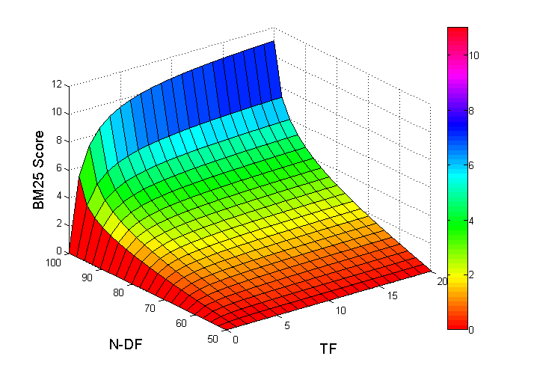
BM25 Example
3-d plot of a simplified BM25 scoring function using k₁=1.2 as parameter (DF is mirrored for better readability)
scores for df>N/2 are negative!

Slide 27
III.3.4 Extensions to Probabilistic IR
Consider term correlations in documents (with binary X_{i})
→ Problem of estimating m-dimensional prob. distribution
P[X₁=... ∧ X₂= ... ∧ ... ∧ X_{m}=...] =: f_{X}(X₁, ..., X_{m})
One possible approach: Tree Dependence Model
a) Consider only 2-dimensional probabilities (for term pairs i,j)
f_{ij}(X_{i}, X_{j})=P[X_{i}=..∧X_{j}=..]=
b) For each term pair i,j
estimate the error between independence and the actual correlation
c) Construct a tree with terms as nodes and the
m-1 highest error (or correlation) values as weighted edges

Slide 28
Considering Two-dimensional Term Correlations
Variant 1:
Error of approximating f by g (Kullback-Leibler divergence)
with g assuming pairwise term independence:
Variant 2:
Correlation coefficient for term pairs:
Variant 3:
level-α values or p-values
of Chi-square independence test

Slide 29
Example for Approximation Error ε (KL Strength)
m=2:
given are documents:
d₁=(1,1), d₂(0,0), d₃=(1,1), d₄=(0,1)
estimation of 2-dimensional prob. distribution f:
f(1,1) = P[X₁=1 ∧ X₂=1] = 2/4
f(0,0) = 1/4, f(0,1) = 1/4, f(1,0) = 0
estimation of 1-dimensional marginal distributions g₁ and g₂:
g₁(1) = P[X₁=1] = 2/4, g₁(0) = 2/4
g₂(1) = P[X₂=1] = 3/4, g₂(0) = 1/4
estimation of 2-dim. distribution g with independent X_{i}:
g(1,1) = g₁(1)*g₂(1) = 3/8,
g(0,0) = 1/8, g(0,1) = 3/8, g(1,0) =1/8
approximation error ε (KL divergence):
ε = 2/4 log 4/3 + 1/4 log 2 + 1/4 log 2/3 + 0

Slide 30
Constructing the Term Dependence Tree
Given:
Complete graph (V, E) with m nodes X_{i} ∈V and
m² undirected edges ∈ E with weights ε (or ρ)
Wanted:
Spanning tree (V, E’) with maximal sum of weights
Algorithm:
Sort the m² edges of E in descending order of weights
E’ := ∅
Repeat until |E’| = m-1
E’ := E’ ∪ {(i,j) ∈E | (i,j) has max. weight in E}
provided that E’ remains acyclic;
E := E – {(i,j) ∈E | (i,j) has max. weight in E}
0.7
Example:
Web
Surf
Web
0.5
0.9
0.7
0.9
0.3
0.1
Internet
Surf
Internet
Swim
0.3
0.1
Swim

Slide 31
Estimation of Multidimensional Probabilities with Term Dependence Tree
Given is a term dependence tree (V = {X₁, ..., X_{m}}, E’).
Let X₁ be the root, nodes are preorder-numbered, and assume that
X_{i} and X_{j} are independent for (i,j) ∉ E’. Then:
cond. prob.
chain rule
cond. indep.
cond. prob.
Example:
Web
P[Web, Internet, Surf, Swim] =
Internet
Surf
Swim

Slide 32
Bayesian Networks
A Bayesian network (BN) is a directed, acyclic graph (V, E) with
the following properties:
Nodes ∈ V representing random variables and
Edges ∈ E representing dependencies.
For a root R ∈ V the BN captures the prior probability P[R = ...].
For a node X ∈ V with parents parents(X) = {P₁, ..., P_{k}}
the BN captures the conditional probability P[X=... | P₁, ..., P_{k}].
Node X is conditionally independent of a non-parent node Y
given its parents parents(X) = {P₁, ..., P_{k}}:
P[X | P₁, ..., P_{k}, Y] = P[X | P₁, ..., P_{k}].
This implies:
by the chain rule:
by cond. independence:

Slide 33
Example of Bayesian Network (aka. “Belief Network”)
P[C]:
Cloudy
P[C] P[¬C]
0.5 0.5
P[R | C]:
P[S | C]:
Sprinkler
Rain
C P[R] P[¬R]
F 0.2 0.8
T 0.8 0.2
C P[S] P[¬S]
F 0.5 0.5
T 0.1 0.9
Wet
S R P[W] P[¬W]
F F 0.0 1.0
F T 0.9 0.1
T F 0.9 0.1
T T 0.99 0.01
P[W | S,R]:

Slide 34
Bayesian Inference Networks for IR
d₁
...
d_{j}
...
d_{N}
P[d_{j}]=1/N
with
binary
random
variables
P[t_{i} | d_{j}∈parents(t_{i})] =
1 if t_{i} occurs in d_{j},
0 otherwise
t₁
...
t_{i}
...
t_{l}
...
t_{M}
P[q | parents(q)] =
1 if ∃t∈parents(q): t is relevant for q,
0 otherwise
q

Slide 35
Advanced Bayesian Network for IR
d₁
...
d_{j}
...
d_{N}
t₁
...
t_{i}
...
t_{l}
...
t_{M}
c₁
...
c_{k}
...
c_{K}
with concepts / topics c_{k}
q
Problems:
parameter estimation (sampling / training)
(non-) scalable representation
(in-) efficient prediction
fully convincing experiments

Slide 36
Summary of Section III.3
Probabilistic IR reconciles principled foundations
with practically effective ranking
Parameter estimation requires smoothing to avoid overfitting
Poisson-model-based Okapi BM25 has won many benchmarks
Multinomial & Dirichlet models are even more expressive
Extensions with term dependencies, such as Bayesian Networks,
are intractable for general-purpose IR but interesting for specific apps

Slide 37
Additional Literature for Section III.3
Manning/Raghavan/Schuetze, Chapter 11
K. van Rijsbergen: Information Retrieval, Chapter 6: Probabilistic Retrieval, 1979,
http://www.dcs.gla.ac.uk/Keith/Preface.html
R. Madsen, D. Kauchak, C. Elkan: Modeling Word Burstiness Using the
Dirichlet Distribution, ICML 2005
S.E. Robertson, K. Sparck Jones: Relevance Weighting of Search Terms,
JASIS 27(3), 1976
S.E. Robertson, S. Walker: Some Simple Effective Approximations to the
2-Poisson Model for Probabilistic Weighted Retrieval, SIGIR 1994
A. Singhal: Modern Information Retrieval – a Brief Overview,
IEEE CS Data Engineering Bulletin 24(4), 2001
K.W. Church, W.A. Gale: Poisson Mixtures,
Natural Language Engineering 1(2), 1995
C.T. Yu, W. Meng: Principles of Database Query Processing for
Advanced Applications, Morgan Kaufmann, 1997, Chapter 9
D. Heckerman: A Tutorial on Learning with Bayesian Networks,
Technical Report MSR-TR-95-06, Microsoft Research, 1995
S. Chaudhuri, G. Das, V. Hristidis, G. Weikum: Probabilistic information retrieval
approach for ranking of database query results, TODS 31(3), 2006.

