Slide 1
Chapter IV: Link Analysis
Information Retrieval & Data Mining
Universität des Saarlandes, Saarbrücken
Winter Semester 2011/12

Slide 2
Chapter IV: Link Analysis*
IV.1 Page Rank
IV.2 HITS Algorithm
IV.3 Extensions & Comparisons
IV.4 Personalized Link Analysis
IV.5 Link Spam Detection
IV.6 Distributed Link Analysis
*mostly following Chapter 21 from Manning/Raghavan/Schütze,
with additions from other sources

Slide 3
IV.2 HITS: Hyperlink-Induced Topic Search
[Kleinberg: JACM’99]
Idea:
Determine
good content sources: Authorities
(high indegree)
good link sources: Hubs
(high outdegree)
Find
better authorities that have good hubs as predecessors
better hubs that have good authorities as successors
For Web graph G = (V, E) define for nodes p, q ∈V
Authority score and
Hub score
“Mutual
reinforcement”
between hubs &
authorities

Slide 4
HITS as Eigenvector Computation
Authority and hub scores in matrix notation:
with constants α, β
Iteration with adjacency matrix E:
→ a and h are Eigenvectors of E^{T} E and E E^{T}, respectively
Intuitive interpretation:
is the cocitation matrix: M^{(auth)}_{ij} is the
number of nodes that point to both i and j
is the bibliographic-coupling matrix: M^{(hub)}_{ij}
is the number of nodes to which both i and j point

Slide 5
HITS Algorithm
Compute fixpoint solution by
Iteration (until convergence) with length normalization:
Initialization: a⁽⁰⁾ = (1, 1, ..., 1)^{T}, h⁽⁰⁾ = (1, 1, ..., 1)^{T}
Repeat until sufficient convergence
h^{(i+1)} := E a^{(i)}
h^{(i+1)} := h^{(i+1)} / ||h^{(i+1)}||₁
a^{(i+1)} := E^{T} h^{(i)}
a^{(i+1)} := a^{(i+1)} / ||a^{(i+1)}||₁
Convergence is guaranteed under fairly general conditions:
For a symmetric n x n matrix M and a vector v that is not orthogonal to the principal Eigenvector w(M), the unit vector in the direction of M^{k}v converges to w(M), for k → ∞.

Slide 6
Implementation & Tuning of HITS
Determine a sufficient number r of “root pages” (e.g., 50-200 pages)
via relevance ranking (e.g., using TF*IDF ranking)
Add all successors of root pages
For each root page add up to d predecessors
Compute iteratively
authority and hub scores of this “expansion set” (e.g., 1000-5000 pages)
with initialization a_{i} := h_{i} := 1 / |expansion set|
and L₁ normalization after each iteration
→ converges to principal Eigenvectors of EE^{T} and E^{T}E, resp.
5) Return pages in descending order of authority scores
(e.g., the 10 largest elements of vector a)
“Drawback” of HITS algorithm:
→ relevance ranking (by keywords) within root set is not considered

Slide 7
Example: Construction of HITS Graph
keyword query
1
6
4
2
7
5
8
3
root set
expansion set

Slide 8
Improved HITS Algorithm [Bharat, Henzinger: SIGIR’98]
Potential weakness of the HITS algorithm:
irritating links (automatically generated links, spam, etc.)
topic drift (e.g., from “Jaguar car” to “car” in general)
Improvement:
Introduce edge weights:
0 for links within the same host,
1/k with k links from k URLs of the same host to 1 URL (aweight)
1/m with m links from 1 URL to m URLs on the same host (hweight)
Consider relevance weights w.r.t. query topic (e.g., TF*IDF)
Iterative computation of
authority score
hub score

Slide 9
Finding Related URLs [Bharat, Henzinger: WWW’99]
Cocitation algorithm:
Determine up to B predecessors of given URL u
For each predecessor p determine up to BF successors ≠ u
Determine among all siblings s of u those
with the largest number of predecessors that
point to both s and u (degree of cocitation)
Companion algorithm (next slide):
Determine appropriate base set for URL u (“vicinity” of u)
Apply HITS algorithm to this base set

Slide 10
Companion Algorithm for Finding Related URLs [Bharat, Henzinger: WWW’99]
Companion algorithm:
Determine expansion set: u plus
up to B predecessors of u and
for each predecessor p up to BF successors ≠ u plus
up to F successors of u and
for each successor c up to FB predecessors ≠ u
with elimination of stop URLs (e.g., www.yahoo.com)
Duplicate elimination:
Merge nodes both of which have more than 10 successors
and have 95 % or more overlap among their successors
Compute authority scores
using the improved HITS algorithm (previous slide)

Slide 11
Application of HITS for “Community Detection”
Root set may contain multiple topics or communities,
e.g., for queries “jaguar”, “Java”, or “randomized algorithm”.
Approach:
Compute k largest Eigenvalues of E^{T} E
and the corresponding Eigenvectors a (authority scores)
(e.g., using SVD on E)
For each of these k Eigenvectors a,
the largest authority scores indicate
a densely connected “community”

Slide 12
IV.3 Comparison/Extensions of PR & HITS
PR HITS
Matrix construction static query time
Matrix size huge moderate
Stochastic matrix yes no
Dampening by random jumps yes no
Outdegree normalization yes no
Preference for bipartite cores no yes
Score stability to perturbations yes no
Resilience to topic drift n/a no
Resilience to spam no no
But: features of PR can be incorporated into HITS extensions,
and vice versa

Slide 13
Comparison of PR/HITS with In/Out-Degree [Najork, Zaragoza, Taylor: HITS on the Web: How does it Compare? SIGIR’07]
Comparative study of link analysis methods:
PageRank, HITS, in/out-degree in combination with field-weighted BM25F
all – all links
id – only inter-domain links
ih – only inter-host links
(based on a crawl of 463 million web pages containing 17.6 billion hyperlinks and
referencing 2.9 billion distinct URLs; and a set of 28,043 queries sampled from a
query log)

Slide 14
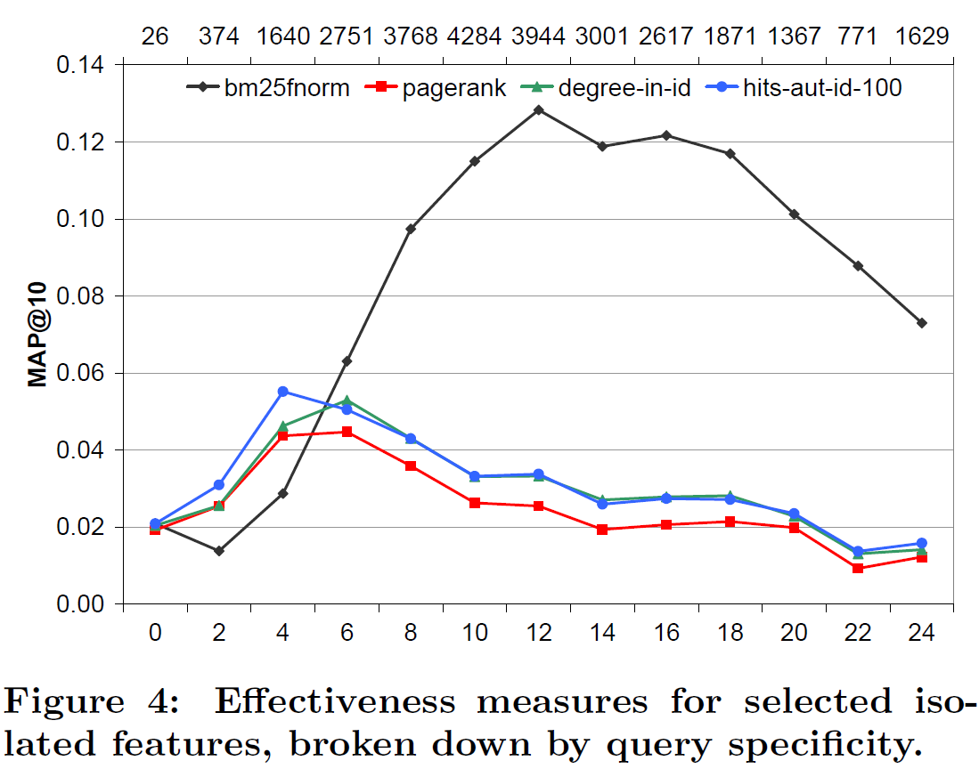
Comparison of PR/HITS with In/Out-Degree [Najork, Zaragoza, Taylor: HITS on the Web: How does it Compare? SIGIR’07]

Slide 15
SALSA: Random Walk on Hubs and Authorities [Lempel/Moran, TOIS 2001]
View each node v of the link graph as two nodes v_{h} and v_{a}
Construct bipartite undirected graph G’(V’,E’) from link graph G(V,E):
V’ = {v_{h} | v∈V and outdegree(v)>0} ∪ {v_{a} | v∈V and indegree(v)>0}
E’ = {(v_{h ,}w_{a}) | (v,w) ∈E}
G(V,E)
G’(V’,E’)
1h
2a
1
2
3
2h
3a
4
5
4h
4a
6
5h
6a

Slide 16
SALSA: Random Walk on Hubs and Authorities [Lempel/Moran: TOIS 2001]
→ Perform PageRank-like random walks for both Hubs and Authorities:
Stochastic hub matrix H:
for i, j and k ranging over all nodes with (i_{h},k_{a}), (j_{h},k_{a}) ∈ E’
Stochastic authority matrix A:
for i, j and k ranging over all nodes with (k_{h},i_{a}), (k_{h},j_{a}) ∈ E’
The corresponding Markov chains are ergodic in each connected component.
Stationary solution: π[v_{h}] ~ outdegree(v) for H, π[v_{a}] ~ indegree(v) for A
Further extension with random jumps: PHITS (Probabilistic HITS)

Slide 17
More Link Analysis Variants
Hub-Averaging:
and
Authority-Threshold (only k best authorities per hub):
and
with
Max-Authority (authority threshold with k=1):
and
Breadth-First-Search (transitive citations up to depth k):
where N^{(j)}(q) are nodes that
have a path to q by alternating
o OUT and i IN steps with j=o+i

Slide 18
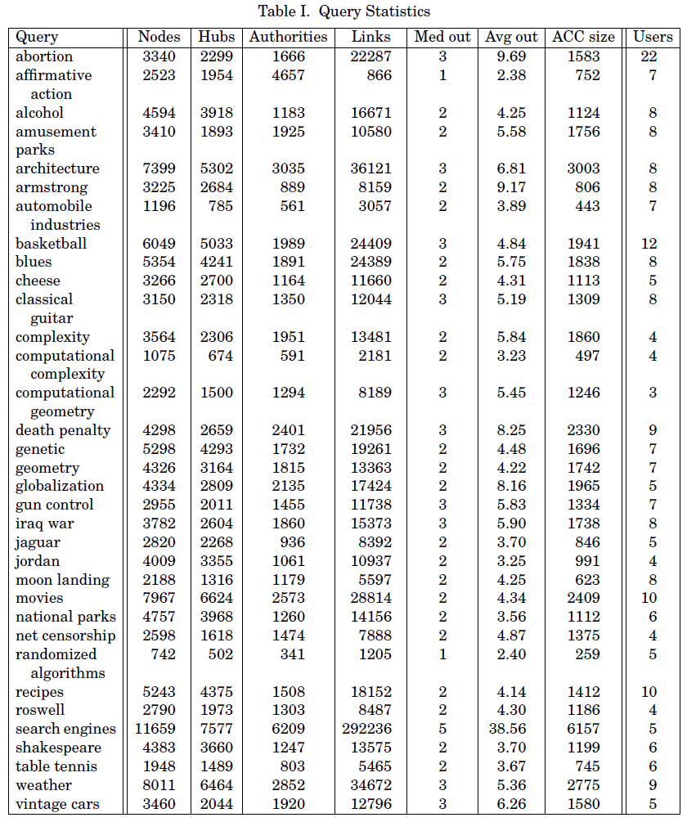
Comparison of Link Analysis Methods: Queries
Experimental setup:
34 queries
rootsets of 200 pages each
obtained from Google
base sets computed
using Google with first
50 predecessors per page
Source: Borodin et al.,
ACM TOIT 2005

Slide 19
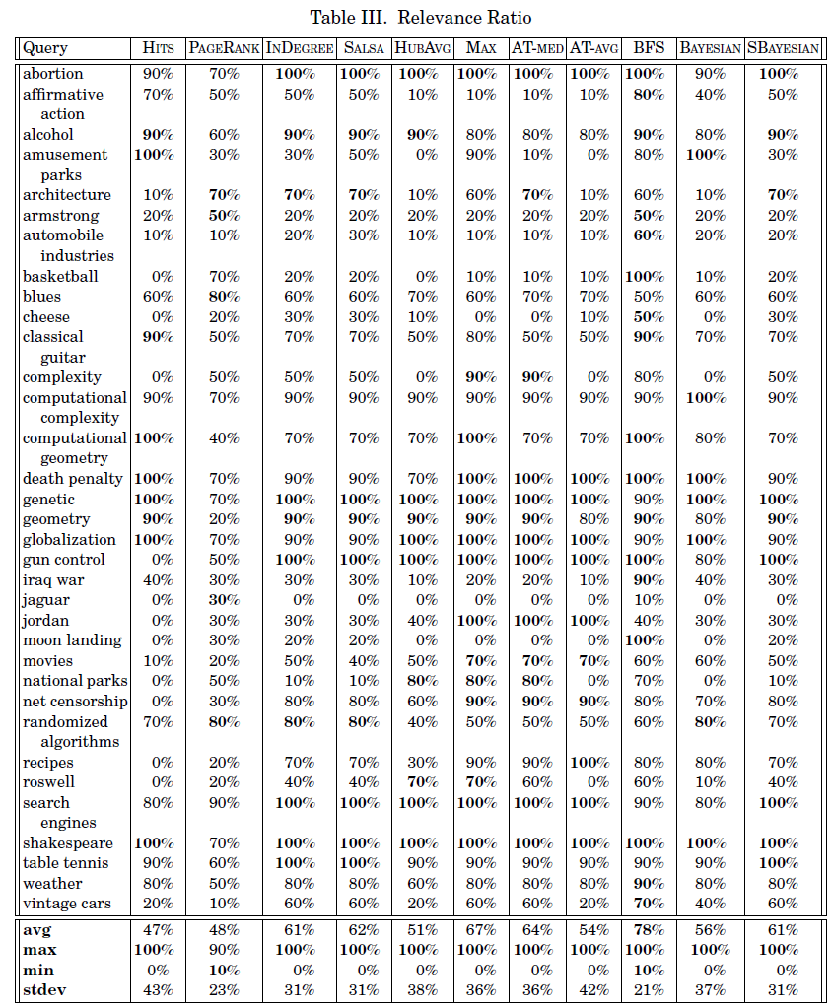
Comparison of Link Analysis Methods: Precision@10
Source: Borodin et al.,
ACM TOIT 2005

Slide 20
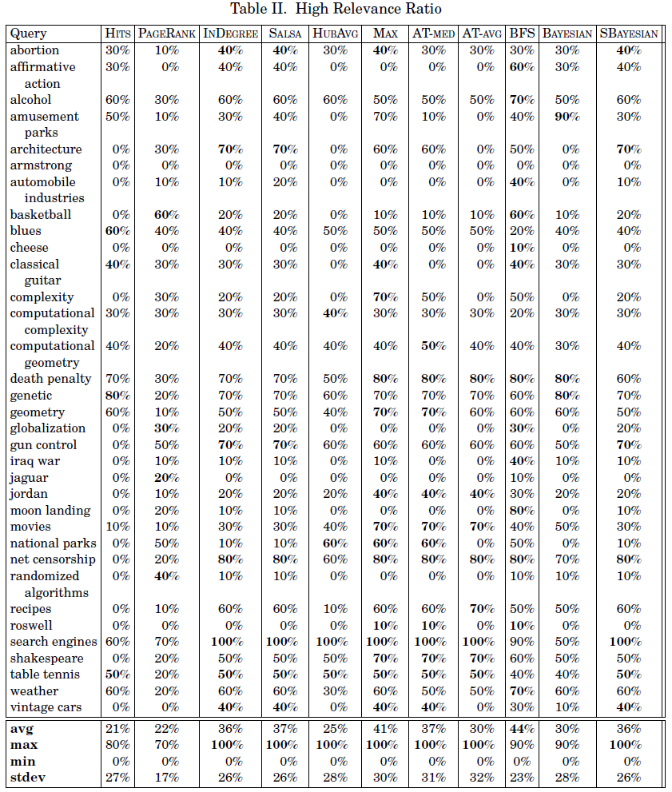
Comparison of Link Analysis Methods: Key Authorities
So who’s the winner?
Source: Borodin et al.,
ACM TOIT 2005

Slide 21
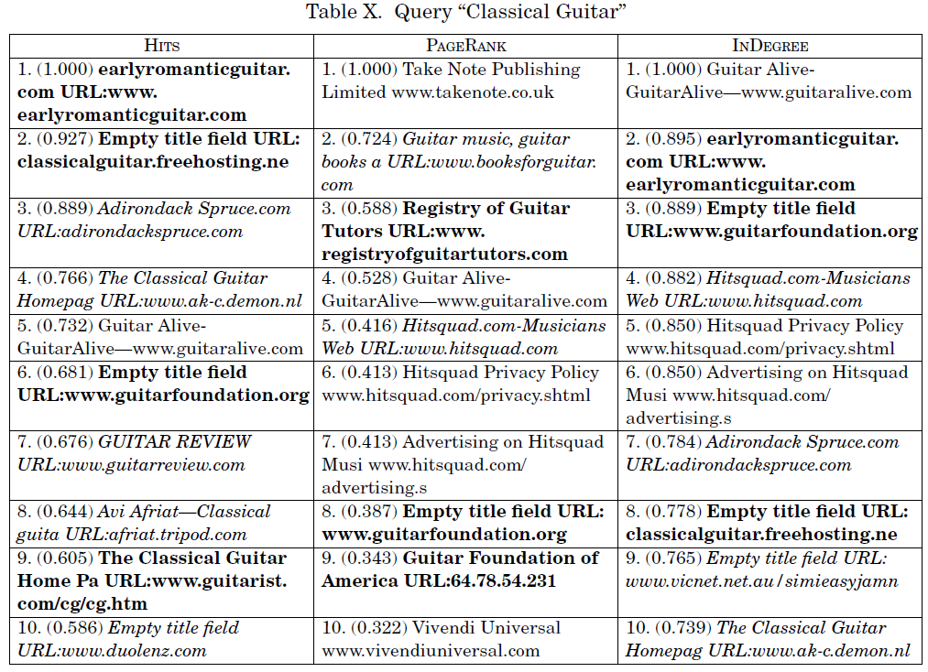
Link Analysis for Query “Classical Guitar” (1)
Source: Borodin et al., ACM TOIT 2005

Slide 22
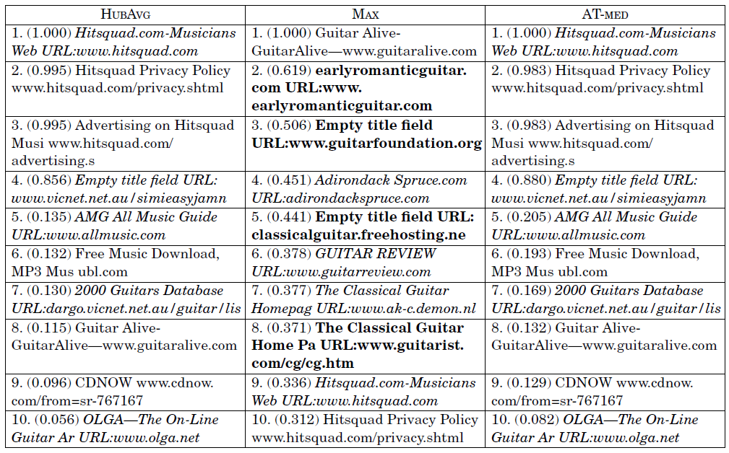
Link Analysis for Query “Classical Guitar” (2)
Source: Borodin et al., ACM TOIT 2005

Slide 23
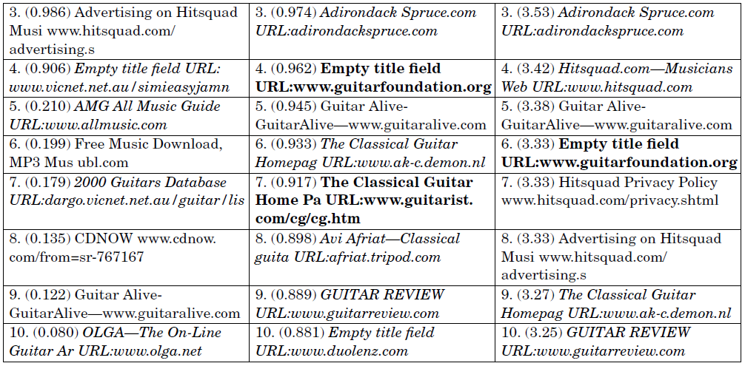
Link Analysis for Query “Classical Guitar” (3)
Source: Borodin et al., ACM TOIT 2005

Slide 24
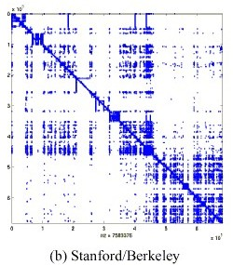
Efficiency of PageRank Computation [Kamvar/Haveliwala/Manning/Golub 2003]
Exploit block structure of the link graph:
Partition link graph by domain names
2) Compute local PR vector of pages within
each block → LPR(i) for page i
3) Compute block rank of each block:
a) block link graph B with
b) run PR computation on B,
yielding BR(I) for block I
4) Approximate global PR vector using LPR and BR:
a) set x_{j}⁽⁰⁾ := LPR(j) ⋅ BR(J) where J is the block that contains j
b) run PR computation on A
Dotplot of the Web graph:
Point (i,j) for link between pages i
and j (pages sorted by URL)
Speeds up convergence by factor of 2 in good “block cases”,
however unclear how effective it is in general.

Slide 25
Efficiency of Storing PageRank Vectors [T. Haveliwala: Internet Computing 2003]
Memory-efficient encoding of PR vectors
(important for large number of topic-specific vectors)
→ 100 topics * 20 Bio. pages * 4 Bytes would cost 8 TB
Key idea:
Map real PR scores to n cells and encode cell no into ceil(log₂ n) bits
Approx. PR score of page i is the mean score of the cell that contains i
Should use non-uniform partitioning of score values to form cells
Possible encoding schemes:
Equi-depth partitioning: choose cell boundaries such that
is the same for each cell
Equi-width partitioning with log values: first transform all
PR values into log PR, then choose equi-width boundaries
Cell no. could be variable-length encoded (e.g., using Huffman code)

Slide 26
SimRank: Measuring Structural Context Similarity [Jeh, Widom: KDD 02]
0.62
Idea: Two objects are similar
if they relate to objects that
are similar objects!
{sugar, frosting}
0.62
1.0
{sugar, eggs}
0.44
sugar
{A,A}
{sugar, flour}
0.55
1.0
{frosting, frosting}
Person_{A}
frosting
1.0
{A,B}
{frosting, eggs}
B
1.0
0.62
eggs
{frosting, flour}
Person_{B}
1.0
{B,B}
{eggs, eggs}
flour
0.62
{eggs, flour}
O_{i}(a) – i-th object in a’s
inlink neighborhood
I_{i}(a) – i-th object in a’s
outlink neighborhood
and constants c₁,c₂ ∈ [0,1]

Slide 27
IV.4 Topic-specific and Personalized PageRank
Idea: random jumps favor designated high-quality pages (B)
such as personal bookmarks, frequently visited pages, etc.
with
Authority (page q)
= stationary prob.
of visiting q
random walk:
uniformly random choice of links
+ biased jumps to personal favorites (or trusted pages, or ...)
[see also: Haveliwala 2002, Jeh 2003, Benczur 2004, Gyöngyi 2004, Guha 2004]

Slide 28
Topic-specific PageRank [Haveliwala: TKDE 2003]
Given: A (small) set of topics c_{k}, each with a set T_{k} of authorities
(taken from a directory such as ODP (www.dmoz.org)
or bookmark collection)
Idea :
Change the PageRank random walk by biasing the
random-jump probabilities to the topic authorities T_{k}:
p_{k} = α C p +(1−α) r_{k} with usual transition matrix C
and (r_{k})_{j} = 1/|T_{k}| for j∈T_{k}, 0 else (instead of r_{j} = 1/n)
Method:
1) Precompute topic-specific PageRank vectors p_{k}
2) Classify user query q (incl. query context) w.r.t. each topic c_{k}
→ probability w_{k} := P[c_{k} | q]
3) Total authority score of doc d is

Slide 29
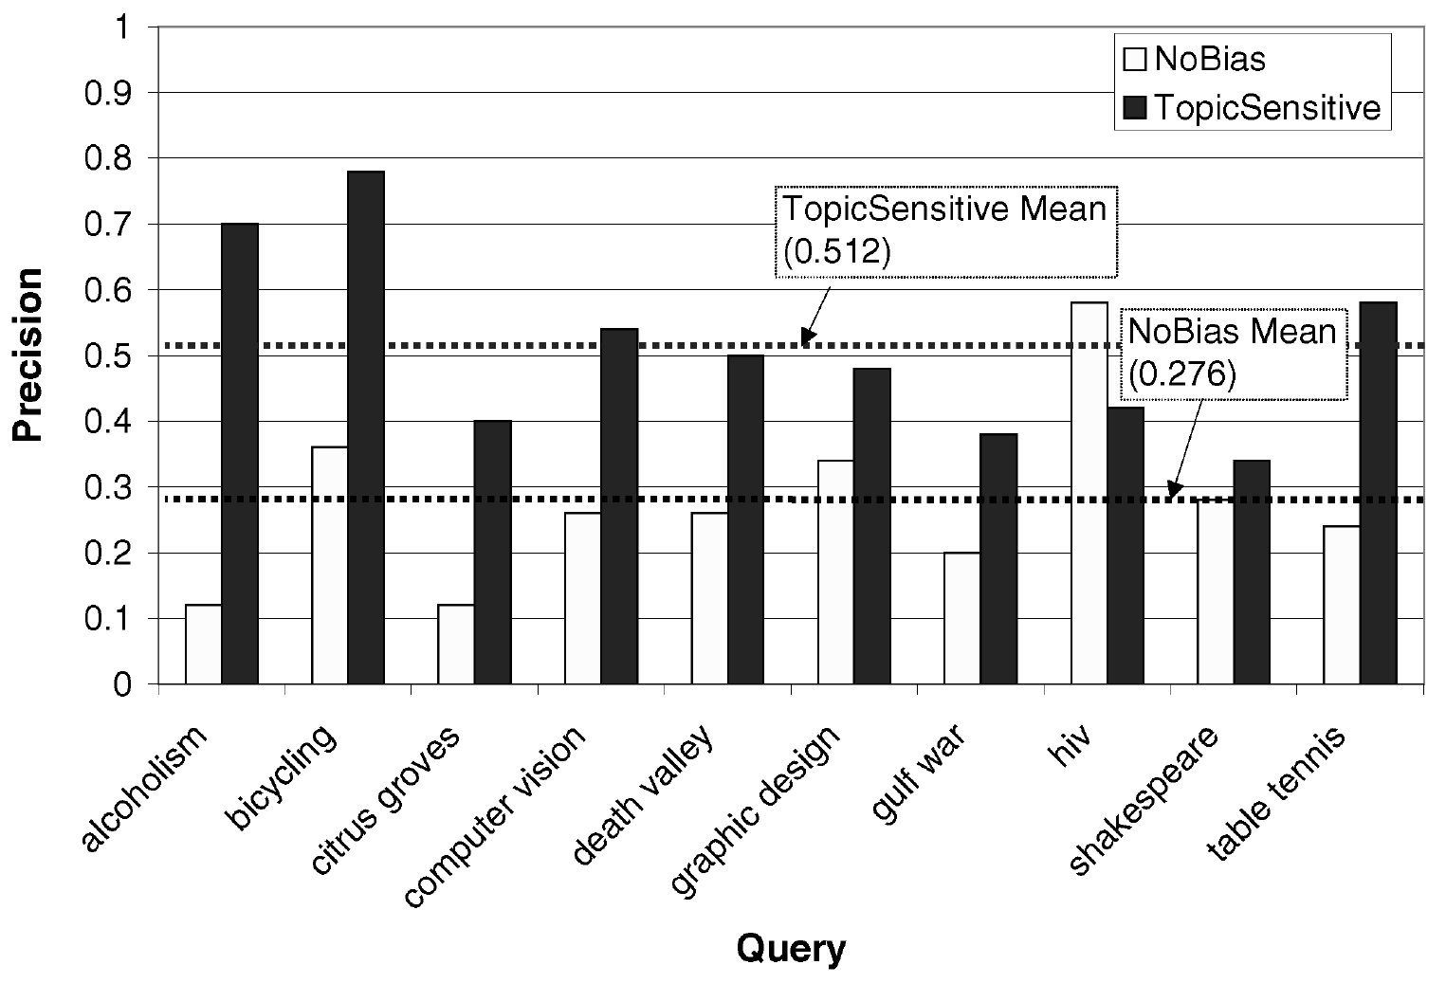
Performance of Topic-Specific PageRank [Haveliwala: TKDE 2003]

Slide 30
Personalized PageRank
Goal: Efficient computation and efficient storage of user-specific
personalized PageRank vectors (PPR)
PageRank equation: p = α C p +(1−α) r
Linearity Theorem:
Let r₁ and r₂ be personal preference vectors for random-jump targets,
and let p₁ and p₂ denote the corresponding PPR vectors.
Then for all β₁, β₂ ≥ 0 with β₁ + β₂ = 1 the following holds:
β₁ p₁ + β₂ p₂ = α C (β ₁ p₁ + β₂ p₂) + (1−α) (β₁ r₁ + β₂ r₂)
Corollary:
For preference vector r with m non-zero components and
base vectors e_{k} (k=1..m) with (e_{k})_{i} =1 for i=k, 0 for i≠k, we obtain:
with constants β₁ ... β_{m}
and for PPR vector p with p_{k} = α C p_{k} +(1−α) e_{k}
[for further optimizations see Jeh/Widom: WWW 2003]

Slide 31
Exploiting Click Streams
Simple idea:
Modify HITS or Page-Rank algorithm by weighting edges with
the relative frequency of users clicking on a link
(as observed by DirectHit, Alexa, etc.).
More sophisticated approach:
[Chen et al.: WISE 2002]
Consider link graph A and
link-visit matrix V (V_{ij}=1 if user i visits page j, 0 else):
Define
authority score vector: a = βA^{T}h + (1- β)V^{T}u
hub score vector: h = βAa + (1- β)V^{T}u
user importance vector: u = (1- β)V(a+h)
with a tunable parameter β (with β=1: HITS, β=0: DirectHit)

Slide 32
Link Analysis based on Implicit Links
Apply simple data mining to browsing sessions of many users,
where each session i is a sequence (pi₁, pi₂, ...) of visited pages:
consider all pairs (pi_{j}, pi_{j+1}) of successively visited pages,
compute their total frequency f, and
select those with f above some min-support threshold.
Construct implicit-link graph with the selected page pairs as edges
and their normalized total frequencies f as edge weights.
[Xue et al.: SIGIR 2003]
Apply edge-weighted Page-Rank for authority scoring,
and linear combination of query relevance and
link authority for overall scoring.

Slide 33
Exploiting Query Logs and Click Streams [Luxenburger et al.: WISE 2004, WebDB 2006]
QRank: links + query-doc transitions + query-query transitions
+ doc-doc transitions on implicit links (w/ thesaurus)
with probabilities estimated from log statistics
max
planck
max planck
gesellschaft
mpg
budget
A.M.
with
MPII
MPII
A.M.

Slide 34
QRank Experiments
Setup:
70 000 Wikipedia docs, 18 volunteers posing Trivial-Pursuit queries
ca. 500 queries, ca. 300 refinements, ca. 1000 positive clicks
ca. 15 000 implicit links based on doc-doc similarity
Results (assessment by blind-test users):
QRank top-10 result preferred over PageRank in 81% of all cases
QRank has 50.3% precision@10, PageRank has 33.9%
Untrained example query “philosophy”:
PageRank QRank
1. Philosophy Philosophy
2. GNU free doc. license GNU free doc. license
3. Free software foundation Early modern philosophy
4. Richard Stallman Mysticism
5. Debian Aristotle

Slide 35
Additional Literature for Sections IV.1-2
Web Graph Modeling in General:
A. Z. Broder, R. Kumar, F. Maghoul, P. Raghavan, S. Rajagopalan, R. Stata,
A. Tomkins, J.L. Wiener: Graph structure in the Web, WWW 2000
G.W. Flake, S. Lawrence, C.L. Giles, F. Coetzee: Self-Organization and
Identification of Web Communities. IEEE Computer 35(3), 2002
Link Analysis Principles & Algorithms:
J.M. Kleinberg: Authoritative Sources in a Hyperlinked Environment, JACM 46(5), 1999
S Brin, L. Page: The Anatomy of a Large-Scale Hypertextual Web Search Engine,
WWW 1998
K. Bharat, M. Henzinger: Improved Algorithms for Topic Distillation in a
Hyperlinked Environment, SIGIR 1998
J. Dean, M. Henzinger: Finding Related Pages in the World Wide Web, WWW 1999
C. Ding, X. He, P. Husbands, H. Zha, H. Simon: PageRank, HITS, and a Unified
Framework for Link Analysis, SIAM Int. Conf. on Data Mining, 2003.
A. Borodin, G.O. Roberts, J.S. Rosenthal, P. Tsaparas: Link analysis ranking: algorithms,
theory, and experiments. ACM TOIT 5(1), 2005
A.N. Langville, C.D. Meyer: Deeper inside PageRank. Internet Math., 1(3), 2004
A.N. Langville, C.D. Meyer: Google‘s PageRank and Beyond – The Science of
Search Engine Rankings, Princeton University Press, 2006
M. Najork, H. Zaragoza, M. Taylor: HITS on the Web: How does it Compare?, SIGIR 2007

Slide 36
Additional Literature for Sections IV.3
Comparison and Extensions of Link Analysis Algorithms:
R. Lempel, S. Moran: SALSA: The Stochastic Approach for Link-Structure
Analysis, ACM TOIS 19(2), 2001.
G. Jeh, J. Widom: SimRank: a Measure of Structural-Context Similarity, KDD 2002
A. Borodin, G.O. Roberts, J.S. Rosenthal, P. Tsaparas: Finding Authorities and
Hubs from Link Structures on the World Wide Web, WWW 2001
Matt Richardson, Pedro Domingos: The Intelligent surfer: Probabilistic
Combination of Link and Content Information in PageRank, NIPS 2001
C. Ding, X. He, P. Husbands, H. Zha, H. Simon: PageRank, HITS, and a Unified
Framework for Link Analysis, SIAM Int. Conf. on Data Mining, 2003.
M. Bianchini, M. Gori, F. Scarselli: Inside PageRank.ACM TOIT 5(1), 2005
A.N. Langville, C.D. Meyer: Deeper inside PageRank. Internet Math., 1(3), 2004
A.X. Zheng, A.Y. Ng, M.I.: Stable Algorithms for Link Analysis, SIGIR 2001

Slide 37
Additional Literature for Sections IV.4
Efficient PageRank Computation:
Sepandar D. Kamvar, Taher H. Haveliwala, Christopher D. Manning, Gene H. Golub: Extrapolation methods for accelerating PageRank computations. WWW 2003: 261-270
Taher H. Haveliwala: Efficient Encodings for Document Ranking Vectors (Extended Abstract). International Conference on Internet Computing 2003: 3-9
Personalized Authority Scoring:
Taher Haveliwala: Topic-Sensitive PageRank: A Context-Sensitive Ranking
Algorithm for Web Search, IEEE Trans. on Knowledge and Data Engineering, 2003.
G. Jeh, J. Widom: Scaling personalized web search, WWW 2003.
D. Fogaras, B. Racz, K. Csalogany, A. Benczur: Towards Scaling Fully
Personalized PageRank: Algorithms, Lower Bounds, and Experiments,
Internet Mathematics 2(3): 333-358, 2006.
J. Luxenburger, G. Weikum: Query-Log Based Authority Analysis for Web
Information Search, WISE 2004
J. Luxenburger, G. Weikum: Exploiting Community Behavior for Enhanced Link
Analysis and Web Search, WebDB 2006

