Slide 1
IV.5 Link Spam: Not Just E-mails Anymore
Distortion of search results by “spam farms” and “hijacked” links
(aka. search engine optimization)
“hijacked”
links
Web
boosting
pages
(spam farm)
page to be
“promoted”
Susceptibility to manipulation and lack of trust model
is a major problem:
Successful 2004 DarkBlue SEO Challenge: “nigritude ultramarine”
Pessimists estimate 75 Mio. out of 150 Mio. Web hosts are spam
Research challenge:
Robustness to egoistic and malicious behavior
Trust/distrust models and mechanisms
→But often unclear borderline between spam and community opinions

Slide 2
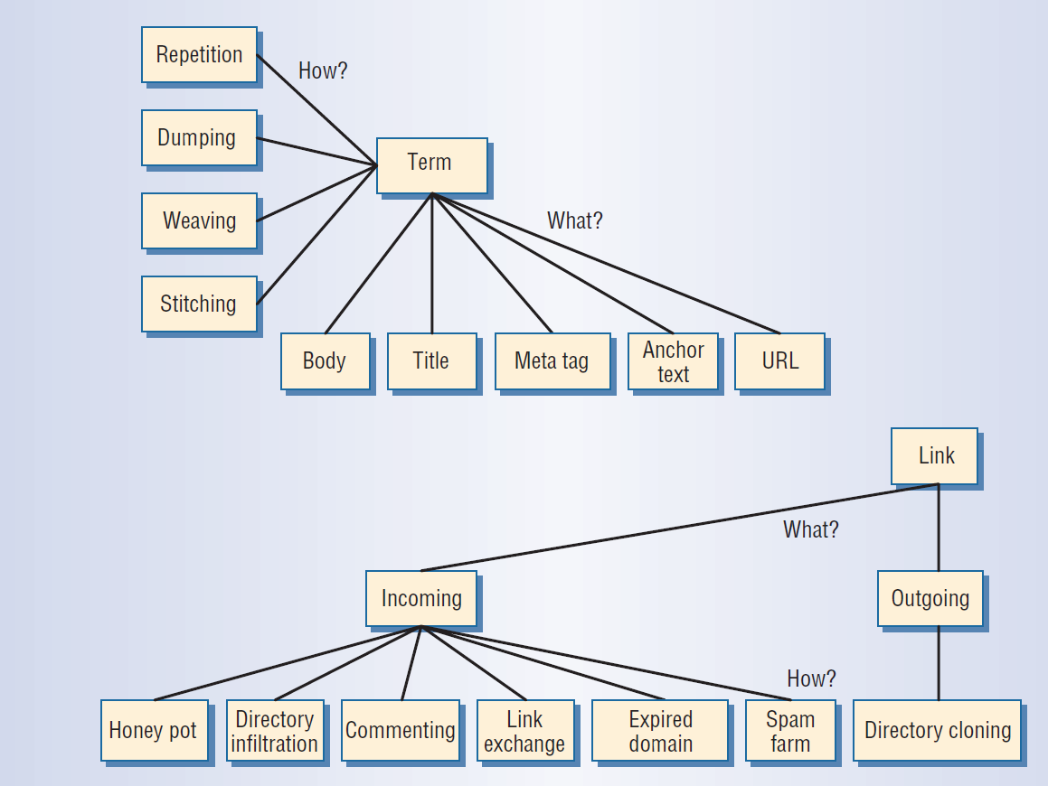
Content Spam vs. Link Spam
Source: Z. Gyöngyi, H. Garcia-Molina: Spam: It‘s Not Just for Inboxes Anymore,
IEEE Computer 2005

Slide 3
From PageRank to TrustRank
[Kamvar et al.: WWW’03, Gyöngyi et al.: VLDB‘04]
Idea: PRP random jumps favor designated high-quality pages (B)
such as personal bookmarks, frequently visited pages, etc.
Authority (page q)
= stationary prob.
of visiting q
Random walk: uniformly random choice of links
+ biased jumps to trusted pages

Slide 4
Counter Measures: TrustRank and BadRank
TrustRank:
Start with explicit set T of trusted pages with trust values t_{i} and
define random-jump vector r by setting r_{i} = 1/|T| if i ∈T, and 0 else.
Propagate TrustRank mass to successors:
BadRank:
Start with explicit set B of blacklisted pages and
define random-jump vector r by setting r_{i}=1/|B| if i∈B, and 0 else.
Propagate BadRank mass to predecessors
Problems:
Difficult maintenance of explicit page lists
Difficult to understand (& guarantee) effects

Slide 5
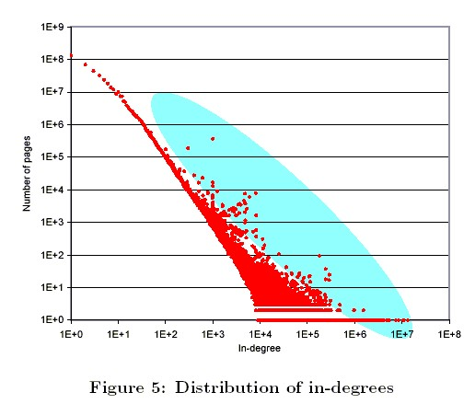
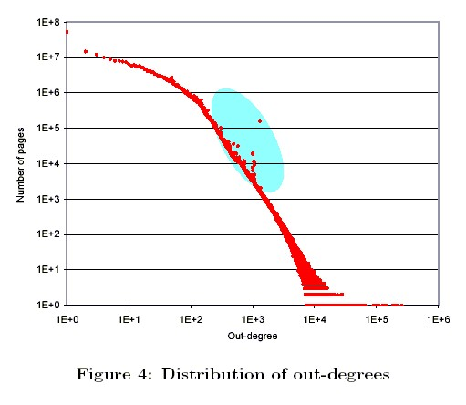
Spam, Damn Spam, and Statistics
Spam detection based on statistical deviation:
Content spam:
compare the word frequency distribution
to the general distribution in “good sites”
Link spam:
find outliers in outdegree and indegree distributions
and inspect intersection
Typical for the Web:
P[degree=k] ~ (1/k)^{α}
α ≈ 2.1 for indegrees
≈ 2.7 for outdegrees
(Zipfian distribution)
Source: D. Fetterly, M. Manasse, M. Najork: WebDB 2004

Slide 6
SpamRank [Benczur et al. 2005]
Key idea:
Inspect PR distribution among a suspected page’s neighborhood
in a power-law graph.
Should also be power-law distributed, and deviation is suspicious
(e.g., pages that receive their PR from very many low-PR pages).
3-Phase computation:
For each page q and supporter p compute approximate PPR(q)
with random-jump vector r_{p}=1, and 0 otherwise.
→ PPR_{p}(q) is interpreted as support of p for q.
For each page p compute a penalty based on PPR vectors.
Define one PPR vector with penalties as random-jump prob’s
and compute SpamRank as “personalized” BadRank.
→ TrueAuthority(p) = PageRank(p) – SpamRank(p)

Slide 7
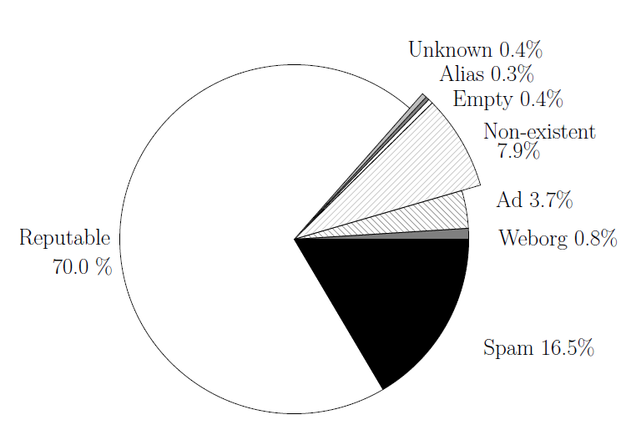
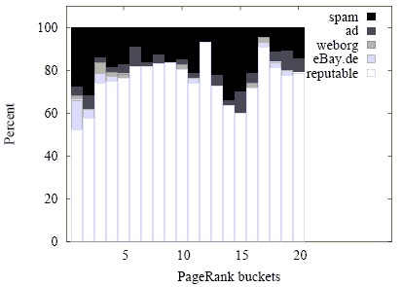
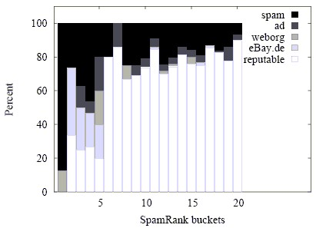
SpamRank Experimental Results
Distribution of PageRank and SpamRank Mass
over Web-Page Categories (1000 pages sample)
Source: Benczur et al., AIRWeb Workshop 2005

Slide 8
How to Estimate “Spam Mass” [Gyöngyi et al.: VLDB 05/06]
Naïve approach:
Only consider number of
immediate in-neighbors for
spam detection.
“good” pages
spam pages
s₁
g₀
x
s₀
s₂
g₁
…
s_{k}
Consider general PR formula:
For the above graph, we obtain
For ε = 0.15 and
k ≥ ceil(1/ε) = 2, the
largest part of PR(x)
comes from spam pages!
where
is due to spam pages s_{i}.

Slide 9
SpamMass Score [Gyöngyi et al.: VLDB 05/06]
PR contribution of page p to page q:
→ Compute by PPR
with jump to p only
PR of page q:
Method:
Assume Web W is partitioned into good pages W⁺ and bad pages W⁻ .
Assume that “good core” V ⁺ ⊂ W⁺ is known.
Estimate SpamMass of page q:
and relative SpamMass of q:

Slide 10
Learning Spam Features [Drost/Scheffer 2005]
Use page classifier (e.g., Naïve Bayes, SVM) to predict
“spam vs. ham” based on page and page-context features
But spammers may
learn to adjust to the
anti-spam measures.
It‘s an arms race!
Most discriminative features are:
tfidf weights of words in p0 and IN(p0)
avg. #inlinks of pages in IN(p0)
avg. #words in title of pages in OUT(p0)
#pages in IN(p0) that have same length as some other page in IN(p0)
avg. # inlinks and outlinks of pages in IN(p0)
avg. #outlinks of pages in IN(p0)
avg. #words in title of p0
total #outlinks of pages in OUT(p0)
total #inlinks of pages in IN(p0)
clustering coefficient of pages in IN(p0) (#linked pairs / m(m-1) possible pairs)
total #words in titles of pages in OUT(p0)
total #outlinks of pages in OUT(p0)
avg. #characters of URLs in IN(p0)
#pages in IN(p0) and OUT(p0) with same MD5 hash signature as p0
#characters in domain name of p0
#pages in IN(p0) with same IP number as p0

Slide 11
IV.6 Online and Distributed Link Analysis
Goals:
Compute Page-Rank-style authority measures online,
i.e., without having to store the complete link graph.
Recompute authority incrementally as the graph changes.
Compute authority in decentralized, asynchronous manner
with the graph distributed across many peers.

Slide 12
Online Link Analysis [Abiteboul et al.: WWW 2003]
Key idea:
Compute small fraction of authority as crawler proceeds
without storing the Web graph.
Each page holds some “cash” that reflects its importance.
When a page is visited, it distributes its cash among its successors.
When a page is not visited, it can still accumulate cash.
This random process has a stationary limit that captures
the importance of pages (but generally not the same
as the actual PageRank score).

Slide 13
OPIC Algorithm (Online Page Importance Computation)
Maintain for each page i (out of n pages):
C[i] – cash that page i currently has and distributes
H[i] – history of how much cash page has ever had in total
Plus global counter:
G – total amount of cash that has ever been distributed
G := 0; for each i do { C[i] := 1/n; H[i] := 0 };
do forever {
choose page i (e.g., by crawling randomly or greedily);
H[i] := H[i] + C[i];
for each successor j of i do C[j] := C[j] + (C[i] / outdegree(i));
G := G + C[i];
C[i] := 0; };
Note: 1) for convergence, every page needs to be visited infinitely often
2) the link graph is assumed to be strongly connected

Slide 14
OPIC Importance Measure
At each step t, an estimate of the importance of page i is:
X_{t}[i] = H_{t}[i] / G_{t} or alternatively: X_{t}[i] = ( H_{t}[i] + C_{t}[i] ) / (G_{t} + 1)
Theorem:
Let X_{t} = H_{t} / G_{t} denote the vector of cash fractions
accumulated by pages until step t.
The limit X = lim _{t→∞} X_{t} exists with ||X||₁ = Σ_{i} X[i] = 1.
With crawl strategies such as:
random
greedy: read page i with highest cash C[i]
(fair because non-visited pages accumulate cash until eventually read)
cyclic (round-robin)

Slide 15
Adaptive OPIC for Evolving Link Graph
Consider a time window [now-T, now] where time is the value of G.
The estimated importance of page i is:
X_{now}[i] = ( H_{now}[i] – H_{now-T}[i] ) / T
G[i]
G
H_{now-T}[i]
H_{now}[i]
now-T
now
time
For a new crawl at time “now”,
update page history H_{now}[i] by a simple interpolation:
Let H_{now-T}[i] be cash acquired by page i until time (now-T)
C_{now}[i] the current cash of page i
Let G[i] denote the time G at which i was crawled previously
Then
set

Slide 16
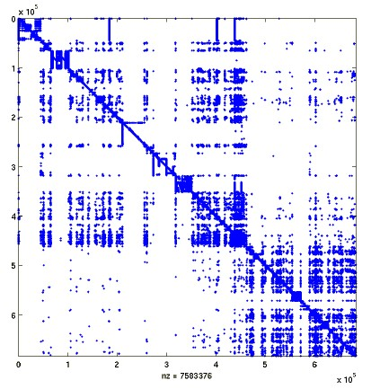
Distributed Link Analysis
Page authority is important for final result scoring.
Exploit locality in Web link graph: construct block structure
(disjoint graph partitioning) based on sites or domains.
Compute page PR within site/domain & across site/domain weights:
Combine local page scores with site/domain scores.
[Kamvar03, Lee03, Broder04, Wang04, Wu05]
Communicate PR mass propagation across sites.
[Abiteboul00, Sankaralingam03, Shi03, Kempe04, Jelasity07]

Slide 17
Decentralized PageRank in P2P Network
Decentralized computation in peer-to-peer network
with arbitrary, a-priori unknown overlaps of graph fragments.
global graph
local
subgraph 1
local subgraph 3
local sub-
graph 2
Generalizable to graph analysis applied to:
Pages, sites, tags, users, groups, queries, clicks, opinions, etc. as nodes
Assessment and interaction relations as weighted edges
Can compute various notions of authority, reputation, trust, quality

Slide 18
JXP (Juxtaposed Approximate PageRank) [J.X. Parreira et al.: WebDB 05, VLDB 06, VLDB Journal]
Scalable, decentralized P2P algorithm based on:
Markov-chain aggregation [Courtois 1977, Meyer 1988]
Each peer represents external, a priori unknown part of
the global graph by one superstate: a “world node”
Peers meet randomly:
Exchange local graph fragments & PR vectors
Learn incoming edges to nodes of local graph
Compute local PR on enhanced local graph
Keep only improved PR and own local graph
Don’t keep other peers’ graph fragments
Theorem: JXP scores converge to global PR scores.
Convergence sped up by biased p2pDating strategy:
Prefer peers whose node set of outgoing links
has high overlaps with our node set (e.g., Bloom filters as synopses).

Slide 19
JXP Algorithm at Work (1)
G: local graph
GOUT: {q∈G | q→ s ∧ s∈W}
n: #pages in G; N: #pages in U = G∪W
WIN(G): {p∈W | p→ q ∧ q∈G}
WIN*(G) ⊆ WIN(G): known part of WIN(G)
π*(q) for q∈G:
est. stationary prob‘s (PR)
π*(G) = ∑_{q∈G} π*(q)=1- π*(W)
est. total mass of G
Intput:
Output:
F
G
W
H
At each meeting with another peer G, compute:
For all q∈G:
World self-loop:
Compute all π* values for G∪W; remember only WIN*(G) info.

Slide 20
JXP Algorithm at Work (2)
G: local graph
GOUT: {q∈G | q→ s ∧ s∈W}
n: #pages in G; N: #pages in U = G∪W
WIN(G): {p∈W | p→ q ∧ q∈G}
WIN*(G) ⊆ WIN(G): known part of WIN(G)
π*(q) for q∈G:
est. stationary prob‘s (PR)
π*(G) = ∑_{q∈G} π*(q)=1- π*(W)
est. total mass of G
Intput:
Output:
F
G
W
W
H
At each meeting with another peer G, compute:
For all q∈G:
World self-loop:
Compute all π* values for G∪W; remember only WIN*(G) info.

Slide 21
JXP Algorithm at Work (3)
G: local graph
GOUT: {q∈G | q→ s ∧ s∈W}
n: #pages in G; N: #pages in U = G∪W
WIN(G): {p∈W | p→ q ∧ q∈G}
WIN*(G) ⊆ WIN(G): known part of WIN(G)
π*(q) for q∈G:
est. stationary prob‘s (PR)
π*(G) = ∑_{q∈G} π*(q)=1- π*(W)
est. total mass of G
Intput:
Output:
F
G
W
H
At each meeting with another peer G, compute:
For all q∈G:
World self-loop:
Compute all π* values for G∪W; remember only WIN*(G) info.

Slide 22
JXP Algorithm at Work (4)
G: local graph
GOUT: {q∈G | q→ s ∧ s∈W}
n: #pages in G; N: #pages in U = G∪W
WIN(G): {p∈W | p→ q ∧ q∈G}
WIN*(G) ⊆ WIN(G): known part of WIN(G)
π*(q) for q∈G:
est. stationary prob‘s (PR)
π*(G) = ∑_{q∈G} π*(q)=1- π*(W)
est. total mass of G
Intput:
Output:
F
G
W
W
H
At each meeting with another peer G, compute:
For all q∈G:
World self-loop:
Compute all π* values for G∪W; remember only WIN*(G) info.

Slide 23
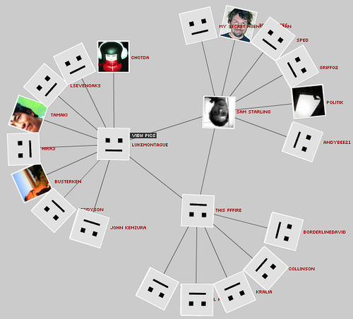
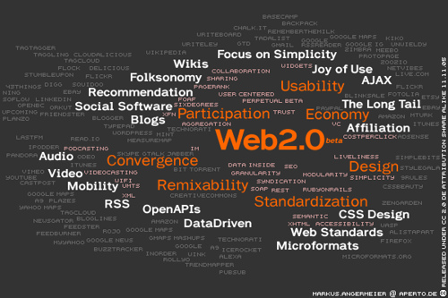
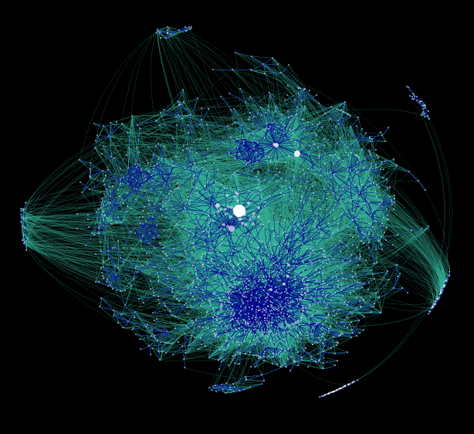
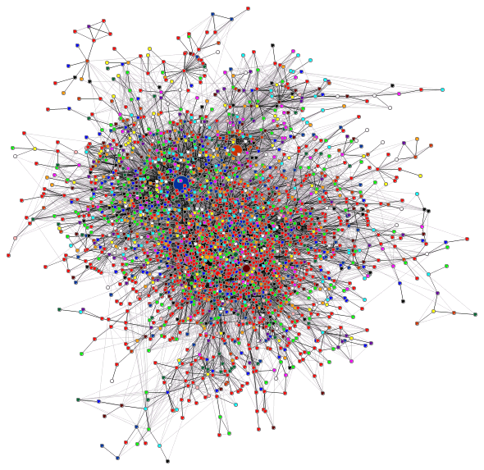
Outlook: Social Networks
http://www.flickr.com/photos/lukemontague/14038129/
Examples:
myspace, facebook, Google+,
linkedIn, flickr, del.icio.us, youtube,
groups/communities, blogs, etc.
http://www.flickr.com/photos/shopping2null/395271855/
People
Opinions
Graphs are everywhere!
Data
http://datamining.typepad.com/gallery/newblog-crop.png
http://datamining.typepad.com/gallery/core.png

Slide 24
Analyzing Social Networks
users
tags
docs
Typed graphs: data items, users, friends, groups,
postings, ratings, queries, clicks, …
with weighted edges

Slide 25
Social-Network Database
Simplified and cast into relational schema:
Users (UId, Nickname, …)
Docs (DId, Author, PostingDate, …)
Tags (TId, String)
Friendship (UId1, UId2, FScore)
Content (DId, TId, Score)
Rating (UId, DId, RScore)
Tagging (UId, TId, DId, TScore)
TagSim (TId1, TId2, TSim)
Actually several kinds of “friends”: same group, fan & star, true friend, etc.
Tags could be typed or explicitly organized in hierarchies.
Numeric values for FScore, RScore, TScore, TSim
may be explicitly specified or derived from co-occurrence statistics.

Slide 26
Social-Network Graphs
Tagging relation is central:
Ternary relationship between <users, tags, docs>
Could be represented as hypergraph (edges connect mult. nodes)
or (lossfully) decomposed into 3 binary projections (graphs):
UsersTags (UId, TId, UTscore)
x.UTscore := Σ_{d} {s | (x.UId, x.TId, d, s) ∈ Ratings}
TagsDocs (TId, DId, TDscore)
x.TDscore := Σ_{u} {s | (u, x.TId, x.DId, s) ∈ Ratings}
DocsUsers (DId, UId, DUscore)
x.DUscore := Σ_{t} {s | (x.UId, t, x.DId, s) ∈ Ratings}

Slide 27
Authority in Social Networks
Apply link analysis (PR etc.) to appropriately defined matrices!
SocialPageRank [Bao et al.: WWW 2007]:
Let M_{UT}, M_{TD}, M_{DU} be the matrices corresponding to
relations DocsUsers, TagsDocs, UsersTags
Compute iteratively:
FolkRank [Hotho et al.: ESWC 2006]:
Define graph G as union of graphs UsersTags, TagsDocs, DocsUsers
Assume each user has personal preference vector
Compute iteratively:

Slide 28
Search & Ranking with Social Relations
Web search (or search in social network) can benefit from
the taste, expertise, experience, recommendations of friends.
Naive method:
Look up your best friend’s bookmarks or search with her tags.
→ Combine content scoring with FolkRank, SocialPR, etc.
Better approach:
Integrate friendship strengths, tag similarities, user & page PR, e.g.:

Slide 29
Additional Literature for Chapter IV.5
Spam-Resilient Authority Scoring:
Z. Gyöngyi, H. Garcia-Molina: Spam: It‘s Not Just for Inboxes Anymore,
IEEE Computer 2005
Z. Gyöngyi, P. Berkhin, H. Garcia-Molina, J. Pedersen: Link Spam Detection
based on Mass Estimation, VLDB‘06
Z. Gyöngyi, H. Garcia-Molina: Combating Web Spam with TrustRank, VLDB‘04
D.Fetterly, M.Manasse, M.Najork: Spam, Damn Spam, and Statistics, WebDB‘05
I. Drost, T. Scheffer: Thwarting the Nigritude Ultramarine:
Learning to Identify Link Spam, ECML‘05
A.A. Benczur, K. Csalongany, T. Sarlos, M. Uher: SpamRank – Fully Automatic
Link Spam Detection, AIRWeb Workshop 2005
R. Guha, R. Kumar, P. Raghavan, A. Tomkins: Propagation of Trust and Distrust,
WWW 2004
C. Castillo, D. Donato, A. Gionis, V. Murdock, F. Silvestri: Know your neighbors:
web spam detection using the web topology, SIGIR 2007
L. Becchetti, C. Castillo, D. Donato, R.A. Baeza-Yates, S. Leonardi:
Link analysis for Web spam detection. TWEB 2(1): (2008)
Workshop on Adversarial Information Retrieval on the Web,
http://airweb.cse.lehigh.edu/

Slide 30
Additional Literature for Chapter IV.6
Online and Distributed Link Analysis:
S. Abiteboul, M. Preda, G. Cobena: Adaptive on-line page importance computation, WWW 2003.
J.X. Parreira, D.Donata, C. Castillo, S. Michel, G. Weikum: The JXP Method for Robust PageRank Approximation in a Peer-to-Peer Web Search Network,
VLDB Journal 2008
D. Kempe, F. McSherry: A decentralized algorithm for spectral analysis. STOC’04
A.Z. Broder, R. Lempel, F. Maghoul, J.O. Pedersen: Efficient PageRage Approximation via Graph Aggregation. Inf. Retr. 9(2), 2006
Ranking in Social Networks:
S. Bao, X. Wu, B. Fei, G. Xue, Z. Su, Y. Yu: Optimizing Web Search Using Social Annotations, WWW 2007
Christoph Schmitz, Andreas Hotho, Robert Jäschke, Gerd Stumme: Content Aggregation on Knowledge Bases Using Graph Clustering. ESWC 2006
Andreas Hotho, Robert Jäschke, Christoph Schmitz, Gerd Stumme: FolkRank : A Ranking Algorithm for Folksonomies. LWA 2006

Slide 31
Summary of Chapter IV
PageRank, HITS, etc. are major achievements for better Web search.
Improvements compared to in-/out-degree mostly for highly
specific queries, best results with good content ranking function.
Link analysis built on well-founded theory, but full understanding
of sensitivity and special properties still missing.
Personalized link analysis is promising and viable.
Link spam is major problem; addressed by statistical methods
(but may need deeper adversary theory).
Online and distributed link analysis practically viable.
Link analysis has potential for generalization to social networks.

