Slide 1
Chapter V: Indexing & Searching
Information Retrieval & Data Mining
Universität des Saarlandes, Saarbrücken
Winter Semester 2011/12

Slide 2
Chapter V: Indexing & Searching*
V.1 Indexing & Query processing
Inverted indexes, B⁺-trees, merging vs. hashing,
Map-Reduce & distribution, index caching
V.2 Compression
Dictionary-based vs. variable-length encoding,
Gamma encoding, S16, P-for-Delta
V.3 Top-k Query Processing
Heuristic top-k approaches, Fagin’s family of threshold-algorithms,
IO-Top-k, Top-k with incremental merging, and others
V.4 Efficient Similarity Search
High-dimensional similarity search, SpotSigs algorithm,
Min-Hashing & Locality Sensitive Hashing (LSH)
*mostly following Chapters 4 & 5 from Manning/Raghavan/Schütze
and Chapter 9 from Baeza-Yates/Ribeiro-Neto with additions from recent research papers

Slide 3
V.1 Indexing
- Web, intranet, digital libraries, desktop search
- Unstructured/semistructured data
......
.....
......
.....
crawl
extract
& clean
index
search
rank
present
handle
dynamic pages,
detect duplicates,
detect spam
fast top-k queries,
query logging,
auto-completion
GUI, user guidance,
personalization
strategies for
crawl schedule and
priority queue for
crawl frontier
build and analyze
Web graph,
index all tokens
or word stems
scoring function
over many data
and context criteria
Server farms with 10 000‘s (2002) – 100,000’s (2010) computers,
distributed/replicated data in high-performance file system (GFS,HDFS,…),
massive parallelism for query processing (MapReduce, Hadoop,…)

Slide 4
Content Gathering and Indexing
......
.....
......
.....
Bag-of-Words representations
Surfing
Internet
Cafes
...
Surf
Internet
Cafe
...
Surf
Wave
Internet
WWW
eService
Cafe
Bistro
...
Crawling
Web Surfing:
In Internet
cafes with or
without
Web Suit ...
Extraction
of relevant
words
Linguistic
methods:
stemming,
lemmas
Statistically
weighted
features
(terms)
Indexing
Documents
Thesaurus
(Ontology)
Index
(B⁺-tree)
Synonyms,
Sub-/Super-
Concepts
...
Bistro
Cafe
URLs

Slide 5
Vector Space Model for Relevance Ranking
Ranking by
descending
relevance
Similarity metric:
(e.g., Cosine measure)
Search engine
Query
(set of weighted
features)
Documents are feature vectors
(bags of words)
Using, e.g., tf*idf as
weights
e.g., using:

Slide 6
Combined Ranking with Content & Links Structure
Ranking by
descending
relevance & authority
Search engine
Query
(set of weighted
features)
Ranking functions:
Low-dimensional queries (ad-hoc ranking, Web search):
BM25(F), authority scores, recency, document structure, etc.
High-dimensional queries (similarity search):
Cosine, Jaccard, Hamming on bitwise signatures, etc.
+ Dozens of more features employed by various search engines

Slide 7
Digression: Basic Hardware Considerations
16 GB/s
(64bit@2GHz)
Typical
Computer
CPU
Bus system (32–256 bits
@200–800 MHz)
...
...
M
C
300 MB/s
(SATA-300)
3,200 MB/s
(DDR-SDRAM
@200MHz)
HD
6,400 MB/s –
12,800 MB/s
(DDR2, dual channel, 800MHz)
Secondary Storage
Tertiary Storage
HD
TransferRate = width (number of bits) x clock rate x data per clock / 8
(bytes/sec)
typically 1

Slide 8
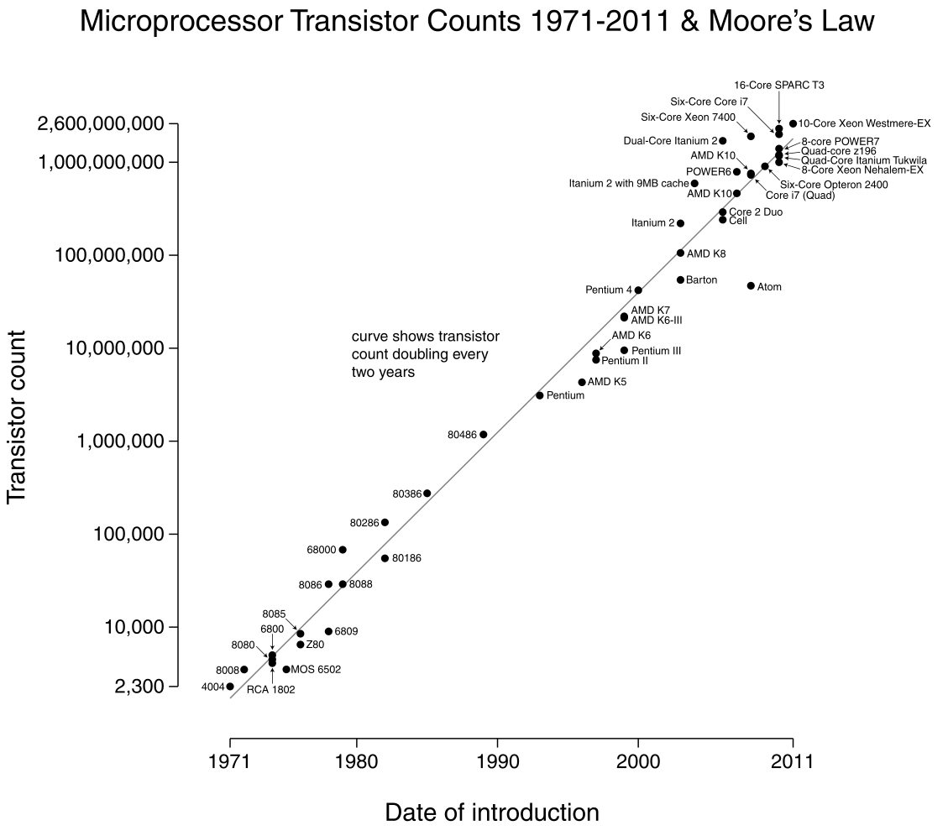
Moore’s Law
Gordon Moore (Intel) anno 1965:
“The density of integrated
circuits (transistors) will
double every 18 months!”
→ Has often been generalized to clock rates of CPUs, disk & memory sizes, etc.
→ Still holds today for
integrated circuits!
Source: http://en.wikipedia.org/wiki/Moore%27s_law

Slide 9
More Modern View on Hardware
CPU
CPU
Multi-core-
multi-CPU
Computer
CPU
CPU
CPU
CPU
CPU
CPU
...
L1/L2
L1/L2
...
...
C
M
CPU-to-L1-Cache:
3-5 cycles initial latency,
then “burst” mode
HD
CPU-cache becomes primary storage!
Main-memory becomes secondary storage!
Secondary Storage
CPU-to-L2-Cache:
15-20 cycles latency
HD
CPU-to-Main-Memory:
~200 cycles latency

Slide 10
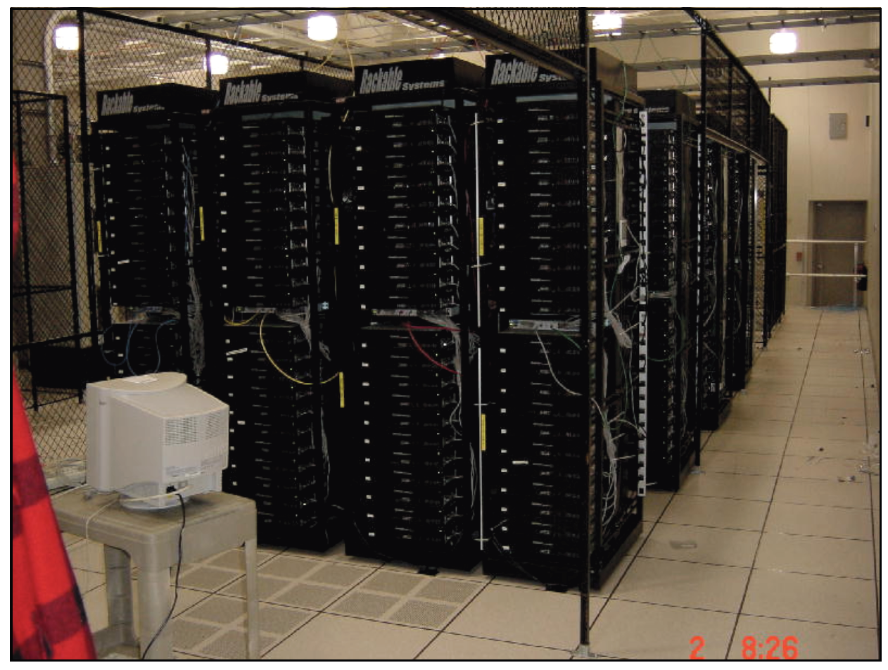
Data Centers
Google Data Center anno 2004
Source: J. Dean: WSDM 2009 Keynote

Slide 11
Different Query Types
Find relevant docs
by list processing
on inverted indexes
Conjunctive queries:
all words in q = q₁ … q_{k} required
Disjunctive (“andish”) queries:
subset of q words qualifies,
more of q yields higher score
Including variant:
scan & merge
only subset of q_{i} lists
lookup long
or negated q_{i} lists
only for best result
candidates
Mixed-mode queries and negations:
q = q₁ q₂ q₃ +q₄ +q₅ –q₆
Phrase queries and proximity queries:
q = “q₁ q₂ q₃” q₄ q₅ …
Vague-match (approximate) queries
with tolerance to spelling variants
see Chapter III.5
Structured queries and XML-IR
//article[about(.//title, “Harry Potter”)]//sec

Slide 12
Indexing with Inverted Lists
Vector space model suggests term-document matrix,
but data is sparse and queries are even very sparse.
→ Better use inverted index lists with terms as keys for B+ tree.
q: {professor
research
xml}
B+ tree on terms
...
...
professor
research
xml
17: 0.3
17: 0.3
12: 0.5
11: 0.6
index lists
with postings
(docId, score)
sorted by docId
44: 0.4
44: 0.4
14: 0.4
17: 0.1
17: 0.1
Google:
> 10 Mio. terms
> 20 Bio. docs
> 10 TB index
52: 0.1
28: 0.1
28: 0.7
53: 0.8
44: 0.2
...
44: 0.2
55: 0.6
51: 0.6
...
52: 0.3
...
terms can be full words, word stems, word pairs, substrings, N-grams, etc.
(whatever “dictionary terms” we prefer for the application)
Index-list entries in docId order for fast Boolean operations
Many techniques for excellent compression of index lists
Additional position index needed for phrases, proximity, etc.
(or other pre-computed data structures)

Slide 13
B+-Tree Index for Term Dictionary
Keywords [A-Z]
[A-I]
[J-Z]
m = 3
[A-D]
[E-F]
[G-I]
[J-K]
[L-Q]
[R-Z]
[A-B]
[C]
[D]
[G]
[H]
[I]
…
[E]
[F]
…
…
B-tree: balanced tree with internal nodes of ≤m fan-out
B⁺-tree: leaf nodes additionally linked via pointers for efficient range scans
For term dictionary: Leaf entries point to inverted list entries on local disk and/or node in compute cluster

Slide 14
Inverted Index for Posting Lists
Documents: d₁, …, d_{n}
Index-list entries usually stored
in ascending order of docId
(for efficient merge joins)
or
in descending order of
per-term score
(impact-ordered lists
for top-k style pruning).
Usually compressed and divided
into block sizes which are
convenient for disk operations.
d₁₀
s(t₁,d₁) = 0.9
…
s(t_{m},d₁) = 0.2
sort
Index lists
t₁
d10
0.9
d23
0.8
d54
0.8
d67
0.7
d88
0.2
…
t₂
d10
0.8
d12
0.6
d17
0.6
d23
0.2
d78
0.1
…
t₃
d10
0.7
d12
0.5
d23
0.4
d88
0.2
d99
0.1
…

Slide 15
Query Processing on Inverted Lists
q: {professor
research
xml}
B+ tree on terms
...
...
professor
research
xml
17: 0.3
17: 0.3
12: 0.5
11: 0.6
index lists
with postings
(docId, score)
sorted by docId
44: 0.4
44: 0.4
14: 0.4
17: 0.1
17: 0.1
52: 0.1
28: 0.1
28: 0.7
53: 0.8
44: 0.2
...
44: 0.2
55: 0.6
51: 0.6
...
52: 0.3
...
Given: query q = t₁ t₂ ... t_{z} with z (conjunctive) keywords
similarity scoring function score(q,d) for docs d∈D, e.g.:
with precomputed scores (index weights) s_{i}(d) for which q_{i}≠0
Find: top-k results for score(q,d) =aggr{s_{i}(d)} (e.g.: Σ_{i∈q} s_{i}(d))
Join-then-sort algorithm:
top-k (
σ[term=t₁] (index) ⏐×⏐_{DocId}
σ[term=t₂] (index) ⏐×⏐_{DocId}
... ⏐×⏐_{DocId}
σ[term=t_{z}] (index) order by s desc)

Slide 16
Index List Processing by Merge Join
Keep L(i) in ascending order of doc ids.
Delta encoding: compress L_{i} by actually storing the gaps between
successive doc ids (or using some more sophisticated prefix-free code).
QP may start with those L_{i} lists that are short and have high idf.
→ Candidates need to be looked up in other lists L_{j}.
To avoid having to uncompress the entire list L_{j}, L_{j} is encoded into groups (i.e., blocks) of compressed entries with a skip pointer at the start of each block → sqrt(n) evenly spaced skip pointers for list of length n.
L_{i}
2 4 9 16 59 66 128 135 291 311 315 591 672 899
…
skip!
L_{j}
…
1 2 3 5 8 17 21 35 39 46 52 66 75 88

Slide 17
Index List Processing by Hash Join
Keep L_{i} in ascending order of scores (e.g., TF*IDF).
Delta Encoding: compress L_{i} by storing the gaps between
successive scores (often combined with variable-length encoding).
QP may start with those L_{i} lists that are short and have high scores,
schedule may vary adaptively to scores.
→ Candidates can immediately be looked up in other lists L_{j}.
→ Can aggregate candidate scores on-the-fly.
L_{i}
66 2 672 4 899 128 135 1 591 16 315 59 291 311
…
L_{j}
…
75 1 17 2 52 66 88 3 672 5 8 21 35 39
?

Slide 18
Index Construction and Updates
Index construction:
extract (docId, termId, score) triples from docs
can be partitioned & parallelized
scores need idf (estimates)
sort entries termId (primary) and docId (secondary)
disk-based merge sort (build runs, write to temp, merge runs)
can be partitioned & parallelized
load index from sorted file(s), using large batches for disk I/O,
compress sorted entries (delta-encoding, etc.)
create dictionary entries for fast access during query processing
Index updating:
collect large batches of updates in separate file(s)
periodically sort these files and merge them with index lists

Slide 19
Map-Reduce Parallelism for Index Building
a..c
a..c
sort
merge
...
...
Inverter
Extractor
u..z
u..z
sort
a b … z
a
b
merge
c
a
d
...
u
f
f
a..c
a..c
merge
sort
z
y
t
...
...
Inverter
Extractor
u..z
u..z
sort
merge
input
files
Map
Reduce
output
files
Intermediate files

Slide 20
Map-Reduce Parallelism
Programming paradigm and infrastructure
for scalable, highly parallel data analytics.
can run on 1000’s of computers
with built-in load balancing & fault-tolerance
(automatic scheduling & restart of worker processes)
Easy programming with key-value pairs:
Map function: K×V → (L ×W)*
(k1, v1) |→ (l1,w1), (l2,w2), …
Reduce function: L ×W* → W*
l1, (x1, x2, …) |→ y1, y2, …
Examples:
Index building: K=docIds, V=contents, L=termIds, W=docIds
Click log analysis: K=logs, V=clicks, L=URLs, W=counts
Web graph reversal: K=docIds, V=(s,t) outlinks, L=t, W=(t,s) inlinks

Slide 21
Map-Reduce Example for Inverted Index Construction
class Mapper
procedure MAP(docId n, doc d)
H ← new Map<term, int>
For term t ∈ doc d do // local tf aggregation
H(t) ← H(t) + 1
For term t ∈ H d do // emit reducer job, e.g., using hash of term t
EMIT(term t, new posting <docId n, H(t)>)
class Reducer
procedure REDUCE(term t, postings [<n₁,f₁>, <n₂,f₂>, …])
P ← new List<posting>
For posting <n, f> ∈ postings [<n₁,f₁>, <n₂,f₂>, …] do // global idf aggregation
P.APPEND(<n,f>)
SORT(P) // sort all postings hashed to this reducer by <term, docId || score>
EMIT(term t, postings P) // emit sorted inverted lists for each term
Source: Lin & Dyer (Maryland U): Data Intensive Text Processing with MapReduce

Slide 22
Challenge: Petabyte-Sort
Jim Gray benchmark:
Sort large amounts of 100-byte records (10 first bytes are keys)
Minute-Sort: sort as many records as possible in under a minute
Gray-Sort: must sort at least 100 TB, must run at least 1 hour
May 2011: Yahoo sorts 1 TB in 62 seconds and 1 PB in 16:15 hours on Hadoop
(http://developer.yahoo.com/blogs/hadoop/posts/2009/05/hadoop_sorts_a_petabyte_in_162/)
Nov. 2008: Google sorts 1 TB in 68 seconds and 1 PB in 6:02 hours on MapReduce (using 4,000 computers with 48,000 hard drives)
(http://googleblog.blogspot.com/2008/11/sorting-1pb-with-mapreduce.html)

Slide 23
Index Caching
queries
queries
a b:
a c d:
Query-Result
Caches
e f:
g h:
Query Processor
Query Processor
Index-List
Caches
…
Index Server
Index Server

Slide 24
Caching Strategies
What is cached?
index lists for individual terms
entire query results
postings for multi-term intersections
Where is an item cached?
in RAM of responsible server-farm node
in front-end accelerators or proxy servers
as replicas in RAM of all (many) server-farm
When are cached items dropped?
estimate for each item: temperature = access-rate / size
when space is needed, drop item with lowest temperature
Landlord algorithm [Cao/Irani 1997, Young 1998], generalizes LRU-k [O‘Neil 1993]
prefetch item if its predicted temperature is higher than
the temperature of the corresponding replacement victims

Slide 25
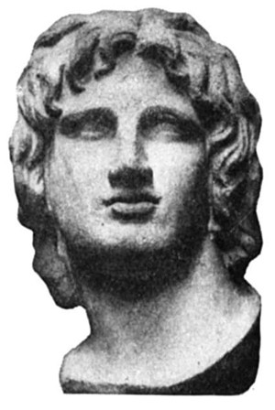
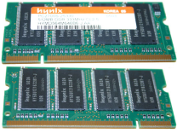
Distributed Indexing: Doc Partitioning
Index-list entries are
hashed onto nodes by docId.
…
Each complete query
is run on each node;
results are merged.
→ Perfect load balance,
embarrasingly scalable,
easy maintenance.

Slide 26
Data, Workload & Cost Parameters
20 Bio. Web pages, 100 terms each → 2 x 10¹² index entries
10 Mio. distinct terms → 2 x 10⁵ entries per index list
5 Bytes (amortized) per entry → 1 MB per index list, 10 TB total
Query throughput: typical 1,000 q/s; peak: 10,000 q/s
Response time: all queries in ≤ 100 ms
Reliability & availability: 10-fold redundancy
Execution cost per query:
1 ms initial latency + 1 ms per 1,000 index entries
2 terms per query
Cost per PC (4 GB RAM): $ 1,000
Cost per disk (1 TB): $ 500 with 5 ms per RA, 20 MB/s for SA’s

Slide 27
Back-of-the-Envelope Cost Model for Document-Partitioned Index (in RAM)
3,000 computers for
one copy of index = 1 cluster
3,000 x 4 GB RAM = 12 TB
(10 TB total index size + workspace RAM)
Query Processing:
Each query executed by all 3,000 computers in parallel: 1 ms + (2 x 200 ms / 3000) ≈ 1 ms
→ each cluster can sustain ~1,000 queries / s
10 clusters = 30,000 computers
to sustain peak load and guarantee reliability/availability
→ $ 30 Mio = 30,000 x $1,000 (no “big” disks)

Slide 28
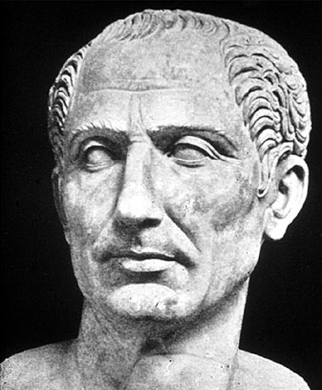
Distributed Indexing: Term Partitioning
Entire index lists are
hashed onto nodes by termId.
…
Queries are routed
to nodes with
relevant terms.
→ Lower resource consumption,
susceptible to imbalance
(because of data or load skew),
index maintenance non-trivial.

Slide 29
Back-of-the-Envelope Cost Model for Term-Partitioned Index (on Disk)
10 nodes, each with 1 TB disk, hold entire index
Execution time:
max (1 MB / 20 MB/s, 1 ms + 200 ms)
but limited throughput:
5 q/s per node for 1-term queries
Need 200 nodes = 1 cluster
to sustain 1,000 q/s with 1-term queries
or 500 q/s with 2-term queries
Need 20 clusters for peak load and reliability/availability 4,000 computers → $ 6 Mio = 4,000 x ($1,000 + $500)
saves money & energy
but faces challenge of update costs & load balance

