Slide 1
Chapter VI: Information Extraction
Information Retrieval & Data Mining
Universität des Saarlandes, Saarbrücken
Winter Semester 2011/12

Slide 2
Chapter VI: Information Extraction
VI.1 Motivation and Overview
IE systems: Wolfram Alpha, Yago-Naga, EntityCube
Applications: Knowledge base building, question answering
VI.2 IE for Entities and Relations
Basic NLP techniques, rule-based IE, learning-based IE
VI.3 Named Entity Disambiguation
Entity reconciliation & matching functions, Markov Logic Networks
VI.4 Large-Scale Knowledge Base Construction and Open IE
Bootstrapping pattern mining, TextRunner, NELL

Slide 3
VI.1 Motivation and Overview
Beyond keywords as queries
and documents as retrieval units:
Extract entities and annotate text documents or Web pages
(e.g., named entity recognition)
Find instances of semantic classes (e.g., not yet known in WordNet)
Extract facts (relations among entities) from text documents
or Web pages (e.g., Wikipedia) to automatically populate and
enhance an ontology/knowledge base
Answer questions by analyzing natural-language
and translation into machine-processable format
Technologies:
Lexicon lookups (name dictionaries, geo gazetteers, etc.)
NLP (PoS tagging, chunking/parsing, semantic role labeling, etc.)
Pattern matching & rule learning (regular expressions, FSAs)
Statistical learning (HMMs, MRFs, etc.)
Text mining in general

Slide 4
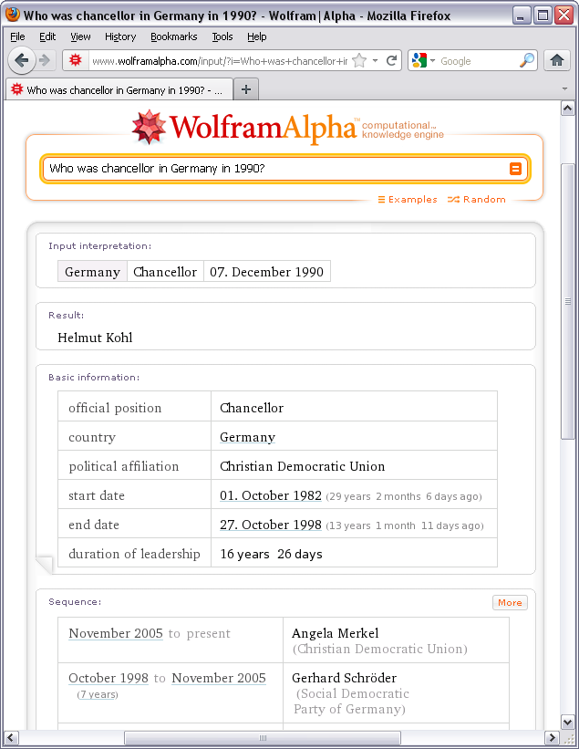
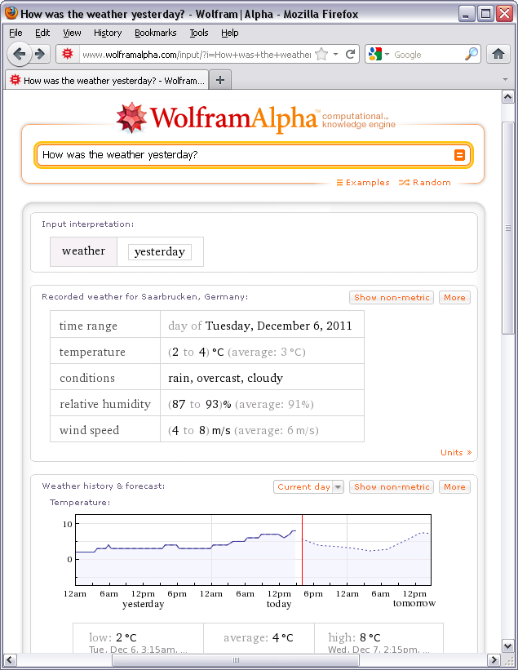
Example: Wolfram Alpha
http://www.wolframalpha.com/

Slide 5
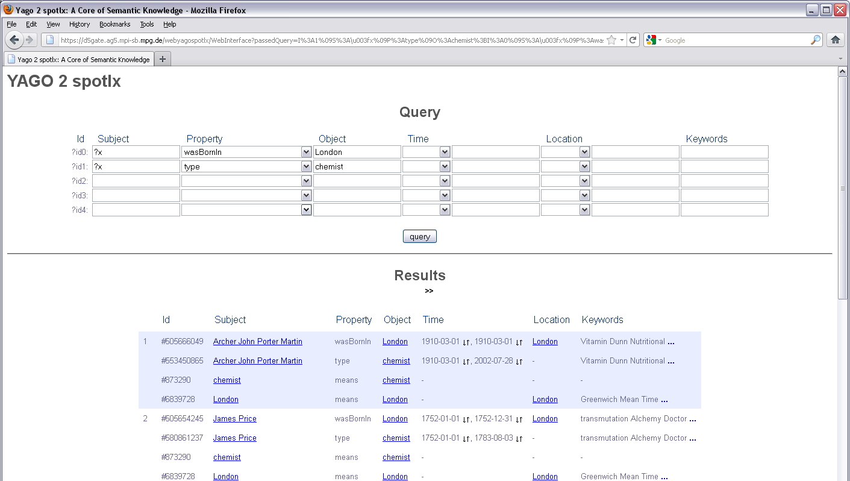
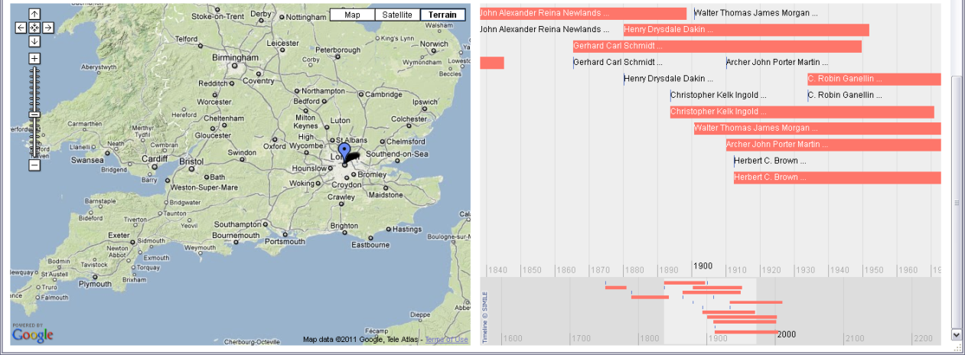
Example: YAGO-NAGA
http://www.mpi-inf.mpg.de/
yago-naga/

Slide 6
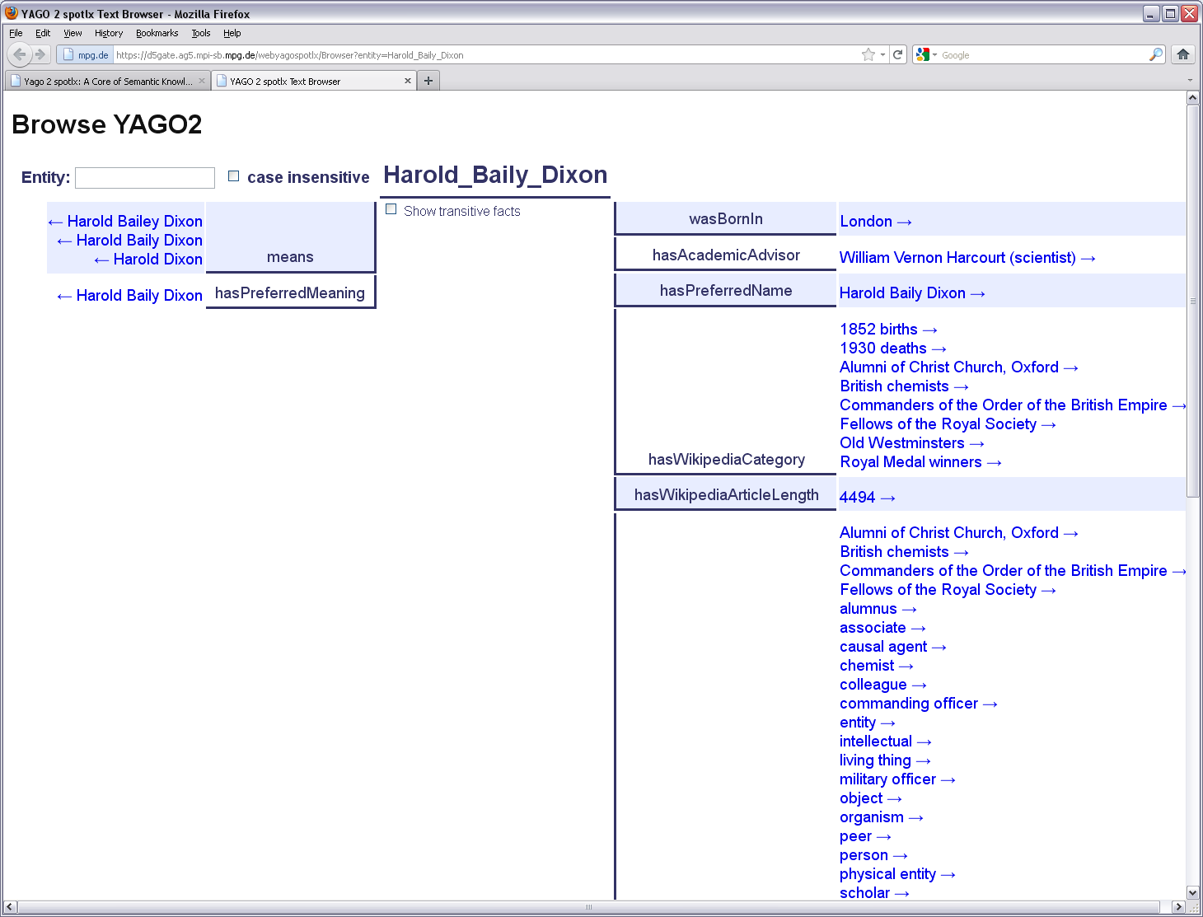
Example: YAGO-NAGA
http://www.mpi-inf.mpg.de/
yago-naga/

Slide 7
Information Extraction (IE): Text to Relations
bornOn (Max Planck, 23 April 1858)
bornIn (Max Planck, Kiel)
Max Karl Ernst Ludwig Planck was born in Kiel,
Germany, on April 23, 1858, the son of
Julius Wilhelm and Emma (née Patzig) Planck.
Planck studied at the Universities of Munich and Berlin,
where his teachers included Kirchhoff and Helmholtz,
and received his doctorate of philosophy at Munich in 1879.
He was Privatdozent in Munich from 1880 to 1885, then
Associate Professor of Theoretical Physics at Kiel until 1889,
in which year he succeeded Kirchhoff as Professor at
Berlin University, where he remained until his retirement in 1926.
Afterwards he became President of the Kaiser Wilhelm Society
for the Promotion of Science, a post he held until 1937.
He was also a gifted pianist and is said to have at one time
considered music as a career.
Planck was twice married. Upon his appointment, in 1885,
to Associate Professor in his native town Kiel
he married a friend of his childhood, Marie Merck, who died
in 1909. He remarried her cousin Marga von Hösslin.
Three of his children died young, leaving him with two sons.
type (Max Planck, physicist)
advisor (Max Planck, Kirchhoff)
advisor (Max Planck, Helmholtz)
AlmaMater (Max Planck, TU Munich)
plays (Max Planck, piano)
spouse (Max Planck, Marie Merck)
spouse (Max Planck, Marga Hösslin)
Person BirthDate BirthPlace ...
Max Planck 4/23, 1858 Kiel
Albert Einstein 3/14, 1879 Ulm
Mahatma Gandhi 10/2, 1869 Porbandar
Person Award
Max Planck Nobel Prize in Physics
Marie Curie Nobel Prize in Physics
Marie Curie Nobel Prize in Chemistry

Slide 8
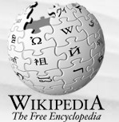
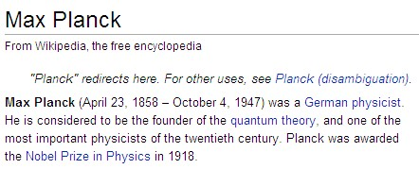
IE for Knowledge Base Construction
automatically build large knowledge base
from Wikipedia infoboxes & categories,
WordNet, and similar high-quality sources
{{Infobox_Scientist
| name = Max Planck
| birth_date = [[April 23]], [[1858]]
| birth_place = [[Kiel]], [[Germany]]
| death_date = [[October 4]], [[1947]]
| death_place = [[Göttingen]], [[Germany]]
| residence = [[Germany]]
| nationality = [[Germany|German]]
| field = [[Physicist]]
| work_institution = [[University of Kiel]]</br>
[[Humboldt-Universität zu Berlin]]</br>
[[Georg-August-Universität Göttingen]]
| alma_mater = [[Ludwig-Maximilians-Universität München]]
| doctoral_advisor = [[Philipp von Jolly]]
| doctoral_students =
[[Gustav Ludwig Hertz]]</br>
…
| known_for = [[Planck's constant]],
[[Quantum mechanics|quantum theory]]
| prizes = [[Nobel Prize in Physics]] (1918)
…

Slide 9
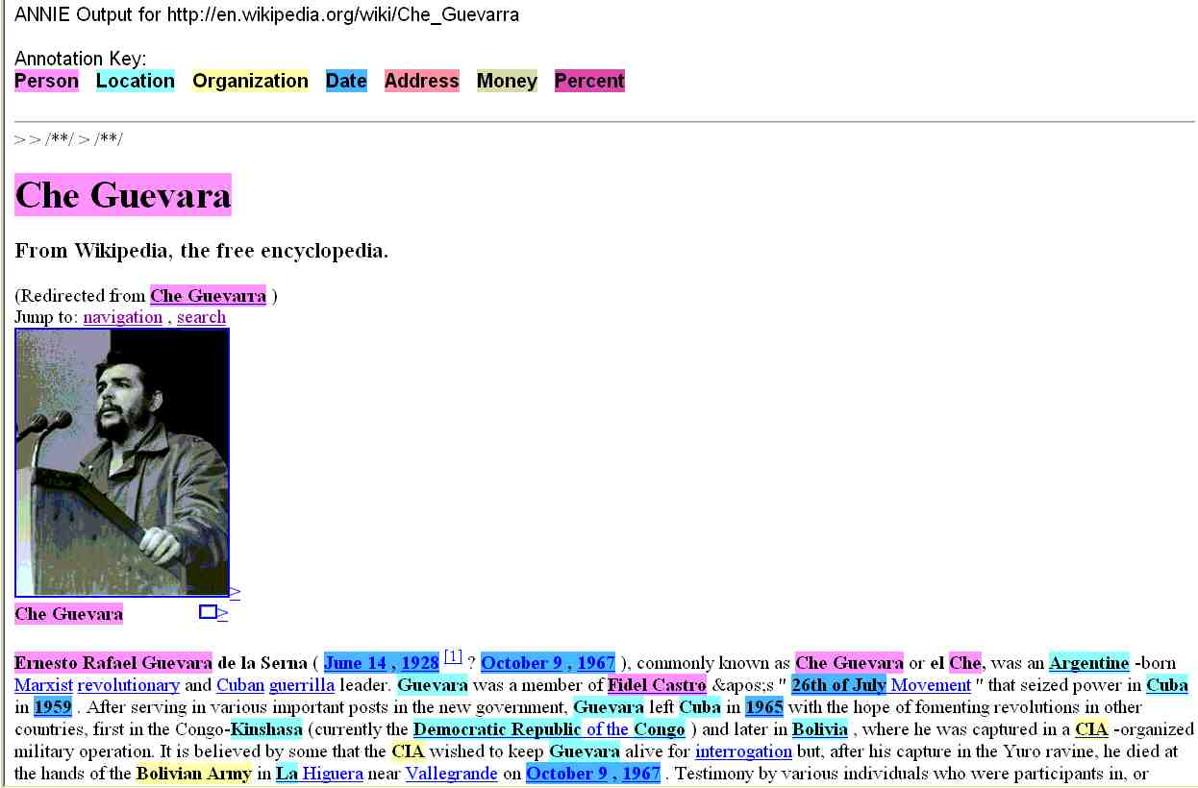
NLP-based IE (on the Web)
Open-source tool: GATE/ANNIE
http://www.gate.ac.uk/annie/

Slide 10
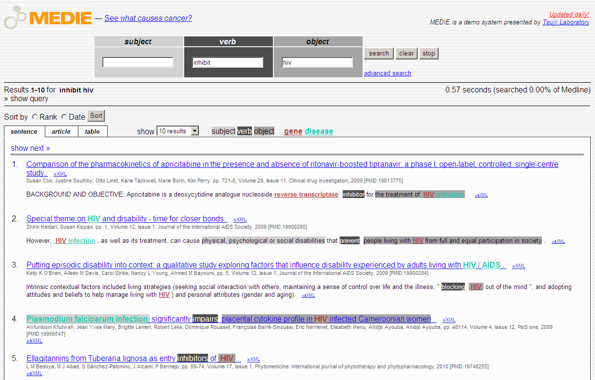
IE for Life Sciences http://www-tsujii.is.s.u-tokyo.ac.jp/medie/

Slide 11
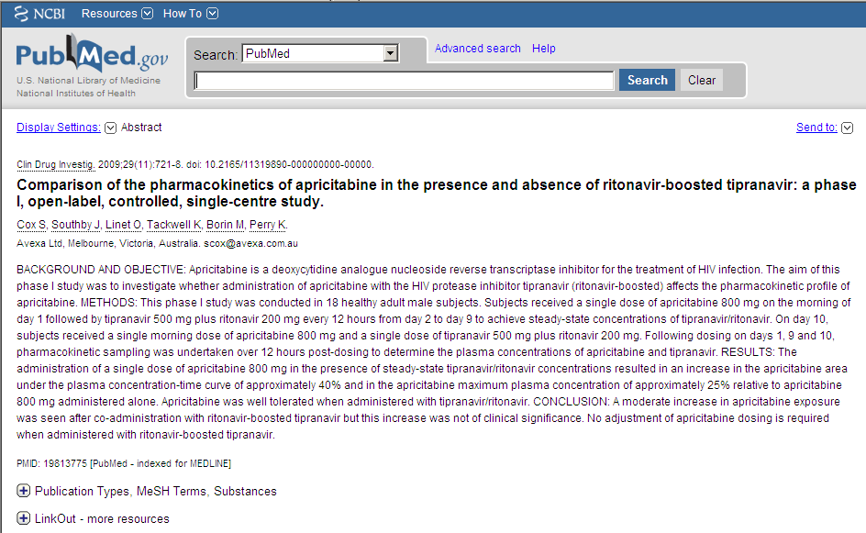
NLP-based IE from Scientific Publications (1)

Slide 12
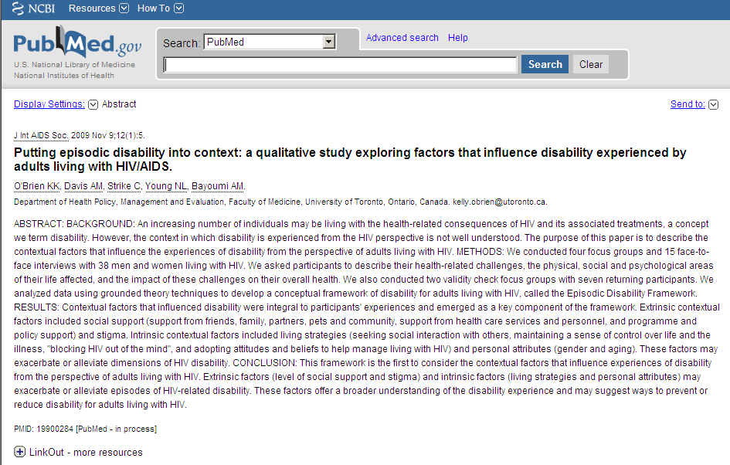
NLP-based IE from Scientific Publications (2)

Slide 13
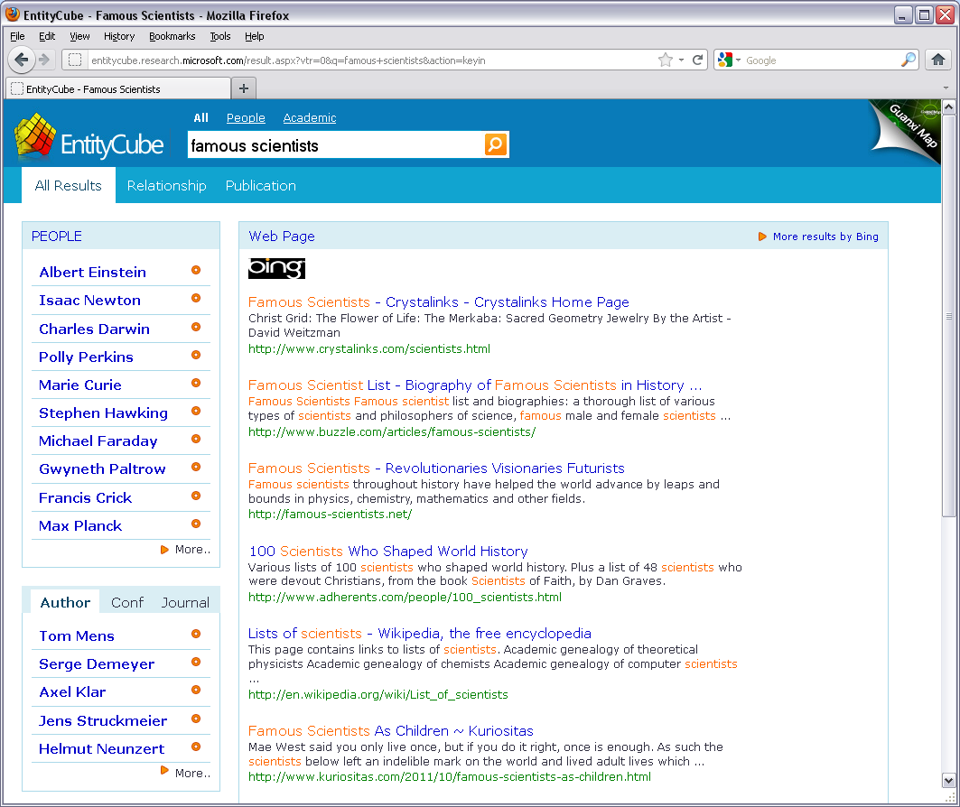
Entity-Centric Web Search: Entity Cube

Slide 14
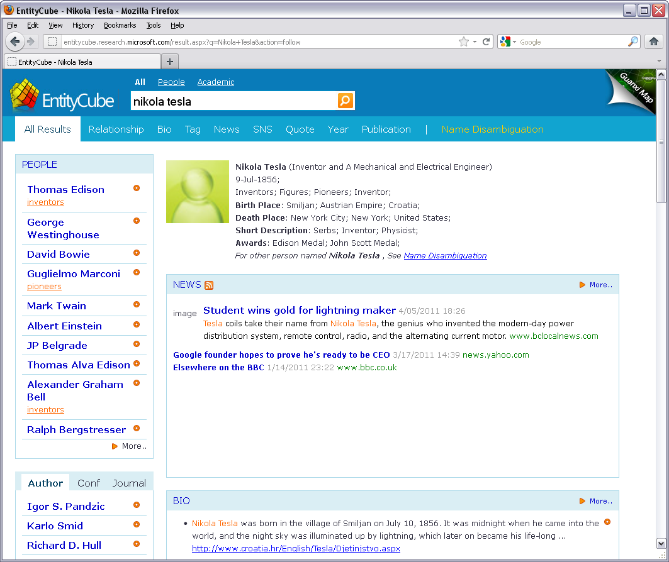
Entity-Centric Web Search: Entity Cube

Slide 15
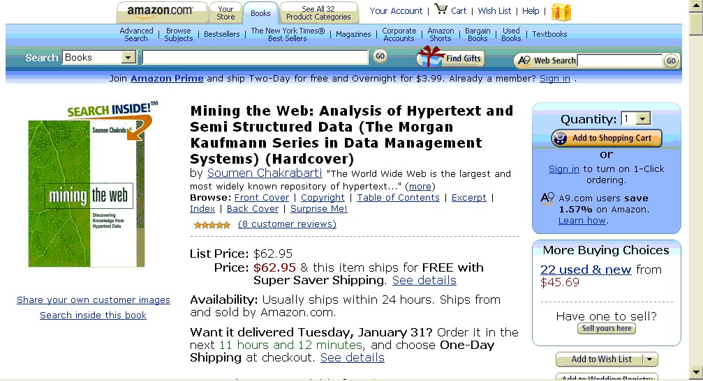
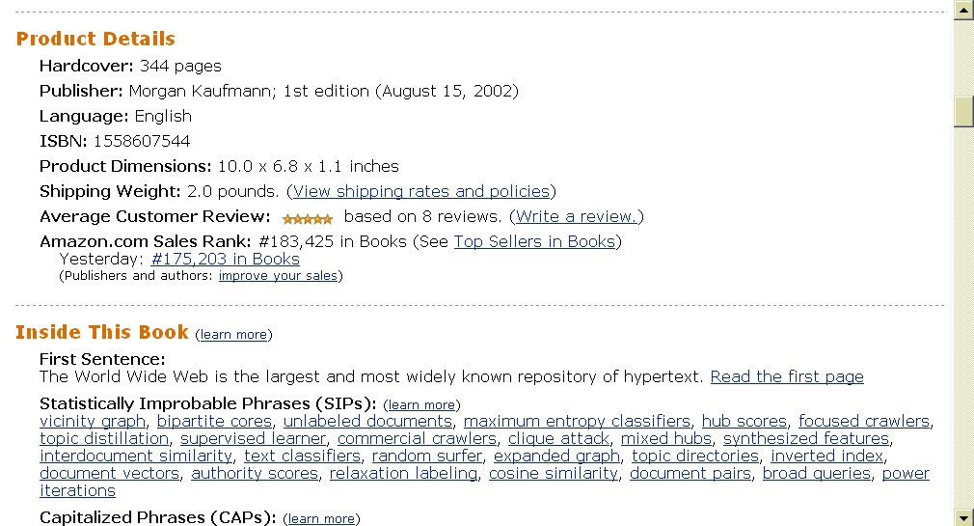
Extracting Structured Records from Deep Web Sources (1)

Slide 16
Extracting Structured Records from Deep Web Sources (2)
<div class="buying"><b class="sans">Mining the Web: Analysis of Hypertext and
Semi Structured Data (The Morgan Kaufmann Series in Data Management Systems)
(Hardcover)</b><br />by
<a href="/exec/obidos/search-handle-url/index=books&field-author-exact=Soumen%20Chakrabarti&rank=-relevance%2C%2Bavailability%2C-daterank/102-8395894-5490548">Soumen Chakrabarti</a>
<div class="buying" id="priceBlock">
<style type="text/css">
td.productLabel { font-weight: bold; text-align: right; white-space: nowrap; vertical-align: top; padding-right: 5px; padding-left: 0px; }
table.product { border: 0px; padding: 0px; border-collapse: collapse; }
</style>
<table class="product">
<tr>
<td class="productLabel">List Price:</td>
<td>$62.95</td>
</tr>
<tr>
<td class="productLabel">Price:</td>
<td><b class="price">$62.95</b>
& this item ships for <b>FREE with Super Saver Shipping</b>.
...
Extract record:
Title: Mining the Web …
Author: Soumen Chakrabarti,
Hardcover: 344 pages,
Publisher: Morgan Kaufmann,
Language: English,
ISBN: 1558607544.
...
AverageCustomerReview: 4
NumberOfReviews: 8,
SalesRank: 183425
...

Slide 17
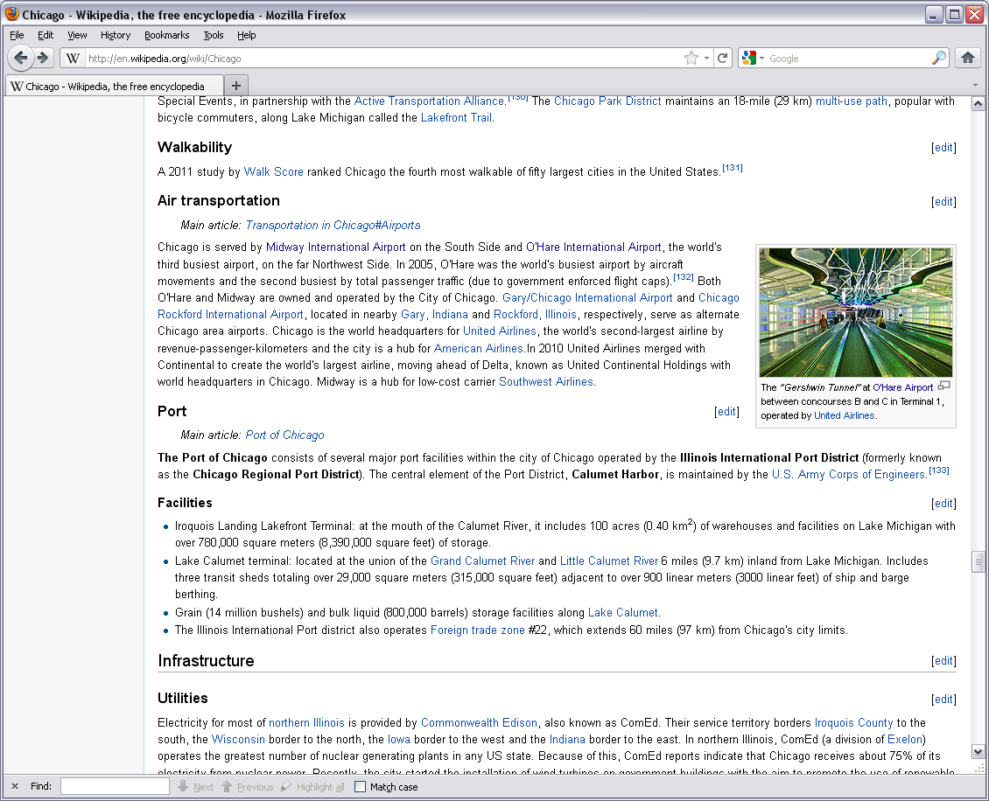
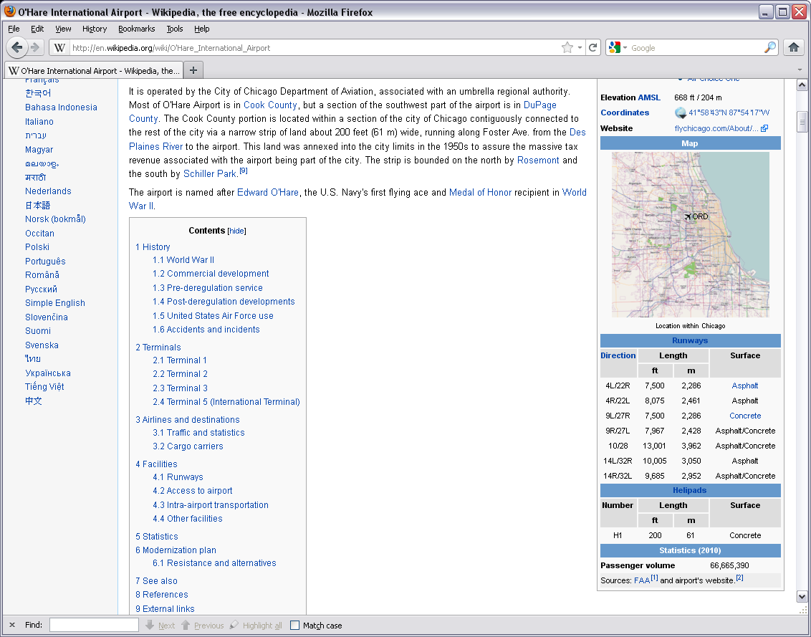
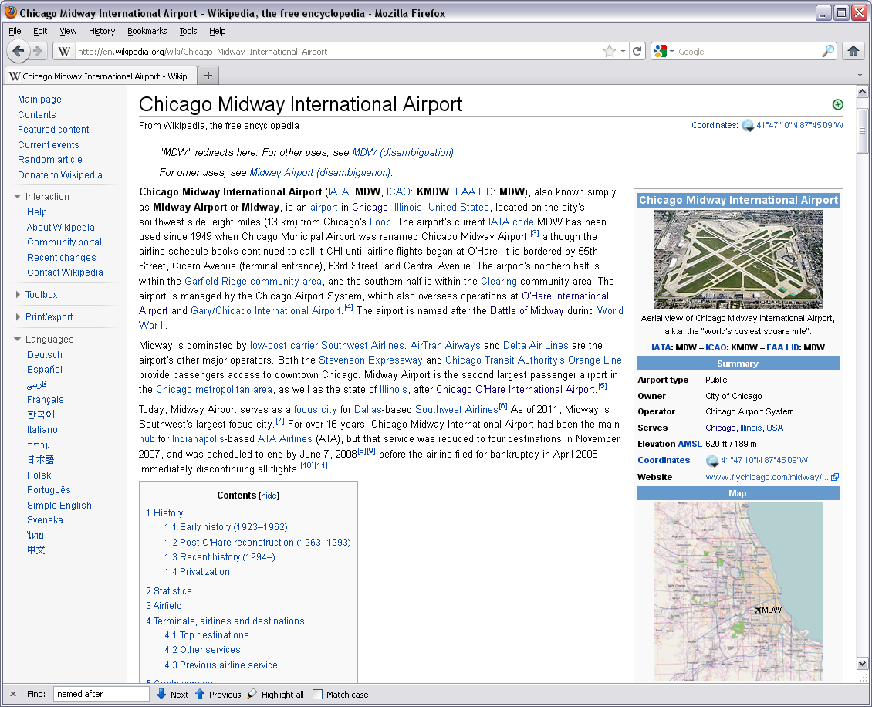
Jeopardy!
A big US city with two airports, one named after a World
War II hero, and one named after a World War II battle field?

Slide 18
Structured Knowledge Queries
A big US city with two airports, one named after a World
War II hero, and one named after a World War II battle field?
Select Distinct ?c Where {
?c type City . ?c locatedIn USA .
?a1 type Airport . ?a2 type Airport .
?a1 locatedIn ?c . ?a2 locatedIn ?c .
?a1 namedAfter ?p . ?p type WarHero .
?a2 namedAfter ?b . ?b type BattleField . }
Use manually created templates for mapping sentence patterns to structured queries.
Focus on factoid and list questions.

Slide 19
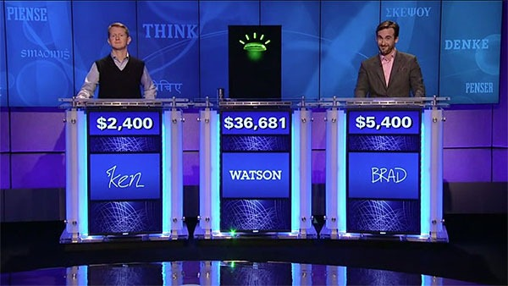
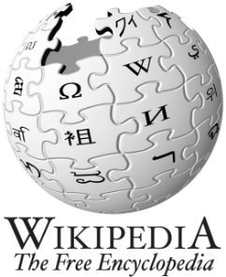
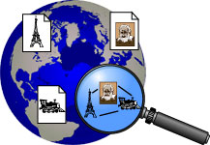
Deep-QA in NL
William Wilkinson's "An Account of the Principalities of Wallachia and Moldavia" inspired this author's most famous novel
This town is known as "Sin City" & its downtown is "Glitter Gulch"
As of 2010, this is the only
former Yugoslav republic in the EU
99 cents got me a 4-pack of Ytterlig coasters from this Swedish chain
question
classification &
decomposition
knowledge
backends
D. Ferrucci et al.: Building Watson: An Overview of the
DeepQA Project. AI Magazine, 2010.
YAGO
www.ibm.com/innovation/us/watson/index.htm

Slide 20
More IE Applications
Comparison shopping & recommendation portals
e.g. consumer electronics, used cars, real estate, pharmacy, etc.
Business analytics on customer dossiers, financial reports, etc.
e.g.: How was company X (the market Y) performing in the last 5 years?
Market/customer, PR impact, and media coverage analyses
e.g.: How are our products perceived by teenagers (girls)?
How good (and positive?) is the press coverage of X vs. Y?
Who are the stakeholders in a public dispute on a planned airport?
Job brokering (applications/resumes, job offers)
e.g.: How well does the candidate match the desired profile?
Knowledge management in consulting companies
e.g.: Do we have experience and competence on X, Y, and Z in Brazil?
Mining E-mail archives
e.g.: Who knew about the scandal on X before it became public?
Knowledge extraction from scientific literature
e.g.: Which anti-HIV drugs have been found ineffective in recent papers?
General-purpose knowledge acquisition
Can we learn encyclopedic knowledge from text & Web corpora?

Slide 21
IE Viewpoints and Approaches
IE as learning (restricted) wrappers/regular expressions
(wrapping pages with common structure from Deep-Web sources)
IE as learning relations
(rules for identifying instances of n-ary relations)
IE as learning fact boundaries
IE as learning text/sequence segmentation (HMMs, etc.)
IE as learning contextual patterns (graph models, etc.)
IE as natural-language analysis (NLP methods)
IE as large-scale text mining for knowledge acquisition
(combination of tools incl. Web queries)

Slide 22
IE Viewpoints and Approaches
Classify Pre-segmented Candidates
Lexicons
Sliding Window (+Classifier)
Abraham Lincoln was born in Kentucky.
Abraham Lincoln was born in Kentucky.
Abraham Lincoln was born in Kentucky.
member?
Classifier
Alabama
Alaska
…
Wisconsin
Wyoming
Classifier
which class?
which class?
Try alternate window sizes:
Boundary Models (+Classifier)
Finite State Machines
Context Free Grammars
Abraham Lincoln was born in Kentucky.
Abraham Lincoln was born in Kentucky.
Abraham Lincoln was born in Kentucky.
BEGIN
Most likely state sequence?
NNP
NNP
V
V
P
NP
Classifier
Most likely parse?
PP
which class?
VP
NP
VP
BEGIN
END
BEGIN
END
S
…and beyond
Source: W. Cohen, A. McCallum: Information Extraction from the Web, Tutorial, KDD 2003

Slide 23
IE Quality Assessment
Fix IE task (e.g., extracting all book records
from a set of bookseller Web pages)
Manually extract all correct records
Use standard IR measures:
→ precision, (relative) recall, F1 measure, etc.
or if too large to inspect manually:
→ statistical tests w/confidence intervals for precision, recall, etc.
Benchmark settings:
MUC (Message Understanding Conference), no longer active
ACE (Automatic Content Extraction), http://www.nist.gov/speech/tests/ace/
TREC Enterprise Track, http://trec.nist.gov/tracks.html
INEX Entity Ranking Track, http://www.inex.otago.ac.nz/
Enron e-mail mining, http://www.cs.cmu.edu/~enron
CLEF (Multilingual&Multimodal Information Access Evaluation) http://clef2010.org/
CoNNL (Conference on Computational Natural Language Learning) ,
http://www.cnts.ua.ac.be/conll/

