Slide 1
Chapter VII: Frequent Itemsets & Association Rules
Information Retrieval & Data Mining
Universität des Saarlandes, Saarbrücken
Winter Semester 2011/12

Slide 2
Chapter VII: Frequent Itemsets & Association Rules
VII.1 Definitions
Transaction data, frequent itemsets, closed and maximal itemsets,
association rules
VII.2 The Apriori Algorithm
Monotonicity and candidate pruning, mining closed and maximal
itemsets
VII.3 Mininig Association Rules
Apriori, hash-based counting & extensions
VII.4 Other measures for Association Rules
Properties of measures
Following Chapter 6 of
Mohammed J. Zaki, Wagner Meira Jr.: Fundamentals of Data Mining Algorithms.

Slide 3
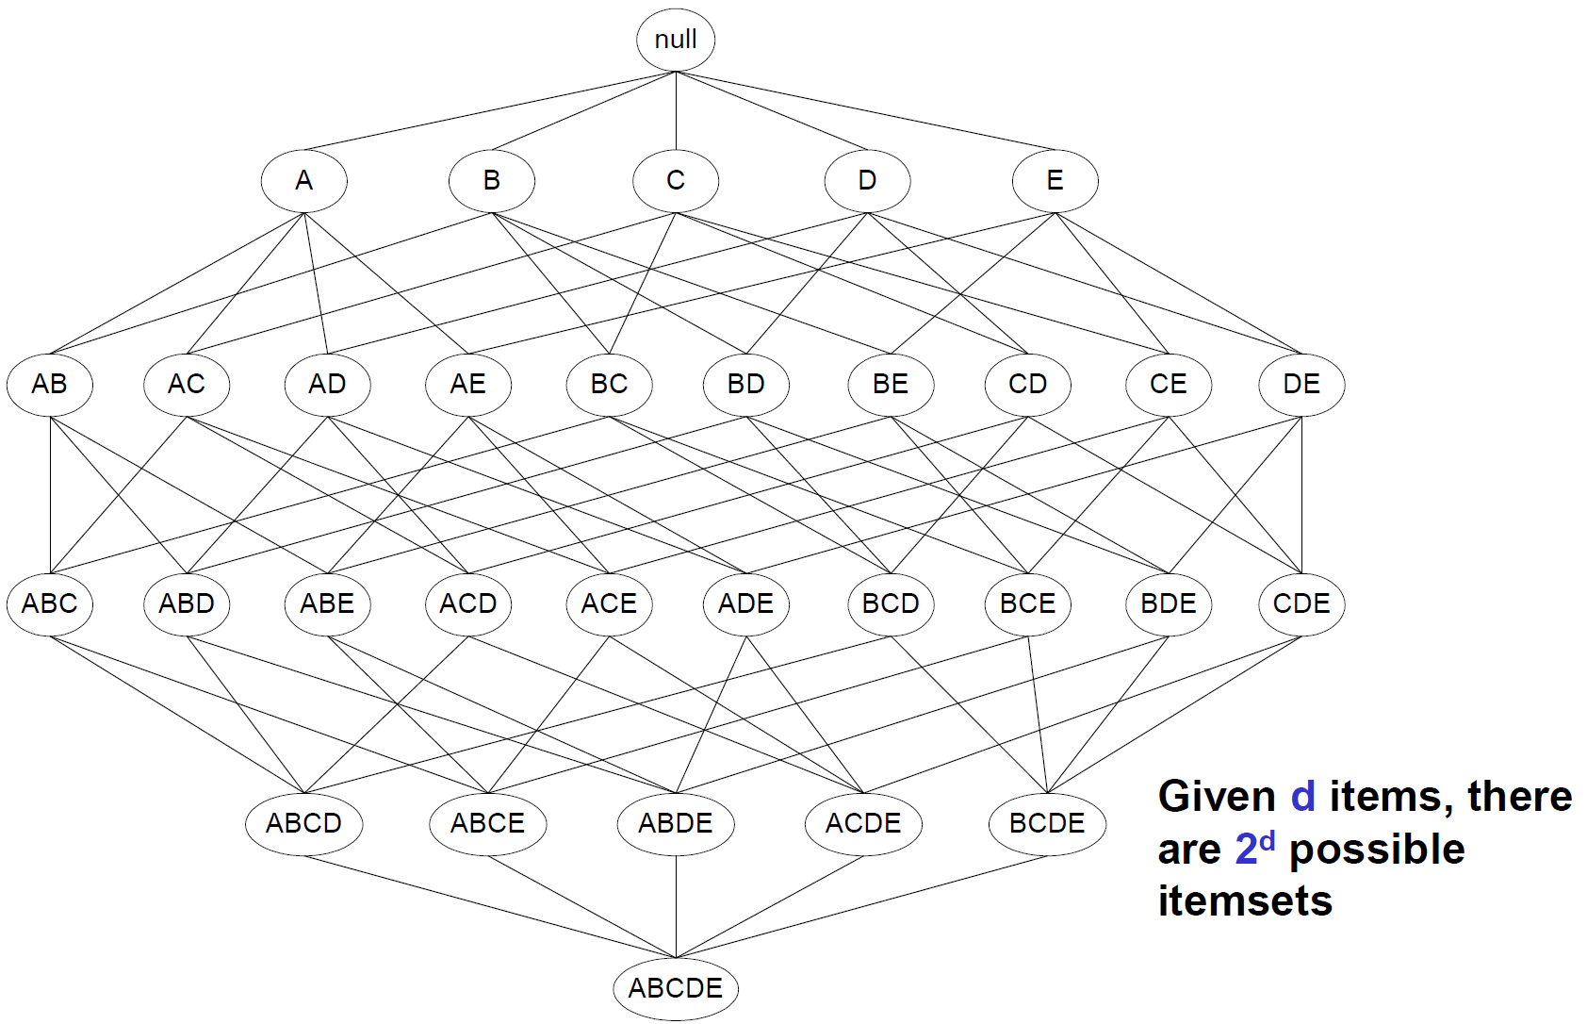
VII.2 Apriori Algorithm for Mining Frequent Itemsets
Lattice of items

Slide 4
A Naïve Algorithm For Frequent Itemsets
• Generate all possible itemsets (lattice of itemsets):
Start with 1-itemsets, 2-itemsets, ..., d-itemsets.
• Compute the frequency of each itemset from the data:
Count in how many transactions each itemset occurs.
• If the support of an itemset is above minsupp
then report it as a frequent itemset.
Runtime:
Match every candidate against each transaction.
For M candidates and N=|D| transactions, the complexity
is: O(N M) => this is very expensive since M = 2^{|I|}

Slide 5
Speeding Up the Naïve Algorithm
Reduce the number of candidates (M):
– Complete search: M=2^{|I|}
– Use pruning techniques to reduce M.
• Reduce the number of transactions (N):
– Reduce size of N as the size of itemset increases.
– Use vertical-partitioning of the data to apply the mining
algorithms.
• Reduce the number of comparisons (N*M)
– Use efficient data structures to store the candidates or
transactions.
– No need to match every candidate against every transaction.

Slide 6
Reducing the Number of Candidates
• Apriori principle (main observation):
– If an itemset is frequent, then all of its subsets must
also be frequent.
• Anti-monotonicity property (of support):
– The support of an itemset never exceeds the support
of any of its subsets.

Slide 7
Apriori Algorithm: Idea and Outline
Outline:
Proceed in phases i=1, 2, ..., each making a single pass over D,
and generate item set X with |X|=i in phase i;
Use phase i-1 results to limit work in phase i:
Anti-monotonicity property (downward closedness):
For i-item-set X to be frequent,
each subset X’ ⊆ X with |X’|=i-1 must be frequent, too;
Worst-case time complexity still is exponential in |I| and linear in |D|*|I|, but usual behavior is linear in N=|D|.
(detailed average-case analysis is strongly data dependent, thus difficult)

Slide 8
Apriori Algorithm: Pseudocode
procedure apriori (D, min-support):
L₁ = frequent 1-itemsets(D);
for (k=2; L_{k-1} ≠ ∅; k++) {
C_{k} = apriori-gen (L_{k-1}, min-support);
for each t ∈ D { // linear scan of D
C_{t} = subsets of t that are in C_{k};
for each candidate c ∈ C_{t} {c.count++} }; //end for
L_{k} = {c ∈ C_{k} | c.count ≥ min-support} }; //end for
return L = ∪_{k} L_{k}; // returns all frequent item sets
procedure apriori-gen (L_{k-1}, min-support):
C_{k} = ∅:
for each itemset x₁ ∈ L_{k-1} {
for each itemset x₂ ∈ L_{k-1} {
if x₁ and x₂ have k-2 items in common and differ in 1 item { // join
x = x₁ ∪ x₂;
if there is a subset s ⊆ x with s ∉ L_{k-1} {disregard x} // infreq. subset
else {add x to C_{k}} } } };
return C_{k};

Slide 9
Illustration For Pruning Infrequent Itemsets
Lattice of items
Suppose {AB}, {E}
are infrequent.
Pruned items

Slide 10
Using Just One Pass over the Data
Idea:
Do not use the database for counting support after
the 1st pass anymore!
Instead, use data structure C_{k}’ for counting support in every step:
C_{k}’ = {<TID, {X_{k}}> | X_{k} is a potentially frequent
k-itemset in transaction with id=TID}
C₁’: corresponds to the original database
The member C_{k}’ corresponding to transaction t is
defined as <t.TID, {c ∈ C_{k} | c is contained in t}>

Slide 11
AprioriTID Algorithm: PseudoCode
procedure apriori (D, min-support):
L₁ = frequent 1-itemsets(D);
C₁’ = D;
for (k=2; L_{k-1} ≠ ∅; k++) {
C_{k} = apriori-gen (L_{k-1}, min-support);
C_{k}’ = ∅
for each t ∈ C_{k-1}’ { // linear scan of C_{k-1}’ instead of D
C_{t} = {c ∈ C_{k} | t[c – c[k]]=1 and t[c – c[k-1]]=1};
for each candidate c ∈ C_{t} {c.count++};
if (C_{t} ≠ ∅) {C_{k}’ = C_{k}’ ∪ C_{t}};
}; // end for
L_{k} = {c ∈ C_{k} | c.count ≥ min-support}
}; // end for
return L = ∪_{k} L_{k}; // returns all frequent item sets
procedure apriori-gen (L_{k-1}, min-support):
… // as before

Slide 12
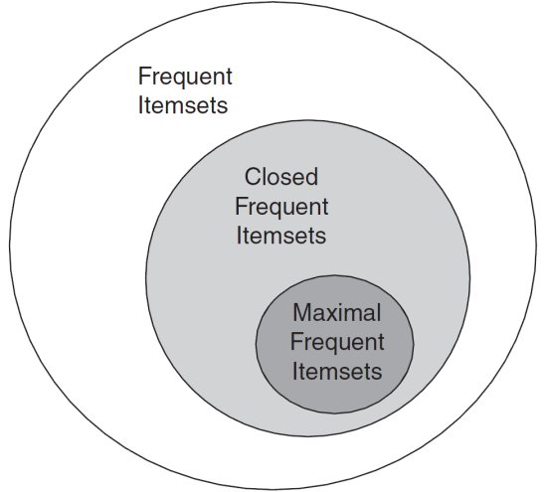
Mining Maximal and Closed Frequent Itemsets with Apriori
Naïve Algorithm: (Bottum-Up Approach)
Compute all frequent itemsets using Apriori.
Compute all closed itemsets by checking all subsets of frequent itemsets found in 1).
3) Compute all maximal itemsets
by checking all subsets of closed and frequent itemsets found in 2).

Slide 13
CHARM Algorithm (I) for Mining Closed Frequent Itemsets [Zaki, Hsiao: SIAM’02]
Basic Properties of Itemset-TID-Pairs:
Let t(X) denote the transaction ids associated with X.
Let X₁ ≤ X₂ (for under any suitable order function, e.g., lexical order).
1) If t(X₁) = t(X₂), then t(X₁ ∪ X₂) = t(X₁) ∩ t(X₂) = t(X₁) = t(X₂).
→ Replace X₁ with X₁ ∪ X₂, remove X₂ from further consideration.
2) If t(X₁) ⊂ t(X₂), then t(X₁ ∪ X₂) = t(X₁) ∩ t(X₂) = t(X₁) ≠ t(X₂).
→ Replace X₁ with X₁ ∪ X₂. Keep X₂, as it leads to a different closure.
3) If t(X₁) ⊃ t(X₂), then t(X₁ ∪ X₂) = t(X₁) ∩ t(X₂) = t(X₂) ≠ t(X₁).
→ Replace X₂ with X₁ ∪ X₂. Keep X₁, as it leads to a different closure.
4) Else if t(X₁) ≠ t(X₂), then t(X₁ ∪ X₂) = t(X₁) ∩ t(X₂) ≠ t(X₂) ≠ t(X₁).
→ Do not replace any itemsets. Both X₁ and X₂ lead to different closures.

Slide 14
CHARM Algorithm (II) for Mining Closed Frequent Itemsets [Zaki, Hsiao: SIAM’02]
Items: A C D T W
{}
Transactions
ACTW
CDW
ACTW
ACDW
ACDTW
CDT
A x 1345
C x 123456
D x 2456
T x 1356
W x 12345
AC x 1345
ACW x 1345
ACD x 45
ACT x 135
CD x 2456
CT x 1356
CW x 12345
ACTW x 135
Support Frequent Itemsets
100% C
84% W, CW
67% A, D, T, AC, AW,
CD, CT, ACW
50% AT, DW, TW, ACT, ATW,
CDW, CTW, ACTW
CDT x 56
CDW x 245
CTW x 245
Done in 10 steps, found 7 closed & frequent itemsets!

Slide 15
VII.3 Mining Association Rules
Given:
A set of items I = {x₁, ..., x_{m}}
A set (bag) D={t₁, ..., t_{n}}
of itemsets (transactions) t_{i} = {x_{i1}, ..., x_{ik}} ⊆ I
Wanted:
Association rules of the form X ⇒ Y with X ⊆ I and Y∈ I such that
X is sufficiently often a subset of the itemsets t_{i}, and
when X ⊆ t_{i} then most frequently Y∈ t_{i} holds as well.
support (X ⇒ Y) = absolute frequency of itemsets that contain X and Y
frequency (X ⇒ Y) = support(X ⇒ Y) / |D| = P[XY] relative frequency
frequency of itemsets that contain X and Y
confidence (X ⇒ Y) = P[Y|X] = relative frequency of itemsets
that contain Y provided they contain X
Support is usually chosen to be low (in the range of 0.1% to 1% frequency),
confidence (aka. strength) in the range of 90% or higher.

Slide 16
Association Rules: Example
Market basket data (“sales transactions”):
t1 = {Bread, Coffee, Wine}
t2 = {Coffee, Milk}
t3 = {Coffee, Jelly}
t4 = {Bread, Coffee, Milk}
t5 = {Bread, Jelly}
t6 = {Coffee, Jelly}
t7 = {Bread, Jelly}
t8 = {Bread, Coffee, Jelly, Wine}
t9 = {Bread, Coffee, Jelly}
frequency (Bread ⇒ Jelly) = 4/9
frequency (Coffee ⇒ Milk) = 2/9
frequency (Bread, Coffee ⇒ Jelly) = 2/9
confidence (Bread ⇒ Jelly) = 4/6
confidence (Coffee ⇒ Milk) = 2/7
confidence (Bread, Coffee ⇒ Jelly) = 2/4
Other applications:
book/CD/DVD purchases or rentals
Web-page clicks and other online usage
etc. etc.

Slide 17
Mining Association Rules with Apriori
Given a frequent itemset X, find all non-empty subsets
Y ⊂ X such that Y → X – Y satisfies the minimum confidence requirement.
If {A,B,C,D} is a frequent itemset, candidate rules are:
ABC → D, ABD → C, ACD → B, BCD → A, A → BCD,
B → ACD, C → ABD, D → ABC, AB → CD, AC → BD,
AD → BC, BC → AD, BD → AC, CD → AB
• If |X| = k, then there are 2^{k}–2 candidate association rules
(ignoring L → ∅ and ∅ → L).

Slide 18
Mining Association Rules with Apriori
How to efficiently generate rules from frequent itemsets?
In general, confidence does not have an anti-monotone property.
conf(ABC → D) can be larger or smaller than conf(AB → D)
But confidence of rules generated from the same itemset has an
anti-monotone property!
Example:
X = {A,B,C,D}:
conf(ABC → D) ≥ conf(AB → CD) ≥ conf(A → BCD)
Why?
→ Confidence is anti-monotone w.r.t. number of items on
the RHS of the rule!

Slide 19
Apriori Algorithm For Association Rules
Outline:
Proceed in phases i=1, 2, ..., each making a single pass over D,
and generate rules X ⇒ Y with
frequent item set X (sufficient support) and |X|=i in phase i;
Use phase i-1 results to limit work in phase i:
Anti-monotonicity property (downward closedness):
For i-item-set X to be frequent,
each subset X’ ⊆ X with |X’|=i-1 must be frequent, too;
Generate rules from frequent item sets;
Test confidence of rules in final pass over D;

Slide 20
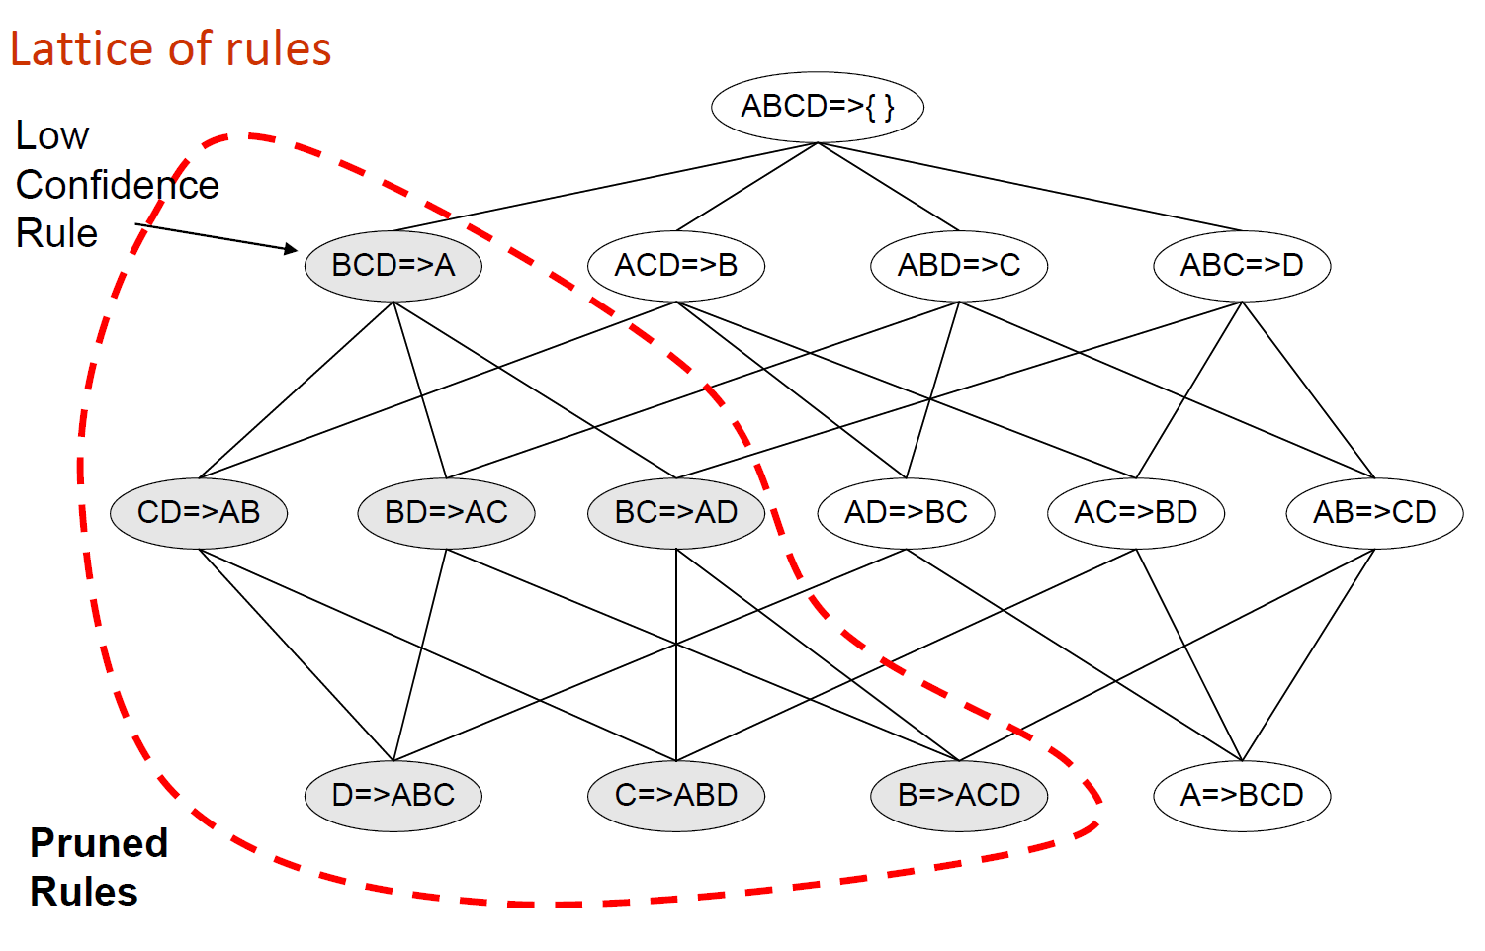
Illustration for Association Rule Mining

Slide 21
Algorithmic Extensions and Improvements
Hash-based counting (computed during very first pass):
map k-itemset candidates (e.g., for k=2) into hash table and
maintain one count per cell; drop candidates with low count early.
Remove transactions that don’t contain frequent k-itemset
for phases k+1, ...
Partition transactions D:
An itemset is frequent only if it is frequent in at least one partition.
Exploit parallelism for scanning D.
Randomized (approximative) algorithms:
Find all frequent itemsets with high probability (using hashing, etc.).
Sampling on a randomly chosen subset of D, then correct sample.
...
Mostly concerned about reducing disk I/O cost
(for TByte databases of large wholesalers or phone companies).

Slide 22
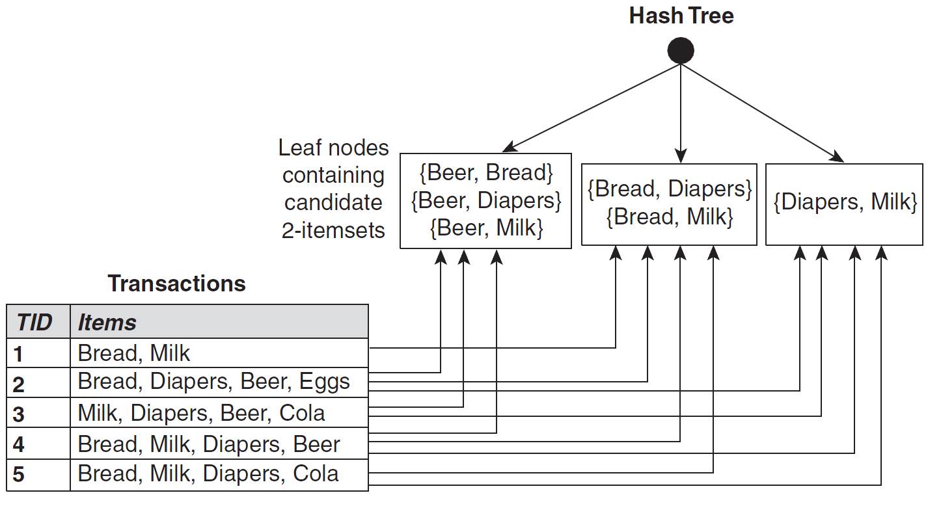
Hash-based Counting of Itemsets
During the main loop of Apriori, the support of candidate itemsets is calculated
by matching each candidate against each transaction.
This step can be accelerated by matching a candidate only against transactions that
are relevant for this candidate (i.e., the ones that are contained in the same bucket).

Slide 23
Hash-Tree Index for Itemsets
Hash-tree for 3-itemsets:
Inner nodes denote same hash-function
H(p) = p mod 3
Leaf nodes contain all candidate 3-itemsets
Build hash-tree index by splitting
candidate itemsets according to H
Stop splitting into subsets if current
split contains only one element
Transaction
H
1,4,7
3,6,9
1 2 3 5 6
2,5,8
H
2 3 4
5 6 7
H
1,4,7
3,6,9
1,4,7
3,6,9
2,5,8
2,5,8
1 4 5
H
1 3 6
3 4 5
3 6 7
3 6 8
3 5 6
3 5 7
6 8 9
1,4,7
3,6,9
2,5,8
1 2 4
4 5 7
1 2 5
4 5 8
1 5 9
Lookup a transaction by iteratively
matching its items against H
Check for containment if a leaf is reached

Slide 24
Extensions and Generalizations of Association Rules
Quantified rules: consider quantitative attributes of item in transactions
(e.g., wine between $20 and $50 ⇒ cigars, or
age between 30 and 50 ⇒ married, etc.)
Constrained rules: consider constraints other than count thresholds,
(e.g., count itemsets only if average or variance of price exceeds ...)
Generalized aggregation rules: rules referring to aggr. functions other
than count (e.g., sum(X.price) ⇒ avg(Y.age))
Multilevel association rules: considering item classes
(e.g., chips, peanuts, bretzels, etc., belonging to class “snacks”)
Sequential patterns (e.g., customers who purchase books in some order):
combine frequent sequences x₁ x₂ … x_{n} and x₂ … x_{n} x_{n+1}
into frequent-sequence candidate x₁ x₂ … x_{n} x_{n+1}
From strong rules to interesting rules:
consider also lift (aka. interest) of rule X ⇒Y: P[XY] / P[X]P[Y]
Correlation rules (see next slides)

Slide 25
VII.4 Other Measures For Association Rule Mining
Limitations of support and confidence:
Many interesting items might fall below minsupp threshold!
Confidence ignores the support of the itemset in the consequent!
Consider contingency table (assume n=100 transactions):
T
¬T
Consider the rule: tea ⇒ coffee
→ support(tea ⇒ coffee) = 20
→ confidence(tea ⇒ coffee) = 0.8
C
20
70
90
¬C
5
5
10
25
75
100
But support of coffee alone is 90, and of tea alone it is 25. That is,
drinking coffee makes you less likely to drink tea, and drinking tea
makes you less likely to drink coffee!
→ Tea and coffee have negative correlation!

Slide 26
Correlation Rules
Example for strong, but misleading association rule:
tea ⇒ coffee with confidence 80% and support 20
But support of coffee alone is 90, and of tea alone it is 25
→ tea and coffee have negative correlation!
Consider contingency table (assume n=100 transactions):
T
¬T
C
20
70
90
→ {T, C} is a frequent and correlated item set
¬C
5
5
10
25
75
100
Correlation rules are monotone (upward closed):
If the set X is correlated then every superset X’ ⊃ X is correlated, too.

Slide 27
Correlation Rules
Example for strong, but misleading association rule:
tea ⇒ coffee with confidence 80% and support 20
But support of coffee alone is 90, and of tea alone it is 25
→ tea and coffee have negative correlation!
Consider contingency table (assume n=100 transactions):
T
¬T
E[C]=0.9
E[T]=0.25
E[(T-E[T])2]=1/4 * 9/16 +3/4 * 1/16= 3/16=Var(T)
E[(C-E[C])2]=9/10 * 1/100 +1/10 * 1/100 = 9/100=Var(C)
E[(T-E[T])(C-E[C])]=
2/10 * 3/4 * 1/10
– 7/10 * 1/4 * 1/10
– 5/100 * 3/4 * 9/10
+ 5/100 * 1/4 * 9/10 =
60/4000 – 70/4000 – 135/4000 + 45/4000 = – 1/40 = Cov(C,T)
ρ(C,T) = – 1/40 * 4/sqrt(3) * 10/3 ≈ -1/(3*sqrt(3)) ≈ – 0.2
C
20
70
90
¬C
5
5
10
25
75
100

Slide 28
Correlated Item Set Algorithm
procedure corrset (D, min-support, support-fraction, significance-level):
for each x ∈ I compute count O(x);
initialize candidates := ∅; significant := ∅;
for each item pair x, y ∈ I with O(x) > min-support and O(y) > min-support {
add (x,y) to candidates};
while (candidates ≠ ∅) {
notsignificant := ∅;
for each itemset x ∈ candidates {
construct contingency table T;
if (percentage of cells in T with count > min-support
is at least support-fraction) { // otherwise too few data for chi-square
if (chi-square value for T ≥ significance-level)
{add X to significant} else {add X to notsignificant} } }; // if/for
candidates := itemsets with cardinality k such that
every subset of cardinality k-1 is in notsignificant;
// only interested in correlated itemsets of min. cardinality
}; //while
return significant;

Slide 29
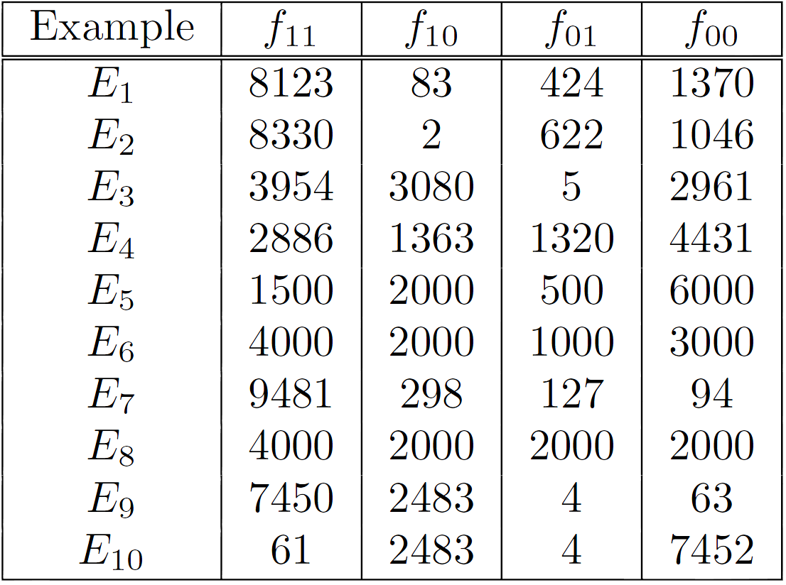
Examples of Contingency Tables
General form:
(for pair of variables A, B)
Examples for binary cont. tables:
B
¬B
A
f₁₁
f₁₀
f₁₊
¬A
f₀₁
f₀₀
f₀₊
f₊₁
f₊₀
N

Slide 30
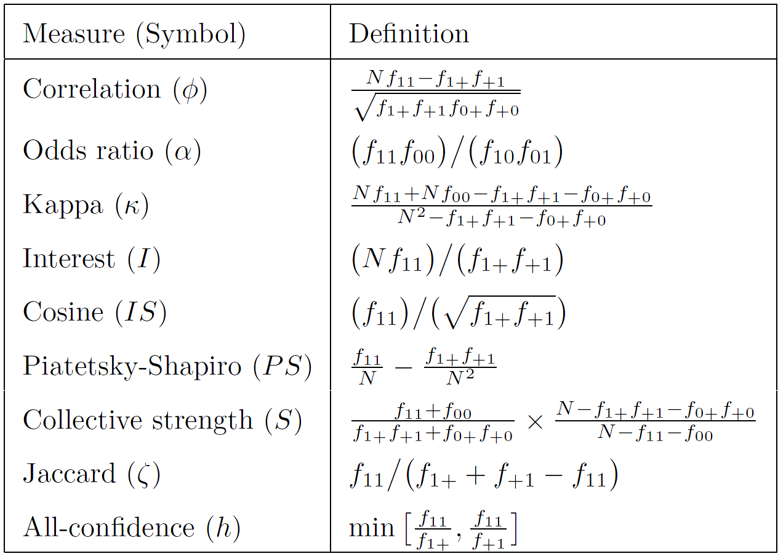
Symmetric Measures for Itemset {A,B}

Slide 31
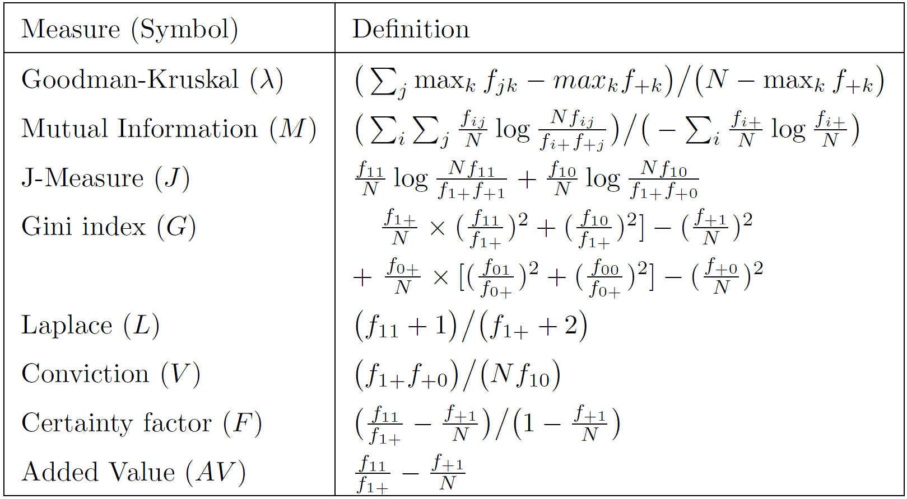
Asymmetric Measures For Rule A ⇒ B

Slide 32
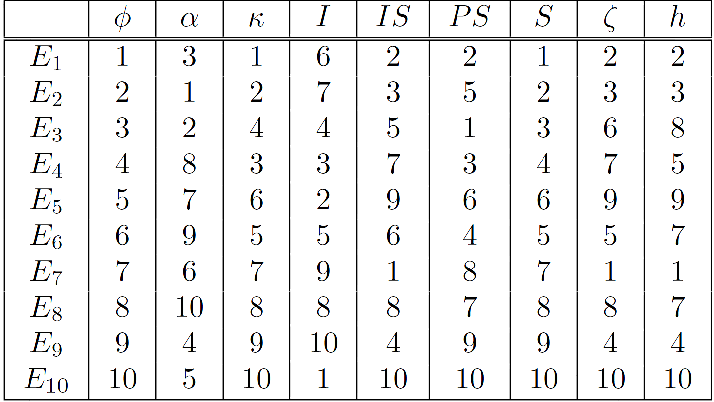
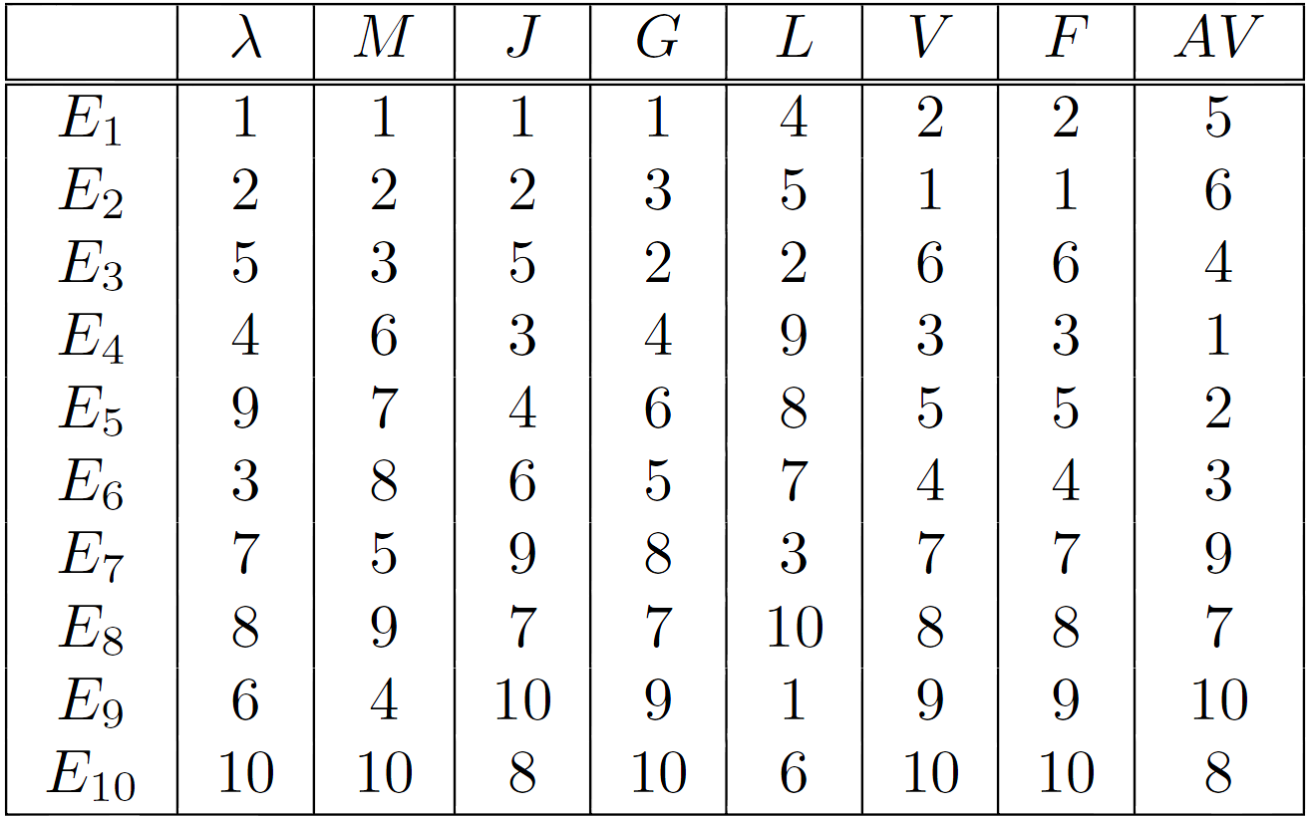
Consistency of Measures
Ranking of tables according to symmetric measures
Rankings may
vary substantially!
Many measures
provide conflicting
information about
quality of a pattern.
Want to define
generic properties of
measures.
Ranking of tables according to asymmetric measures

Slide 33
Properties of Measures
Definition (Inversion Property):
An objective measure M is invariant under the inversion operation
if its value remains the same when exchanging the frequency counts
f₁₁ with f₀₀ and f₁₀ with f₀₁.
Definition (Null Addition Property):
An objective measure M is invariant under the null addition operation
if it is not affected by increasing f₀₀, while all other frequency counts
stay the same.
Definition (Scaling Invariance Property):
An objective measure M is invariant under the row/column scaling
operation if M(T) = M(T’), where T is a contingency table with
frequency counts [f₁₁, f₁₀, f₀₁, f₀₀], T’ is a contingency table with
frequency counts [k₁k₃f₁₁, k₂k₃f₁₀, k₁k₄f₀₁, k₂k₄f₀₀], and k₁, k₂, k₃, k₄
Are positive constants.

Slide 34
Example: Confidence and the Inversion Property
Recall the general form:
confidence(A ⇒ B) := P[B|A]
= f₁₁/f₁₊ = f₁₁ / f₁₁+ f₁₀
f₀₀ / f₀₀ + f₁₀ = f₀₀/f₊₀
(Inversion)
B
¬B
A
f₁₁
f₁₀
f₁₊
≠
¬A
f₀₁
f₀₀
f₀₊
f₊₁
f₊₀
N
Counter example:
confidence(T ⇒ C)
= 20/25 = 0.8 ≠ 5/90 = 0.055
T
¬T
C
20
70
90
¬C
5
5
10
25
75
100

Slide 35
Simpson’s Paradox (I)
Consider the following correlation between people buying an
HTDV (H) and an exercise machine (E):
E
¬E
H
99
81
180
¬H
54
66
120
153
147
300
confidence(H ⇒ E) = 99/180 = 0.55
confidence(¬ H ⇒ E) = 54/120 = 0.45
→ Customers who buy an HDTV are more likely to buy an exercise
machine than those who do not buy an HDTV.

Slide 36
Simpson’s Paradox (II)
Consider stratified data by including additional variables
(data split two groups: college students and working employees):
E
¬E
Total
Students
(44)
H
1
9
10
confidence(H ⇒ E) = 1/10 = 0.10 =: a/b
confidence(¬H ⇒ E) = 4/34 = 0.12 =: c/d
confidence(H ⇒ E) = 98/170 = 0.57 =: p/q
confidence(¬H ⇒ E) = 50/86 = 0.58 =: r/s
¬H
4
30
34
Employees
(256)
H
98
72
170
¬H
50
36
86
H and E are positively correlated in the combined data but negatively
correlated in each of the strata!
When pooled together, the confidences of H ⇒ E and ¬H ⇒ E are
(a+p)/(b+q) and (c+r)/(d+s), respectively.
Simpson’s paradox occurs when: (a+p)/(b+q) > (c+r)/(d+s)

Slide 37
Summary of Section VII
Mining frequent itemset and association rules is a versatile tool for many applications (e-commerce, user recommendations, etc.).
One of the most basic building blocks in data mining for identifying interesting correlations among items/objects based on co-occurrence statistics.
Complexity issues mostly due to the huge amount of possible combinations of candidate itemsets (and rules), also expensive when amount of transactions is huge and needs to be read from disk.
Apriori builds on anti-monotonicity property of support, whereas confidence does not generally have this property (however pruning is possible to some extent within a given itemset).
Many quality measures considered in the literature, each with different properties.
Additional Literature:
M. J. Zaki and C. Hsiao: CHARM: An efficient algorithm for closed itemset mining. SIAM’02.

