Slide 1
NoRM: No-Reference Metric for Computer Graphics
Robert Herzog*, Martin Čadík*, Tunç Aydın◊, Kwang In Kim*, K. Myszkowski*, H.-P. Seidel*
*MPI Informatik, ◊Disney Research Zürich

Slide 2
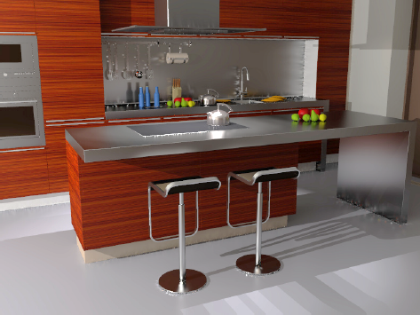
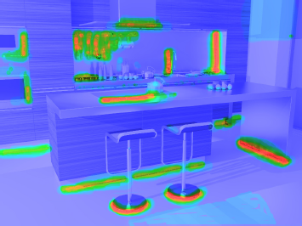
Goals
Input: distorted image/video frame (wo reference)
Output: map of distortions (possibly perceptually weighted)
NoRM

Slide 3
No-Reference Metric
What is it good for?
Often hard to get reference
Guiding/ parameter estimation of renderers
Stopping criterions
Algorithm analysis/validation/evaluation
NoRef Quality assessment scenarios in compression/transmission, etc.

Slide 4
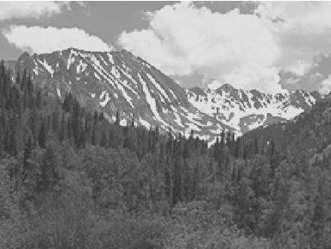
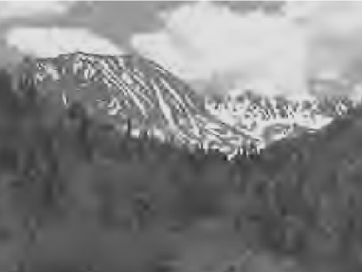
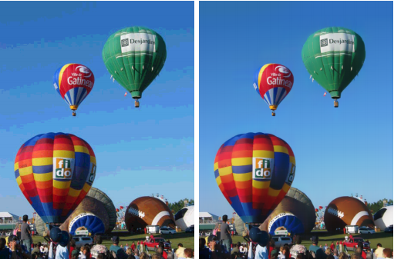
Image Quality Metrics
Common quality metrics were designed for predicting visibility of typical distortions in photographs: blur, sharpending, noise, JPEG/ MPEG compression,...
What about synthetic CG-images?
Blur
Sharpening
JPEG/ MPEG distortions
Contouring, banding

Slide 5
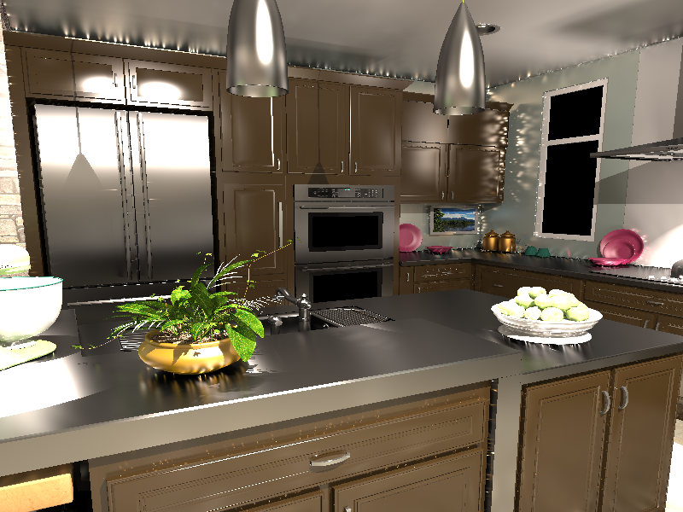
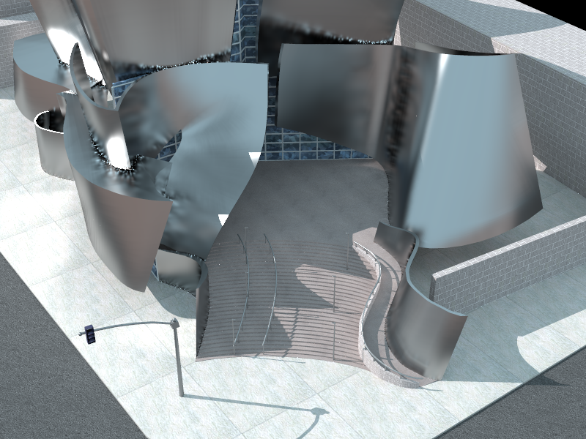
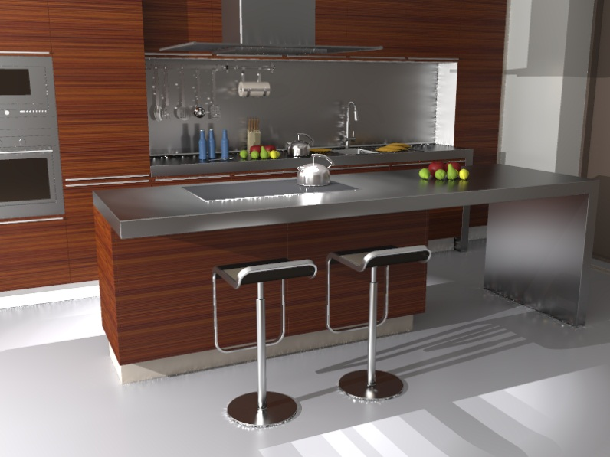
Rendering Artifacts
e.g., low-freq. noise from glossy instant radiosity or photon density estimation

Slide 6
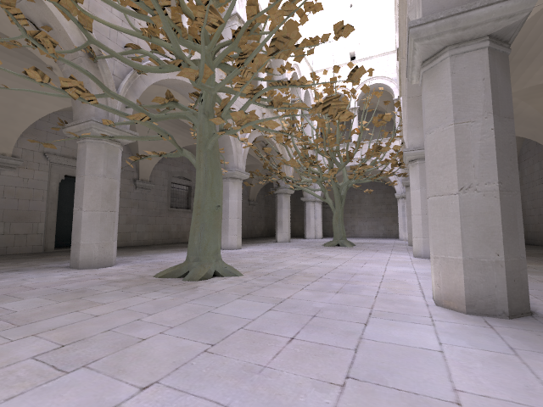
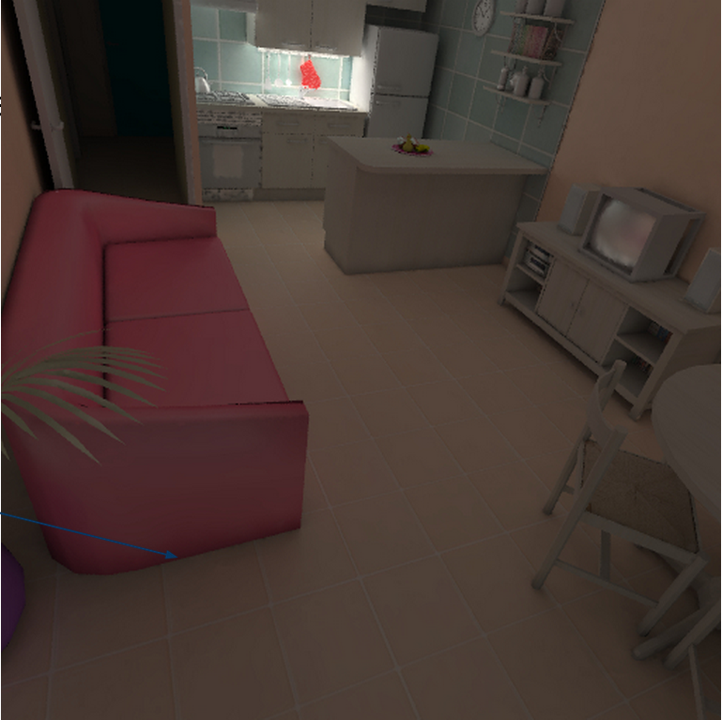
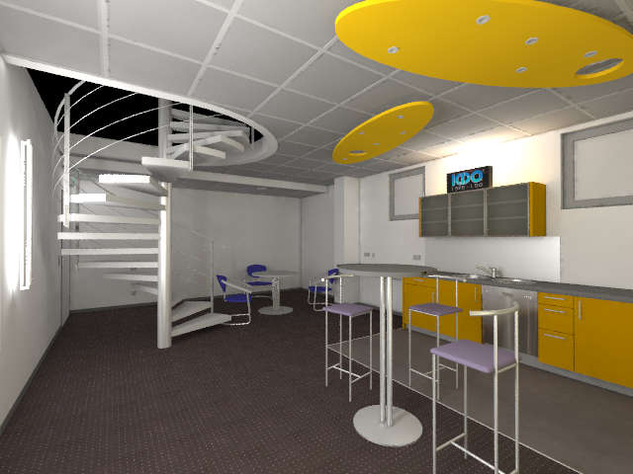
Rendering Artifacts
Clamping Bias (darkening in corners)

Slide 7
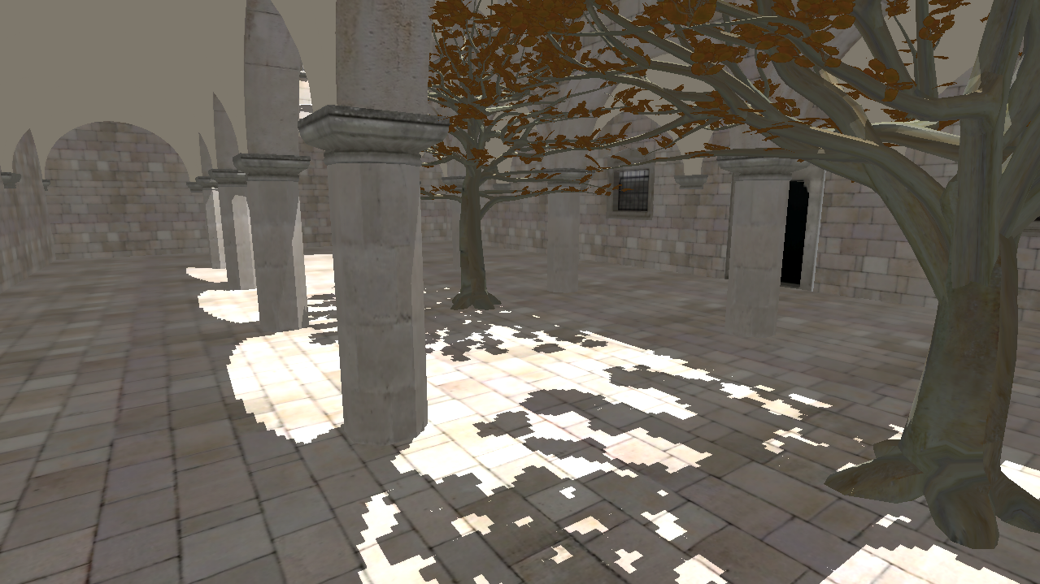
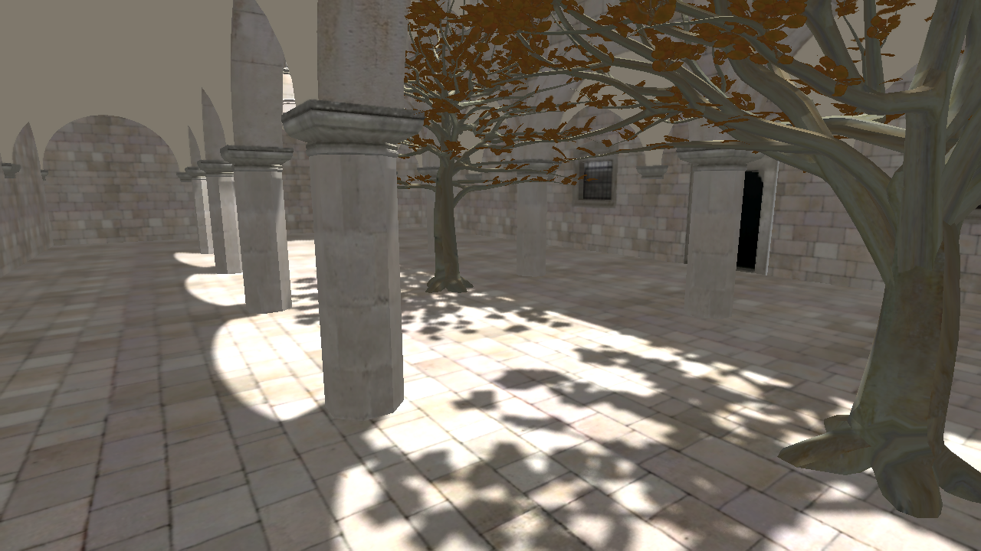
Rendering Artifacts
Shadow Mapping
easy to generate large sample set

Slide 8
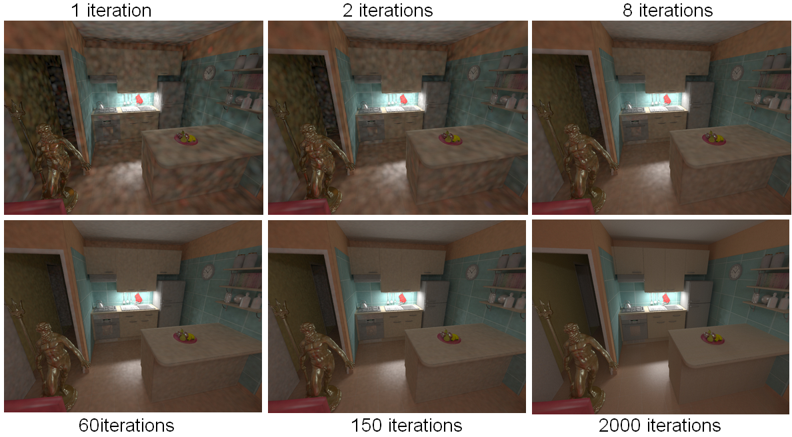
Rendering Artifacts
Progressive photon mapping: when to stop iterating?
1 iteration
2 iteration
8 iteration
60 iteration
150 iteration
1500 iteration

Slide 9
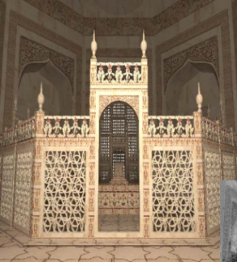
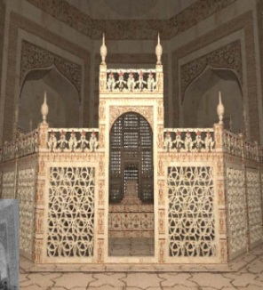
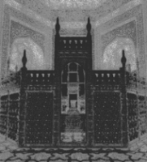
Related Work: IQM
With-reference Image Quality Metrics
LDR visual difference predictor (VDP): [Daly Sigg ‘93, VDP, Wang et al. ‘04, SSIM]
HDR+LDR VDP: [Mantiuk et al. ’04 (Sigg. ‘11), Aydin et al. ’09]
Perceptual Rendering
Texture-based visual masking: [ Ramasubramanian et al. Sigg.’99; Bolin & Meyer ’98, Walter et al., EG’02; Stokes et al., Sigg.’04 ]
Visual equivalence for instant radiosity: Krivanek et al. Sigg. ’10
No-Ref. IQM, Quality Assessment (QA)
Detecting blockiness in JPEG/MPEG: [Wang & Bovik ’06, Wu & Rao ‘05]
Blurriness measure: [Liu et al. SPIE ’11, Chen et al. SPIE ’11]
Detection / removal of false contours (color quantization): [Daly S. & Feng SPIE ’04]
Natural image statistics no-ref. QA: [Sheikh et al. ‘05, Jpeg2000]
CG versus Photograph: [Reinhard et al. ‘01, Tian-Tsong Ng ’04]
⬄
Physically correct
6% samples
Thresholds
4.2

Slide 10
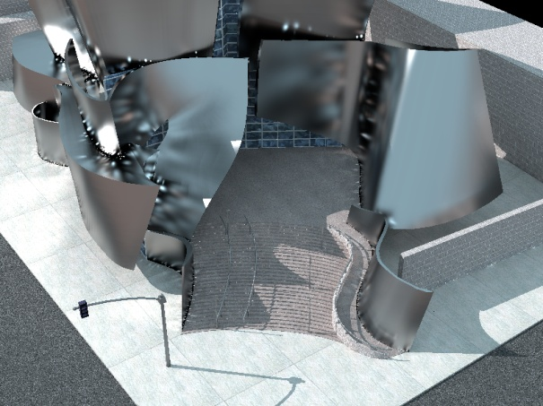
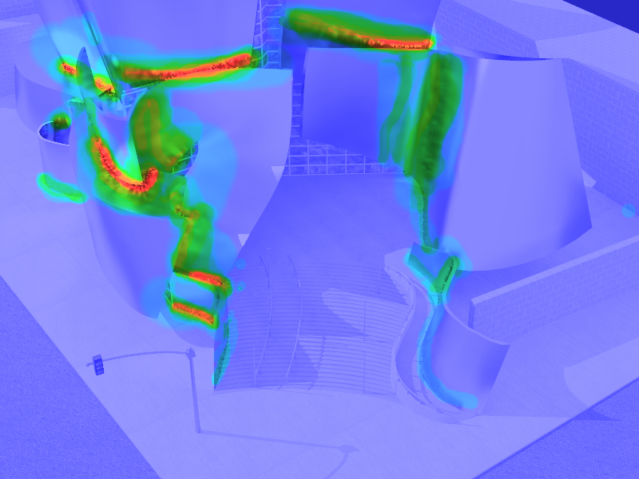
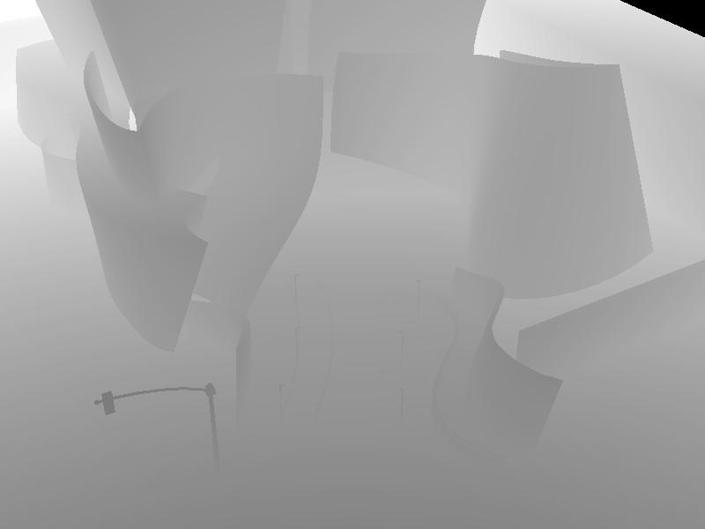
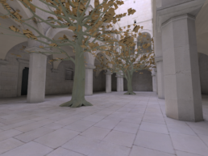
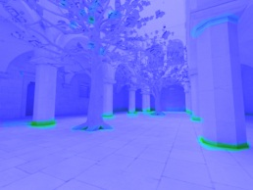
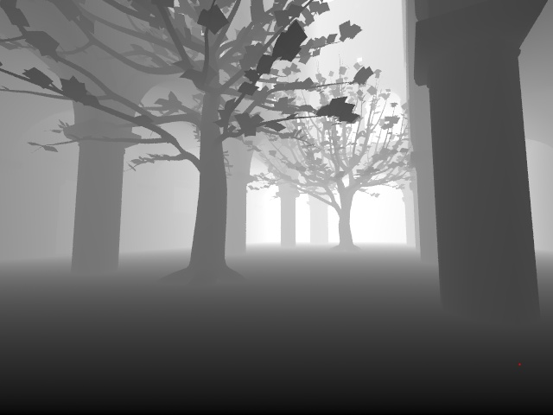
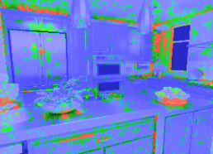
Data-Driven No-Ref. IQM
Feature descriptors (various information available)
Distortion maps (possibly real subjective data)
Depth + 3D related information
SVM / K-NN …
…
…

Slide 11
Data-Driven No-Ref. IQM
Feature descriptors (various information available)
Distortion maps (possibly real subjective data)
Depth + 3D related information
Distorted (rendered) image → prediction
Traditional metrics: just a number on scale 1-5
We want a distortion map per pixel
Much harder problem
But ... we have 3D data!!!
…
…
SVM / K-NN …
3
…
Distortion strength
…

Slide 12
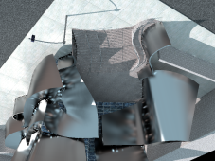
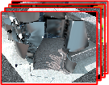
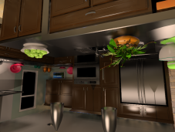
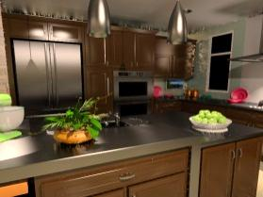
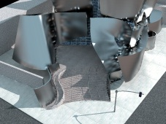
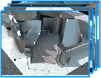
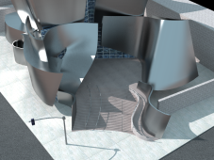
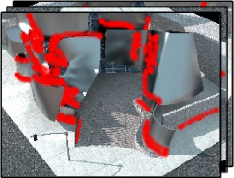
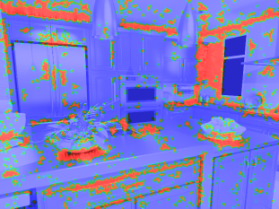
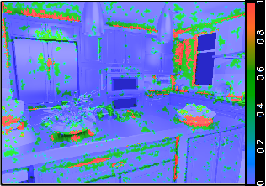
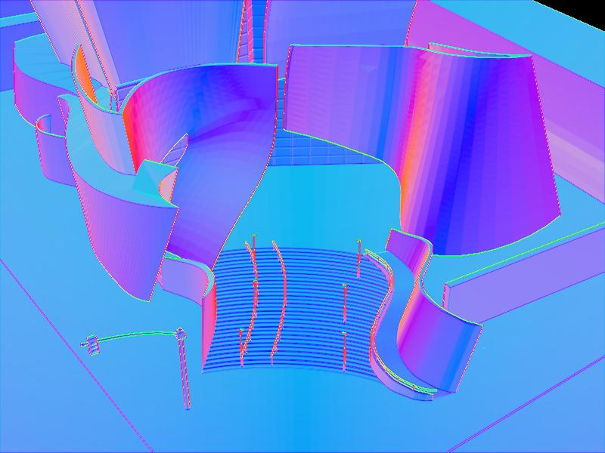
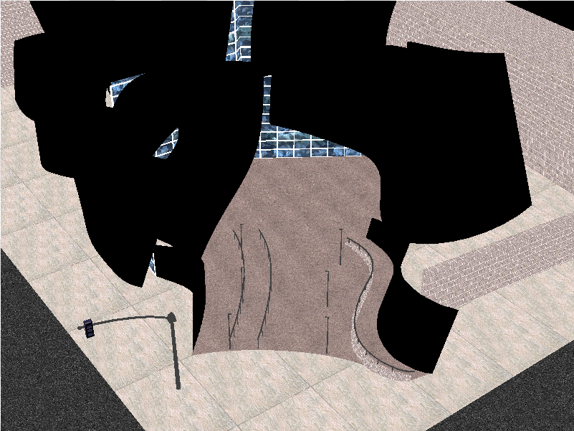
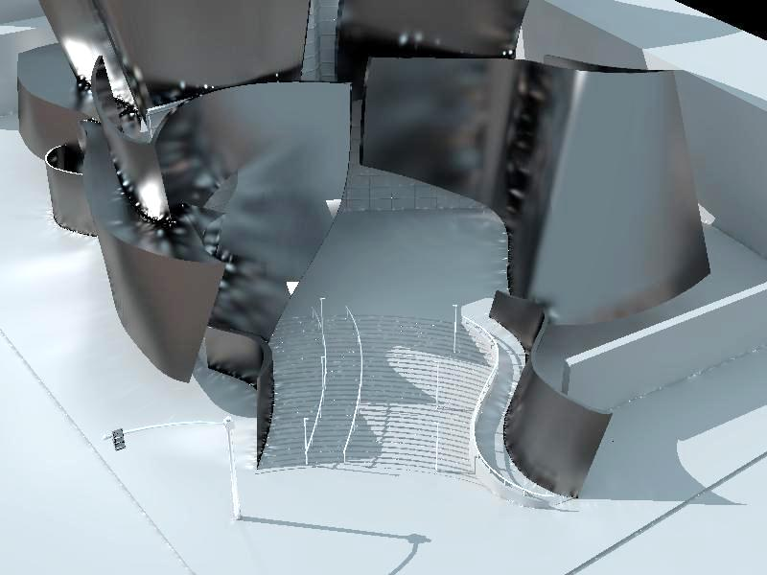
System Pipeline NoRM
Data Preparation
Training
Prediction
Artifact Correction
Image QM
Input set
Selected artifacts
Sample locations
New test image
Training pairs
Pseudo reference
Descriptors + labels
Inpainting
-
&
Perceptual Normalization
Extract local 3D features
Predict artifact
Blend mask
Train
Classifier
(SVM)
Classifier
(trained)
Reference pairs
User scribbles
Multi-scale lighting, material, depth images
Predicted artifact probability
Perceptual artifact strength

Slide 13
System Pipeline NoRM: Prepare Data
Data Preparation
Training
Prediction
Artifact Correction
Image QM
Input set
Selected artifacts
Sample locations
New test image
Training pairs
Pseudo reference
Descriptors + labels
Inpainting
-
&
Perceptual Normalization
Extract local 3D features
Predict artifact
Blend mask
Train
Classifier
(SVM)
Classifier
(trained)
Reference pairs
User scribbles
Multi-scale lighting, material, depth images
Predicted artifact probability
Perceptual artifact strength

Slide 14
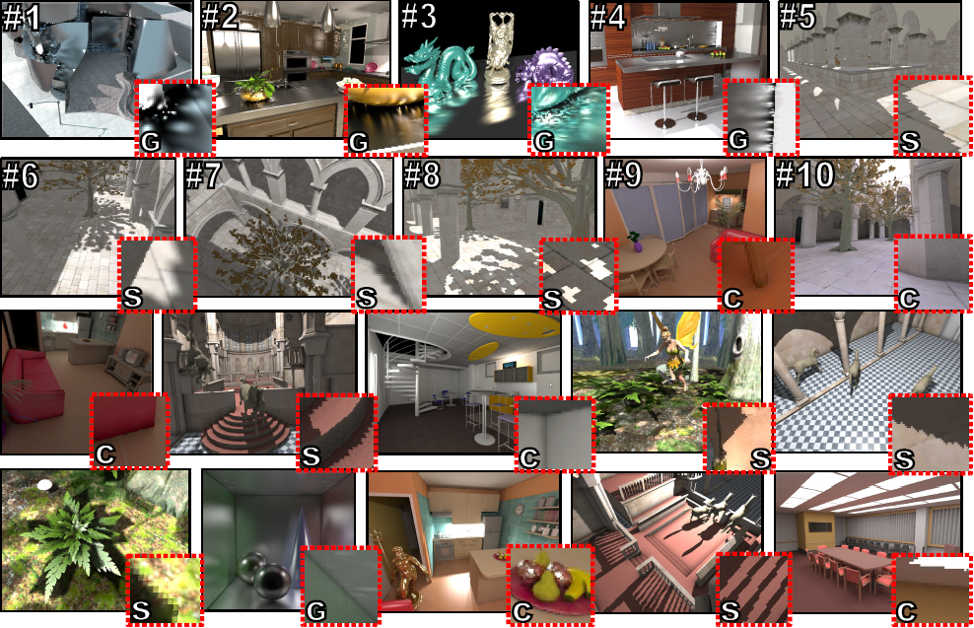
Rendering Artifact Data Sample

Slide 15
User Experiment
Which Pixels are Artifacts?
Full-reference metrics (e.g. HDR-VDP2, SSIM)

Slide 16
User Experiment
Which Pixels are Artifacts?
Asked 20 subjects
Scribbling application
No-reference / With-reference

Slide 17
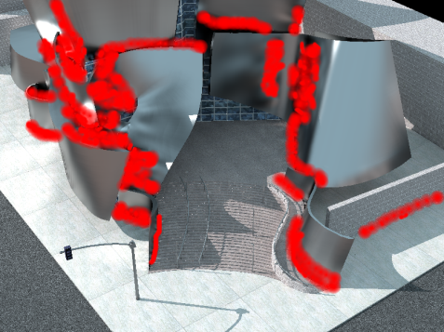
Computing the Mask
Given artifact image + reference + user mask
compute the error labels within the user mask
Image with artifacts
User Mask
Labels
⁻
&

Slide 18
System Pipeline NoRM: Training
Data Preparation
Training
Prediction
Artifact Correction
Image QM
Input set
Selected artifacts
Sample locations
New test image
Training pairs
Pseudo reference
Descriptors + labels
Inpainting
-
&
Perceptual Normalization
Extract local 3D features
Predict artifact
Blend mask
Train
Classifier
(SVM)
Classifier
(trained)
Reference pairs
User scribbles
Multi-scale lighting, material, depth images
Predicted artifact probability
Perceptual artifact strength

Slide 19
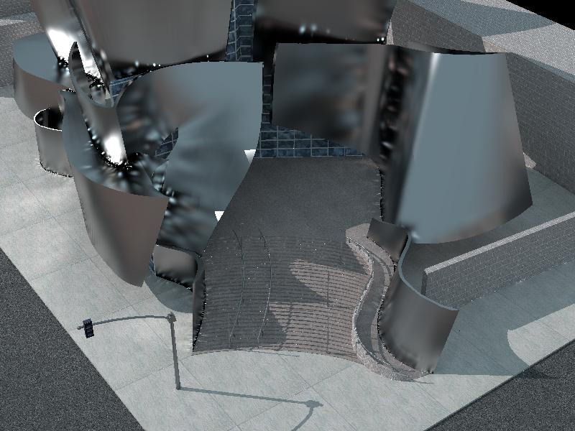
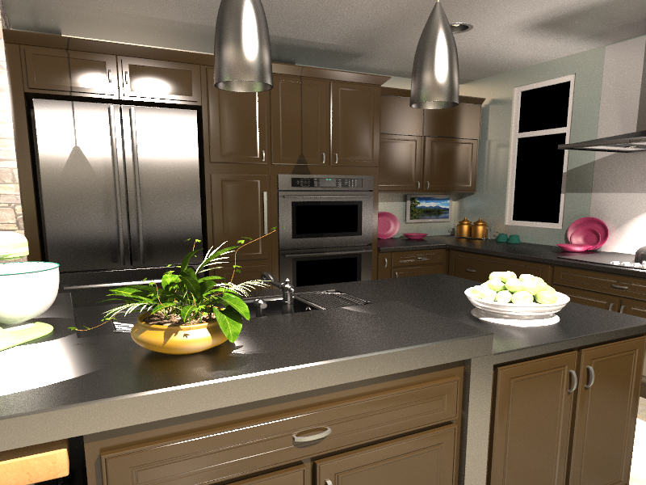
Training Classifier
Given input data:
color, depth, material for one artifact type
user scribbled artifact mask
reference image without artifacts

Slide 20
Rendering Output – Classification Input
HDR (LDR) color image (may contain noise)
depth buffer (in high precision, no noise)
diffuse texture buffer

Slide 21
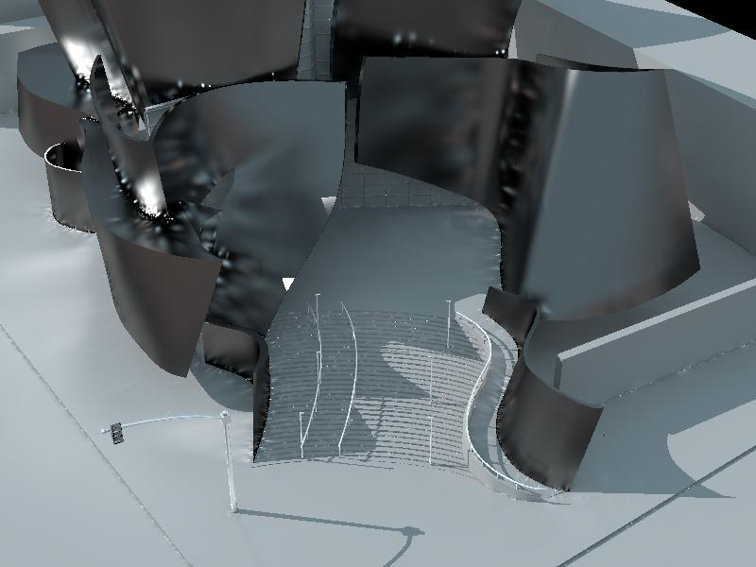
Computation of Additional Input Data
color (pixel radiance)
textures
depth
/mat
lighting (irradiance)
surface normals (computed from depth)

Slide 22
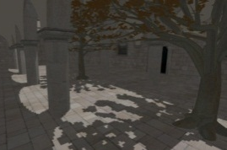
Feature Descriptors
Tested several “standard” features
Color-features from computer vision
Histogram of oriented Gradients (HoG)
Frequency domain features (DCT)
Difference of Gaussians (DoG)
Local first-order statistics
Plus 3D features given depth
Cropped block
DCT coeff.

Slide 23
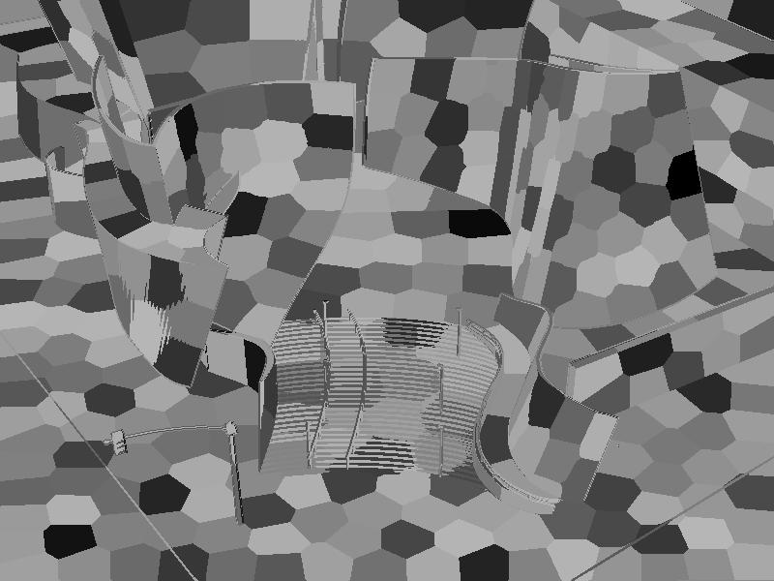
Segmenting Surfaces
segments surface pixels with similar normal and world-space position (i.e. each segment is part of a continuous surface)
k-means

Slide 24
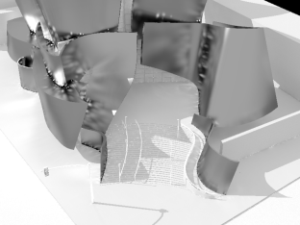
3D Features: Local First-order Statistics
compute mean, variance, skewness, kurtosis in each segment at different scales of the grey-scale image pyramid (also for depth, normals)

Slide 25
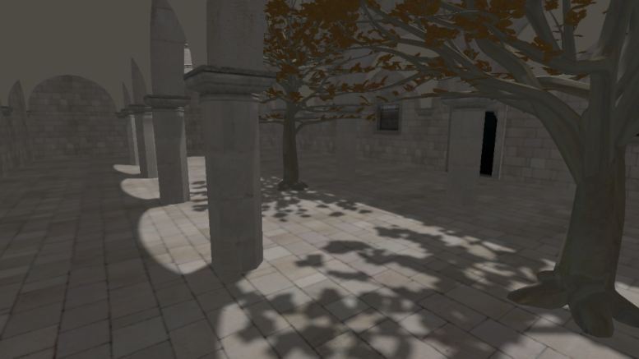
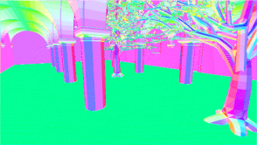
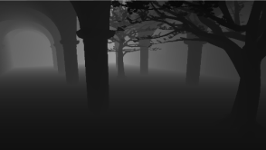
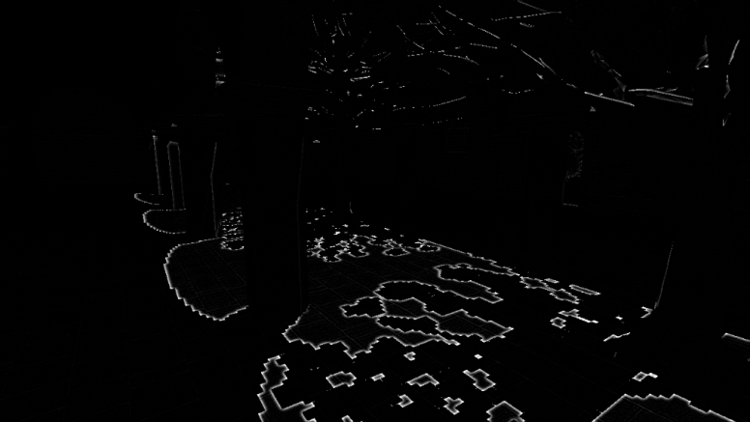
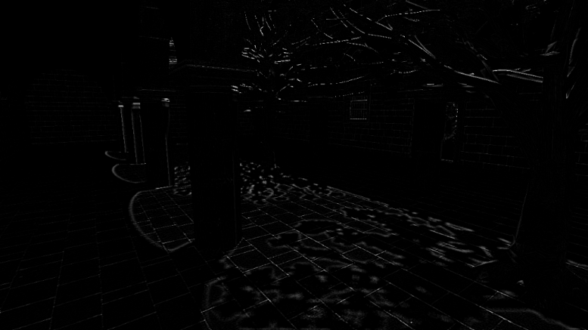
3D Features: Joint-Bilateral Prefiltering
Distorted Image
Reference
(w_{f}*I) - I
w_{f} = w_{n}
.
(w_{f}*I_{ref}) - I_{ref}
w_{d}
normals
depth
Residual Image

Slide 26
3D Features: Ambient Occlusion
given depth extract approx. ambient occlusion per pixel (distance to nearest occluder)
screen-space ambient occlusion (SSAO)

Slide 27
System Pipeline NoRM: Prediction
Data Preparation
Training
Prediction
Artifact Correction
Image QM
Input set
Selected artifacts
Sample locations
New test image
Training pairs
Pseudo reference
Descriptors + labels
Inpainting
-
&
Perceptual Normalization
Extract local 3D features
Predict artifact
Blend mask
Train
Classifier
(SVM)
Classifier
(trained)
Reference pairs
User scribbles
Multi-scale lighting, material, depth images
Predicted artifact probability
Perceptual artifact strength

Slide 28
Feature Performance
ROC curves for each individual feature (SVM + RBF)
And best combined features (black curve)
Shadow Map Aliasing
Clamping Bias
VPL Noise
recall
recall
recall
HoG (color) + DCT (color) + Stats.(Depth)
HoG (color) + HoG (depth) + SSAO +
Stats.(color)
HoG (color) + HoG (depth) + SSAO +
Stats. (color)
False positive rate
False positive rate
False positive rate

Slide 29
Performance 2D / 3D
HoG (lighting) versus HoG (lighting + depth)
Input
Color
Ground-truth (User-masks)
Color Descriptor
Color + Depth Descriptor

Slide 30
REFERENCE IMAGE

Slide 31
SUBJECTS WITH REFERENCE
IMAGE WITH ARTIFACTS

Slide 32
Classification Results
SUBJECTS (NO REFERENCE)
SUBJECTS (WITH REFERENCE)
OUR RESULT (NO REFERENCE)
HDRVDP2 [Mantiuk et al. ‘11] (FULL REFERENCE)

Slide 33
Artifact Strength
So far only binary classification
Could we also learn Human Perception Model?
i.e., visible strength of the distortions
Support vector regression?
No good results!
Instead, we model the artifact perception explicitly
needs contrast to approximate strength
Requires a reference!

Slide 34
System Pipeline NoRM
Data Preparation
Training
Prediction
Artifact Correction
Image QM
Input set
Selected artifacts
Sample locations
New test image
Training pairs
Pseudo reference
Descriptors + labels
Inpainting
-
&
Perceptual Normalization
Extract local 3D features
Predict artifact
Blend mask
Train
Classifier
(SVM)
Classifier
(trained)
Reference pairs
User scribbles
Multi-scale lighting, material, depth images
Predicted artifact probability
Perceptual artifact strength

Slide 35
Patch Inpainting
Training pairs
(patch database)
Threshold artifacts
Search k-nn patches
Sample mask
Blend
Gaussian splats weights
Splatted patches
(only subset shown)
“Pseudo”-Reference result
Resample holes

Slide 36
Inpainting for Shadow Artifacts

Slide 37
System Pipeline NoRM
Data Preparation
Training
Prediction
Artifact Correction
Image QM
Input set
Selected artifacts
Sample locations
Distorted Image
Training pairs
Pseudo reference
Descriptors + labels
Inpainting
-
&
Perceptual Normalization
Extract local 3D features
Predict artifact
Blend mask
Train
Classifier
(SVM)
Classifier
(trained)
Reference pairs
User scribbles
Multi-scale lighting, material, depth images
Predicted artifact probability
Perceptual artifact strength

Slide 38
Perceptual Normalization
Classification output (relative conservative)
Perceptually normalized result
Full-ref. Perceptual Model
*
=
Replace artifacts (inpainting)
Ground-Truth (Subjects)
⁻
CSF
CSF
Blended “Pseudo” Reference (L_{k})
Distorted Test Image
: Wilson transducer function applied on k pyramid scales

Slide 39
Perceptual Normalization
NoRM
Ground-Truth (Subjects)
Classification (rel. Conservative)
Perceptually normalized result

Slide 40
Results (VPL noise)
Subjects (NO REF)
Our Result (NO REF)
SSIM [Wang et al. ‘04] – (REF)
corr = 0.662 (0.628)
corr = 0.674
HDRVDP2 [Mantiuk et al. ‘11] – (REF)
Subjects (REF)
Artifact Image
corr = 0.725
corr = 0.903

Slide 41
Results (VPL noise)
Subjects (NO REF)
Our Result (NO REF)
SSIM [Wang et al. ‘04] – (REF)
corr = 0.436 (0.298)
corr = 0.469
HDRVDP2 [Mantiuk et al. ‘11] – (REF)
Subjects (REF)
Artifact Image
corr = 0.495
corr = 0.913

Slide 42
Results (VPL clamping)
Subjects (NO REF)
Our Result (NO REF)
SSIM [Wang et al. ‘04] – (REF)
corr = 0.470 (0.450)
corr = 0.637
HDRVDP2 [Mantiuk et al. ‘11] – (REF)
Subjects (REF)
Artifact Image
corr = 0.134
corr = 0.186

Slide 43
Results (Shadow aliasing)
Subjects (NO REF)
Our Result (NO REF)
SSIM [Wang et al. ‘04] – (REF)
corr = 0.767 (0.638)
corr = 0.742
HDRVDP2 [Mantiuk et al. ‘11] – (REF)
Subjects (REF)
Artifact Image
corr = 0.669
corr = 0.772

Slide 44
Conclusions & Future Work
NoRM: Data-driven No-Reference CG-image quality Metric
Blind metric for local rendering artifacts is possible
If we know what we are looking for
3D and texture information is available
NoRM

Slide 45
Conclusions & Future Work
NoRM: Data-driven No-Reference CG-image quality Metric
Blind metric for local rendering artifacts is possible
If we know what we are looking for
3D and texture information is available
As future work:
NoRM is slow → further optimization possible
e.g. using faster classifiers (decision forests, gaussian processes)
Enlarge the set of artifacts and images
Test multi-class classification
Classification with neighborhood information (markov random field)

Slide 46
Thank You!
Thanks to: Tomáš Davidovič for VPL renderings, Mario Fritz, Chuong Nguyen, and Rafał Mantiuk for discussions.
http://www.mpi-inf.mpg.de/resources/hdr/norm/ rherzog@mpi-inf.mpg.de

