Slide 1

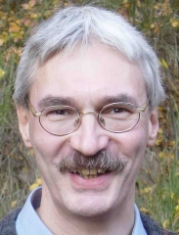
Knowledge Harvesting
in the Big Data Era
Fabian Suchanek & Gerhard Weikum
Max Planck Institute for Informatics, Saarbruecken, Germany
http://suchanek.name/
http://www.mpi-inf.mpg.de/~weikum/
http://www.mpi-inf.mpg.de/yago-naga/sigmod2013-tutorial/

Slide 2




















Turn Web into Knowledge Base
Very Large Knowledge Bases
KB Population
Entity Linkage
Web of Usrs & Contents
Disambiguation
Web of Data
Semantic Docs
Info Extraction
Semantic Authoring
2

Slide 3
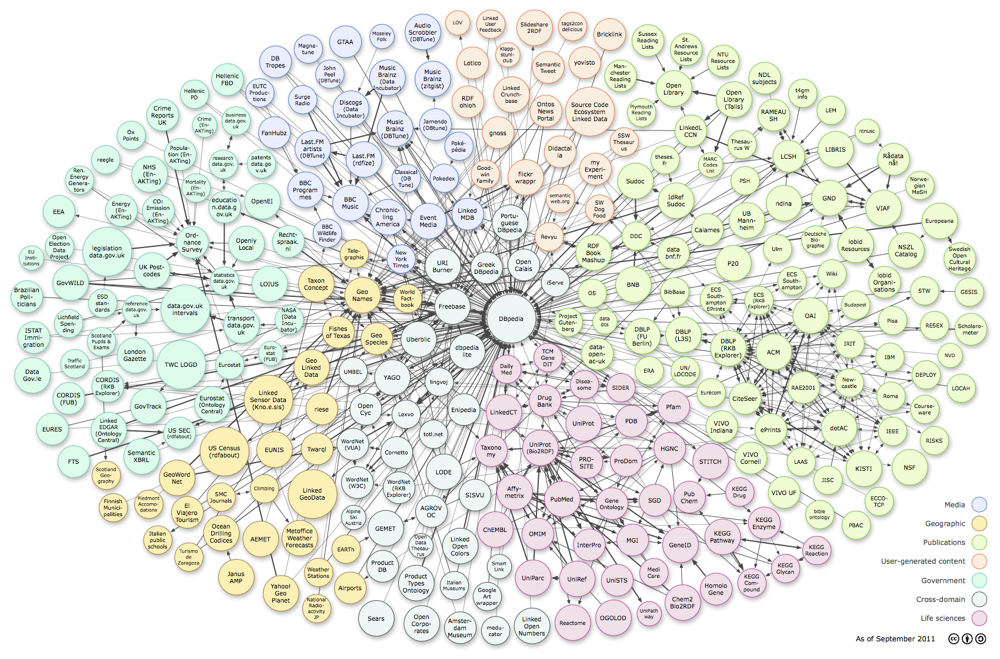



















Web of Data: RDF, Tables, Microdata
60 Bio. SPO triples (RDF) and growing
ReadTheWeb
SUMO
Cyc
BabelNet
TextRunner/
ReVerb
ConceptNet 5
WikiTaxonomy/
WikiNet
http://richard.cyganiak.de/2007/10/lod/lod-datasets_2011-09-19_colored.png
3

Slide 4
Web of Data: RDF, Tables, Microdata
60 Bio. SPO triples (RDF) and growing
4M entities in
250 classes
500M facts for
6000 properties
live updates
10M entities in
350K classes
120M facts for
100 relations
100 languages
95% accuracy
25M entities in
2000 topics
100M facts for
4000 properties
powers Google
knowledge graph
Ennio_Morricone type composer
Ennio_Morricone type GrammyAwardWinner
composer subclassOf musician
Ennio_Morricone bornIn Rome
Rome locatedIn Italy
Ennio_Morricone created Ecstasy_of_Gold
Ennio_Morricone wroteMusicFor The_Good,_the_Bad_,and_the_Ugly
Sergio_Leone directed The_Good,_the_Bad_,and_the_Ugly
http://richard.cyganiak.de/2007/10/lod/lod-datasets_2011-09-19_colored.png
4

Slide 5

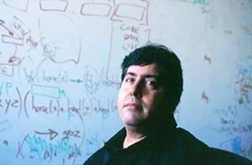
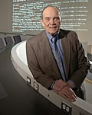

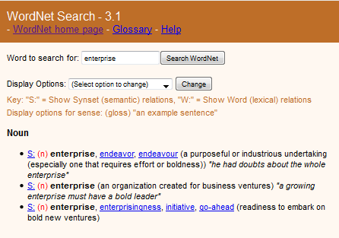
History of Knowledge Bases
Cyc project (1984-1994)
cont‘d by Cycorp Inc.
WordNet project
(1985-now)
Cyc and WordNet
are hand-crafted
knowledge bases
Doug Lenat:
„The more you know, the more
(and faster) you can learn.“
George
Miller
Christiane
Fellbaum
∀ x: human(x) ⇒ male(x) ∨ female(x)
∀ x: (male(x) ⇒ ¬ female(x)) ∧
(female(x) ⇒ ¬ male(x))
∀ x: mammal(x) ⇒ (hasLegs(x)
⇒ isEven(numberOfLegs(x))
x: human(x) ⇒
(∃ y: mother(x,y) ∧ ∃ z: father(x,z))
∀ x ∀ e : human(x) ∧ remembers(x,e)
⇒ happened(e) < now

Slide 6
Some Publicly Available Knowledge Bases
YAGO: yago-knowledge.org
Dbpedia: dbpedia.org
Freebase: freebase.com
Entitycube: research.microsoft.com/en-us/projects/entitycube/
NELL: rtw.ml.cmu.edu
DeepDive: research.cs.wisc.edu/hazy/demos/deepdive/index.php/Steve_Irwin
Probase: research.microsoft.com/en-us/projects/probase/
KnowItAll / ReVerb: openie.cs.washington.edu
reverb.cs.washington.edu
PATTY: www.mpi-inf.mpg.de/yago-naga/patty/
BabelNet: lcl.uniroma1.it/babelnet
WikiNet: www.h-its.org/english/research/nlp/download/wikinet.php
ConceptNet: conceptnet5.media.mit.edu
WordNet: wordnet.princeton.edu
Linked Open Data: linkeddata.org
6

Slide 7
Knowledge for Intelligence
Enabling technology for:
disambiguation in written & spoken natural language
deep reasoning (e.g. QA to win quiz game)
machine reading (e.g. to summarize book or corpus)
semantic search in terms of entities&relations (not keywords&pages)
entity-level linkage for the Web of Data
Politicians who are also scientists?
European composers who have won film music awards?
East coast professors who founded Internet companies?
Relationships between
John Lennon, Billie Holiday, Heath Ledger, King Kong?
Enzymes that inhibit HIV?
Influenza drugs for teens with high blood pressure?
...
7

Slide 8
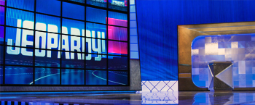
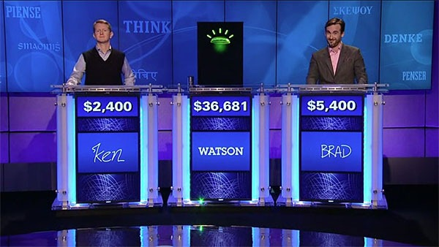


Use Case: Question Answering
This town is known as "Sin City" & its downtown is "Glitter Gulch"
Q: Sin City ?
→ movie, graphical novel, nickname for city, …
A: Vegas ? Strip ?
→ Vega (star), Suzanne Vega, Vincent Vega, Las Vegas, …
→ comic strip, striptease, Las Vegas Strip, …
This American city has two airports
named after a war hero and a WW II battle
question
classification &
decomposition
knowledge
back-ends
D. Ferrucci et al.: Building Watson. AI Magazine, Fall 2010.
IBM Journal of R&D 56(3/4), 2012: This is Watson.
8

Slide 9
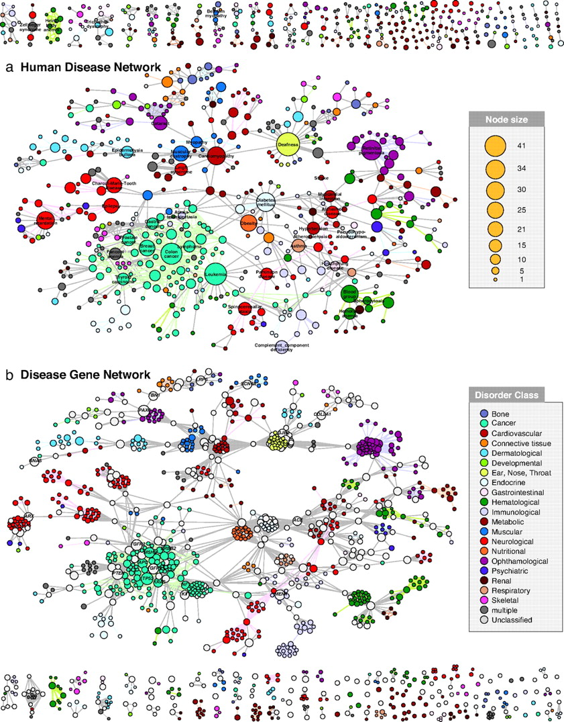

Use Case: Text Analytics
But try this with:
diabetes mellitus, diabetis type 1, diabetes type 2, diabetes insipidus,
insulin-dependent diabetes mellitus with ophthalmic complications,
ICD-10 E23.2, OMIM 304800, MeSH C18.452.394.750, MeSH D003924, …
K.Goh,M.Kusick,D.Valle,B.Childs,M.Vidal,A.Barabasi: The Human Disease Network, PNAS, May 2007

Slide 10
Use Case: Big Data+Text Analytics
Entertainment:
Who covered which other singer?
Who influenced which other musicians?
Health:
Drugs (combinations) and their side effects
Politics:
Politicians‘ positions on controversial topics
and their involvement with industry
Business:
Customer opinions on small-company products,
gathered from social media
General Design Pattern:
Identify relevant contents sources
Identify entities of interest & their relationships
Position in time & space
Group and aggregate
Find insightful patterns & predict trends
10

Slide 11
Spectrum of Machine Knowledge (1)
factual knowledge:
bornIn (SteveJobs, SanFrancisco), hasFounded (SteveJobs, Pixar),
hasWon (SteveJobs, NationalMedalOfTechnology), livedIn (SteveJobs, PaloAlto)
taxonomic knowledge (ontology):
instanceOf (SteveJobs, computerArchitects), instanceOf(SteveJobs, CEOs)
subclassOf (computerArchitects, engineers), subclassOf(CEOs, businesspeople)
lexical knowledge (terminology):
means (“Big Apple“, NewYorkCity), means (“Apple“, AppleComputerCorp)
means (“MS“, Microsoft) , means (“MS“, MultipleSclerosis)
contextual knowledge (entity occurrences, entity-name disambiguation)
maps (“Gates and Allen founded the Evil Empire“,
BillGates, PaulAllen, MicrosoftCorp)
linked knowledge (entity equivalence, entity resolution):
hasFounded (SteveJobs, Apple), isFounderOf (SteveWozniak, AppleCorp)
sameAs (Apple, AppleCorp), sameAs (hasFounded, isFounderOf)
11

Slide 12
Spectrum of Machine Knowledge (2)
multi-lingual knowledge:
meansInChinese („乔戈里峰“, K2), meansInUrdu („کے ٹو“, K2)
meansInFr („école“, school (institution)), meansInFr („banc“, school (of fish))
temporal knowledge (fluents):
hasWon (SteveJobs, NationalMedalOfTechnology)@1985
marriedTo (AlbertEinstein, MilevaMaric)@[6-Jan-1903, 14-Feb-1919]
presidentOf (NicolasSarkozy, France)@[16-May-2007, 15-May-2012]
spatial knowledge:
locatedIn (YumbillaFalls, Peru), instanceOf (YumbillaFalls, TieredWaterfalls)
hasCoordinates (YumbillaFalls, 5°55‘11.64‘‘S 77°54‘04.32‘‘W ),
closestTown (YumbillaFalls, Cuispes), reachedBy (YumbillaFalls, RentALama)
12

Slide 13
Spectrum of Machine Knowledge (3)
ephemeral knowledge (dynamic services):
wsdl:getSongs (musician ?x, song ?y), wsdl:getWeather (city?x, temp ?y)
common-sense knowledge (properties):
hasAbility (Fish, swim), hasAbility (Human, write),
hasShape (Apple, round), hasProperty (Apple, juicy),
hasMaxHeight (Human, 2.5 m)
common-sense knowledge (rules):
∀ x: human(x) ⇒ male(x) ∨ female(x)
∀ x: (male(x) ⇒ ¬ female(x)) ∧ (female(x) ) ⇒ ¬ male(x))
∀ x: human(x) ⇒ (∃ y: mother(x,y) ∧ ∃ z: father(x,z))
∀ x: animal(x) ⇒ (hasLegs(x) ⇒ isEven(numberOfLegs(x))
13

Slide 14

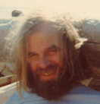
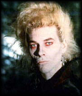

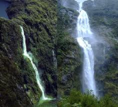





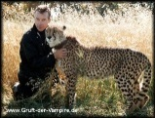
Spectrum of Machine Knowledge (4)
emerging knowledge (open IE):
hasWon (MerylStreep, AcademyAward)
occurs („Meryl Streep“, „celebrated for“, „Oscar for Best Actress“)
occurs („Quentin“, „nominated for“, „Oscar“)
multimodal knowledge (photos, videos):
JimGray
JamesBruceFalls
social knowledge (opinions):
admires (maleTeen, LadyGaga), supports (AngelaMerkel, HelpForGreece)
epistemic knowledge ((un-)trusted beliefs):
believe(Ptolemy,hasCenter(world,earth)), believe(Copernicus,hasCenter(world,sun))
believe (peopleFromTexas, bornIn(BarackObama,Kenya))
✓
?
❒
✓
❒
❒
❒
❒
❒
❒
✓
14

Slide 15
Knowledge Bases in the Big Data Era
Big Data Analytics
Scalable algorithms
Distributed platforms
Discovering data sources
Knowledge
Bases:
entities,
relations,
time, space,
…
Tapping unstructured data
Connecting structured &
unstructured data sources
Making sense of
heterogeneous, dirty,
or uncertain data
15

Slide 16
Outline

Motivation and Overview
Taxonomic Knowledge:
Entities and Classes
Factual Knowledge:
Relations between Entities
Big Data
Methods for
Knowledge
Harvesting
Emerging Knowledge:
New Entities & Relations
Temporal Knowledge:
Validity Times of Facts
Contextual Knowledge:
Entity Name Disambiguation
Knowledge
for Big Data
Analytics
Linked Knowledge:
Entity Matching
Wrap-up
http://www.mpi-inf.mpg.de/yago-naga/sigmod2013-tutorial/

Slide 17
Outline

Motivation and Overview
Taxonomic Knowledge:
Entities and Classes
✶ Scope & Goal
✶ Wikipedia-centric Methods
✶ Web-based Methods
Factual Knowledge:
Relations between Entities
Emerging Knowledge:
New Entities & Relations
Temporal Knowledge:
Validity Time of Facts
Contextual Knowledge:
Entity Name Disambiguation
Linked Knowledge:
Entity Matching
Wrap-up
http://www.mpi-inf.mpg.de/yago-naga/sigmod2013-tutorial/

Slide 18
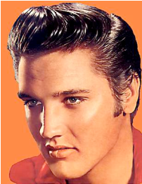
Knowledge Bases are labeled graphs
resource
subclassOf
subclassOf
Classes/
Concepts/
Types
person
location
subclassOf
singer
city
type
Relations/
Predicates
type
bornIn
Instances/
entities
Tupelo
A knowledge base can be seen as a directed labeled multi-graph,
where the nodes are entities and the edges relations.
18

Slide 19
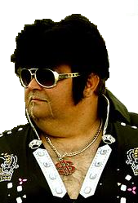
An entity can have different labels
The same entity
has two labels:
synonymy
person
singer
The same label for two entities:
ambiguity
type
type
label
label
“The King”
“Elvis”
19

Slide 20
Different views of a knowledge base
Triple notation:
We use "RDFS Ontology" and "Knowledge Base (KB)"
synonymously.
Subject | Predicate | Object
Elvis | type | singer
Elvis | bornIn | Tupelo
... | ... | ...
Graph notation:
singer
type
Logical notation:
bornIn
Tupelo
type(Elvis, singer)
bornIn(Elvis,Tupelo)
...
20

Slide 21
Our Goal is finding classes and instances
Which classes exist?
(aka entity types, unary predicates, concepts)
person
subclassOf
Which subsumptions hold?
singer
type
Which entities belong to which classes?
Which entities exist?
21

Slide 22


WordNet is a lexical knowledge base
living being
WordNet contains
82,000 classes
subclassOf
label
person
subclassOf
WordNet contains
thousands of subclassOf
relationships
“person”
singer
“individual”
“soul”
WordNet project
(1985-now)
WordNet contains
118,000 class labels
22

Slide 23
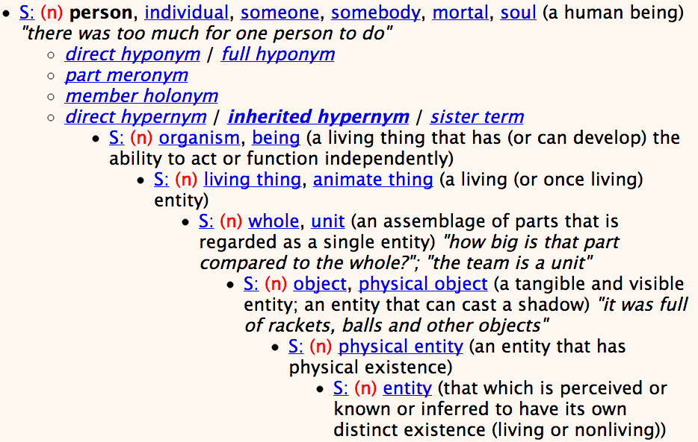
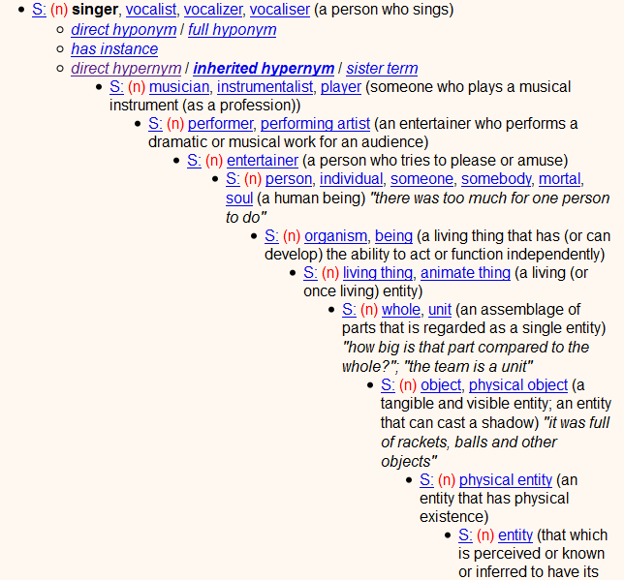
WordNet example: superclasses
23

Slide 24
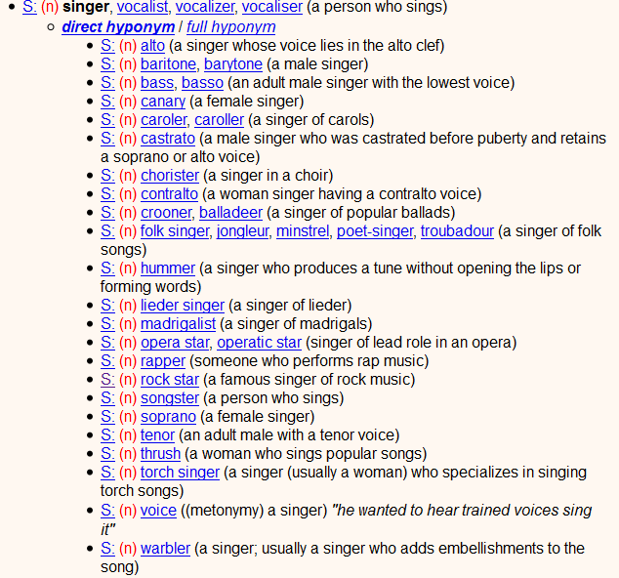
WordNet example: subclasses
24

Slide 25
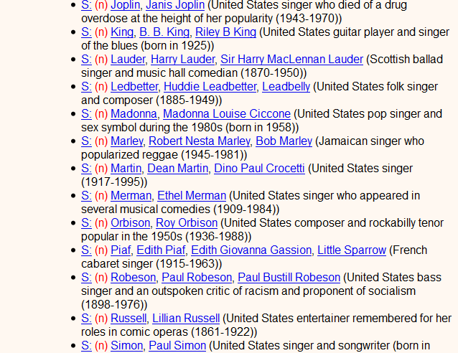
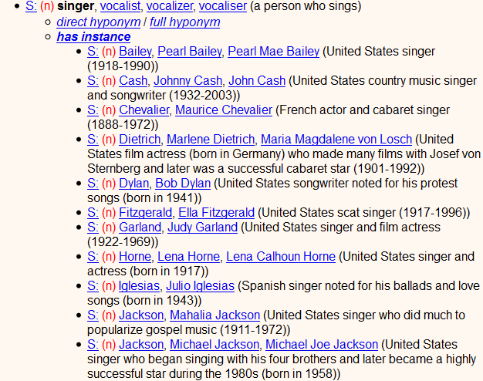
WordNet example: instances
only 32 singers !?
4 guitarists
5 scientists
0 enterprises
2 entrepreneurs
WordNet classes
lack instances 
25

Slide 26
Goal is to go beyond WordNet
WordNet is not perfect:
it contains only few instances
it contains only common nouns as classes
it contains only English labels
... but it contains a wealth of information that can be the starting point for further extraction.
26

Slide 27
Outline

Motivation and Overview
Taxonomic Knowledge:
Entities and Classes
 Basics & Goal
✶ Wikipedia-centric Methods
✶ Web-based Methods
Factual Knowledge:
Relations between Entities
Emerging Knowledge:
New Entities & Relations
Temporal Knowledge:
Validity Times of Facts
Contextual Knowledge:
Entity Name Disambiguation
Linked Knowledge:
Entity Matching
Wrap-up
http://www.mpi-inf.mpg.de/yago-naga/sigmod2013-tutorial/

Slide 28

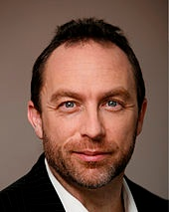
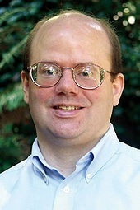
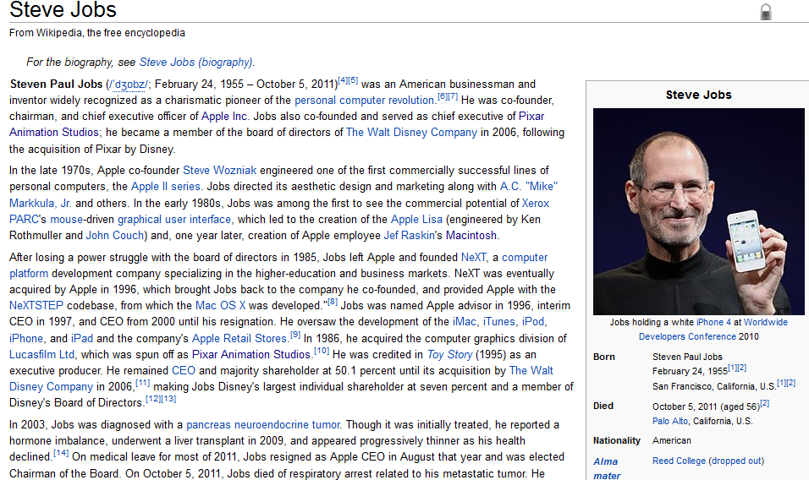
Wikipedia is a rich source of instances
Jimmy
Wales
Larry
Sanger
28

Slide 29
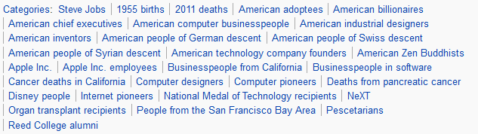
Wikipedia's categories contain classes
But: categories do not form a taxonomic hierarchy
29

Slide 30
Link Wikipedia categories to WordNet?
American billionaires
Technology company founders
Apple Inc.
Deaths from cancer
Internet pioneers
tycoon, magnate
entrepreneur
?
pioneer, innovator
?
pioneer, colonist
Wikipedia categories
WordNet classes
30

Slide 31
Categories can be linked to WordNet
singer
gr. person
person
people
descent
WordNet
“singer”
“person”
“people”
“descent”
Most
frequent
meaning
Head has to be plural
person
Stemming
pre-modifier
head
post-modifier
Noungroup
parsing
American people of Syrian descent
American people of Syrian descent
Wikipedia
31

Slide 32

YAGO = WordNet+Wikipedia
Related project:
WikiTaxonomy
105,000 subclassOf links
88% accuracy
[Ponzetto & Strube: AAAI‘07]
200,000 classes
460,000 subclassOf
3 Mio. instances
96% accuracy
[Suchanek: WWW‘07]
organism
subclassOf
WordNet
person
subclassOf
American people of Syrian descent
Wikipedia
type
Steve Jobs
32

Slide 33
Link Wikipedia & WordNet by Random Walks
construct neighborhood around source and target nodes
use contextual similarity (glosses etc.) as edge weights
compute personalized PR (PPR) with source as start node
rank candidate targets by their PPR scores
Michael
Schumacher
causal
agent
{driver, operator
of vehicle}
motor
racing
chauffeur
tool
Formula One
drivers
race driver
Barney
Oldfield
trucker
computer
program
Formula One
champions
{driver,
device driver}
truck
drivers
Wikipedia categories
WordNet classes
[Navigli 2010]
33

Slide 34
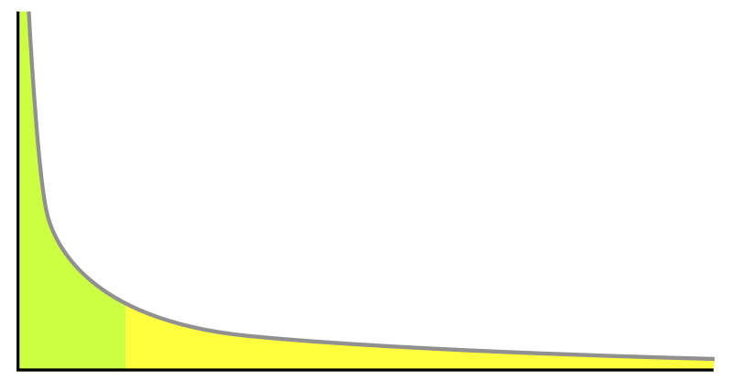
Learning More Mappings [ Wu & Weld: WWW‘08 ]
Kylin Ontology Generator (KOG):
learn classifier for subclassOf across Wikipedia & WordNet using
  YAGO as training data
  advanced ML methods (SVM‘s, MLN‘s)
  rich features from various sources
category/class name similarity measures
category instances and their infobox templates:
template names, attribute names (e.g. knownFor)
Wikipedia edit history:
refinement of categories
Hearst patterns:
C such as X, X and Y and other C‘s, …
other search-engine statistics:
co-occurrence frequencies
> 3 Mio. entities
> 1 Mio. w/ infoboxes
> 500 000 categories
34

Slide 35
Outline

Motivation and Overview
Taxonomic Knowledge:
Entities and Classes
 Basics & Goal
 Wikipedia-centric Methods
✶ Web-based Methods
Factual Knowledge:
Relations between Entities
Emerging Knowledge:
New Entities & Relations
Temporal Knowledge:
Validity Times of Facts
Contextual Knowledge:
Entity Name Disambiguation
Linked Knowledge:
Entity Matching
Wrap-up
http://www.mpi-inf.mpg.de/yago-naga/sigmod2013-tutorial/
35

Slide 36
Hearst patterns extract instances from text
[M. Hearst 1992]
Goal: find instances of classes
Hearst defined lexico-syntactic patterns for type relationship:
  X such as Y; X like Y;
  X and other Y; X including Y;
  X, especially Y;
  Find such patterns in text: //better with POS tagging
  companies such as Apple
  Google, Microsoft and other companies
  Internet companies like Amazon and Facebook
  Chinese cities including Kunming and Shangri-La
  computer pioneers like the late Steve Jobs
  computer pioneers and other scientists
  lakes in the vicinity of Brisbane
Derive type(Y,X)
type(Apple, company), type(Google, company), ...
36

Slide 37
Recursively applied patterns increase recall
[Kozareva/Hovy 2010]
use results from Hearst patterns as seeds
then use „parallel-instances“ patterns
X such as Y
companies such as Apple
companies such as Google
Y like Z
*, Y and Z
Apple like Microsoft offers
IBM, Google, and Amazon
Y like Z
*, Y and Z
Microsoft like SAP sells
eBay, Amazon, and Facebook
Y like Z
*, Y and Z
Cherry, Apple, and Banana
potential problems with ambiguous words
37

Slide 38
Doubly-anchored patterns are more robust
[Kozareva/Hovy 2010, Dalvi et al. 2012]
Goal:
find instances of classes
Start with a set of seeds:
companies = {Microsoft, Google}
Parse Web documents and find the pattern
W, Y and Z
If two of three placeholders match seeds, harvest the third:
Google, Microsoft and Amazon
type(Amazon, company)
Cherry, Apple, and Banana
38

Slide 39
Instances can be extracted from tables
[Kozareva/Hovy 2010, Dalvi et al. 2012]
Goal: find instances of classes
Start with a set of seeds:
cities = {Paris, Shanghai, Brisbane}
Parse Web documents and find tables
Paris France
Shanghai China
Berlin Germany
London UK
Paris Iliad
Helena Iliad
Odysseus Odysee
Rama Mahabaratha
If at least two seeds appear in a column, harvest the others:
type(Berlin, city)
type(London, city)
39

Slide 40
Extracting instances from lists & tables
[Etzioni et al. 2004, Cohen et al. 2008, Mitchell et al. 2010]
State-of-the-Art Approach (e.g. SEAL):
Start with seeds: a few class instances
Find lists, tables, text snippets (“for example: …“), …
that contain one or more seeds
Extract candidates: noun phrases from vicinity
Gather co-occurrence stats (seed&cand, cand&className pairs)
Rank candidates
  point-wise mutual information, …
  random walk (PR-style) on seed-cand graph
Caveats:
Precision drops for classes with sparse statistics (IR profs, …)
Harvested items are names, not entities
Canonicalization (de-duplication) unsolved
40

Slide 41
Probase builds a taxonomy from the Web
Use Hearst liberally to obtain many instance candidates:
„plants such as trees and grass“
„plants include water turbines“
„western movies such as The Good, the Bad, and the Ugly“
Problem: signal vs. noise
Assess candidate pairs statistically:
P[X|Y] >> P[X*|Y] → subclassOf(Y X)
Problem: ambiguity of labels
Merge labels of same class:
X such as Y₁ and Y₂ → same sense of X
ProBase
2.7 Mio. classes from
1.7 Bio. Web pages
[Wu et al.: SIGMOD 2012]
41

Slide 42
Use query logs to refine taxonomy
[Pasca 2011]
Input:
type(Y, X₁), type(Y, X₂), type(Y, X₃), e.g, extracted from Web
Goal: rank candidate classes X₁, X₂, X₃
Combine the following scores to rank candidate classes:
H1: X and Y should co-occur frequently in queries
→ score1(X) ∼ freq(X,Y) * #distinctPatterns(X,Y)
H2: If Y is ambiguous, then users will query X Y:
→ score2(X) ∼ (∏_{i=1..N} term-score(t_{i}∈X))^{1/N}
example query: "Michael Jordan computer scientist"
H3: If Y is ambiguous, then users will query first X, then X Y:
→ score3(X) ∼ (∏_{i=1..N} term-session-score(t_{i}∈X))^{1/N}
42

Slide 43
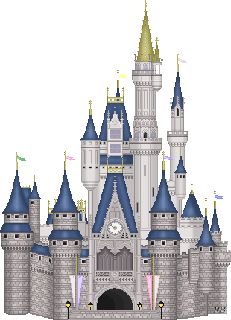
Take-Home Lessons
Semantic classes for entities
> 10 Mio. entities in 100,000‘s of classes
backbone for other kinds of knowledge harvesting
great mileage for semantic search
e.g. politicians who are scientists,
French professors who founded Internet companies, …
Variety of methods
noun phrase analysis, random walks, extraction from tables, …
Still room for improvement
higher coverage, deeper in long tail, …
43

Slide 44


Open Problems and Grand Challenges
Wikipedia categories reloaded: larger coverage
comprehensive & consistent instanceOf and subClassOf
across Wikipedia and WordNet
e.g. people lost at sea, ACM Fellow,
Jewish physicists emigrating from Germany to USA, …
Long tail of entities
beyond Wikipedia: domain-specific entity catalogs
e.g. music, books, book characters, electronic products, restaurants, …
New name for known entity vs. new entity?
e.g. Lady Gaga vs. Radio Gaga vs. Stefani Joanne Angelina Germanotta
Universal solution for taxonomy alignment
e.g. Wikipedia‘s, dmoz.org, baike.baidu.com, amazon, librarything tags, …
44

Slide 45
Outline

Motivation and Overview

Taxonomic Knowledge:
Entities and Classes
Factual Knowledge:
Relations between Entities
✶ Scope & Goal
✶ Regex-based Extraction
✶ Pattern-based Harvesting
✶ Consistency Reasoning
✶ Probabilistic Methods
✶ Web-Table Methods
Emerging Knowledge:
New Entities & Relations
Temporal Knowledge:
Validity Times of Facts
Contextual Knowledge:
Entity Name Disambiguation
Linked Knowledge:
Entity Matching
Wrap-up
http://www.mpi-inf.mpg.de/yago-naga/sigmod2013-tutorial/

Slide 46
We focus on given binary relations
Given binary relations with type signature
  hasAdvisor: Person × Person
  graduatedAt: Person × University
  hasWonPrize: Person × Award
  bornOn: Person × Date
...find instances of these relations
  hasAdvisor (JimGray, MikeHarrison)
  hasAdvisor (HectorGarcia-Molina, Gio Wiederhold)
  hasAdvisor (Susan Davidson, Hector Garcia-Molina)
  graduatedAt (JimGray, Berkeley)
  graduatedAt (HectorGarcia-Molina, Stanford)
  hasWonPrize (JimGray, TuringAward)
  bornOn (JohnLennon, 9-Oct-1940)
46

Slide 47
IE can tap into different sources
Information Extraction (IE) from:
Semi-structured data
  “Low-Hanging Fruit”
    Wikipedia infoboxes & categories
    HTML lists & tables, etc.
Free text
  “Cherrypicking”
    Hearst patterns & other shallow NLP
    Iterative pattern-based harvesting
    Consistency reasoning
Web tables
47

Slide 48
Source-centric IE vs. Yield-centric IE
Source-centric IE
Document 1:
  instanceOf (Surajit, scientist)
  inField (Surajit, c.science)
  almaMater (Surajit, Stanford U)
  …
Surajit
obtained his
PhD in CS from
Stanford ...
1) recall !
2) precision
one source
Yield-centric IE
hasAdvisor
Student Advisor
Surajit Chaudhuri Jeffrey Ullman
Jim Gray Mike Harrison
… …
+ (optional)
targeted
relations
1) precision !
2) recall
worksAt
Student University
Surajit Chaudhuri Stanford U
Jim Gray UC Berkeley
… …
many sources
48

Slide 49
We focus on yield-centric IE
Yield-centric IE
hasAdvisor
Student Advisor
Surajit Chaudhuri Jeffrey Ullman
Jim Gray Mike Harrison
… …
+ (optional)
targeted
relations
1) precision !
2) recall
worksAt
Student University
Surajit Chaudhuri Stanford U
Jim Gray UC Berkeley
… …
many sources
49

Slide 50
Outline

Motivation and Overview

Taxonomic Knowledge:
Entities and Classes
Factual Knowledge:
Relations between Entities
 Scope & Goal
✶ Regex-based Extraction
✶ Pattern-based Harvesting
✶ Consistency Reasoning
✶ Probabilistic Methods
✶ Web-Table Methods
Emerging Knowledge:
New Entities & Relations
Temporal Knowledge:
Validity Times of Facts
Contextual Knowledge:
Entity Name Disambiguation
Linked Knowledge:
Entity Matching
Wrap-up
http://www.mpi-inf.mpg.de/yago-naga/sigmod2013-tutorial/

Slide 51
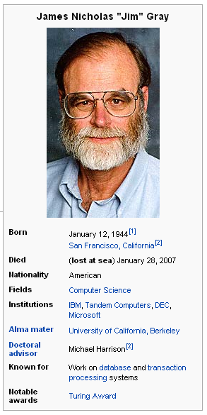
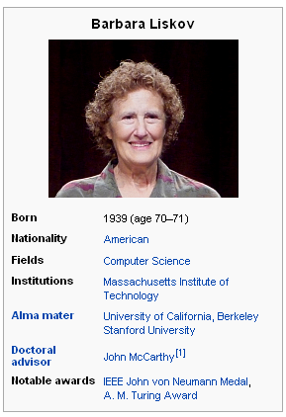
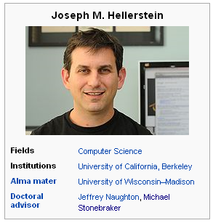
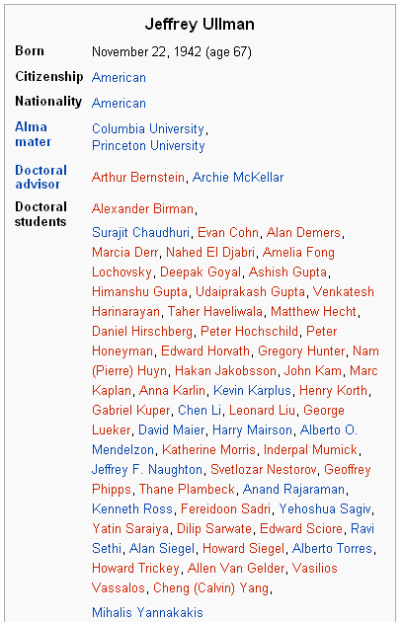
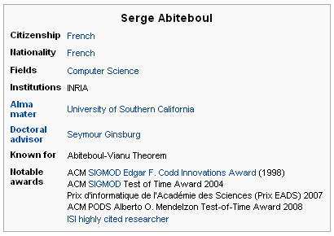
Wikipedia provides data in infoboxes
51

Slide 52
Wikipedia uses a Markup Language
{{Infobox scientist
| name = James Nicholas "Jim" Gray
| birth_date = {{birth date|1944|1|12}}
| birth_place = [[San Francisco, California]]
| death_date = ('''lost at sea''')
{{death date|2007|1|28|1944|1|12}}
| nationality = American
| field = [[Computer Science]]
| alma_mater = [[University of California,
Berkeley]]
| advisor = Michael Harrison
...
52

Slide 53
Infoboxes are harvested by RegEx
{{Infobox scientist
| name = James Nicholas "Jim" Gray
| birth_date = {{birth date|1944|1|12}}
Use regular expressions
to detect dates
to detect links
to detect numeric expressions
\{\{birth date \|(\d+)\|(\d+)\|(\d+)\}\}
\[\[([^\|\]]+)
(\d+)(\.\d+)?(in|inches|")
53

Slide 54
Infoboxes are harvested by RegEx
{{Infobox scientist
| name = James Nicholas "Jim" Gray
| birth_date = {{birth date|1944|1|12}}
Map attribute to canoncial, predefined
relation
(manually or
crowd-sourced)
Extract data item by
regular expression
wasBorn
1944-01-12
wasBorn(Jim_Gray, "1944-01-12")
54

Slide 55
Learn how articles express facts
James "Jim" Gray (born January 12, 1944
find attribute value
in full text
learn pattern
XYZ (born MONTH DAY, YEAR
55

Slide 56
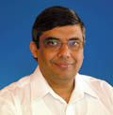
Extract from articles w/o infobox
Name: R.Agrawal
Birth date: ?
Rakesh Agrawal (born April 31, 1965) ...
propose
attribute value...
apply
pattern
XYZ (born MONTH DAY, YEAR
... and/or build fact
bornOnDate(R.Agrawal,1965-04-31)
[Wu et al. 2008: "KYLIN"]
56

Slide 57
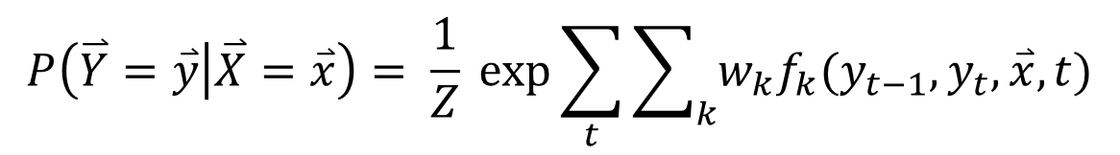
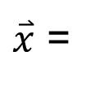
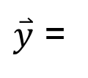
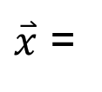
Use CRF to express patterns
$\overset{⃑}{x}$ =
James "Jim" Gray (born January 12, 1944
$\overset{⃑}{x}$ =
James "Jim" Gray (born in January, 1944
$\overset{⃑}{y}$ =
OTH OTH OTH OTH OTH VAL VAL
$$P\left(\overset{⃑}{Y}=\overset{⃑}{y} | \overset{⃑}{X}=\overset{⃑}{x}\right)= \frac{1}{Z} exp\sum_{t}{\sum_{k}{w_{k}f_{k}(y_{t−1}, y_{t}, \overset{⃑}{x}, t)}}$$
Features can take into account
  token types (numeric, capitalization, etc.)
  word windows preceding and following position
  deep-parsing dependencies
  first sentence of article
  membership in relation-specific lexicons
[R. Hoffmann et al. 2010: "Learning 5000 Relational Extractors]
57

Slide 58
Outline

Motivation and Overview

Taxonomic Knowledge:
Entities and Classes
Factual Knowledge:
Relations between Entities
 Scope & Goal
 Regex-based Extraction
✶ Pattern-based Harvesting
✶ Consistency Reasoning
✶ Probabilistic Methods
✶ Web-Table Methods
Emerging Knowledge:
New Entities & Relations
Temporal Knowledge:
Validity Times of Facts
Contextual Knowledge:
Entity Name Disambiguation
Linked Knowledge:
Entity Matching
Wrap-up
http://www.mpi-inf.mpg.de/yago-naga/sigmod2013-tutorial/

Slide 59
Facts yield patterns – and vice versa
Facts
& Fact Candidates
Patterns
(JimGray, MikeHarrison)
X and his advisor Y
(BarbaraLiskov, JohnMcCarthy)
X under the guidance of Y
(Surajit, Jeff)
(Alon, Jeff)
X and Y in their paper
(Sunita, Mike)
X co-authored with Y
(Renee, Yannis)
X rarely met his advisor Y
(Sunita, Soumen)
…
good for recall
noisy, drifting
not robust enough
for high precision
(Soumen, Sunita)
(Surajit, Moshe)
(Alon, Larry)
(Surajit, Microsoft)
59

Slide 60
Statistics yield pattern assessment
Support of pattern p:
# occurrences of p with seeds (e1,e2)
# occurrences of all patterns with seeds
Confidence of pattern p:
# occurrences of p with seeds (e1,e2)
# occurrences of p
Confidence of fact candidate (e1,e2):
Σ_{p} freq(e1,p,e2)*conf(p) / Σ_{p} freq(e1,p,e2)
freq(e1,e2)
or: PMI (e1,e2) = log
freq(e1) freq(e2)
gathering can be iterated,
can promote best facts to additional seeds for next round
60
Notes:
can use onto service for various purposes
...
heuristically map Web queries onto search interfaces of Deep Web portals, for example, query forms for sheetmusic like this;
as a Web Service it looks like this,
but key problem is what to do with query flute if interface has no general-purpose keyword field but rather has specific parameters like instrument, category, style, etc.

Slide 61
Negative Seeds increase precision
(Ravichandran 2002; Suchanek 2006; ...)
Problem: Some patterns have high support, but poor precision:
X is the largest city of Y for isCapitalOf (X,Y)
joint work of X and Y for hasAdvisor (X,Y)
Idea: Use positive and negative seeds:
pos. seeds: (Paris, France), (Rome, Italy), (New Delhi, India), ...
neg. seeds: (Sydney, Australia), (Istanbul, Turkey), ...
Compute the confidence of a pattern as:
# occurrences of p with pos. seeds
# occurrences of p with pos. seeds or neg. seeds
can promote best facts to additional seeds for next round
can promote rejected facts to additional counter-seeds
works more robustly with few seeds & counter-seeds
61
Notes:
can use onto service for various purposes
...
heuristically map Web queries onto search interfaces of Deep Web portals, for example, query forms for sheetmusic like this;
as a Web Service it looks like this,
but key problem is what to do with query flute if interface has no general-purpose keyword field but rather has specific parameters like instrument, category, style, etc.

Slide 62
Generalized patterns increase recall
(N. Nakashole 2011)
Problem: Some patterns are too narrow and thus have small recall:
X and his celebrated advisor Y
X carried out his doctoral research in math under the supervision of Y
X received his PhD degree in the CS dept at Y
X obtained his PhD degree in math at Y
Idea: generalize patterns to n-grams, allow POS tags
Compute
n-gram-sets
by frequent
sequence
mining
X { his doctoral research, under the supervision of} Y
X { PRP ADJ advisor } Y
X { PRP doctoral research, IN DET supervision of} Y
Compute match quality of pattern p with sentence q by Jaccard:
|{n-grams ∈ p} ∩ {n-grams ∈ q]|
|{n-grams ∈ p} ∪ {n-grams ∈ q]|
=> Covers more sentences, increases recall
62

Slide 63
Deep Parsing makes patterns robust
(Bunescu 2005 , Suchanek 2006, …)
Problem: Surface patterns fail if the text shows variations
  Cologne lies on the banks of the Rhine.
  Paris, the French capital, lies on the beautiful banks of the Seine.
Idea: Use deep linguistic parsing to define patterns
Cologne lies on the banks of the Rhine
Ss
MVp
DMc
Mp
Dg
Jp
Js
Deep linguistic patterns work even on sentences with variations
Paris, the French capital, lies on the beautiful banks of the Seine
63
Notes:
can use onto service for various purposes
...
heuristically map Web queries onto search interfaces of Deep Web portals, for example, query forms for sheetmusic like this;
as a Web Service it looks like this,
but key problem is what to do with query flute if interface has no general-purpose keyword field but rather has specific parameters like instrument, category, style, etc.

Slide 64
Outline

Motivation and Overview

Taxonomic Knowledge:
Entities and Classes
Factual Knowledge:
Relations between Entities
 Scope & Goal
 Regex-based Extraction
 Pattern-based Harvesting
✶ Consistency Reasoning
✶ Probabilistic Methods
✶ Web-Table Methods
Emerging Knowledge:
New Entities & Relations
Temporal Knowledge:
Validity Times of Facts
Contextual Knowledge:
Entity Name Disambiguation
Linked Knowledge:
Entity Matching
Wrap-up
http://www.mpi-inf.mpg.de/yago-naga/sigmod2013-tutorial/

Slide 65
Extending a KB faces 3+ challenges
(F. Suchanek et al.: WWW‘09)
Problem: If we want to extend a KB, we face (at least) 3 challenges
1. Understand which relations are expressed by patterns
"x is married to y“ ∼ spouse(x,y)
2. Disambiguate entities
"Hermione is married to Ron": "Ron" = RonaldReagan?
3. Resolve inconsistencies
spouse(Hermione, Reagan) & spouse(Reagan,Davis) ?
"Hermione is married to Ron"
type (Reagan, president)
spouse (Reagan, Davis)
spouse (Elvis,Priscilla)
?
65

Slide 66
SOFIE transforms IE to logical rules
(F. Suchanek et al.: WWW‘09)
Idea: Transform corpus to surface statements
"Hermione is married to Ron"
occurs("Hermione", "is married to", "Ron")
Add possible meanings for all words from the KB
means("Ron", RonaldReagan)
Only one of these
can be true
means("Ron", RonWeasley)
means("Hermione", HermioneGranger)
means(X,Y) & means(X,Z) ⇒ Y=Z
Add pattern deduction rules
occurs(X,P,Y) & means(X,X') & means(Y,Y') & R(X',Y') ⇒ P~R
occurs(X,P,Y) & means(X,X') & means(Y,Y') & P~R ⇒ R(X',Y')
Add semantic constraints (manually)
spouse(X,Y) & spouse(X,Z) ⇒ Y=Z
66

Slide 67
The rules deduce meanings of patterns
(F. Suchanek et al.: WWW‘09)
type(Reagan, president)
spouse(Reagan, Davis)
spouse(Elvis,Priscilla)
"Elvis is married to Priscilla"
"is married to“ ~ spouse
Add pattern deduction rules
occurs(X,P,Y) & means(X,X') & means(Y,Y') & R(X',Y') ⇒ P~R
occurs(X,P,Y) & means(X,X') & means(Y,Y') & P~R ⇒ R(X',Y')
Add semantic constraints (manually)
spouse(X,Y) & spouse(X,Z) ⇒ Y=Z
67

Slide 68
The rules deduce facts from patterns
(F. Suchanek et al.: WWW‘09)
type(Reagan, president)
spouse(Reagan, Davis)
spouse(Elvis,Priscilla)
"Hermione is married to Ron"
"is married to“ ~ married
spouse(Hermione,RonaldReagan)
spouse(Hermione,RonWeasley)
Add pattern deduction rules
occurs(X,P,Y) & means(X,X') & means(Y,Y') & R(X',Y') ⇒ P~R
occurs(X,P,Y) & means(X,X') & means(Y,Y') & P~R ⇒ R(X',Y')
Add semantic constraints (manually)
spouse(X,Y) & spouse(X,Z) ⇒ Y=Z
68

Slide 69
The rules remove inconsistencies
(F. Suchanek et al.: WWW‘09)
type(Reagan, president)
spouse(Reagan, Davis)
spouse(Elvis,Priscilla)
spouse(Hermione,RonaldReagan)
spouse(Hermione,RonWeasley)
Add pattern deduction rules
occurs(X,P,Y) & means(X,X') & means(Y,Y') & R(X',Y') ⇒ P~R
occurs(X,P,Y) & means(X,X') & means(Y,Y') & P~R ⇒ R(X',Y')
Add semantic constraints (manually)
spouse(X,Y) & spouse(X,Z) ⇒ Y=Z
69

Slide 70
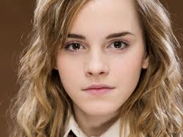
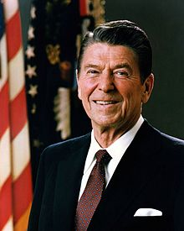
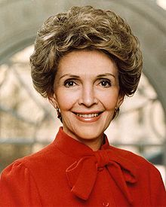

The rules pose a weighted MaxSat problem
(F. Suchanek et al.: WWW‘09)
We are given a set of rules/facts, and wish
to find the most plausible
possible world.
type(Reagan, president) [10]
married(Reagan, Davis) [10]
married(Elvis,Priscilla) [10]
spouse(X,Y) & spouse(X,Z) => Y=Z [10]
occurs("Hermione","loves","Harry") [3]
means("Ron",RonaldReagan) [3]
means("Ron",RonaldWeasley) [2]
...
Possible World 1:
Possible World 2:
married
married
Weight of satisfied rules: 30
Weight of satisfied rules: 39

Slide 71
PROSPERA parallelizes the extraction
(N. Nakashole et al.: WSDM‘11)
Mining the pattern occurrences is embarassingly parallel
occurs()
occurs()
occurs()
Reasoning is hard to parallelize as atoms depends on other atoms
spouse()
loves()
occurs()
means()
Idea: parallelize along min-cuts
loves()
means()
71

Slide 72
Outline

Motivation and Overview

Taxonomic Knowledge:
Entities and Classes
Factual Knowledge:
Relations between Entities
 Scope & Goal
 Regex-based Extraction
 Pattern-based Harvesting
 Consistency Reasoning
✶ Probabilistic Methods
✶ Web-Table Methods
Emerging Knowledge:
New Entities & Relations
Temporal Knowledge:
Validity Times of Facts
Contextual Knowledge:
Entity Name Disambiguation
Linked Knowledge:
Entity Matching
Wrap-up
http://www.mpi-inf.mpg.de/yago-naga/sigmod2013-tutorial/

Slide 73
Markov Logic generalizes MaxSat reasoning
(M. Richardson / P. Domingos 2006)
In a Markov Logic Network (MLN), every atom is represented by a Boolean random variable.
spouse()
loves()
X2
X1
occurs()
X3
means()
X4
loves()
X5
means()
means()
X6
X7
73

Slide 74
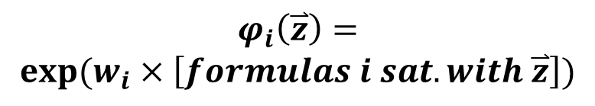
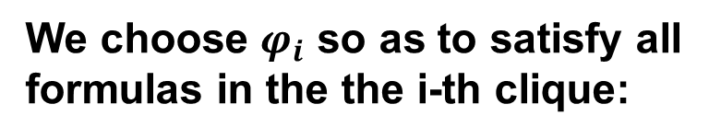
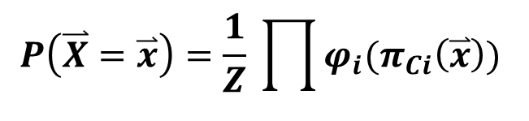
Dependencies in an MLN are limited
The value of a random variable $X_{i}$depends only on its neighbors:
$$P\left(X_{i} | X_{1},…,X_{i−1}, X_{i+1},…,X_{n}\right)=P(X_{i}|N\left(X_{i}\right))$$
The Hammersley-Clifford Theorem tells us:
$$P\left(\overset{⃑}{X}=\overset{⃑}{x}\right)=\frac{1}{Z} \prod{φ_{i}(π_{Ci}\left(\overset{⃑}{x}\right))}$$
X2
X1
We choose $φ_{i}$ so as to satisfy all formulas in the the i-th clique:
X3
$$φ_{i}\left(\overset{⃑}{z}\right)=$$
$$exp⁡(w_{i}×\left[formulas i sat. with \overset{⃑}{z}\right])$$
X4
X5
X6
X7
74

Slide 75
There are many methods for MLN inference
To compute the values that maximize the joint probability
(MAP = maximum a posteriori) we can use a variety of methods:
  Gibbs sampling, other MCMC, belief propagation,
  randomized MaxSat, …
In addition, the MLN can model/compute
marginal probabilities
the joint distribution
X2
X1
X3
X4
X5
X6
X7
75

Slide 76
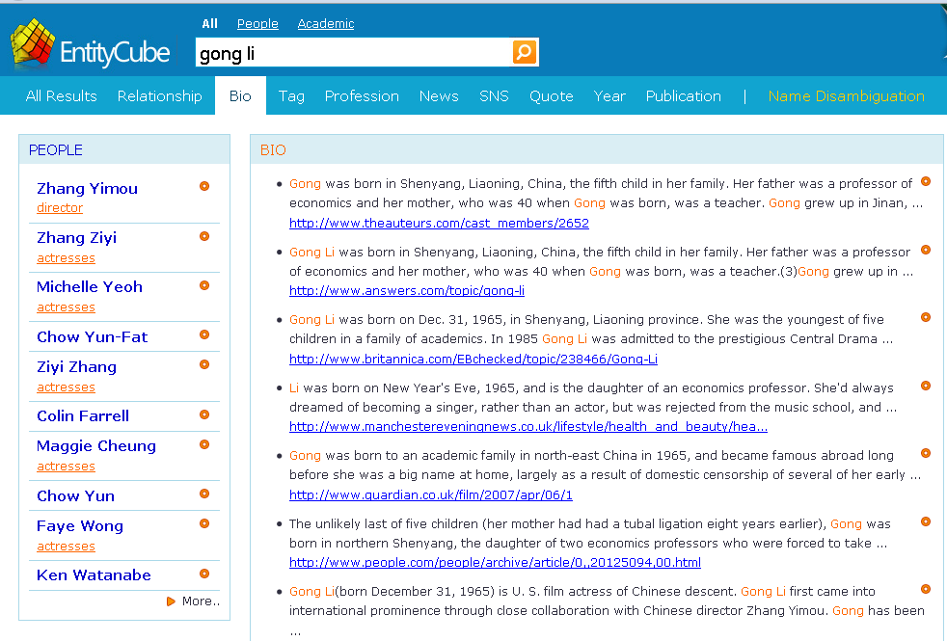
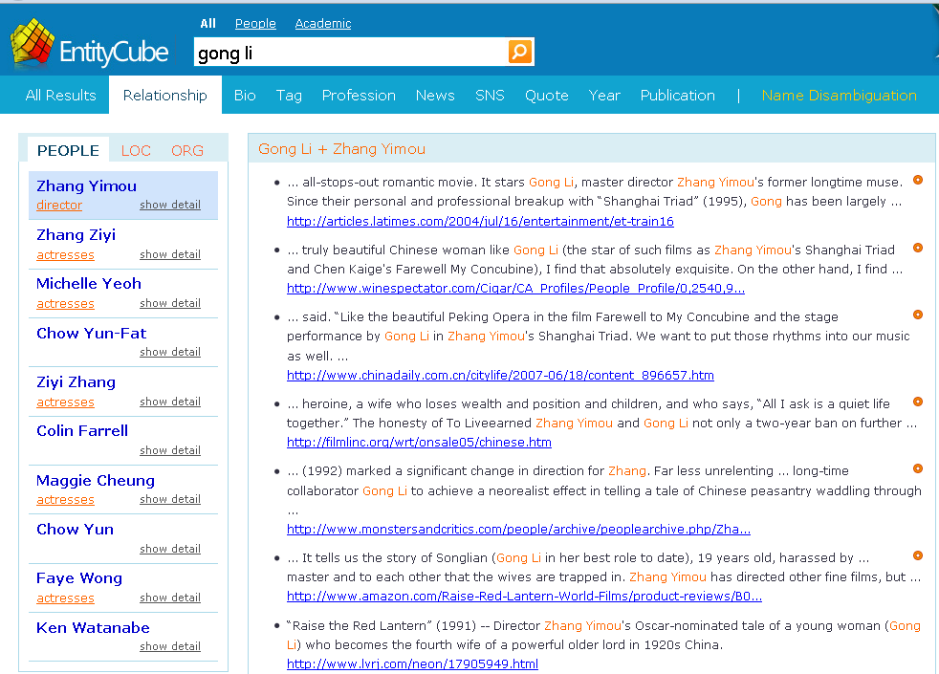
Large-Scale Fact Extraction with MLNs
[J. Zhu et al.: WWW‘09]
StatSnowball:
start with seed facts and initial MLN model
iterate:
  extract facts
  generate and select patterns
  refine and re-train MLN model (plus CRFs plus …)
BioSnowball:
automatically creating biographical summaries
renlifang.msra.cn / entitycube.research.microsoft.com
76

Slide 77
NELL couples different learners
[Carlson et al. 2010]
Initial Ontology
Table Extractor
Krzewski Blue Angels
Miller Red Angels
Natural Language
Pattern Extractor
Krzewski coaches the Blue Devils.
Mutual exclusion
sports coach != scientist
Type Check
If I coach, am I a coach?
http://rtw.ml.cmu.edu/rtw/
77

Slide 78
Outline

Motivation and Overview

Taxonomic Knowledge:
Entities and Classes
Factual Knowledge:
Relations between Entities
 Scope & Goal
 Regex-based Extraction
 Pattern-based Harvesting
 Consistency Reasoning
 Probabilistic Methods
✶ Web-Table Methods
Emerging Knowledge:
New Entities & Relations
Temporal Knowledge:
Validity Times of Facts
Contextual Knowledge:
Entity Name Disambiguation
Linked Knowledge:
Entity Matching
Wrap-up
http://www.mpi-inf.mpg.de/yago-naga/sigmod2013-tutorial/

Slide 79
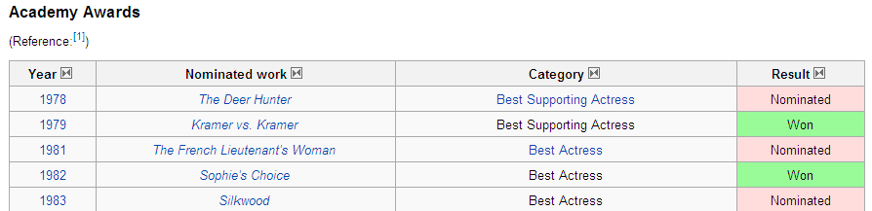
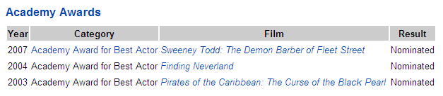
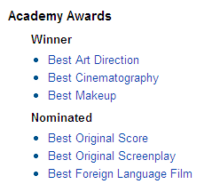
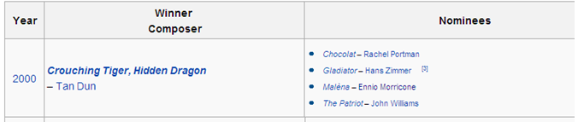
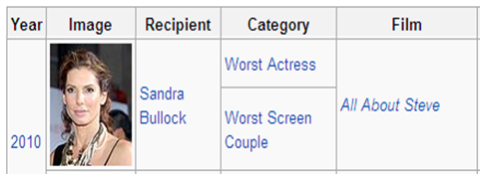
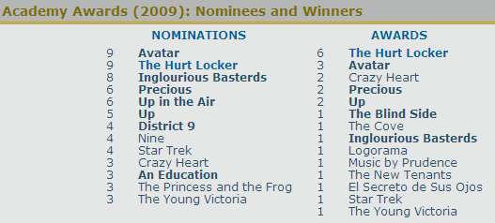
Web Tables provide relational information
[Cafarella et al: PVLDB 08; Sarawagi et al: PVLDB 09]
79

Slide 80
Web Tables can be annotated with YAGO
[Limaye, Sarawagi, Chakrabarti: PVLDB 10]
Goal: enable semantic search over Web tables
Idea:
Map column headers to Yago classes,
Map cell values to Yago entities
Using joint inference for factor-graph learning model
Title
Author
Entity
Hitchhiker's guide
D Adams
A short history of time
S Hawkins
Book
Person
hasAuthor
80

Slide 81
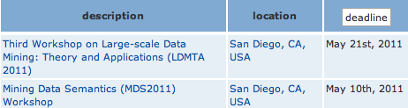

Statistics yield semantics of Web tables
Conference
City
Idea: Infer classes from co-occurrences, headers are class names
$$P\left(class | {val}_{1},…,{val}_{n}\right)= \prod{\frac{P(class|{val}_{i})}{P(class)}}$$
Result from 12 Mio. Web tables:
1.5 Mio. labeled columns (=classes)
155 Mio. instances (=values)
[Venetis,Halevy et al: PVLDB 11]
81

Slide 82
Statistics yield semantics of Web tables
Idea: Infer facts from table rows, header identifies relation name
hasLocation(ThirdWorkshop, SanDiego)
but: classes&entities not canonicalized. Instances may include:
Google Inc., Google, NASDAQ GOOG, Google search engine, …
Jet Li, Li Lianjie, Ley Lin Git, Li Yangzhong, Nameless hero, …
82

Slide 83
Take-Home Lessons
Bootstrapping works well for recall
but details matter: seeds, counter-seeds,
pattern language, statistical confidence, etc.
For high precision, consistency reasoning is crucial:
various methods incl. MaxSat, MLN/factor-graph MCMC, etc.
Harness initial KB for distant supervision & efficiency:
seeds from KB, canonicalized entities with type contraints
Hand-crafted domain models are assets:
expressive constraints are vital, modeling is not a bottleneck,
but no out-of-model discovery
83

Slide 84

Open Problems and Grand Challenges
Robust fact extraction with both high precision & recall
as highly automated (self-tuning) as possible
Efficiency and scalability of best methods for
(probabilistic) reasoning without losing accuracy
Extensions to ternary & higher-arity relations
events in context: who did what to/with whom when where why …?
Large-scale studies for vertical domains
e.g. academia: researchers, publications, organizations,
collaborations, projects, funding, software, datasets, …
Real-time & incremental fact extraction
for continuous KB growth & maintenance
(life-cycle management over years and decades)
84

Slide 85
Outline

Motivation and Overview
Taxonomic Knowledge:
Entities and Classes
Factual Knowledge:
Relations between Entities
Big Data
Methods for
Knowledge
Harvesting
Emerging Knowledge:
New Entities & Relations
✶ Open Information Extraction
✶ Relation Paraphrases
✶ Big Data Algorithms
Temporal Knowledge:
Validity Times of Facts
Contextual Knowledge:
Entity Name Disambiguation
Knowledge
for Big Data
Analytics
Linked Knowledge:
Entity Matching
Wrap-up
http://www.mpi-inf.mpg.de/yago-naga/sigmod2013-tutorial/

Slide 86
Discovering “Unknown” Knowledge
so far KB has relations with type signatures
<entity1, relation, entity2>
< CarlaBruni marriedTo NicolasSarkozy> ∈ Person × R × Person
< NataliePortman wonAward AcademyAward > ∈ Person × R × Prize
Open and Dynamic Knowledge Harvesting:
would like to discover new entities and new relation types
<name1, phrase, name2>
Madame Bruni in her happy marriage with the French president …
The first lady had a passionate affair with Stones singer Mick …
Natalie was honored by the Oscar …
Bonham Carter was disappointed that her nomination for the Oscar …
86

Slide 87
Open IE with ReVerb
[A. Fader et al. 2011, T. Lin 2012]
Consider all verbal phrases as potential relations
and all noun phrases as arguments
Problem 1: incoherent extractions
“New York City has a population of 8 Mio” → <New York City, has, 8 Mio>
“Hero is a movie by Zhang Yimou” → <Hero, is, Zhang Yimou>
Problem 2: uninformative extractions
“Gold has an atomic weight of 196” → <Gold, has, atomic weight>
“Faust made a deal with the devil” → <Faust, made, a deal>
Problem 3: over-specific extractions
“Hero is the most colorful movie by Zhang Yimou”
→ <..., is the most colorful movie by, …>
Solution:
regular expressions over POS tags:
VB DET N PREP; VB (N | ADJ | ADV | PRN | DET)* PREP; etc.
relation phrase must have # distinct arg pairs > threshold
http://ai.cs.washington.edu/demos
87

Slide 88


Open IE Example: ReVerb
http://openie.cs.washington.edu/
?x „a song composed by“ ?y
88

Slide 89

Open IE Example: ReVerb
http://openie.cs.washington.edu/
?x „a piece written by“ ?y
89

Slide 90
Diversity and Ambiguity of
Relational Phrases
Who covered whom?
Amy Winehouse‘s concert included cover songs by the Shangri-Las
Amy Winehouse‘s concert included cover songs by the Shangri-Las
Amy‘s souly interpretation of Cupid, a classic piece of Sam Cooke
Amy‘s souly interpretation of Cupid, a classic piece of Sam Cooke
Nina Simone‘s singing of Don‘t Explain revived Holiday‘s old song
Nina Simone‘s singing of Don‘t Explain revived Holiday‘s old song
Cat Power‘s voice is sad in her version of Don‘t Explain
Cat Power‘s voice is sad in her version of Don‘t Explain
16 Horsepower played Sinnerman, a Nina Simone original
16 Horsepower played Sinnerman, a Nina Simone original
Cale performed Hallelujah written by L. Cohen
Cale performed Hallelujah written by L. Cohen
Cave sang Hallelujah, his own song unrelated to Cohen‘s
Cave sang Hallelujah, his own song unrelated to Cohen‘s
{cover songs, interpretation of,
singing of, voice in, …} ⇔ SingerCoversSong
{classic piece of, ‘s old song,
written by, composition of, …} ⇔ MusicianCreatesSong
90

Slide 91
Scalable Mining of SOL Patterns
[N. Nakashole et al.: EMNLP-CoNLL’12, VLDB‘12]
  Syntactic-Lexical-Ontological (SOL) patterns
  Syntactic-Lexical: surface words, wildcards, POS tags
  Ontological: semantic classes as entity placeholders
  <singer>, <musician>, <song>, …
  Type signature of pattern: <singer> × <song>, <person> × <song>
  Support set of pattern: set of entity-pairs for placeholders
  → support and confidence of patterns
SOL pattern: <singer> ’s ADJECTIVE voice * in <song>
Matching sentences:
Amy Winehouse’s soul voice in her song ‘Rehab’
Jim Morrison’s haunting voice and charisma in ‘The End’
Joan Baez’s angel-like voice in ‘Farewell Angelina’
Support set:
(Amy Winehouse, Rehab)
(Jim Morrison, The End)
(Joan Baez, Farewell Angelina)
91

Slide 92
Pattern Dictionary for Relations
[N. Nakashole et al.: EMNLP-CoNLL’12, VLDB‘12]
WordNet-style dictionary/taxonomy for relational phrases
based on SOL patterns (syntactic-lexical-ontological)
  Relational phrases are typed
<person> graduated from <university>
<singer> covered <song> <book> covered <event>
  Relational phrases can be synonymous
“graduated from” ⇔ “obtained degree in * from”
“and PRONOUN ADJECTIVE advisor” ⇔ “under the supervision of”
One relational phrase can subsume another
“wife of” ⇒ “ spouse of”
350 000 SOL patterns from Wikipedia, NYT archive, ClueWeb
http://www.mpi-inf.mpg.de/yago-naga/patty/
92

Slide 93


PATTY: Pattern Taxonomy for Relations
[N. Nakashole et al.: EMNLP 2012, demo at VLDB 2012]
350 000 SOL patterns with 4 Mio. instances
accessible at: www.mpi-inf.mpg.de/yago-naga/patty
93

Slide 94
Big Data Algorithms at Work
Frequent sequence mining
with generalization hierarchy for tokens
Examples: famous → ADJECTIVE → *
her → PRONOUN → *
<singer> → <musician> → <artist> → <person>
Map-Reduce-parallelized on Hadoop:
identify entity-phrase-entity occurrences in corpus
compute frequent sequences
repeat for generalizations
text pre-
processing
n-gram
mining
pattern
lifting
taxonomy
construction
94

Slide 95
Take-Home Lessons
Triples of the form <name, phrase, name>
can be mined at scale and
are beneficial for entity discovery
Scalable algorithms for extraction & mining
have been leveraged – but more work needed
Semantic typing of relational patterns
and pattern taxonomies are vital assets
95

Slide 96
Open Problems and Grand Challenges
Overcoming sparseness in input corpora and
coping with even larger scale inputs
tap social media, query logs, web tables & lists, microdata, etc.
for richer & cleaner taxonomy of relational patterns
Cost-efficient crowdsourcing
for higher coverage & accuracy
Exploit relational patterns for
question answering over structured data
Integrate canonicalized KB with emerging knowledge
KB life-cycle: today‘s long tail may be tomorrow‘s mainstream
96

Slide 97
Outline

Motivation and Overview
Taxonomic Knowledge:
Entities and Classes
Factual Knowledge:
Relations between Entities
Emerging Knowledge:
New Entities & Relations
Temporal Knowledge:
Validity Times of Facts
Contextual Knowledge:
Entity Name Disambiguation
Linked Knowledge:
Entity Matching
Wrap-up
http://www.mpi-inf.mpg.de/yago-naga/sigmod2013-tutorial/

Slide 98
As Time Goes By: Temporal Knowledge
Which facts for given relations hold
at what time point or during which time intervals ?
marriedTo (Madonna, GuyRitchie) [ 22Dec2000, Dec2008 ]
capitalOf (Berlin, Germany) [ 1990, now ]
capitalOf (Bonn, Germany) [ 1949, 1989 ]
hasWonPrize (JimGray, TuringAward) [ 1998 ]
graduatedAt (HectorGarcia-Molina, Stanford) [ 1979 ]
graduatedAt (SusanDavidson, Princeton) [ Oct 1982 ]
hasAdvisor (SusanDavidson, HectorGarcia-Molina) [ Oct 1982, forever ]
How can we query & reason on entity-relationship facts
in a “time-travel“ manner - with uncertain/incomplete KB ?
US president‘s wife when Steve Jobs died?
students of Hector Garcia-Molina while he was at Princeton?
98

Slide 99




Temporal Knowledge
for all people in Wikipedia (300 000) gather all spouses,
incl. divorced & widowed, and corresponding time periods!
>95% accuracy, >95% coverage, in one night
recall: gather temporal scopes for base facts
precision: reason on mutual consistency
consistency constraints are potentially helpful:
  functional dependencies: husband, time → wife
  inclusion dependencies: marriedPerson ⊆ adultPerson
  age/time/gender restrictions: birthdate + Δ < marriage < divorce

Slide 100


Dating Considered Harmful
explicit dates vs. implicit dates
100

Slide 101



Machine-Reading Biographies
vague dates
relative dates
narrative text
relative order

Slide 102

PRAVDA for T-Facts from Text
[Y. Wang et al. 2011]
Candidate gathering:
extract pattern & entities
of basic facts and
time expression
Pattern analysis:
use seeds to quantify
strength of candidates
Label propagation:
construct weighted graph
of hypotheses and
minimize loss function
Constraint reasoning:
use ILP for
temporal consistency
102

Slide 103
Reasoning on T-Fact Hypotheses
[Y. Wang et al. 2012, P. Talukdar et al. 2012]
Temporal-fact hypotheses:
m(Ca,Nic)@[2008,2012]{0.7}, m(Ca,Ben)@[2010]{0.8}, m(Ca,Mi)@[2007,2008]{0.2},
m(Cec,Nic)@[1996,2004]{0.9}, m(Cec,Nic)@[2006,2008]{0.8}, m(Nic,Ma){0.9}, …
Cast into evidence-weighted logic program
or integer linear program with 0-1 variables:
for temporal-fact hypotheses X_{i}
and pair-wise ordering hypotheses P_{ij}
maximize Σ w_{i} X_{i} with constraints
  X_{i} + X_{j} ≤ 1
  if X_{i}, X_{j} overlap in time & conflict
  P_{ij} + P_{ji} ≤ 1
  (1 − P_{ij} ) + (1 − P_{jk}) ≥ (1 − P_{ik})
  if X_{i}, X_{j}, X_{k} must be totally ordered
  (1 − X_{i} ) + (1 − X_{j}) + 1 ≥ (1 − P_{ij}) + (1 − P_{ji})
  if X_{i}, X_{j} must be totally ordered
Efficient
ILP solvers:
www.gurobi.com
IBM Cplex
…
103

Slide 104

TIE for T-Fact Extraction & Ordering
[Ling/Weld : AAAI 2010]
TIE (Temporal IE) architectures builds on:
  TARSQI (Verhagen et al. 2005)
  for event extraction, using linguistic analyses
  Markov Logic Networks
  for temporal ordering of events
104

Slide 105
Take-Home Lessons
Temporal knowledge harvesting:
crucial for machine-reading news, social media, opinions
Combine linguistics, statistics, and logical reasoning:
harder than for „ordinary“ relations
105

Slide 106
Open Problems and Grand Challenges
Robust and broadly applicable methods for
temporal (and spatial) knowledge
populate time-sensitive relations comprehensively:
marriedTo, isCEOof, participatedInEvent, …
Understand temporal relationships in
biographies and narratives
machine-reading of news, bios, novels, …
106

Slide 107
Outline

Motivation and Overview
Taxonomic Knowledge:
Entities and Classes
Factual Knowledge:
Relations between Entities
Emerging Knowledge:
New Entities & Relations
Temporal Knowledge:
Validity Times of Facts
Contextual Knowledge:
Entity Name Disambiguation
✶ NERD Problem
✶ NED Principles
✶ Coherence-based Methods
✶ Rare & Emerging Entities
Linked Knowledge:
Entity Matching
Wrap-up
http://www.mpi-inf.mpg.de/yago-naga/sigmod2013-tutorial/

Slide 108
Three Different Problems
Harry fought with you know who. He defeats the dark lord.
Dirty
Harry
Harry
Potter
Prince Harry
of England
The Who
(band)
Lord
Voldemort
Three NLP tasks:
1) named-entity recognition (NER): segment & label by CRF
(e.g. Stanford NER tagger)
2) co-reference resolution: link to preceding NP
(trained classifier over linguistic features)
3) named-entity disambiguation (NED):
map each mention (name) to canonical entity (entry in KB)
tasks 1 and 3 together: NERD
108

Slide 109
Outline

Motivation and Overview
Taxonomic Knowledge:
Entities and Classes
Factual Knowledge:
Relations between Entities
Emerging Knowledge:
New Entities & Relations
Temporal Knowledge:
Validity Times of Facts
Contextual Knowledge:
Entity Name Disambiguation
 NERD Problem
✶ NED Principles
✶ Coherence-based Methods
✶ Rare & Emerging Entities
Linked Knowledge:
Entity Matching
Wrap-up
http://www.mpi-inf.mpg.de/yago-naga/sigmod2013-tutorial/

Slide 110
Named Entity Disambiguation
Eli (bible)
Sergio talked to
Ennio about
Eli‘s role in the
Ecstasy scene.
This sequence on
the graveyard
was a highlight in
Sergio‘s trilogy
of western films.
Eli Wallach
Benny Goodman
?
Ecstasy (drug)
Ecstasy of Gold
Benny Andersson
Star Wars Trilogy
KB
Lord of the Rings
Dollars Trilogy
Sergio means Sergio_Leone
Sergio means Serge_Gainsbourg
Ennio means Ennio_Antonelli
Ennio means Ennio_Morricone
Eli means Eli_(bible)
Eli means ExtremeLightInfrastructure
Eli means Eli_Wallach
Ecstasy means Ecstasy_(drug)
Ecstasy means Ecstasy_of_Gold
trilogy means Star_Wars_Trilogy
trilogy means Lord_of_the_Rings
trilogy means Dollars_Trilogy
… … …
Entities
(meanings)
Mentions
(surface names)
110
D5 Overview May 30, 2011

Slide 111

Mention-Entity Graph
weighted undirected graph with two types of nodes
bag-of-words or
language model:
words, bigrams,
phrases
Sergio talked to
Ennio about
Eli‘s role in the
Ecstasy scene.
This sequence on
the graveyard
was a highlight in
Sergio‘s trilogy
of western films.
Eli (bible)
Eli Wallach
Ecstasy (drug)
Ecstasy of Gold
Star Wars
Lord of the Rings
Dollars Trilogy
Popularity
(m,e):
freq(e|m)
length(e)
#links(e)
Similarity
(m,e):
cos/Dice/KL
(context(m),
context(e))
KB+Stats
111

Slide 112
Mention-Entity Graph
weighted undirected graph with two types of nodes
Sergio talked to
Ennio about
Eli‘s role in the
Ecstasy scene.
This sequence on
the graveyard
was a highlight in
Sergio‘s trilogy
of western films.
Eli (bible)
Eli Wallach
Ecstasy (drug)
joint
mapping
Ecstasy of Gold
Star Wars
Lord of the Rings
Dollars Trilogy
Popularity
(m,e):
freq(e|m)
length(e)
#links(e)
Similarity
(m,e):
cos/Dice/KL
(context(m),
context(e))
KB+Stats
112

Slide 113
Mention-Entity Graph
weighted undirected graph with two types of nodes
Sergio talked to
Ennio about
Eli‘s role in the
Ecstasy scene.
This sequence on
the graveyard
was a highlight in
Sergio‘s trilogy
of western films.
Eli (bible)
Eli Wallach
Ecstasy(drug)
Ecstasy of Gold
Star Wars
Lord of the Rings
Dollars Trilogy
Popularity
(m,e):
freq(m,e|m)
length(e)
#links(e)
Similarity
(m,e):
cos/Dice/KL
(context(m),
context(e))
KB+Stats
Coherence
(e,e‘):
dist(types)
overlap(links)
overlap
(keyphrases)
113 / 20

Slide 114
Mention-Entity Graph
weighted undirected graph with two types of nodes
American Jews
film actors
artists
Academy Award winners
Sergio talked to
Ennio about
Eli‘s role in the
Ecstasy scene.
This sequence on
the graveyard
was a highlight in
Sergio‘s trilogy
of western films.
Eli (bible)
Eli Wallach
Ecstasy (drug)
Metallica songs
Ennio Morricone songs
artifacts
soundtrack music
Ecstasy of Gold
Star Wars
spaghetti westerns
film trilogies
movies
artifacts
Lord of the Rings
Dollars Trilogy
Popularity
(m,e):
freq(m,e|m)
length(e)
#links(e)
Similarity
(m,e):
cos/Dice/KL
(context(m),
context(e))
KB+Stats
Coherence
(e,e‘):
dist(types)
overlap(links)
overlap
(keyphrases)
114 / 20

Slide 115
Mention-Entity Graph
weighted undirected graph with two types of nodes
http://.../wiki/Dollars_Trilogy
http://.../wiki/The_Good,_the_Bad, _the_Ugly
http://.../wiki/Clint_Eastwood
http://.../wiki/Honorary_Academy_Award
Sergio talked to
Ennio about
Eli‘s role in the
Ecstasy scene.
This sequence on
the graveyard
was a highlight in
Sergio‘s trilogy
of western films.
Eli (bible)
Eli Wallach
Ecstasy (drug)
http://.../wiki/The_Good,_the_Bad,_the_Ugly
http://.../wiki/Metallica
http://.../wiki/Bellagio_(casino)
http://.../wiki/Ennio_Morricone
Ecstasy of Gold
Star Wars
http://.../wiki/Sergio_Leone
http://.../wiki/The_Good,_the_Bad,_the_Ugly
http://.../wiki/For_a_Few_Dollars_More
http://.../wiki/Ennio_Morricone
Lord of the Rings
Dollars Trilogy
Popularity
(m,e):
freq(m,e|m)
length(e)
#links(e)
Similarity
(m,e):
cos/Dice/KL
(context(m),
context(e))
KB+Stats
Coherence
(e,e‘):
dist(types)
overlap(links)
overlap
(keyphrases)
115 / 20

Slide 116
Mention-Entity Graph
weighted undirected graph with two types of nodes
The Magnificent Seven
The Good, the Bad, and the Ugly
Clint Eastwood
University of Texas at Austin
Sergio talked to
Ennio about
Eli‘s role in the
Ecstasy scene.
This sequence on
the graveyard
was a highlight in
Sergio‘s trilogy
of western films.
Eli (bible)
Eli Wallach
Ecstasy (drug)
Metallica on Morricone tribute
Bellagio water fountain show
Yo-Yo Ma
Ennio Morricone composition
Ecstasy of Gold
Star Wars
For a Few Dollars More
The Good, the Bad, and the Ugly
Man with No Name trilogy
soundtrack by Ennio Morricone
Lord of the Rings
Dollars Trilogy
Popularity
(m,e):
freq(m,e|m)
length(e)
#links(e)
Similarity
(m,e):
cos/Dice/KL
(context(m),
context(e))
KB+Stats
Coherence
(e,e‘):
dist(types)
overlap(links)
overlap
(keyphrases)
116 / 20

Slide 117
Outline

Motivation and Overview
Taxonomic Knowledge:
Entities and Classes
Factual Knowledge:
Relations between Entities
Emerging Knowledge:
New Entities & Relations
Temporal Knowledge:
Validity Times of Facts
Contextual Knowledge:
Entity Name Disambiguation
 NERD Problem
 NED Principles
✶ Coherence-based Methods
✶ Rare & Emerging Entities
Linked Knowledge:
Entity Matching
Wrap-up
http://www.mpi-inf.mpg.de/yago-naga/sigmod2013-tutorial/

Slide 118
Joint Mapping
50
30
50
20
30
10
10
90
100
30
80
20
90
100
90
5
30
Build mention-entity graph or joint-inference factor graph
from knowledge and statistics in KB
Compute high-likelihood mapping (ML or MAP) or
dense subgraph such that:
each m is connected to exactly one e (or at most one e)
118

Slide 119
Joint Mapping: Prob. Factor Graph
50
30
50
20
30
10
10
90
100
30
80
20
90
100
90
5
30
Collective Learning with Probabilistic Factor Graphs
[Chakrabarti et al.: KDD’09]:
  model P[m|e] by similarity and P[e1|e2] by coherence
  consider likelihood of P[m1 … mk | e1 … ek]
  factorize by all m-e pairs and e1-e2 pairs
  use MCMC, hill-climbing, LP etc. for solution
119

Slide 120
Joint Mapping: Dense Subgraph
50
30
50
20
30
10
10
90
100
30
80
20
90
100
90
5
30
Compute dense subgraph such that:
each m is connected to exactly one e (or at most one e)
NP-hard → approximation algorithms
Alt.: feature engineering for similarity-only method
[Bunescu/Pasca 2006, Cucerzan 2007, Milne/Witten 2008, …]
120

Slide 121
Coherence Graph Algorithm
[J. Hoffart et al.: EMNLP‘11]
140
50
30
50
20
180
30
10
10
50
90
100
30
470
80
20
90
100
145
90
5
30
230
Compute dense subgraph to
maximize min weighted degree among entity nodes
such that:
each m is connected to exactly one e (or at most one e)
Greedy approximation:
iteratively remove weakest entity and its edges
Keep alternative solutions, then use local/randomized search
121

Slide 122
Random Walks Algorithm
ε
0.5
50
ε
0.83
0.3
50
30
0.2
20
0.23
ε
0.1
0.17
30
10
10
0.7
90
0.77
100
0.25
30
0.2
ε
0.4
20
0.75
80
90
0.75
0.96
90
100
ε
0.15
0.04
30
5
ε
for each mention run random walks with restart
(like personalized PageRank with jumps to start mention(s))
rank candidate entities by stationary visiting probability
very efficient, decent accuracy
122

Slide 123
Mention-Entity Popularity Weights
[Milne/Witten 2008, Spitkovsky/Chang 2012]
Need dictionary with entities‘ names:
  full names: Arnold Alois Schwarzenegger, Los Angeles, Microsoft Corp.
  short names: Arnold, Arnie, Mr. Schwarzenegger, New York, Microsoft, …
  nicknames & aliases: Terminator, City of Angels, Evil Empire, …
  acronyms: LA, UCLA, MS, MSFT
  role names: the Austrian action hero, Californian governor, CEO of MS, …
…
plus gender info (useful for resolving pronouns in context):
Bill and Melinda met at MS. They fell in love and he kissed her.
Collect hyperlink anchor-text / link-target pairs from
  Wikipedia redirects
  Wikipedia links between articles and Interwiki links
  Web links pointing to Wikipedia articles
  query-and-click logs
…
Build statistics to estimate P[entity | name]
123

Slide 124
Mention-Entity Similarity Edges
Precompute characteristic keyphrases q for each entity e:
anchor texts or noun phrases in e page with high PMI:
„Metallica tribute to Ennio Morricone“
Match keyphrase q of candidate e in context of mention m
Extent of partial matches
Weight of matched words
The Ecstasy piece was covered by Metallica on the Morricone tribute album.
Compute overall similarity of context(m) and candidate e
124

Slide 125
Entity-Entity Coherence Edges
Precompute overlap of incoming links for entities e1 and e2
Alternatively compute overlap of keyphrases for e1 and e2
or overlap of keyphrases, or similarity of bag-of-words, or …
Optionally combine with type distance of e1 and e2
(e.g., Jaccard index for type instances)
For special types of e1 and e2 (locations, people, etc.)
use spatial or temporal distance
125

Slide 126




AIDA: Accurate Online Disambiguation
http://www.mpi-inf.mpg.de/yago-naga/aida/

Slide 127




AIDA: Very Difficult Example
http://www.mpi-inf.mpg.de/yago-naga/aida/

Slide 128
NED: Experimental Evaluation
Benchmark:
Extended CoNLL 2003 dataset: 1400 newswire articles
originally annotated with mention markup (NER),
now with NED mappings to Yago and Freebase
difficult texts:
… Australia beats India … → Australian_Cricket_Team
… White House talks to Kreml … → President_of_the_USA
… EDS made a contract with … → HP_Enterprise_Services
Results:
Best: AIDA method with prior+sim+coh + robustness test
82% precision @100% recall, 87% mean average precision
Comparison to other methods, see [Hoffart et al.: EMNLP‘11]
see also [P. Ferragina et al.: WWW’13] for NERD benchmarks
128

Slide 129
NERD Online Tools
  J. Hoffart et al.: EMNLP 2011, VLDB 2011
  https://d5gate.ag5.mpi-sb.mpg.de/webaida/
  P. Ferragina, U. Scaella: CIKM 2010
  http://tagme.di.unipi.it/
  R. Isele, C. Bizer: VLDB 2012
  http://spotlight.dbpedia.org/demo/index.html
  Reuters Open Calais: http://viewer.opencalais.com/
  Alchemy API: http://www.alchemyapi.com/api/demo.html
  S. Kulkarni, A. Singh, G. Ramakrishnan, S. Chakrabarti: KDD 2009
  http://www.cse.iitb.ac.in/soumen/doc/CSAW/
  D. Milne, I. Witten: CIKM 2008
  http://wikipedia-miner.cms.waikato.ac.nz/demos/annotate/
  L. Ratinov, D. Roth, D. Downey, M. Anderson: ACL 2011
  http://cogcomp.cs.illinois.edu/page/demo_view/Wikifier
  some use Stanford NER tagger for detecting mentions
  http://nlp.stanford.edu/software/CRF-NER.shtml
129

Slide 130
Coherence-aware Feature Engineering
[Cucerzan: EMNLP 2007; Milne/Witten: CIKM 2008, Art.Int. 2013]
m
e
influence in
context(m)
weighted by
coh(e,e_{i}) and
pop(e_{i})
Avoid explicit coherence computation by turning
other mentions‘ candidate entities into features
sim(m,e) uses these features in context(m)
special case: consider only unambiguous mentions
or high-confidence entities (in proximity of m)
130

Slide 131
TagMe: NED with Light-Weight Coherence
[P. Ferragina et al.: CIKM‘10, WWW‘13]
m
e
e₁
m_{j}
e₂
e₃
Reduce combinatorial complexity by using
avg. coherence of other mentions‘ candidate entities
for score(m,e) compute
avg _{ei ∈ cand(mj)} coherence (e_{i} ,e) ⋅ popularity (e_{i} | m_{j})
then sum up over all m_{j} ≠ m („voting“)
131

Slide 132
Outline

Motivation and Overview
Taxonomic Knowledge:
Entities and Classes
Factual Knowledge:
Relations between Entities
Emerging Knowledge:
New Entities & Relations
Temporal Knowledge:
Validity Times of Facts
Contextual Knowledge:
Entity Name Disambiguation
 NERD Problem
 NED Principles
 Coherence-based Methods
✶ Rare & Emerging Entities
Linked Knowledge:
Entity Matching
Wrap-up
http://www.mpi-inf.mpg.de/yago-naga/sigmod2013-tutorial/

Slide 133
Long-Tail and Emerging Entities
wikipedia.org/Good_Luck_Cave
Cave
composed
haunting
songs like
Hallelujah,
O Children,
and the
Weeping Song.
wikipedia.org/Nick_Cave
wikipedia/Hallelujah_Chorus
wikipedia/Hallelujah_(L_Cohen)
last.fm/Nick_Cave/Hallelujah
wikipedia/Children_(2011 film)
last.fm/Nick_Cave/O_Children
wikipedia.org/Weeping_(song)
last.fm/Nick_Cave/Weeping_Song
[J. Hoffart et al.: CIKM’12]
133

Slide 134

Long-Tail and Emerging Entities
Gunung Mulu National Park
Sarawak Chamber
largest underground chamber
wikipedia.org/Good_Luck_Cave
Bad Seeds
No More Shall We Part
Murder Songs
Cave
composed
haunting
songs like
Hallelujah,
O Children,
and the
Weeping Song.
wikipedia.org/Nick_Cave
Messiah oratorio
George Frideric Handel
wikipedia/Hallelujah_Chorus
Leonard Cohen
Rufus Wainwright
Shrek and Fiona
wikipedia/Hallelujah_(L_Cohen)
last.fm/Nick_Cave/Hallelujah
eerie violin
Bad Seeds
No More Shall We Part
wikipedia/Children_(2011 film)
South Korean film
last.fm/Nick_Cave/O_Children
Nick Cave & Bad Seeds
Harry Potter 7 movie
haunting choir
KO (p,q) = $\frac{\sum_{t}{min(weight\left(t in p\right) , weight\left(t in q\right))}}{\sum_{t}{max(weight\left(t in p\right), weight\left(t in q\right))}}$
KORE (e,f) ~ $\sum_{p∈e,q∈f}{){KO(p,q)}^{2} ×min(weight\left(p in e\right), weight\left(q in f\right))}$
implementation uses min-hash and LSH
[J. Hoffart et al.: CIKM‘12]
wikipedia.org/Weeping_(song)
Dan Heymann
apartheid system
last.fm/Nick_Cave/Weeping_Song
Nick Cave
Murder Songs
P.J. Harvey
Nick and Blixa duet

Slide 135
Long-Tail and Emerging Entities
Gunung Mulu National Park
Sarawak Chamber
largest underground chamber
wikipedia.org/Good_Luck_Cave
Bad Seeds
No More Shall We Part
Murder Songs
Cave‘s
brand-new album
contains
masterpieces like
Water‘s Edge
and
Mermaids.
wikipedia.org/Nick_Cave
excellent seafood
clam chowder
Maine lobster
…/Water‘s Edge Restaurant
Nathan Fillion
horrible acting
…/Water‘s Edge (2003 film)
all phrases minus
keyphrases of known
candidate entities
any OTHER „Water‘s Edge“
Pirates of the Caribbean 4
My Jolly Sailor Bold
Johnny Depp
…/Mermaid‘s Song
…/The Little Mermaid
Walt Disney
Hans Chrisitan Andersen
Kiss the Girl
any OTHER „Mermaids“
all phrases minus
keyphrases of known
candidate entities

Slide 136
Semantic Typing of Emerging Entities
[N. Nakashole et al.: ACL 2013, T. Lin et al.: EMNLP 2012]
Problem: what to do with newly emerging entities
Idea: infer their semantic types using PATTY patterns
Sandy threatens to hit New York
Nive Nielsen and her band performing Good for You
Nive Nielsen‘s warm voice in Good for You
Given triples (x, p, y) with new x,y
and all type triples (t1, p, t2) for known entities:
score (x,t) ~ Σ_{p:(x,p,y)} P [t | p,y] + Σ_{p:(y,p,x)} P [t | p,y]
corr(t₁,t₂) ~ Pearson coefficient ∈ [-1,+1]
For each new e and all candidate types t_{i}:
  max α Σ_{i} score(e,t_{i}) X_{i} + β Σ_{ij} corr(t_{i},t_{j}) Y_{ij}
  s.t. X_{i}, Y_{ij} ∈{0,1} and Y_{ij} ≤ X_{i} and Y_{ij} ≤ X_{j} and X_{i} + X_{j} – 1 ≤ Y_{ij}

Slide 137
Big Data Algorithms at Work
Web-scale keyphrase mining
Web-scale entity-entity statistics
MAP on large factor graph or
dense subgraphs in large graph
data+text queries on huge KB or LOD
Applications to large-scale input batches:
discover all musicians in a week‘s social media postings
identify all diseases & drugs in a month‘s publications
track a (set of) politician(s) in a decade‘s news archive
137

Slide 138
Take-Home Lessons
NERD is key for contextual knowledge
High-quality NERD uses joint inference over various features:
popularity + similarity + coherence
State-of-the-art tools available
Maturing now, but still room for improvement,
especially on efficiency, scalability & robustness
Handling out-of-KB entities & long-tail NERD
Good approaches, more work needed
138

Slide 139
Open Problems and Grand Challenges
Efficient interactive & high-throughput batch NERD
a day‘s news, a month‘s publications, a decade‘s archive
Entity name disambiguation in difficult situations
Short and noisy texts about long-tail entities in social media
Robust disambiguation of entities, relations and classes
Relevant for question answering & question-to-query translation
Key building block for KB building and maintenance
Word sense disambiguation in natural-language dialogs
Relevant for multimodal human-computer interactions
(speech, gestures, immersive environments)
139

Slide 140
Outline

Motivation and Overview
Taxonomic Knowledge:
Entities and Classes
Factual Knowledge:
Relations between Entities
Emerging Knowledge:
New Entities & Relations
Temporal Knowledge:
Validity Times of Facts
Contextual Knowledge:
Entity Name Disambiguation
Linked Knowledge:
Entity Matching
Wrap-up
http://www.mpi-inf.mpg.de/yago-naga/sigmod2013-tutorial/

Slide 141


Knowledge bases are complementary
141

Slide 142
No Links ⇒ No Use
Who is the spouse of the guitar player?
142

Slide 143
There are many public knowledge bases
60 Bio. triples
500 Mio. links
http://richard.cyganiak.de/2007/10/lod/lod-datasets_2011-09-19_colored.png
143

Slide 144
Link equivalent entities across KBs
yago/wordnet: Artist109812338
rdf:subclassOf
yago/wordnet:Actor109765278
rdf:subclassOf
rdf:type
yago/wikicategory:ItalianComposer
imdb.com/name/nm0910607/
rdf:type
prop:actedIn
dbpedia.org/resource/Ennio_Morricone
imdb.com/title/tt0361748/
prop: composedMusicFor
dbpprop:citizenOf
dbpedia.org/resource/Rome
owl:sameAs
owl:sameAs
rdf.freebase.com/ns/en.rome
data.nytimes.com/51688803696189142301
owl:sameAs
geonames.org/5134301/city_of_rome
Coord
N 43° 12' 46'' W 75° 27' 20''
144

Slide 145
Link equivalent entities across KBs
yago/wordnet: Artist109812338
rdf:subclassOf
yago/wordnet:Actor109765278
rdf:subclassOf
rdf:type
yago/wikicategory:ItalianComposer
imdb.com/name/nm0910607/
rdf:type
prop:actedIn
dbpedia.org/resource/Ennio_Morricone
imdb.com/title/tt0361748/
prop: composedMusicFor
dbpprop:citizenOf
dbpedia.org/resource/Rome
?
?
owl:sameAs
owl:sameAs
rdf.freebase.com/ns/en.rome_ny
data.nytimes.com/51688803696189142301
Referential data quality?
hand-crafted sameAs links?
generated sameAs links?
?
owl:sameAs
geonames.org/5134301/city_of_rome
Coord
N 43° 12' 46'' W 75° 27' 20''
145

Slide 146
Record Linkage between Databases
record 1
record 2
record 3
…
Susan B. Davidson
O.P. Buneman
P. Baumann
Peter Buneman
S. Davison
S. Davidson
Yi Chen
Y. Chen
Cheng Y.
University of
Pennsylvania
U Penn
Penn State
Goal: Find equivalence classes of entities, and of records
Techniques:
similarity of values (edit distance, n-gram overlap, etc.)
joint agreement of linkage
similarity joins, grouping/clustering, collective learning, etc.
often domain-specific customization (similarity measures etc.)
Halbert L. Dunn: Record Linkage. American Journal of Public Health. 1946
H.B. Newcombe et al.: Automatic Linkage of Vital Records. Science, 1959.
I.P. Fellegi, A.B. Sunter: A Theory of Record Linkage. J. of American Statist. Soc., 1969.
146

Slide 147



Linking Records vs. Linking Knowledge
record
KB / Ontology
Susan B. Davidson
Peter Buneman
university
Yi Chen
University of
Pennsylvania
Differences between DB records and KB entities:
Ontological links have rich semantics (e.g. subclassOf)
Ontologies have only binary predicates
Ontologies have no schema
Match not just entities,
but also classes & predicates (relations)
147

Slide 148
Similarity of entities depends on similarity of neighborhoods
KB 1
KB 2
sameAs ?
x₁
x₂
y₁
?
y₂
?
sameAs(x1, x2) depends on sameAs(y1, y2)
which depends on sameAs(x1, x2)
148

Slide 149
Equivalence of entities is transitive
KB 1
KB 2
KB 3
sameAs ?
sameAs ?
sameAs ?
e_{i}
e_{j}
e_{k}
…
…
…
149

Slide 150


Matching is an optimization problem
KB 1
KB 2
sameAs ?
e_{i}
e_{j}
Define:
$sim\left(e_{i}, e_{j}\right)∈$ [-1,1]: Similarity of two entities
$coh(x,y)∈$ [-1,1]: likelihood of being mentioned together
decision variables X_{ij} = 1 if sameAs(x_{i}, x_{j}), else 0
Maximize
... under constraints:
Σ_{ij} X_{ij} (sim(e_{i},e_{j}) + Σ_{x∈Ni, y∈Nj} coh(x,y))
+ Σ_{jk} (…) + Σ_{ik} (…)
$$∀i\sum_{j}{X_{ij}<1}$$
$∀ i,j, k:$(1−X_{ij} ) + (1−X_{jk} )
≥ (1−X_{ik})
150

Slide 151



Problem cannot be solved at Web scale
KB 1
KB 2
Joint Mapping
ILP model
or prob. factor graph or …
Use your favorite solver
How?
sameAs ?
e_{i}
e_{j}
Define:
$sim\left(e_{i}, e_{j}\right)∈$ [-1,1]: Similarity of two entities
$coh(x,y)∈$ [-1,1]: likelihood of being mentioned together
at Web
scale ???
decision variables X_{ij} = 1 if sameAs(x_{i}, x_{j}), else 0
Maximize
...under constraints:
Σ_{ij} X_{ij} (sim(e_{i},e_{j}) + Σ_{x∈Ni, y∈Nj} coh(x,y))
+ Σ_{jk} (…) + Σ_{ik} (…)
$$∀i\sum_{j}{X_{ij}<1}$$
$∀ i,j, k:$(1−X_{ij} ) + (1−X_{jk} )
≥ (1−X_{ik})
151

Slide 152



Similarity Flooding matches entities at scale
Build a graph:
nodes: pairs of entities, weighted with similarity
edges: weighted with degree of relatedness
relatedness
0.8
similarity: 0.9
similarity: 0.7
similarity: 0.8
Iterate until convergence:
similarity := weighted sum of neighbor similarities
many variants (belief propagation, label propagation, etc.), e.g. SigMa
152

Slide 153

Some neighborhoods are more indicative
sameAs
Many people born in 1935
⇒ not indicative
1935
1935
sameAs ?
sameAs
Few people called "Elvis"
⇒ highly indicative
"Elvis"
"Elvis"
153

Slide 154






Inverse functionality as indicativeness
sameAs
$$ifun\left(r,y\right)=\frac{1}{|\left\{x:r\left(x,y\right)\right\}|}$$
1935
1935
$$ifun\left(born,1935\right)=\frac{1}{5}$$
sameAs ?
$ifun\left(r\right)={HM}_{y} ifun(r,y)$
$ifun\left(born\right)=0.01$
sameAs
$ifun\left(label\right)=0.9$
"Elvis"
"Elvis"
The higher the inverse functionality of r for r(x,y), r(x',y),
the higher the likelihood that x=x'.
$$ifun\left(r\right)=1 ⇒x=x′$$
[Suchanek et al.: VLDB’12]
154

Slide 155
Match entities, classes and relations
subClassOf
sameAs
subPropertyOf
155

Slide 156

PARIS matches entities, classes & relations
[Suchanek et al.: VLDB’12]
Goal:
given 2 ontologies, match entities, relations, and classes
Define
P(x ≡ y) := probability that entities x and y are the same
P(p ⊇ r) := probability that relation p subsumes r
P(c ⊇ d) := probability that class c subsumes d
Initialize
P(x ≡ y) := similarity if x and y are literals, else 0
P(p ⊇ r) := 0.001
Iterate until convergence
P(x ≡ y) := $\int{42∇e^{−iωt} … P(p \text{⊇} r)}$
P(p ⊇ r) := $θℵ+{}_{1}^{n}Y …P(x \text{≡} y)$
Recursive
dependency
Compute
P(c ⊇ d) := ratio of instances of d that are in c
156

Slide 157

PARIS matches entities, classes & relations
[Suchanek et al.: VLDB’12]
Goal:
given 2 ontologies, match entities, relations, and classes
Define
P(x ≡ y) := probability that entities x and y are the same
P(p ⊇ r) := probability that relation p subsumes r
P(c ⊇ d) := probability that class c subsumes d
PARIS matches YAGO and DBpedia
time: 1:30 hours
precision for instances: 90%
precision for classes: 74%
precision for relations: 96%
Initialize
P(x ≡ y) := similarity, if x and y are literals, else 0
P(p ⊇ r) := 0.001
Iterate until convergence
P(x ≡ y) := $\int{42∇e^{−iωt} … P(p>r)}$
P(p ⊇ r) := $θℵ+{}_{1}^{n}Y …P(x=y)$
Recursive
dependency
Compute
P(c ⊇ d) := ratio of instances of d that are in c
157

Slide 158
Many challenges remain
Entity linkage is at the heart of semantic data integration.
More than 50 years of research, still some way to go!
Highly related entities with ambiguous names
George W. Bush (jun.) vs. George H.W. Bush (sen.)
Long-tail entities with sparse context
Enterprise data (perhaps combined with Web2.0 data)
Records with complex DB / XML / OWL schemas
Entities with very noisy context (in social media)
Ontologies with non-isomorphic structures
Benchmarks:
OAEI Ontology Alignment & Instance Matching: oaei.ontologymatching.org
TAC KBP Entity Linking: www.nist.gov/tac/2012/KBP/
TREC Knowledge Base Acceleration: trec-kba.org
158

Slide 159
Take-Home Lessons
Web of Linked Data is great
100‘s of KB‘s with 30 Bio. triples and 500 Mio. links
mostly reference data, dynamic maintenance is bottleneck
connection with Web of Contents needs improvement
Entity resolution & linkage is key
for creating sameAs links in text (RDFa, microdata)
for machine reading, semantic authoring,
knowledge base acceleration, …
Linking entities across KB‘s is advancing
Integrated methods for aligning entities, classes and relations
159

Slide 160
Open Problems and Grand Challenges
Web-scale, robust ER with high quality
Handle huge amounts of linked-data sources, Web tables, …
Combine algorithms and crowdsourcing
with active learning, minimizing human effort or cost/accuracy
Automatic and continuously maintained sameAs links
for Web of Linked Data with high accuracy & coverage
160

Slide 161
Outline

Motivation and Overview

Taxonomic Knowledge:
Entities and Classes

Factual Knowledge:
Relations between Entities

Emerging Knowledge:
New Entities & Relations

Temporal Knowledge:
Validity Times of Facts

Contextual Knowledge:
Entity Name Disambiguation

Linked Knowledge:
Entity Matching
Wrap-up
http://www.mpi-inf.mpg.de/yago-naga/sigmod2013-tutorial/

Slide 162
Summary
Knowledge Bases from Web are Real, Big & Useful:
Entities, Classes & Relations
Key Asset for Intelligent Applications:
Semantic Search, Question Answering, Machine Reading, Digital Humanities,
Text&Data Analytics, Summarization, Reasoning, Smart Recommendations, …
Harvesting Methods for Entities & Classes Taxonomies
Methods for extracting Relational Facts
NERD & ER: Methods for Contextual & Linked Knowledge
Rich Research Challenges & Opportunities:
scale & robustness; temporal, multimodal, commonsense;
open & real-time knowledge discovery; …
Models & Methods from Different Communities:
DB, Web, AI, IR, NLP
162

Slide 163
Knowledge Bases in the Big Data Era
Big Data Analytics
Scalable algorithms
Distributed platforms
Discovering data sources
Knowledge
Bases:
entities,
relations,
time, space,
…
Tapping unstructured data
Connecting structured &
unstructured data sources
Making sense of
heterogeneous, dirty,
or uncertain data
163

Slide 164
see comprehensive list in
Fabian Suchanek and Gerhard Weikum:
Knowledge Harvesting in the Big-Data Era,
Proceedings of the ACM SIGMOD
International Conference on Management of Data,
New York, USA, June 22-27, 2013,
Association for Computing Machinery, 2013.
References
http://www.mpi-inf.mpg.de/yago-naga/sigmod2013-tutorial/
164

Slide 165



Take-Home Message:
From Web & Text to Knowledge
analysis
acquisition
Web & Text
Knowledge
Knowledge
synthesis
interpretation
http://www.mpi-inf.mpg.de/yago-naga/sigmod2013-tutorial/

Slide 166
Thank You !
http://www.mpi-inf.mpg.de/yago-naga/sigmod2013-tutorial/
166

